Slide 1
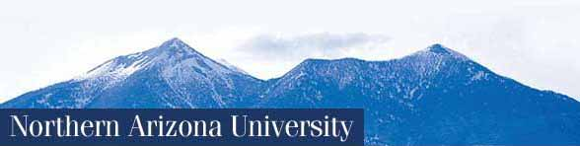
Developing & Delivering Curriculum to Meet the
Needs of Diné Students
SILS/AIITEC
June 21, 2025
Jon Reyhner, Ed.D.
Professor of Education

Slide 2
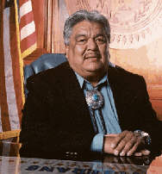
In a September 2000 press release, then Navajo Nation President Kelsey Begaye declared that the “preservation of Navajo culture, tradition, and language” is the number one guiding principle of the Navajo Nation.”

Slide 3
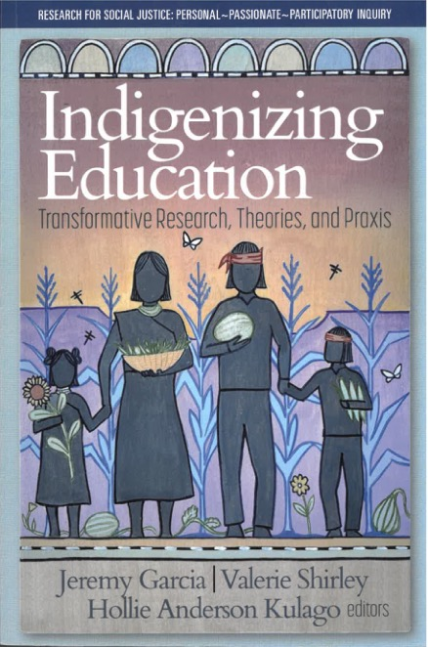
I would like to discuss today what can be done to help Indigenize and Navajoize education to make it more engaging and relevant for Diné and other students. Two of the editors of the book shown here are Diné

Slide 4
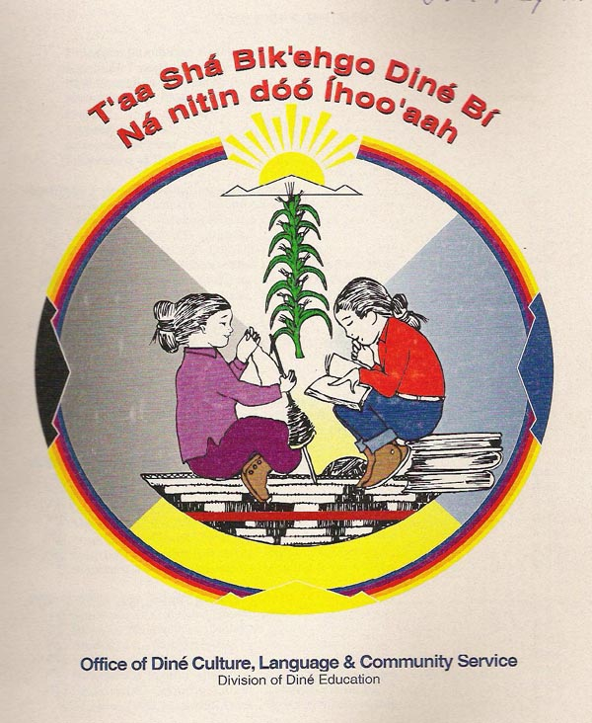
The Navajo Nation’s 2000 “Diné Cultural Content Standards [for schools] is predicated on the belief that firm grounding of native students in their indigenous cultural heritage and language, is a
fundamentally sound prerequisite
to well developed and culturally
healthy students.” Navajo values
to be taught include being
generous and kind, respecting
kinship, values, and sacred
knowledge.”

Slide 5
Culture-, Place-, and Community-Based Education
Success in school and in life is related to people’s identity, how as a group and individually people are viewed by others and how they see themselves. Identity is not just a positive self-concept. It is learning your place in the world with both humility and strength. In the words of Vine Deloria (Standing Rock Sioux), it is “accepting the responsibility to be a contributing member of a society.” It is children finding a “home in the landscapes and ecologies they inhabit” as they grow up.

Slide 6
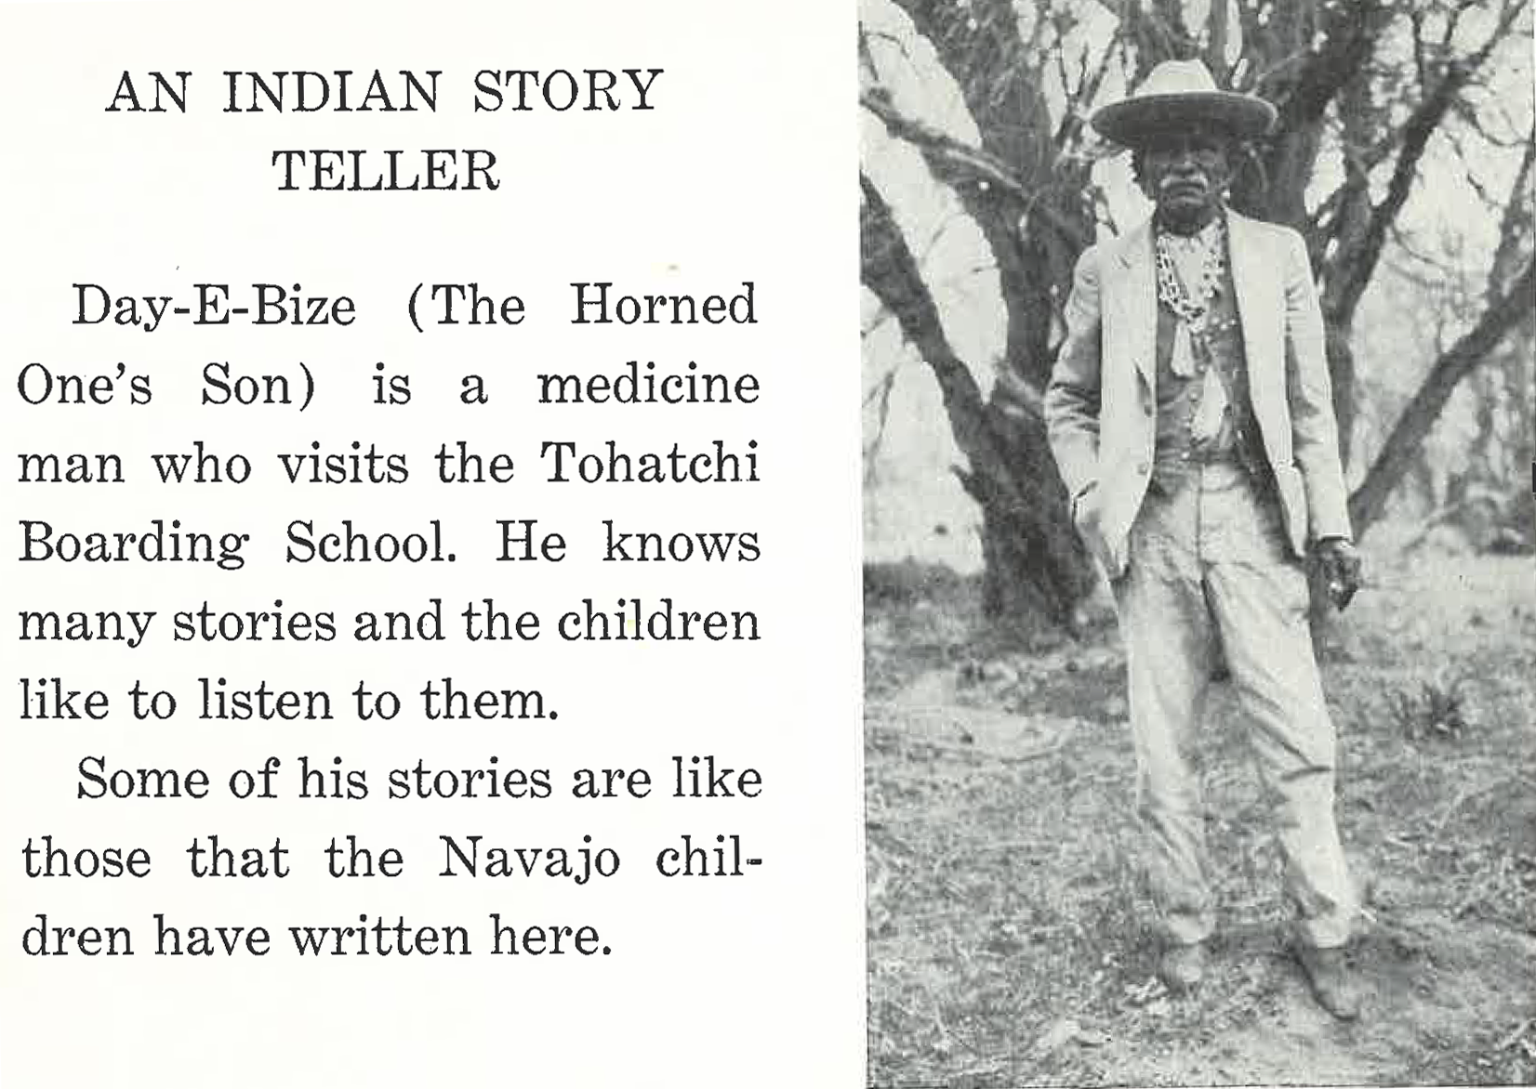
Culture Based Education Is Not New
This is p. 59 of This Colored Land: A Navajo Indian Book edited by the BIA’s Elementary Education Supervisor and published in 1937

Slide 7
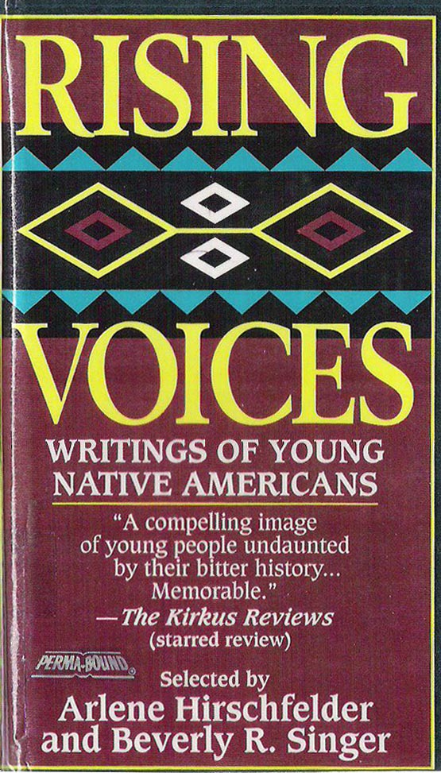
This poem, written by Navajo students at Tohatchi, was first published in 1933 & reprinted in This Colored Land:
If
If I were a pony,
A spotted pinto pony,
A racing, running pony,
I would run away from school.
And I’d gallop on the mesa,
And I’d eat on the mesa,
And I’d sleep on the mesa,
And I’d never think of school.

Slide 8
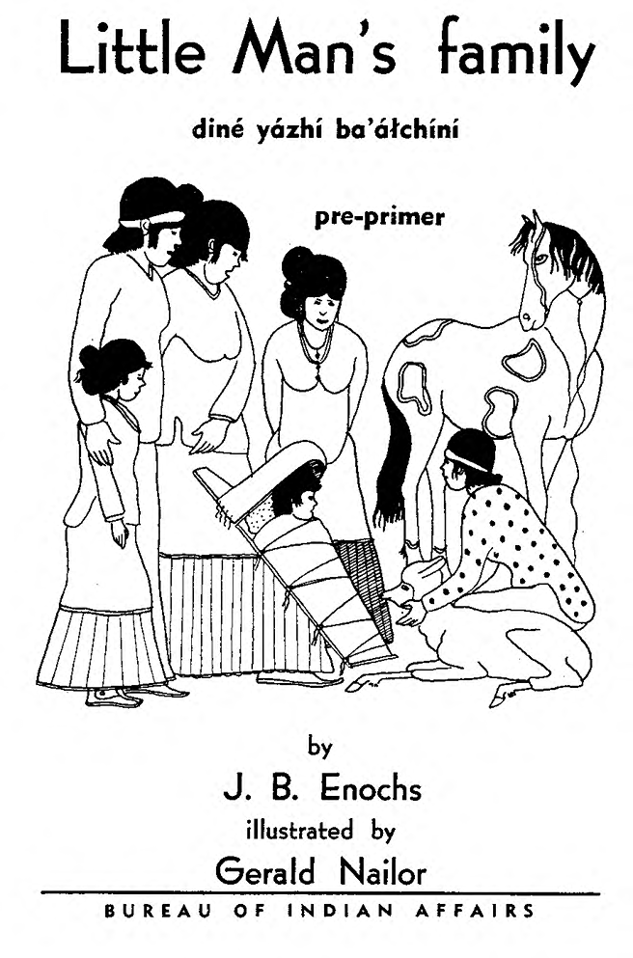
This is the cover of a 1940 bilingual BIA publication printed by students at Phoenix Indian School that continued to be in print into the 1950s

Slide 9
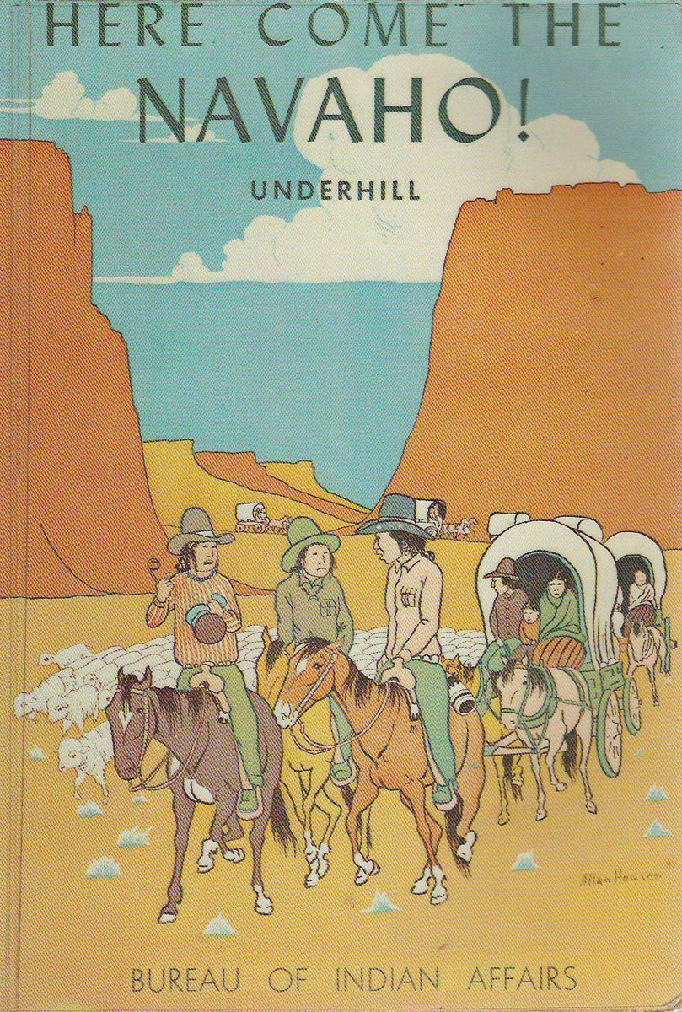
The 285 page1953 Navajo history book, Here Come the Navaho! written by an anthropologist working for the U.S. Bureau of Indian Affairs is a good example of Navajo specific educational material that I think gives a balanced view of Navajo history.

Slide 10
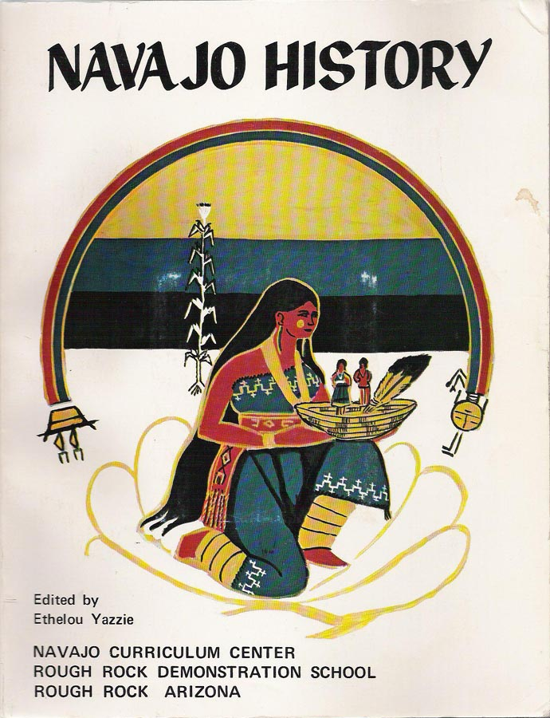
Navajo students learned about their history and culture at Rough Rock Demonstration School, the first US. Indian-controlled school in modern times, founded in 1966.
Rough Rock published a variety of Navajo specific curriculum material.
BIA schools also published material.

Slide 11
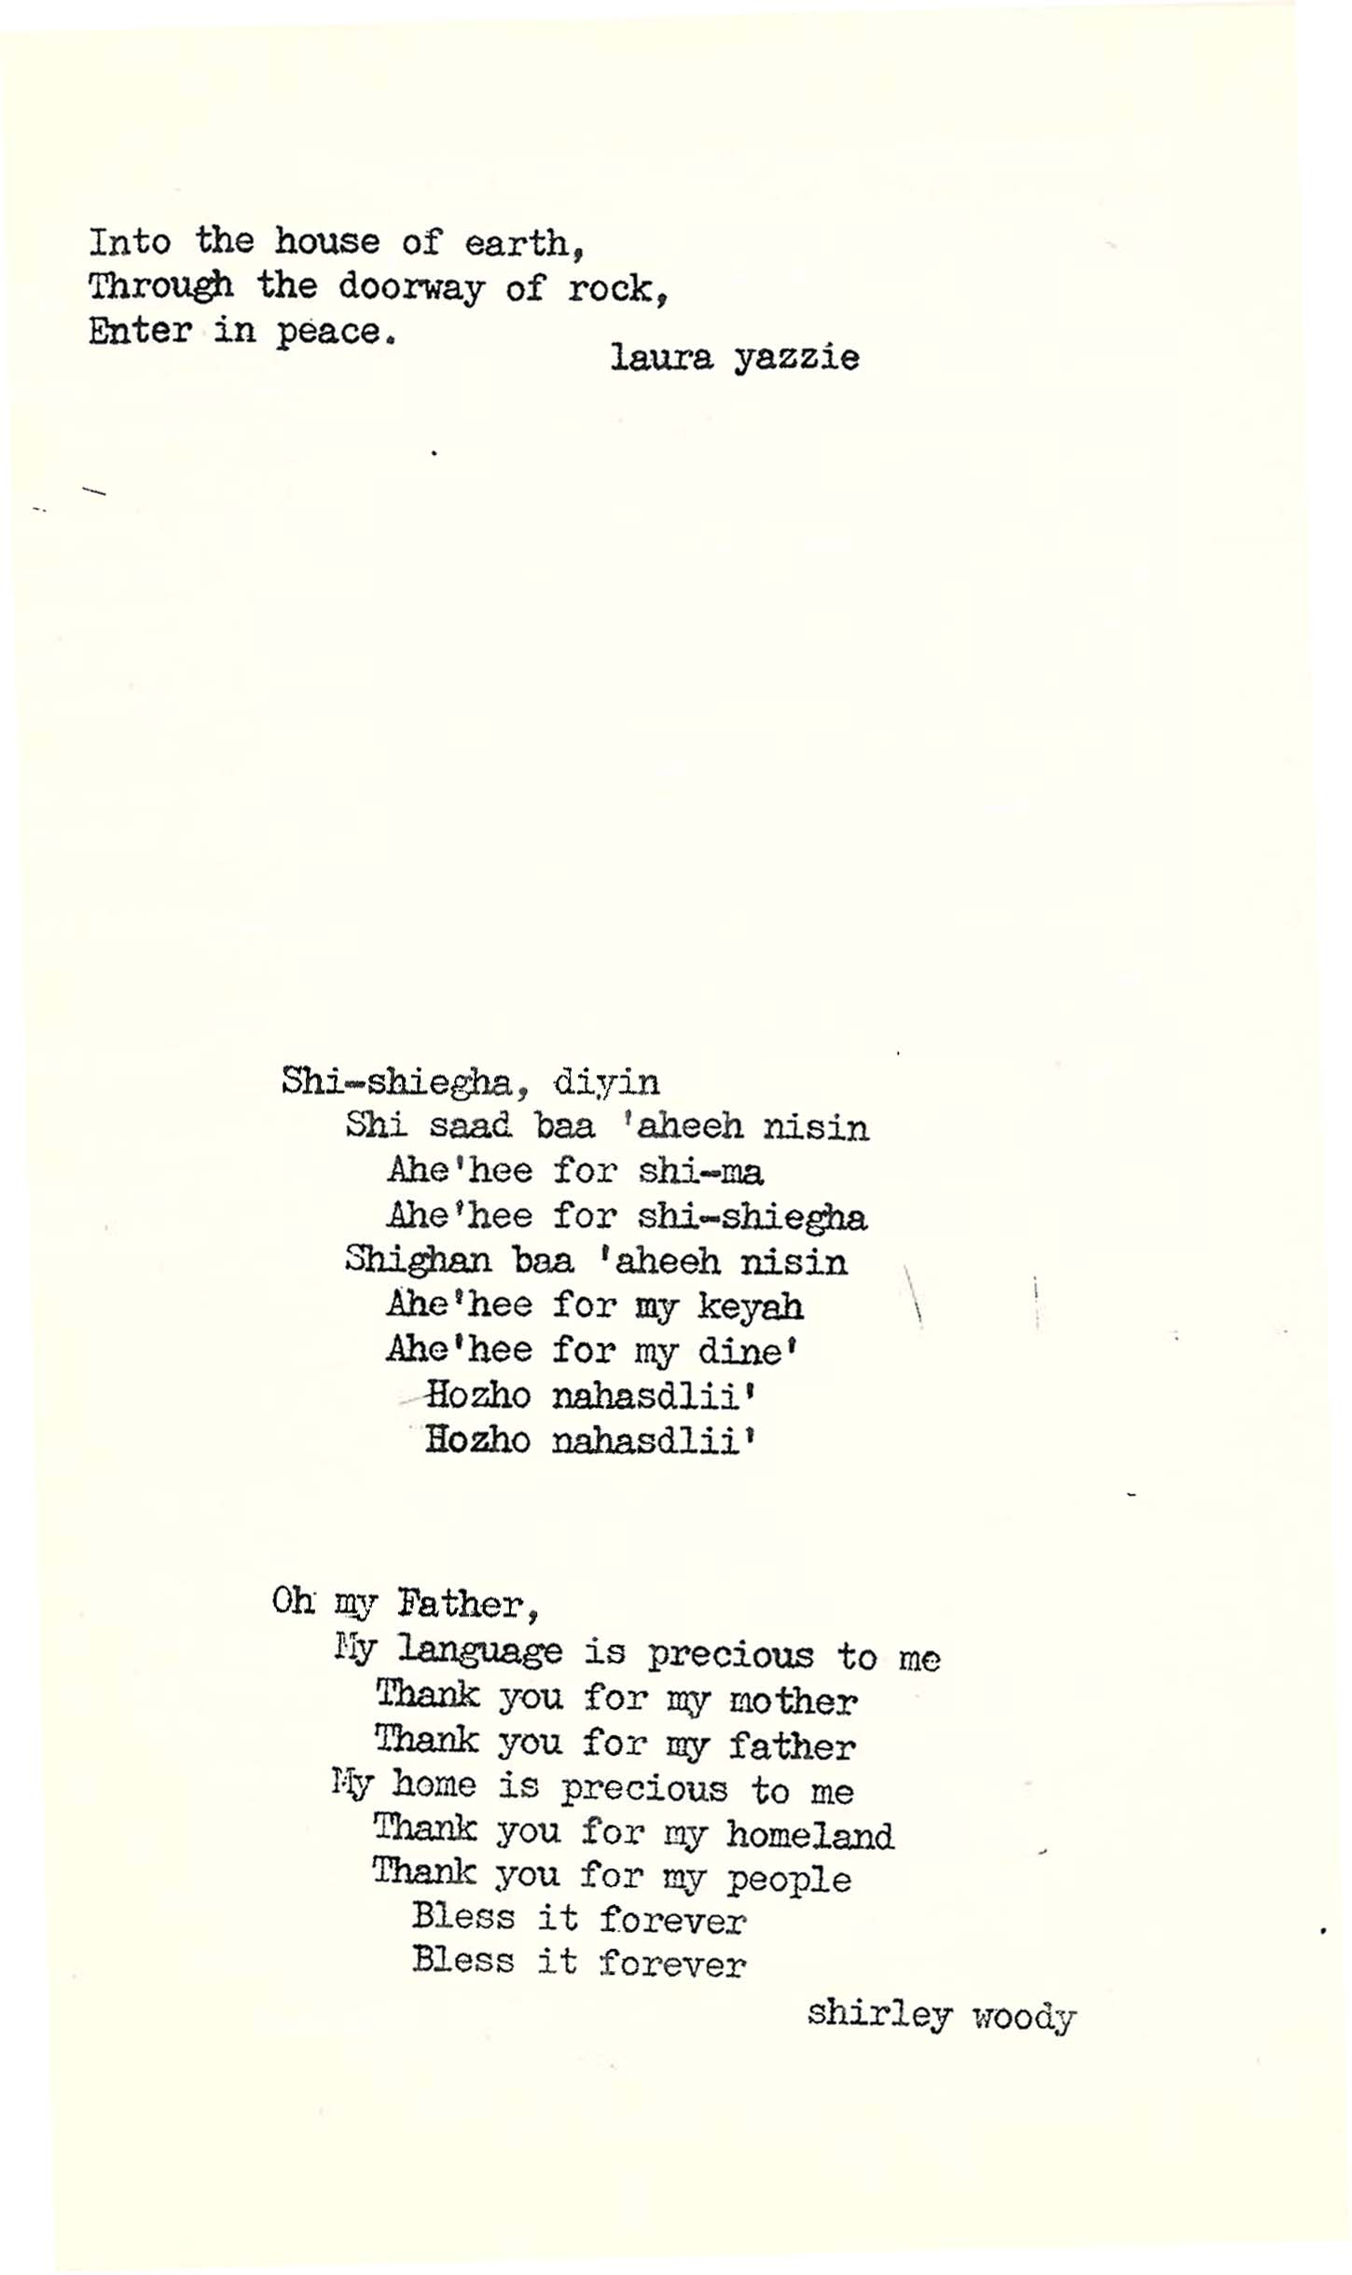
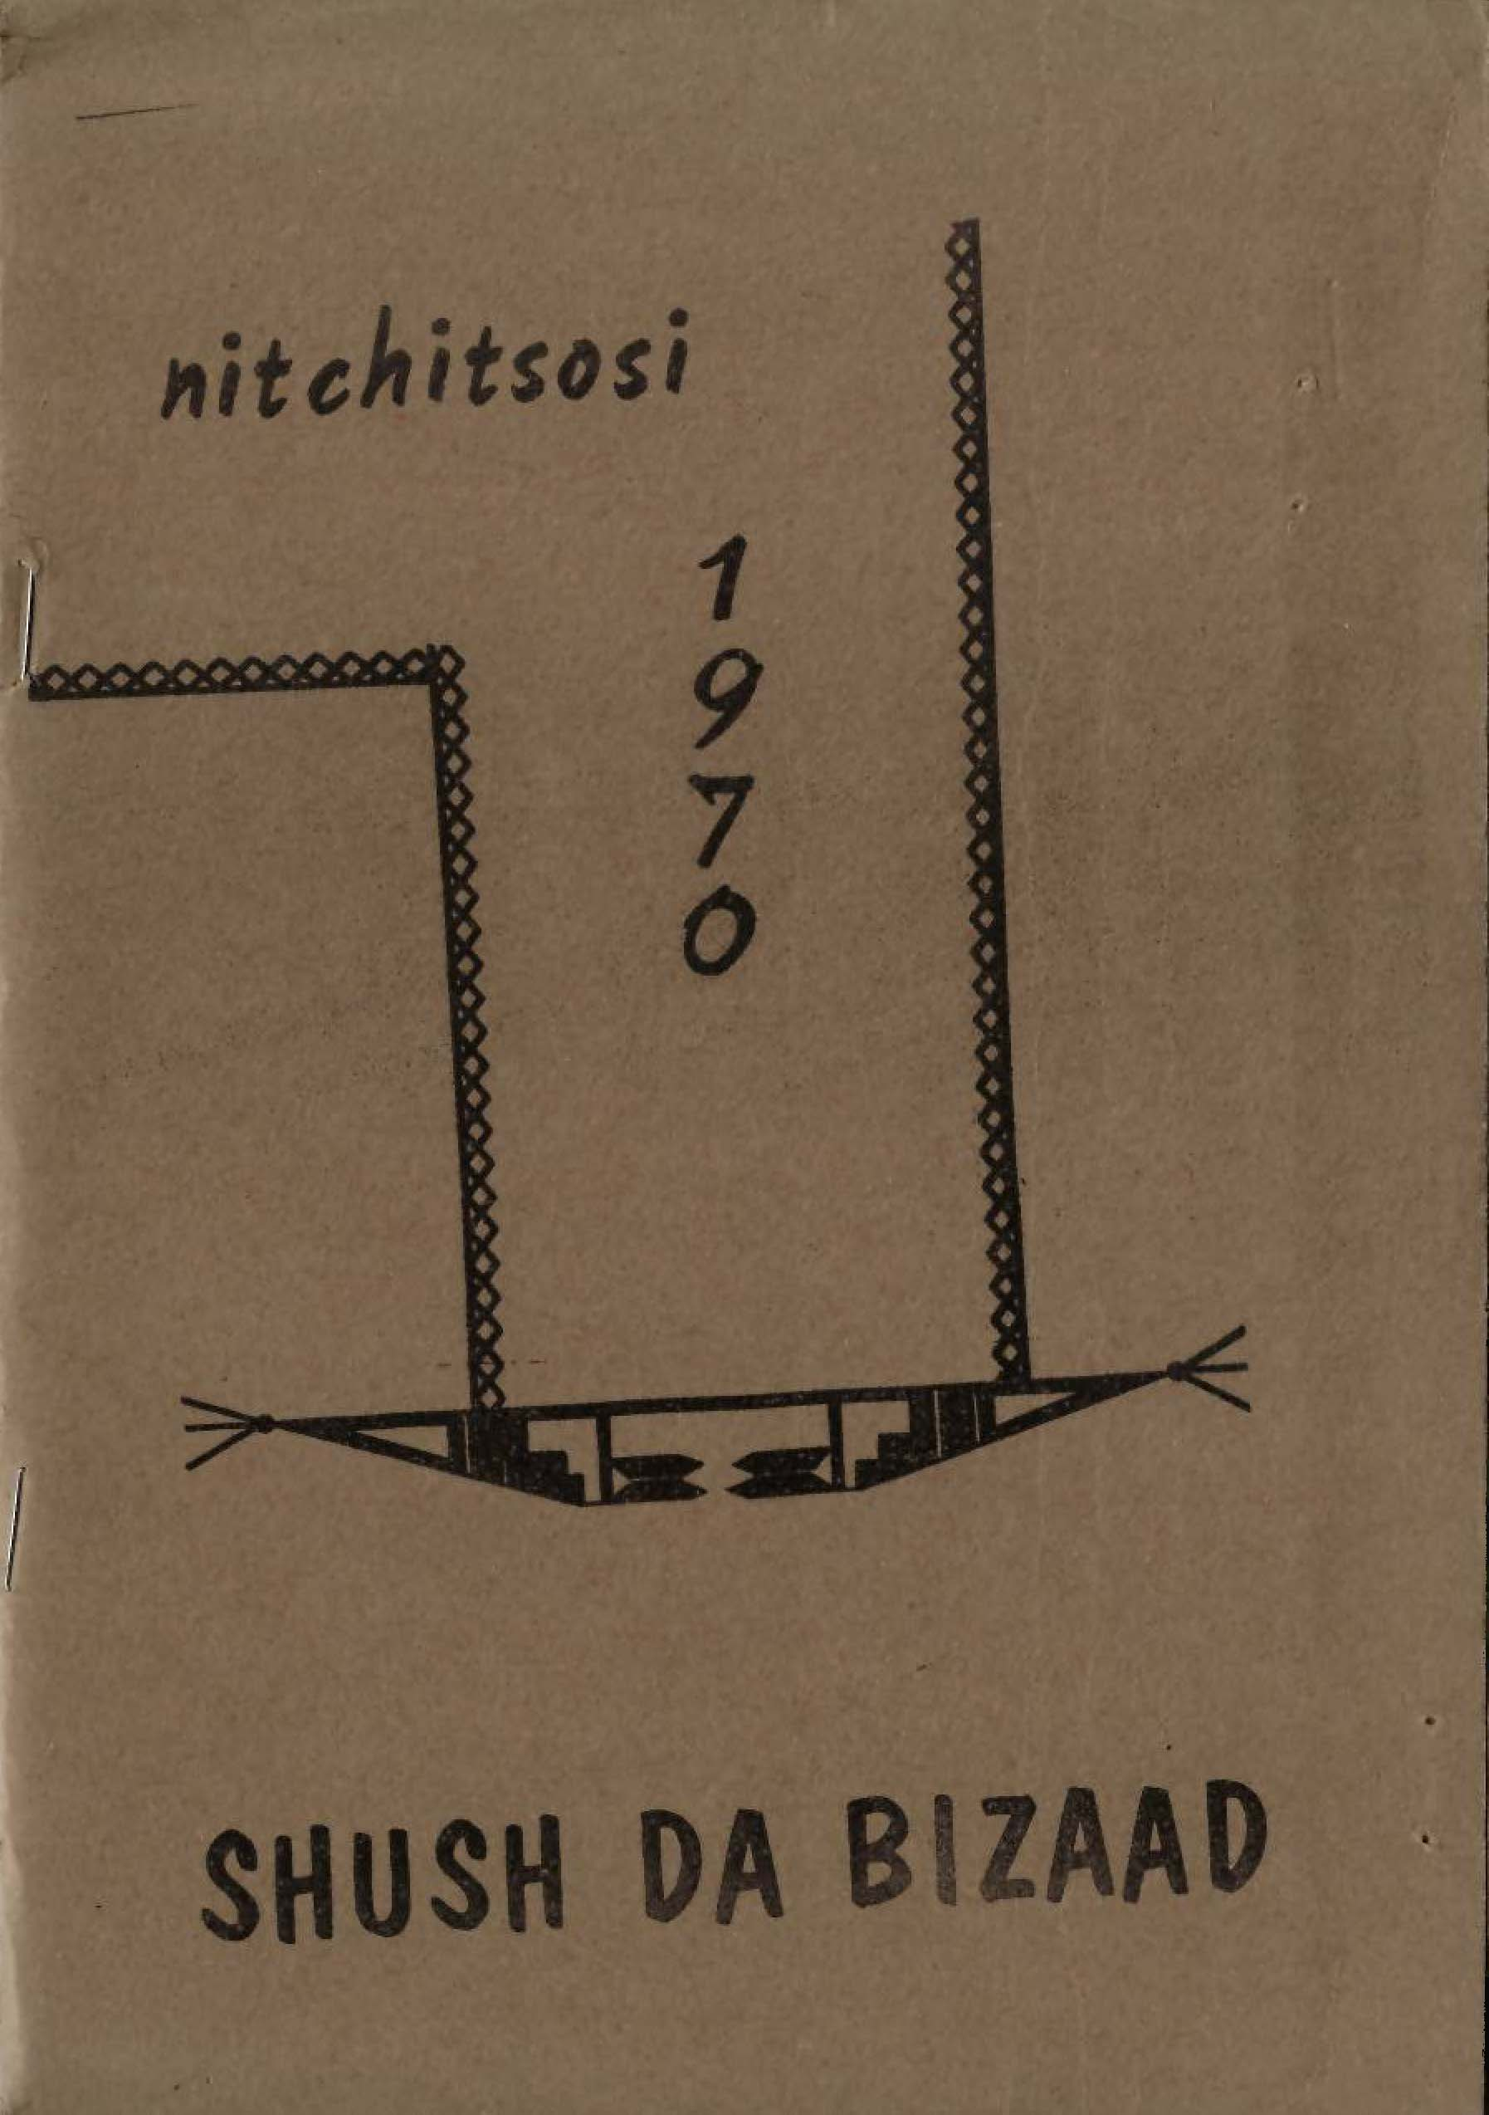
Wingate High School Student Publication 1970

Slide 12
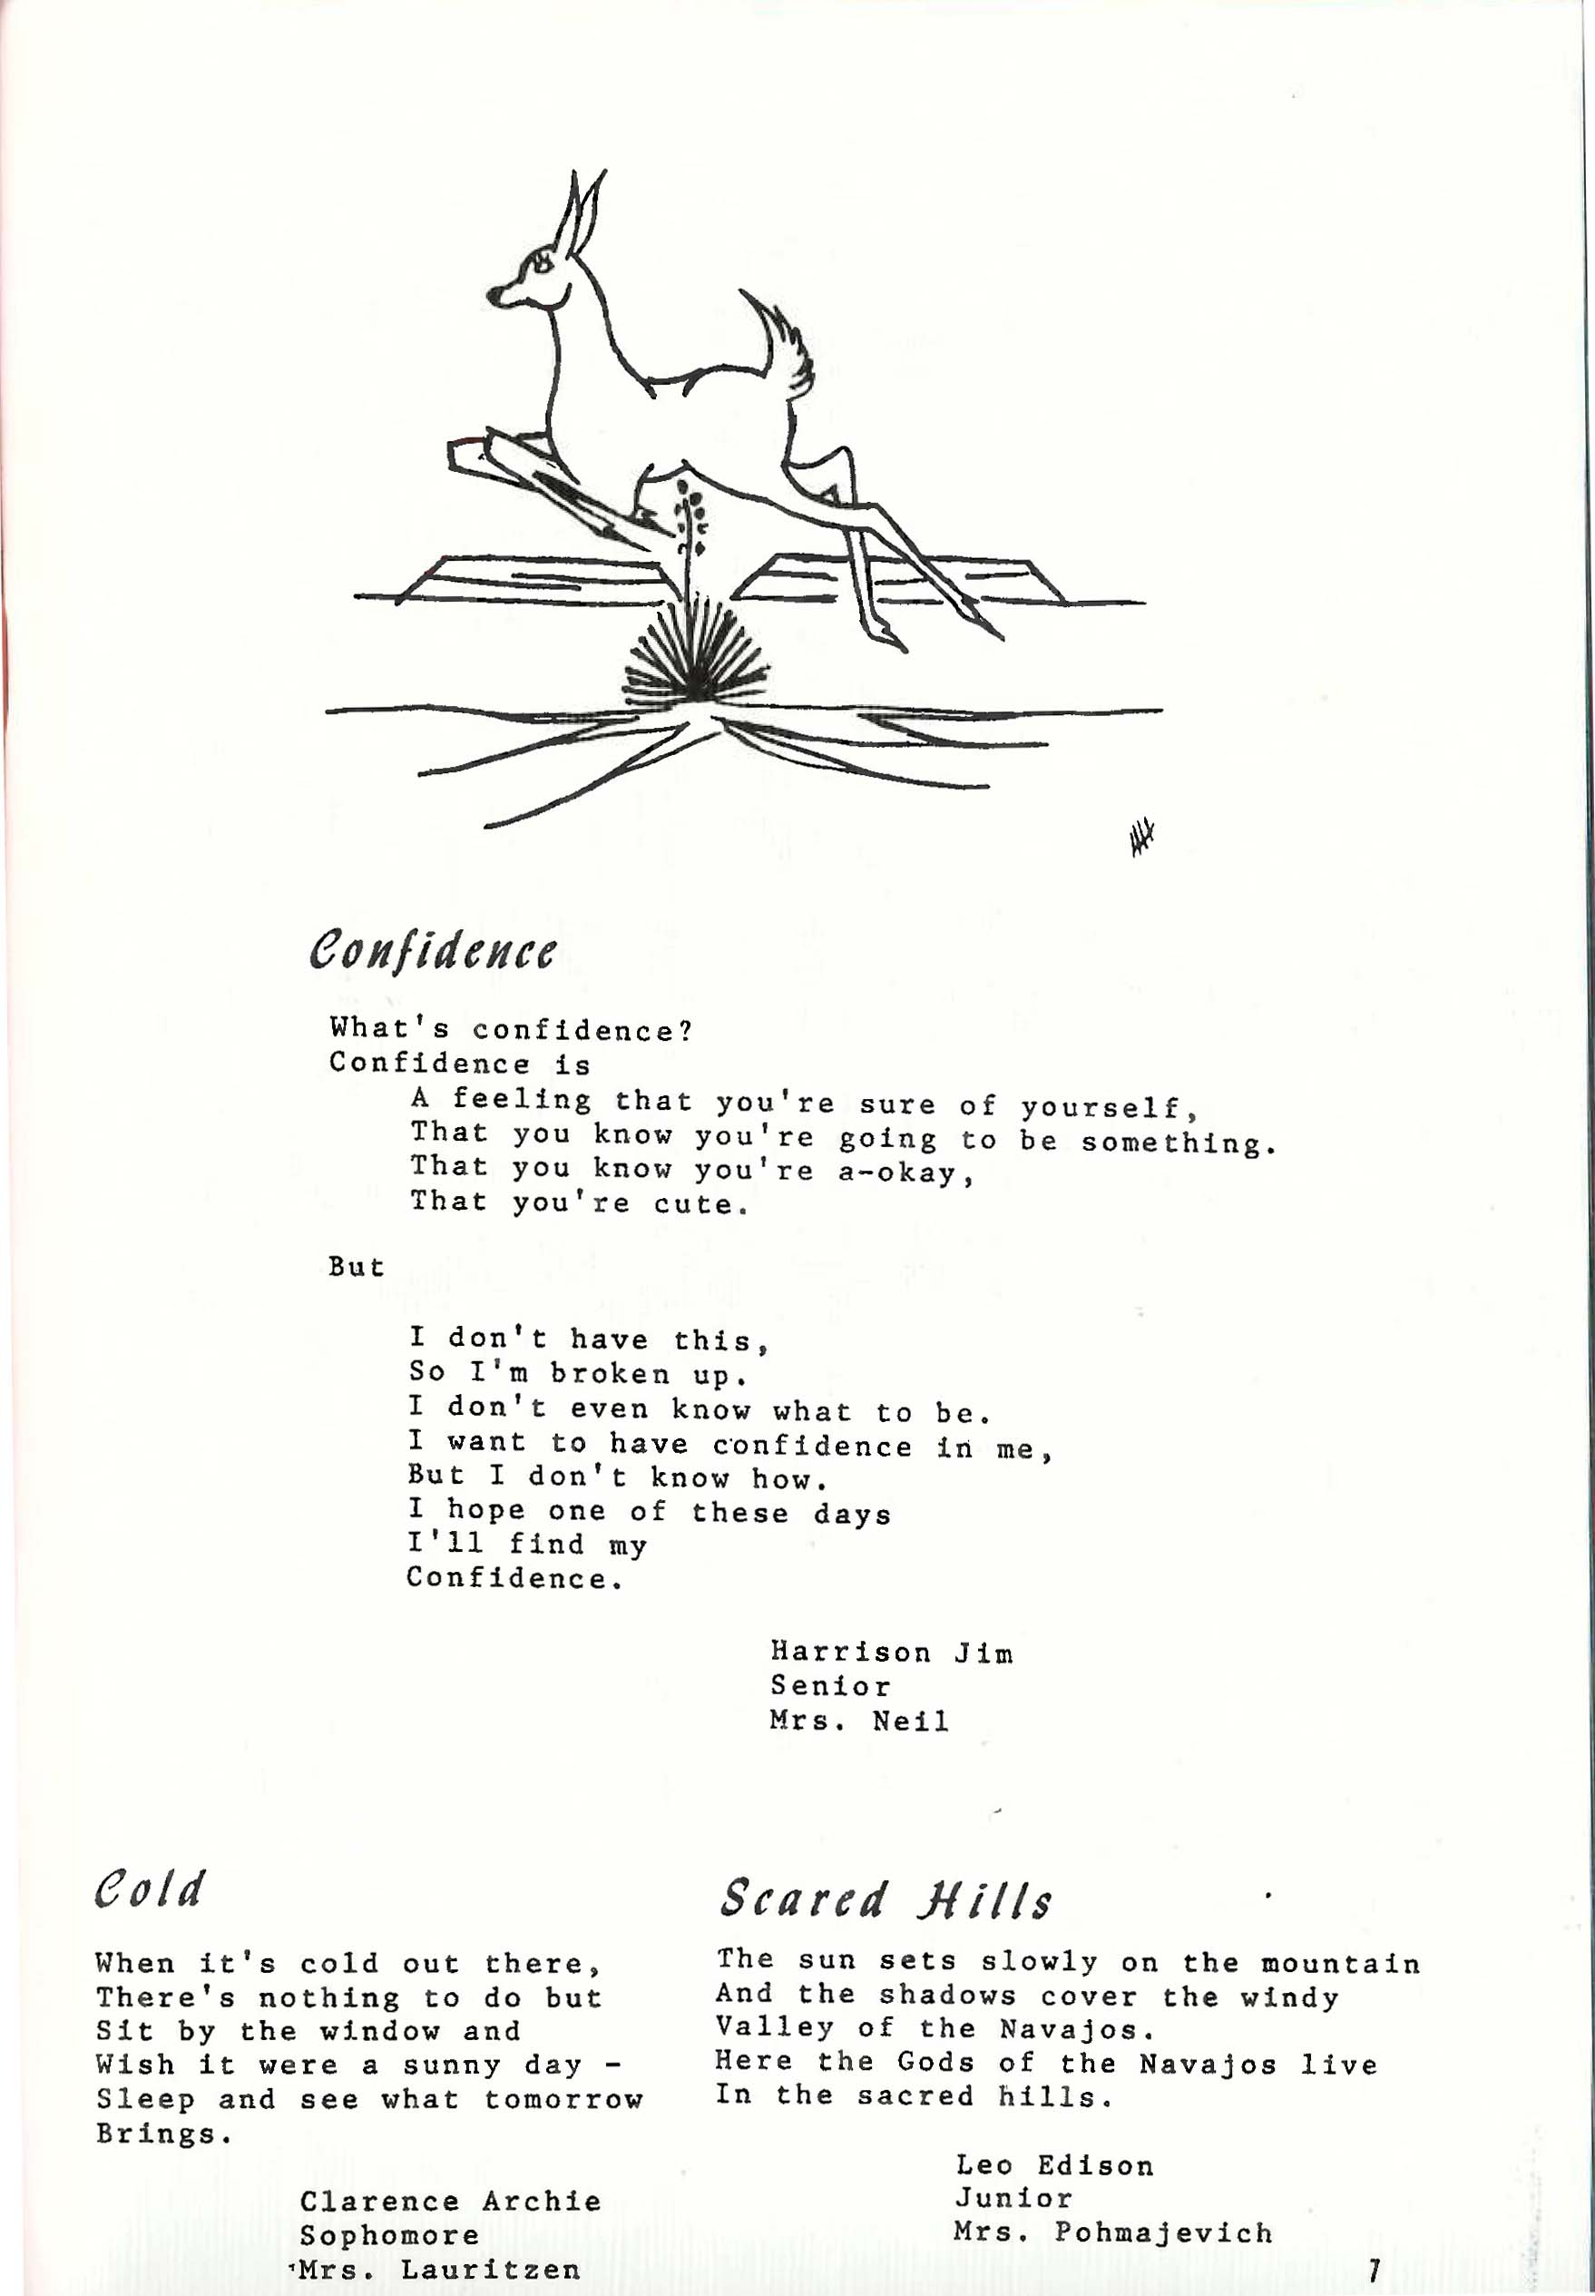
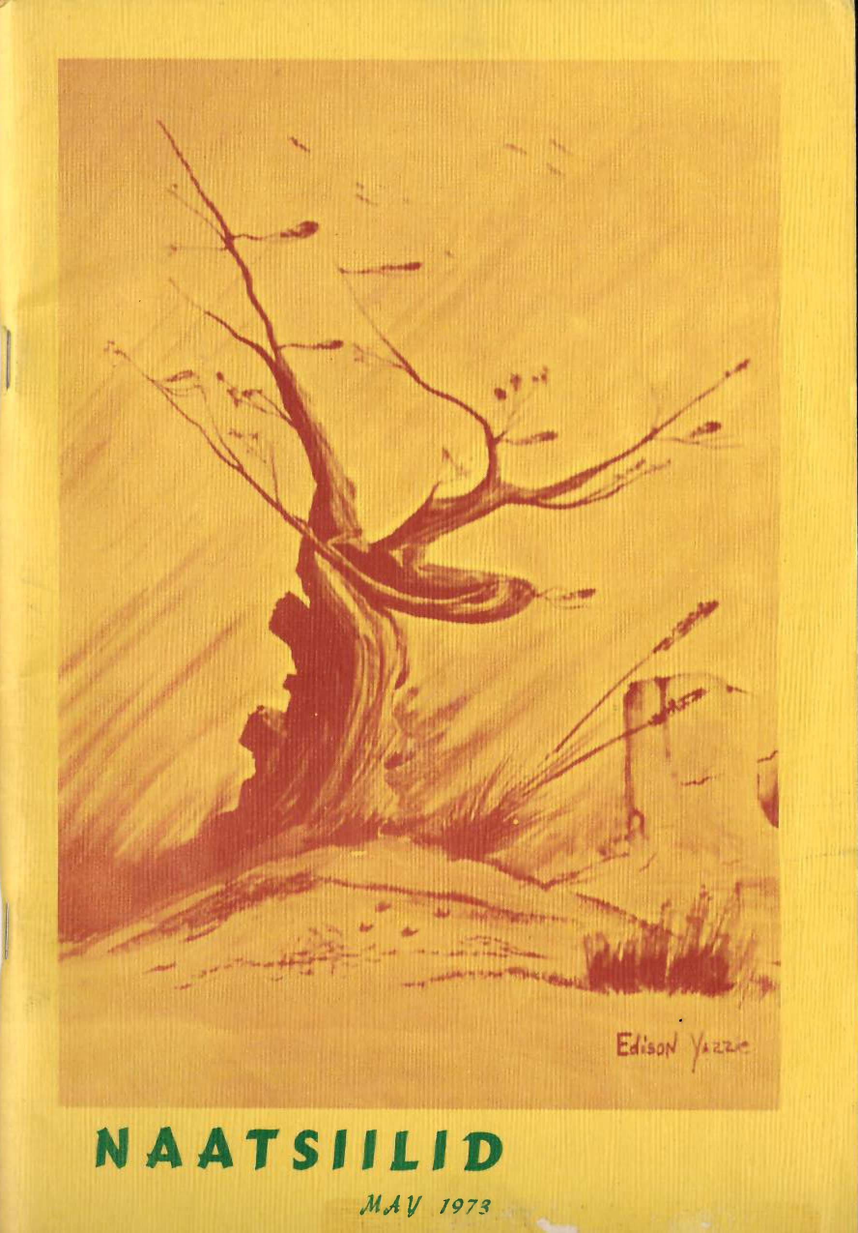
Intermountain Boarding School Student Publication 1973

Slide 13
Intermountain’s Naatsiillid won 1st place from Columbia Scholastic Press Assn. The 1st issue was published in 1968.
Besides creative writing, giving voice to students, there were also classes where Allan Houser (Chiricahua Apache) and others taught art.
Intermountain also had Navajo translators to help students.

Slide 14
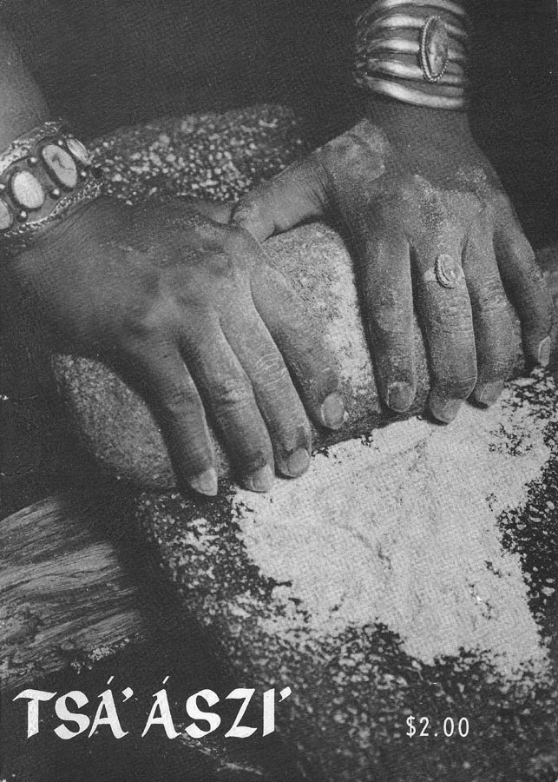
Culture-based curriculum can include students writing and publishing school newspapers and magazines as was done with the best selling “Foxfire” publications in the southeastern United States. This TSÁ’ ÁSZI’ magazine was published by Ramah Navajo students in 1975.

Slide 15
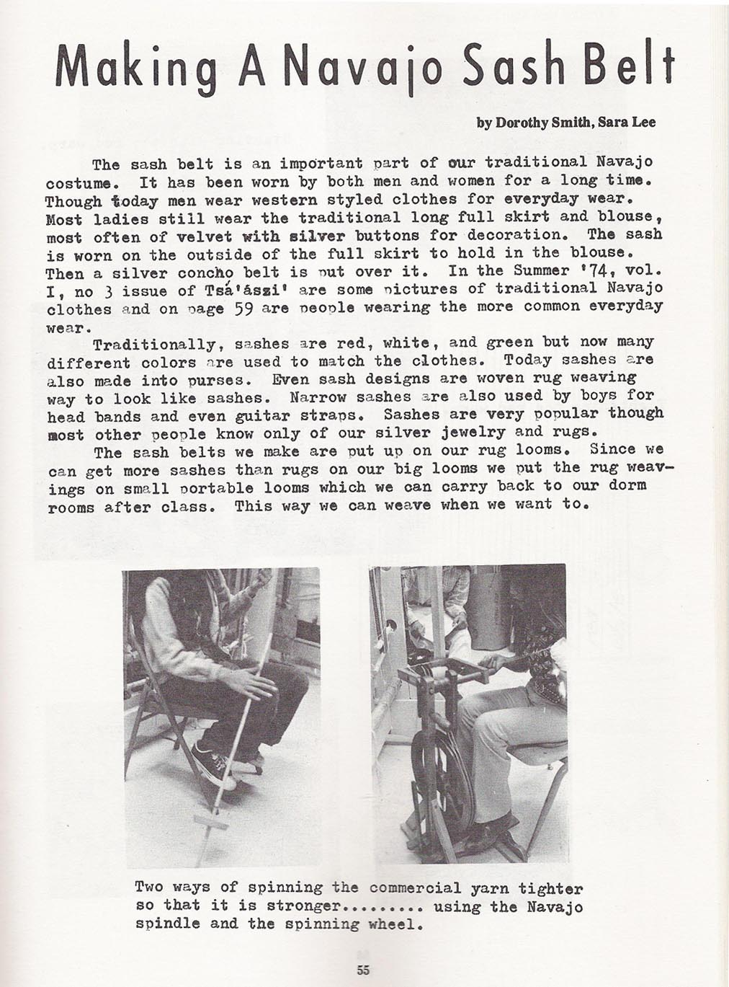
Culture-based content can be combined with standards based academic content like writing five paragraph (or more) essays and various forms of process writing where students brainstorm ideas, write drafts, discuss drafts with fellow students (and their teacher), edit, and finally publish their writing.

Slide 16
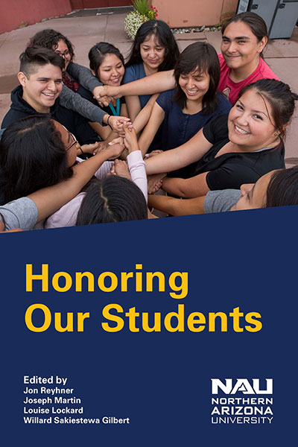
I have concluded from my research that teachers of any subject need to know about the experiential and cultural background of their students and relate the subject matter they teach to that background—their students’ cultures, communities, and lands.

Slide 17

University of Toronto
Professor Jim Cummins
describes this as a trans-
formative teaching that
enables “students to
relate curriculum content
to their individual and collective experience and to analyze broader social issues relevant to their lives.” This is a joint learning experience that involves both students and teachers in the learning process.

Slide 18
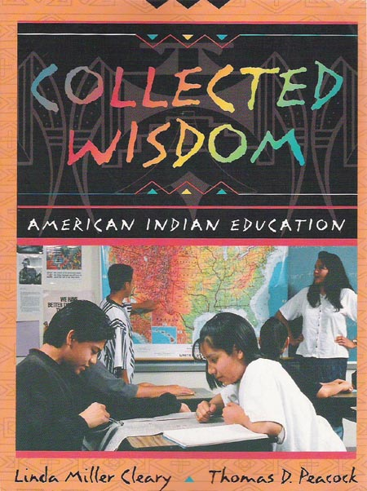
Cummins found that teachers must learn from their students as well as having the students learn from them.
Linda Cleary and Thomas Peacock’s Collected Wisdom emphasizes this theme of “teacher as learner.”

Slide 19
Cleary and Peacock learned from over a hundred interviews of teachers of American Indian students that teachers need to learn about the lives of their students beyond the school grounds in order to learn more about the home language and culture of their students and understand the challenges they face. They also write about the importance of giving students some choices in what they read and study.

Slide 20
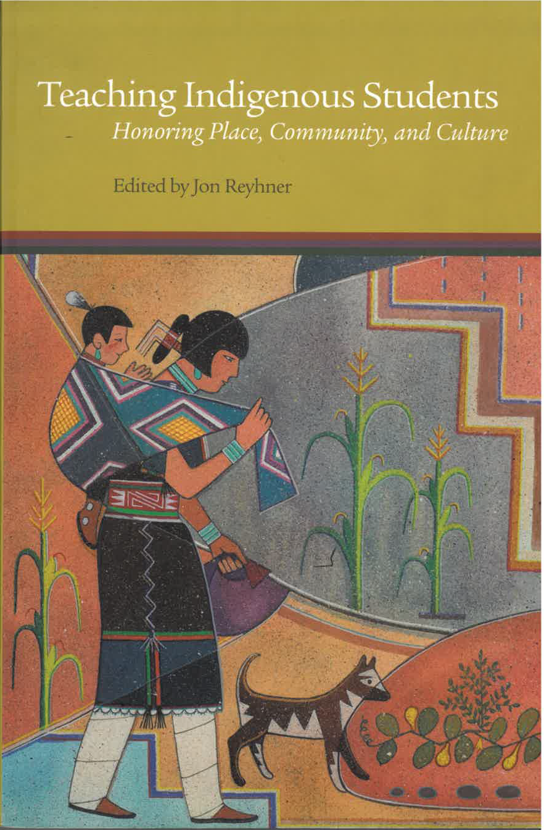
The contributors to my Teaching Indigenous Students: Honoring Place, Community, and Culture wrote chapters on promoting Indigenous literacy, mathematics, science, social studies, music, art, and physical education.

Slide 21
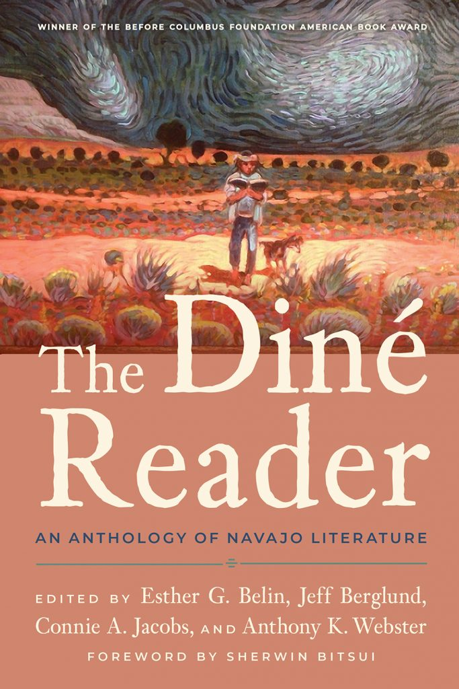
In writing and literature classes students need to see examples of literature written by Diné and other Indigenous authors. This 2021 book focuses on the work of Navajo writers.

Slide 22
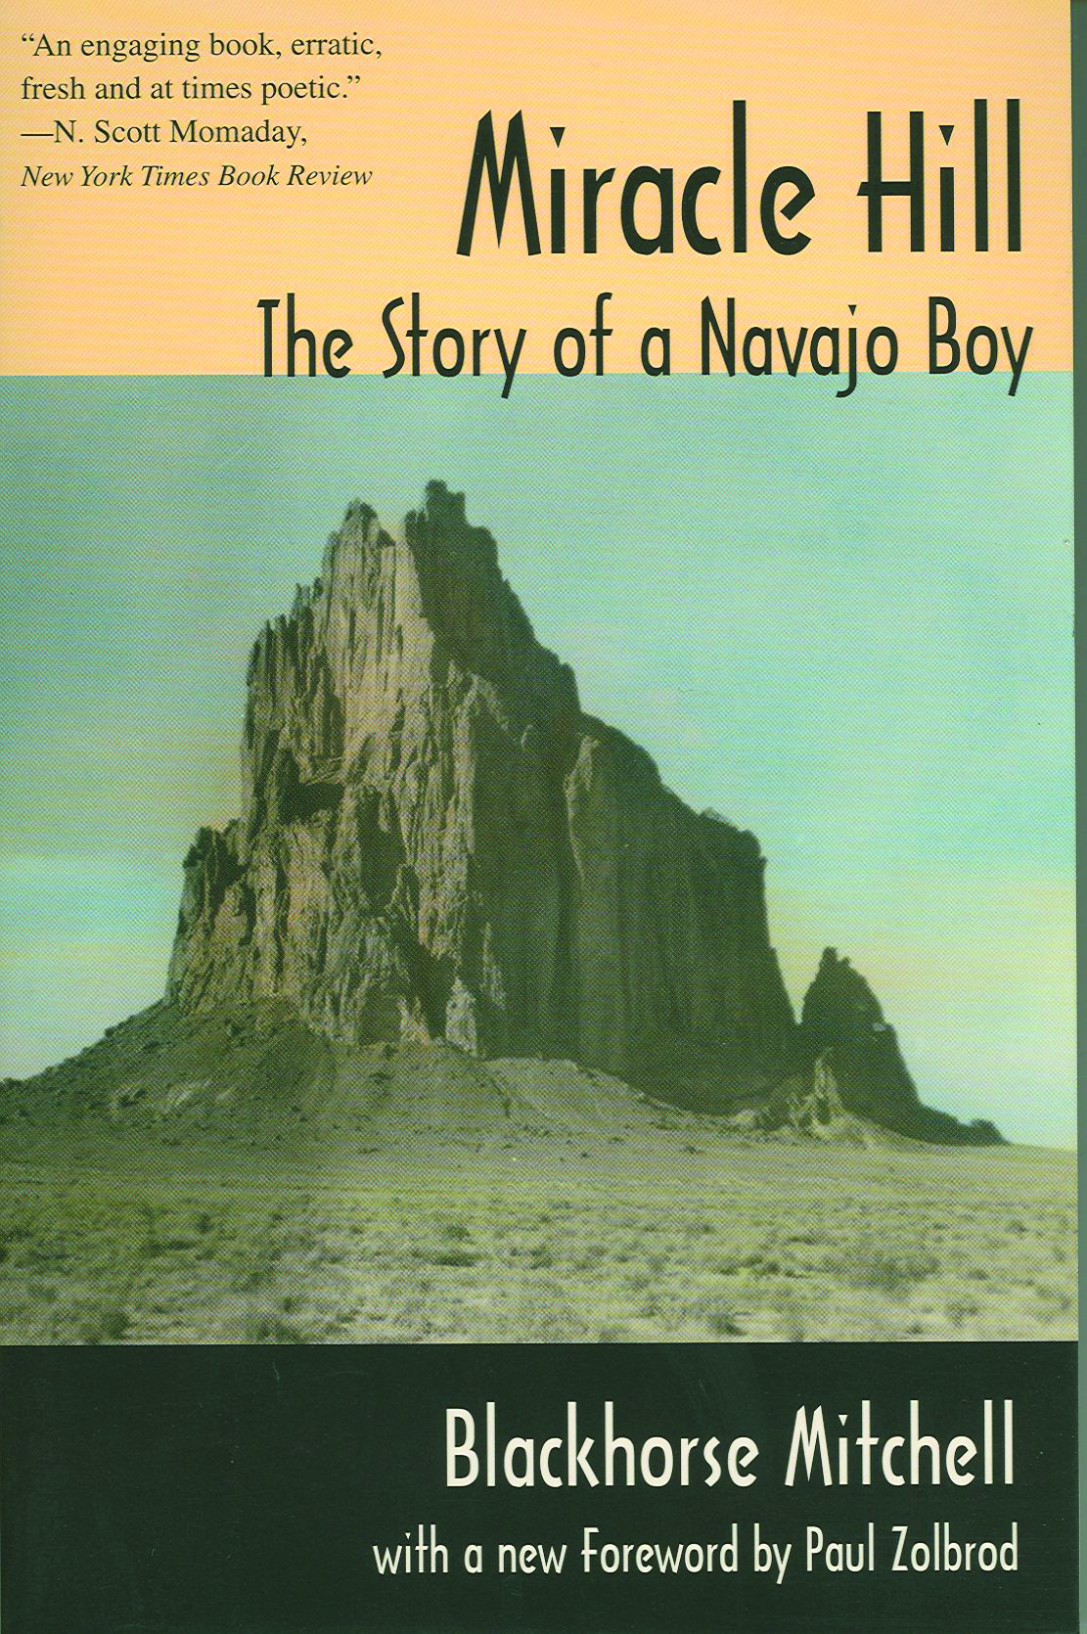
One example of Diné Blackhorse Mitchell’s autobiography, Miracle Hill, was originally published in 1967 by the University of Oklahoma Press and has been reprinted by the University of Arizona Press. It started as a high school writing assignment!

Slide 23
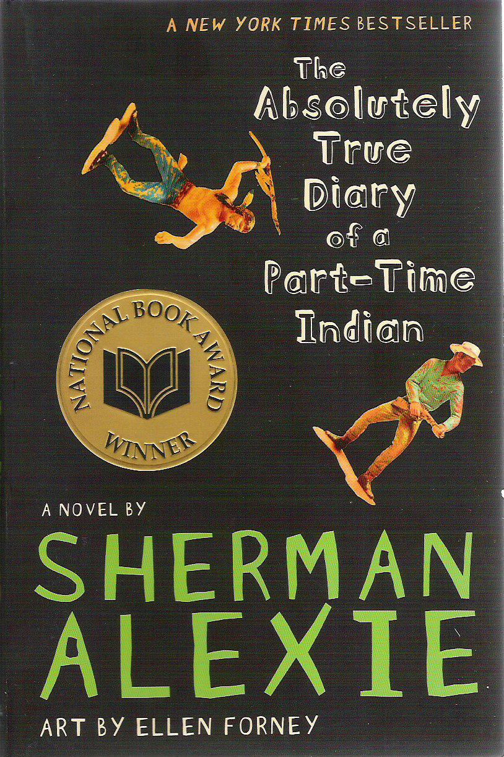
Seek out books that students will hopefully find to be “good reads” and that can show them the possibilities and opportunities that education can offer them.

Slide 24
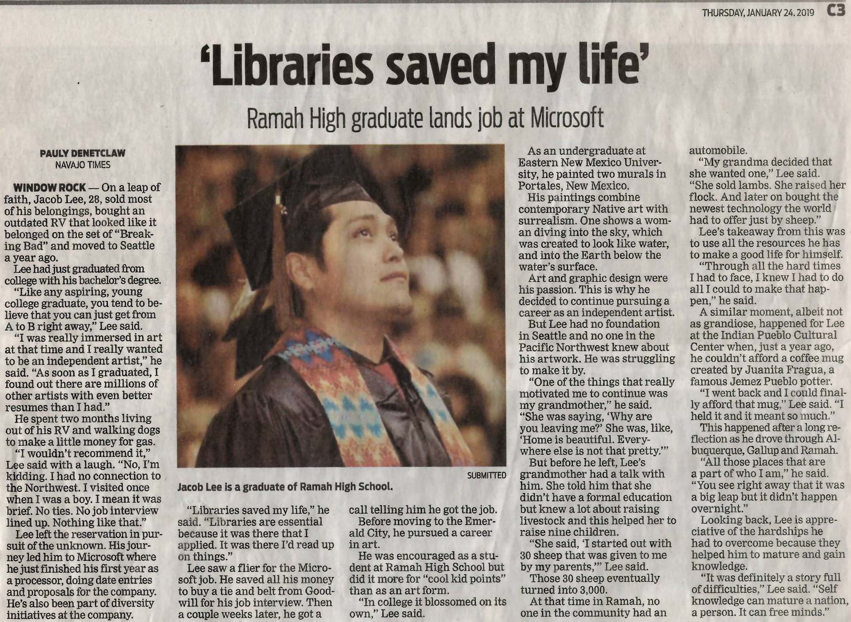

Slide 25
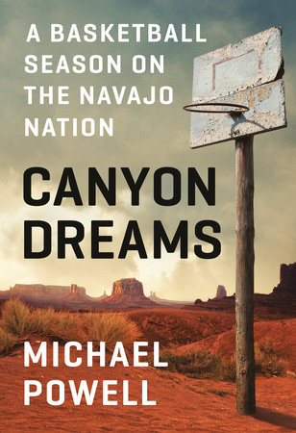
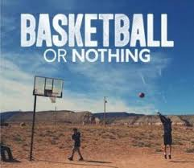
A book like this one can give students practice reading.

Slide 26
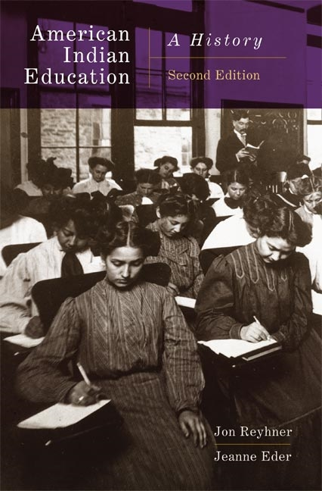
In researching the history of American Indian education, I was impressed by how Navajo history is intertwined with U.S. and world history. The Navajo Long Walk is connected to the U.S. Civil War, stock reduction to the Great Depression, and Navajo sovereignty to post World War II United Nations human rights efforts.

Slide 27
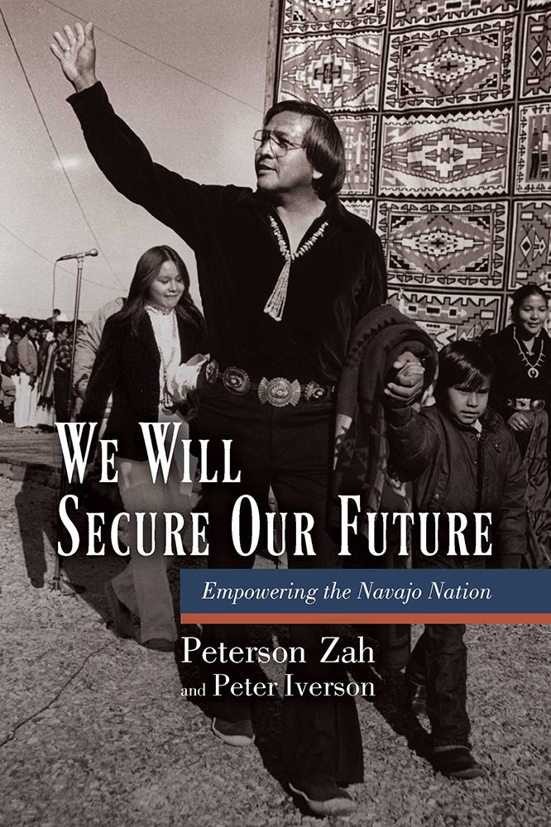
Peterson Zah’s autobiography. It also could be used in a history and civics classes.

Slide 28
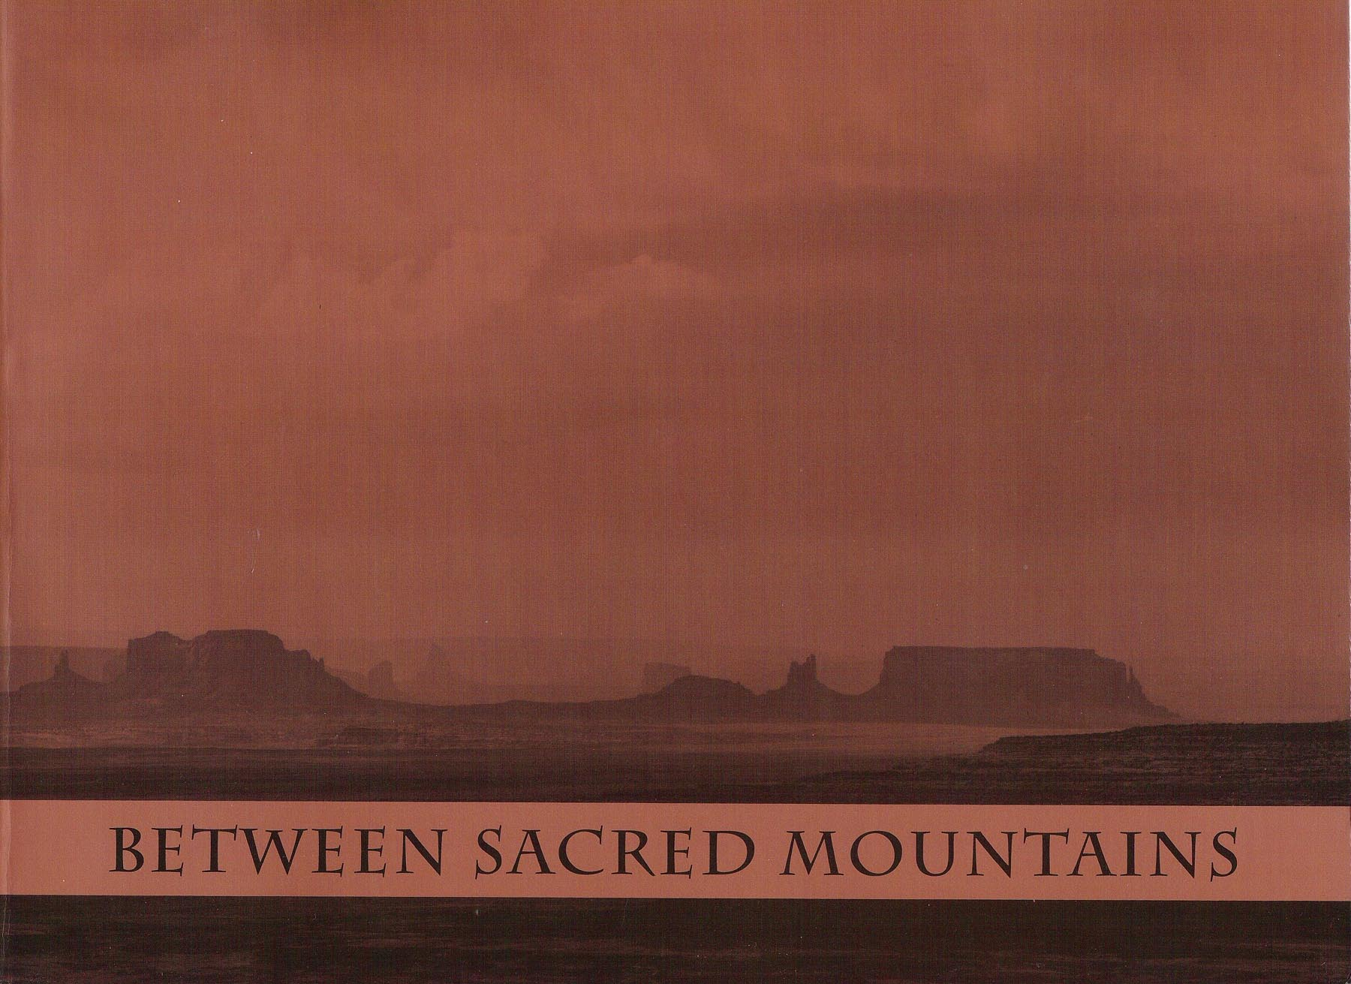
Teachers, students, and community members at Rock Point Community School contributed articles
on various aspects of Navajo history, culture, and then current affairs to a 300-page book that could be used in history, culture, and even science classes.

Slide 29
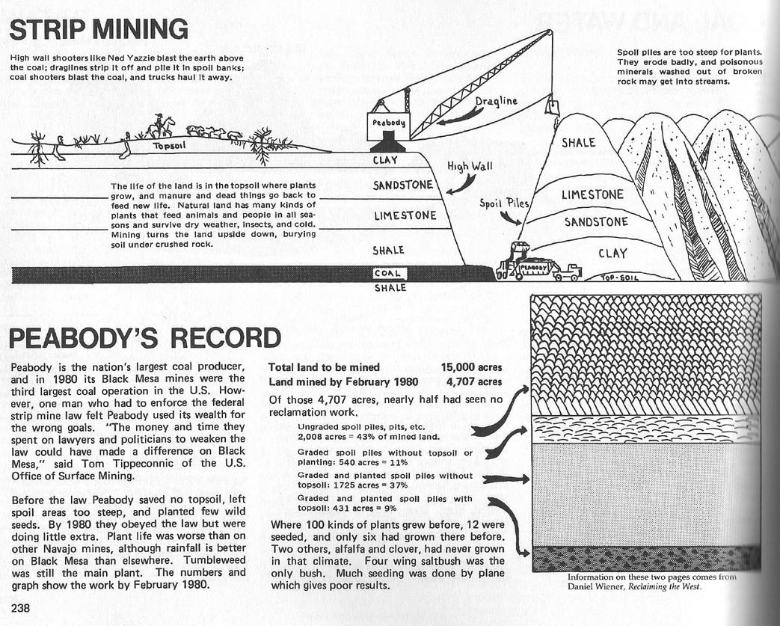

Slide 30
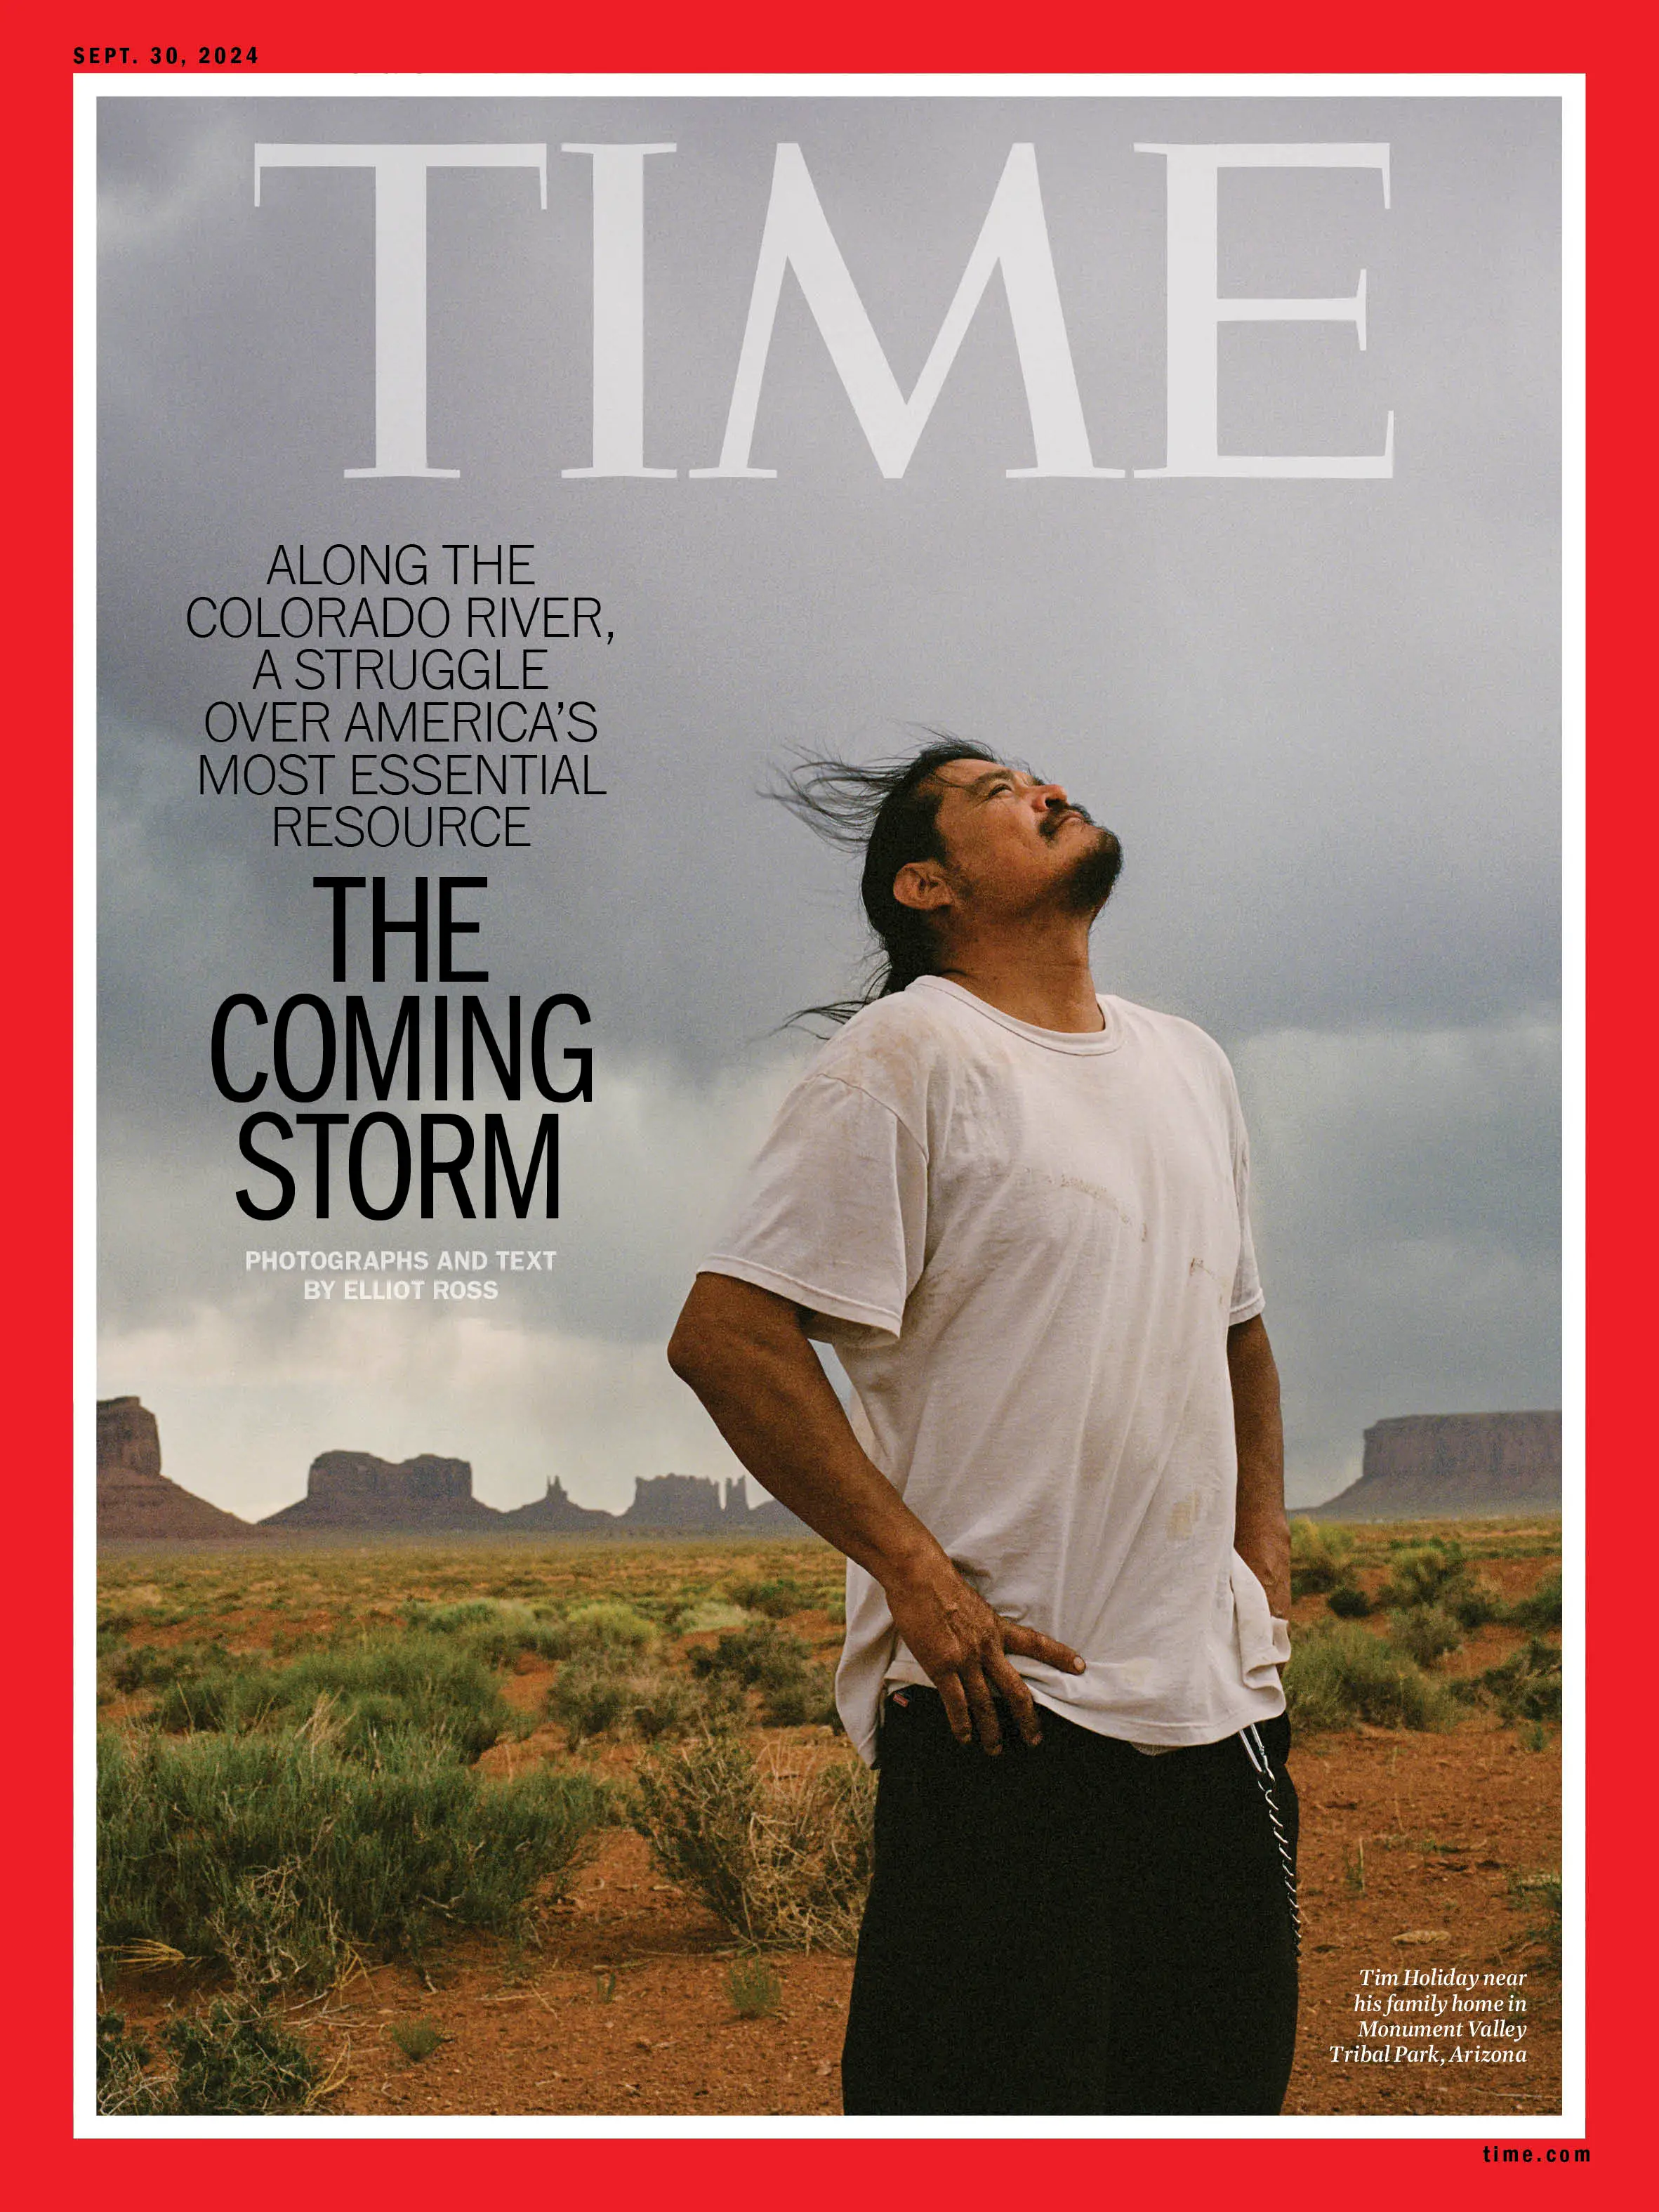
Recent publica-tions can be used in classrooms. For example, the Septem-ber 30, 2024, issue of Time magazine had a great article on how the flow of the Colorado River is over allocated and how the Navajo can get left out of the discussions about that water.

Slide 31

The 2005 Project Wet book Discover a Watershed; The Colorado can provide students with valuable information about the Navajo aquifer that many com-munities rely on for their water.

Slide 32
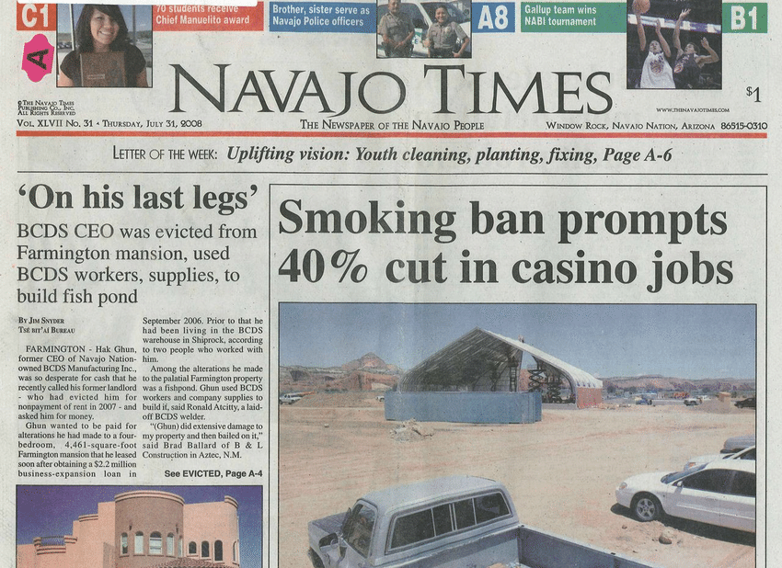

Slide 33
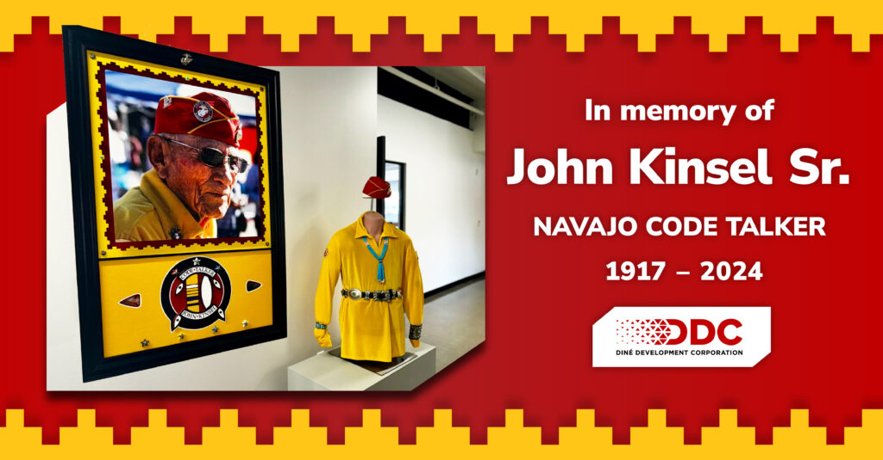
The Navajo Times had a great article about John Kinsel, Sr. that could be used in a variety of different classes. For example, what kind of behavior (diet, exercise, etc.) helps someone live to 107 years old.

Slide 34
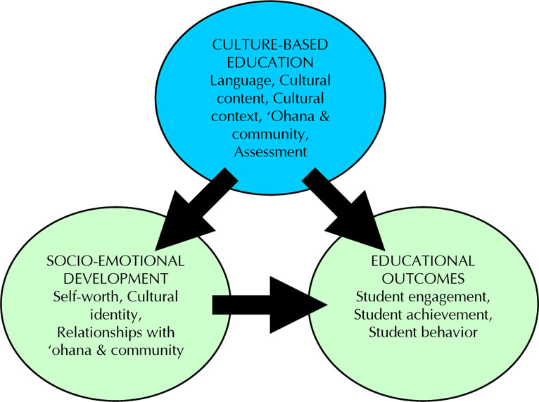
    Culture-, Community-, Place-Based Education
    1. Promotes healthier lifestyles, including eating traditional foods rather than less healthy processed and fast foods.
    2. Promotes traditional values of respect, humility, hard work, generosity, etc. that lead to safer, stronger communities.
    3. Develops a strong positive sense of identity that leads to perseverance and resiliency .
    —Kana’iaupuni, Ledward, & Jensen, 2010.

Slide 35
John Dewey added a short chapter on projects in the 1933 edition of his classic book How We Think. Projects were used successfully in American Indian schools in the 1930s and 40s. He wrote that “constructive occupations” or “projects” are characterized by the following:
Engage interest: “Unless the activity lays hold on the emotions and desires, unless it offers an outlet for energy that means something to the individual himself, his mind will turn in aversion from it, even though externally he keeps at it.”
Intrinsic worth: “The activity must be worthwhile intrinsically.” Projects must “stand for something valuable in life itself.”

Slide 36
3. Awaken curiosity: The project must “awaken new curiosity and create a demand for information.”
4. Time span: “The project must involve a considerable time span for its adequate execution. The plan and the object to be gained must be capable of development, one thing leading on naturally to another. It is not a succession of unrelated acts, but is a consecutively ordered activity in which one step prepares the need for the next one and that one adds to, and carries further in a cumulative way, what has already been done.”

Slide 37
Examples of a Possible
Indigenous-Oriented Individual or Group Projects
President Biden on October 25, 2024, issued an apology to Indigenous peoples for the mistreatment that the U.S. Government’s Bureau of Indian Affairs Boarding Schools inflicted on Indigenous peoples. Students could interview Navajo adults about their boarding school experiences and compare those experiences to one or more published accounts. Other projects could include the effects on Navajos of uranium mining, diabetes, and other such local challenges as my son Tsosie’s chemistry teacher, Mansel Nelson, did at Tuba City High School.

Slide 38
Hallett, Chandler and LaLonde (2007) examined data from 150 First Nations communities in British Columbia and found that communities with less conversational knowledge of their Native language had suicide rates six times greater than those with more knowledge. Language loss is cultural loss.

Slide 39
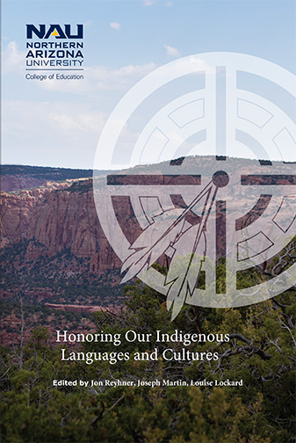
NAU has also supported Indigenous language revitalization and education through conferences, books, and a Teaching Indigenous Languages web site:
http://nau.edu/til

Slide 40
For Further Reading
    Alvord, L. A., & Van Pelt, E.C. 1999. The scalpel and the silver bear. Bantam.
    Belin, E.G., Berglund, J., Jacobs, C.A., & Webster, A.W. 2021. The Diné reader: An anthology of Navajo literature. University of Arizona Press.
    Bingham, S. & Bingham, J. (Eds.). 1982. Between sacred mountains: Navajo stories and lessons from the land. University of Arizona Press.
    Blackhorse, Mitchell. 2004/1967. Miracle hill: The story of a Navajo boy. University of Arizona Press.
    Cleary, L. M., & Peacock, T. D. 1997. Collected wisdom: American Indian education. Pearson.
    Cummins, J. 1992. The empowerment of Indian students. In J. Reyhner (Ed.). Teaching American Indian students (pp. 1-12). University of Oklahoma Press.
    Deyhle, D. 2009. Reflections in place: Connected lives of Navajo women. University of Arizona Press.
    Garcia, Jeremy, Shirley, Valerie, & Kulago, Hollie A. (Eds.). 2022. Indigenizing education: Transformative research, theories, and praxis. Information Age Publishing.
Iverson, Peter. 2002. Diné: A history of the Navajos. University of New Mexico.
Kana’iaupuni, S., Ledward, B., & Jensen, U. (2010). Culture-based education and its relationship to student outcomes. Kamehameha Schools, Research & Evaluation. http://www.ksbe.edu/
_assets/spi/pdfs/CBE_relationship_to_student_outcomes.pdf

Slide 41
McClowsky, Joanne. 2007. Living through the generations: Continuity and change in Navajo women’s lives. University of Arizona.
Powell, Michael. 2019. Canyon dreams: A basketball season on the Navajo Nation. Blue Ridge Press.
Reyhner, J. (2017). Affirming identity: The role of language and culture in American Indian education. Cogent Education, 4(1). http://www.tandfonline.com/doi/full/10.1080/2331186X.2017.1340081
Reyhner, J. 2017. American Indian education: A history (2nd ed.). University of Oklahoma Press.
Reyhner, J. (Ed.). 2015. Teaching Indigenous students: Honoring place, community, and culture. University of Oklahoma Press.
Reyhner, J., Martin, J.,& Lockard, L. (Eds.). 2024. Honoring our Indigenous languages and cultures. Northern Arizona University. https://jan.ucc.nau.edu/~jar/HOILC/
Reyhner, J., Martin, J., Lockard, L., & Gilbert, W.S. (Eds.). (2013). Honoring our children: Culturally appropriate approaches for teaching Indigenous students. Northern Arizona University. https://jan.ucc.nau.edu/~jar/HOC/
Reyhner, J., Gilbert, W.S., & Lockard, L. (Eds.). 2011). Honoring our heritage: Culturally appropriate approaches for teaching Indigenous students. Flagstaff, AZ: Northern Arizona University. https://jan.ucc.nau.edu/~jar/HOH/

Slide 42
Singh, N. K., & Reyhner, J. 2013. Indigenous knowledge and pedagogy for Indigenous children. In J. Reyhner, Martin, L. Lockard & W.S. Gilbert (Eds.), Honoring our children: Culturally appropriate approaches for teaching Indigenous students (pp. 37-52). Northern Arizona University. https://jan.ucc.nau.edu/~jar/HOC/HOC-4.pdf
Zah, Peterson, & Iverson, Peter. 2012. We will secure our future: Empowering the Navajo Nation. University of New Mexico Press.

