Slide 1
Finding Marie Sommerville: The Global Life of a Small Town Teacher in India
Sanjay Joshi, April 4, 2019

Slide 2
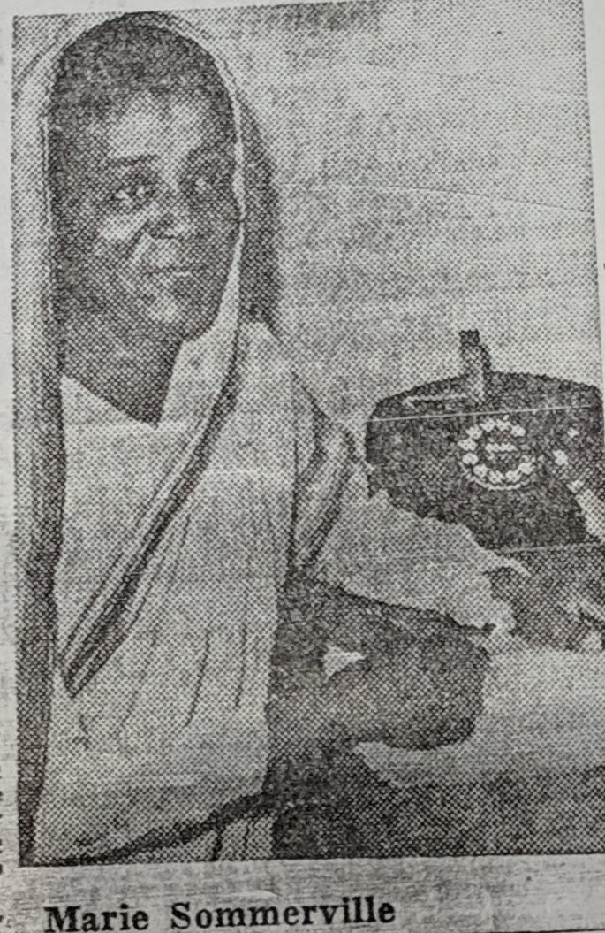
Plan for the talk
Two parts
  The Process of Discovery
  Implications and connections with historiography

Slide 3
The “Discovery”
Crooked Lines and All that Jazz

Slide 4
Dr. Marie Muriel Sommerville’s life
Born in 1903 in Calcutta
Father, John Sommerville (Summerville) a former sailor from British colony of Barbados
John married Letitia Gomez, an Indian Christian woman in Calcutta
Marie grew up poor, but took to school
Trained as a teacher at Isbella Thoburn (IT) College in Lucknow
Taught at various schools including ADAMS School for Girls in Almora
Returned to IT College as teacher and later Dean
Went to UNM, Albuquerque for her PhD when she was 49, possibly the first PhD in English Literature from UNM
Returned to IT then back to the US to teach at Keuka, and later at Winthrop and Voorhees (both HBC)
Retired to Pilgrims Place in Caremont CA, died there in 1988

Slide 5
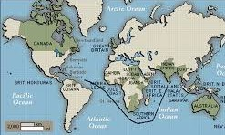
John Sommerville’s Journey

Slide 6
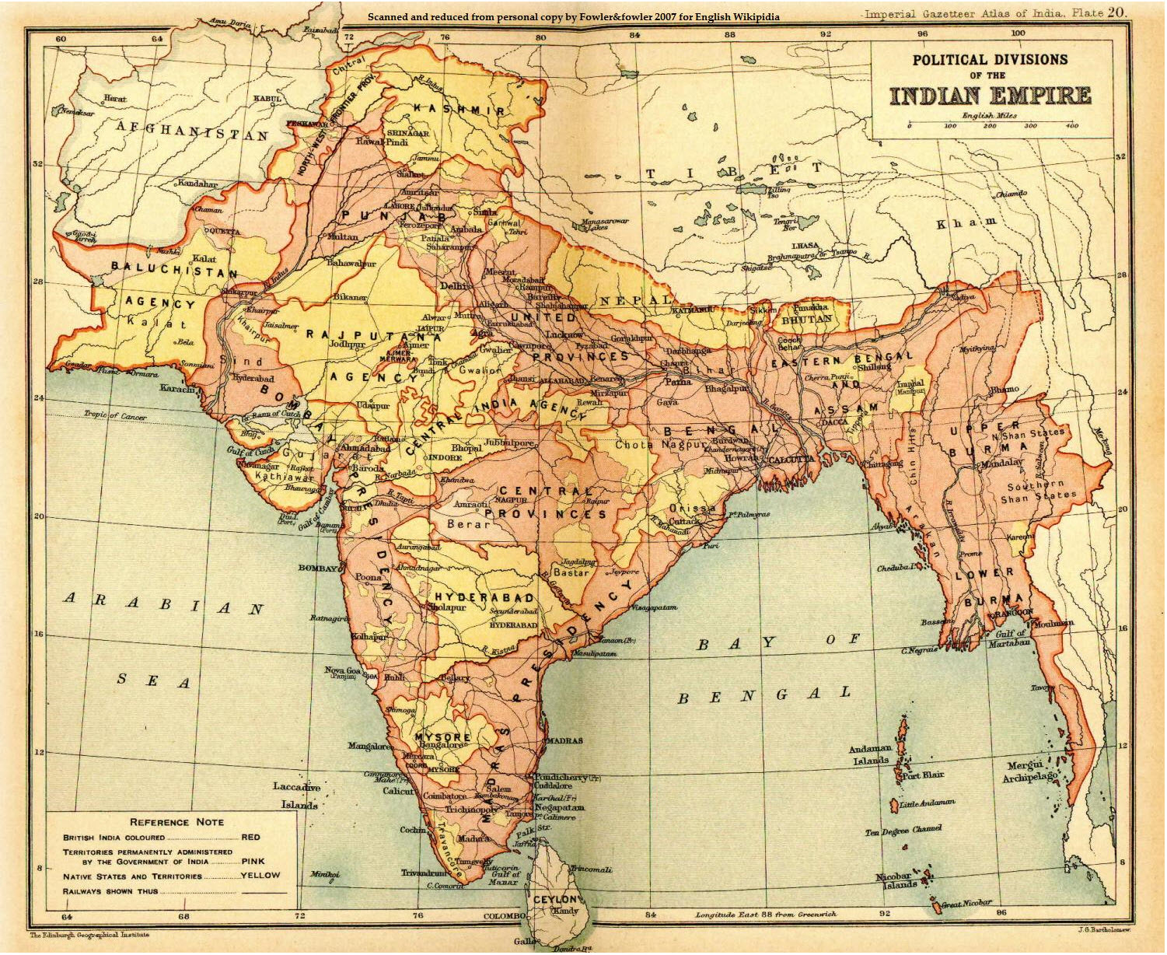
Mari’s Early Travels: Calcutta, Lucknow, Almora

Slide 7
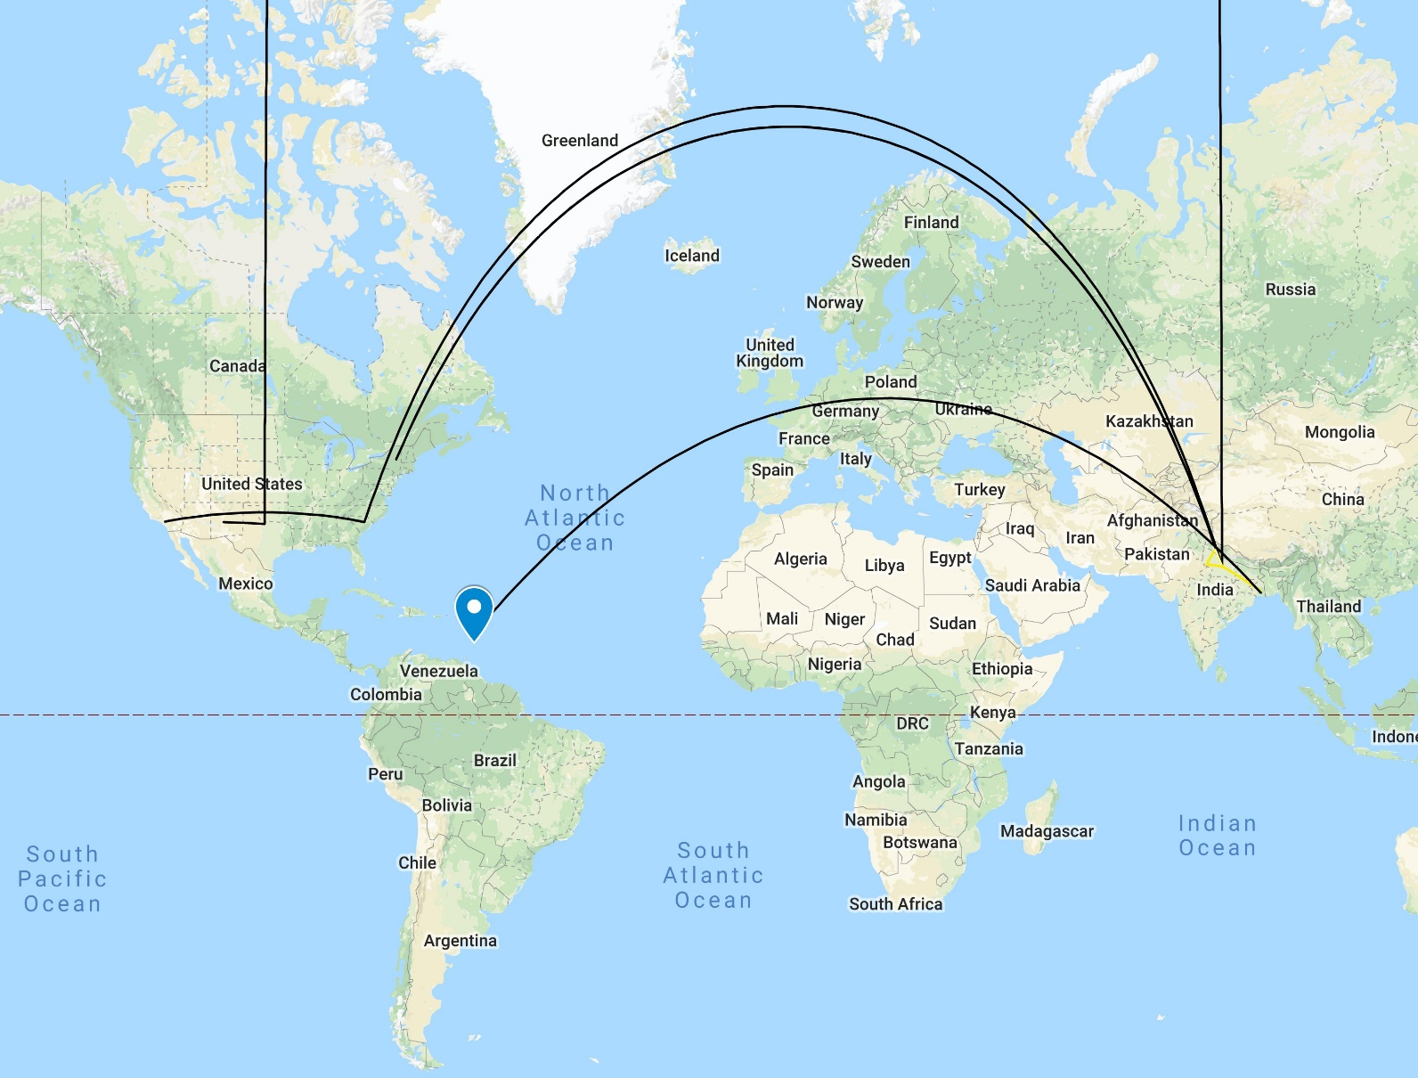
Global Life of a Small Town Teacher

Slide 8
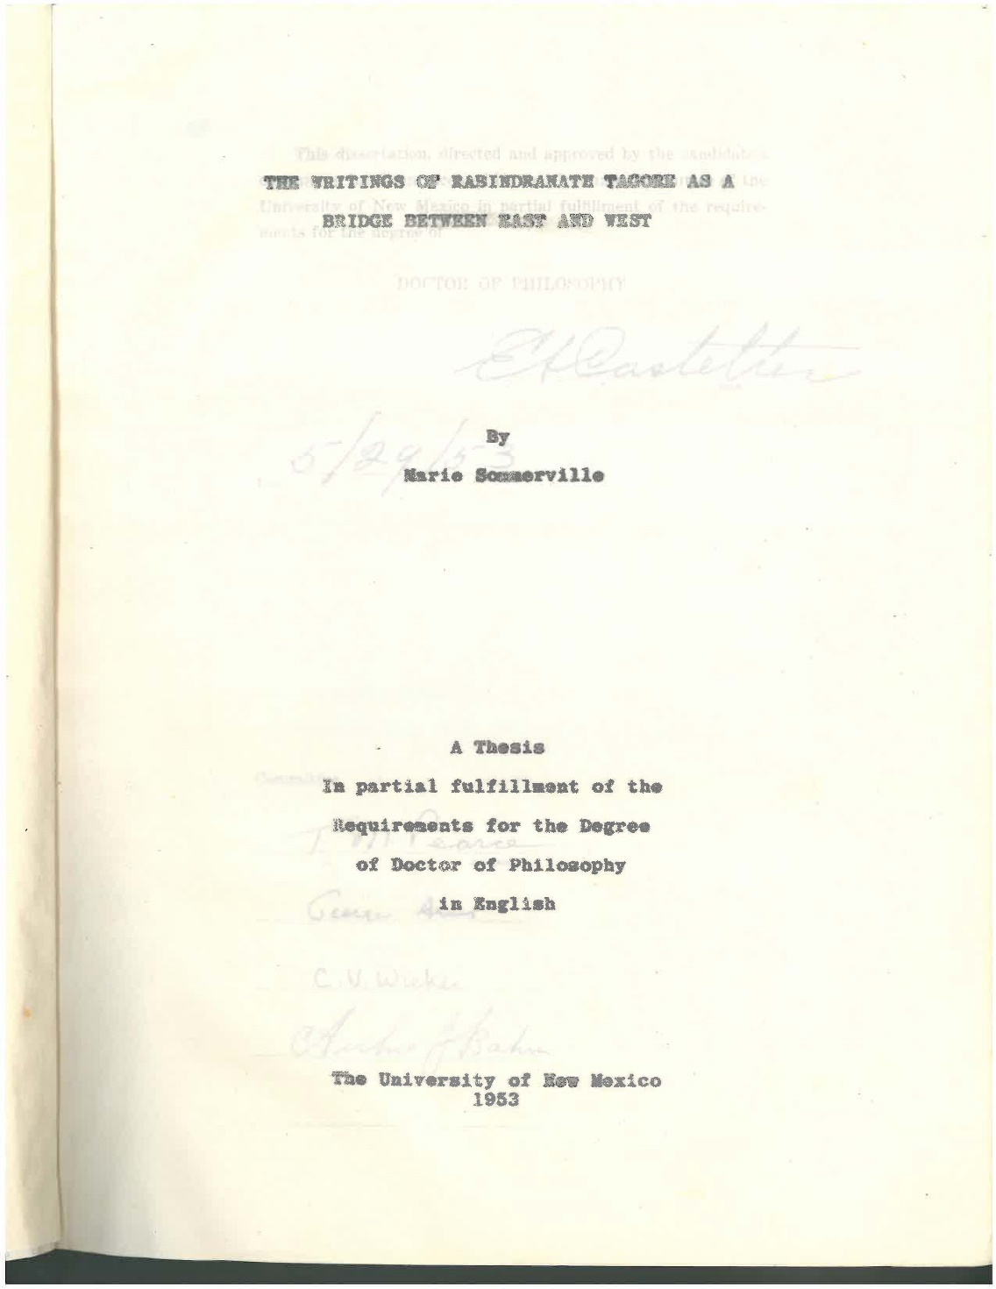
Dissertation

Slide 9
Barbara Williams (former student at Keuka)
“Because Dr. Sommerville was Black but not American, I as Black and American felt responsible for making sure I could help her if she ran into any discrimination problems on campus or in town.”

Slide 10
Albuquerque Journal 1949

Slide 11
Albuquerque Journal May 29, 1953

Slide 12
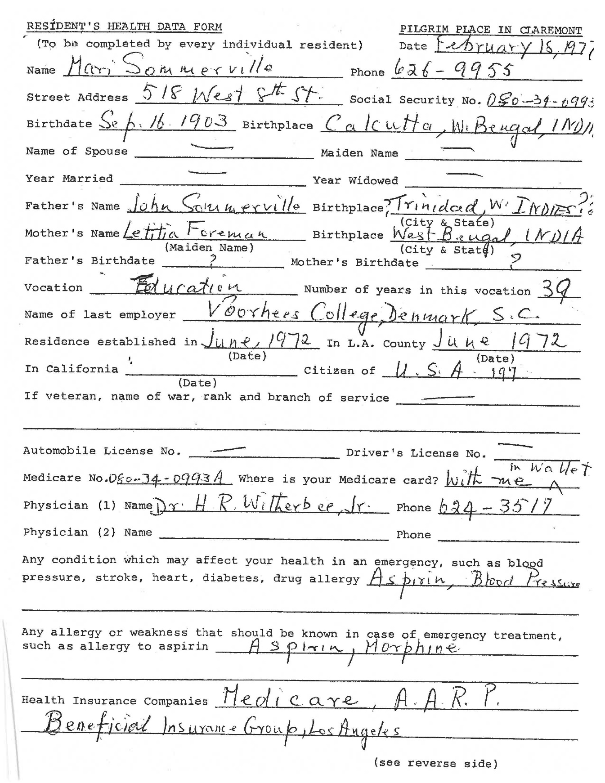
Pilgrim Place Archive

Slide 13
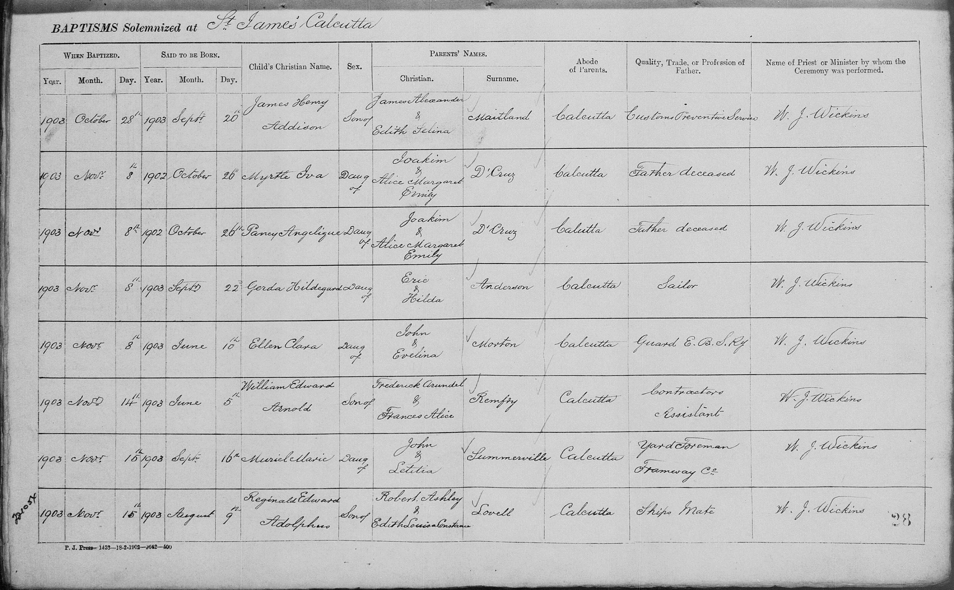
Marie Muriel Sommerville Baptism Record

Slide 14
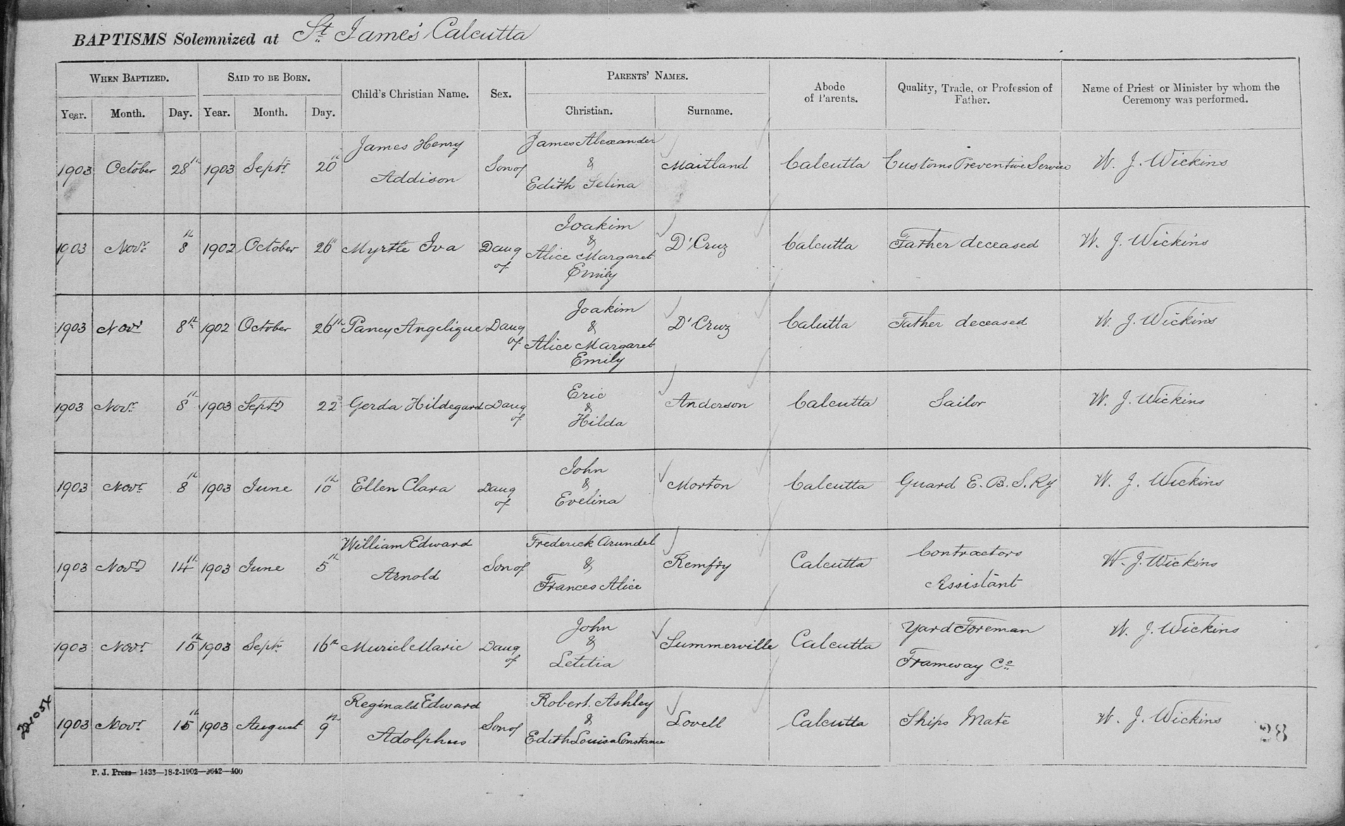
John and Letitia Summerville Marriage record

Slide 15
Implications
Or… why this project might be of interest to the larger scholarly community

Slide 16
Global Life of a Small Town Teacher

Slide 17
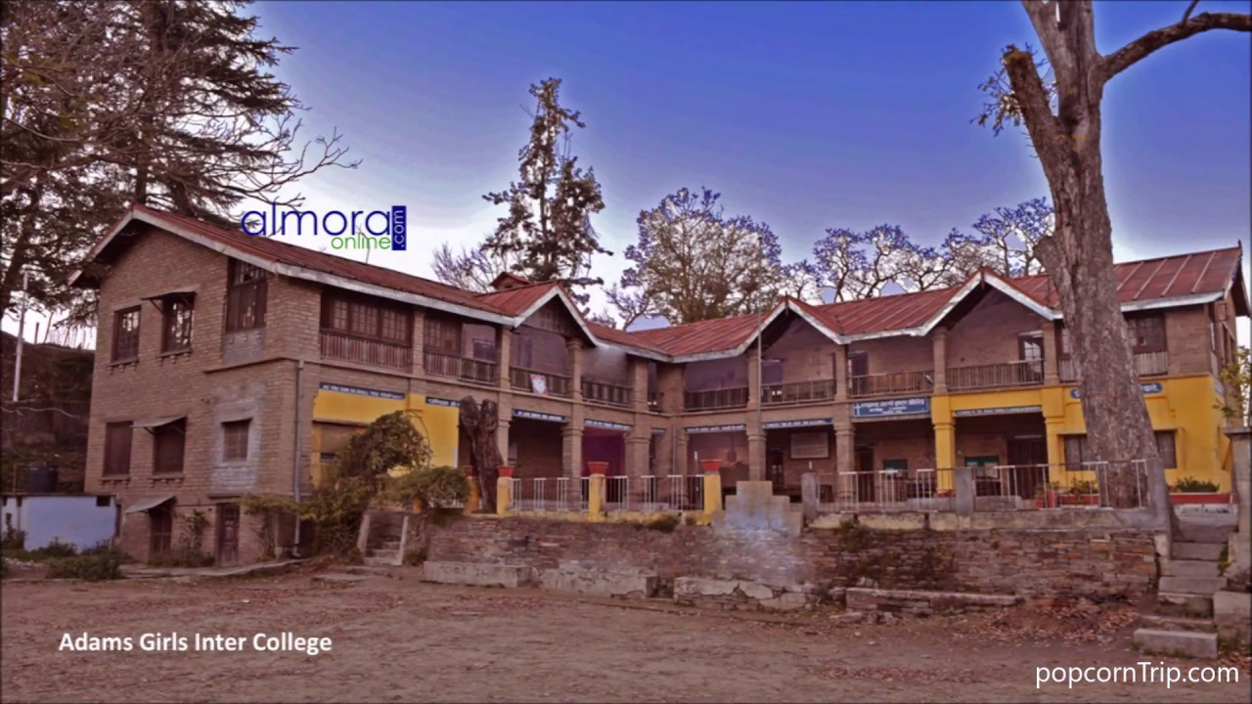
Adams Girl’s School, Almora (contemporary)

Slide 18
Marie in the US

Slide 19
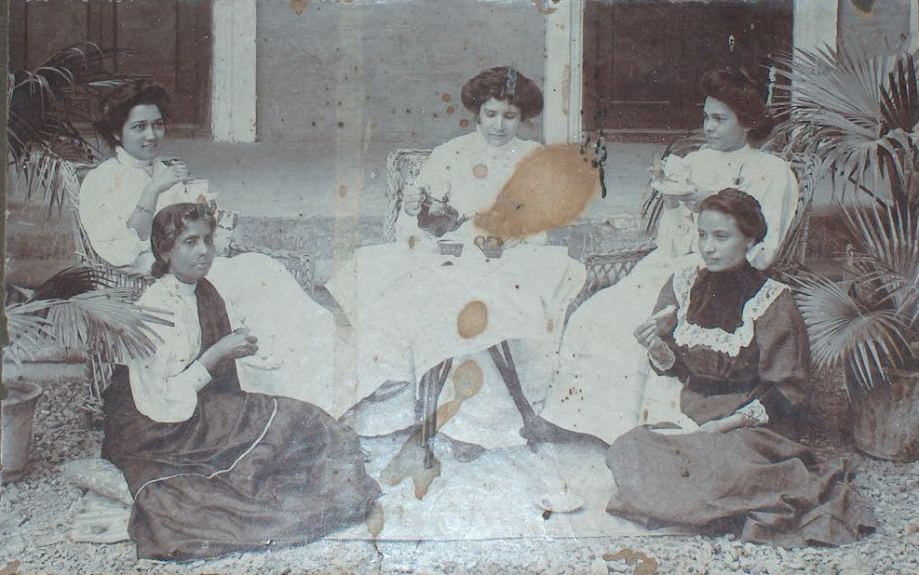
Missionaries and Converts in Western Dress
Almora ca. 1890?

Slide 20
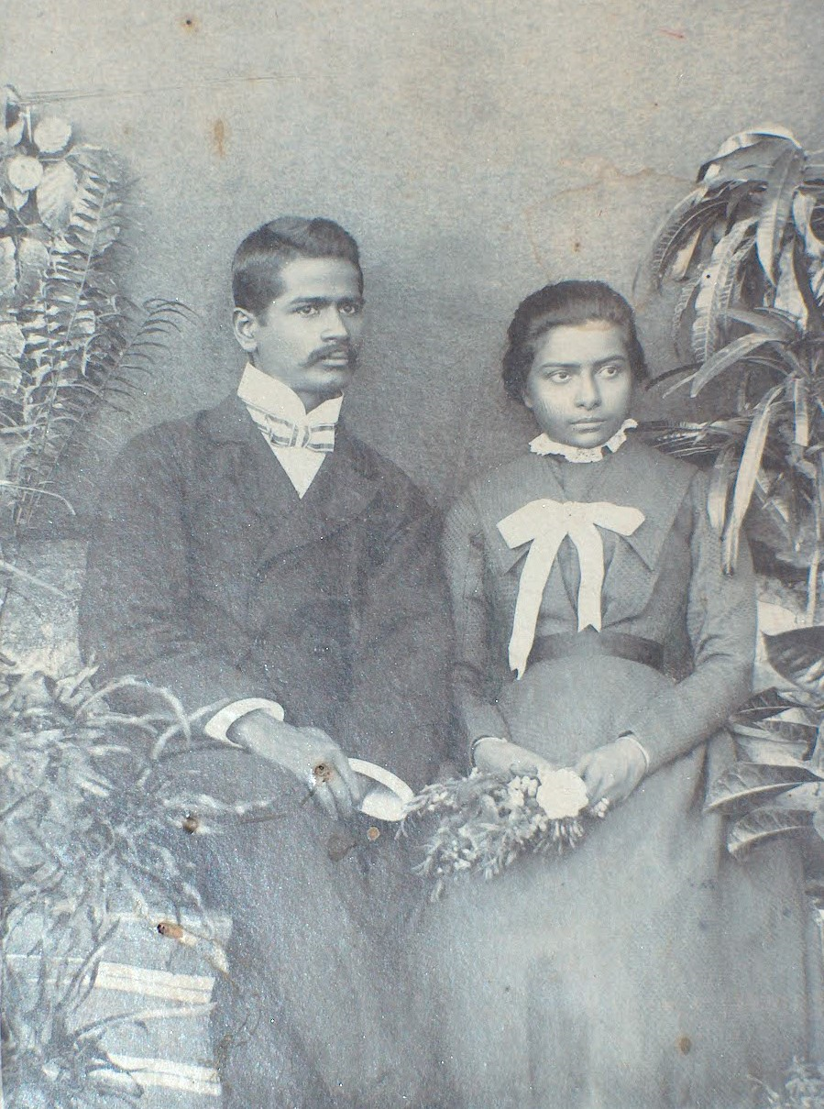
Indian Christian Wedding Photograph ca. early 20th C Almora

Slide 21
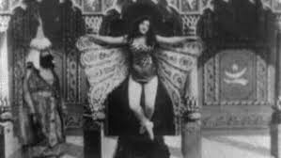
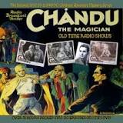
American Fascination with the “Exotic East”
Popularity of “Gurus” or interest in “wisdom of the east” goes back to at least the 19th Century.
Clearly marketable as well. Edison’s 1902 “Hindoo Fakir”
(interestingly termed the “first yoga film” by the
Smithsonian!)
Radio drama Chandu the Magician 1930s
And, the success of Korla Pandit in the 1950s
(more on that in a bit!)

Slide 22
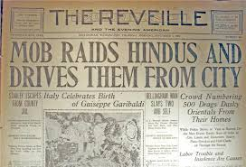
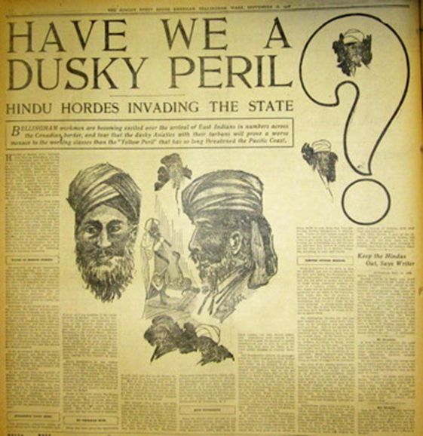
Fascination coexists with Antagonism
Migration of Sikh farmers to California early 20thC
Bellingham Anti Hindu Riots of 1907
In 1917, the US Congress passed an immigration act which restricted migrants from the "Asiatic Barred Zone“ included all of South Asia
1923 United States vs Bhagat Singh Thind denied “Hindus” the right to naturalize, saying, “It is a matter of familiar observation and knowledge that the physical group characteristics of the Hindus renders them readily distinguishable from the various groups of persons in this country commonly recognized as white”
Sept 16, 1906 Puget Sound American

Slide 23
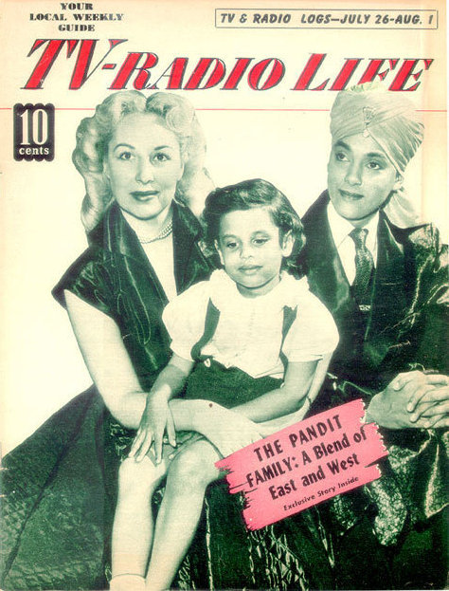
“Korla Pandit” born John Roland Redd
John Roland Redd, son of an African American minister, reinvented himself as “Korla Pandit” claiming to have been born to an Indian father and a French ballerina in New Delhi.
Pandit became an important TV star in that avatar
“Exotica,” Manan Desai argues allowed Pandit to cloak “Blackness through stereotypes of the Third World”

Slide 24
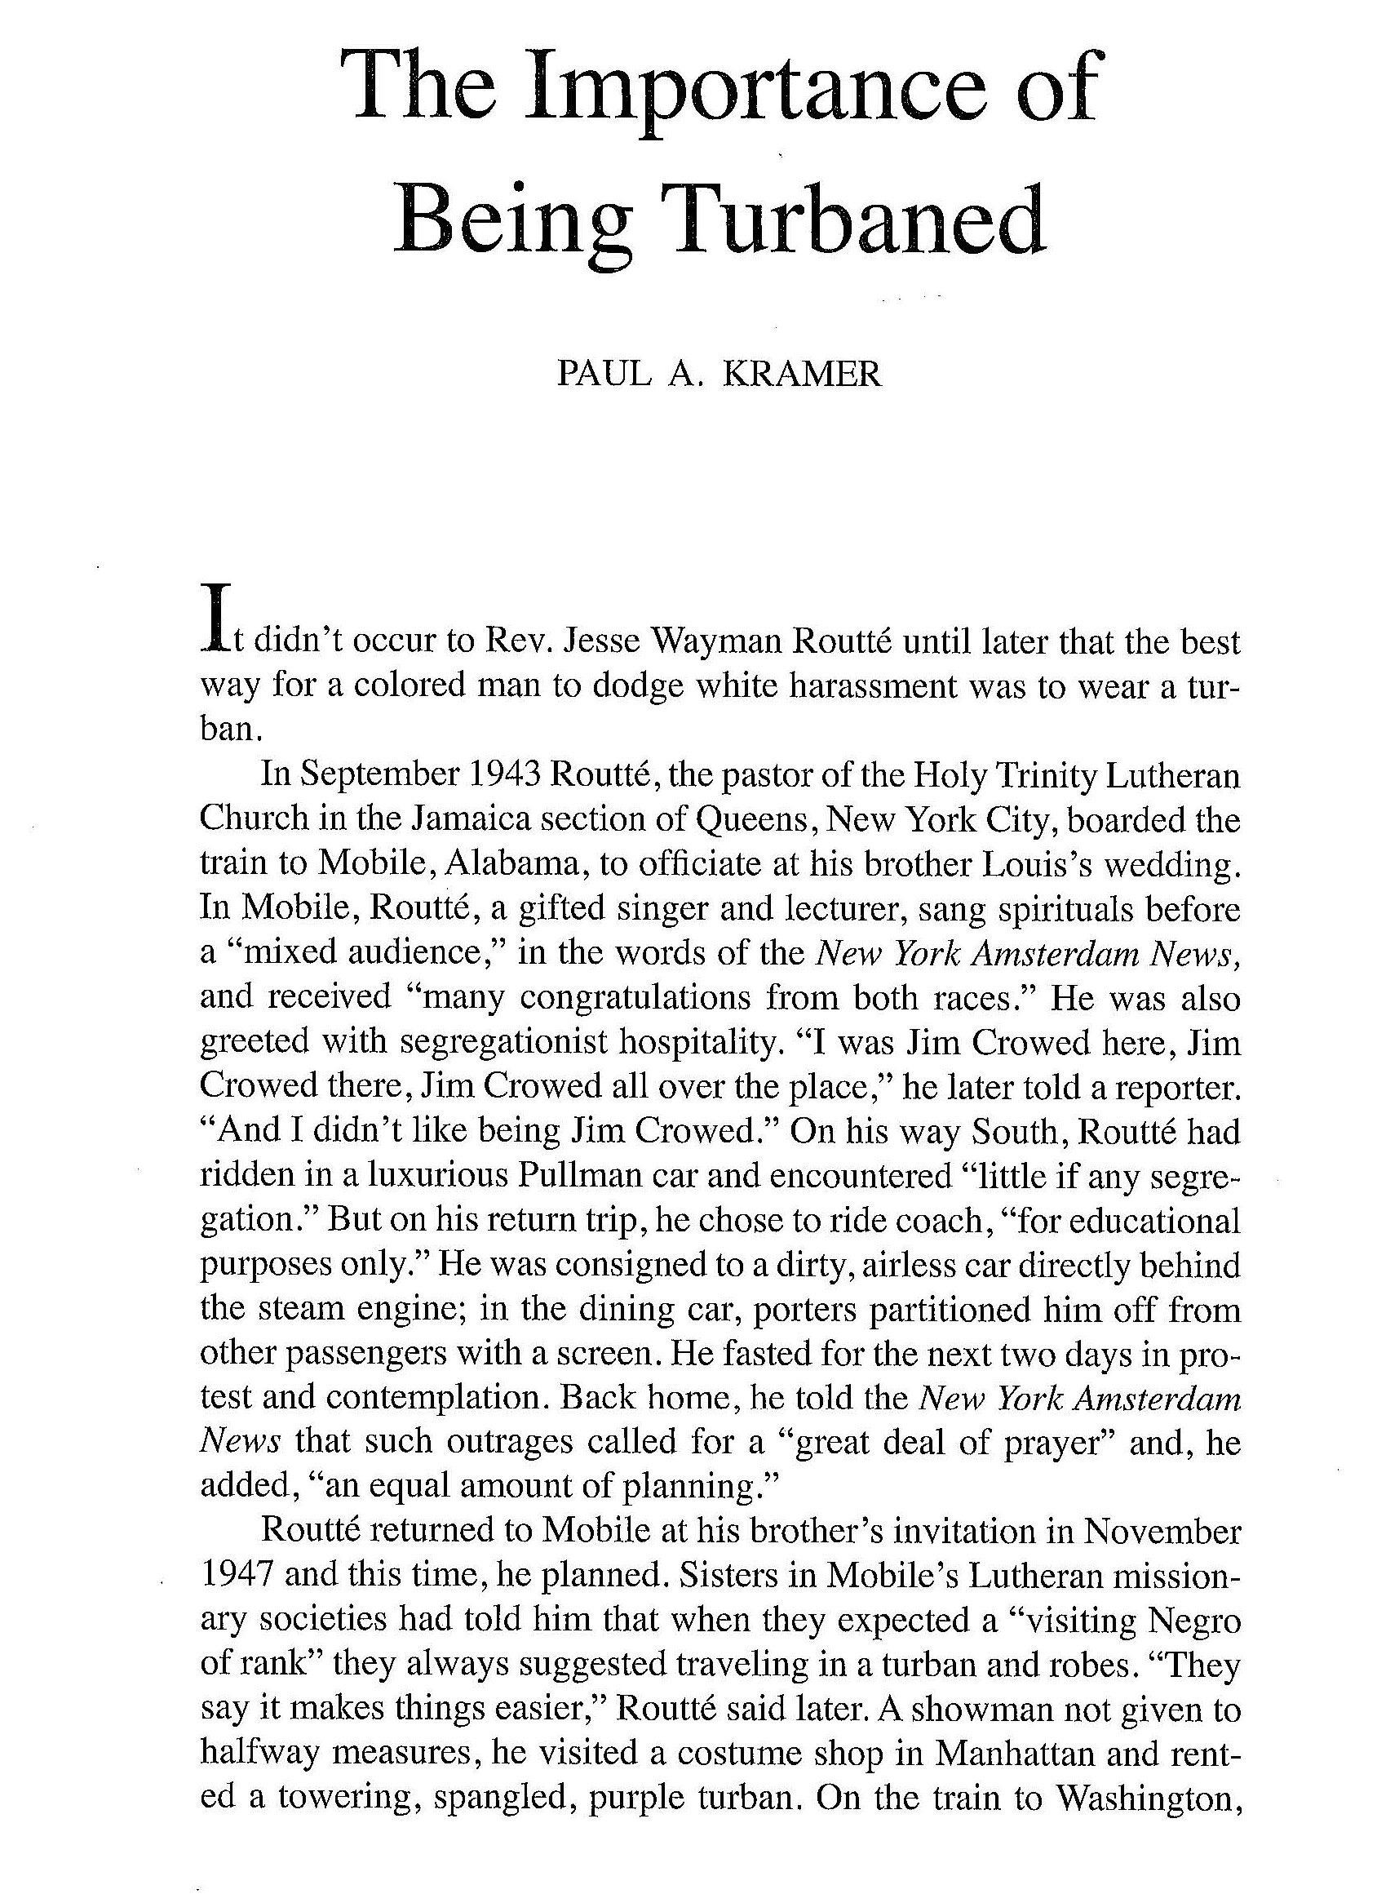
Rev. Jesse Wayman Routté and the Turban
In November 1947, Rev. Routté discovered that wearing a turban could allow him to circumvent the color bar to “turn a threat into a guest” (Kramer, 209)

Slide 25
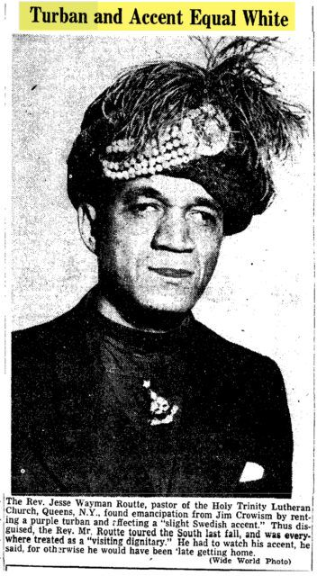
Routté?
This unsourced image may or may not be Routté
Rather than the simplistic caption though, Paul Kramer provides a more nuanced explanation, arguing that by wearing a turban, “Routté … projected and confounded blackness by rendering it illegible” (220)

Slide 26

Marie Sommerville and Global History
A story that involves as many border crossings as Marie Sommerville’s, from her Barbadian father to her own travels and peregrinations, cannot and should not be confined to the limits of “Indian” or “American” history
Sebastian Conrad defines Global History as one whose “core concerns are with mobility and exchange, with processes that transcend borders and boundaries. It takes the interconnected world as its point of departure, and the circulation and exchange of things, people, ideas, and institutions are among its key subjects” (5)

