Slide 1
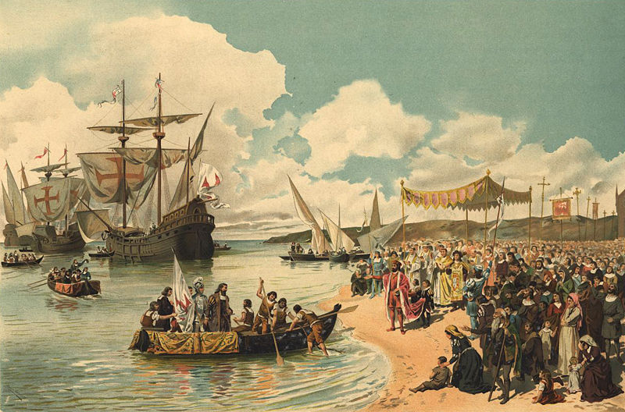
Europeans in India
1500-1800

Slide 2
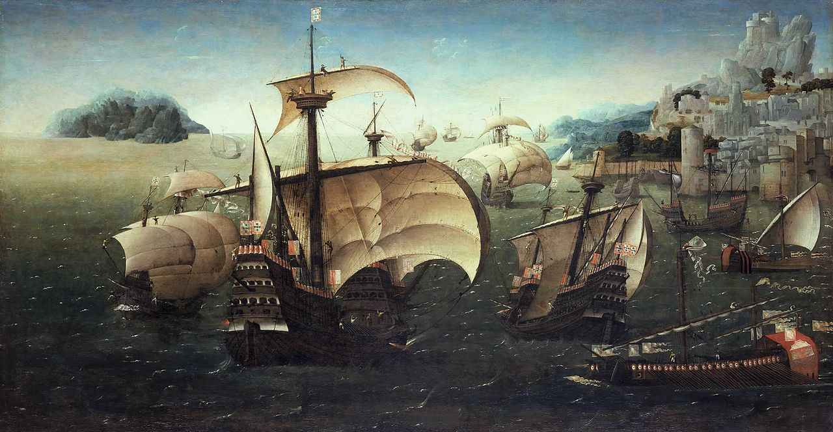
Changes over three centuries
Roughly
1500-1600 Portuguese control over Indian Ocean and enclaves along coasts
1600-1700 North European Protestant Powers (England, France and the Netherlands [Dutch]) replace Southern European Catholics as explorers and conquerors, including control over the Indian Ocean
1700-1800 The ENGLISH overcome challenges from the French to establish themselves and predominant European power in the Indian Subcontinent

Slide 3
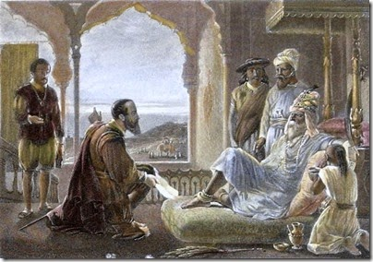
Mughals and European Traders 1500-1700
European success in controlling Maritime trade simultaneous with growing Mughal power, yet the two hardly ever come into conflict
Mughal state was based on collection of land revenue
What India and Mughals lacked was an indigenous source of gold and silver
International trade brought in precious metals but no other commodities that Europe could produce (recall, this is well before Industrial Revolution)
Sea trade important for Mughals because brought precious metals, but not interested in controlling trade
Relative size of Mughal India vs. smaller European nations one explanation for latter’s greater interest in trade

Slide 4
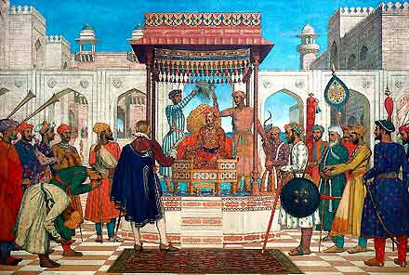
East India Company
The ENGLISH East India Company (EIC) was one of the earliest JOINT-STOCK companies, with shareholders sharing risk and reward
Given a ROYAL CHARTER in December 1600, and later MONOPOLY RIGHTS to trade between India and England. In return paid a fixed sum to British Parliament
EIC approaches Mughal Emperor JAHANGIR for permission to start a “factory” (a warehouse) in SURAT in 1615, granted
Rest of 1600s EIC expanded, always with permission, areas of trade operations. Diversify items of trade, from spices to textiles (calicos & fine cottons most important), also indigo for dyes
Move south down western coast, then up the eastern coast. In 1642 acquire Madras (Ft. St. George) and in 1668 lease over Bombay for L10 a year!! 1692 Calcutta

Slide 5
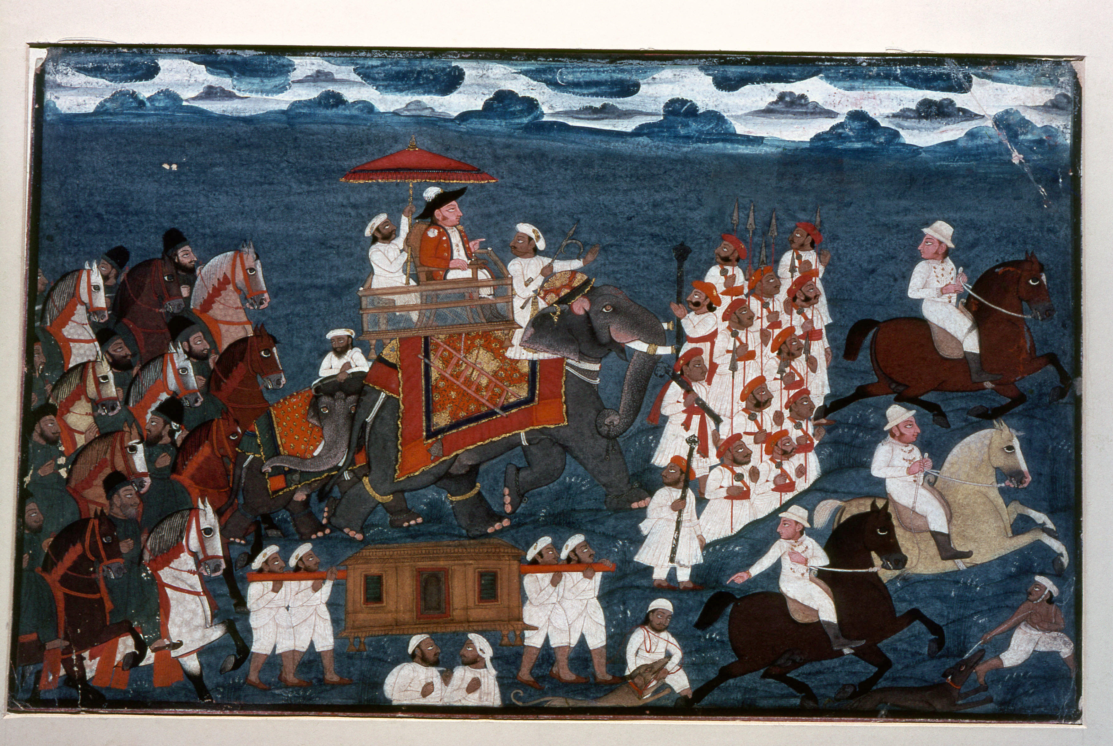
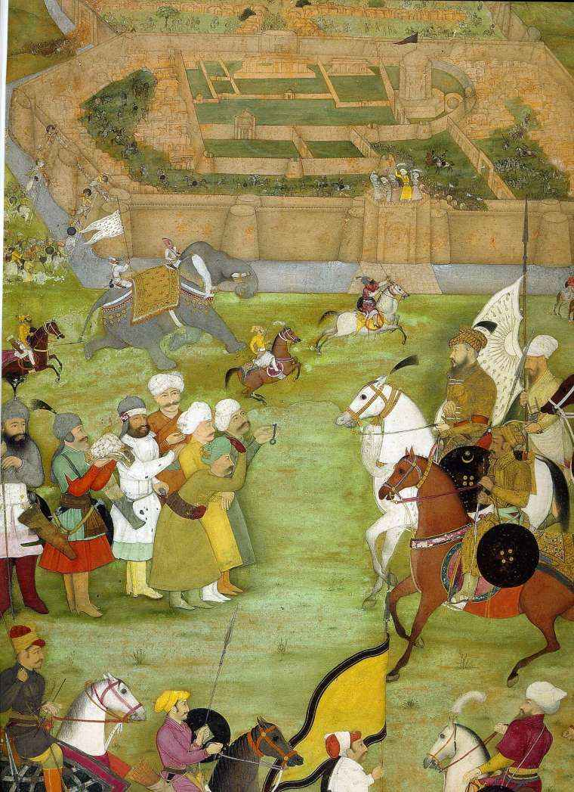
Mughals and the EIC 1600s- early 1700s
Mughals were still at the peak of their powers, at the time of Jahangir and Shahjahan
At this point in the EIC's career, important to remember that they did not play a very significant role in Indian affairs
Though defeat of Portuguese at sea made them important in maritime matters, their influence was insignificant as far as Mughal Empire concerned
Mughal Empire still way more powerful, and until the end of the 17th century Europeans still very much dependent on Mughal goodwill
1686-88 EIC misuse of trading privileges led to humiliating defeat, and two years of negotiations and promise of better behavior to restore privileges
But the relationship did begin to shift in the 1700s with decline of Mughal authority and rise of the successor states

Slide 6
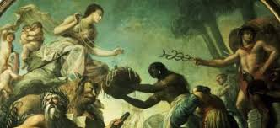
Rise of EIC as political player 1700s
Context of Decline of Mughals and Rise of Successor States: Primarily AWADH (aka Oudh), BENGAL, MARATHAS, HYDERABAD, MYSORE
Successor states large and powerful too: vigorous local rulers, e.g., ALIVARDI KHAN in Bengal, Marathas, or Hyder Ali in Mysore
Till the middle of 1700s no significant conflicts. EIC not want to jeopardize trade, and nor did the new almost-independent rulers wish to deprive themselves of trade that brought in wealth
EIC continue to work with the local system, with merchants like JAGAT SETH family, and obey the rulers
Rivalry between successor states allow them opportunities
Need armed body to guard convoys in post-Mughal India, uncertain borders
Hire out their troops (almost all Indian) to rival successor states, gives them first political role
EIC by now around for 100-150 years, not seen as “foreign”
Anglo-French rivalries also play a role

Slide 7
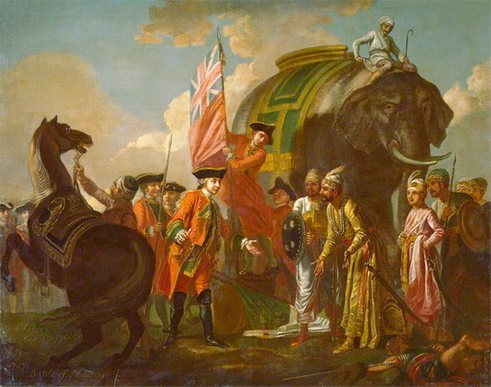
EIC and Local Allies
Successor state use well-drilled French and English EIC armies
  Use of new European battle techniques, simultaneous firing, etc
  Regularly paid! Indian rulers (with exception of Tipu) often not pay, lose soldiers
  British excellent with logistics, businessmen who understood money!!
UPTO the 1st half of the 18th century, the EIC was bringing IN, precious gold and silver INTO the country. For instance, in the 1710s, the British brought in about TWO MILLION POUNDS to Bengal alone. This trade was too good to be turned away.
The other people who had a stake in the EIC were big Indian merchants engaged in trade within India as well as across Indian Ocean. Some of them were rich enough to finance Mughal state. The family of JAGAT SETH was one very important entity.
Traders, however, depended upon political stability. Decline of Mughal authority in early 18th C hit some of them hard
European Companies, with their armed ships and fortified settlements, on the other hand, do well in the unstable climate of the later Mughal period.
Many Indian merchants were agents for the EIC, get their goods from inland areas, and become in effect partners or compradores
Once the EIC start to acquire some political and military control, good for their business

Slide 8
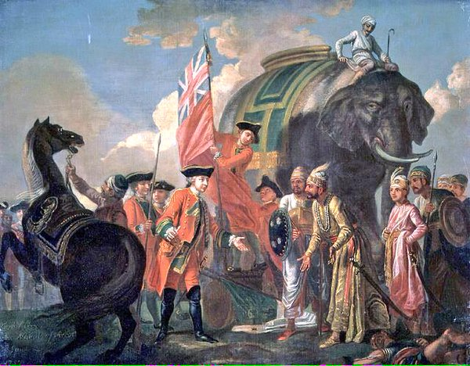
EIC: from traders to rulers, ca. 1750-1800
TWO major events start the process
Battles of PLASSEY and BUXAR
Acquisition of DIWANI RIGHTS by the EIC
PLASSEY: SIRAJ UD DAULAH, Nawab (title of ruler) of Bengal not allow EIC to fortify Ft. William with guns. Leads to conflict, EIC defeated, “Black Hole” incident. Then comes battle of Plassey, and treachery; Mir Jafar and Jagat Seth collude with EIC and first military defeat of an Indian power by a European one. Siraj ud Daulah replaced by Mir Jafar as Nawab
EIC increase troop strength rapidly
Plassey not as significant as battle of BUXAR in 1764. Nawabs of Bengal, Awadh, and titular Mughal Emperor defeated by EIC armies at Buxar and ultimately Mughal ruler forced to appoint the EIC as his DIWAN (tax collector) for Bengal
With DIWANI 1765 , EIC a real political force in India. De facto rulers of Bengal. Other states, AWADH the MARATHAS, HYDERABAD, and MYSORE still there. But fighting amongst themselves. EIC from Bengal loan out troops as mercenaries, at high price, by end of 18c Awadh paid heavily, money as well as important revenue-yielding territory to EIC
Late 18th C challenge to EIC came from rulers of Mysore, who sought an all-India alliance against the EIC. Also help from French. But alliance not work not work, and French help was not enough as France itself in throes of revolution then. Mysore defeated in 1799

Slide 9
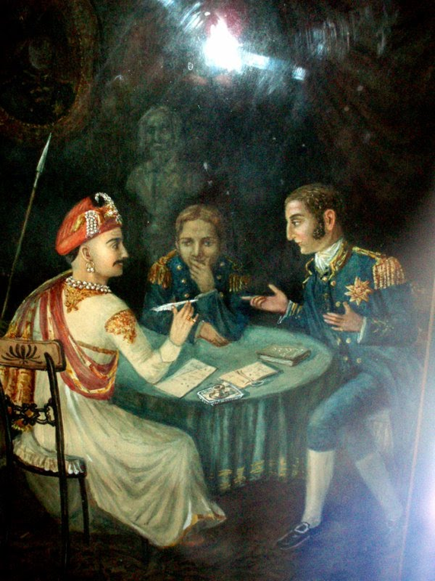
Expansion Post 1800
EIC now begins to compel independent Indian states to sign "subsidiary alliances" formalization of a system that had informally been in place since mid 1700s. Protection Racket, pay the EIC to become subsidiary allies in return for military protection.
MARATHAS were the last to sign SA in 1802, as a result of factional fight within the confederacy
Post 1802, EIC de facto rulers of India. There were one or two minor (or not so minor) irritants, such as the Sikh kingdom of Ranjit Singh in Punjab. By 1848 that too militarily defeated and annexed
Two other expansionist policies in first half of 19thC: Doctrine of Lapse, and Paramountcy,. Both "spurious legal doctrines" that allowed EIC to annex more and more territories to its empire.
Lapse = only NATURAL-BORN sons of a king could inherit, if not the kingdom “lapsed” to EIC domains
This was established through doctrine of Paramountcy: Even as independent rulers were recognized as sovereign in their own domains, EIC took over role from Mughals as Paramount Power to decide on matters of succession of independent states, for instance

Slide 10
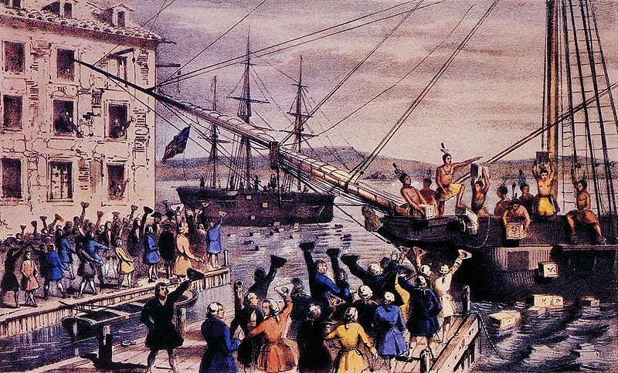
WHY did a trading company want territory?
Complex answer: early 19th C saw Anglo French conflict in different theaters of the world, including Europe, but also in INDIA, where DUPLEIX (French) starts policy of political intrigues with Indian princes. Competition with French (this is also the period when emergence of nationalism in Europe) was one motivation
But no ideology without economics. Huge opportunity of economic gain in territorial expansion. The annexation of Punjab 1848 , e.g., not only paid for the cost of conquest and future administration, but left an ANNUAL surplus of 5 million rupees. Nagpur, under doctrine of lapse, yielded 4 million
Economic logic to expansion. More revenue, more goods bought in India, more profits

Slide 11
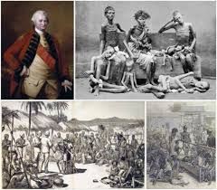
IMPACT of colonialism? For that is what it is now
Now, gold and silver not coming from England, rather goods bought with taxes gathered from Indians in India
Each item of export was now a net DRAIN from India (as opposed to bringing IN money, earlier) Conquests allow EIC to mitigate the trade deficit that it had in its trade with India.
Also other kinds of "drain": Company officials forced Indian rulers to hand over large "presents" most top officials of the EIC, for example ROBERT CLIVE or WARREN HASTINGS returned home very rich men, among the ranks of super rich, able to buy themselves important positions in the British Parliament
Indian nationalist historians have calculated that a large percentage of the capital that was invested into industrial production in Britain, the Revolution that made Britain the leading world power for a century and half, was financed by the "drain" from India.
For Indians consequences of plunder were heavy. The Famine of 1770 in Bengal wipe out ONE THIRD of the population!!

Slide 12
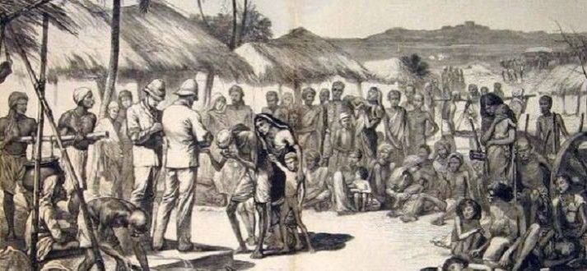
Changing Policies and Impacts 1770-1850
Until Industrial Revolution take off, taxes, land revenue remained important source of income.
Different modes of collection. EIC experiment with revenue farming in Bengal (selling collection rights to highest bidder) and created the famine of 1770
In 1793, under Lord Cornwallis, introduce the PERMANENT SETTLEMENT (PS) where land revenue was fixed in perpetuity. Collected from the ZAMINDARS in Bengal whom the EIC saw as LANDOWNERS. PS based on ignorance, and introduced a huge change. Land was never Private Property to be sold; Zamindars were not owners but had RIGHTS over land, right to collect tax and to demand services. PS made Zamidars into OWNERS and LAND as COMMODITY to be bought and sold. Not pay tax, land sold at auction.
By the first quarter of 19th C, Industrial Revolution took off. Policies changed. India less important as source of revenue from land, but as captive market for British industry
So more solicitude for peasants. RYOTWARI and MAHALWARI settlements with cultivating communities. Even the revenue burden was reduced in areas conquered in early 19th C. Peasants a possible customer of British products, so keep them alive and with surplus to spend on manufactured goods
Also DEINDUSTRIALIZATION factories able to produce cotton cheaper, flooded Indian markets. Textile production, once the main export, was now “outsourced” to Lancashire factories. Thousands of Indian handloom producers perished.
Other importance of India was as source of raw materials. More strict collection of revenue to encourage growing of commercial rather than food crops. For some crops plantations as well
Indian peasant made dependent on an volatile international economy at disadvantageous terms. When global prices went up, peasants saw very little gain but when prices collapsed, peasants who had been encouraged through taxation policies to grow cash crops, suffered. Could not even eat cash crops!

Slide 13
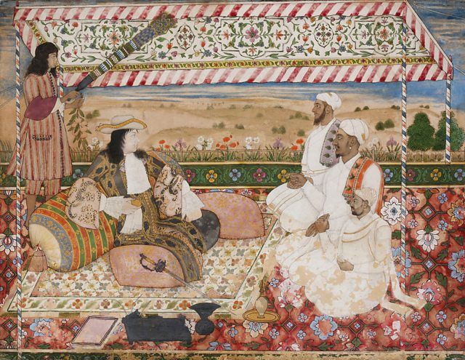
EIC and Cultural Attitudes and Practices
The sort of racist and / or condescending attitudes or derogatory opinions that were to later characterize British attitudes towards Indians (and continue to inform the attitudes in the western world towards the “non west”) were not in place in 18thC.
English or French merchants, lived in India, took on Indian customs, sometimes married or lived with Indian women, appreciated aspects of Indian culture.
This was also the time that created first of ORIENTALISTS, or people who were to make their careers or hobbies the study of the Orient (at this time mainly India and the middle east, only later China and Japan too)
CONTEXT : Until 19th C most European merchants were SUBORDINATE in status and power to Indians
No SUEZ CANAL (1869), Journey took over a month around Africa. Europeans stuck in place, so adapt and adopt.
But this began to change in the 19th By 1830s “White Mughals” were looked down upon, by 1850s, clear separation and attitudes of white supremacism prevail

Slide 14
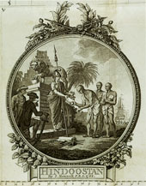
Culture and Power “Orientalism”
After becoming RULERS (of Bengal), the first completely alien set of rulers, EIC realize important to KNOW India.
From the 18thC onwards EIC sponsored scholars and administrators to systematically research India, its languages, religion, culture, etc.
But this knowledge was produced in a particular context, from a certain point of view, and most important for a certain PURPOSE, that is information that would be USEFUL for the EIC to RULE India
Though based on Indian informants, this knowledge was often very different from the way Indians themselves perceived their society
Early scholar-administrators called ORIENTALISTS, scholars of the Orient, and their representations of India have shaped in very important ways that we think about India today.
Research into Indian culture left most Orientalists impressed with philosophical ideas and literary and cultural productions of classical India

Slide 15
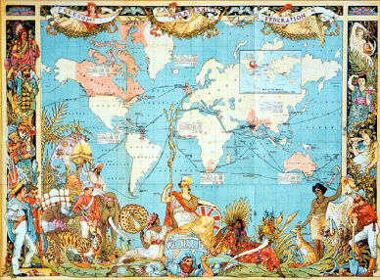
Knowledge and Power: Orientalism and the creation of NEW Knowledge about India
Knowledge and Power connected, always!
Orientalist knowledge was created for a certain PURPOSE, that is to facilitate rule over India and Indians
Created NEW kinds of knowledge: for example the ideas about DESPOTISM, or the “knowledge” that only religious LAWS applied in India, and particular interpretations of those laws (see M&M pp. 58-59)
Helped create and JUSTIFY new systems of governance, that sought to blend “Oriental despotism” and “British rule of law”
Equally helpful was KNOWLEDGE ABOUT GEOGRAPHY that helped draw up detailed topographical MAPS used in military campaigns (do you need a map for an area to which you “belong”?)
Equally so, knowledge about history, or culture (M&M p. 62) was knowledge that was created to help the EIC RULE parts of the subcontinent

Slide 16
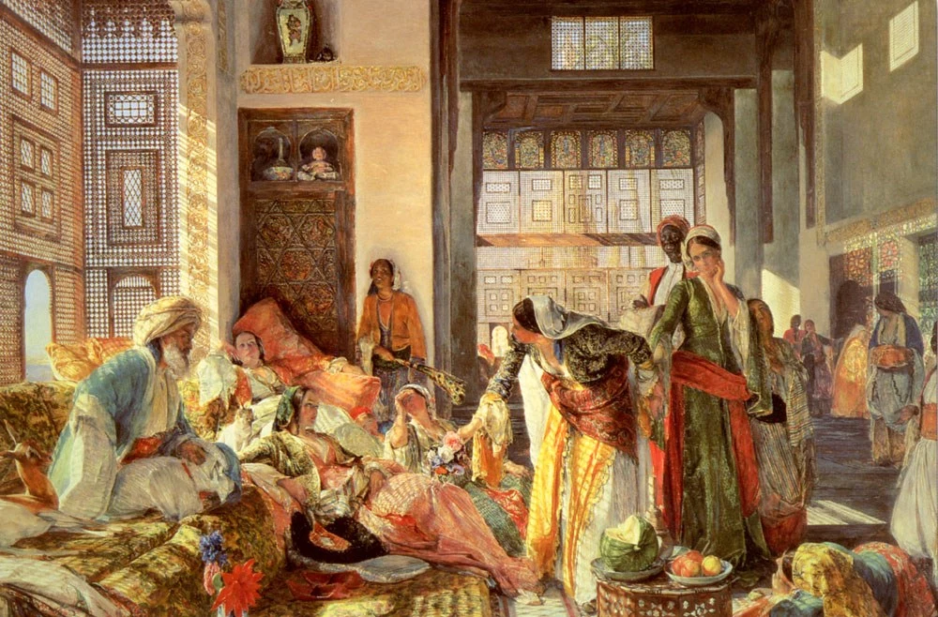
Orientalism and the “Invention of Tradition”
The idea of “religion” somehow being DEFINITIVE of Indian identity was one of the most significant products of Orientalist knowledge (continues to this day!)
To do this, tradition and history were reinvented, e.g. WILLIAM JONES had high praise for ancient Indian (Hindu) traditions
But these traditions had been DYNAMIC and the legal system flexible and locally inflected
Under Orientalism they came to be rigid and fixed, e.g. through the codification of “Hindu Law” or “Muslim Law”
Orientalist knowledge was ELITIST. Orientalists, from British upper classes were themselves hierarchical, low opinion of their OWN lower classes (or women for that matter). Turned only to INDIAN ELITES for their information. Ideas about “Hindu” came from BRAHMINS, and Indian Muslims from CLERICS, QAZIS, who gave a formal textual interpretation of their “traditions”
This ignored more flexible practices and ended up producing “laws” and “traditions” that undermined the interests of lower classes, castes, and women and other subordinated groups
Indians living under these laws (and learning British inspired History in classrooms), over time, came to adopt these as their “own” traditions and even identity. More of this later!

Slide 17
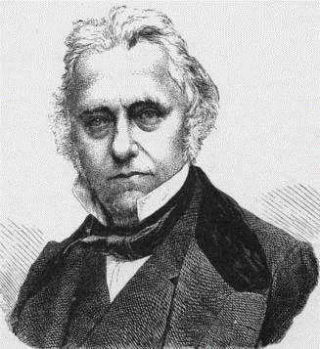
Orientalists to Anglicists
Late 18th and early 19th C, the generally favorable attitudes (of Orientalists, e.g.) towards India and Indians, start to change
This change was two fold,
  i. new ideas connected with Evangelical Christianity and Utilitarianism (society changed with RATIONAL laws, ... and that rationality meant individuals were ONLY profit maximizers)
  ii. EIC’s POLITICAL POWER GROWS
As a result, the ORIENTALIST world-view came into disfavor. Rather, EVERYTHING Indian came to be denigrated
Exemplified by MACAULAY who admitted that he knew nothing of Indian languages, claimed that an English elementary school text book contained more useful knowledge than all the books written in Sanskrit or Persian!
Various measures of social reform, e.g. outlawing irrational practices like Sati, etc. Encourage a western-educated Indian elite in cities like Calcutta who would be trained in USEFUL and RATIONAL ways using ENGLISH rather than in languages such as Persian and Sanskrit

Slide 18
“Culture and History”: Changing Contexts
1660-1750 Early merchants came to trade, were politically insignificant. Embrace Mughal authority, and Indian lifestyles
1750-1800 ORIENTALISTS represented a second phase where political authority growing
By 1830s, EIC had been RULERS in Bengal for over 70 years. India had become a career for English upper classes
These men CAME as rulers, with ideas very different from those of early Orientalist scholar-administrators
Orientalists had ensured that Indian languages and culture preserved, albeit in some distorted fashion
But ANGLICISTS, influenced by Evangelical and Utilitarian thinking. This new breed of Englishmen operated with profound self confidence and arrogance, and sought to restructure colonial administration, into a much more intrusive, “improving” venture
Indian RESPONSES were a product of BOTH Orientalist and Anglicist ventures

