Slide 1
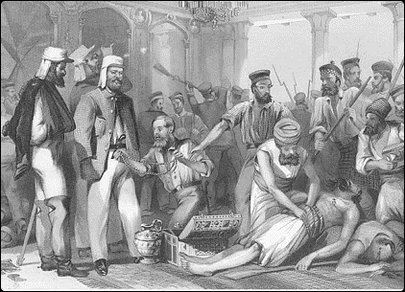
Early Indian Responses to EIC Rule
~1800-1857

Slide 2
Changing Contexts: “Culture and History”
1660-1750 Early merchants came to trade, were politically insignificant. Embrace Mughal authority, and Indian lifestyles
1750-1800 ORIENTALISTS represented a second phase where political authority growing
By 1830s, EIC had been RULERS in Bengal for over 70 years. India had become a career for English upper classes
These men CAME as rulers, with ideas very different from those of early Orientalist scholar-administrators
Orientalists had ensured that Indian languages and culture preserved, albeit in some distorted fashion
But ANGLICISTS, influenced by Evangelical and Utilitarian thinking. This new breed of Englishmen operated with profound self confidence and arrogance, and sought to restructure colonial administration, into a much more intrusive, “improving” venture
Indian RESPONSES were a product of BOTH Orientalist and Anglicist ventures

Slide 3
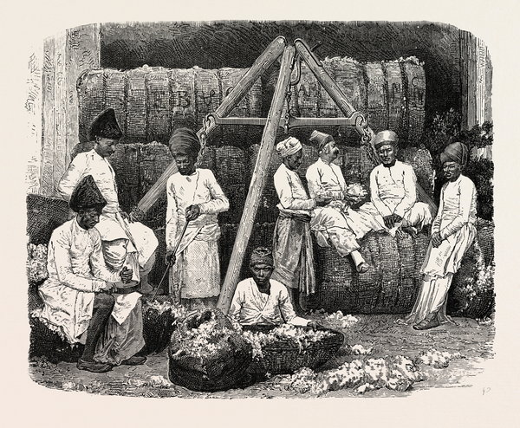
Response in context of a combination of issues
Political Expansion of EIC at expense of Indian rulers
Economic Impacts
  Famine
  Peasants
  Zamindars
  Artisans: Deindustrialization
Orientalist Ideas
Evangelical and Utilitarian Reforms

Slide 4
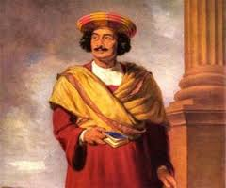
Variety of Early Responses
Not assume ALL INDIANS respond in similar ways
Focus first on urban products of both ORIENTALIST ideas and ANGLICIST/ Supremacist ideologies& differences within them too:
  People like DEROZIO & Young Bengal: enthusiastic about West, and criticize Indian customs like ANGLICISTS did (M&M, 83)
  CONSERVATIVES, like DHARMA SABHA supporters (88 )who defend social customs and practices, or religious leaders who felt that Christian EVANGELISTS would destroy religion
  Similar movements of reform among MUSLIMS, back to QURAN, purify and reform popular Islam. WAHABI Saiyyad Ahmad Barelvi and FARAIZI peasant (85)
  Best known, RAJA RAM MOHUN ROY, sought to blend western with often ORIENTALIST-derived ideas about “traditional” India: Roy wanted to change India in ways compatible with western rationality but sought justification in the ANCIENT Hindu such as the UPANISHADS that Orientalists scholars had praised(86-88)
  These different responses often called proto-nationalism, especially when ORIENTALIZED tradition was contrasted with MACAULAY-like derogatory interpretation of Indian culture or tradition or practices
Produced a period of great debate and discussion that carried on to late 19thC

Slide 5
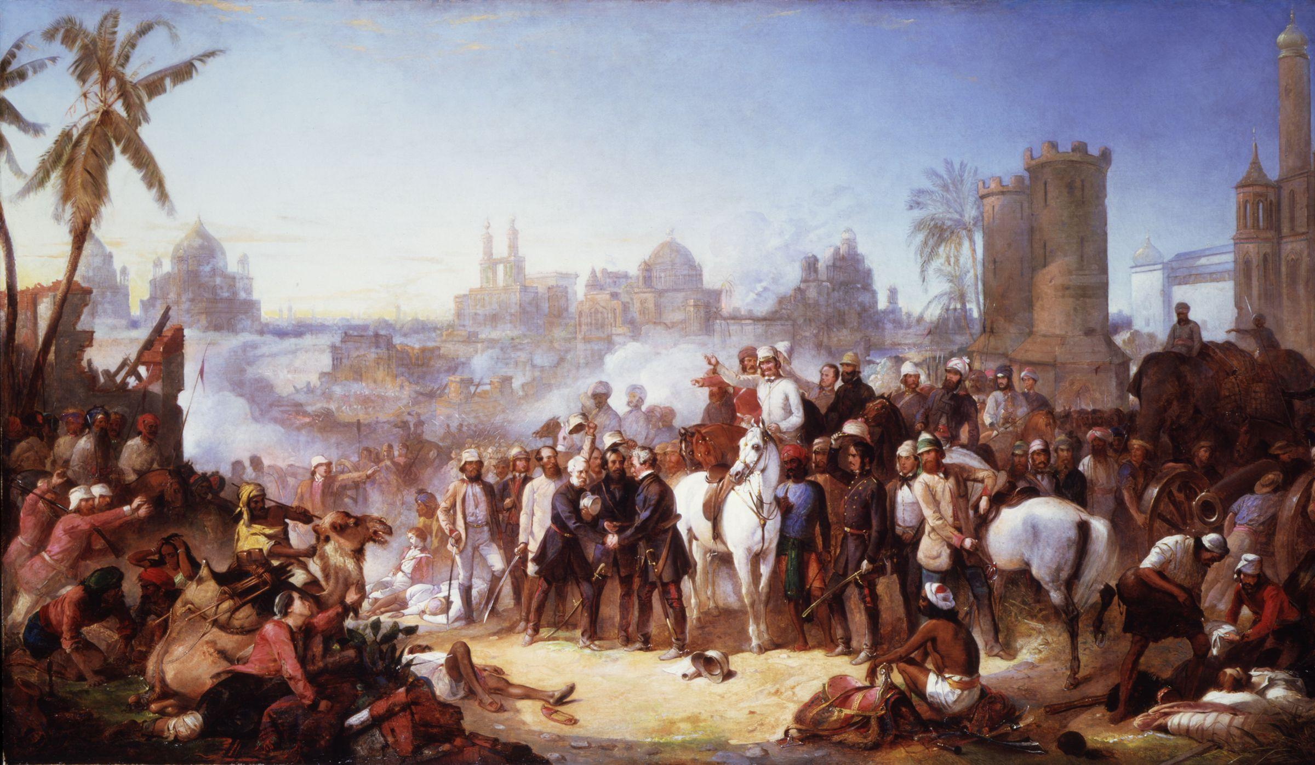
1857
Dramatic, unlike the ones discussed earlier
Start as a “sepoy” (soldiers’) mutiny, but quickly expands to include those who had grievances against the EIC, among former rulers, current peasants and artisans among others
Soldiers reach Delhi where they "restored" as the ruler of India, a very reluctant Mughal emperor Bahadur Shah II
Over the next year or so, British lost control over large parts of northern India, some parts of Deccan, and sections of eastern India.
Differently described as a mutiny, a revolt, a rebellion, or a war of independence
Was crushed within a year, and very brutally so, by the force of arms, and with a ferocity that bordered on genocide at times.

Slide 6
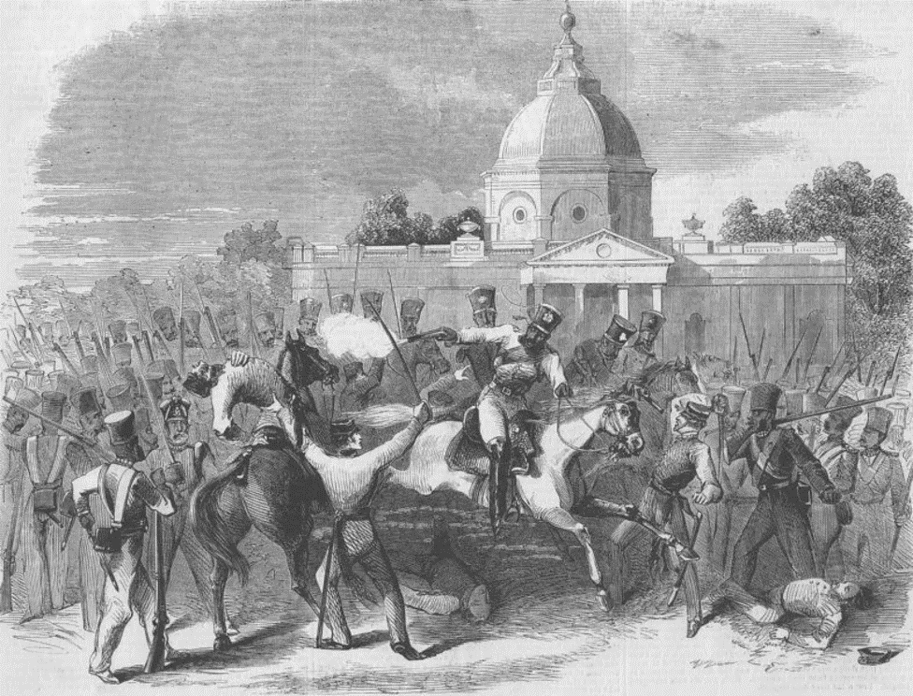
Three Questions about 1857
Why?
What sort of revolt was it? Nature of the Movement
What IMPACTS did it have?

Slide 7
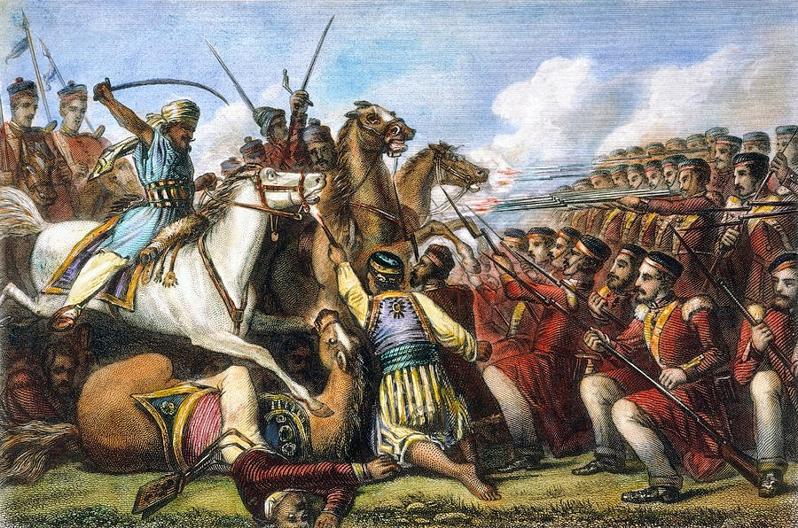
Causes: WHY Revolt?
ECONOMIC policies of EIC : LAND REVENUE; COMMERCIALIZATION of AGRICULTURE; DEINDUSTRIALIZATION
  Impact on the lower orders of society, but also some ZAMINDARS and influential people
FORMER RULERS : Conquest, Doctrine of LAPSE, etc. Former rulers of territories annexed by the British obviously unhappy with the state of affairs, and they were some of the major leaders of the revolt
Immediate cause was annexation of AWADH (OUDH) in 1856: A "subsidiary ally“ who, in return for "protection" paid huge amount annually
But treaty did not save Awadh from annexation in 1856 on grounds of “maladministration.” No resistance, because thanks to earlier treaty no real Awadh army. This patently deceitful act made a lot of rulers angry, and others very worried
British attempts at introducing "reforms“ (Abolition of Sati for example) often cited as important, because it was perceived as attack on religion. While religion important, had that been primary cause, the revolt more widespread than it was
The infamous greased cartridges were the last straw... asking Hindu or Muslim soldiers to bite into cartridges they believed to be covered with pig or beef fat, insensitive and strategically shortsighted. Pigs unclean to Muslims, and Hindus of most castes not touch beef.
Policies from 1765-1856 contributed to revolt of 1857

Slide 8
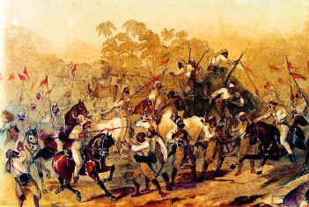
Nature of Revolt: National? Feudal? Neither?
1857 was neither a nationalist, nor "feudal" revolt
Not widespread enough to be a “national” revolt. LIMITED geographically. Main focus NORTH, and EAST. There too NO PUNJAB, NO BENGAL.
NO support in PRESIDENCY TOWNS (BOMBAY, CALCUTTA, MADRAS). Derozians and ROY remained loyal, conservative Hindus and Muslims did join rebels
Restorationist, rather than transformative, seeking to re-establish something that had existed, rather than something NEW, like a NATION
Led for most part by TRADITIONAL leaders, but NOT everywhere, and many traditional leaders stayed LOYAL to British.
Important role played by LOWER orders of society (Subaltern groups) In many cases peasants, tribal groups, poor people FORCED leaders to take up arms against the British
These subaltern groups have their own logic, operate according to own cultural principles.
Precisely because it was NOT a modern nationalist revolt, they do not forge extra-local linkages

Slide 9
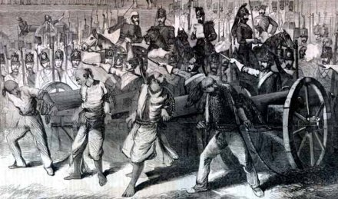
IMPACT
Put down with a very heavy hand. "Mutineers" were tied to the mouths of cannons and blown away, entire villages were lynched, the whole population of Delhi was made to move out the city, and made to sign an oath of allegiance before they were allowed to return
Realized the worst fears of the British in India and had a deep impact on the ruling psyche. 1857 became an important metaphor, never far from the surface in whatever policies they adopted after the revolt
Direct colonial rule now: EIC authority was being eroded over time, now Britain took direct charge, and in 1877 Queen Victoria crowned Empress of India
Victoria’s Proclamation said no more political expansion, and no interference in religious customs on Indians
So, end reform policies that many British believed led to the revolt
Politically, alliances with some important local interests, e.g. the TALUQDARS a group of landowners in Awadh
Princes assured of their territories and become allies
Now security issues more important than ever, and steps taken to ensure that British never lost monopoly of force, coercion, in India
  Army larger % of white troops
  PAX Britannica, outlaw possession of arms by Indians

Slide 10
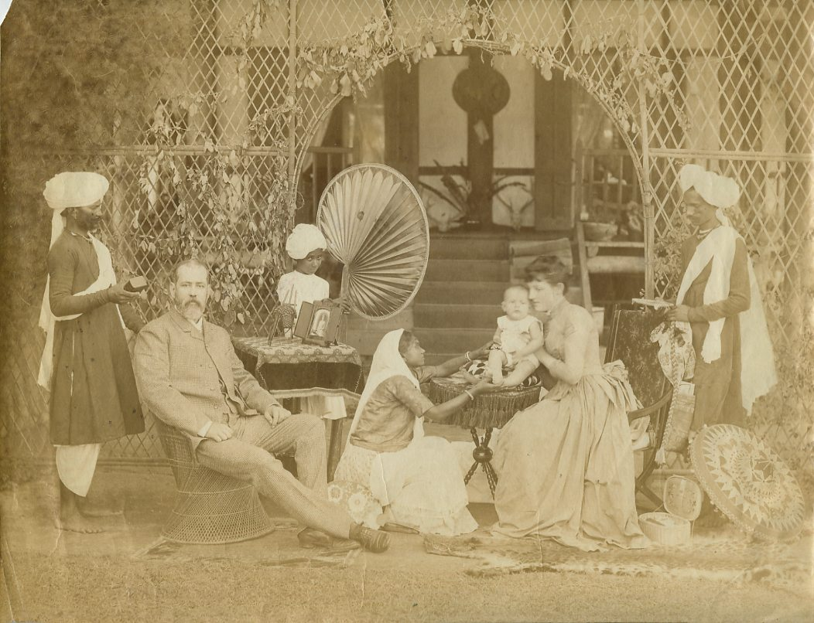
Change in Attitudes: Increased Separation
A major shift reflected most clearly in social life
Strict separation of white clubhouses and residential areas (“civil lines”) divided Indians and British, white town and black town
SANITATION
Hill Stations
Growth of ideas of so called "scientific racism" in Europe from middle of 19thC, helped reinforce racial barriers
Any attempt by Indians to breach these social and political walls, were denigrated at best or explicitly punished
Not all the British in India were racists. Some, e.g. George Orwell (served in the British Police in Burma in the 1930s), were critical of the colonial enterprise, but individual political convictions were relatively irrelevant. The system ensured that the "sahib" maintained his superiority through mindless acts of violence and bravado, even when the individuals concerned had other ideas

Slide 11
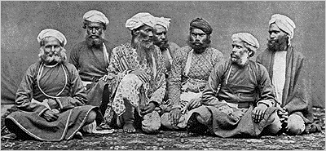
Administrative Changes
By the last quarter of the 19th C, the administrative machinery of the empire firmly established down to local levels
The administration of India was run by the elite Indian Civil Service (ICS) called the “steel frame of the Empire.” At local levels district collectors and police were supreme. ICS manned exclusively by white British officers
A Modern State based on surveillance, information, and control
Various sorts of administrative measures to better know and therefore control India (power / knowledge connections reinforced)
  Detailed local level reports, customs, religions, etc. Census of India begin in 1891
With greater information, also create new categories, even identities
Census for example, asked people to specify themselves as Hindus or Muslims. Whereas, earlier, many of those who the British defined as Hindus, would have identified by caste or sect, e.g. by their jati title, as an agriculturalist, or a metalworker, now larger kinds of identities created through British administrative institutions. Ideas of a single Hindu and Muslim community sharpened through this, as were new Caste based categories, and notions of “martial races” and “criminal tribes”
These administrative measures were in turn conditioned by certain British PRECONCEPTIONS about the nature of Indian society. For instance, the idea that India was fundamentally a RELIGIOUS society was based on the ideas of earlier ORIENTALIST interpretation of India, as indeed was the British understanding of the nature of Indian religions themselves.
But ultimately significant because these attitudes of people who can determine POLICY that Indians had to live with

Slide 12
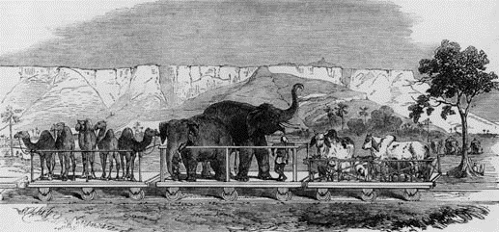
Economic Changes
India is now a CLASSIC COLONY
Captive market, its trade surplus used to balance BRITAIN’s deficit in international trade. Indian troops used to promote and defend empire overseas (Afghanistan, China, South Africa, among others)
“Home charges” imposed on the economy = ANNUAL 16-17 million pound sterling!
Office of the Secretary of State for India, the British Indian Army operating across the world, the purchase of army supplies, guaranteed returns of railway investments, the pensions to all British officers who served in India; all of these paid for by home charges. PLUS private remittances. PLUS “services” (invisible charges) shipping, banking etc.
Drain = 5-6% of Indian resources; represented a potential of wealth which COULD have been productively invested in India
“IMPROVEMENTS”
Railways, 5000 miles : but for troops or from raw material to ports, or for marketing British manufactures. NOT to connect centers of use to Indians
Guaranteed profit TO BRITISH INVESTORS
NO MULTIPLIER EFFECT (everything imported, no technology transfer)
Telegraph and postal service (and not mentioned in textbook so much, PUBLISHING)
Railways, posts and telegraph had unintended consequences too, allowed Indians to communicate, facilitate a sense of modern nationalism

