Slide 1
Age of Heterodoxies
6th to 4th Centuries BCE (500s to 300s BCE)

Slide 2
Age of Heterodoxies
Our focus on Buddhism, but actually other equally important heterodox ideas
  “Heterodox” = different from the “orthodox” (even the opposite sometimes)
JAINISM (founder MAHAVIRA) equally important, more so in some areas
AJIVIKAS who were atheists
*All* heterodox sects though, teach something different from what the BRAHMINS were saying about worship, social order, or salvation
All sects were different, but share some characteristics
  RITUAL less important, specially sacrifice.
  UNDERPLAY though not deny VARNA (caste)
  More inclusive, and did not subscribe to purity-pollution division (emerging out of Varna ideology)

Slide 3
Plan for this section
Our focus less on religious ideas or philosophies, but on historical context, what they tell about the context and how they shape it
Main sources: textbook, Thapar essay and Jataka stories
Lectures to start off, but soon we will *discuss* (no lecture!) the stories from Jataka as primary sources
In this section we will focus on:
Buddha and his times
  Discuss CONTEXT: political, social, economic
Buddhist ideas and organization and HOW THEY FIT INTO CONTEXT
What were the implications of heterodoxies for that time in history?

Slide 4
Buddha
SIDDHARTHA GAUTAMA (aka BUDDHA) born c. 563 B.C.E. (Recent research suggests a slightly later date) in the Sakhya tribal confederacy
  Non-monarchical, less Brahmanical influence. Importance of Location
Buddha’s teachings UNDERPLAY varna, among close followers
  Close followers expected to join the SANGHA (monastic organization)
A distinction between MONKS and LAY followers
  Sangha = radical equality, Lay followers could and should continue regular lifestyle
All followers though, had to:
  Recognize Four Noble Truths 1. World full of sorrow 2. Sorrow comes from DESIRE, so 3. Desire only ends when overcome ignorance, not realize the transitory and ephemeral state of world i.e. Maya 4. The way to end Maya is to follow the Eight Fold Path of right conduct
  Eight Fold Path of right conduct in 1. Vision 2. Thought 3. Speech 4. Action 5. Charity 6. Striving, trying 7. Vigilance in own conduct 8. Concentration
Following these will EVENTUALLY lead to the desired Nirvana, or freedom from endless cycles of birth and re-birt.

Slide 5
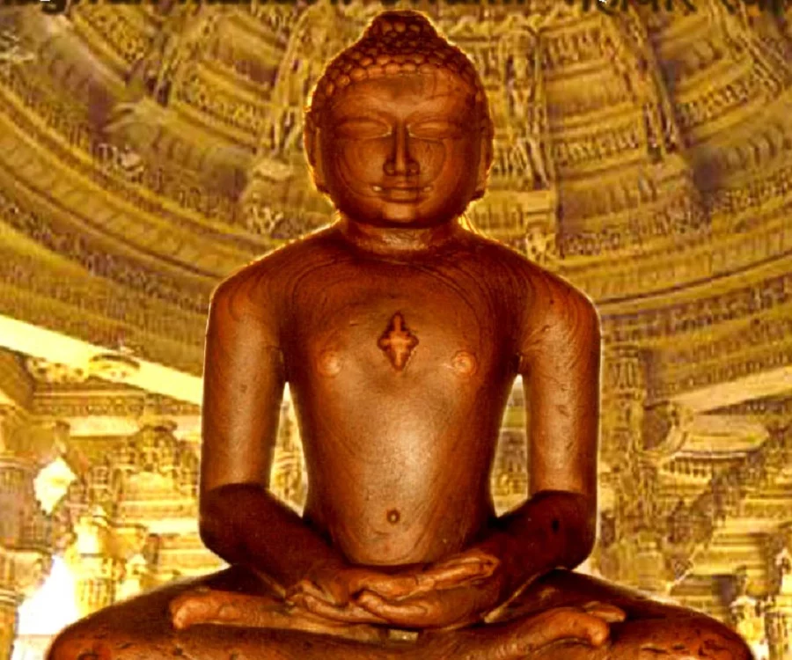
Mahavira : Founder of JAINISM
Born ca. 540 BCE
emphasize Ahimsa (non-violence) towards all creatures
Thus agriculture, e.g., became a forbidden activity for his followers (Jains)
Jains took to trade
Like Buddhism, had different rules for monks and lay folk

Slide 6
Outline
Heterodoxies of the 6th C BCE were part of intellectual tradition that undermined Brahmanical, priestly, authority.
POPULARITY of these religions also reflected social and political changes occurring in society of their time
Both GAUTAMA BUDHHA (b. 563 BC) and MAHAVIRA (b. 540 BC) were KSHATRIYAS, not BRAHMINS
Both from the eastern Gangetic plain, not the heartland of Brahmanical influence at the time (middle Gangetic plain)
Both reject varna to a great extent, at least among immediate followers. Their institutions, the Buddhist SANGHA for example, were more democratic
Need to relate these to changes occurring: Growth of settled agriculture and commerce, towns were coming up along the river Ganga, with possibility of social mobility
Existing Brahmanical hierarchy not allow for this mobility. Both Buddhists Jains do allow for this
These ideas most popular among Vaishyas traders, whose occupations as traders, also allow them to practice non-violence
If not the heterodox ideas themselves, the POPULARITY of such ideas was related to historical contexts

Slide 7
Context I
Janapadas to Mahajanapadas: MAGADHA emerges as pre-eminent
Economic Changes: Agriculture, Commerce, and Urbanization. Evidence in cities like Kausambi, and finds of Punch Marked Coins
ECONOMY: with use of IRON and domestication of the HORSE there is intensification of agriculture, thus more trade, and urban dwellers
IN TOWNS SETTHI-GAHAPATI (merchant-householder) become prominent, as do SRENIS: guilds
  BUT VEDIC / BRAHMANICAL religion give low place to merchants, as it does to ARTISANS, who are seen as SUDRA
Major landlords were kshatriya, and obviously important, but some of them were also town-dwellers, and may well have invested money in trade, which was obviously booming!

Slide 8
Context II
POLITICAL: State increasingly complex, elaborate revenue collection methods (in 200 years, Chanakya would elaborate in Arthashastra)
  in this situation a state based on a “prestige economy” was a liability to merchants and artisans, saw it as wasteful
  what is “prestige economy” ? That shows of prestige (ASWAMEDHA, e.g., or huge elaborate sacrifices) bolster authority of state
Notions of KINGSHIP change, kingship of Vedic/Epic variety, with focus on personal bravery and victory in battle, divine status, not longer the need of the time
Change was necessary, and heterodoxies support such changes but Brahmins do not

Slide 9
Context III
SOCIETY: increasing complexity and specialization of occupations
The word “jati” often used in Buddhist texts to refer to occupational groups. By now, jati becoming the “real” unit of social existence
Varna (based on hierarchy of greater purity/pollution) still an important category of classification, but for ritual not social status
Varna itself move from the Arya/Dasa division to Arya/Sudra distinction, that 1st 3 varnas “twice born” but Sudra, not pure, also a fifth MLECHHA = impure
Formation of rules (e.g. the dharmasutras) , where Brahmins were the arbiters of rules of social conduct advocating greater separation between the Arya and Sudra and within different jati groups
But an emerging contradiction and hence greater possibility of conflict when ECONOMIC standing (say of Sudra artisans) does not match their RITUAL (varna) status

Slide 10
Heterodoxies better suit the new context
Buddhism (and Jainism) creates a division between Monks and Lay folk
  Buddhist Sangha radical, no caste, equality, renunciation
  But lay folk are asked to follow the MIDDLE WAY: obedience, social discipline, ORDER, follow rules, do good karma, and better life in next birth
  All of these better fit the new situation
Main support for Buddhism from the urban dwelling trading classes, for a number of reasons
  An important one was that it did not overtly CHALLENGE the existing social, political, or even religious order, but rather provided a way to fit into it better
Certainly accorded HIGH place to SETTHI- GANAHPATI and wooed the SRENIS

Slide 11
Buddhism and LAY Society
The difference in Buddha’s teachings, is that it offers an advantage that to ALL, monks and LAY people, advocating a middle path, avoiding excess, so ascetics included but also the new, emerging traders, merchants, the setthis and gahapatis
Stress that social harmony was desirable, b/w all classes, good for the kshatriya and the urban dweller
Non violence important for these business oriented people at a time when life was becoming complex, and more opportunities for conflicts
Lay Buddhists urged to continue with family life. Although Buddha preached that family breeds possessiveness and thus aggression, he recognized its importance for maintaining social harmony, so respect the institution
Buddha did not want women in Sangha, seen as disruptive because reminded monks of family, and family ties seen as an obstacle to renunciation, but after much debate allow for nuns
Buddhists and Jainas were the ONLY monastic orders allowing nuns. Others, such as Vedic Brahmins, accorded women low status
Courtesans respected, and one of the famous courtesans of the time was a prominent follower of the Buddha

Slide 12
Buddhism: SANGHA and DHAMMA (law?)
ASCETICISM a very old alternative to Vedic ritualism, from Upanishadic time (ca 1000 BCE) Other sects like the AJIVIKAS also stress asceticism
Renunciation itself not so other worldly, specially when monks expected to return to the world to preach
When this is done by a (former) Kshatriya from a kingly background, can have significant authority
Importance of LAW, Dhamma, as it provides a uniform, universal set of broad social-ethical principles, applied to a variety of social groups
Helped undermine the differences in jati-based religious practices that were emerging

Slide 13
Importance of Ahimsa and Dhamma
No sacrifice of precious cattle in sacrifice (yagna) Particularly important as cattle now used for agriculture
  Prestige economy was willfully destroying wealth, urban dwellers (traders) resent this
Buddhist Ahmisa not only literal, but also figurative, there is non violence in honoring parents, all household members, in exhibiting ideas about patience, about meekness, and in self control
Advocating Ahimsa also helps in ending wars between Mahajanapadas
Fits in with overall Buddhist ethic of conciliation as a solution to social ills
At a time when VEDIC basis of kingship in decline, when statecraft becoming more and more complex, Buddhist theory of Kingship seem to work better, emphasize monarchy as contract
King too, expected to follow Dhamma, so not above the law (notions of rule of law, that the law is above all institutions or persons)
  King should not coerce: fairly radical in the circumstances

Slide 14
Evaluating Heterodoxies
In some interpretations, Buddhism seen as RADICAL alternative, that brought a revolution in thinking about society and religion
If there was radicalism, it was in the monastery, (this in itself pretty revolutionary in context of Brahmanical religion), but no radicalism outside the Sangha. But what it offered the laity was important too:
It provided a VIABLE, LIVABLE solution to a time when existing ideas about social and religious organization seemed out of whack with the way people lived their lives
Via Buddhism people found new ways of dealing with social hierarchies, with higher status to gahapati, new theories of kingship, less wasteful religious practices, etc.
Moreover OUTSIDE of the monastery, Buddhism provided an ideology that expressed these ideas in a way THAT DID NOT THREATEN the status-quo, either politically, socially, or even in terms of religion
Nor would successful traders, landowing kshatriya WANT such radical change
The only people who were really ANTI-Buddhist were the Brahmins, and they too had their way, but after a few 100 years ....
In its own time, as Romila Thapar argues, Buddhism helped sustain a new elite, not a social transformation

Slide 15
Reading the Jatakas
Look for INFORMATION on:
  Society
  Material conditions
  Trade
  Political system
BUT ALSO and more importantly perhaps
Buddhism and.... (i.e what is Buddhism of this time’s “take” on):
  SOCIAL RELATIONS
  STATE
  GENDER
  AUTHORITY/LAW

Slide 16
Reading the Jatakas
1. What sort of ACTORS do you see in a story? What do they do? Are they different from VEDAS or the MAHABHARATA? How so?
2. What impression do you get of the MATERIAL conditions of the society around this time from the stories? Again, occupations, but also otherwise – the homes they live in, the money they have, etc.
3. What are the MORAL lessons these stories are telling us, and do you think they are different from the morals of the Vedas/Epics
4. Can you infer anything at all about ideas about POLITICAL AUTHORITY? Are the stories telling readers to rebel? Obey? What can you say, if anything about what makes a King’s authority legitimate?
5. Can you make any comments about VARNA or GENDER relations based on your reading of one (or more) stories?

