Slide 1
Age of the Epics
Mahabharata ca. 800 BCE to ca. 500 CE

Slide 2
Main Focus of our Class
Mahabharata (MBH) as a source for understanding HISTORY
As a product of and representative of History
We pay attention to literary merits, but that the story, the characters, etc. are not our major focus except when they illustrate important historical themes

Slide 3
Outline
1. What is an Epic
2. Outline of MBH plot
3. HOW do we use MBH as SOURCE for HISTORY
4. MBH as EPIC of COLONIZATION : conquest AND assimilation
5. Contradictions and how they help us understand the epic and history

Slide 4
MBH and Epics
Two major Epics of India: the RAMAYANA and the MAHABHARATA
Like all epics, MBH relates a heroic battle between good and evil
Like all epics, MBH part of a long standing ORAL tradition. EPICs by nature are told and re-told
Unlike Vedas, that are regarded as “fixed” (sruti), MBH part of a body of texts that allows for a more flexible retelling from memory (smriti)
The MBH and Ramayana not written down till around 5th or 6th C CE. So what we have a variety of stories, with interpolations over time.
Creates complications when using as text to understand History!

Slide 5
Plot outline
STORY of two sets of cousins, the PANDAVAS and KAURAVAS. Their battle, main part of the story
Like all epics, there are a lot of intersections between heaven and earth, between humans and Gods
Cousins descended from two brothers, PANDU and DHRITARASHTRA. Kauravas trick Pandavas out of share of kingdom, via a game of dice (gambling)
Lose the game and, have to spend 12 years in exile and 1 in disguise
Pandavas go to exile, but Kauravas refuse to honor terms of the bet
Leads to the battle, the Mahabharata, that Pandavas, with the help of ally, KRISHNA, able to win. This war is the central part of the story
Lots of subplots, and some philosophy, particularly through the BHAGWAT GITA, a section which probably incorporated later into the text

Slide 6
MBH as a Historical Source
Problems with dating an oral epic
How?
Creative use of historical imagination
Interpretation of the text in light of what we DO know
Little archeological evidence we do have available
Earlier thought to be completely fanciful, but now believe the MBH is a MULTILAYERED AND CONTRADICTORY text, probably containing stories and interpolations from many times
But which times? When is the core story? What evidence do we have for later interpolations

Slide 7
Tentative arguments for dating MBH
It is a text of the VEDIC people, whose core story relates to the transition from early to later Vedic age, or thereabouts
WHY?
Kingdoms organized TERRITORIALLY, reference to the ASHWAMEDHA (horse sacrifice), ruling over territory etc. These are the NORMAL modes of organization
So not nomadic. Disdain for forest dwellers (see EKLAVYA story) supports that. Also supported by:
Archeological evidence
Geographical location of core story
There are anomalies, e.g. Varna divisions much more established than evident in Rig Veda
But we can date the CORE of the story to around 1000-800 BCE and always keep in mind that parts were added later

Slide 8
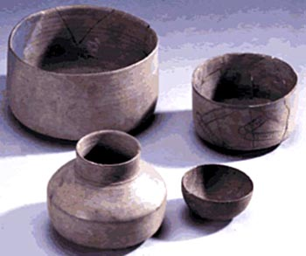
MBH and Archeology
ARCHEOLOGICAL excavations reveal places named and located in the epics with some evidence of settlement around 1000-800 BCE and later
These are mostly sites connected with PAINTED GREY WARE, dated around 800-400 BCE, so there WERE settlements which are described in the MBH
However these were not grand cities like the Pandavas’ Indraprastha, evidence suggests small mud and wattle dwellings, no bricks, no evidence of the fantastic palace the Pandavas built
Perhaps simply exaggerations, but also likely later additions to the story
Story says around 5 million people die in 18 day war, that indicates a total population of about 200 million, India’s population did not reach such numbers till 18th or 19th centuries

Slide 9
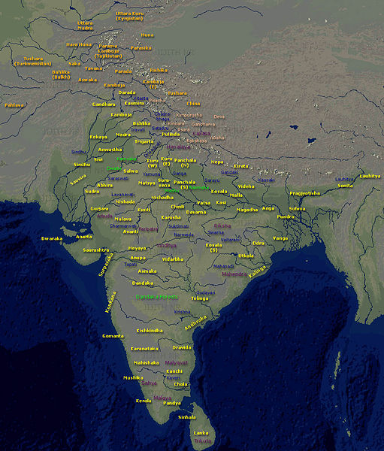
MBH Geography and History LOCATION of the Story is Critical
LOCATION of places mentioned mainly in the north, Indo Gangetic Plain
HASTINAPUR is 57 miles north of Delhi and INDRAPRASTHA present-day Delhi
At the time of the core story, THE CENTRE of power of the Vedic people not moved further east as it did in the next few hundred years
Although some locations further east and south mentioned, they are not central to the story
Center of the RAMAYANA story further east

Slide 10
Studying the Source
In reading ANY historical source, first we have to be aware of who is presenting that source, whose point of view (POV) it represents
MBH clearly the POV of Vedic people, and even more so of the BRAHMINS or priests, who are TELLING the story
At various points, Brahmins have obviously GLOSSED the story in a way favorable to themselves
There are, as we will see, clear indications also of LATER interpolations by Brahmins
BUT, although Brahmins tell the story, the story as we know it does have some element of what really happened (itihas, the Sanskrit word for History) too

Slide 11
Text and Context
By ca. 700 BCE, the time estimated to be the original story of MBH, Vedic people given up pastoral nomadism, in favor of more settled life
Led to territorial states, evident in the central plot of the MBH, that is a fight over territory
Text mentions numbers of villages, and Duryodhana saying not even point of a needle of land would he give to his cousins
We can locate most places mentioned as existing between c. 700 and 400
Kauravas and Pandavas belong to the tribe of the KURUS, Gandhari, mother of Kauravas from GANDHARA, Draupadi from PANCHALA, as also, MATSYA where the Pandavas spent last year of exile and ANGA, whose King Duryodhana made KARNA. Also mentioned KASHI, AVANTI, MAGADHA (Jarasandha, whom Bhima defeats) etc. So this is the geographical terrain.
Map does not help us comprehend the much more DYNAMIC situation being described in the MBH... not the product of a single moment, but a period, and some of that pre-dates our map
MBH describes a period when these territorial states still being set up, when boundaries still not fixed, when the eastward movements still happening, when the Vedic People still IN THE PROCESS of establishing their hegemony over the Gangetic plain

Slide 12
READING the MBH as Epic of Colonization
Important to keep in mind that this is a READING of the text, “against the grain.” It is certainly not WRITTEN that way by the authors!
Why Colonization? Because the eastward expansion into Gangetic plain did not occur over an EMPTY frontier
People, Dasa and forest dwellers, living in areas into which Vedic influence expanded
If we care to read it in that fashion, MBH can reveal to us something about the nature of the interaction between Vedic and non-Vedic people
What is colonization?
The action or process of settling among and establishing control over the indigenous people of an area
Two parts to this, CONQUEST and ASSIMILATION, we will look at both

Slide 13
Colonization as Conquest and Assimilation
Brahmins (priests) PIONEERS in the eastward movement. Vedas and Upanishads depict them in forests performing their SACRIFICES, with fire
Brahmin colonizers, therefore consume large amount of forest for sacrifices
Provokes forest dwellers to come out and attack them
Who get termed RAKSHASAS, demons, represented as NON HUMAN (see HIDIMBAA, p. 31-33)
RAKSHASA derive from word RAKSHA (to protect), thus the “demon-ized” ones may only be trying to protect their own resource base
Brahmins then call on specialist warriors: Kshatriyas to help out, thus we have battle between Kshatriyas and Rakshasas that recurs in this epic and the Ramayana
Disdain for forest dwellers also apparent in EKLAVYA story (see video)
Colonization is not ONLY conquest and destruction, s also assimilation
Bhima MARRIES a RAKSHASA, HIDIMBAA... suggesting they are not non-human after all!!

Slide 14
Contradictions and MBH as Process
MBH is not just a story of conquest, or victory, careful reading reveals contradictions
Contradictions or lacunae (gaps, missing stuff) reveals a bit of the on-going process that created the text we have today
There are many, but for our purposes will focus on TWO of them
ONE, Caste or VARNA
TWO, GENDER or depictions of relations between men and women in the MBH

Slide 15
VARNA contradictions, relations between Brahmins and Kshatriya
Lots of examples suggesting a FIXITY of Varna status and the clearly superior status of Brahmins within the varna hierarchy
E.g. p 59 Duty of Kshatriya to look after Brahmins when leaving for forest
Yudhishtira gambles away all land, except that given to Brahmins (p. 51)
Yet, other examples point to something different
Karna, regardless of known-varna status, can be made King (p. 26)
Parasurama legend (p. 14)
Drona a Brahmin, is not just a teacher, but a warrior. Bhima berates for not following the roles of his varna (p. 158)
So what do these contradictions tell us?

Slide 16
Historical context, production over time
Move to settled life, agriculture, kingship in transition period from early to later Vedic period does increase power of Brahmins
Kings dependent on their authority to legitimize position
But, as the Parasurama legend suggests, a great deal of tension between Brahmin and Kshatriya
Much of the “unquestioned” respect for and superiority of, Brahmins probably a LATER INTERPOLATION into the story
MBH text not written up until ca. 500 CE, that is a period of Brahminical reaction after a history (ca. 400 BCE to 300 CE) that had marginalized Brahmins and their ideologies
MBH an attempt to GLOSS the story to emphasize their own ideology
BUT, because people KNEW the story, from oral traditions, could not completely RE WRITE it, but give it a GLOSS

Slide 17
GENDER roles in the MBH
This process of “glossing” most evident when looking at gender roles
Strong women figures: KUNTI, DRAUPADI, GANDHARI, AMBA
Yet a NARRATIVE framework that is evidently PATRIARCHAL
A system … in which men hold the power and women are largely excluded...
CORE story, ca 800 BCE, state formation in place but not firmly established, varna society in place, but not firmly established, similarly gender relations not fully established
Gender (and Varna and State) relations ARE established by ca. 300 CE (as we will see) giving predominance to men, Brahmins and kingship
Thus, INTERPOLATIONS because orally known, cannot CHANGE it completely, but can insinuate narrative structure, as was done to MBH

Slide 18
Text and Context, again
Women not as subordinate in pre-Vedic society, and quite possible that gender roles different in EARLY Vedic era too
Seals and figures from the Indus Valley show women in roles that are not prescribed for women in later Vedic texts
What we see in MBH therefore, are COMPETING and CONTRADICTORY elements, “explained” by the narrative structure
Thus, Kunti exercises sexual choices, but with DIVINE beings
Draupadi has five husbands, POLYANDRY, but only because her mother in law says so, accidentally
Amba has her revenge, but as a MAN
MBH reveals a social order in the MAKING
Story of KRISHNA (dark skinned one) is another sort of example, but to which we will return later

