Slide 1
Between Empires?
India and the World ca. 185 BCE – 350 CE

Slide 2
Lack of Single Dynastic Center
Historians love periods where a single dynasty or empire dominates because then they can recount the history of one dynasty, and claim it as the history of all of India
Or they club a few together, and then some bright historian gives a title like the "Age of Imperial Unification" or, in the case of the period roughly b/w 300 and 700 CE, "The Classical Age"
Conventional narratives have more trouble dealing with periods where there is NO single power center, either give these NEGATIVE titles, disunity, “dark ages” etc... or as I have and label the period as being BETWEEN empires

Slide 3
Between Empires? Mauryas (end 185 BCE) and GUPTAS (300-700 CE)
BUT, is this period of Pre Modern history really bereft of EMPIRES? Are there no great empires to be found at this time?
185 BCE Brahmin general Pushyamitra Shungha kill last Maurya, initiates short period of Brahmanical revival. Why? Because upstart general need NEW forms of legitimacy, patronize Brahmins performed horse sacrifice
But Shungha’s large army, repel the forces of what is a new name for us, the BACTRIANS
BACTRIANS, Scythians, Parthians, Huns, Kushans: these are the new players in the so-called interregnum

Slide 4
New Political Players
BACTRIAN aka Indo-Bactrian, Indo Greek, Greco Bactrian. Sanskrit and Buddhist sources refer to them as YAVANAS (from IONIAN)
  Product of the breakdown of the Greek empire created by the conquests of Alexander of Macedon
  MENANDER, or MILINDA, had a kingdom within India ca. 130 BCE believed to have converted to Buddhism.
  GANDHARA school of art
KALINGA under King KHARAVELA
ca. 50 BCE SHAKAS, or Scythians pushed by Yeuh Chih (Yuezhi) and Xiongnu (ancestors of the Huns) from present-day China down to South Asia
Shaka replaced by a short lived kingdom of PARTHIAN ruler, Gondophernes, associated with St Thomas and apparently one of the three magi!

Slide 5
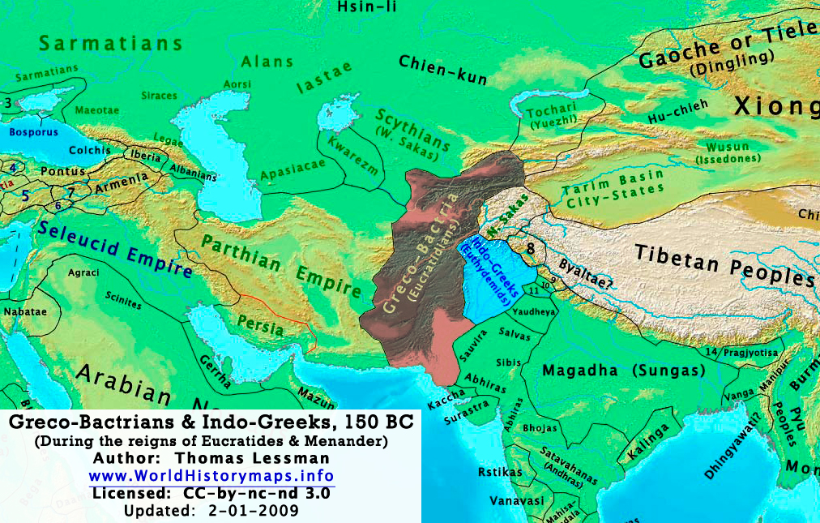
Greco Bactrians

Slide 6
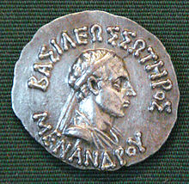
Menander Coin

Slide 7
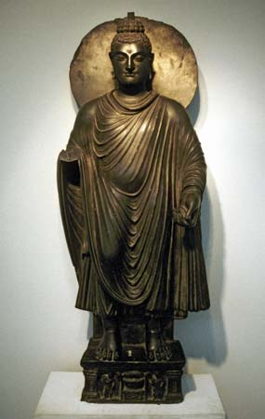
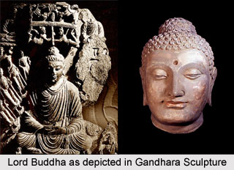
Gandhara Art

Slide 8
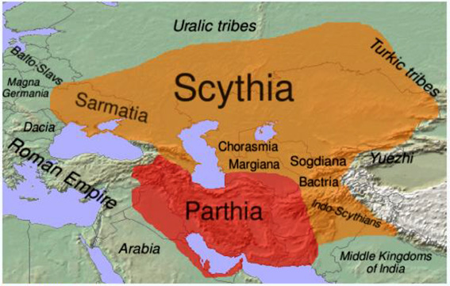
Scythian/ Shaka

Slide 9
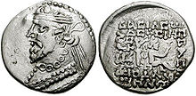
Gondophernes Coin

Slide 10
Who is “Foreign”?
So not quite true that there were no empires at this time, rather, these were not empires with their ORIGINS within what is today “India” in that sense we could argue that these were “foreign” empires
That brings us to some VERY difficult questions as to who and what is FOREIGN at this time.
Let’s assume we are at the beginning of CE
Indo Parthians such as Gondophernes and the SHAKAS are the most recent foreigners, one could argue, having only been around for less than 100 years
What about BACTRIANS? Bactrians control the Indus and Punjab basins since the Mauryan collapse, almost 200 years
If THEY are foreign, then why not Vedic People, now only about 1300 years old in India?
Problem of trying to impose MODERN national categories of identity on PRE MODERN histories

Slide 11
Kushans
Middle 1stC CE, KUSHANS (YUEH CHIH), pushed SHAKAS further down into central and western parts of subcontinent. Shaka had been pushed earlier by YeuChi and in the time they had establish self in India, Yeuh Chi settled into kingdoms in Bactria
Under Kajula Kadphises and his son VIMA (or Wema) Kadphises Kushanas expand into India. The greatest of Kushan emperors was probably KANISHKA, under whose rule Kushana empire was at its peak, in terms of political boundaries. Era of religious syncretism and cultural production
Close to 150 years at peak from (OXUS) Bactria to Banaras, include Kashmir, Sanchi, south to Gujarat. Control trade route between India, Rome and China... trade flourished, guilds of artisans and traders SRENIS too, as did the state. Gold coins issued. KANISHKA, greatest emperor, said to have converted to Buddhism. This period saw prosperity in not just North, but also far south of subcontinent

Slide 12
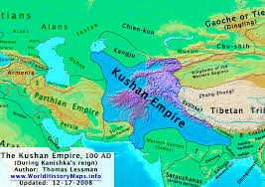
Kushan Empire

Slide 13
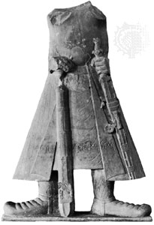
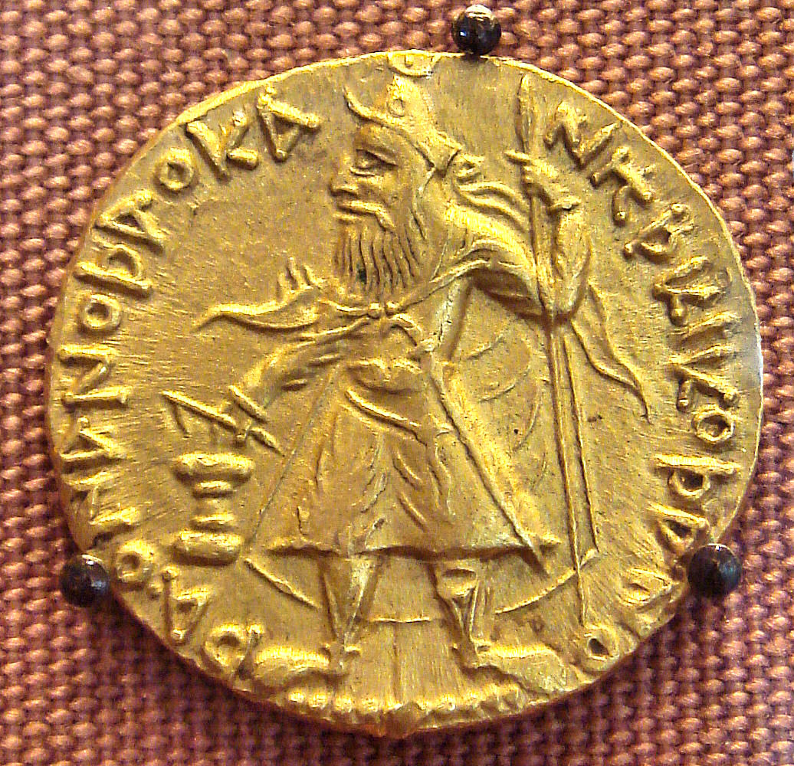
Kanishka and Kushans
Kanishka Headless Statue
Kushan Gold Coin

Slide 14
Problem of “National” Histories
HISTORY written under the sign of the nation state. Problem of presentism. Thus ARIZONA comes to be written as a part of histories of the UNITED STATES, even though for the longest period, it was NOT a part of the United States. Even using the term “borderlands” assumes that a region can only be studied in the CONTEXT of other larger NATIONAL entities.
INDIA, an entity which comes into being much later, FRAMES the history we write of the region. Thus we pay more attention to empires that emerge from WITHIN, and cover more of “INDIA” rather than others which are then deemed “foreign.”
If we were to lose this national frame, the Kushana era, e.g., reveals deep and abiding connections between India and the rest of the world, the world of CHINA, of PERSIA and the world fashioned in the aftermath of GREEK conquests, and the world of what was emerging as a new imperial center, the world of ROME.
Till we do, though, we can only see this period as an interregnum, a transition between two “indigenous” NORTH INDIAN empires, that of Mauryas and Guptas.

