Slide 1
Challenges to Nehru

Slide 2
Challenges
Some that challenge the system from within, e.g., KASHMIR or Naga separatism (Chapters 12-13)
Others emerge from the democratic order Nehru had helped to create, regional parties and Communist Party of India
Others from outside of India, e.g., CHINA war in 1962
Overall theme of chapters 12-16 is that the record Nehru’s leadership is ultimately a MIXED record
Some major successes others not too great
Chapters support a variety of possible positions you can take up in discussion two

Slide 3
Kashmir: The Ideological Dimension
Very important in this respect to understand not only the POLITICAL or GEOPOLITICAL historical context, but the IDEOLOGICAL place of Kashmir in Imagination of India, Pakistan, and Kashmir
For Pakistan, accession of Kashmir to India was wrong: Kashmir, with a Muslim majority had to be part of Pakistan (the K in original acronym making P(unjab), Afghania, Kashmir, Sind and BaluchisTAN)
For NEHRU’s India, India was premised on the idea of diversity. Religion nothing to do with citizenship. Hindus AND MUSLIMS belong equally to India. Kashmir critical for that claim
THIRD and one that GUHA DOES NOT REALLY tell us much about: ABDULLAH popular precisely because he stood for KASHMIRIYAT highlighting the UNIQUENESS of Kashmir as different from both India AND Pakistan
BEYOND Hari Singh’s ambitions, there may well have been a real groundswell of support for the AUTONOMY if not the INDEPENDENCE of Kashmir at the POPULAR level

Slide 4
Kashmir Issue in Nehru’s Time: Overview
Sheikh Abdullah’s ambivalence on accession to India, particularly in the context of Hindu political mobilization in Jammu
Abdullah’s idea of Kashmiriat, often drifted into idea of an independent Kashmir
Abdullah’s popularity high in VALLEY, but not so in JAMMU, PRAJA PARISHAD formed in 1949
The role of the Praja Parishad, Jana Sangh in “communal” mobilization against Abdullah

Slide 5
Kashmiri Politics
Shyama Prasad Mukherjee (leader of Jana Sangh) die in custody in 1953. Massive protests that push Abdullah to “rethink” ties to India
Split engineered in National Conference (Abdullah’s party) and Abdullah’s government dismissed, Bakshi Ghulam Muhammad installed as Premier and Abdullah arrested
Bakshi was a populist but serious charges of nepotism and corruption. Bakshi seen as “India’s man” and his corruption came to be associated with Nehru and India
Abdullah released and rearrested in 1958. Both in 1953 and 1958, on charges that even Guha says were “trumped up”
The HAZRATBAL incident (loss of a relic from mosque), loss to China, and Nehru’s desire to “settle” Kashmir all lead to Abdullah’s release in 1963 and Nehru’s last attempt to solve the Kashmir conundrum

Slide 6
Context for Nehru’s last attempts on Kashmir
Abdullah committed to secularism and a multicultural Kashmir (thus close to Nehru in vision). But also an ambitious politician willing to use *any* leverage he had to forward his politics. Settle for what he got for a while and then try to push the stakes up when he could
Climate of POSSESSIVE NATIONALISM, not just Hindu Right parties but also sections within the INC (especially old right wing of party)
Kashmir is OURS, the accession is SETTLED, we will not GIVE AWAY WHAT IS OURS. No real concern for the feelings of KASHMIRIS
Abdullah’s later visit to PAKISTAN suggests mainstream opinion there not very different

Slide 7
Contemporary Context
In August 2019- Indian government stripped Jammu and Kashmir state of the special status that gave it significant autonomy. In fact J&K no longer a STATE at all, but two UNION TERRITORIES J&K and Ladakh.
To understand the significance of this step though, we have to return to HISTORY we examine in this course
At the very start of this chapter, Guha points out that “The Indian Constitution treated Kashmir as part of the Indian Union, but “guaranteed the state a certain autonomy; thus Article 370 specified that the president would consult the state government with regard to subjects other than defence, foreign affairs, and communications”
He also asks question that is very telling for our own times: “Could a Muslim majority state exist, without undue fuss or friction, in a Hindu-dominated but ostensibly ‘secular’ India?”
BOTH of these questions animate the contemporary situation

Slide 8
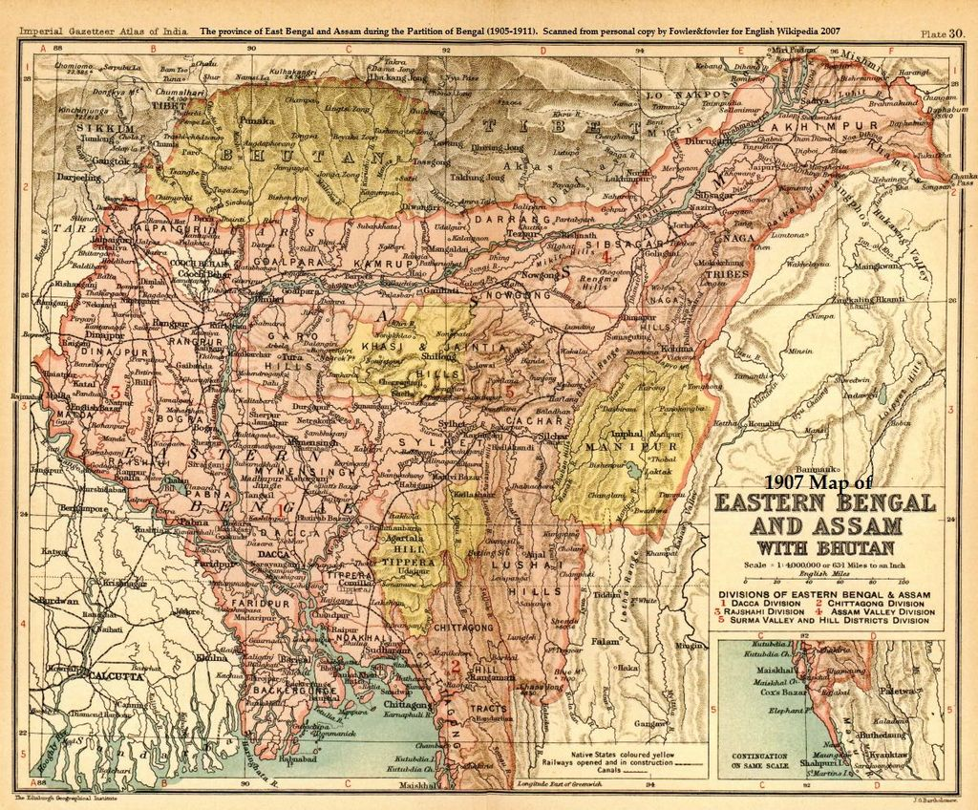
Northeastern Challenges
Northeastern corner often completely IGNORED in discussions of India. WHY?
Colonialism, indirect rule in many parts of this area, with some independent kingdoms, e.g., Manipur, Tripura, and other TRIBAL areas, with special laws, paternalist British protection.
When rest of India demanding British leave, the special relationship with tribes became important for many British administrators.... unlike the rest of the ungrateful natives, at least THESE FOLKS love us and need us!
Partly as a result Nationalism, weak. Assam has strong INC presence but NOT in NEFA, Manipur, and specially not in the NAGA hills
Religious cultural and ethnic differences with most of India
Geographically cut off from the rest of “mainstream” India after independence and partition

Slide 9
Nagaland
1946 sees formation of the NNC (Naga National Congress) with two factions
One for autonomy WITHIN India
Other for INDEPENDENCE (had British support)
Angami Zapu PHIZO, Baptist educated, a poet and Naga Nationalist, was chosen to be president of NNC and declare for full independence in 1950
The Indian state did not pay a lot of attention to the NE (never does until there is trouble!!) Phizo’s demands are rejected by Nehru as ridiculous. But Phizo continues
Nehru not unsympathetic, more so than many local officials, but matters came to head when NNC went underground to launch insurgency
Atrocities from Naga rebels and State force (but state must take greater blame, as has to be held to higher standards; this was not an ethnic conflict between unofficial entities)
So 1953 onwards insurgency in Nagaland, which to all intents and purposes, still not over yet

Slide 10
1957 Elections
Second General Elections. State and Central Elections together
Nehru’s daughter, Indira Gandhi, begins to play a political role representing women’s interests in the Working Committee of the INC
Campaign in elections
Like 1952, 1957 a REFERENDUM on Nehru’s governance, and like 1952 won a comfortable victory
BUT, with some differences, REGIONAL parties based on local state issues make significant gains in the elections to STATE ASSEMBLIES (see p. 290)

Slide 11
Nehru’s challenge from REGIONAL PARTIES
ONE example was Dravida Munnetra Kazagham (DMK) in what became Tamilnadu
Dravida separatism, anti north India, specially over imposition of HINDI as national language
Also lower caste, anti BRAHMIN
Though not successful in 1957, DMK was here to stay
In the long run though, the DMK also a great example of how participation in electoral process coopted what was a separatist movement to a REGIONAL force

Slide 12
Communists
In 1957 the only SUCCESSFUL electoral challenge to Nehru and INC though, came from Communists
The world’s first democratically elected Communist government in KERALA
Education, Kerala today has about 99.8% literacy. High literacy rates preceded independence in Kerala, and the correlation between high literacy and first elected communist government was NOT a coincidence
Though Kerala society still oppressive, like Andhra, education changing that (in both locations, but Kerala does better)

Slide 13
Undermining the Communist Challenge
Communist Party of India (CPI) adapt to electoral politics. Win first assembly elections they participate in, AND DELIVER
EMS Namboodripad, good honest cabinet. DO WHAT INC HAD PROMISED, e.g. in terms of land redistribution
CPI govt brought down by a disparate group uniting against them -- INC, RIGHT WING religious groups, and CASTE associations, such as those of the NAIRS (dominant landlords)
Opposition take to the streets, demonstrations, shut the administration down, and when government respond, forcibly DISMISSED BY CENTER
Next elections, INC win! But Nehru’s reputation as democrat is undermined

Slide 14
China and Imperial Borders
LOTS of high minded rhetoric from both sides
Nehru believed in India-China relations to be the new Axis of not only Asian but potentially WORLD politics
Both countries sign the PANCHSHEEL agreement, five principles including non violence in international affairs
Nehru and Chao Enlai both saw themselves as anti-imperialist ideologues
Ironic then that the issue between the two came from TWO sets of IMPERIALLY CREATED borders
1962 war, loss. Nehru devasted, never really recovered from shock

Slide 15
Post China-War Challenges
October 1963, Nehru was forced to accept what came to be called the KAMARAJ PLAN
K Kamaraj from Tamilnadu, seeing growth of regional parties. Recommended that senior INC leaders resign from government posts and work at grassroots level. Felt power made them unable to understand people’s issues
Example of how REGIONAL leaders now felt confident enough to challenge Nehru’s leadership
Nov 1963 opposition parties initiated a NO CONFIDENCE motion in Parl. Unprecedented in Nehru’s time. Though defeated, evidence of waning popularity
Most evident in the challenges Nehru faced when he made his last attempt to resolve the Kashmir issue

Slide 16
Minorities
Majoritarianism and Democracy? Discuss!
Pandey has argued that the association of India with Hinduness was baked into even mainstream, liberal, nationalism within the INC
One could easily extend that to argue that so was the idea that upper caste men had a natural right to rule over India
Two minorities discussed in Ch. 17, Muslims and Untouchables, make up 25% of population, a not insignificant percentage!
Safeguarding the rights of minorities against majoritarianism and upper caste privilege were an important part of the vision of Gandhi and Nehru (though they disagreed on other things such as patterns of economic development)

Slide 17
Indian Muslims
Muslims: Not just the RSS or Hindu right parties but even right wing of INC not sympathetic to idea that Muslims were equal citizens. See Patel’s notings on ASI files (368-69)
Muslims suspected of harboring anti-national sentiments and were forced to offer proof of their loyalty to India
Maulana Azad, virtually in hibernation after 1947, devastated by partition
No substantial Muslim middle class mostly poor and under represented in govt and public life.
Suspicion of large sections of the majority
Fear and suspicion among Muslims

Slide 18
Former “Untouchables”
Untouchables: Poor, landless, geographically scattered. Historically denied rights to own land, or get an education
Both GANDHI and AMBEDKAR sought to right this wrong, but the differences between their approach was by the terms they described this community: HARIJAN vs DALIT
CONSTITUTION of 1950 was the single most radical step toward equality in the history of Dalits, but not enough
Needed to organize politically too

Slide 19
Dalit/Harijan Politics
Groups like the Communist Party of India organized Dalit groups
But the two major forces shaping this politics were “Harijan” leaders within the INC such as Babu JAGJIVAN RAM and of course AMBEDKAR himself, who organized outside of the INC
“Educate, Agitate, Organize” was the slogan of his REPULICAN PARTY of INDIA (RPI)
Reservations of seats in Parliament, Assemblies, in government jobs and in state educational institutions helped
Many Harijan groups preferred to support the party of Gandhi and Nehru
All former untouchables, though, faced blowback from the traditionally privileged, whether it was outright violence or social snubs (382-83)

Slide 20
Minorities in Nehru’s India
Was Nehru able to curb majoritarianism or upper caste assumptions of privilege entirely? Certainly not
Would it have been better without someone like him? Unlikely
An editor, also a bitter opponent of Nehru, wrote about the “reactionary forces” who, “had Nehru shown the slightest weakness, . . . would have turned this country into a Hindu state in which the minorities. . . could not have lived with any measure of safety or security.”
It was also to Nehru’s ‘everlasting credit, he wrote, “that he insisted that Untouchables be granted full rights, such that ‘in public life and in all government action, the equality of man would be scrupulously maintained in the secular state of India”
THIS is one reason why the present Hindu Nationalists ruling India see Nehru as their biggest historical enemy, and insist on undermining Nehru at every stage and in every way possible

