Slide 1
China in [Nationalist] Revolution
国民革命 2:
The 1911Revolution辛亥革命, End of the Qing Era, and a Historical Assessment

Slide 2
The Revolutionary Movement: Overlapping Phases
The Early Phase (1895-1905)
The Organizational Phase (1903-1908)
The Activist Phase (1908-1911 & beyond)
The Aftermath

Slide 3
The Early Phase 1895-1905
The Sino-Japanese War and the T. of Shimonoseki (1895) galvanized not only the Radical Reform movement but also “jump-started” the Chinese Rev. movt.
The roots of revolutionary ideas
Inspirations from the Taiping
Influence of the West: Ideas and “national” revolutions
Chinese history: Rebellions and revolutions
Revolutionary personalities (some arbitrary typologies)
Anarchists (Wu Zhihui, The Nouveau Siecle group in Europe, Liu Shipei, He Zhen, Liu Sifu: European and American influence)
Anti-dynastic and anti-Manchu (Zhang Taiyan)
Revolutionary organizers (Cai Yuanpei, Sun Yat-sen [Sun Zhongshan], Huang Xing, Song Jiaoren)
Revolutionary romantics (Zou Rong, Chen Tianhua, Qiu Jin, Wu Zhiying, Xu Xilin)
Others (Military types, e.g., Yuan Shikai, Cai Songbo, Li Liejun)

Slide 4

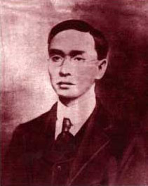

Slide 5
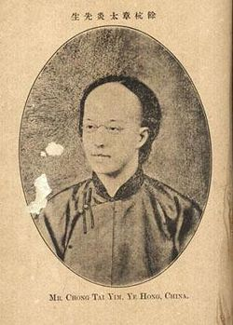
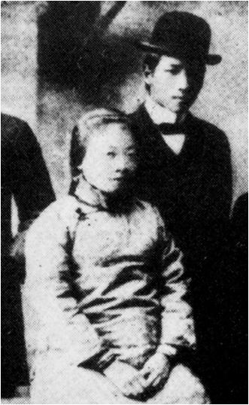
Zhang Taiyan
Liu Shipei and He Zhen

Slide 6
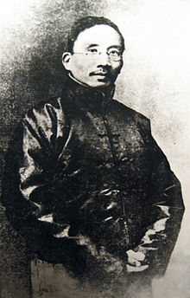
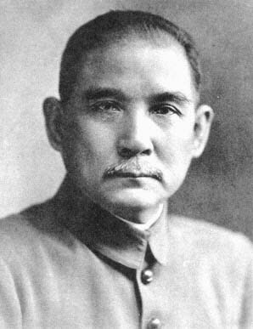
Cai Yuanpei
Sun Yat-sen

Slide 7
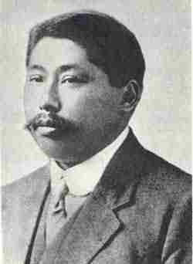
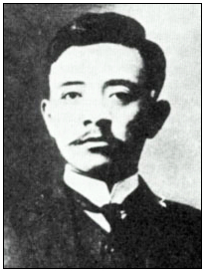
Song Jiaoren
Huang Xing

Slide 8
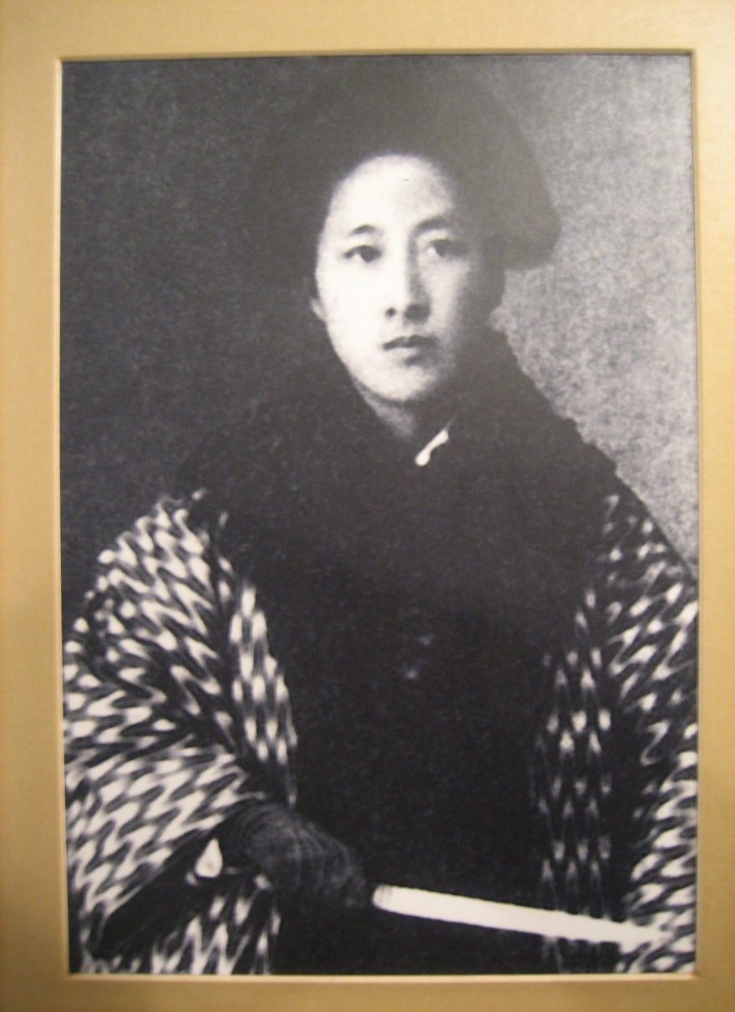
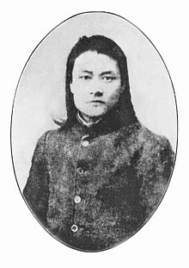
Qiu Jin
Chen Tianhua

Slide 9
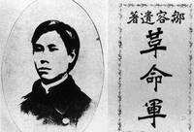
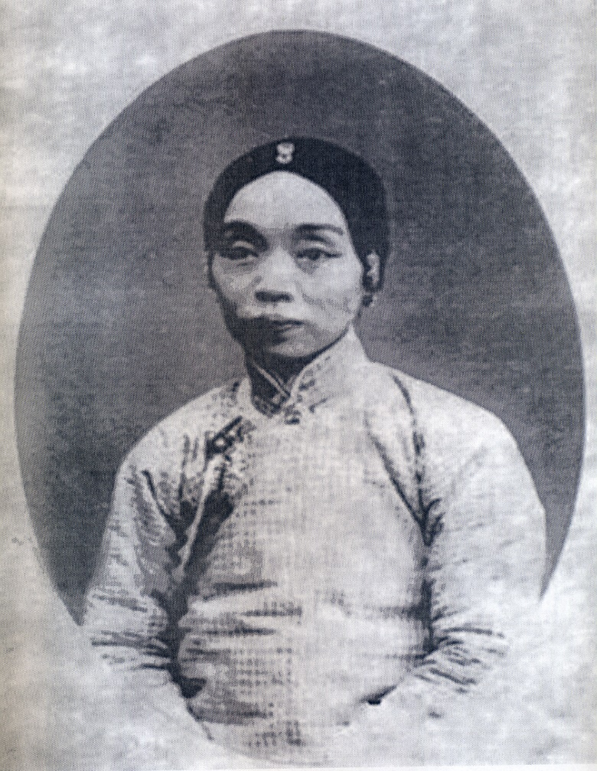
Zou Rong, The Revolutionary Army
Wu Zhiying

Slide 10
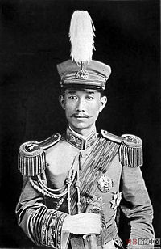
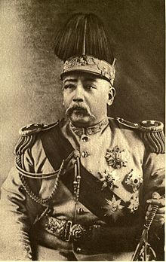
Cai E (Cai Songbo)
Yuan Shikai

Slide 11
Emergence of strands of revolutionary ideologies
Anarchism: Various stripes, European influence (Bakunin, Kropotkin, Tolstoy, Emma Goldman)
Anti-Manchu? Anti-Monarchy?
Democracy and Republicanism (Liang Qichao, Cai Yuanpei, Yan Fu, Sun Yat-sen, Wang Jingwei)
The contested terrain of Chinese “nationalism”
Revolution vs. Constitution
Revolutionary discourses: Political, national, social, cultural
Media (Schools, newspapers, gazetteers, local publications) The Subao case (1903)

Slide 12
Sun Yat-sen and the Three-in-One Revolution (publishes in 1908 “Sanmin zhuyi” or, the Three Principles of “The People”: minzu (Principle of the people’s character as a nation, or “nationalism”); minzhu or minchuan (People’s sovereignty/power – or, the democratic principle); minsheng (the principle of a state’s responsibility to care for People’s Lives or Livelihoods – later Sun equates this with “socialism” or shehui zhuyi )

Slide 13
        Sun Yat-sen 孙文，孙中山，孙逸仙 1866-1925 b. Guangdong, Xiangshan 1878-1883 Honolulu, Iolani School, later (1882) Oahu College (today’s Punahou School) Return to China 1883 Incurred the wrath of home village leaders when he and Lu Haodong 陆皓东, a boyhood friend, toppled a temple statue. Escaped to HK. Studied at Diocesan’s Boys Sch. and at Central School. In 1886 studied Western medicine under John Kerr at the Christian Boji 博济Hospital in Guangzhou.1892 grad from HK College of Medicine for the Chinese. Licensed and pract. Medicine in Guangzhou, HK, and Macau. Got involved w/ reform & revolutionary thinking. Formed friendship with Chi. & British progressives in HK and elsewhere. Joined the radical reformist Furen Literary Society 辅仁文社 which had been formed by Yang Quyun 杨衢云 (a.k.a. Yeung Kuwan) in Hong Kong in 1891.

Slide 14

Qiu Jin 秋瑾 (1875-1907) b. Xiamen, Fujian, grew up in Shaoxing, Zhejiang. Moderately well-off family background. Entered into an arranged and oppressive marriage to Wang Tingjun. Developed women’s circle of friends to study new ideas of women’s liberation and general social reform. Left family and two children in 1903 to go to Japan to study. Enrolled in Japanese language school and then in Shimoda Utako 下田歌子’s Practical School for Women (Jissen jogakuin实践女学院) Practiced martial skills training. Took on Japanese and Western dress styles. Often wore the Western clothes of men. Took name of “Jingxiong” 竞雄 (competing with and surpassing men). Joined Cai Yuanpei’s Guangfuhui in 1904, and Sun Yat-sen’s Tongmenghui in 1905. Returned to China in 1906 to foment revolutionary activity. Taught at various schools. Became headmistress of Datong School in early 1907. Plotted with Xu Xilin and others in the Anqing Rebellion. Plot failed on July 6, 1907. Qiu Jin was arrested on July 12 at her school in Shaoxing, and was beheaded on July 16.

Slide 15
The Organizational Phase of the Revolution 1903-1908
The precursors of the Tongmenghui
Sun Yat-sen 1893 presents letter w/ reform proposals (relatively moderate ones) to Li Hongzhang and was ignored. Turns to a revolutionary mode. Forms the Revive China Society (Xingzhonghui 兴中会) in Hong Kong, Honolulu, and London. Sets off the Guangzhou Uprising (Oct.1895), abject defeat, nearly 100 revolutionaries arrested and killed
1896 Sun “arrested” by Qing imperial secret “police” in London, “incarcerated” for 16 days. James Cantlie’s intercession – gained support in foreign societies
Revive China Society tries again with the Huizhou Uprising (1900), also defeated
Recovery Society (Guangfuhui 光复会) Cai Yuanpei (1903)
The China Revival Society (Huaxinghui华兴会) – Huang Xing (1903) & the Changsha (Hunan) Uprising
Peripheries (e.g.，Gelaohui 哥老会 , Hongmen洪门, Triads 三合会, the Chinese Masons and Masonic lodges)

Slide 16
The Tongmenghui
The influence of the Japanese
The Organization of the Tongmenghui (August 1905) Yokohama & Tokyo, spread
Organizational structure: Relationship betw. Sun and others, the Xingzhonghui core and other revolutionary organizations
The consolidation of ideology
Dissemination of the revolutionary agenda
What is lacking? (Party, unified leadership, military)

Slide 17
Revolutionary associations and their connections w/ “new” (or “relatively new”) social organizations
Schools
Publications: Newspapers and journals
The Subao Case (1903): Jiangsu province
Zou Rong, Gemingjun (The Revolutionary Army)
Urban organizations
merchants and workers
women’s organizations
Connections with foreign supporters
Provincial assemblies
Railroad companies
Local military corps

Slide 18
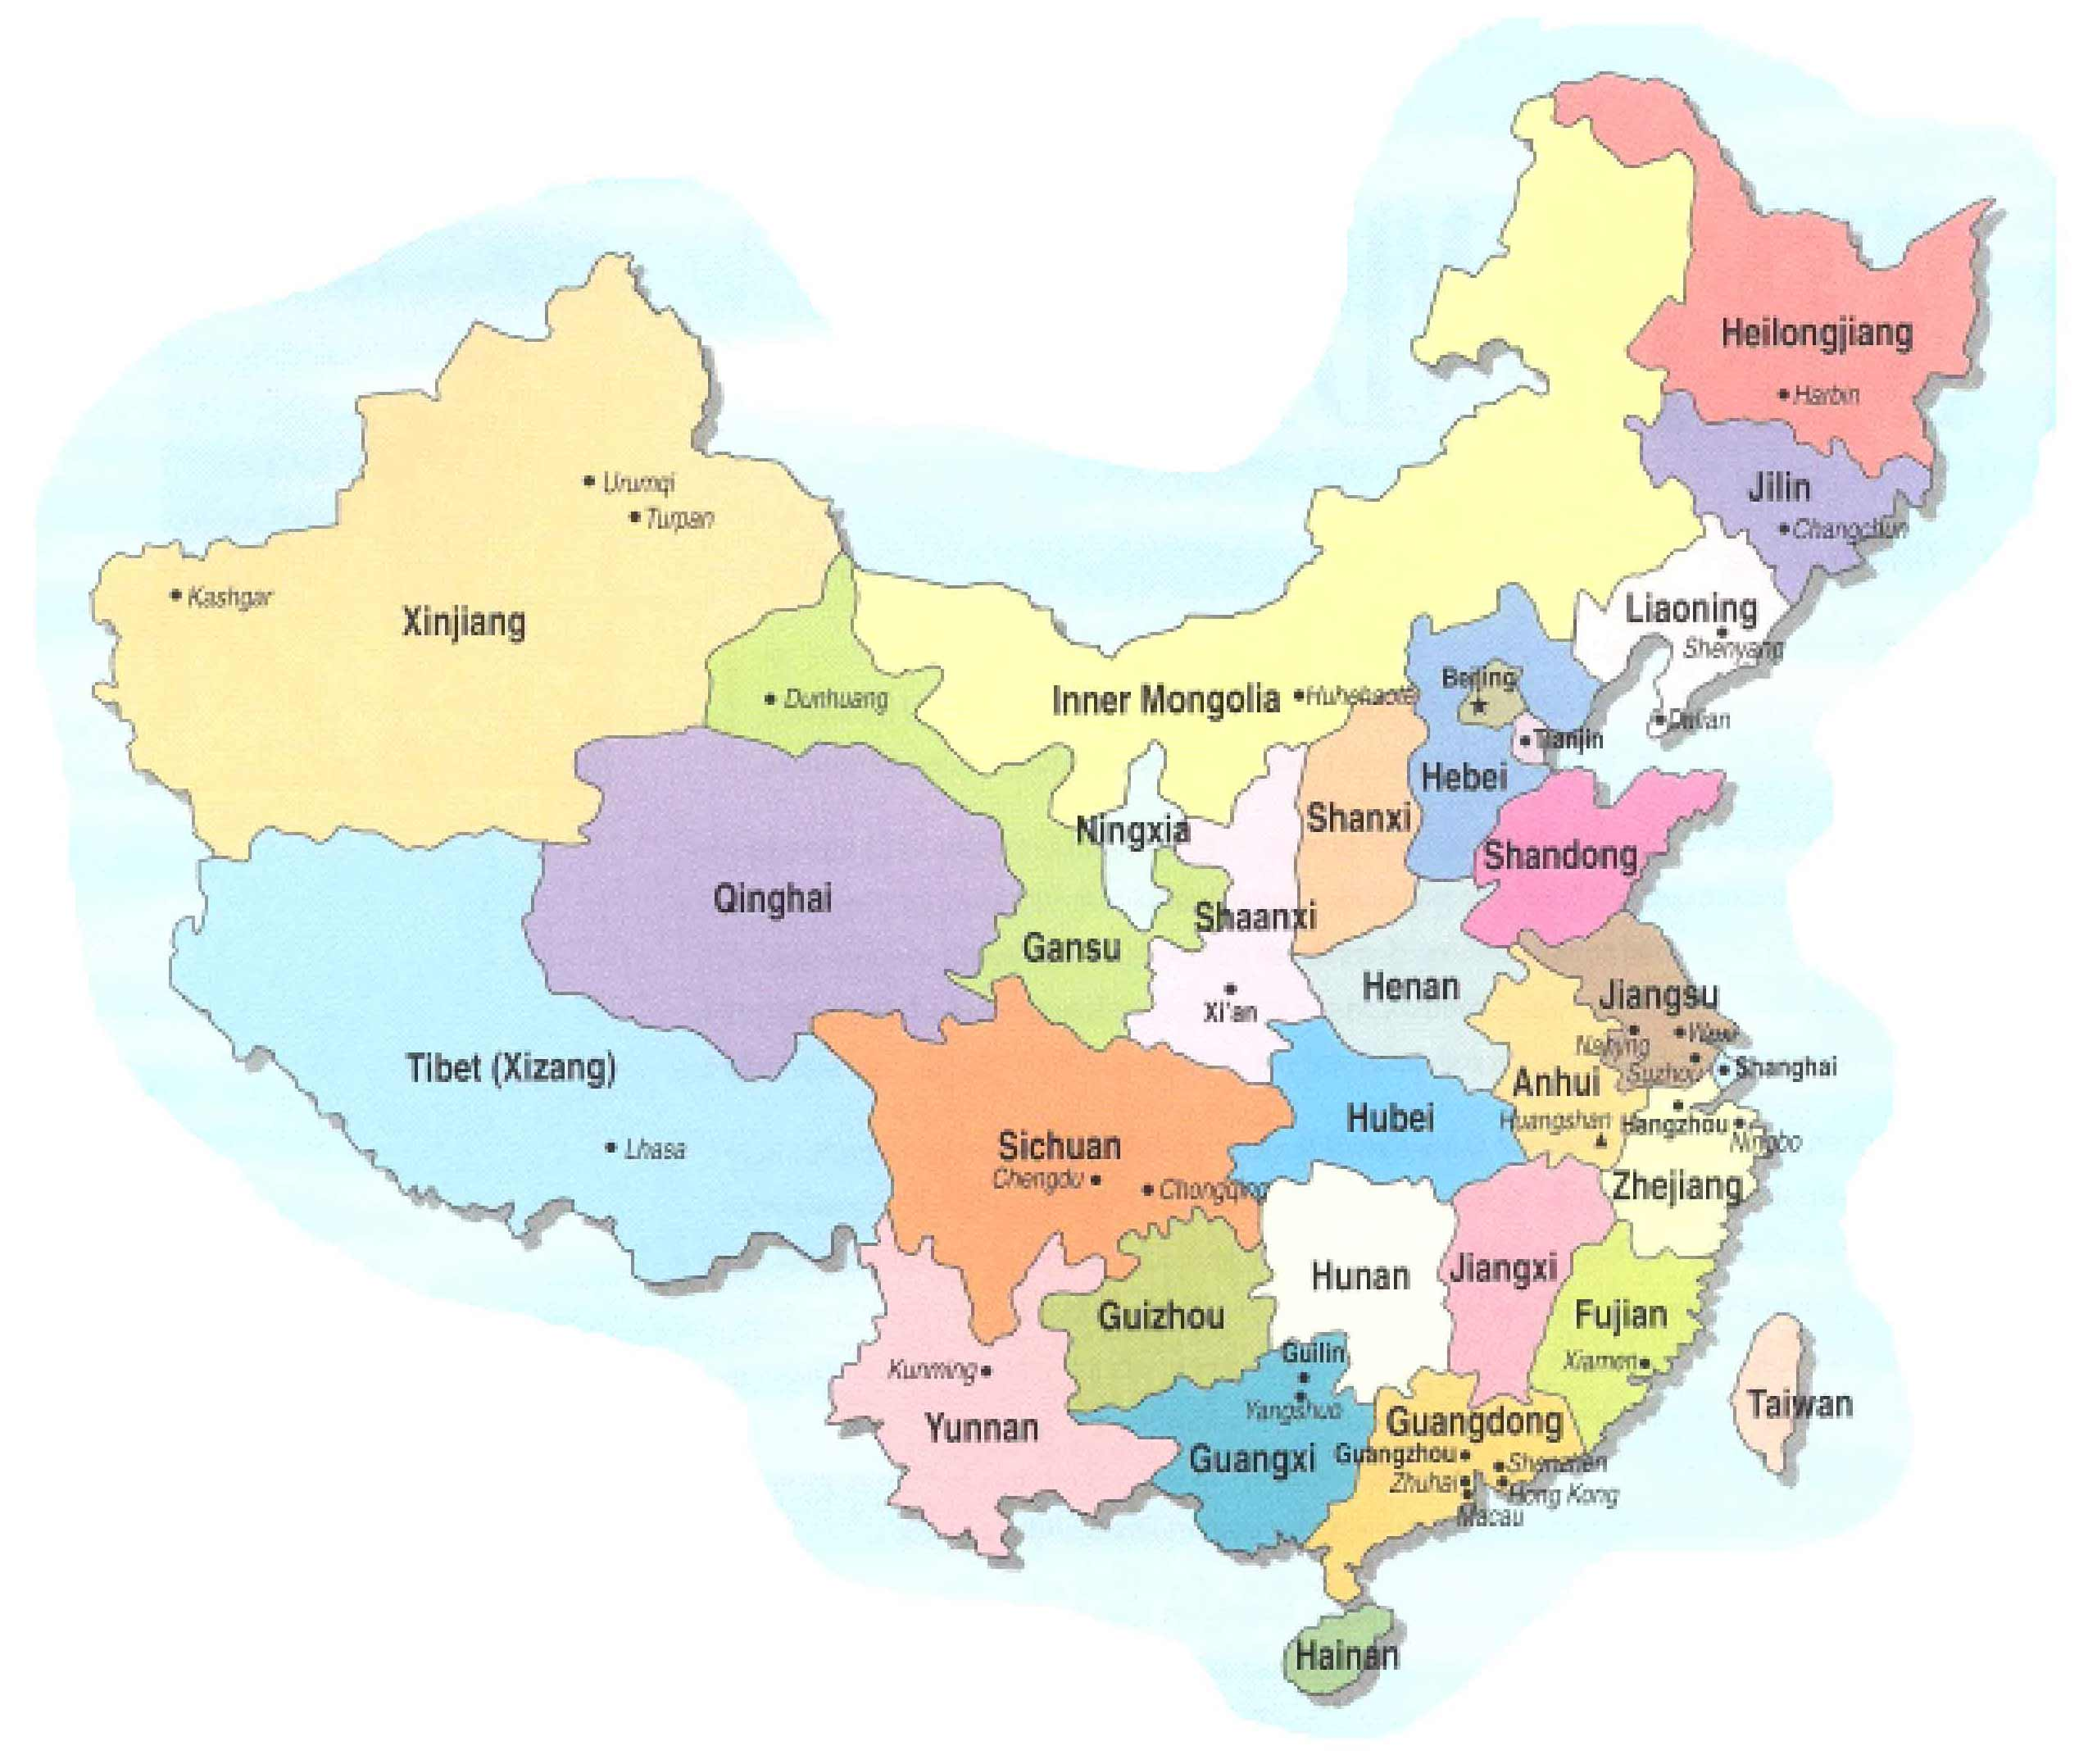

Slide 19
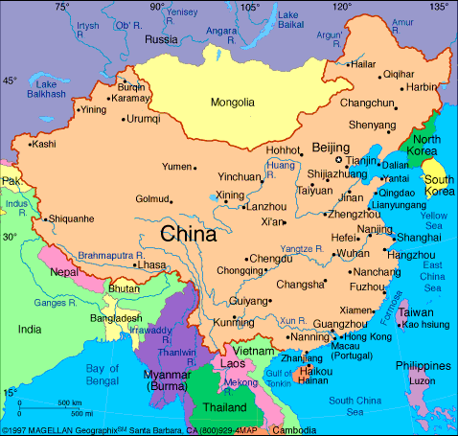

Slide 20
The Action Phase of the Revolution (1908-1911)
Fuses of the Revolution
The New Army and the provincial academies and units, officer corps
The provincial assemblies and new structures of provincial governments
Assassination attempts (emulating the Japanese shishi of the 1850s? Or the European anarchists)
The railroads: “nationalization” and “protection”
Series of unsuccessful uprisings (e.g., the 4/27/1911Huanghuagang [Yellow Flowers Hill] uprising in Guangzhou – the 72 “Martyrs”
The Wuchang Uprising
A brief revolutionary war
The abdication of the Xuantong Emperor (Feb. 1912)

Slide 21
The Railroads Controversy
The growth of railroads and Chinese railroad companies:
Before & immediately after 1895 (Scramble for Concession era): utter foreign domination
1898-1906: Attempts on the part of Chinese regional gentry to build Chinese companies and participate in the enterprise: (1) Guangdong, Hunan, Hubei, Sichuan; (2) Financial problems
1908 & afterward: Central Qing government resumes “control” – based on negotiated loans with foreign banking consortia
May 1911 Qing government orders nationalization of railroads in the 4 provinces

Slide 22
Regional gentry protest vs. government nationalization and against the invasion of foreign capital, form “railroad protection associations”
Provincial assemblies (organized under the aegis of the Qing government’s “constitutional monarchy” plan) mobilized
June 1911 Qing court’s plan to indemnify regional gentry railroad investors backfire due to unequal treatment of the provinces involved – Sichuan becomes the focus
August 24 Massive demonstration in Chengdu (promoted by the Sichuan provincial assembly – gentry): Tax boycott, worker & student strikes
Governor-general action: Arrests of demonstrators, turns Sichuan gentry and assembly against Qing govt. and toward revolutionaries
Fusion of the railroad issue w/ revolutionary cause

Slide 23
Strategic Revolutionary Organization (Summer 1911)
Decision to focus revolutionary action in Central China (ability to respond to either south or north-Beijing.)
7/13/1911 Organization of the Central China Bureau of the TMH (Shanghai, Song Jiaoren) – target, the upstream Yangzi River tri-city area of Wuhan (Wuchang, Hanyang, Hankou) in Hubei province
Organizational liaison with the Gongjinhui (Common Advancement Society) [students] & the Wenxuehui (Literary Society) [military cadets of the “New Army” in Hubei province
Song & Huang Xing: Revolutionary leadership and tactical planning for action later that year

Slide 24
Wuchang Uprising and the Revolutionary War
Transfer of “New Army” HQ to Wuchang (to deal w/ Sichuan railroad issue)
Members of the Hubei New Army junior officer corps infiltrated by revolutionary movt.
10/9/1911 Bomb accidentally exploded in revolutionary HQ (Russian concession in Hankou): Police raids and arrests led to seizure of weapons and lists of revolutionaries
Forced the revolutionaries in the Engr. And Artillery battalions in the Hubei New Army to move up the plans of action

Slide 25
The “Revolutionary War”
10/10/1911 Army units seized munitions depot & prov gov-general in Wuchang, gained control of city of Wuchang
10/12 Fall of Hanyang & Hankou to revs.
Li Yuanhong (Hubei New Army brigade commander) became military gov. of Hubei; Tang Hualong (chairman of Hubei prov assembly) chief exec of revolutionary govt in Hubei
Li (Tang) (1) issued telegrams to other provinces and municipalities, urging declarations of independence from Qing govt; (2) urged foreign consuls in Wuhan to stay neutral: Methods worked
The War: Qing govt recovers Hankou & Hanyang in November, but loses Shanghai & Nanjing in December

Slide 26
Defection of Provinces & Municipalities
Municipalities: Changsha (Hunan) 10/22; Shanghai 11/3; Nanjing “liberated” 12/4;
Provinces: Yunnan 10/31; Zhejiang 11/5; Fujian 11/9; Guangdong 11/9; Sichuan 11/27; 10 others followed in early December
12/25 Sun Yat-sen returned to Shanghai from the US via Britain & France; 12/29 elected provisional president of the Republic of China (Li Yuanhong: provisional VP; Huang Xing: Min. of War)
January 1, 1912 Declared 1st day of the Republic of China in Nanjing

Slide 27
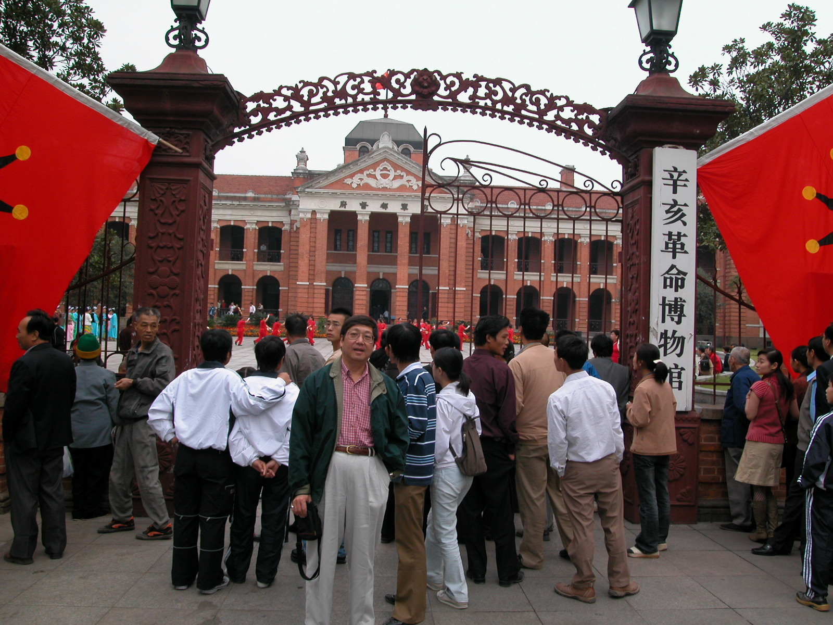

Slide 28
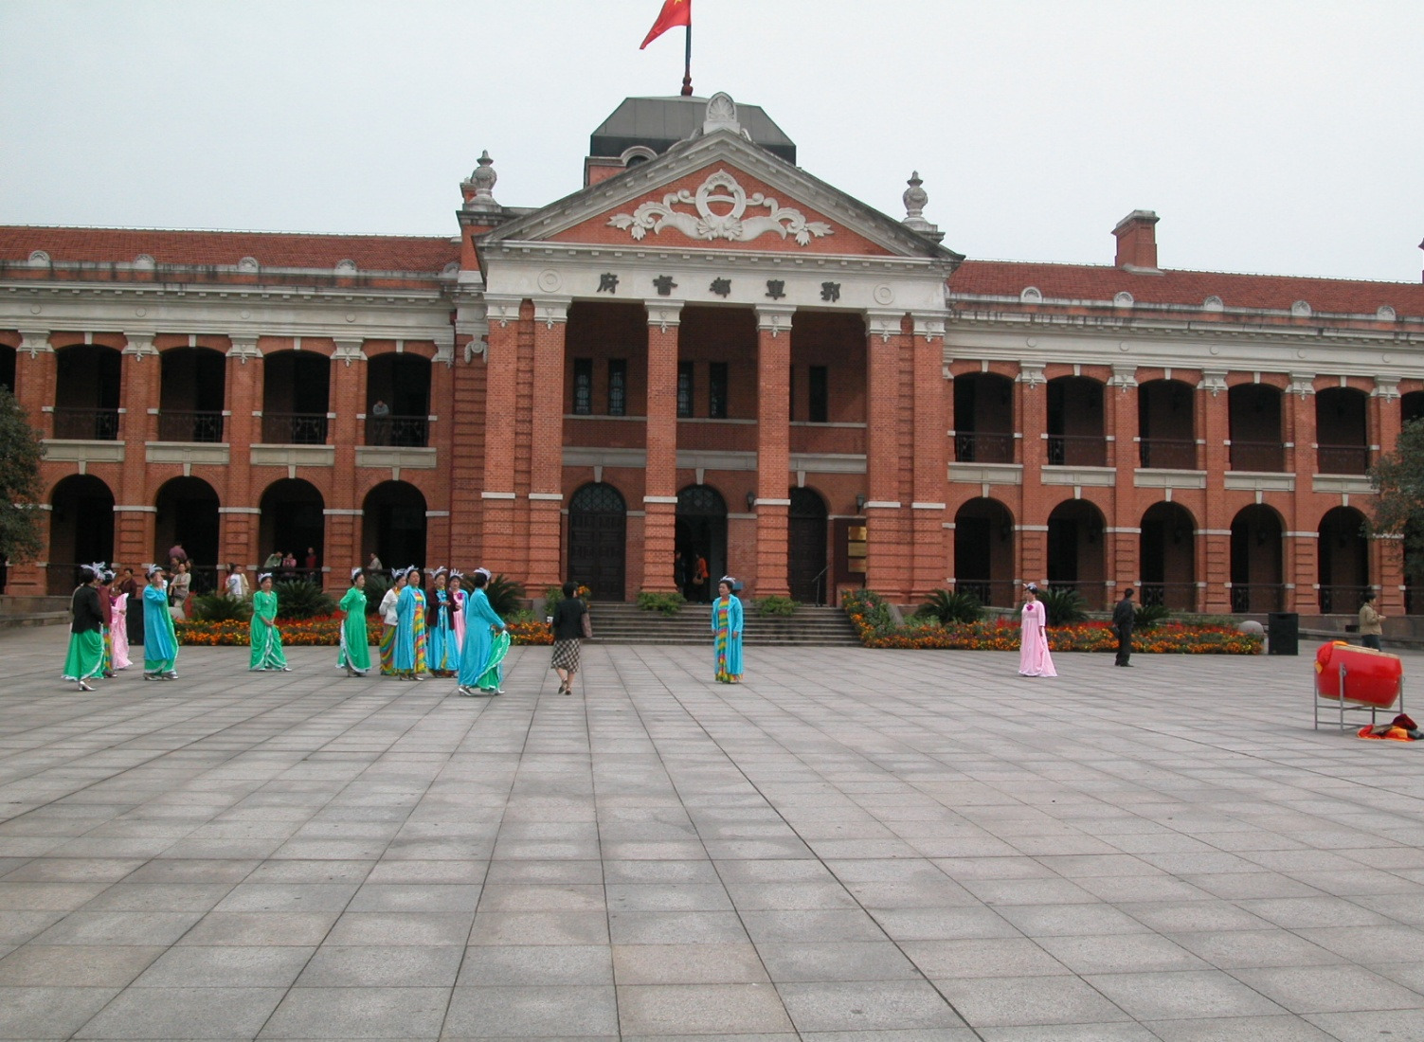

Slide 29
The Aftermath of the Revolution
The Rise of warlordism
The weaknesses of the revolutionary movement
China divided: The abortion of the revolution, Warlord rule and regrouping of the revolution

Slide 30
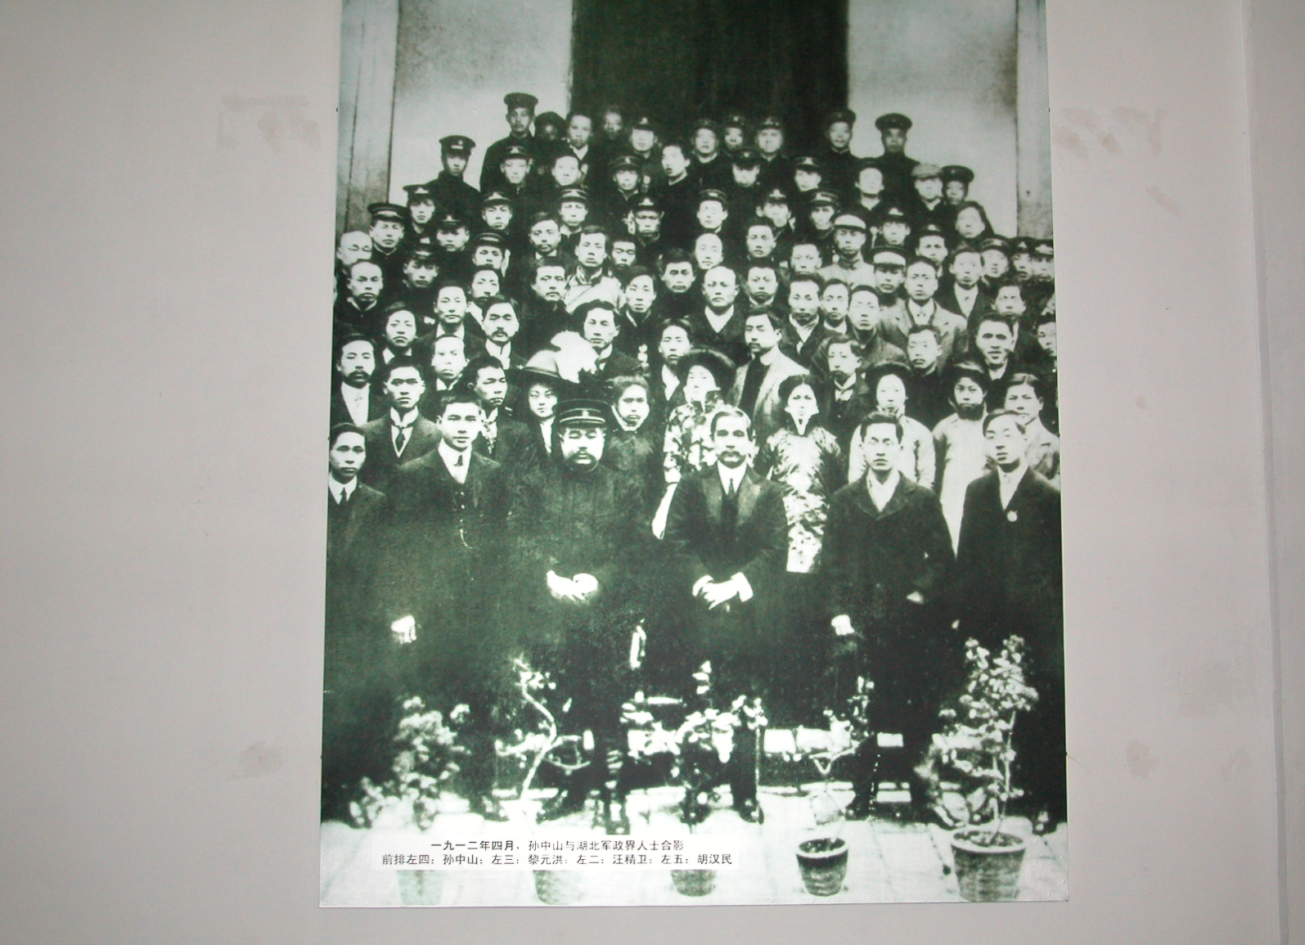

Slide 31
Rise of warlordism
The Rise of warlordism
The seeds of a warlord system in Qing history: The post-Taiping environment and the late-19th C military reforms
Yuan Shikai and suppression of opposition
The national assembly and Song Jiaoren
The “Second Revolution” of 1913
The “Protect the Nation” campaign – Cai E and Yunnan
The formation of the Beiyang warlord system

Slide 32
Weaknesses of the Revolution
Military weakness
China remained regionalized and divided
Lack of a disciplined political party or structure. Weakness of the national assembly
“Neutrality” of foreign powers & Japan’s ambitions
Lack of social and cultural agenda. Falling short of the “Three People’s Principles”
Lack of any mass social revolutionary movt.

