Slide 1
CHINA: RESPONSES TO IMPERIALISM

Slide 2
Overview
We will focus on two aspects
INTERNAL TENSIONS
Lead to Revolts, such as the TAIPING
STATE RESPONSES
Restorationist efforts
Reforms

Slide 3
INTERNAL TENSIONS: TAIPING & OTHER REVOLTS
TAIPING (1840s to 1868) largest and best known, but second half of 19thC saw a SERIES of revolts against Manchu authority.
NIAN (1851-1873) Northwestern Muslim revolt (1862-1873) among others
WHY? ANY REVOLT has to be understood in two contexts
OBJECTIVE CONDITIONS & SUBJECTIVE PERCEPTIONS
OBJECTIVE conditions included
Population Growth of18thC, pressure on land and fragmentation of holding
Bureaucracy less under control (Corruption: impact of Opium on China)
Natural disasters and flooding
OPIUM trade led to outflow of silver and rise in real taxes (see previous)
SUBJECTIVE PERCEPTIONS
Mandate of Heaven Lost
Increase in activities of TRIADS -- secret societies that blur line between self-help, rebellion, and criminality -- who stress ANTI FOREIGN nature of MANCHUS

Slide 4
TAIPING
LOCATION: S-E China, near Guangzhou (CANTON)
HONG XIUQUAN poor family, repeated failure to pass exam for bureaucracy 1836, learn about Christianity from some missionaries, started to get dreams where he sees himself as younger brother of Jesus
1840s starts to preach about HEAVENLY KINGDOM OF GREAT PEACE (TAIPING TIANGUO) Lots of followers by 1850s
1853 Capture NANJING and next 11 years run a parallel government
EGALITARIAN Land redistribution, and equality between men and women
PURITANICAL Fiercely Anti Opium
But divisions within, inspired by foreign ideologies, military state becomes exploitative. No Coordination with other rebellions

Slide 5
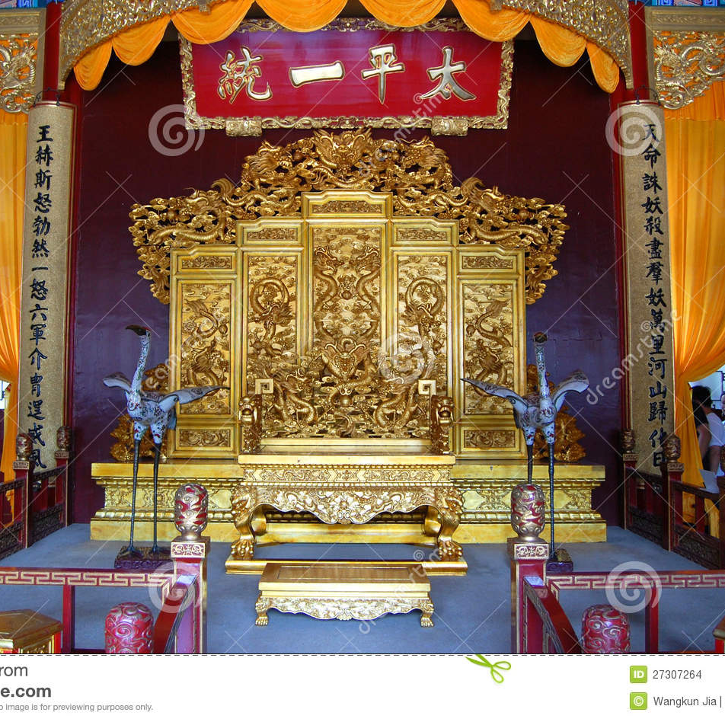
TAIPING SPLENDOR
Originally an oppositional (people’s or peasants) movement, soon the Taiping government acquired all trappings of traditional power. This is the image of the “Throne of Heavenly Kingdom” at Nanjing, reportedly used by the new rulers and former rebels!

Slide 6
DEFEATING THE REBELS
Manchu state in no shape to defeat rebels. Lack of finances, bureaucracy in shambles
Role of Han Confucian scholars such as ZENG GUOFAN : Zeng raises Hunan Army (and naval force) to defeat the rebels
“Restored” Imperial authority, but with their regional bases, also undermined that authority
Role of WESTERN POWERS
Why Support the enemy and not a Christian-inspired rebel?
Role of Wade and Gordon
OPIUM and Anti-Colonial sentiments of the rebels
Manchus now under their control and able to OPEN the CHINA MARKET

Slide 7
Self Strengthening: Restoring Manchu Power?
Role of Confucian Scholar-Officials such as ZENG GUOFAN and his protégé, LI HONGZHANG as well as Prince Gong and the Dowager Empress Cixi
Sought to strengthen China through adoption of western technology but retain Confucian ideology and hierarchies
Initial institutional changes such as the ZONGLI YAMEN
Adopt Western technology, establish arsenals, shipyards, military academies, mines, factories
Ultimately, a limited movement, almost doomed to fail, as not far reaching enough. Corruption, regionalism, etc., but most significantly, tried to graft western technology to a Confucian outlook. And of course, intrigues at the Imperial Court contributed their mite!
Could not strengthen China enough to resist the continuing advance of Imperialism, from the West, and also, more recently, from Japan

Slide 8
Imperialism Redux
Settlements in Treaty Ports
Shanghai Park notice “no dogs or Chinese allowed”
Missionary Activities
Some positive impacts, new knowledge, but also
Attacks on Confucianism, Racism, Tianjin Massacre 1870
Territorial Expansion in and around China
French in Indo China
British in Burma
Japan and Ruyuku Islands
Korea and humiliation in Sino-Japanese War, 1894

