Slide 1
China in [Nationalist] Revolution: 1898-1912

Slide 2
Prelude to the Chinese Nationalist Revolution: 1895-~1905
The final stages of two modalities of change in 19-20C China
To review:
Rebellion: The Taiping Rebellion; the Nian Rebellion; the Dongan and Panthay (Muslim) Rebellions
Reform: The Self-Strengthening Reforms
(Revolution)
Developments in 1895-1905
A more radical reform movement: The “Hundred Days Reform” (1898)
The Boxer “Rebellion” (Insurgency) 1899-1900
The Qing government’s last-ditch Reforms: Xinzheng 1903-1910

Slide 3
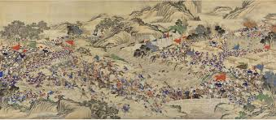
INTERNAL TENSIONS: TAIPING & OTHER REVOLTS
TAIPING (1840s to 1868) largest and best known, but second half of 19thC saw a SERIES of revolts against Manchu authority.
NIAN (1851-1873) Northwestern Muslim revolt (1862-1873) among others
WHY? ANY REVOLT has to be understood in two contexts
  OBJECTIVE CONDITIONS & SUBJECTIVE PERCEPTIONS
OBJECTIVE conditions included
  Population Growth of18thC, pressure on land and fragmentation of holding
  Bureaucracy less under control (Corruption: impact of Opium on China)
  Natural disasters and flooding
  OPIUM trade led to outflow of silver and rise in real taxes (see previous)
SUBJECTIVE PERCEPTIONS
  Mandate of Heaven Lost
  Increase in activities of TRIADS -- secret societies that blur line between self-help, rebellion, and criminality -- who stress ANTI FOREIGN nature of MANCHUS

Slide 4
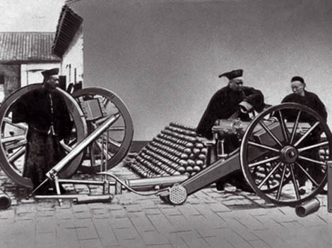
Self Strengthening: Restoring Manchu Power?
Role of Confucian Scholar-Officials such as ZENG GUOFAN and his protégé, LI HONGZHANG as well as Prince Gong and the Dowager Empress Cixi
Sought to strengthen China through adoption of western technology but retain Confucian ideology and hierarchies
Initial institutional changes such as the ZONGLI YAMEN
Adopt Western technology, establish arsenals, shipyards, military academies, mines, factories
Ultimately, a limited movement, almost doomed to fail, as not far reaching enough. Corruption, regionalism, etc., but most significantly, tried to graft western technology to a Confucian outlook. And of course, intrigues at the Imperial Court contributed their mite!
Could not strengthen China enough to resist the continuing advance of Imperialism, from the West, and also, more recently, from Japan

Slide 5
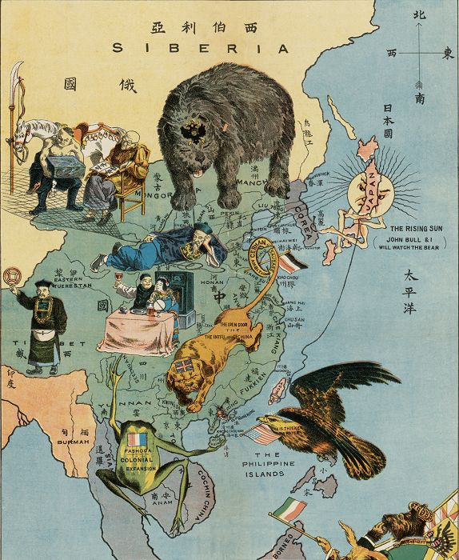
Imperialism Redux
Settlements in Treaty Ports
  Shanghai Park notice “no dogs or Chinese allowed”
Missionary Activities
  Some positive impacts, new knowledge, but also
  Attacks on Confucianism, Racism, Tianjin Massacre 1870
Territorial Expansion in and around China
  French in Indo China
  British in Burma
  Japan and Ruyuku Islands
  Korea and humiliation in Sino-Japanese War, 1894

Slide 6
The Hundred Days Reform: 1898
Key historical figures
The Hundred Days
The aftermath of the Hundred Days:
The legacy of “Constitutionalism” (the ideology of Japan/Germany style constitutional monarchy)
Kang’s utopia (Ideal society, ideal world) – The Datongshu (Book on Ultimate Harmony)

Slide 7
Background and Environment of Radical Reform
Radical reformers: Kang Youwei (1858-1927), Liang Qichao (1873-1929), Tan Sitong (1865-1898), Yan Fu (1853-1921)
The triggering effect of the Treaty of Shimonoseki (1895): China in peril (not just Japan) and the activism of the “young scholars”: Kang’s memorials
Subsequent activities: Formation of schools and study societies; newspapers and writings, cultivating regional officials
Initiation of reforms in certain provinces (e.g., Hunan) under influence and leadership of “progressive” governors (e.g., Huang Zunxian): Schools and reform-minded intellectual organizations (e.g., the Shiwuxuetang, or School of Current Affairs, 1897; the Nanxueshe, or Southern Learning Society, 1897-1898) and newspapers (e.g., the Xiangxuebao [Hunan Studies], Xiangbao [Hunan News], and Shiwubao [Current Affairs])

Slide 8
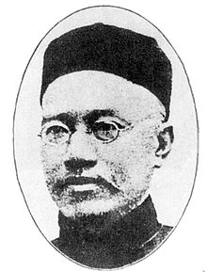
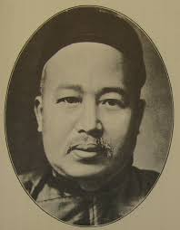
Kang Youwei Yan Fu

Slide 9
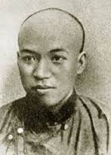
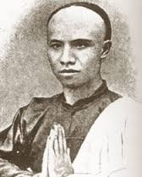
Tan Sitong & Liang Qichao

Slide 10
Ideologies of Reform: Elements of Radicalism
Kang, Liang, and Tan
Kang: Radical reinterpretation of Confucianism
Kang: A utopian vision of the future of the world (Datongshu, or The Book of Great Harmony) – the “Three Worlds” of Chaos, Development and Great Harmony from the Confucian classic “Liyun” 1887
Tan Sitong’s theories of cosmic compassion (Ether), Renxue, “Breaking all conventional bonds”
Liang Qichao: Fundamental change of institution and society; “renew the people”, democratic ideas

Slide 11
Western influences
The role of the “new missionaries” (Timothy Richards, J. Young Allen), secularization, the social gospel, concern for China’s fate, promotion of education and dissemination of ideas of change through newspapers (the Wanguo gongbao)
Translation work and writing: Kang, Liang, but especially Yan Fu studied naval practices in Br. 1876, examined Br. political system and legal thought, constitutionalism, Darwin and Social Darwinism. Promoted idea of a deeper understanding of the West: not just yangwu, but that the West had a “different vision of reality” and strength lie in deeper cultural elements and factors (anti- tiyong view) Subsequent (1900-09) translations: Thomas Huxley, Evolution and Ethics, Adam Smith excerpts from Wealth of Nations, J.S. Mills On Liberty, Logic, Rousseau, Montesquieu, H. Spencer, Sociology

Slide 12
Literary translations – in Classical Chinese writing style: Lin Shu (1892-1924, Aesop’s Fables, Shakespeare, Chaucer, Dumas, Dickens, Walter Scott, Rider Haggard, Hugo, Jonathan Swift, Dafoe, Washington Irving, Harriet Beecher Stowe, R.L. Stevenson, Arthur Conan Doyle, Balzac, Tolstoy); Su Manshu (1884-1918, poetry of Keats, Shelley, and Wordsworth)
Western modeling for reforms
Idea of new nations and nation states: Chinese nationalism
Development: Industrial Rev., Russia, Germany, Japan
Democratic institutions: Britain, France, USA
Romanticism and revolution: French Revolution, Italy

Slide 13
Processes in 1898
The Guangxu Emperor (r. 1875-1908) only 3 when ascended to the throne, came “of age” in 1889 to reign on his own, but under the influence of Empress Dowager
The role of Weng Tonghe and the “conservative reformers” 1895-1898
Kang’s 1st “interview w/ high officials (Jan 1898)
Allowed to present memorials (6 in the month of January; the 7th, in Feb. introduced emperor to the examples of reform in Meiji Japan and Russia (Peter the Great)
June 16, 1898, Kang, attended by Liang, had audience with Guangxu, laid out ideas, convinced Guangxu about reforms, allowed to send memorials directly to the emperor
June 11 to Sept 20, Hundred Days Reform

Slide 14
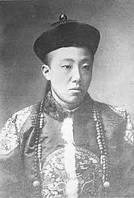
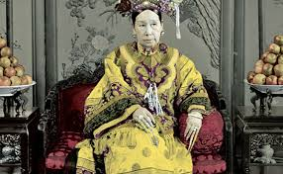
Emperor Guangxu & Empress Dowager Cixi

Slide 15
The 100 Days: June 11-Sept. 20, 1898
Education (Replacing traditional essays for new forms and subjects in the keju examination system; a modern school system to replace old academies)
Political system (Abolition of unnecessary offices, simplification and efficiency, encouraging private citizens – gentry – to provide govt with suggestions)
Industrial and commercial development
Development of capital
Diplomacy and foreign relations
Legal codes reform
Government budget
Perhaps most importantly, the idea of a constitutional monarchy

Slide 16
The Failure and the collapse of the Reform Movement
The role of the Empress Dowager Cixi; Rong Lu and Yuan Shikai (Yuan summoned by Rong – at the behest of ED, to Beijing on 9/14; Tan Sitong’s visit night of 9/18; 9/20, Emperor Guangxu’s audience w/ Yuan, appoints him, that day, Yuan betrays the reform movt)
9/21, ED raids the emperor’s palace, seizing evidence; declares that the emperor had become incapacitated due to serious illness (actually under house arrest since then)
Kang and Liang had fled; Tan Sitong, Yang Rui, Liu Guangdi, Lin Xu, Kang Guangren, Yang Shenxiu beheaded, 22 others arrested, imprisoned or banished.
The important legacies
Constitutionalism movement
Radical vision

Slide 17
The Boxer Rebellion:1899-1901
Background: People, organizations, locations
Phases of Development: From Anti-Qing to Pro-Qing, but always Anti-Foreign (“mieyang”: Destroy the foreign)
The Expeditionary Army: Britain, France, Germany, Austria-Hungary, Italy, Russia, Japan
The Boxer Protocol

Slide 18
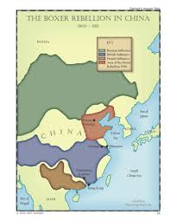
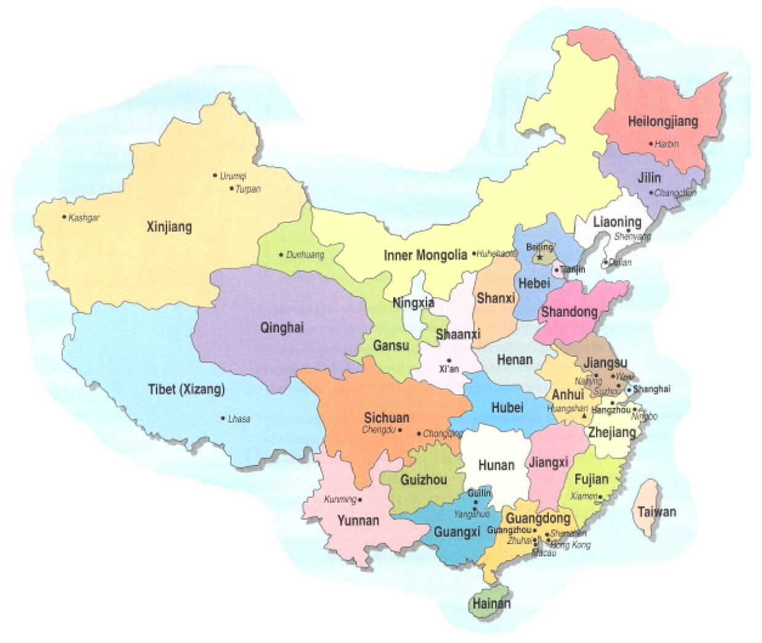

Slide 19

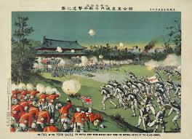
W.A. Rogers in Harper’s Magazine, 2/1900
Chinese woodblock print (The Fall of Beijing to the Allied Armies)

Slide 20
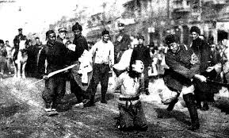
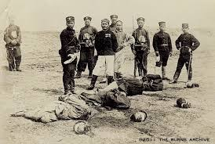
Scenes of Executions of Boxer “Rebels” in 1900

Slide 21
Origins of the “Boxers”
Northern China: mainly Shandong, Zhili provinces
The Yihequan (Righteous and Harmonious Fists)
Related secret society and underground social (some millenarian) movements: The White Lotus Sect (Bailianjiao) and the Eight Trigram Sect (Baguajiao); Big Swords Society (Dadaohui); Small Swords Society (Xiaodaohui); Red Lanterns (Hongdenghui)
Character, Ideology and symbolism
Short-term Background
Late-19C anti-monarchical and anarchistic movements
Response to local disasters and economic distress
Anti-Western Anti-Christian reactions to imperialism erupted 1896 in Shandong (Dadaohui in Caozhou, under Zhu Hongdeng in Dezhou) Loose federation, women groups; two German missionaries murdered in Shandong in 1896; German govt. retaliation
The Yihequan, “Self-defense” teaching units, formed tighter organizations through ritualized relations: “tan” (“temples,” “altars”) and “tuan” (leagues)

Slide 22
Boxer Activities and Developments, 1899-1900
Mid-1899 formed league, re-named Yihetuan; still not centralized; many local leagues carrying out local disturbances
Late- 1899 Shandong “league” first adopted slogan “Support the Qing, Eliminate the Foreigners” (fuqing mieyang), became a pro-dynastic anti-Western force of disturbance
Rapid expansion in early-Spring 1900, esp. in Tianjin-Beijing area (800+ “tan” in Beijing alone)
Movement reaches peak in mid-1900, threatens legations
April 1900 Jt dispatch by Br., US, Fr., Germany to Qing court demanding that Boxers be eliminated
Late May 1900 foreign troops begin manoeuvering into Beijing-Tianjin region to protect embassies

Slide 23
June 10, 1900, Joint expeditionary force (Britain, USA, France, Russia, Japan, Austria, Italy, Germany) amass in Tianjin and head toward Beijing on troop transport trains. Boxers sabotage tracks and stop troop movt at Lanfang
6/17, off shore foreign troops land, assault Tagu forts
6/18 the B. of Tianjin begins
6/20-21 Court mtg. Empress Dowager Cixi decides to use Boxers and go to war with the foreigners
7/14 Expeditionary force takes Tianjin
8/4 begins march on Beijing (20,000+ troops)
8/14 breaks into Beijing, burns the city and the summer palace compound. Qing court flees to Xian (Shaanxi)
Foreign force expands to 100,000; massacres in Beijing and Tianjin, attacks Baoding and Zhangjiakou (outlying Hebei/Zhili)
Russian action in Manchuria, Japanese in Shandong

Slide 24
Aftermath
The Boxer Protocol (Dec. 1900 -1901)
Punishment
Indemnity
Apology
Destruction of fortifications
Stationing of foreign troops
Cession of railroads
Suspension of official exams

Slide 25
The Last Ditch Reforms of the Qing Government: Xinzheng (New Policies) 1903-1910
Post Boxer and the terms of the Boxer Protocol
The first steps: August 1900 Imperial edict; Jan. 1901 Emp. Dowager’s summons; Feb. 1901 Reiteration of edict; Aug. 1901 Edict of Reform (promises)
Phase 1: 1901-1905
Administration: 1901 Office of the Superintendent of Governmental Affairs
Military: Establishment of the “New Army” and training
Phase 2: 1905 and beyond
Education: The “modern” schooling system
The Abolition of the Exam System
The universities of China
Women’s education
The Issue of Constitution
The Russo-Japanese War and the Tr. of Portsmouth (1905)

Slide 26
The Constitutional Reforms
The Japanese model of constitutionalism
Missions abroad (Europe, USA, Japan) 1905-1906
1906-7: The ambiguities of the Manchu court
A Plan and a schedule
1907 First edict on national and provincial assemblies
1908 The Nine-year plan
The death of Guangxu 11/14 and Empress Dowager Cixi 11/15 and the beginning of Xuantong’s “reign”

Slide 27
The Legacy of the Xinzheng Reforms
How revolutionary were these reforms? (Taking on Schoppa’s interpretation, ch. 7 “Revolutionary Manchus”? (Ranbir Vohra: “The Manchus in charge of constitutional change”) or a “last ditch” New Deal to save a dying dynasty?
Long-term impact of institutional reforms:
Educational changes
Institutional changes
The Wider impact of the constitutionalist reforms
Relationship between Constitutionalism and Revolution: A decade’s debate
The divisions within the ranks of “Change” & the intelligentsia: Kang, Liang, Yan, Sun, Wang, Song, and the “young intellectuals”
Mobilization at home and overseas
Constitutionalism in the provinces
The Constitutionalists and the ranks of the revolution

Slide 28
Historical Connections: Reform, Rebellions, and Revolution
Historical Figures: Empress Dowager Cixi; Qing government officials (e.g., Zhang Zhidong);
Transitional figures: Chinese intellectuals (e.g., Liang Qichao; Yan Fu) and “strong men” (e.g., Yuan Shikai)
Ideologies of Change: Constitutional reform or nationalist republican revolution?
Colonialism’s intensification and impact on China: Development of two modalities
Britain (& US): Integral colonization (Open Door Policy, 1900)
Other European powers and Japan: Partition model
“Scramble for Concessions” since 1860s
Spheres of Influences: Macro and “micro”
Conclusion: The solution lies in revolution

Slide 29
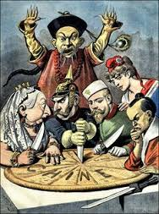

Slide 30
