Slide 1
China’s Nationalist Revolutions (note plural)
1900-1919 (and beyond?)

Slide 2
The contested terrain of Chinese “nationalism”
While enamored by the model of European nation states, at least three, if not more, strands that often OVERLAP in the context of emergence of nationalism in China
ANTI MANCHU sentiment
Anti Foreign sentiment
Regional Identities
The tripartism of modern Chinese nationalism:
China as a nation
Anti-Manchu nationalism
Centralism vs. division & regionalism
For many, the resolution was synthesis: A new China: a Nation of nations

Slide 3
Approaches to Nationalism
Two Approaches:
1. Calling for Social, Cultural and Economic transformation in addition to POLITICAL CHANGE.
  ANTI colonial, AND aim to transform China’s Society and Economy.
  In the last decade of 19th and early 20th century, exemplified by a variety of intellectuals such as LIANG QI CHAO. Later, this strand would lead to a revolutionary SOCIALIST, Nationalism.
2. Get control over the STATE.
  Make China strong by securing control of the state and transforming it, in the Japanese model. This was more successful in the short run, contributing to the conflicts between nationalists. Personified by YUAN SHIKAI (YSK)

Slide 4
Context
Imperialism
Domestic Politics
Global Context

Slide 5
Context: Anti-Imperialist Nationalism
Wars: From the Opium War to the Sino-Japanese War
Threat of national destruction (wangguo) and dismemberment
Spheres of Influence and Scramble for Concessions (“Open Door Policy” and the Boxer Protocol)

Slide 6
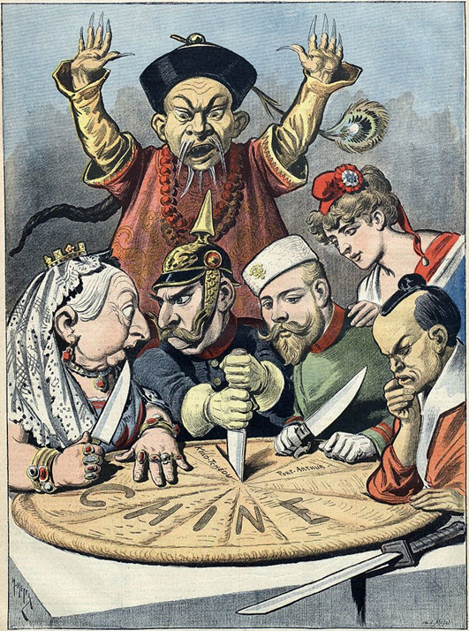
Slicing of the Chinese Melon
Western powers seeking more and more concessions after the Treaty of Nanjing, 1842
In 1843 the United States demands and is granted the same concessions
Christian missionaries are to be allowed to work in China
EXTRA TERRITORIALITY Chinese laws no longer apply to Westerners in China
1844 France joins the club
Emergence of the MOST FAVORED NATION clause. All get same concessions as others!!
Scramble for Concessions” since 1860s
1900 US proposed “Open Door policy” to mediate competing interests of colonial powers
After defeat in the Sino-Japanese War (1894–1895) Japan joins in the slicing up of China into “spheres of influence” of colonial powers

Slide 7
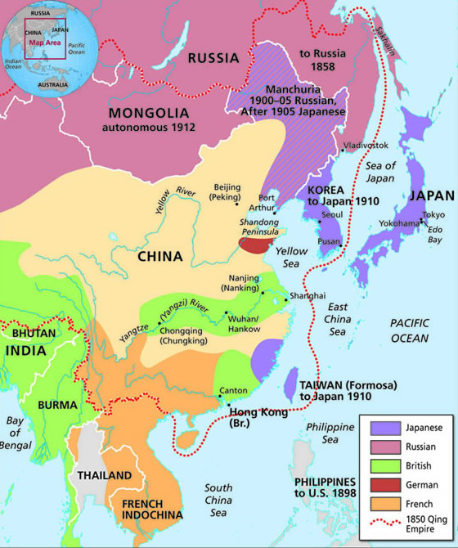
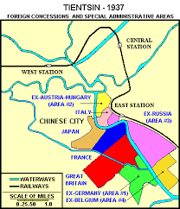
DIVISIONS WITHIN CITIES
SPHERES OF INFLUENCE

Slide 8
Context: Domestic Roots of Nationalism
Long tradition of people’s revolts (think of Taiping and Boxers in the most recent context)
Undermining of the 100 Days of Reforms and demands constitutionalist monarchical system
Failures of the conservative reforms under Empress Cixi following the defeat of the Boxers
Anti Manchu sentiment
  Failure to protect the interests of China
  Manchus’ continued distinction between themselves and Han and other Chinese ethnicities
  => Resentment against “foreign” Machu

Slide 9
Global Context for Chinese Nationalism
19th and early 20th C the Age of Revolutions and age of Nationalisms
Among others, in
  Europe: Germany, Poland, Italy Asia: Japan and India
  Middle East: Egypt, Iran, Lebanon, Palestine, Zionism
  Asia: Japan and India
Successes of Meiji nationalism in Japan
Nationalism is a representation of modernity
Other ideas such as Democracy and Republicanism or Anarchism and Socialism shape thinking of Chinese nationalists
  Socialism provides a modern alternative that is not allied to Imperialism
  New SOVIET UNION e.g., gives up Tsarist claims on Chinese territ
Overseas Chinese communities were great supporters of nationalism

Slide 10
Overlapping Phases of Development
The Early Phase: Ideas of Revolutionary Nationalism (1895-1905)
The Organizational Phase: Organizations and Parties (1903-1908)
The Activist Phase (1908-1911 & beyond)
The Aftermath: Warlordism and the need to RESTRUCTURE the Nationalist Revolution

Slide 11
Moving to Revolutionary Nationalism
The failure of the 100 Days’ Reforms and exile of advocates of constitutionalist monarchy left room for more radical ideas
Influence of European thinkers, utopian socialists and anarchists
Zou Rong, Gemingjun (The Revolutionary Army) 1903: “Revolution is a universal rule of evolution. Revolution is a universal principle of the world. Revolution is the essence of a transitional period of struggle for survival. Revolution follows nature and corresponds to the nature of man. Revolution eliminates what is corrupt and holds on to what is good. Revolution is to advance from savagery to civilization. Revolution is to eradicate slavery and become the master…”

Slide 12
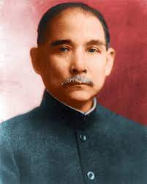
Sun Yat Sen (1906) [background see p. 95-96]
San min zhuyi (“Three People’s Principles”)
Minzu (People’s national identity – “nationalism”)
Minquan (People’s rights/power – “democracy”)
Minsheng (People’s livelihood – “socialism”)
1907 Tongmenghui Revolutionary Proclamation
1. Expulsion of Manchus
2. Restoring China to the Chinese (Han Chinese?)
3. Establishing a republic
4. Equality of land ownership

Slide 13
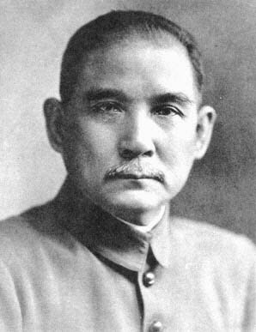
        Sun Yat-sen 孙文，孙中山，孙逸仙 1866-1925 b. Guangdong, Xiangshan 1878-1883 Honolulu, Iolani School, later (1882) Oahu College (today’s Punahou School) Return to China 1883 Incurred the wrath of home village leaders when he and Lu Haodong 陆皓东, a boyhood friend, toppled a temple statue. Escaped to HK. Studied at Diocesan’s Boys Sch. and at Central School. In 1886 studied Western medicine under John Kerr at the Christian Boji 博济Hospital in Guangzhou.1892 grad from HK College of Medicine for the Chinese. Licensed and pract. Medicine in Guangzhou, HK, and Macau. Got involved w/ reform & revolutionary thinking. Formed friendship with Chi. & British progressives in HK and elsewhere. Joined the radical reformist Furen Literary Society 辅仁文社 which had been formed by Yang Quyun 杨衢云 (a.k.a. Yeung Kuwan) in Hong Kong in 1891.

Slide 14
Start of Nationalist Organizations
Sun Yat-sen 1893 presents letter w/ reform proposals (relatively moderate ones) to Li Hongzhang and was ignored. Turns to a revolutionary mode. Forms the Revive China Society (Xingzhonghui 兴中会) in Hong Kong, Honolulu, and London. Sets off the Guangzhou Uprising (Oct.1895), abject defeat, nearly 100 revolutionaries arrested and killed
1896 Sun “arrested” by Qing imperial secret “police” in London, “incarcerated” for 16 days. James Cantlie’s intercession – gained support in foreign societies
The Tongmenghui (1905) precursor of the Guomindang (the Nationalist Party). Japanese influence. Starts in Yokohama and Tokyo among exiled
Impact of the Tongmenghui
The consolidation of ideology
Dissemination of the revolutionary agenda
What’s missing? (Unity, military capacity, political standing)

Slide 15
The Action Phase of the Revolution (1908-1911)
Fuses of the Revolution
The New Army and the provincial academies and units, officer corps
The provincial assemblies and new structures of provincial governments
Assassination attempts (emulating the Japanese shishi of the 1850s? Or the European anarchists)
The railroads: “nationalization” and “protection”
The Wuchang Uprising
A brief revolutionary war
The abdication of the Xuantong Emperor (Feb. 1912)

Slide 16
The Railroads Controversy
The growth of railroads and Chinese railroad companies:
Before & immediately after 1895 (Scramble for Concession era): utter foreign domination
1898-1906: Attempts on the part of Chinese regional gentry to build Chinese companies and participate in the enterprise: (1) Guangdong, Hunan, Hubei, Sichuan; (2) Financial problems
1908 & afterward: Central Qing government resumes “control” – based on negotiated loans with foreign banking consortia
May 1911 Qing government orders nationalization of railroads in the 4 provinces

Slide 17
Railroads and Nationalism
Regional gentry protest vs. government nationalization and against the invasion of foreign capital, form “railroad protection associations”
Provincial assemblies (organized under the aegis of the Qing government’s “constitutional monarchy” plan) mobilized
June 1911 Qing court’s plan to indemnify regional gentry railroad investors backfire due to unequal treatment of the provinces involved – Sichuan becomes the focus
August 24 Massive demonstration in Chengdu (promoted by the Sichuan provincial assembly – gentry): Tax boycott, worker & student strikes
Governor-general action: Arrests of demonstrators, turns Sichuan gentry and assembly against Qing govt. and toward revolutionaries
Fusion of the railroad issue w/ revolutionary cause

Slide 18
Wuchang Uprising
Transfer of “New Army” HQ to Wuchang (to deal w/ Sichuan railroad issue)
Members of the Hubei New Army junior officer corps infiltrated by revolutionary movt.
10/9/1911 Bomb accidentally exploded in revolutionary HQ (Russian concession in Hankou): Police raids and arrests led to seizure of weapons and lists of revolutionaries
Forced the revolutionaries in the Engr. And Artillery battalions in the Hubei New Army to move up the plans of action
An uprising FROM BELOW (see p. 102), compel leaders to lead!!
But despite its disorganization, SPREAD, because lots of ANTI MANCHU sentiment, anti Foreign sentiment, and some NATIONALIST sentiment. Keep in mind that not all three the same!!

Slide 19
The “Revolutionary War”
10/10/1911 Army units seized munitions depot & prov gov-general in Wuchang, gained control of city of Wuchang
10/12 Fall of Hanyang & Hankou to revs.
Li Yuanhong (Hubei New Army brigade commander) became military gov. of Hubei; Tang Hualong (chairman of Hubei prov assembly) chief exec of revolutionary govt in Hubei
Li (Tang) (1) issued telegrams to other provinces and municipalities, urging declarations of independence from Qing govt; (2) urged foreign consuls in Wuhan to stay neutral: Methods worked
The War: Qing govt recovers Hankou & Hanyang in November, but loses Shanghai & Nanjing in December

Slide 20
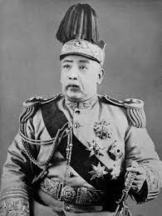
Yuan Shikai
A Qing official and military commander of the New Army 1895
A reformist, he was quite possibly also part of the coup that defeated the 100 Days’ Reforms
His Beiyang Army was probably the most powerful military force in China in the early 20th C
A wily political actor and military figure, Yuan was close to the Empress Cixi and was sent to exile after her death in 1908 though retained the loyalty of the Beiyang army
The Manchu court turned to Yuan to defeat the revolutionaries
Yuan instead negotiated with revolutionaries and arranged for the abdication of the emperor and was declared the first President of the new Republic

Slide 21
The New Republic
12/25/1911 Sun Yat-sen returned to Shanghai from the US via Britain & France; 12/29 elected provisional president of the Republic of China (Li Yuanhong: provisional VP; Huang Xing: Min. of War)
Yuan negotiates with Sun Yat-sen to provisionally take the post of President
January 1, 1912 Declared 1st day of the Republic of China in Nanjing
YSK STATE centric, holds elections 1913 but then outlaws the main nationalist party, the GUOMINDANG (GMD) [the new name for the old Tongmenghui or Revolutionary Alliance]
Yuan even tries to have himself declare Emperor but dies in 1916. In the middle of WWI.

Slide 22
Limitations of the 1911 Revolution
Sun Yat Sen’s GMD outlawed, Yuan Shikai’s connections with rural gentry, attempts to become a monarch, failed negotiations with Western powers and Japan
The emergence of WARLORDISM (China virtually divided into warlord-led provinces [there were differences among them, some even progressive] 1916-1927)
The seeds of a warlord system in Qing history: The post-Taiping environment and the late-19th C military reforms
Continued Western Imperialism in China
Japanese Imperialism
Revolution needed RESTRUCTURING, Nationalism needed to be rethought

Slide 23
Two sorts of responses
State-Centric
People Centric
Yuan Shikai type: Strengthen State
Military Academies and strengthening of state institutions
Chiang Kai Shek’s later approaches
Later, post revolutionary, CCP State
THIS MAY BE SEEN AS COMPARABLE TO OTHER EXAMPLES OF “NATIONALISM FROM ABOVE” THAT WE WILL EXAMINE (particularly Meiji era)
New Culture Movement
May Fourth Incident
May Fourth Movement
Birth of the CCP
THESE MORE OF “NATIONALISM FROM BELOW” MODEL THAT WE WILL BRIEFLY DISCUSS FOR INDIA

Slide 24
Sun Yat-sen (SYS) and the Guomindang (GMD)
At different times, represent both of the responses
Sun Yat-sen was an idealistic, but not much of a political and certainly no military organizer
  From Guangdong province, educated in Hawaii and travel in west. Dreams of establishing a republic. Creates an organization called the TONGMENGHUI or REVOLUTIONARY ALLIANCE, which later became the GUOMINDANG (nationalist party) after elections and new parliament of Feb 1913
SYS not committed to a single ideology. Three Principles: nationalism, democracy and and “people’s livelihood”
GMD (much like INC in India) was a mix of all sorts of people. Some were leftists with Communist sympathies, others like Chiang Kai-shek, were more of military men, and quite anti-communist. Many others were simply opportunists!!

Slide 25
Context for Cultural (People-Centric) Nationalism
Cultural and intellectual trends were blooming in the second decade of the 20thC: perhaps political confusion and uncertainly led intellectuals and even common people to start thinking about and offering opinions about the nature of Chinese society and the politics
Also an economic context: In URBAN areas, despite confusion, economy doing well, new industries, factories, and working class
Because new industrialization almost always brutal, new working-class organizations. In 1921 Chinese Communist Party (CCP) formed, though minuscule certainly does contribute to new ferment
Chinese students returning from Japan contribute to this
Presence of western enclaves is also a source of new ideas and institutions

Slide 26
New Culture (May 4th) Movement
Chen DU-XIU (magazine New Youth) condemn old, attack tradition, Confucianism
Hu SHI : Adoption of BAI HUA (vernacular speech-based language) replace WEN YAN (classical written Chinese)
LU XUN: literature for social and political change!
All of these reflect new ideas of NATION. Not about emperors, not about mandates of heaven, but an IMAGINED COMMUNITY of China!!
Ferment, usually referred to as the MAY 4th MOVEMENT taking its name from an event on May 4th 1919

Slide 27
May 4th Event
May 4th, 1919, saw a student protest against treaty of Versailles, going to allow Japan to keep its colonial gains on the Chinese mainland
To understand this go back a little bit: A lot of was happening in China while WWI occur. YSK in power, dies, still hope of nationalism from above, that if China gives up “retrograde” and “backward” characteristics and seeks to be “modern” they will get support of western powers
100000 Chinese serve allied cause in WWI. Hope to get Shandung peninsula back from Germany. Japan joins WWI very late, acquire most of the peninsula while western powers busy in European war theater.
Now, Japan makes its 21 demands including control over china’s police force
YSK cannot resist, also chose this inopportune time to make bid to become a new emperor!! Major protests and YSK dies in 1916.
Versailles decision favoring Japan was the spark: Violence and total disaffection with the new world, ripe for total change. This was to start with May 4 and eventually culminate in Communist victory (but that’s a LONG time away)
Advocates of westernization, modernizers hoped for a lot from Woodrow Wilson and western powers, a world safe for democracy, self determination, nationalism, League of Nations, etc. But found western powers did secret deal with Japan
3000 student protest, pressure Japan. Arrested. Spark off FIRST MASS NATIONALIST movement, spread of nationalist culture and ideas. Pressure government to fire the pro-Japanese minsters and refuse to sign Versailles

Slide 28
Limitations of May 4th and possibilities
Politically this had little impact: not on western powers, Japan or on landlords.
The movement did, however, lead to growth of new organizations like the national students union or CCP, and led to older political leaders like SYS wooing the new politicized classes
BUT it was precisely BECAUSE this sort of awakening or ferment was initially confined to a small section of the society, among the intellectuals, that POLITICALLY, China of the early 20s remained dominated by WARLORDS. To get beyond this, revolution would need restructuring, and need to even think beyond the paradigm of liberal democratic nation-state.

