Slide 1
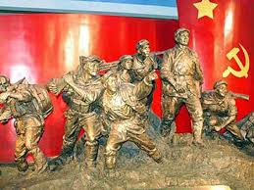
Consequences of Nationalism 3
The Case of China, 1911-1949: Nationalism, Socialism and Socialism as Nationalism

Slide 2
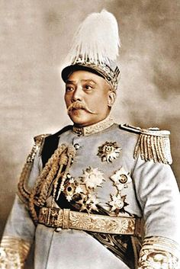
Contexts
Limitations of the 1911 revolution
Sun Yat Sen’s GMD outlawed, Yuan Shi Kai’s connections with rural gentry, attempts to become a monarch, failed negotiations with Western powers and Japan
The emergence of WARLORDISM (China virtually divided into warlord-led provinces [there were differences among them, some even progressive] 1916-1927)
Continued Western Imperialism in China
Japanese Imperialism
Revolution needed RESTRUCTURING, Nationalism needed to be rethought

Slide 3
Two sorts of responses
State-Centric
People Centric
Yuan Shi Kai type: Strengthen State
Military Academies and strengthening of state institutions
Chiang Kai Shek’s later approaches
Later, post revolutionary, CCP State
THIS MAY BE SEEN AS COMPARABLE TO OTHER EXAMPLES OF “NATIONALISM FROM ABOVE” THAT WE HAVE EXAMINED (particularly Meiji era)
New Culture Movement
May Fourth Incident
May Fourth Movement
Birth of the CCP
THESE MORE OF “NATIONALISM FROM BELOW” MODEL THAT WE BRIEFLY DISCUSSED FOR INDIA

Slide 4
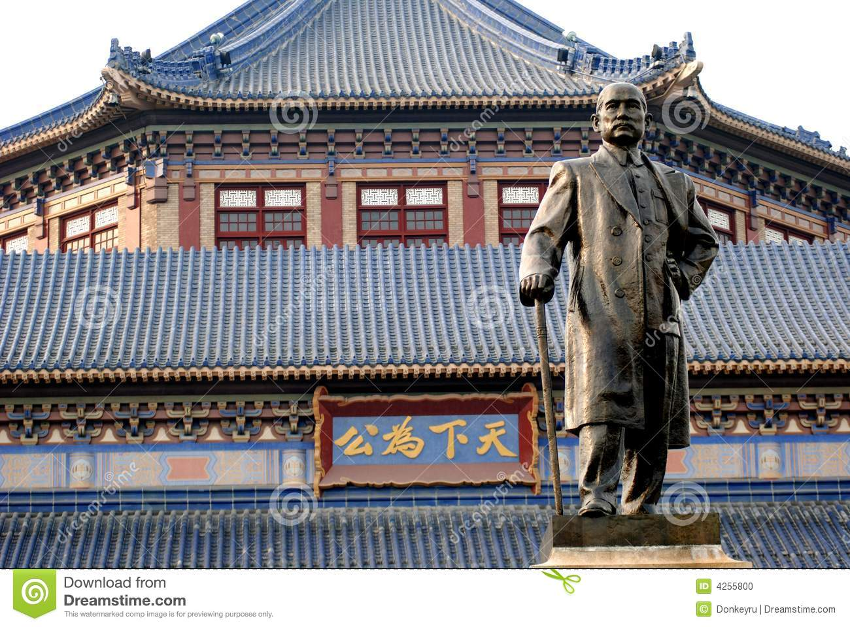
Sun Yat Sen (SYS) and the Guomindang (GMD)
At different times, represent both of the responses
Sun Yat Sen was an idealistic, but not much of a political and certainly no military organizer
  From Guandong province, educated in Hawaii and travel in west. Dreams of establishing a republic. Creates an organization called the TONGMENGHUI or REVOLUTIONARY ALLIANCE, which later became the GUOMINDANG (nationalist party) after elections and new parliament of Feb 1913
SYS not committed to a single ideology. Three Principles: nationalism, democracy and and “people’s livelihood”
GMD (much like INC in India) was a mix of all sorts of people. Some were leftists with Communist sympathies, others like Chiang Kai-shek, were more of military men, and quite anti-communist. Many others were simply opportunists!!

Slide 5
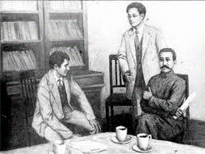
Context for Cultural (People-Centric) Nationalism
Cultural and intellectual trends were blooming in the second decade of the 20thC: perhaps political confusion and uncertainly led intellectuals and even common people to start thinking about and offering opinions about the nature of Chinese society and the politics
Also an economic context: In URBAN areas, despite confusion, economy doing well, new industries, factories, and working class
Because new industrialization almost always brutal, new working class organizations. In 1921 Chinese Communist Party (CCP) formed, though minuscule certainly does contribute to new ferment
Chinese students returning from Japan contribute to this
Presence of western enclaves is also a source of new ideas and institutions

Slide 6
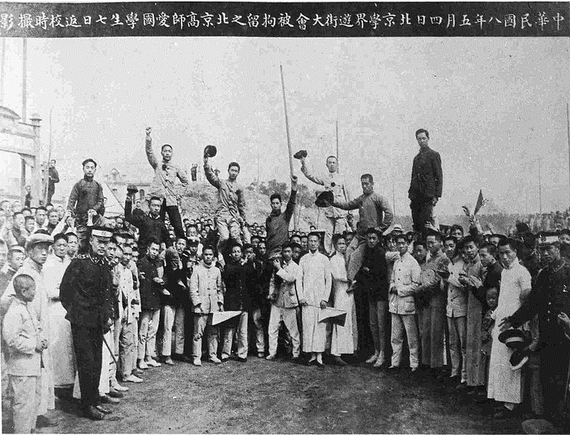
New Culture (May 4th) Movement
Chen DU-XIU (magazine New Youth) condemn old, attack tradition, Confucianism
Hu SHI : Adoption of BAI HUA (vernacular speech based language) replace WEN YAN (classical written Chinese)
LU XUN: literature for social and political change!
All of these reflect new ideas of NATION. Not about emperors, not about mandates of heaven, but an IMAGINED COMMUNITY of China!!
Ferment, usually referred to as the MAY 4th MOVEMENT taking its name from an event on May 4th 1919

Slide 7
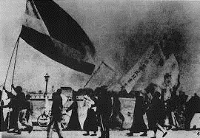
May 4th Event
May 4th, 1919, saw a student protest against treaty of Versailles, going to allow Japan to keep its colonial gains on the Chinese mainland
To understand this go back a little bit: A lot of was happening in China while WWI occur. YSK in power, dies, still hope of nationalism from above, that if China gives up “retrograde” and “backward” characteristics and seeks to be “modern” they will get support of western powers
100000 Chinese serve allied cause in WWI. Hope to get Shandung peninsula back from Germany. Japan joins WWI very late, acquire most of the peninsula while western powers busy in European war theater.
Now, Japan makes its 21 demands including control over china’s police force
YSK cannot resist, also chose this inopportune time to make bid to become a new emperor!! Major protests and YSK dies in 1916.
Versailles decision favoring Japan was the spark: Violence and total disaffection with the new world, ripe for total change. This was to start with May 4 and eventually culminate in Communist victory (but that’s a LONG time away)
Advocates of westernization, modernizers hoped for a lot from Woodrow Wilson and western powers, a world safe for democracy, self determination, nationalism, League of Nations, etc. But found western powers did secret deal with Japan
3000 student protest, pressure Japan. Arrested. Spark off FIRST MASS NATIONALIST movement, spread of nationalist culture and ideas. Pressure government to fire the pro-Japanese minsters and refuse to sign Versailles

Slide 8
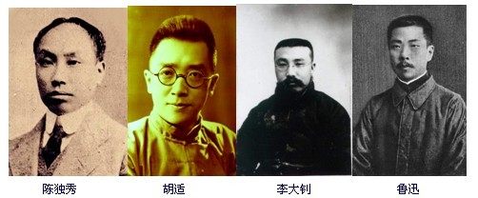
Limitations of May 4th and possibilities
Politically this had little impact: not on western powers, Japan or on landlords.
The movement did, however, lead to growth of new organizations like the national students union or CCP, and led to older political leaders like SYS wooing the new politicized classes
BUT it was precisely BECAUSE this sort of awakening or ferment was initially confined to a small section of the society, among the intellectuals, that POLITICALLY, China of the early 20s remained dominated by WARLORDS. To get beyond this, revolution would need restructuring, and need to even think beyond the paradigm of liberal democratic nation-state.

Slide 9
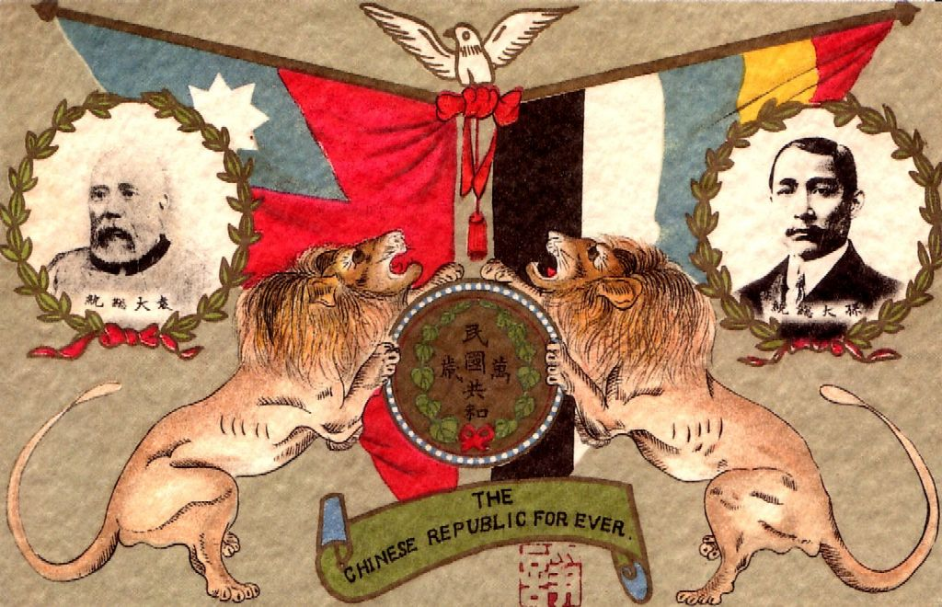
Thematically
What we see in China a close relationship between (lower case) socialism and (lower case) nationalism and a much more troubled and conflicted history of the relations between (upper case) Socialism (represented by the Communist Party of China – CCP) and (upper case) Nationalism (represented by the Guomindang GMD)
Need to understand these themes within the context of a POLITICAL history

Slide 10

Socialism
What IS Socialism? More socialization? Partying hard?? Not really☺
Socialism is a 19th C ideology, emerges in wake of French Revolution, desire for a more egalitarian society. MANY varieties of socialism, from milk and toast liberal intellectuals to fiery revolutionaries. Most share some beliefs:
  1. Equality is a goal to which they should strive
  2. Equality cannot be achieved unless there is a level playing field, that there is equal access to resources, and
  3. to get to a level playing field, there needs to be redistribution of key resources, whether those be land, property, or other MEANS of PRODUCTION, in a way that entire SOCIETY benefits
Socialists have and continue to differ among themselves on how this is going to be achieved, whether ballot box, bullets, or otherwise
In the Chinese context (as in most others) need to distinguish between socialists (believers in a certain ideology) and Socialists (usually members of CCP)

Slide 11
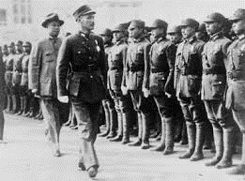
Political Events: Overview
Warlords 1912-1927
Formation of Chinese Communist Party (CCP) in 1921
First United Front (UF) between GMD and CCP 1924-1927
Breakdown of the First UF 1927
Exile and experience for the CCP 1927-1934 (start of transformation)
  Experience of the JIANGXI Soviet
Long March 1934-35 & new base in North-West China, in YANAN
Japanese Occupation 1930-1945
Second UF 1937-46
Civil War 1946-49
Communist victory and creation of the People’s Republic of China 1949

Slide 12
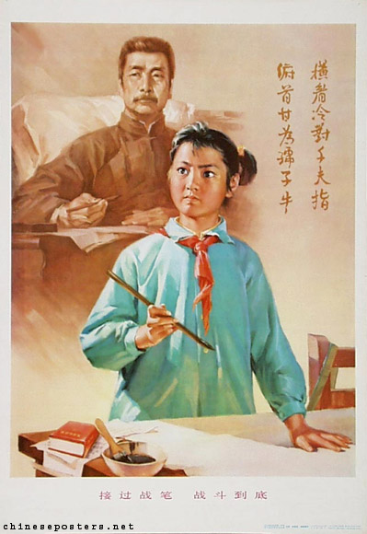
S[s]ocialism in Chinese Nationalism
Vohra says that even neo-Confucian nationalists such as Liang Qichao or staunch nationalists such as Sun Yat-sen had some socialist strains in their ideas
Could nationalists in a feudal, semi colonial, society NOT be socialists, and what sort of nationalists would they be if they were not?
May 4th movement rejected tradition, demanded change. But because of imperialism had a very ambiguous relationship with Westernization. Early nationalists did seek to model Chinese nationalism on west. But colonialism, western deals with Japan, were a problem
Soviet Revolution in 1917 offer an alternative, a “modern” ideology, which was also anti-Imperialist, New SOVIET UNION e.g. gives up Tsarist claims on Chinese territory
Communists: ideology attractive as it was both “modern” yet critical of the system of domination that western-style capitalism had engendered in China
Base of CCP was very limited, to urban, coastal areas, among small industrial working class
May 4th movement and broader cultural movements associated with that had led to a proliferation of Marxist and Socialist “study groups” and societies in different Chinese cities. Of course, these were limited to intellectuals, but still provided a possible basis for future growth

Slide 13

Alternatives: State-Centric Nationalism
One alternative to Socialism was JAPANESE style state-centered nationalism.
SYS model had reached out to people, OVER the heads of the conservative scholar gentry and warlords, offer them a better life, and so, e.g., SYS three principles REINTERPRETED as NATIONALISM, DEMOCRACY and MOST SIGNIFICANT: PEOPLE’S LIVELIHOOD (that did draw on socialist ideology)
Death of SYS in 1925 and rise to power of Chiang Kai-shek (CKS)
CKS was a military commander, of GMD military academy at Whampoa. Unlike socialists and/or earlier generation of nationalists like SYS, CKS had few ideological commitments
CKS return to a state-centric nationalist model. Top priority to strengthen the state, and to do that, was willing to make many compromises. Deals made with wardlords. Also with Comintern (the Soviet organization charged with “exporting revolution”, see 126-128). These allows him resources to fight warlords, Northern Expedition in 1926
Comintern also brokers the first United Front between CCP and GMD 1924-27

Slide 14
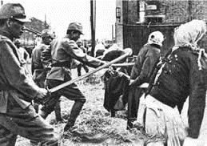
Strains and Conflicts
GMD nationalist leadership OK with socialism, even Comintern support, but not with Socialism(i.e. CCP). Socialist ideology OK, but not socialist practice because many were themselves landlords
UNLIKE GANDHI, Mao does not seek to suppress conflicts for some fictional national unity! Early on, radical peasant associations (see p. 129) take initiatives, no rent, attack landlords, even kill parents of a prominent CCP member!
Success against Warlords made contradictions in GMD-CCP alliance apparent. Who was going to exercise power? CKS quite certain it was not going to be the communists
In 1927 a workers’ strike made the conquest of Shanghai possible, but CKS responds by making a deal with Shanghai merchants leading to massacre of working class of Shanghai in 1927
Quickly followed by declaration of a national government at Nanjing by CKS, and the outlawing of the CCP
NATIONALISM, of the CKS variety, begins to have a serious problem with SOCIALISM of the CCP variety. One is seeking state power, other is seeking social and economic transformation

Slide 15
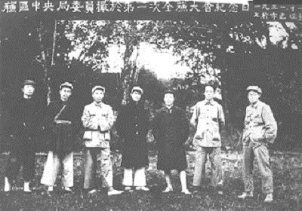
CCP: Learning from a Retreat, Jiangxi
Outlawing of CCP in 1927 leads to retreats and the establishing of many “soviets” (liberated areas, where CCP establish control)
We have a great deal of information about one of these in JIANGXI because of the presence of MAO ZEDONG, later a leading figure, but till now a high level but not a top leader of CCP
See details about Jiangxi Soviet in Textbook, but the most significant of these was the new-found focus on peasants.... and on redistribution of land
This is a very significant move. Marx envisaged the industrial working class as leading a socialist revolution. Saw peasants as inherently conservative “sack of potatoes”
China was 85% peasants, who lived in terrible conditions, often starvation levels. Hugely oppressed by landlords
In retreat at Jiangxi Mao realizes the revolutionary potential of the peasantry. Living with peasants provides CCP activists like Mao with practical experience of government: pragmatic rather than programmatic, e.g. on land redistribution, on keeping up agrarian production.
Mao and other like him in the countryside, learn the techniques of production, the importance of agrarian cycles, etc. So when talk about peasant revolution, know from within, not just some city based intellectuals!!
Time in rural areas also allows for reflection on other social practices including gender. Realize that women face an additional source of oppression, male power. Sought to remedy that, or at least include in program

Slide 16
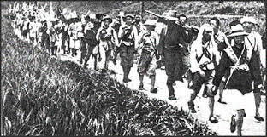
Socialism and Nationalism: Long March
In 1934 Comintern insist on direct confrontation with GMD. Lead to rout and one of the most amazing and productive retreats in recent human history, the LONG MARCH.
For about three to four months 100,000 Communists fled across china, decimated by attacks , less than tenth of them managed to survive the 4000 mile journey. (see map p 79) But built tremendous unity, and at the end of it survivors had a nucleus that was united, led by Mao, and ultimately it would be them who would win out
This is also the period when Japan advancing further into China, and even while fleeing from GMD, the CCP made the call for another UF to fight their common enemy, Japan

Slide 17
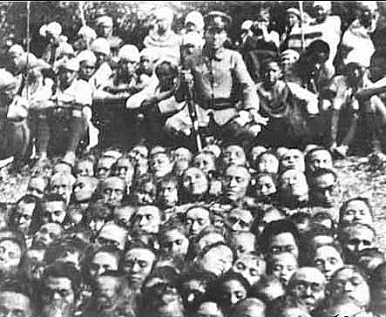
Japanese Imperialism
Japanese expansion begin in the 1930s with annexation of Manchuria, 1931. Officially detached from China to form the Japanese puppet state of MANCHUKUO, and by mid-1930s Japanese occupy much of eastern Chinese seaboard, some of the most industrialized and productive areas of the country
Japan more confident because of appeasement by western powers
Why? Because West more concerned with other developments, Soviet Union, Nazis e.g. Moreover, it suited own interests to do so. United States was Japan’s largest trading partner
So, it was apparent that it was the Chinese themselves who would have to combat Japan’s incursions
As time went on these became more and more brutal because hopes of easy victories belied. 200, 000 people massacred in Nanjing when the Japanese enter the city
Though install a puppet regime in Beijing, the GMD move Nationalist capital from Nanjing to CHONGQUING. so Japanese not able to defeat the Nationalist Govt. Japanese lack the resources to physically conquer all of China.
Japanese attitudes generate both popular resentment, and support for those who opposed them. Ordinary people move with the Nationalist government to Chongquing. Students and professors carried entire libraries across 1500 miles during the move, with enthusiasm, in 1937, such was the level of popular support for the GMD (Nationalists)

Slide 18
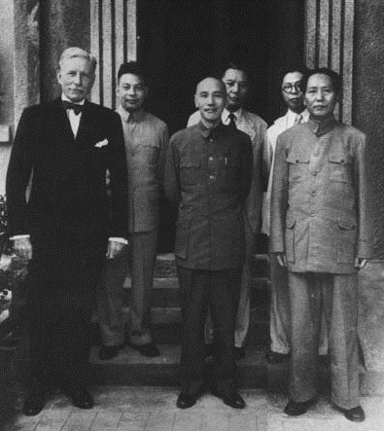
NATIONALIST PROBLEMS
Since the defeat of warlords around 1926, GMD in control of China, the internationally recognized government of China. CCP has liberated areas and bases, but if there is one government, it is the one run by GMD
Japanese invasion creates not only political or military problems, but economic ones too. Isolates government port cities, the richest manufacturing areas. There is a shortage of raw material and finished product in Nationalist China
leads to inflation. An inept administration prints more money : worsens inflation. Also nepotism and corruption.
Increase taxes on the peasantry is their only source of revenue. Peasant conditions worsen under inflationary situation
When things go bad, CKS faces criticism from intellectuals. His response is repression: gags press, suppress criticism ruthlessly. This turns intellectual against him. Those who had carried books on their back now turn their back on CKS and GMD
CKS seek return to CONFUCIANISM through his book China’s Destiny, but times had changed too much for that. Not supported by intelligentsia who had criticized tradition whole heartedly from May 4th time onwards.
Perhaps greatest cause for nationalist failure was that CKS could not even keep military in shape, supposedly his forte, and when that too start collapsing the problem became serious. Report of American generals showed levels of corruption and inefficiency
Although Nationalists were initially short of weaponry compared to Japanese, not so after US enters WW II. Weapons and supplies flown in from Burma, but CKS, now show that he was not really interested in fighting Japanese, and prefers to stockpile those weapons for what he knew would be fight vs. the CCP
CKS initially turns down CCP call for another UF to fight Japan. It was not until one of his own generals put CKS under house arrest and made his agreeing to UF a condition of release that he agreed to the SECOND UF

Slide 19
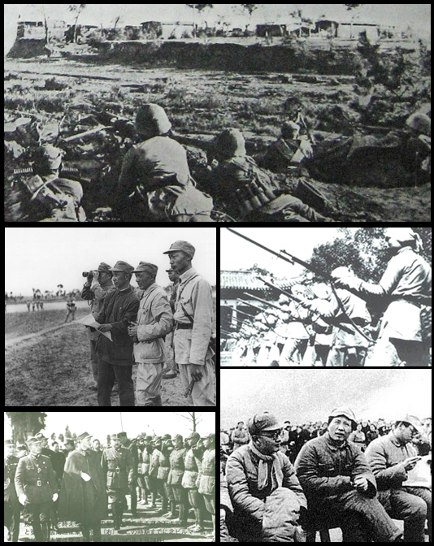
Second UF and Civil War
This UF quite different from 1st UF (1924-27) Then, GMD clearly the leading party but by 1937 CCP steadily expanding operations from bases in their stronghold in YANAN. Use guerrilla warfare tactics, making bases BEHIND Japanese-held territory, converting the countryside into LIBERATED AREAS
CCP under MAO’s leadership now evolving the military strategy that also later won them civil war: ENCIRCLEMENT of towns. Traditional military technique was to take towns, main centers. Mao focuses on countryside, till encircle towns.
In areas they control. CCP offers efficient administration. Not ideologically extreme, learn from JIANGXI period, gradual changes. Soldiers are disciplined, work WITH and Learn FROM the peasantry. Not just rhetoric or some sort of ideological smokescreen for Mao to suppress rivals, it was now central to his revolutionary ideology too, and this was to have an impact on the CCP’s success both against Japan and later against GMD
Militarily not positional war, but guerrilla, work, harass Japanese forces, stretch their lines of communication and supply
WII end suddenly, western powers want a negotiated settlement between the GMD and CCP, but there was too much at stake. CKS had been preparing for this, and wanted to wipe out CCP, so civil war
CKS 3-1 army advantage, better weapons but CCP strategy work better
ENCRICLEMENT, and then cut communication, towns become besieged and fell “like ripe apples”
This was only possible because CCP had greater support in countryside, and even among among urban intellectuals who felt disillusioned by CKS and GMD

Slide 20
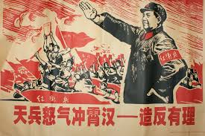
Assessments and Comparison
CCP victory WAS at one level a military victory and reasons were simple
  GMD not good enough, corrupt, ineffectual, factional, brutal
  no support from peasants, business, or intellectuals
  not even militarily that good, outmaneuvered by Mao
CCP in contrast has an efficient, loyal cadre
Undertook GRADUAL land reform, so support in countryside, perceived as just and fair
Most important, CCP seen as patriotic, as “better” nationalists (lower case) than the party that called itself Nationalist!
More than a military victory, this was the victory of a different sort of nationalism from both the Indian and Japanese cases, a revolutionary nationalism from below.
Mao strategy combined class struggle with nationalist goals, in fact belief that only revolution lead to successful nationalism: that is, only when the poor and dispossessed were given their rights, were given the opportunity to be as good as the rich, when everybody played on a level playing field, could there be a successful revolutionary nationalism

