Slide 1
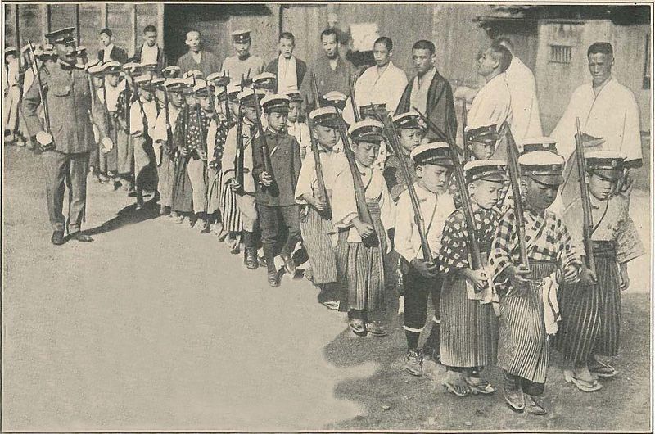
Consequences of Nationalism 2
The Case of Japanese Nationalism in the Meiji and Taisho Eras: A Success Story?

Slide 2
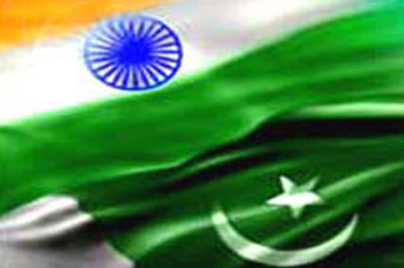
Comparisons
INDIA Consequences: Partition and the holocaust it entailed
Elite nationalism (INC ML) helps to produce a particular result in in India,
One which politically includes partition, and economically a status quo with the privileged maintaining their privileges and no significant change in social relations, or hierarchies
Is Japan really different, the success story of Nationalism in Asia?

Slide 3

China (looking ahead)
In China we WILL (next week), see that the NATIONALIST PARTY or GMD, not able to successfully represent interests of people of CHINA either.
CCP emerges as better equipped to do so. Nationalism in CHINA thus GIVES WAY to a more fundamental, revolutionary, change in the lives of people, in the political system, in dominant ideologies, in social and economic relations.
This does work to benefit many of them. Certainly as we compare basic standards of living, indices of development human and economic, China far ahead of India, though not Japan.

Slide 4
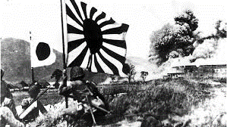
Japan Bucks the Trend?
Meiji Revolution was a NATIONALIST revolution
Meiji leaders used NATIONALIST ideologies to make Japan the greatest success story of colonial Asia
In fact, JAPAN became a model for OTHER nationalists, including those in India, in China, in what is today Indonesia, even in Egypt and Turkey, who admired what Japan had achieved and wanted to emulate its success
One could argue that galvanized by nationalism, Japan able to emerge as a major economic power, factories, supply its armies and navies. Nationalism motivated Japan’s victories first over its one-time overlord, China, and then over Russia
But need to examine in more detail

Slide 5
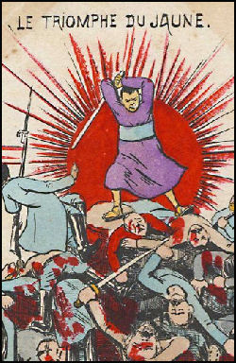
CONTEXT
Background: HUGE changes during the Meiji era. Constitution, social changes, economic transformations to a modern industrial economy, political changes etc. Military victories.
Start of 20thC things seem to be going well, but... some important changes occur
Taisho emperor, 1912-26
WW I
Interwar problems, especially economic but also a growing POLITICAL problem
How the solution to economic and political problems is found through nationalism and imperialism (interconnected)

Slide 6
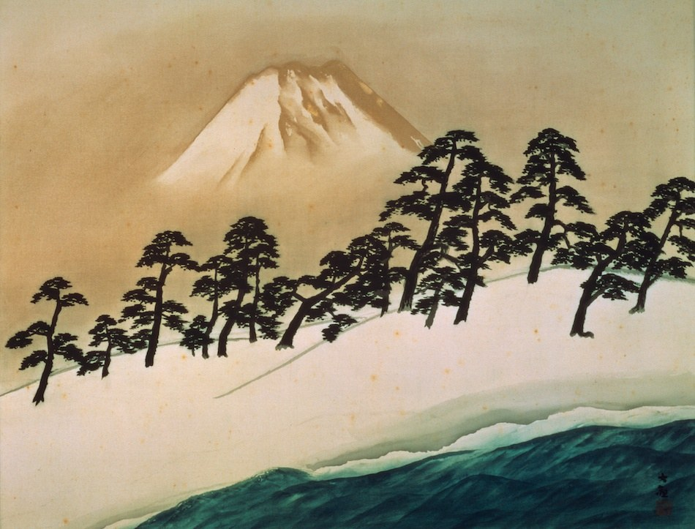
Japanese Nationalism
I want us to focus on THREE interrelated aspects of nationalism in Japan
Contradictions in the nature of Japanese nationalism (Form and Structure)
WHOM did nationalist ideas benefit? (to some extent both are continuation of earlier themes)
WHAT is the relationship between nationalism and imperialism in late 19th and early 20C Japan?

Slide 7
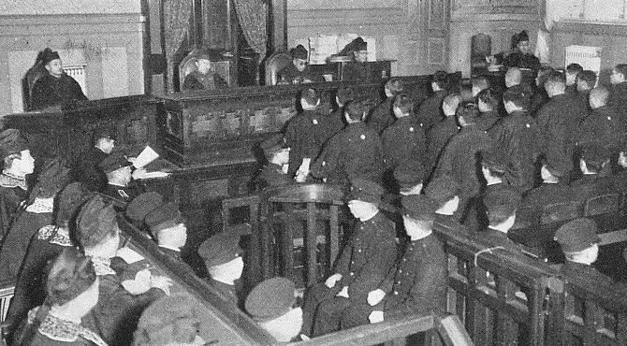
Japanese Nationalism Overview
Two quick points to recap:
  NATIONALISM not NATURAL, but created, a PROJECT
  Japanese nationalism, like most others, based upon INVENTED TRADITIONS (think bumper sticker nationalism or ideas about “American character” “British resilience” “Indian spirituality”. All are INVENTED traditions)
Nationalism from above, but peoples’ “buy in” essential, see Taisuke (p. 116)
Nationalism often contradictory (think of both Westernization AND essential Japanese-ness)
WHY are there some Japanese who DON’T buy into nationalism?
And, why do those who do, do buy-in?

Slide 8
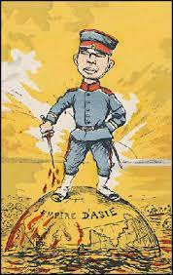
Domestic Roots of Nationalism
Nationalism as a way to diffuse the inevitable tensions as part of industrialization
  Inventing “beautiful traditions of social harmony”
Nationalism justifies outright repression of dissent
  Censorship, banning of public protests etc
Nationalism helps call for sacrifices that will make Japan Great (again?)

Slide 9
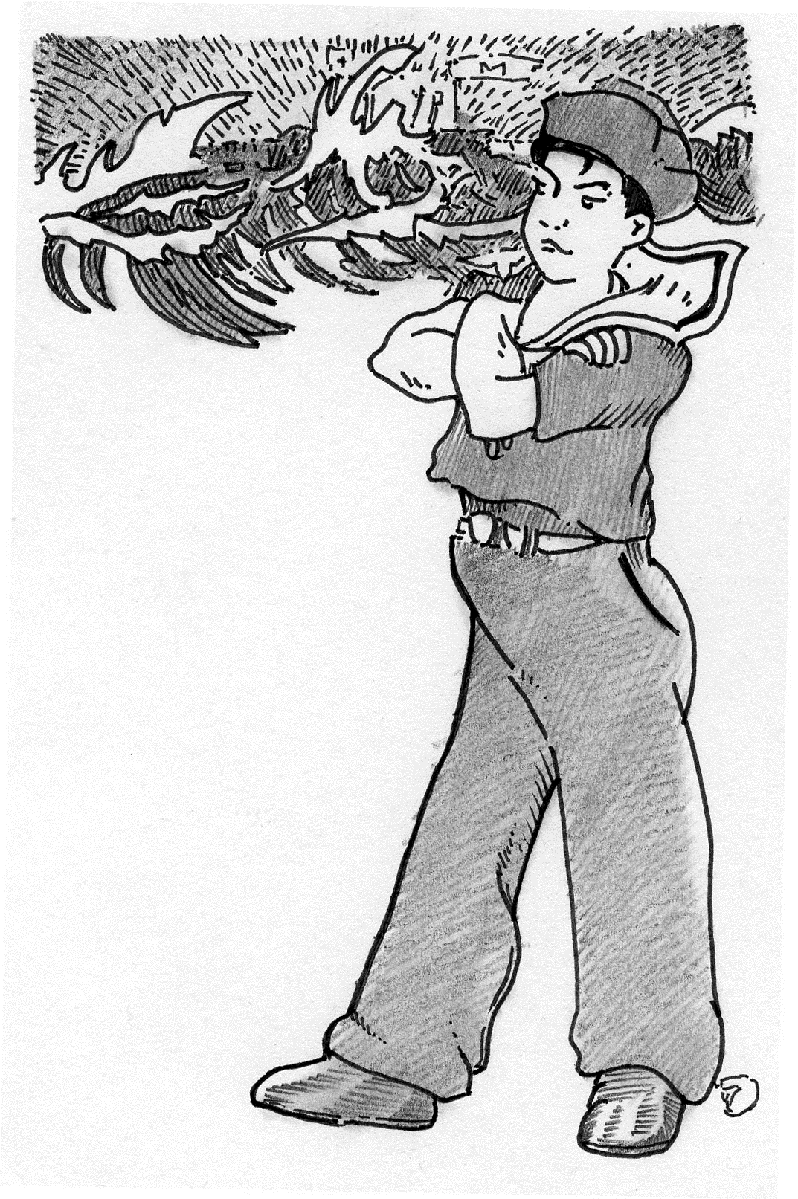
Contradictions in Nature of Japanese Nationalism
FORM and STRUCTURE: For buy-in there must be equality in FORM, that is in APPEARANCE
So, Samurai legal privileges (worth nothing in the new era) are abolished giving APPEARANCE of equality “we are all in this together”
Great example of this = CONSTITUTIONAL reforms ( 118-21) FORMAL equality
But OLIGARCHICAL STRUCTURE ensures power transferred from a single clan to an OLIGARCHY of former samurai
But BECAUSE there is appearance of equality, ordinary Japanese ask questions: e.g. p. 126, a young writer asks “What IS today’s Japan” Why is he asking that?
  Apparent contradictions in the form nationalism was sold to people: Hyper Westernization
  Competition not only with western but also neighboring powers... for resources (leads to two major wars, China and Russia, by 1905)

Slide 10
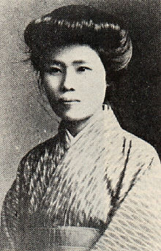
Opponents and Supporters
Plenty of examples where Japanese people DON”T buy nationalist rhetoric: Labor, also peasantry, e.g. During Rice Riots of 1918 (167) Also anarchists or feminist-socialists (see pp. 169-71)
In the late 1920s and 1930s, during worldwide economic depression, strains are most evident and then Nationalism becomes a way of CONTROLLING popular discontent Outlawing of strikes or unions (p 147)
  Even sections of the elite don’t always buy nationalist rhetoric. Revered Samurai, SAIGO TAKAMORI had led a samurai rebellion from Satsuma in 1877
But, traditions invented, not fabricated and there was considerable buy-in from ordinary folks
  Anti Communist and anti Korean riots, e.g. (169-70)
  Parallels how in the 1890s critics of the Meiji constitution were hounded by public
So why do people follow? Not because they are stupid, but because they do feel EMPOWERED by Nationalism
  Feeling part of larger whole .. Being INCLUDED, being TOLD that THEY are the reason, the nation, the beneficiaries of all of this is ESPECIALLY empowering for groups who have traditionally been DISEMPOWERED. Poor, or other marginalized
  E.g., It gives Japanese middle class women middle class and feeling of empowerment to ally with state.
  Nationalism FEELS very empowering....whether it is Gandhi, Nehru, Jinnah, CKS, or Meiji and Taisho leaders saying this

Slide 11
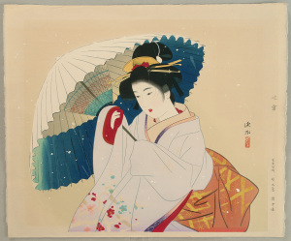
Cui Bono? (not ‘Who is the pop star’!)
Japanese Nationalism was in APPEARANCE all about beautiful traditions, harmony between social groups, obedience, loyalty, etc.
But who benefits (cui bono)? Japanese ELITE
THEY invest in industry, reap the benefits of JAPAN’s military and economic strength
Nature of elites may change, but Japans nationalism not from BELOW
It is a nationalism which helps to contain the natural popular resentments at the traumas of a society undergoing transformation under a militarized capitalist economy

Slide 12
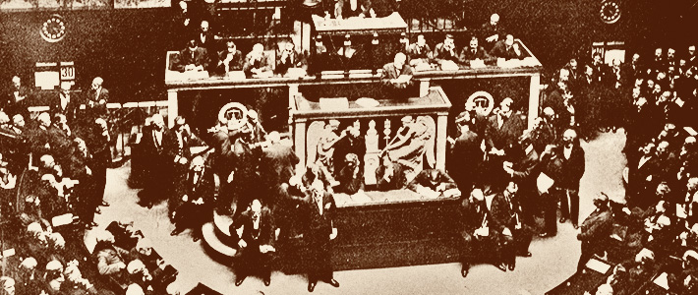
Nationalism and Democracy in Japan
Nationalism becomes basis of DENYING popular participation in politics. (See chapter 10 for details)
  constitution not out of public clamor, but GIVEN by leaders ( see pp. 122-23)
“Transcendent Cabinet” Politics not controlled by masses, but by elites. This is very evident in the Taisho period. (pp. 162-66)
The emergence of POLITICAL PARTIES an interesting development. Challenge oligarchy, but soon also come to be controlled by elites (see 162, also 175-78) and then work to MEDIATE between powerful interest groups: BUSINESS (Zaibatsu), an increasingly autonomous ARMY and BUREAUCRACY (genro [imperial advisors] and others technocrats)
THIS sort of nationalism even more important as DEMOCRACY grows. Although based on an elitist constitution, but difficult to control spread of POLITICIZATION
There are more demands, from labor, socialists, feminists, etc. in the era after WWI
Response is to say they were paying cost FOR the nation, for JAPAN, so that JAPAN could become stronger, so that FUTURE generations of Japanese could benefit
Hence in such contexts NATIONALISM becomes even more important.
It helps maintain STATE power, maintain elites in power. See p. 126 for oligarchs’ view of nationalism: about ORDER, to facilitate an orderly progress

Slide 13
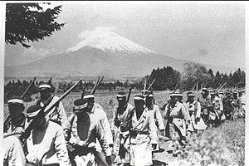
Cui Plagalis: Who Pays? Were they asked?
Do the increasing numbers of landless benefit? Now factory labor, do the women who were tied to machines to produce for the nation benefit?
If nationalism is about the people, then, first, need to ask these people if they were WILLING to pay the cost. Ask their families. Did they do it willingly?
In fact, instead of future generations of the peasants or factory workers benefiting, they were more likely to be recruited into army as cannon fodder for military expansion also integral to Japanese nationalism. Instead of prosperity, saw tremendous sacrifices, higher taxes (145-46), difficult times
See pg 141 for figures, a million men to the war front
100,000 die in Russo Jap war
Though plenty of social discontent, unrest, see poem 143-45... NATIONALISM used to contain this discontent… Enemies at the gate, Japan under siege, etc.

Slide 14
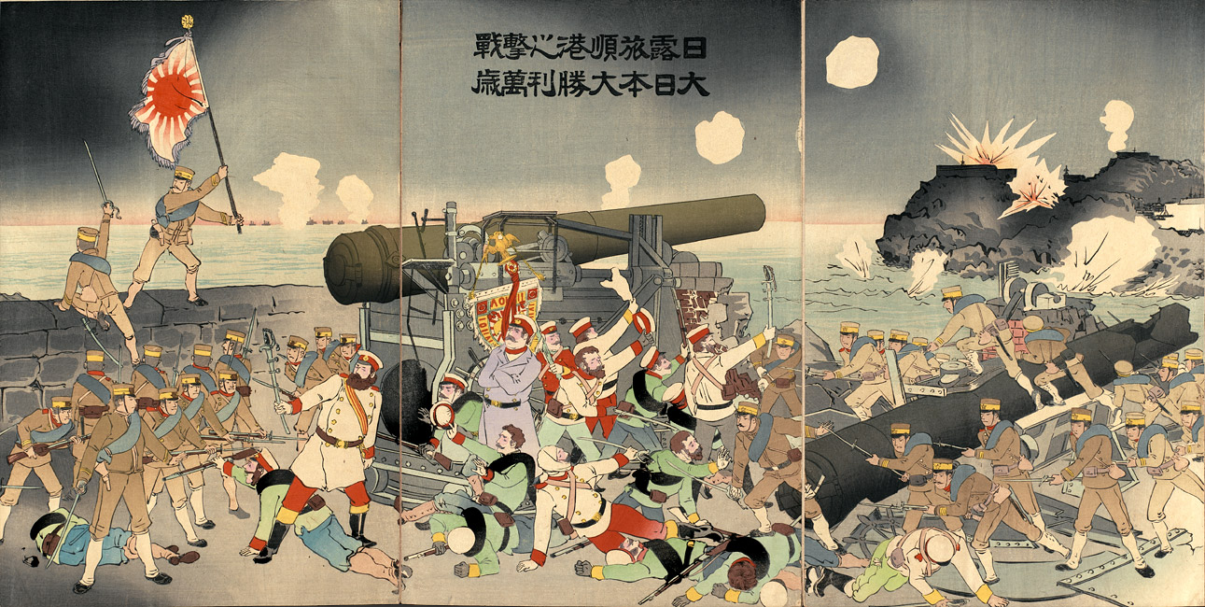
‘Catch Up’ and Japanese Imperialism
Inevitable? Fukuzawa statement 1882: one day Japan would rule over China & India (p. 134) But such grandiose statements usual among bombastic nationalists across the world
Desire itto-koku recognition as “first class country”
Economic catch-up vision, seeking parity with west, and own development, inescapably tied to an agenda that would lead to imperialism.
Early policy on China and western powers culminated in Sino Japanese war of 1895.
First intervention in Korea premised on Korean backwardness in need of help, if Japan not intervene, westerners would, and create instability. Led control over Pt. Arthur and Liaotung peninsula, and then on to southern Manchuria. (see p 137)
But then TRIPLE INTERVENTION negates gains of 1895 war, led to MUCH RESENTMENT

Slide 15
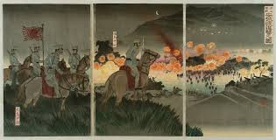
Japan Expanding Imperialism
Imperialism was BOTH strategic and ideological
  Perception of threat > desire control Korea or Liaotung
  But also, the desire to be recognized as one of the “great powers”
Imperialism in turn fuels nationalism.... success in China first, then triple intervention loss fuel nationalism, leads to RUSSO-JAPANESE war in 1905, further fuels nationalist rhetoric around mobilizing for war, demand for sacrifices, etc.
But 1905 does establish status, annexation of Korea 1910 not really contested
Later, WWI leads to seizure of German assets and more

Slide 16
Nationalism and Japanese Imperialism
QUESTION: To what extent do nationalist sentiments contribute to Japan becoming an imperialist power in its own right in the late 19th and early 20th C?
SUMMARY answer is as follows:
  INTERNAL elitism and desire to RETAIN power against popular unrest
and
  EXTERNAL expansion to increase “Japan” strength
are both connected, and both are fueled BY and in turn FUEL nationalism
Chapter 11 shows how political parties LOSE OUT, and MILITARISTS get power in Japan in 30s, fueling another round of imperialist adventures... also related to NATIOANLISM.
Parties, it is now argued do not follow a NATIONALIST ethos, hence nationalism JUSTIFIED their marginalization as military with focus on emperor loyalty become the “real” nationalists

Slide 17
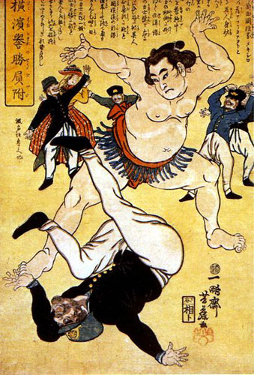
Capitalism, Racism, Imperialism 1
Like any other capitalist economy, Japanese capitalism needed both resources and markets. This need drove Britain, France to seek seek resources abroad. USA larger internal resources, but ultimately also joins this race. Japan’s claim was that all it was doing was what others had long done. Its only fault was that it was late, and it was not white!
Not to justify, but simply to put in comparative perspective
Trouble was that the early imperialists not give up advantages of early imperialism easily, unless faced with big stick (US had to wave it a few times before allowed to join the club)
ALSO, racism was significant. US Congress exclusion acts reinforced the rhetoric of Japanese nationalists that they were merely striving for equality in an unequal world

Slide 18
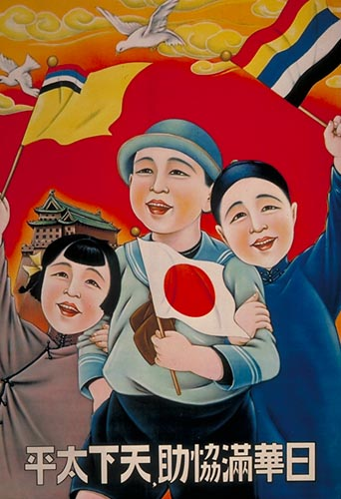
Racism, Capitalism Imperialism 2
Although imperialism continues to be an integral part of Japanese nationalist policy, the real crisis emerges in the interwar period and more so in the period following the great depression
One reason why Japanese ambitions contained was a good economic relationship with the US. (see 185) US largest supplier of capital, buyer of 40% of products in the 1920s
Great Depression hurt ALL, turn to protectionism (186) US, Britain, and China nationalists demand tariffs. And, this is when Japanese nationalists demand they “go it alone” because international agreements only a mask for Anglo American self interest.
Once economic situation worsens exports fall 50%, commodity prices fall, unemployment rise (p 188) then the moderates within government come under attack. Ultimately ULTRANATIONALISTS take over, and lead Japan into catastrophic war in China that leads into WW II

Slide 19
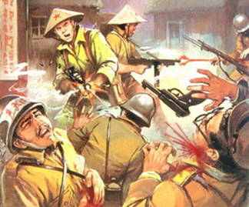
UltraNationalists
Context Economic downturn, 50% fall in exports etc., growing critique from leftists in particular. To thwart this government again unleashes the powerful weapon of nationalism: loyalty to emperor, to Japan. Attacks leftists as anti nationalists. But this time the beast goes out of control
Nationalism had worked to keep elites in power, now it empowers a group OUTSIDE of the genro, the elders, the oligarchs, outside of the parties
These are agrarian, lower middle class, and these ultranationalists take over. Assassinations. Parties cannot control them, and this ultranationalist leadership takes Japan toward increasing authoritarian rule within, marginalization of political parties, and to increasing warlike position abroad and alliances with European fascists
Nationalism of this sort had little respect for others. So leads to atrocities such as those committed in Nanjing in the 1930s and throughout most of SE Asia afterward

Slide 20
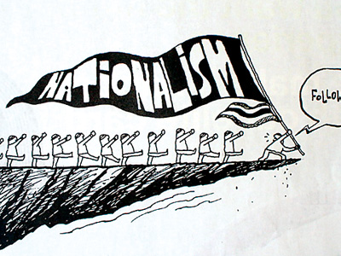
Assessing Japanese Nationalism
How do we assess Japanese nationalism then?
A success story? If so for whom? “The Japanese”? Which of them?
The cure for Japanese backwardness or the curse of the modern age? Your take?
We will look at the question from another POV next class, looking at the struggle between nationalism and socialism in China.

