Slide 1
Culture, Religion and Regional Identities

Slide 2
Overview
We will discuss how new developments in religion and culture, in particular VEDANTA, and BHAKTI, were products of (and in one case, contributed to) the new regionalism that emerged in the 500-1000 CE era
Ask a reasonably well-educated Hindu to outline the main features of HINDUISM, very likely to mention a set of ideas closely related to VEDANTA
Instead of *asking* the well- educated Hindu, if you were to OBSERVE the sort of rituals and practices of most Hindus while worshipping, what you would be seeing are ideas and forms of devotion that emerge in fullest form with the BHAKTI SAINTS in this period
Regionalism closely related to the growth of BHAKTI devotion: Advocates of Bhakti not only used local languages, but also used ideas that identified Gods with certain territories
This happens in a context when REGIONAL KINGDOMS already important: so, what we had at this time was the emergence of distinct regional identities expressed in religious terms too, using regional literatures and languages!

Slide 3
Context
Bhakti and Vedanta are best understood as alternative paths to salvation
Prevailing orthodoxy (of this era) was based on the Dharmashastras (such as the Manu Smriti [aka Laws of Manu]) that insisted that followed rules of appropriate conduct (VARNA ASHRAM DHARMA) was the path to salvation
Vedas had outlined RITUAL as the way to reach the Gods
Vedanta and Bhakti offer alternative models. For Vedanta, the path to salvation lies in KNOWLEDGE while for Bhakti it lies through personal DEVOTION

Slide 4
VEDANTA
"VEDANTA" was a school of philosophy propagated by a Brahmin, SHANKARA
Vedanta drew upon ideas of the Upanishads, and was systematized along with Yoga and four other major philosophical "schools" during the Gupta era
SHANKARA (788-820 CE) was one of the most important advocates of ADVAITA (non-dualistic) Vedanta
Did not particularly care for BUDDHIST interpretations, or for that matter with the sort of “laisser faire” religion that came about after the PURANAS
He travelled across the length and breadth of India, propagating this philosophy and held public disputations with the leading Hindu and Buddhist philosophers
Shankara’s was an attempt to move BEYOND the regional identities emerging in his time, to outline a PAN-INDIC ideology
Possibly to this end, Shankara set up institutions for propagating Vedantic Hinduism in four major centers in the N, S W and E India
At a time when Buddhism was gaining ground at the expense of Hindu practices, Shankara is credited with reviving a "true" monistic "Hinduism." Shankara, and his Advaita Vedanta, created the first “Hindu revival"

Slide 5
Shankara’s Centers

Slide 6
Advaita Vedanta
Shankara reasserts the importance of Upanishadic teachings. Salvation only through knowledge, Gyana!
The path to salvation lay not in actions (karma), or following the code of conduct outlined for instance by MANU, nor was it in achieved through RITUALS as prescribed in the VEDAS,
Drawing from the Upanishads, saw the world as we know it an illusion, MAYA. Maya, or illusion can only be conquered through KNOWLEDGE, (JNANA/GYANA) which alone can lead us to the ultimate reality -- BRAHMAN (*not Brahmin the VARNA or, to avoid this confusion) also called the PARAM ATMAN, the SUPREME SOUL
This supreme soul is the only reality, and actually exists in each and every one (“each is part of the eternal and the eternal is part of all”)
When a person achieves one-ness with the supreme soul then free of SAMSARA, or cycle of births and rebirths, and hence, achieves MOKSHA, freedom from that cycle
Similar to ideas of Buddhism, because Buddha too drew from the Upanishads
Shankara, though, contributes to decline of Buddhism because use a similar explanation, but able to tie into the ideas of popular religion too, by allowing for a “lower truth” which was still not completely free of Maya, but within which people could still live while striving for a higher truth

Slide 7
Bhakti
Even as Shankara was debating elites across India, some saints and teachers in peninsular India had different ideas
These early thinkers and teachers conceived of their relationship with God in intensely personal terms, and insisted that neither KARMA (that is CONDUCT, e.g. Code of Manu) nor abstract knowledge (GYANA of Shankara e.g.) was enough to reach god
God could only be reached through intense, personal devotion -- through BHAKTI
BHAKTI or devotional worship we examine today was only the pre-history of very important Bhakti movements in the 15th and 16th Centuries, that we will (perhaps) return to later in the course

Slide 8
Context for Bhakti
Not entirely novel (But then neither was Shankara, he drew on the Upanishads!)
Eg. the BHAGWAT GITA (a later interpolation into the Mahabharata) says that devotion or BHAKTI is a way of acquiring release from the cycles of rebirth
But one DIFFERENCE in THIS form of Bhakti was its utter INDIFFERENCE to Varna (unlike the Bhagwat Gita, which argues that it is KARMA, following of one’s varna-based duties which ensures a better after life, and eventually release, MOKSHA)
In fact, most of the Bhakti SAINTS were not Brahmins (often lower caste and sometimes, women), and their stories tell of how Brahmins first rejected their ideas, and were forced to accept them because of divine intervention

Slide 9
Bhakti Reaches Commoners
Shankara engaged in intellectual debates with other religious leaders, elites, and used SANSKRIT
Sanskrit by this time only the language of elites, as local languages and literatures develop in the era of regional identities
Bhakti saints and teachers spoke, preached, and occasionally wrote, in LOCAL languages, used local idiom
Not only took PURANIC gods (Vishnu and Shiva) as focus of devotion, but personalized them

Slide 10
Localized Devotion
Thus “bhakti” or devotion offered to the local god, some times it may have been rock, a snake, a pond, or a female deity, were LINKED to the larger pantheon of Hindu gods at this time
This is what happened eg in CHIDAMBARAM, now famous for its image of the DANCING SHIVA, NATARAJA

Slide 11
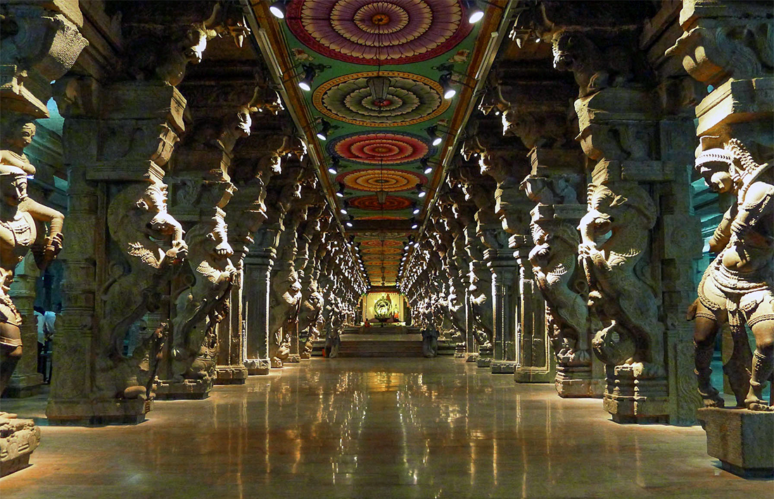
Incorporation of Female Deities
In other cases, local female deities made CONSORTS of a male Hindu god
E.g., MINAKSHI, goddess of the PANDYAS at MADURAI, was symbolically MARRIED to SHIVA at this time, and identified as an image of PARVATI (Shiva’s wife in the Puranas)

Slide 12
Women and Bhakti
The popularity of Bhakti was not only on account of its indifference to caste or the use of local languages
Bhakti also appealed to women, and it was women’s participation that gave the Bhakti movements their mass character
Over the centuries a series of women Bhakti saints and teachers also emerged
Religion one of the few spaces available to women to participate in public life express their (often oblique or indirect) critique of the patriarchal world around them
Songs of women Bhakti saints, poets and teachers reflect their critique of patriarchal families, the drudgery of housework, and the belief that their devotion to their personal god helps them transcend the barriers that limit their lives
Many women Bhakti saints rejected married lives to devote themselves to their god as their lover!

Slide 13
Temples and Pilgrimages
Bhakti devotionalism encouraged PILGRIMAGES
Merely seeing, called DARSHAN of images of gods, was also a form of BHAKTI, or devotion, so people start travelling distances to temples, to see, to get blessings
Each temple began producing own MAHATMYAS. Just as Puranas had linked SOME pre-Vedic to Vedic gods, mahatmayas linked individual TEMPLES to the Puranas. This meant a lot of travel, economic transactions, and also some sort of cultural unity within regions

Slide 14
Bhakti and Regional Identities
Worship or devotion towards gods in specific INDIVIDUAL forms, e.g., Krishna or Shiva, were also located in SPECIFIC places, which became very important. E.g., legends around Krishna made VRINDAVAN in north India an important place
Translation of PURANAS into local languages, and MAHATMAYAS of the temples were often written in local languages, of course
As a result, local languages flourish... by 1000-1300 already about 5-6 languages in the north, and about 3 in the south at least... Sanskrit WAS a unifier, but mainly for an elite, particularly Brahmins
These temples were built and patronized by Mahasamantas and their Samantas
The same regional rulers also patronize local scholars who often worked and wrote in local languages. Bards composed songs in praise. Brahmins too wanted to and did learn local languages to communicate
Thus, politics and religion combine to make important contributions to Indian culture: a diversity of languages and regional cultures seldom seen in other parts of the world, where today 22 different languages, written in 12 to 14 different SCRIPTS, and 1000s of dialects all coexist
HISTORY, both political and religious explain this diversity!

