Slide 1
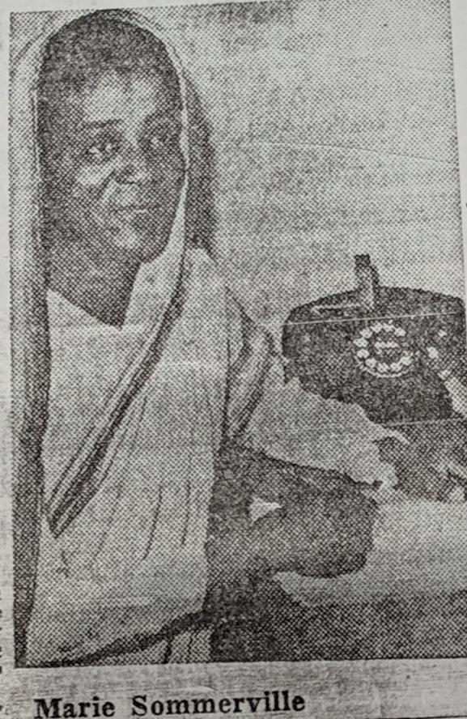
The Enduring Outsider: Dress and Belonging in the Life of Mari Sommerville
Sanjay Joshi, Northern Arizona University
AAAS April 8, 2023

Slide 2
Dr. Marie Muriel Sommerville:Her Life on a Page
Born November 1903 in Calcutta to Letitia Gomez (Foreman?), an Indian Christian woman
Father, John Sommerville (Summerville?), a sailor from British colony of Barbados, married Letitia in January 1903
Marie grew up poor, but took to school
Trained as a teacher at Isabella Thoburn (IT) College in Lucknow
Taught at various schools including ADAMS School for Girls in Almora, 1930-1942
Returned to IT College as teacher and later Dean, 1943-1966
Went to UNM, Albuquerque for her PhD in English Literature in 1949 completed degree in 1953, when she was 49
Taught at Keuka College, New York, 1959-61
Returned to IT College and then back to the US ca. 1967, (already in her 60s) to teach at Winthrop College, and later at Voorhees (an HBCU)
Retired to Pilgrims Place in Claremont CA in June 1972
Died November 23, 1988, at Pomona Valley Community Hospital in California

Slide 3
Paper Outline
My focus in this paper is on dress, and more specifically on Mari Sommerville’s (her preferred spelling) insistence on always wearing a sari (also spelt saree) when in the United States
A sari is the 6-9 yards of unstitched cloth draped across the body by women in the Indian subcontinent
Given her own history, including her sartorial history, I ask why she made that choice?
A possibility I explore in this paper is to read this as act of performing outsider-ness

Slide 4
Performing Outsider-ness
Mari Sommerville was the perpetual outsider
Her biracial history meant she never quite belonged to the various communities around her in British or independent India
In this paper, I suggest that once in the United States, Mari Sommerville chose to make a statement with her adoption of the sari as a marker of her Indian identity
The contexts of a still-segregated America undoubtedly shaped her strategies too
But I argue that her choices were deliberate, and should be read as her effort to demonstrate, to perform, her status as an outsider through dress

Slide 5
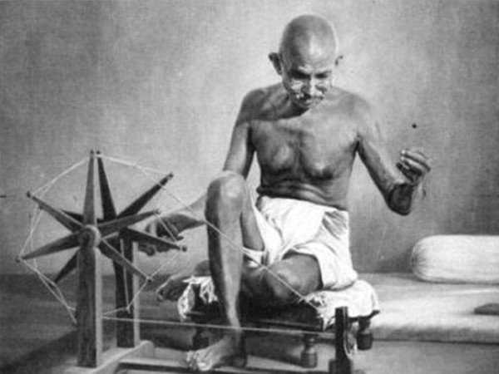

Digression: Politics of Dress and the Sari
Dress has always been political, often a choice used to make a particular point, e.g., Mahatma Gandhi, and homespun “half naked fakir”
Or think about the politics of the hijab in our own times
Once popular in Pakistan, under Zia ul Haq’s Islamization, the sari came to be considered a “Hindu” garment
But two current powerhouses of Bangladeshi politics, Sheikh Hasina and Khaleda Zia, both Muslim, routinely wear saris in public
In India, women from a variety of political positions and over time, Indira Gandhi, J. Jayalalita, Mamta Banerjee, among others, have power-dressed in saris
In the diaspora, Tanya Rawal’s #sareenotsorry made waves, as did Asian women’s efforts to fashion diaspora space in the UK, and Shailja Patel gave us a moving tribute to the saris she inherited from her mother in Migritude

Slide 6
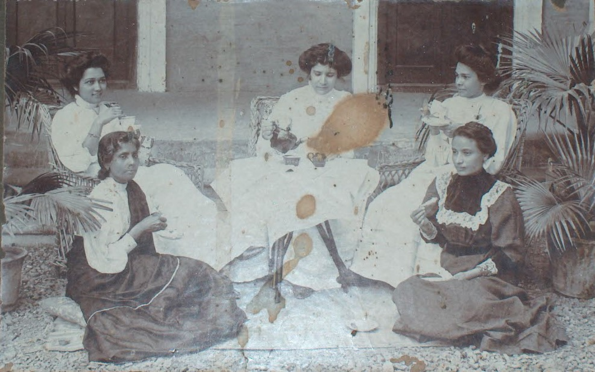
Dress and Mari Sommerville in India
I have no pictures of Mari Sommerville from India
Oral accounts (including from my mother, whom she taught in Almora) indicate she was often in western dress in India
Missionaries in Almora certainly looked down on Indian dress
It’s also entirely possible Mari took to wearing a sari after Indian independence, to indicate her “Indian-ness” at a time when Christianity was increasingly associated with the recently-departed colonizers
Missionaries and Converts in Western Dress, Almora, 1890

Slide 7
Mari in the US
In the US though, Mari always dressed in saris, which (as now?) were considered quite exotic, drawing comment from local media and those around her
Miss Sommerville has become a familiar figure around the UNM campus where she has been seen leisurely walking between buildings in the colorful, flowing saris
Albuquerque Journal, May 29, 1953
Her students from Keuka College (1959-61) recall her as only ever wearing saris, even in the deep snow of upstate New York!
Interview with former student, January 13, 2017
She helped organize “a display of the many exotic saris” she owned at the Spring Fashion Show of the Penn-Yan Keuka Club in 1961
Chronicle-Express, April 20, 1961

Slide 8
Marie in the US

Slide 9
Why the Sari?
Could be just her love for the elegant garment, but if so, this love appears to have come later, when she lived in the US
Racially, the US was deeply segregated by race in the 1950s and 1960s
Her former student had this to say when asked how she got close to Mari
Because Dr. Sommerville was Black but not American, I as Black and American felt responsible for making sure I could help her if she ran into any discrimination problems on campus or in town.
Interview with former student, January 13, 2017
Mari Sommerville therefore had good reasons to make sure she was identified as Indian, as exotic even, rather than add another layer to her already-marginalized life
Nor would she be the first to negotiate Blackness via exotica

Slide 10
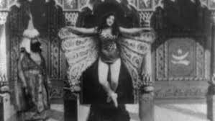

American Fascination with the “Exotic East”
Popularity of “Gurus” or interest in “wisdom of the east” goes back to at least the 19th Century.
Exoticism was marketable. Thomas Edison’s 1902 “Hindoo Fakir” (interestingly termed the “world’s first yoga film” by the Smithsonian!)
Radio drama Chandu the Magician 1930s
And the success of Korla Pandit in the 1950s
(more on that in a bit!)

Slide 11
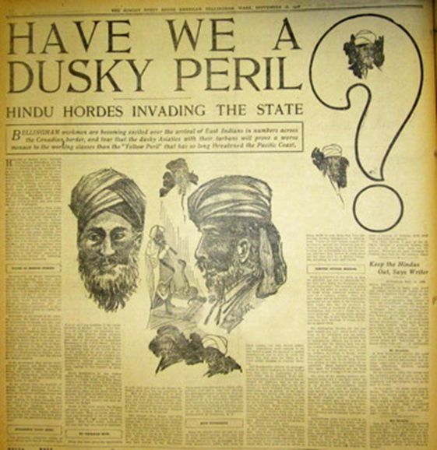
Fascination Coexisted with Antagonism
Migration of Sikh farmers to California early 20thC
Bellingham Anti Hindu Riots of 1907 in WA
In 1917, the US Congress passed an immigration act which restricted migrants from the "Asiatic Barred Zone“ included all of South Asia
1923 United States vs Bhagat Singh Thind denied “Hindus” the right to naturalize, saying, “It is a matter of familiar observation and knowledge that the physical group characteristics of the Hindus renders them readily distinguishable from the various groups of persons in this country commonly recognized as white”
Legislation in 1952 and 1965 reversed the most obvious racial quotas
Puget Sound American Sept 16, 1906

Slide 12
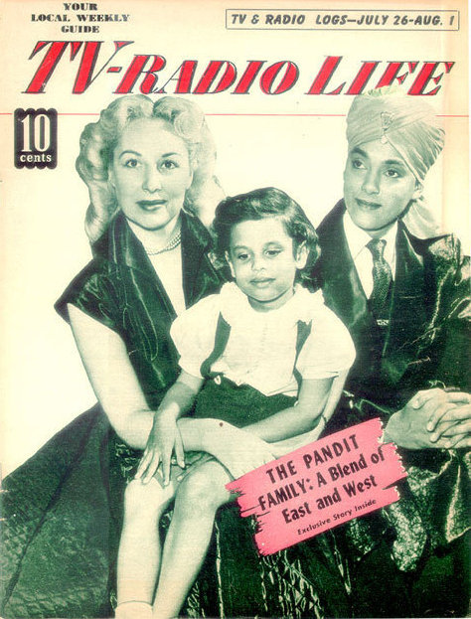
In Jim Crow America though, Exoticism did offer options
In 1950, John Roland Redd, son of an African American minister, reinvented himself as “Korla Pandit” claiming to have been born to an Indian father and a French ballerina in New Delhi
Pandit became an important TV musical star in that avatar
“Exotica,” Manan Desai argues allowed Pandit to cloak “Blackness through stereotypes of the Third World”

Slide 13
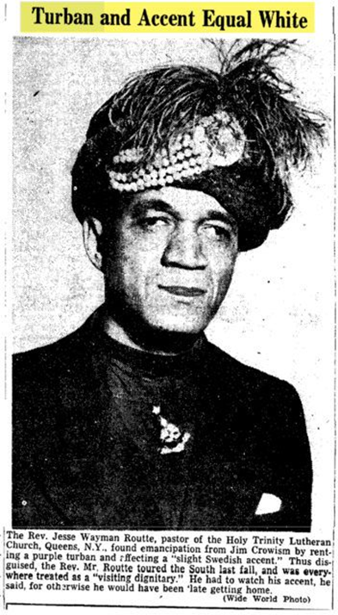
Rev. Jesse Wayman Routté and the Turban
This unsourced image may or may not be Routté
In November 1947, Rev. Routté discovered that wearing a turban could allow him to circumvent the color bar to “turn a threat into a guest” (Kramer, 209)
Rather than the simplistic caption though, Paul Kramer provides a more nuanced explanation, arguing that by wearing a turban, “Routté … projected and confounded blackness by rendering it illegible” (220)

Slide 14
Returning to Mari Sommerville
Did Mari Sommerville also take refuge in exotica to escape blackness?
It could well be, but that does not square with her approach to life
She fought her way out of poverty, and despite her biracial, underprivileged, heritage she made a successful academic career in India
She then made a choice to move to a second career in the United States at an age (65) when most consider retirement
And she did so with experience of living in the US, knowing what she would face
Her sartorial choices in the United States then, can not be extrapolated from those made by African-Americans such as Korla Pandit or Rev. Routte, who did not have the same options that Mari Sommerville did

Slide 15
Performing Outsider-ness
That is why I suggest that “performing” outsider-ness and marking that identity through her dress can be read as the product of a choice by Mari
It was a choice that might be the result of a life of outsider-ness
As an Indian she would not be accepted as one of the ruling elite in British India
Her biracial identity, marked by her hair and skin color, and her Christianity, separated her from her Indian counterparts even after independence
The decision to move to the US at a late age suggests she saw possibilities of reinventing herself in this context
Yet, clearly, there were limits to which she would be accepted into the mainstream, white, academic or religious community here
Hence, I suggest, her wearing a sari be read as a way of performing outsider-ness
As her way of saying I am neither black, nor American, but something else -- an enduring outsider!

