Slide 1
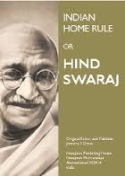
Gandhi and Hind Swaraj
Understanding and Critiquing this very important text

Slide 2
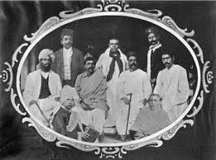
Context
Written 1908 while traveling between S. Africa and India
Written as a conversation, a common rhetorical device
Still based in South Africa, some important successes there, but very aware of what’s going on in India
1905 Partition of Bengal. Split between Moderates and Extremists. Growth of Revolutionary Protest, and Limitations of Elite Politics
“Reader” an extremist, calling for SWARAJ: Home RULE, Gandhi himself is “Editor” (Gandhi is author of BOTH positions, representing the extremists)
SOME NAMES
  DADABHAI NAOROJI: “Grand Old Man” of Indian Nationalism
  Gopal Krishna GOKHALE: Reformer and Moderate Congressman
  Allan Octavian HUME: First President of INC
  William WEDDERBURN: Supporter of INC in Parliament, also member of INC, and sympathizer

Slide 3
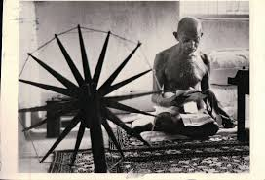

Swaraj (“swa”= self; “raj” = rule)
Multivalent word, rule by oneself and rule OVER oneself
“For” Swaraj, but for Gandhi Swaraj is not simply replacing English with Indian rule
A larger notion of SWARAJ, a truly INDIAN Swaraj that Gandhi describes throughout the rest of the book
Chapter IV, p. 27 Editor responds to Reader’s desire for Home Rule by saying that all the READER wants is “English rule without Englishmen... make India English” but that what HE wants is different
In explaining THAT, is where Gandhi outlines a truly RADICAL step in the context of nationalism in India (and colonized world)
Rather than accepting that India needed to be MORE like the West, which had been the IMPLICIT position (as he shows in this book) of nationalists: Gandhi calls CIVILIZATION itself, western civilization, a DISEASE
Rather than modernity as a source of LIBERATION, sees it as potentially ENSLAVING, contrary to all MORALITY
Read Ch. VI very carefully

Slide 4
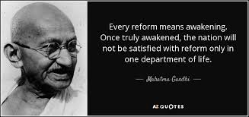
Radical implications of “Reform” (“Sudharo”)
What makes his position truly radical for his time AND ours, is that through this argument he is able to REVERSE the implicit connection between CIVILIZATION and the WESTERN model
Hardiman: By transforming notion of “SUDHARO,” that in his time (as well as ours) often taken to mean change which a change that makes the object MORE like the west (Industry, Representative Government, Profit-maximizing Rational Individual, etc) Gandhi uses SU-DHARO in its original ETYMOLOGICAL sense = GOOD CONDUCT, moral conduct
Even for those who not agree with him entirely, via HS, Gandhi was able to make people think critically about the values they considered civilized
Critiques all aspects of modern civilization (singles out RAILWAY, DOCTORS, and LAWYERS for attack) and blame them for spread of disease and enmity
Restraint of passion, desires, wants. Not necessary to “progress,” to have MORE because there is no end to it, and eventually immorality in pursuit of more
True swaraj consists of ridding ourselves of the tyranny of the western civilizational ideal: Once we do not accept the superiority of ideas and the institutions connected with this civilization and stop interacting with them, we are free, the British CANNOT stay! BASIS of Non Cooperation and Civil Disobedience

Slide 5
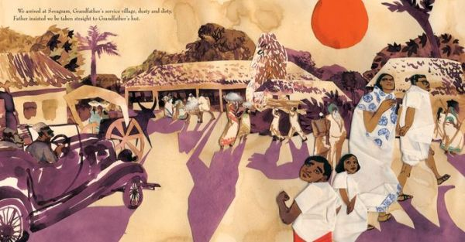
Hind Swaraj and Modernity
Hind Swaraj often seen as a critique of modernity
HARDIMAN says not a critique or rejection, but DIALOG with modernity
HS is primarily a critique of the world which in Gandhi’s time represented by the English in India, but as he repeatedly says he bears no ill-will towards the English, but does to the civilization they bring
Even here, as Hardiman points out, many changes over time. Not a complete rejection of technology, but the SPIRIT with which it is used, not to MASTER nature, extract MORE from it for our own luxury, but in HARMONY with it. Not anti science, e.g.
This critique of modernity is POWERFUL, politically, because most people in India do not see benefits, were not part of the deal with modernity (See Ch. 13, e.g.)
Related to this is that Gandhi, through this work and through SOME of his politics, brings in and highlights a differentiated CLASS analysis of Indian society, and the elitist nature of existing nationalism
Critique of the westernized nationalist leadership. Brings PEOPLE in, in his ideas as well as through POLITICS. (See Ch. 16 on Princes e.g.)
Gandhian Nationalism not simply about ENGLISH vs INDIAN, but for MASSES, not only ELITES. This is a major departure in the context in which he is operating

Slide 6
Critiques of Hind Swaraj/Gandhi (Overview)
Naturalizes the Nation (ahistorical)
Gendered in Language and Politics
Class and Caste, work to preserve status quo
Though the entire text written by Gandhi himself, he makes an honest effort at raising objections to his own position, with the advantage that he raises only the questions he can answer!
What sort of questions would or could YOU raise? What sort of questions do you think Gandhi would NOT be able to answer....?

Slide 7
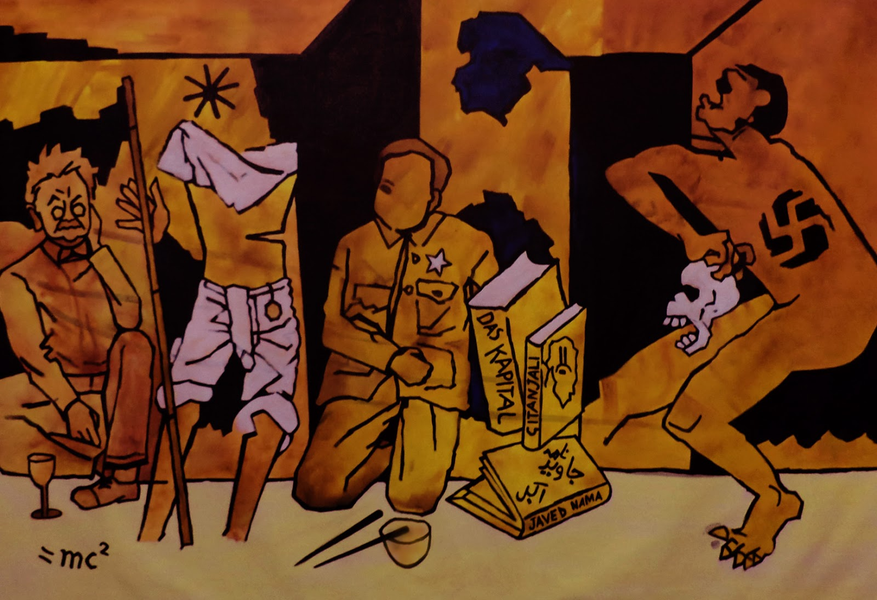
Naturalizing the Nation
Gandhi is able to see and criticize many of the ideas of progress and civilization as derived from western sources, but refuses to acknowledge that the idea of NATIONALISM too is a western import
Despite the fact that India had seldom or only infrequently in its history been organized as a nation state, Gandhi (see Ch. IX, pp. 39-40 e.g.) treats “India” as something NATURAL (were the rebels of 1857 fighting for “India”?)
TRUE civilization, according to Gandhi, can be found in the ideas and practices of India. Similarly, despite acknowledging that he draws on some western thinkers in his critique of CIVILIZATION, Gandhi’s nationalism leads him to repeatedly aver that the source of his criticism is “traditional” and “Indian”
For Gandhi, nationalism is too important to be something attributed to the British, so the SOURCE of his critique has be to attributed to an authentic and pre-British, INDIAN tradition

Slide 8
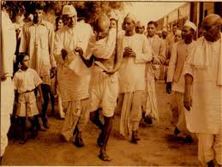
Nation and History
The “golden age” of pre-British India that Gandhi draws up (e.g. Chap. XII 53-54/ Chap XIII 55-56) not only did not exist, but was actually first suggested by early British Orientalist historians! A quick look at early chapters of your textbook will tell you that too!
IS Gandhi being anti-historical? c.f. Hardiman, 32-38
Or is his approach different? As Hardiman says, Gandhi does not valorize MYTH OVER HISTORY, but rather ETHICS over a linear notion of history
History as we know it, is the story of modernity and progress
Rather than celebrate modern historicism (the story of where everyone is progressing to same end, and whose stories will culminate in modern industrial society, representative democracy, etc.), Gandhi wants to imagine a different future, and for that he rejects the idea of a linear historicism
Not so different then to our own times, when we are beginning to question the DESIRABILITY of moving in that one direction, as well as recognizing the IMPOSSIBILITY of everyone in the world with 2-8 cars etc.!!

Slide 9
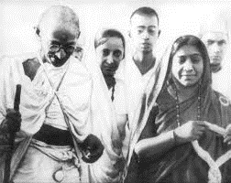
Gandhi and Gendered Nationalism
Gandhi’s masculinity/sexism
Constant use of MANLINESS as a desirable trait, though these ideas not necessarily MANLY eg in the way that colonial rulers would think of manliness.... Courage, bravery etc, hardly exclusive to men, women probably have greater ability to bear pain
Yet when Gandhi talking about the ability to suffer, and bravery, he calls it MANLINESS... Why? Product of his time?
His gendered language, Parliament as Prostitute, as sterile woman, what does that say to us?
What do these factors tell us about the sort of NATION he is imagining, and constructing ? What sort of position does he see for women in it? This is one of the questions I have posed for you for your third discussion

Slide 10
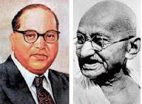
Class Caste and Status Quo
Conclusion of HS (Ch. XX) asks doctors & lawyers give up their practices, but not ask the wealthy man to give up wealth. Hardly anything against merchants or moneylenders... and certainly nothing against landlords or zamindars, although nothing positive about them either! Was it because these were “traditional” occupations?
Although traditional, still exploitative... so despite what he says in Ch. XVI (pg. 63), that “by patriotism I mean the welfare of the whole people” he says nothing about THIS set of economic relations between Indians and other Indians that was HINDERING the welfare of the majority of the people
Gandhi’s ideas, his politics, allowed for controlled mass movement: One thing that HS reveals is that where SOCIAL and ECONOMIC relations WITHIN Indian society are concerned, Gandhian politics could well imply the maintenance of STATUS QUO …. To whose benefit does maintaining status quo work?
Labor leaders had own critique. Lower caste groups their own. AMBEDKAR, someone we will get to a little later in the course, articulated BOTH
The largest “class” in India was peasantry. Reason for Gandhi being the political phenomenon he was, was because of support of peasants. Yet worked as both mobilizer and brake on peasant movements

