Slide 1
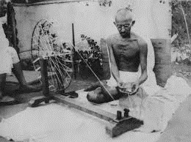
Gandhi and the Transformation of Indian Nationalism

Slide 2
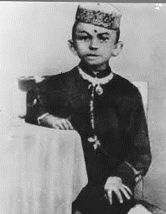
Background
Well to do family
Father was “diwan” or Prime Minister of a small princely state in Gujarat in Western India
Sent to England to study law, qualifies as Barrister
Not a great lawyer on return, shy and diffident
Sent to South Africa through family connections
Discovers true vocation in fighting against racist laws in South Africa, work with small Indian community and develop his politico-moral strategies there
Returns to India in 1915

Slide 3
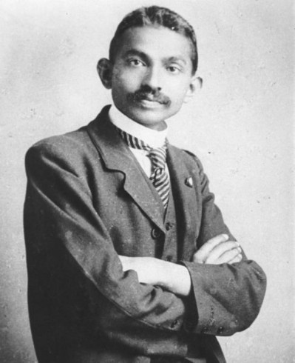
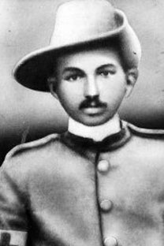
The Gandhi we don’t often see!

Slide 4
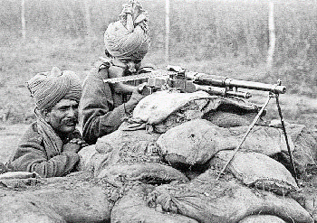
Context for Gandhi’s Return
Textbook for details
WWI 1914-1919, this is the time MKG returns, and at this time:
Recruitment though theoretically voluntary actually conscription. Especially in Punjab where anti-Rowlatt agitation (Gandhi’s first ) strongest.
Taxes increase because of war
Prices two fold impact
1. Price RISE for manufactured goods, kerosene, cloth, etc. War disrupt imports but
2. Prices for agricultural goods FALL because no exports for the same reason
So unhappiness, peasants hardest hit
Differential impact some industrialists made a killing during the war; no imports, so Indians could start own light manufacturing units. Indian cotton mills overtook the British imports and no going back
Indian industrialists want British imports taxed, colonial government unwilling. So some support to Indian nationalism too.
Soldiers demobilized after war. Their wartime experiences crucial. Equality in the trenches. Hear about Russian Revolution

Slide 5
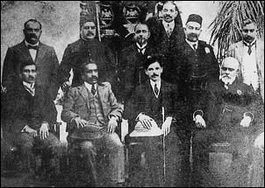
Context of Nationalist Politics
Declining revolutionary activity
INC members in India propaganda against war effort, use of Indian resources, men and material.
Moderates & Extremists come together...
1915 TILAK and ANNIE BESANT form HOME RULE LEAGUES, to press for demands for greater self determination.
1916 INC – Muslim League (ML) sign the LUCKNOW PACT
ML had been founded by landlords, had been pressing for greater Muslim representation in govt. But had been largely LOYALIST, no agitation. Try to distance from INC, which they brand pro-Hindu.
From the very beginning there was a group of younger professional Muslims in the ML who resented the control of the old aristocratic-landlord class. More anti-British, like Extremist sections of the INC
1911 partition of Bengal revoked, mean that ML leadership lose credibility, because INC tactics seem to be more effective, as they had been campaigning, and AGITATING against partition
Problems associated with WWI and Bengal this group a chance to come forward, and wrest control of the party
Thus by 1916, BEFORE Gandhi come to prominence, already a PACT signed between ML and INC, work together, common aim of greater self government. NEITHER party demands complete independence yet

Slide 6
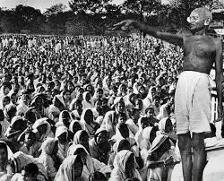
Apparent Contradictions?
Saint or Politician or Both?
Moral, Renouncer, Simplicity, Calls of movements on moral grounds even when close to success, no office even when possible
Yet tactically brilliant, careful, meticulous organizer, great fundraiser
It is we who make these distinctions, who believe that morality and strategy, or truth and politics (in Gandhi’s language), cannot mix
It was because Gandhi was both a saint and a politician that he was as successful as he was
Gandhi transformed the INC from an elite club to a mass organization
It was his apparent simplicity, his saintliness that really attracted millions to follow his lead

Slide 7
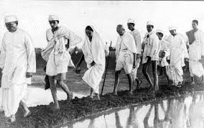
Personality and Issues
Simplicity of his own lifestyle
Never took any office
Renunciation of power, position, lifestyle
Renouncer had a great appeal in India
Great communicator and organizer
Issues always non-divisive (Salt e.g., but also see details of CHAMPARAN satyagraha, his first in India)
Role of Rumor, image in minds of peasants as important as what Gandhi himself said or did

Slide 8
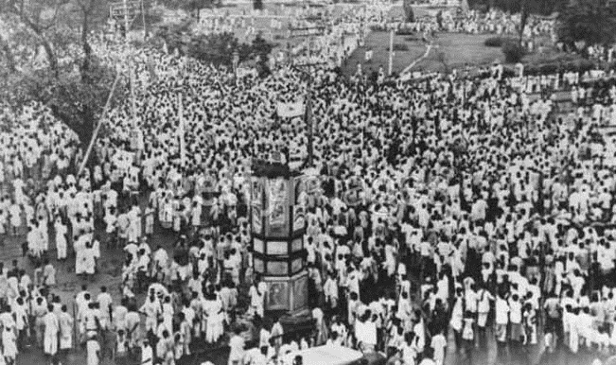
Appropriation (see p. 177-78)
Symbol of righteousness, morality, of someone who stood for “doing the right thing”
Research has shown that in many cases common people, the masses, peasants, factory workers, homemakers, often had their own grievances. These were not always grievances against the colonial state, but often against other Indians, richer, more powerful than themselves, whom they saw as their immediate oppressors
They APPROPRIATED Gandhi to own actions, read into his message what they wanted to, and often worked in ways that were both supportive of Gandhi, yet against his prescriptions
For the INC, the importance of Gandhi lay in that he was able to focus people’s resentments away from conflicts within Indians, and pick up issues which directed the resentment toward the colonial state
In this process, his key precepts were of critical importance

Slide 9
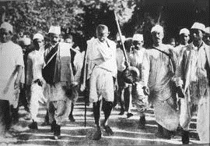
Key Precepts
Two related concepts: AHIMSA (non violence) and SATYAGRAHA (truth force, or literally, insisting upon the truth)
AHIMSA old Indian concept, well developed in Buddhist and Jain thought. Gandhi who elevates it to a political creed.
all humans search for truth, but no one could ever be sure that they had attained ultimate truth, so sinful to violently impose one’s necessarily partial truth on other people. Hence AHIMSA.
Non violence not cowardice, or passive-ness, Rather a moral duty to persuade others of your understanding of truth, hence SATYAGRAHA, the use of non violent means to persuade your opponents of truth
Gandhi also developed a far reaching critique of modern civilization, of industrialization, consumerism. Ideas that he shared with many late 19th Romantic critics such as Tolstoy, Ruskin, Thoreau, Emerson
Although these were important moral precepts for Gandhi, they were also tactically important for India in the context of Gandhi’s time

Slide 10
Gandhi: Ideas and the Context
After 1857 British had effectively demilitarized India and had monopoly of force. Armed insurrection not likely. Gandhi’s ideas of non-violent struggle -- Satyagraha, civil disobedience, more appropriate. Able to influence more people to join his movements
Most nationalist leaders very enamored of modernity. Saw industry and technology as the answer to all problems. Gandhi, in contrast, saw it as the ROOT of India’s problems
This was important because, the limited economic "development” under colonialism had benefited a VERY small section of India’s population
His critique of industrialism, or consumerist economy, and his argument that these were acting against the interests of the mass of the people were hence attractive to a lot of people who saw none of the benefits of modernity, but many of its negative outcomes
A VERY DIFFERENT WAY OF NEGOTIATING MODERNITY

Slide 11
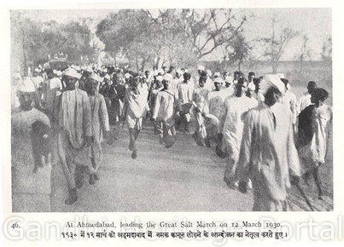
Reputation and Organization
South Africa had not only given Gandhi valuable political experience, but also an ALL INDIA reputation
Important Indian leaders to date, Tilak e.g., were REGIONAL leaders, Gandhi not identified with any single region, but as an “Indian” who had worked miracles in South Africa.
South Africa also taught Gandhi importance on not being parochial. Had worked with a small but very diverse immigrant community, who all identified as INDIANS, although there were Hindus and Muslims, North and South Indians, etc. Gandhi aware of the importance of developing a program that would appeal to a variety of audiences.
At the same time Gandhi was a consummate political organizer, an amazing fundraiser, and an astute tactician in political life. Far from unworldly, Gandhi put a great deal of stress on ORGANIZATIONAL activity. His initiatives transformed the INC from an elite club to a mass organization.

Slide 12
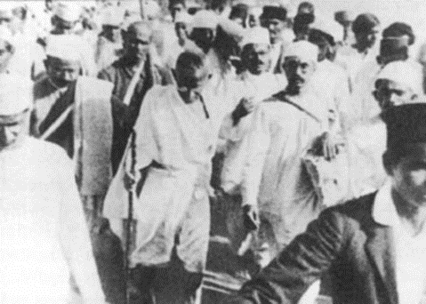
Controlled Mass Movement
This is the “holy grail” of any political movement and Gandhi delivered just that through his insistence on NON VIOLENCE and his close attention to organization and detail
Until the INC was just an elite body, easy for the more privileged sections of Indian society to associate with it. They wanted to run their own country, but no desire to create chaos, which would have hurt their own interests
Yet, without the masses they were ignored by the British
BUT if millions of poor, underprivileged and dispossessed join, a real danger of violence. The millions could turn not just against the colonial state, but against landlords, the factory owners, who exploited them
Gandhian emphasis on Non Violence ensured that masses brought into a nationalist movement, BUT in a controlled fashion.
IF a movement turned violent, Gandhi would call it off.
So rich industrialist, landowner could continue to support the INC
Gandhi could mobilize masses without threatening the elite
So, Gandhi mobilizer but also brake. Movements start and stop (read details in Metcalf and Metcalf!)
This was also ultimately one reason why was marginalized

Slide 13
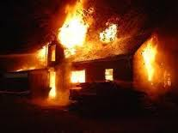
Overview of Important Movements
1917 Champaran
1919: Rowlatt Satyagraha. Big time repression, read about the Amritsar Massacre
1921 First Non Cooperation / Khilafat Movement : 100s of thousands on the streets, give up jobs, professions, drop out of schools, leave fields, to come to follow Gandhi
Undisputed leader of nationalist politics, brought in millions into nationalist movement. Violence in CHAURI CHAURA leads him to call off the movement
1930 Salt Satyagraha. Again mass mobilization. Non divisive issue. This time called off for for no obvious reasons
While reading about this, keep in mind his contributions, both as mobilizer and BRAKE

Slide 14
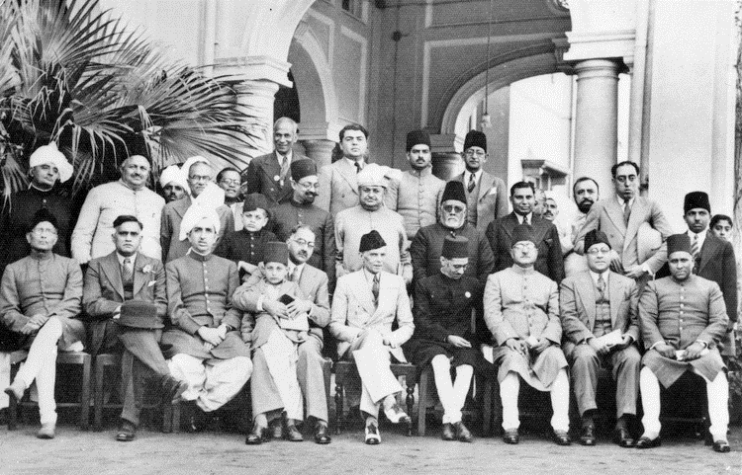
Opposition
British, of course
Princes, who after 1857, were very pro-British
Older leaders of INC and their followers: e.g. C.R. Das, Tilakites
Ideological differences, Tagore, Jinnah e.g.
Alternative political formations, e.g. the Unionist Party in Punjab, emphasizing agrarian interests over the urban support for Gandhi or Justice Party in Madras (now Tamilnadu)
Anti- caste activists, Justice Party, later Ambedkar

