Slide 1
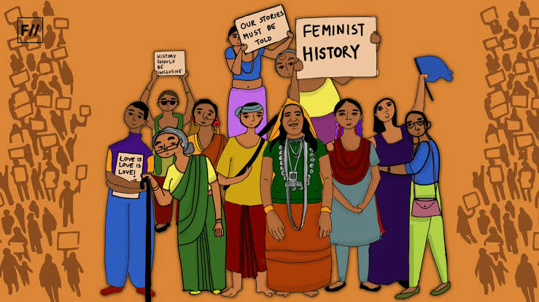
Gender and Nationalism in Colonial India 1850s-1900s

Slide 2

What is a Nation?
NATIONS are imagined entities, Anderson argues they replaced earlier imagined communities based on religion or dynasties
STATES created based on nation-ness only happen in the late 18th C. Think USA “we the people”
Imagination of Nations shaped by the class, gender, etc of the imaginers
In India, MIDDLE CLASS men imagine the nation
Thanks to the British, RELIGION becomes an important component in the imagination

Slide 3
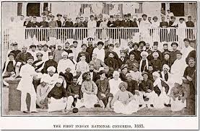
Middle Class and Nationalism
All varieties of Indian nationalisms (and plural is important) were a product of British rule.... Framed in RESPONSE to it, and most often WITHIN its INTELLECTUAL frameworks (M&M 131-144)
Use institutions of British rule, press, railways, ASSOCIATIONS
Use their VOCABULARY (representation, democracy, self-government) and participate in ELECTIONS
Not ANTI-British. See themselves as mediators, Indian to British and vice versa
What is the result? Ridicule from British. Kipling e,g., contrasts the western-educated “babu” with “real” Indians. Claims British better represent "real“ ordinary Indians and that western-educated Indians were the exploiters
Also. criticism from WITHIN the middle class, many AMBIGUOUS about a colonially-derived agenda (see p. M&M 135-136)
Nationalisms negotiate this ambiguity

Slide 4
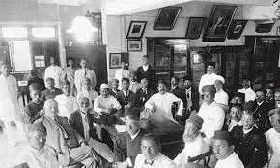
Indian Nationalisms
Keep in mind that not all ANTI-COLONIALISM is Nationalism and not all Nationalism is Anti Colonial!
Focus on Middle Class Indians & Nationalism
Colonial context critical, only BECAUSE of the colonial presence that Indian men felt compelled to redefine traditions or ask for a greater role in public and political affairs of India
After India officially became a part of the empire after 1857, Indians and British, were In theory, equal citizens of the empire
Through English education, young Indians were learning these ideas in their schools and colleges, imbibing ideas of equality, democracy and freedom, concepts they understood well but found lacking in their own environment.
Hence nationalisms, of different varieties
Today, focus on GENDER and CULTURAL NATIONALISM

Slide 5
Why Cultural Nationalism?
Whether modernizing or traditionalists, whether reforming or revivalist, most of these were MIDDLE CLASS movements
In spheres of activities that Queens Proclamation of 1857 said the British would NOT interfere with. Customs and Religions.
So, the so called “middle class” make it their “own” and work on these “inner domains,” where they can:
  Exercise authority, that they lack when they go into spheres dominated by British
  Respond to the criticism from British and Indians, that they are not “authentically Indian”
  Seek to create a stronger “nation” by strengthening what they see as its components, social mores and practices

Slide 6
Cultural Nationalism
Variety of reform efforts, with middle class leadership sought to INSTRUCT and REFORM Indian society. Details on pp. 137-44
Various “sabhas” of castes trying to get ranked “higher” via Census (see pg 138)
Jyotiba Phule's Satya Shodhak Samaj quite different ( see p. 141)
Bramho Samaj (earlier) now ARYA SAMAJ , (141-42), Sikhs and the KHALSA movement, among Muslims Deobandis (143-44)
LANGUAGE issues Hindi Urdu (and in southern India, TAMIL)
Note the extent to which ALL these reforms focus on culture, religion, the family, and particularly, on WOMEN

Slide 7

Some points to note
Although claiming to make “India” or “Bengal” or “Hindus” or “Muslims” or particular castes stronger, middle class cultural nationalists were IMAGINING the nation in their own image
Whether modernizing or traditionalists, whether reforming or revivalist, most of these were MIDDLE CLASS movements. To compensate for their INABILITIES in the sphere of politics that they turn to CONTROL and INSTRUCT in everyday domains of people’s life
Once CULTURAL nationalism enters the sphere of POLITICS (something already been defined in religious terms by the colonial state) there is a FUNDAMENTAL shift
CULTURAL nationalism saw growth of communities (caste or religious) as COMPLEMENTARY
Under politics, this gives way to RELIGIOUS nationalism that sees communities in COMPETITION with each other

Slide 8
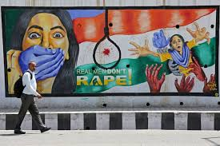
Gender and Nationalism
WOMEN become particularly important symbols of cultural nationalist identity
WHY?
  1. RESPONSE to British who had claimed western civilization superior because it treated women better. Lot of examples, from SATI to POLYGAMY
  Purity of women an OLD “boundary marker” (for British as much as Indians, between castes and communities and between nations/civilizations)
  Part of the “inner domain” of cultural identity still open to nationalist men to control
  Until their voices begun to be heard in the 20thC, women were merely the “stage” or “ground” on which male colonists and nationalists debate between and among themselves
  2. Another important reason: fear of losing control of women. New circumstances, travel away from traditional families for work, less control over women and home. Fear of new ideas. (Banerjee)

Slide 9
Recasting Women
Middle class nationalist men, across religious boundaries, sought to create a “new woman”
Spurt in the publication of “advice to women” written by men such as Thanawi’s Bishishti Zewar (146) or novels e.g., Nazir Ahmad’s Bride’s Mirror
These reinforced new ideas of domesticity, education, efficient managing of households. New word, “grihalakshmi” (goddess of the home)
A clear CLASS element to this project too, as they sought to draw clear boundaries between “middle class” and lower class women

Slide 10

Sumanta Banerjee and Bhadramahila (respectable woman)
Secluded upper caste Hindu women (ee Ghare Baire) entertained & served by lower class women (financially indep.)
Reformist sensibility drawn from Victorian morality
Men (bhadralok) fear lower class women’s uninhibited EXPRESSION and critique of patriarchy
Lower class women earlier not marginal, publish poetry, rival men
Their poetry relevant to everyday life,“god of love like tax collector” (137) not middle class concerns e.g. sati (145)
19th C bhadralok reformism marginalize lower class (151), sanitize their songs (compare p. 137 &158) educate own women
Produce a “refined, reorganized, recast” (163-64) sensibility that became the new norm, internalized by the bhadramahila (165)

Slide 11
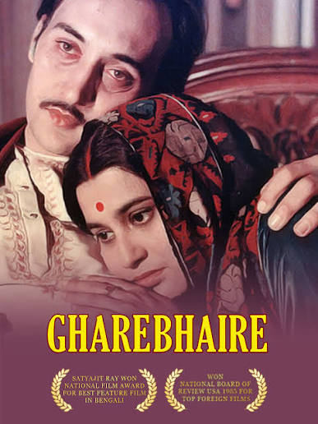
Ghare Baire (English Title Home and the World)
Based on a novel by Nobel-laureate, Rabindranath TAGORE
The novel and film set in BENGAL ca. 1905-1908 during the SWADESHI movement (M&M 155-162)
This movement was launched in protest against the partition of Bengal in 1905 and is the first time we see elite nationalists reach out to a “mass” audience.
It also reveals some of the differences between moderate and extremist members of the Indian National Congress
The film is directed by SATYAJIT RAY, an internationally respected film maker.

Slide 12
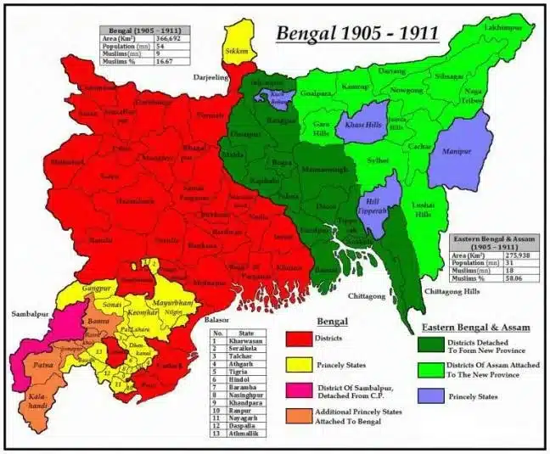
Characters and Positions
NIKHIL, a benevolent landlord (zamindar) and an “improving” husband (NOT like the patriarch Banerjee discusses who were a generation before)
Nikhil wants his wife BIMALA to transcend conventional restrictions imposed on upper class women at that time (see Banerjee)
SANDIP is Nikhil’s friend, and an “extremist” nationalist who wants to impose the nationalist agenda of “Swadeshi” and “Boycott” throughout the province
Sandip’s presence disrupts Nikhil’s “home” when Bimala is attracted to the dashing Sandip and his radical ideas – so different to the measured approach of her husband
Sandip also succeeds in upsetting Nikhil’s “world” where his activities create a riot between the predominantly Muslim peasants and traders who do not wish to adopt “Swadeshi,” and Hindu nationalists who are determined to impose their credo on people for the “larger good” of the nation.

Slide 13
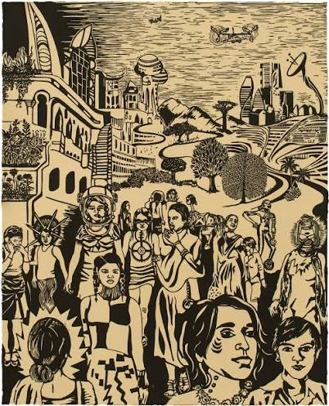
Women Speak Back
Women did not simply look to men for leadership
Ramabai, Begum of Bhopal, among others (M&M, 148)
In 1905 (note date) a Bengali Muslim, ROKEYA SAKHAWAT HOSSAIN, publishes “Sultana’s Dream” a scathing (sci-fi) satire on gender relations of her time
A particularly sharp attack on the practice of (and justifications for) female seclusion

Slide 14
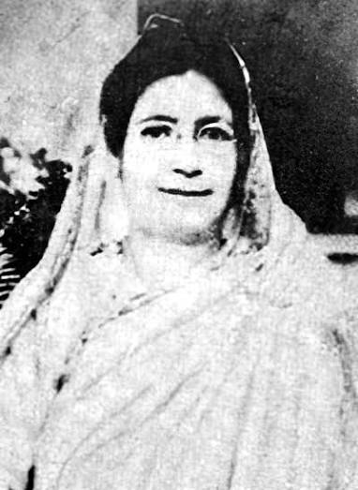
SULTANA’S DREAM (SD)
1905, predates by a decade Charlotte Gilman Perkins’ HERLAND (1915), both science-fiction satires on gender relations.
SD a sharp critique of the practice of seclusion of women (andarmahal) by men
Modernity and Science absolute goods. No sense that these could be oppressive
Only concerned with lives of elite women. No working class women. Gentrified leisure e.g. embroidery. No place for the earthy, ribald, sexually suggestive world Banerjee describe in Ladyland!

Slide 15
Gender, Class and Nation
Banerjee showed education allowed women to express their opinions, but in ways circumscribed by bhadralok ideals, even when describing women’s plight, their language was not coarse, but sentimental
Sultana’s Dream mounts sharp critique, but
  Concerns only with upper class women :“LADY-land”, embroidery, gardens, etc. Very far from concerns of the lower class women Bannerjee described
  No place for earthy, ribald, sexuality in Ladyland!
  Modernity, science, education are the tools through which the women of Ladyland secure control
Was Sultana’s Dream a bhadramahila text?

Slide 16
Masculinity and Nationalism
GENDER not just about women, but also new ways of expressing MASCULINITY.
CULTURAL NATIONALISM very much a MALE project. In as much as trying to recast, reform, reshape women, also new ways of expressing ideas about masculinity
Colonial stereotype of “effeminate Bengali men”
Smarting under that, seek to overcome
For many, emphasis on physical culture, on gyms, on learning how to ride, to shoot, and for a small fraction, led to violent acts, esp post 1905, partition of Bengal (see below)

