Slide 1
HINDU NATIONALISM
An Introduction: Jaffrelot and Beyond

Slide 2
What IS Hindu Nationalism?
Simply put, the idea that India is defined by its religious majority, that India is a HINDU nation (a Hindu rashtra)
Other religions are at best tolerated, and at worst seen as opposing the interests of India
It is, by definition, against the Indian constitution. Created in 1950 (and we will read more about the debates that went into making of that constitution) the Constitution
“does not recognize any official religion… it also guarantees freedom of conscience and of worship.... Article 15 prohibits any discrimination on religious grounds... Article 25 stipulates, “Subject to public order, morality and health . . . all persons are equally entitled . . . freely to profess, practice and propagate religion.” (Jaffrelot, 7)
Yet, this has not stopped Hindu nationalists from trying to establish a Hindu rashtra in India

Slide 3
Contemporary Context
On January 22nd 2024, PM Modi inaugurated a controversial temple dedicated to the Hindu god, Ram, in Ayodhya in north India (see below)
In his speech, Modi said (Bharat is the other word for India): “Ram is the faith of Bharat; Ram is the foundation of Bharat. Ram is the thought of Bharat; Ram is the constitution of Bharat.”
His critics tweeted images of the Preamble to the Indian Constitution in response
2024 is an election year, and with a “model code of conduct” in operation once elections are announced, it might have been difficult to do this later
Hence an incomplete temple (Image Jan 16, 24) was inaugurated, and a tame controlled media parroted Modi’s words that, “January 22, 2024, is not just a date on the calendar. It marks the beginning of a new era” the date, he said, would “lay the foundation for the next thousand years of Bharat”
Someone else had spoken of a thousand year Reich

Slide 4
Origins of Hindu Nationalism: Colonialism
Jaffrelot sees Hindu Nationalism as response to pan-Islamic ideas (12), but it has much longer and complex history which HAS to take into account British colonialism
All nationalisms, secular and religious, were articulated in the context of colonialism
The 19th C socio religious reform movements Jaffrelot discusses (11-12) were a response to colonialism too, and created the possibility of imagining a single “Hinduism”
Hindu nationalism draws on these, particularly the idea of creating a “muscular” Hindu nationalism to counter the colonial stereotype of Hindus as a “puny race” AND to forge a Hindu identity beyond the divisions of caste and sect
But British colonialism created a political context for religious identities by (among other things) insisting on religious political constituencies (Muslims vote only for Muslim candidates etc.)
The Muslim League as a party to represent Muslim interests (created 1906) was encouraged by the British rulers
Pan Islamic interests of ca. 1919 were an unintended consequence of British policy

Slide 5
Secular or Inclusive Nationalism
Hindu Nationalism can’t be understood without its Other, which was not either British Colonialism nor Muslim Nationalism, but SECULAR or Inclusive Nationalism
A peculiarly Indian form of secularism, according equal respect to ALL religions, regions, languages etc. characterized Nehru and Gandhi’s nationalism (Jaffrelot, 7-9)
Given India’s huge diversity and long history of coexistence of diversity, understandably, this was the nationalism that caught the imagination of the majority of Indians
Jaffrelot does not mention that under Gandhi leadership, between 1920-21 there was great unity between Hindus and Muslims in the anti-colonial movement
The RSS created in 1925 at a time when that unity began to splinter
It is THIS vision of an inclusive or diverse India that bothers Hindu Nationalism the most
No coincidence that a Hindu nationalist assassinated Gandhi in 1948. Undermining Nehru’s legacy remains at the center of contemporary Hindu nationalist efforts

Slide 6
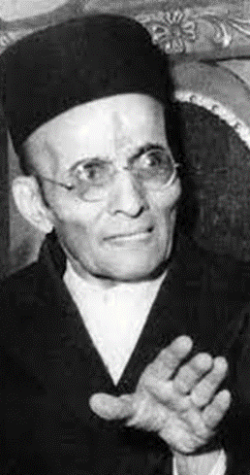
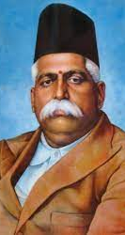
KEY PEOPLE, TEXTS and ORGANIZATIONS
Well before the RASHTRIYA SWAYAMSEWAK SANGH (RSS, 1925) came the HINDU MAHASABHA (HMS, 1913)
Important leaders of the INDIAN NATIONAL CONGRESS (INC, the party of Gandhi and Nehru) were also members of the HMS (as was, later, Nathuram Godse, Gandhi’s assassin)
In 1923 V.D. SAVARKAR, earlier a revolutionary nationalist, published the pamphlet Essentials of Hindutva that became a manifesto of Hindu nationalism
HEGDEWAR left the HMS in 1925 to form the RSS
RSS was a cadre-based organization, with shakhas (branches) at neighborhood levels, that emphasized physical even quasi-militaristic training as well as ideological indoctrination

Slide 7
Role of Hindu Nationalists in Colonial India
Savarkar was released from prison in 1924 after apologizing for his earlier politics and promising loyalty to the colonial government
Under SAVARKAR’s leadership, the HMS turned against the INC and nationalist politics
Both the HMS and the RSS opposed the Gandhi-led nationalist movements in the 1920s and 1930s, and the more revolutionary uprising of 1942
Both the HMS and the RSS opposed the INC-led anti-colonial struggles, often cooperated with the colonial government. The HMS even formed coalition governments with the Muslim League in 1939

Slide 8
Hindu Nationalists and Partition
The idea that there were two, irreconcilable, nations in India, a Hindu and a Muslim nation, was first articulated by V.D. Savarkar (more about whom, later) in 1923, a good 17 years before the Lahore Declaration of the League
The fear of Hindu nationalism (as much as their own ambitions) was a factor in the demand for a separate Muslim nation-state by the Muslim League
While there was horrendous violence inflicted on victims of all communities, there is considerable evidence that RSS cadres organized and carried out systematic attacks on Muslim communities as part of their efforts to “defend” Hindus
The RSS did carry out stellar work among Hindu refugees who had fled Pakistan, and refugee families became some of their most steadfast supporters in the years to come

Slide 9
The Hindu Nationalists
The Rashtriya Swayamsevak Sangh (RSS) explicitly opposed “the idea of a secular state that would not discriminate on the basis of religion.”
The founder of the RSS, GOLWAKLAR, believed:
The non-Hindu people of Hindustan must either adopt Hindu culture and language, must learn and respect and hold in reverence the Hindu religion, must entertain no idea but of those of glorification of the Hindu race and culture . . . in a word they must cease to be foreigners, or may stay in the country, wholly subordinated to the Hindu nation, claiming nothing, deserving no privileges, far less any preferential treatment – not even citizens’ rights (35)
Golwalkar was also a great admirer of Hitler’s methods and ideas:
“…To keep up the purity of the Race and its culture, Germany shocked the world by her purging the country of Semitic Races – the Jews. Race pride at its highest has been manifested here. Germany has also shown how well-nigh impossible it is for races and cultures, having differences going to the root, to be assimilated into one united whole, a good lesson for us in Hindustan to learn and profit by.” (87-88)
The RSS had support from refugees, some of whom even shouted “let him die” as they marched past a location where Gandhi was fasting for peace. Gandhi believed
“that, though geographically and politically India is divided into two, at heart we shall ever be friends and brothers helping and respecting one another and be one for the outside world”
On January 30, 1948, a Hindu nationalist shot the Mahatma to death

Slide 10
Hindu Nationalists AFTER Independence
Hindu nationalism had a marginal following in India up until the late 1980s
Their participation in Gandhi’s assassination was an important immediate reason for their lack of popularity
However, neither the RSS nor the HMS had much support either before or, more significantly, even long after the Mahatma’s assassination
With lack of political success or support came the strategy of creating various specialized affiliate groups. Thus, the ABVP among students, BMS among industrial workers, VKA among tribal groups, and later the VHP among religious specialists (Jaffrelot, 16-17)
To contest elections, the RSS created the Bharatiya Jana Sangh (BJS) a political party, in 1951

Slide 11
Marginalization 1950s-late 70s
The BJS had little electoral success, with the INC, first under Nehru and later his daughter, Indira Gandhi, won every national election from 1951-52 to 1977
INC had its own Hindu traditionalists, who were anti Nehru but WITHIN the party
The BJS won only 3 of 499 Parliamentary seats in 1952; 4 of 505 in 1957; 14 of 508 in 1962; 35 of 523 in 1967 (after Nehru’s death) and; 21 of 521 in 1971 (after a split in the INC)
Between 1975-77 Indira Gandhi ruled India by decree during The Emergency (more on that later)
For the 1977 elections, many parties dissolved their original identities to form the JANATA party, the BJS among them. The Janata Party (that included former BJS) won 295 of 544 seats in Parliament

Slide 12
Post 1977
RSS members got the first taste of office as part of the Janata Party, but their success did not last long
Holding important cabinet positions dealing with education and the media, they were able to insert many fellow ideologues into these spheres
But it was the perceived conflict of interests between dual loyalties to the party and to the RSS of former BJS members that led to the collapse of the Janata
Indira Gandhi swept the elections of 1980
RSS helped to recreate a political affiliate, now called the Bharatiya Janata Party (BJP)
They won only 2 of 543 seats in the national elections of 1984

Slide 13
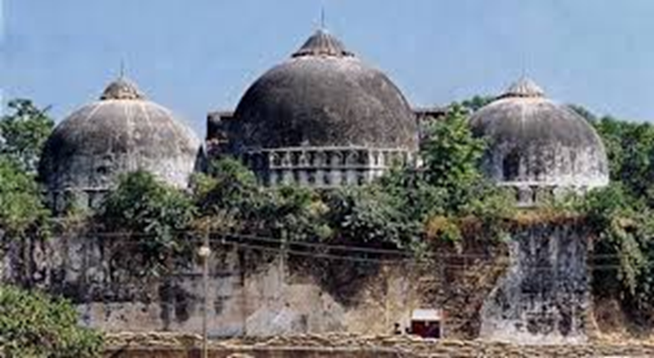
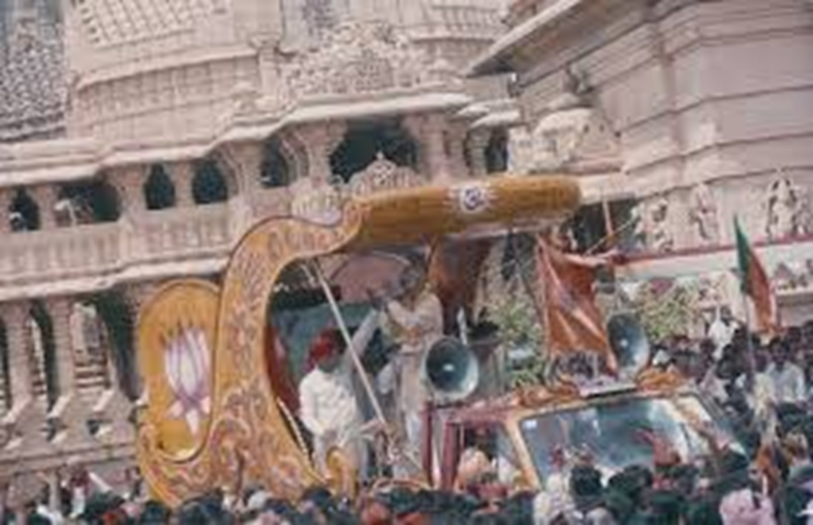
Ayodhya
BJP seats rose from 2 to 85/543 in the elections of 1989, and then 120 of 543 in 1991
The reason was their highlighting a controversy over a mosque/temple in the town of Ayodhya (more on this later in the course) over which the BJP successfully whipped up Hindu nationalist support
It still wasn’t enough to get them a majority in Parliament, but with some strategic alliances with regional parties able to form the first lasting Hindu Nationalist government between 1998 and 2004
Regional allies ensured
moderation of Hindu Nationalist
ideologies

Slide 14
Hindu Nationalism’s Dilemma: Caste
Caste always the Achilles heel of a Hindu Nationalism that claims to speak for and represent ALL Hindus
Historically, though the RSS/BJP were upper caste dominated organizations, they sought to bring lower castes into the fold
OBCs (Other Backward Castes, more about this later!) 53% of the electorate. The MANDAL Commission in 1979 recommended affirmative action programs for this section of the population. Ignored until Prime Minister V. P. Singh in 1989 announces the implementation of the Mandal Commission recommendations
Traditionally privileged upper castes were outraged, while lower castes rejoiced
The BJP in a dilemma, calling it a “caste war” alienated the 53% (Hindu) electorate, but supporting affirmative action alienated the traditional upper caste base
“Social engineering” solutions (Jaffrelot, 26) not popular with RSS leadership

Slide 15
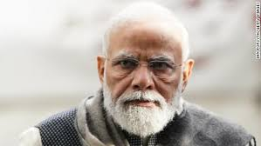
The Answer: Narendra Modi
Representing a new stratum of brash, lower caste, Hindutva ideologues, Narendra Modi became Chief Minister of the state of GUJARAT (Mahatma Gandhi’s home state!) in 2001
He revealed what he was capable of when in 2002 more than 2000 Muslims died in riots while he was in charge. As CM of Gujarat, Modi, gave Hindu mobs a free hand to rampage against Muslims. Police stood by and even helped the rioters
2014 Modi elected PM of India in massive electoral victory
Mandate reinforced by 2019 victory in General Elections. Second term saw Supreme Court decide on Ram Temple in favor of Hindus. Also, the
dissolution of the Muslim-majority state of Jammu and Kashmir
and “reading down” of Articles 370 and 35A of the constitution
granting Kashmir special status. Moves to undermine
citizenship rights of Muslims led to huge nationwide protests led by women and students

Slide 16
Hindu Nationalist Strategies
From the initial calls to save the “dying race” of Hindus in the 1930s, partition in the 1950s, to arguing against the INC’s “pseudo-secularism” in the 1980s and “Hinduphobia” in recent times, the basic strategy of Hindu nationalists has been, as Jaffrelot puts it, “to weaponize a sense of vulnerability” (Jaffrelot, 28)
Economic and social inequalities create a very real reasons for large sections of the Indian society (Hindus and Muslims) to feel vulnerable
The Hindu nationalists’ efforts have been to try and turn this vulnerability to the belief that
Secular politics (initially championed by the INC) is the real reason for their misery
Their greatest fear should be the possible erasure of their Hindu identity
And, more recently, that the liberal intelligentsia and (remaining) sections of the independent media are “anti-Hindu” and hence “anti-national”
Sound at all familiar?

Slide 17
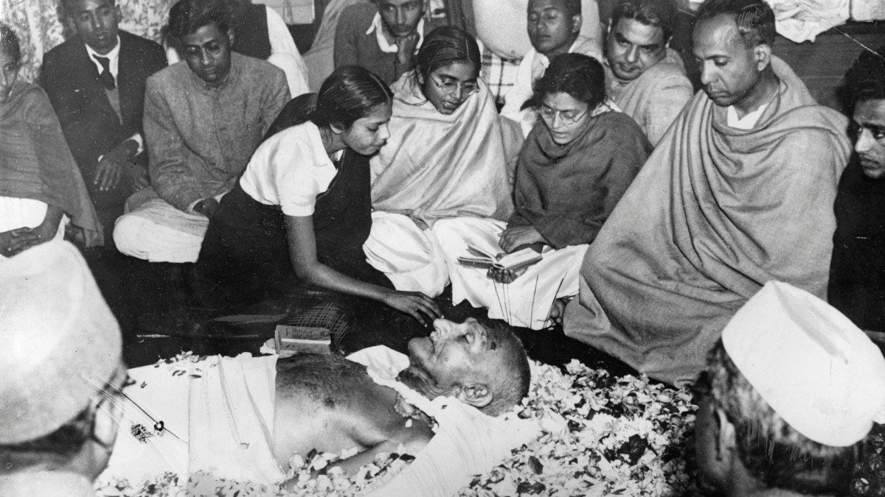
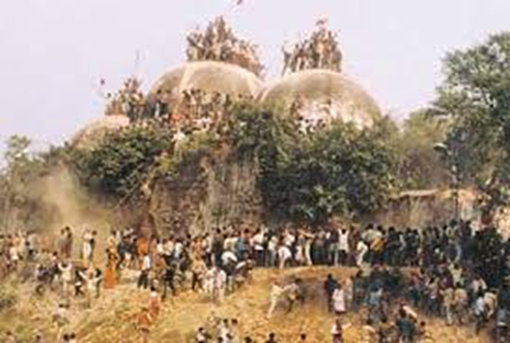
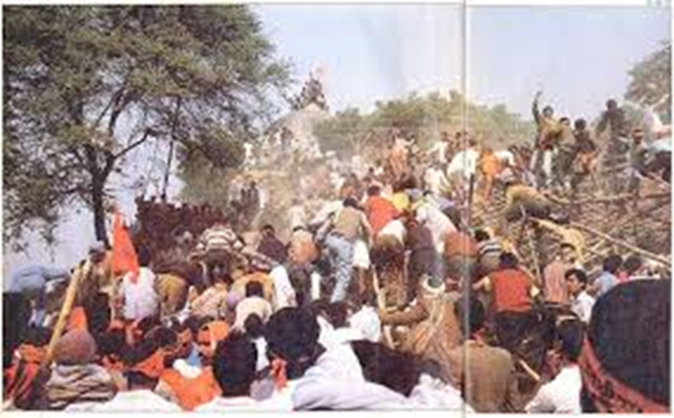
Hindu Nationalism Praxis
Hindu nationalists have always valued their own ideology and vision over that of the Indian constitution
From the assassination of Gandhi in 1948
to the destruction of the Babri Mosque in
1992, Hindu nationalists have not
been shy of using violence to achieve
their ends
Once in power, since 2014, the current
Hindu nationalist government has been systematically undermining historically impartial institutions (e.g. the judiciary, the media, the Election Commission) to move toward the end of making India a Hindu nation

