Slide 1
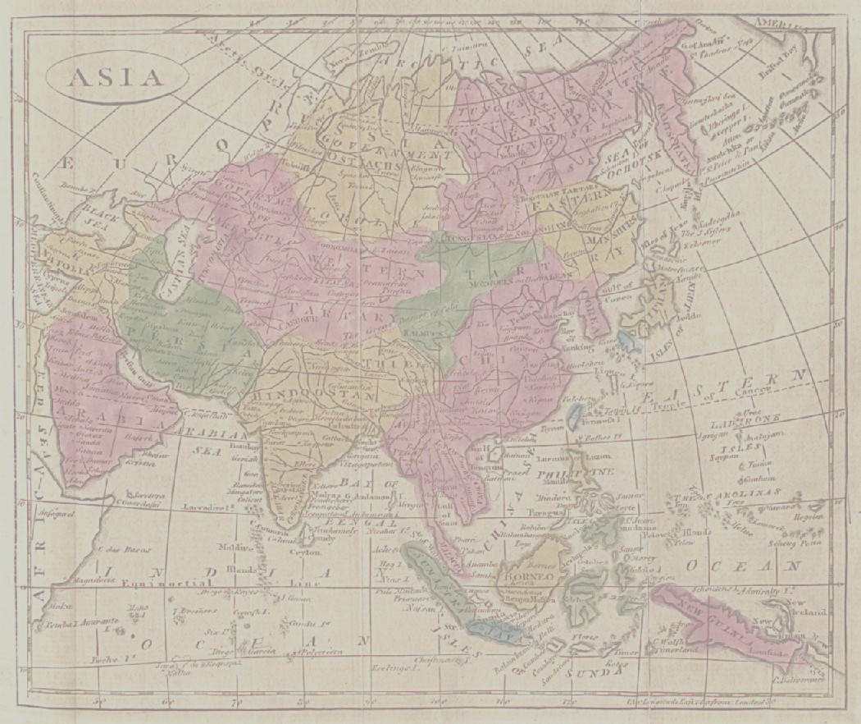
HIS 251: MAKING of MODERN ASIA
Introductions
Sanjay Joshi LA 206 3-6216 Sanjay.Joshi@nau.edu
HIS 251 http://jan.ucc.nau.edu/~sj6/makingmodernasia.html
TODAY
Intro to course
Syllabus
Approach
THEMES
BOOKS and ASSIGNMENTS
READING
IF TIME: Brief Lecture

Slide 2
COURSE INTRODUCTION: MODERN ASIA
https://www.google.com/maps/d/viewer?mid=zuVUPD-N5sEk.k2vClsDw8gtQ&hl=en_US
Where is “Asia”? Contingent Somewhat Arbitrary
OUR Focus, three countries: INDIA, CHINA, JAPAN
As “case studies” of emergence of modernity
What is “Modern”? Context is all
How India, China Japan emerge as MODERN states, in ways very different from the ways in which these countries had been
Governed,
Their economies run
Or their cultures and societies functioned.
In fact one of things we will discover is that these very entities INDIA, CHINA, JAPAN, themselves MADE in this era... at least in the way we know them.

Slide 3
MAKING of modern asia
What do we mean by “making” of Modern Asia?
Geographically India, China, Japan there for millennia. BUT what these words mean to us today are NATION STATES, and we will see how HISTORY produces creates these nations.
By the middle of the 20th century all three countries emerged with very diff POLITICAL and ECONOMIC systems, for instance:
China: Communist Revolution, a popular revolution which changed the face of the country.
Japan: By 1940s was run by an oligarchy, milataristic, but already made HUGE strides economically, with the state promoting capitalist enterprises.
India: In 1947 independent from British, create world’s largest democracy, but experienced partition, India and Pakistan.
All of these are very MODERN systems of political economic organization. Industrial capitalism, socialism, and militarism all very recent developments in human history, AND all of these systems VERY different from the way, e.g., these countries were run in the 1700s in the 18th Century. They were ALL Modern states,
And how is it that these countries all take such diff paths to being modern? This is the central theme of the course.
ONE feature of this course is to try and get to think of modernities in the PLURAL.

Slide 4
Approach to Course
READ syllabus, outlines the approach well.
You WILL be confronted with names, people, places, things, social formations, and ways of thinking, that are QUITE different from what you have been used to reading about.. Even if you ARE history majors. You cannot get away from that in this course, and you HAVE to be prepared to deal with difference! Learning NEW THINGS is an important part of the course, and if you stay in this course you really cannot complain about this!
But WHICH of the many names, etc. are important? This is where the THEMES of the course becomes important, as well as the approach.
By the end of this course I want you to able to make clearly thought out ARGUMENTS on certain questions that relate to the THEMES of this course. The FACTS: that is names, event, people, places, ideas, that are RELEVANT to those argument, to those THEMES, are the most important ones, and the ones you have to focus on.

Slide 5
THEMES
1. Colonialism. Understanding colonialism in Asia is our first objective : WHY western powers, initially primarily Britain, but also later the US, were interested in Asia? We need to understand the NATURE of their intervention, and HOW it was PERCEIVED by DIFFERENT GROUPS in the Asian countries we examine.
What is colonialism? In this context, it is the process by which western countries – in very different ways in three countries – subordinated the interests of the governments, economies, and peoples of Asian countries to their own interests.
2. RESPONSES: Because nature of colonialism different, so were responses. The elites or leaders of India, China, and Japan responded very differently to colonialism. Yet also some comparative patterns.... Reform, adaptation, resistance. e.g.
3. NATIONALISM: in all three countries therefore different forms, see how, and try to evaluate these as critically as we evaluate the history of colonial rule.
4. MODERNITY: Connections with Colonialism. Ambivalence.

Slide 6
SYLLABUS: Nuts and Bolts
Books
Assignments
Lectures (not repeat stuff)
Web Page http://jan.ucc.nau.edu/~sj6/makingmodernasia.html
Study Guides

Slide 7
READING: How To…
Notes: Read paragraph, summarize in one sentence. Summarize entire section or chapter in one para.
BRING your notes to Class, add to them or ask questions if lecture not fit.
Class Lectures will not SUMMARIZE readings, they will add to it.
Use outlines and study guides from course web page, printout, or soft copy, take notes on those when you don’t have own notes from readings.
Stay on top of what we are doing, if you are confused: ASK!

