Slide 1
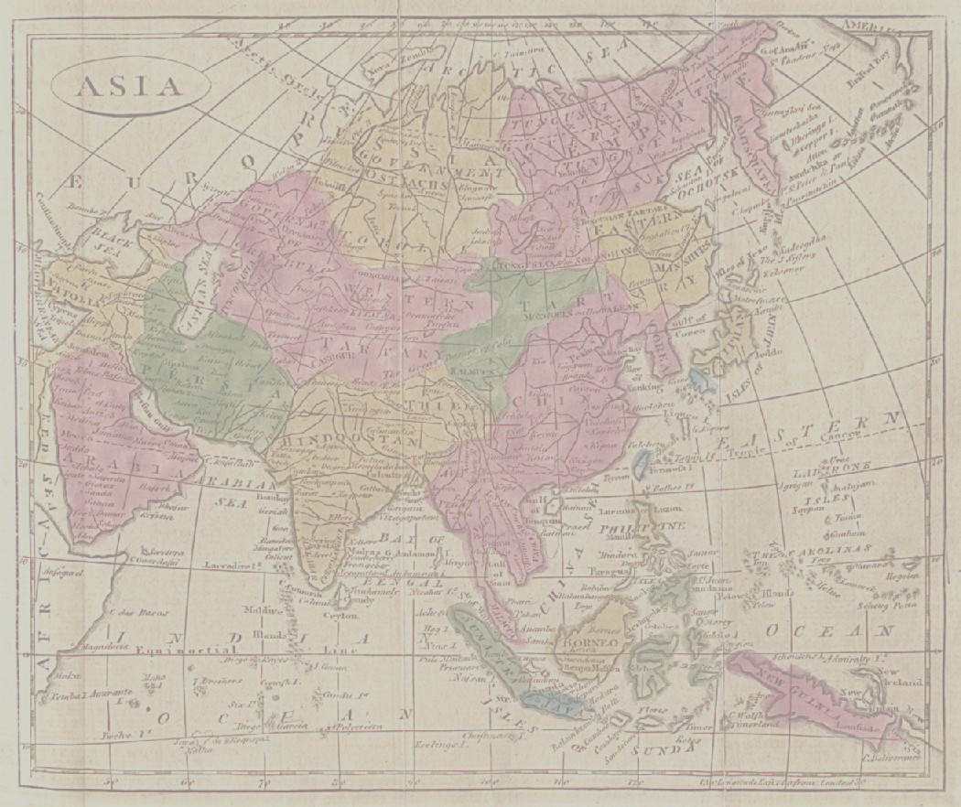
Lecture 02:Section One of the Course
Course and section Objectives WHY, WHAT and HOW
WHY the Europeans came to Asia in the first place... what MOTIVATES the men from far away countries to come to this part of the world.
HOW people from so far away, small countries, able to estab power over Asian countries, and
The impact that they had, WHAT changed, what did not change with coming of Europeans
To understand impact of Europeans, have to understand what went on BEFORE Europeans became dominant in Asia.
2. Start with India/ SOUTH ASIA: first of the three to be colonized
HISTORICAL OVERVIEW
Mughals (via film)

Slide 2
India Historical Background
South Asian, Indian, history is story of both UNITY and DIVERSITY
2500 to 1000 CE “Emergence of a “CLASSICAL” pattern
The period from 2500 BCE to 1000 CE sees
INDUS VALLEY CIVILIZATION: an incredibly advanced urban civilization 2500-1700 BCE
The coming of a nomadic people from NW, who call themselves Arya -- lead to distinctions between themselves and indigenous people, called VARNA, and later incorporated into a hierarchical system we call CASTE
BUT also the emergence of HETERODOX ideas, BUDDHISM and Jainism UNDERMINING these hierarchies
This period sees the emergence of early empires, uniting the region, for example under ASHOKA and later the GUPTAS
But also the emergence of REGIONAL empires that support emergence of different languages, different cultures, that emerge in different parts of India during the time.

Slide 3
Classical Period and Diversity
“Classical” ideas and Institutions were powerful enough for most people to incorporate them into their local belief systems.
BUT, people up to 17th Century seldom saw themselves as “Hindus” : this came with the British.
The entire “classical” era had inward migration: people coming in from NW and absorbed. Huns, Scythians => “Rajputs”.
10-11th Century saw the first group who could not be absorbed into classical, varna, pattern. These were Muslims, own distinct ideas of religion. Equality central to Islam
Islam, name of religion, Muslims = followers of Islam. Islam in India is significantly older than Protestantism in Europe, or Christianity in the Americas.

Slide 4
Islam and Indo-Islamic World ca 1000 to 1700
Indo Islamic Civilization
synthesis: at everyday levels, culture, arts, music, food, etc. Even religion, to some extent, lots of mutual influence between Muslim SUFI and Hindu BHAKTI saints, at popular level today, somemtimes indistinguishable.
By 12th 13th C Muslim rulers over large parts of India.
SULTANS of Delhi
MUGHALS, 1526 BABUR defeat last of the Sultans

Slide 5
Mughals
THE MUGHALS 1526-1857 (effective power ends early 1700s.)
Babur, Humayun, Akbar, Jehangir, Shahjahan, Aurangzeb (followed by “lesser” Mughals)
Create a Modern State: Land Revenue, Bureaucracy, etc
Great Builders Taj Mahal Iconic now But many others
Period of Indo-Islamic synthesis in music, art, language, literature, and architecture, even RELIGION under AKBAR.
Amongst others much of what the west knows of “India”-- e.g. “Indian” food, or even much of “Indian” music, comes from this era.
In decline by 1710s, and by end of 18th Century displaced by the English East Company, formally overthrown by British Crown in 1857.

Slide 6
Return to Course and Section Objectives
WHY, WHAT and HOW
WHY the Europeans (EIC) came to Asia in the first place... what MOTIVATED the men from far away countries to come to this part of the world.
HOW people from so far away, small countries, able to establish power over India, and
The impact that they had, WHAT changed, what did not change with coming of EIC rule over India
THIS Will be our focus next two classes.

