Slide 1
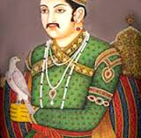
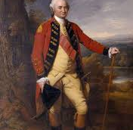
Mughals to Europeans

Slide 2
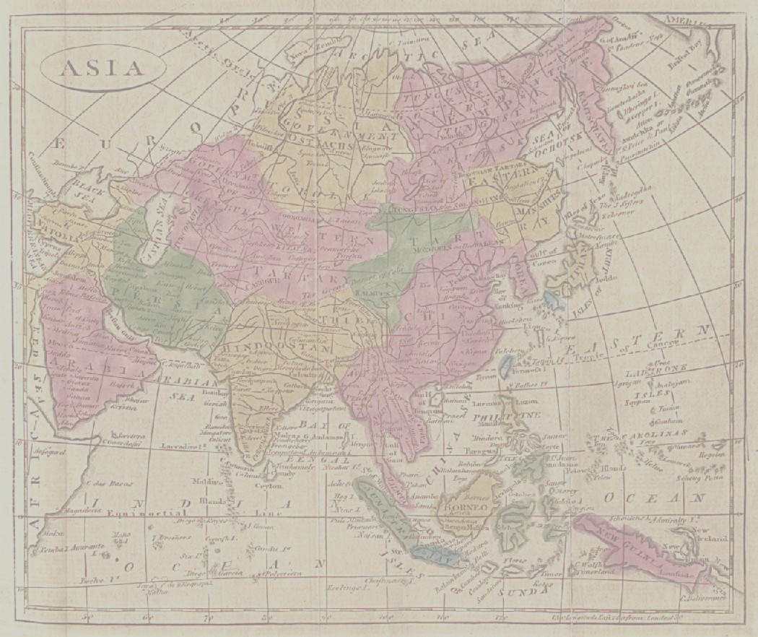
Lecture 2: Keep in mind the Bigger Questions
Course and section Objectives WHY, WHAT and HOW
WHY Westerners came to Asia in the first place... what MOTIVATES the men from far away countries to come to this part of the world.
HOW people from so far away, small countries, able to establish power over Asian countries, and
The impact that they had, WHAT changed, what did not change with coming of Europeans
To understand impact of Western intervention, have to understand what went on BEFORE Europeans became dominant in Asia.
2. Start with India/ SOUTH ASIA: first of the three to be colonized
HISTORICAL OVERVIEW
Mughals (via film)

Slide 3
Changing Relations Over the Centuries
Sixteenth : Portuguese: Souls and Spices
Seventeenth: Mughal Consolidation, EIC emergence
Eighteenth: Mughal Decline, EIC political player
Nineteenth: EIC replaced by British Crown after 1857 Revolt

Slide 4
SIXTEENTH Century (1500s)
1499 Vasco Da Gama “discovers” sea route to India
Voyage nets profits of upto 3000 %
1526 Babur defeats last of the Delhi Sultans to establish the MUGHAL dynasty
Till AKBAR’s time less centralization, see map
Portuguese establish some bases on western coast, and control over Indian Ocean
Mughals expand inland, beginnings of vast empire
Religious wars in Europe

Slide 5
SEVENTEENTH century 1600s
Over this century, Catholic southern Europeans lose out to Protestant northern Europeans
Dutch and English, primarily, displace Portuguese from control over Indian Ocean
English East India Company formed in 1600, 1618 allowed to create a “factory” (i.e. warehouse) in SURAT
Move South and then up East Coast: MADRAS (Ft St. George in 1642. In 1661 Bombay came as part of dowry when Charles II married Catherine of Braganza (Portugal) and was handed over to EIC in 1668 for 10 pounds sterling a year!!

Slide 6
Seventeenth Century 2
EIC a trading company, one of the first corporations
Monopoly Rights to trade with the East. In return paid a handsome sum to Crown (later Parliament)
Hugely profitable, create a new group of ruling elites in Britain who bought themselves prestige, power, and influence (nabobs)
Exported Spices (Pepper) and later Indian textiles (calicos, fine cottons), also indigo, important dye. Blue Jeans anyone!

Slide 7
Seventeenth Century 3
Mughal India did not need any commodities produced by Europe at this time
Europe valued Indian commodities, paid in gold and silver
Hence Mughals allow the sea-borne trade to continue, as it was to mutual benefit.
ANSWER TO FIRST OF SECTION QUESTIONS: WHY?

Slide 8
Seventeenth Century, 4
At this stage of EIC's career they COULD not play a significant role in Indian affairs.
Defeating Portuguese made them important for maritime purposes, Mughal Empire way more powerful
Even by end of the 17th century Europeans still very much dependent on Mughal goodwill. In 1688, eg. Aurangzeb, displeased with English misuse of privileges, drove them out of their factory at Hughli.
Only after much persuasion at the court, EIC got permission to start new trade in Bengal in 1690.

Slide 9
Seventeenth-Eighteenth
Europeans not the only important international merchants in this period.
On the west coast, Gujarat and Malabar coast, merchants had long history of international trade. (Remember this when reading Ghosh’s novel)
Some of these traders rich enough to finance the state. Jagat Seth was one very important family in Bengal.
These traders depended upon political stability. They knew Mughal system and operated within it, were protected by it in their workings in India. Internationally, made arrangements with dominant maritime powers, whether Arab, Portuguese. Dutch or British.
Decline of Mughal authority in early 18th C hit these traders hard

Slide 10
Eighteenth Century Changes 1700s
Mughal Decline
Partly Systemic, Partly Internal Rivalries, Partly Rising Aspirations of Regional Leaders they had promoted
Rise of Regional Powers East, BENGAL. North, AWADH (Oudh). MARATHAS in West, HYDERABAD and MYSORE in Deccan and South.
Invasion of Nadir Shah in 1739, sack of Delhi only highlighted that Mughals a spent force.

Slide 11
Eighteenth Century 2
The English and French still to deal with some powerful local rulers in the Regions, e.g. Nawab (a title) Alivardi Khan in Bengal.
Regional Powers jockeying for power among themselves.
Both British and French realized the importance of their small but better trained and equipped forces in the power struggles following decline of Mughals. French concentrate on South initially, whereas, British in the east, Bengal.
British able to take advantage of factions at the court in Bengal to defeat Nawab Siraj ud Daulah's army at the Battle of Plassey in 1757, a landmark date in Indian history. With Jagat Seth’s help, able to buy off the major part of the Bengal rulers' armies and generals, and defeat and place a puppet in place.

Slide 12
Eighteenth Century 3
A few years later the MARATHAS defeated by the Afghan Ahmad Shah Abdali in 1761, clearing away the most significant Indian power of the time.
In 1764, the Nawabs of Bengal and Awadh and the Mughal Emperor of Delhi (who was a pure figurehead by this time) decided to combine against the English forces, but they were no match for them.
The two major victories, 1757 at Plassey and 1764 at Buxar, signaled the beginning of British political rule over India.
We thus have an answer to the SECOND of our Questions: viz. HOW

Slide 13
Eighteenth Century 4
As tribute, in 1764 the Mughal Emperor granted the EIC "rights" to collect taxes from the province of Bengal (DIWANI), became RULERS of Bengal.
A CRITICAL step, for this revenue now financed their trade, wiped out the trade deficit they ran in India trade. Taxes from Bengal used to buy the cottons.
Led the EIC and the British Parliament to recognize desirability of expansion
Between 1765 and 1813, series of measures taken to DELIBERATELY, CALCULATIVELY expand their rule. SUBSIDIARY ALLIANCES, e.g..
Also MILITARY ACTION. By 1799 BR EIC defeated the last major rival in Southern India -- TIPU and become the dominant force in India.
All of this was to have HUGE impact on the way India was RULED, on its ECONOMY, and on its PEOPLE.

