Slide 1
Quiz One Live 12 pm
A week to complete (Feb 01)
•TIMED: 45 minutes, ONE attempt
•1 map question with 6 locations, MATCHING (points: 3/10)
•7 Multiple choice (points: 7/10)

Slide 2
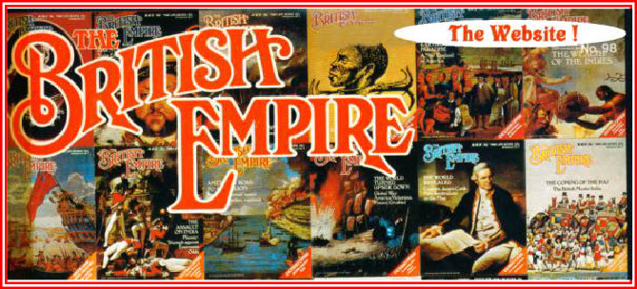
The British Raj in India
1765-1880s

Slide 3
Returning to Questions
HOW?
  Decline Mughals
  Rise of Regional Powers and Competition
  Political Role of English and French Companies
  1757 and 1764 DIWANI
EUROPEAN TRADE WAS PROFITABLE For instance, in the 1710s, the British brought in about TWO MILLION POUNDS to Bengal alone.
By 1750s, Europeans were part of the landscape. EIC first warehouse from 1618

Slide 4

Recap HOW: Eighteenth Century
After loss at Buxar in 1764 the Mughal Emperor granted the EIC "rights" to collect taxes from the province of Bengal (DIWANI), became RULERS of Bengal.
A CRITICAL step, for this revenue now financed their trade, wiped out the trade deficit they ran in India trade. Taxes from Bengal used to buy the cottons.
Led the EIC and the British Parliament to recognize desirability of expansion
Between 1765 and 1813, series of measures taken to DELIBERATELY, CALCULATIVELY expand their rule. SUBSIDIARY ALLIANCES, e.g..
Also MILITARY ACTION. By 1799 BR EIC defeated the last major rival in Southern India -- TIPU and become the dominant force in India.
All of this was to have HUGE impact on the way India was RULED, on its ECONOMY, and on its PEOPLE.

Slide 5
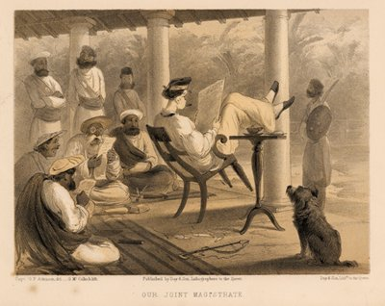

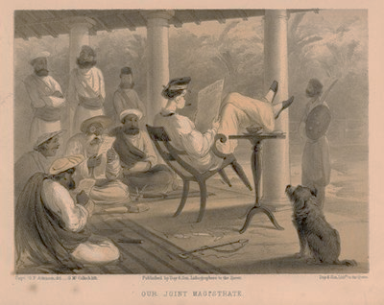
WHY: Redux
SIMPLE ANSWER: Profits
  Change Terms of trade No More Deficit
  Annexation of Punjab in1848 , gave an ANNUAL surplus of 5 million rupees, after costs of military and administration. A small principality like Nagpur yielded 4 million rupees
  LOOT: Folks like Clive made personal fortunes
WHY ANNEXATION?
  Profits from tax collections fuel greater annexation efforts
  Anglo-French rivalries play a part
LOGIC of MERCANTILE CAPITALISM
  This was product of a certain PHASE, once the industrial revolution occurs, less of an emphasis on territorial expansion
  This is what we will see after 1857 in India, and characterizing the colonial enterprise in China and Japan where direct annexation is not practiced.

Slide 6
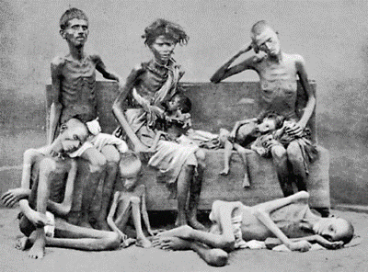
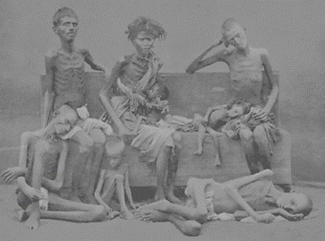
WHAT? Is the Impact of this on India and Indians
DRAIN OF WEALTH Earlier exports led to influx of wealth. Now each ounce of spice, each yard of cotton, was a net DRAIN from India to Britain.
For Indians conseq of such plunder were heavy. The Famine of 1770 in Bengal wipes out ONE THIRD of the population
Led to tax reforms, but now the PERMANENT SETTLEMENT 1793 creates PRIVATE PROPERTY in land.
  ZAMINDARS = “lords of the land” became OWNERS of land.
With Industrial Revolution in 19th Century, Indian artisans out of work. DEINDUSTRIALIZATION of India.
Taxes in Cash. Peasants now forced to grow crops for a market, at terms very unfavorable to them. Forced COMMERCIALIZATION of Agriculture.

Slide 7
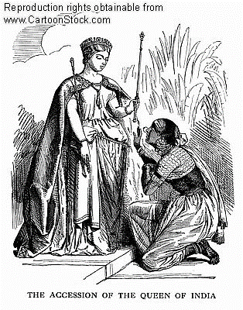
Impacts: New Ideologies of Rule
Early Englishmen in India not really interested in "civilizing" Indians, many adopted Indian lifestyles and customs
With status and role as RULERS, things change
Late 18th C saw ORIENTALIST scholar-administrators such as WILLIAM JONES, NATHANIEL HALHED etc. Appreciate but exotify and REIFY “Indian Culture” The “Invention of Traditions.
19th C saw decline of Orientalists and rise of ANGLICISTS, influenced my evangelical and utilitarian ideas. Little respect for Indian traditions. Promote westernization. MACAULAY

Slide 8
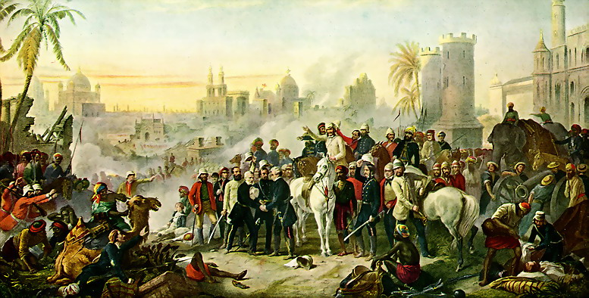
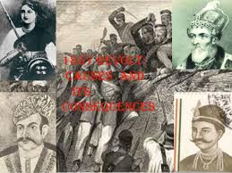
Impacts: 1857
In 1857, dispossessed rulers, some landlords, peasants, artisans and soldiers contribute to a great uprising, the REVOLT OF 1857.
Anti Colonial, but not NATIONALIST, sought to RESTORE, not create a nation.
Almost succeeded in unseating the British, but failed due to lack of coordination and large pockets of quiescence.
Revolt was violent. But put down with even greater ferocity and violence.

Slide 9

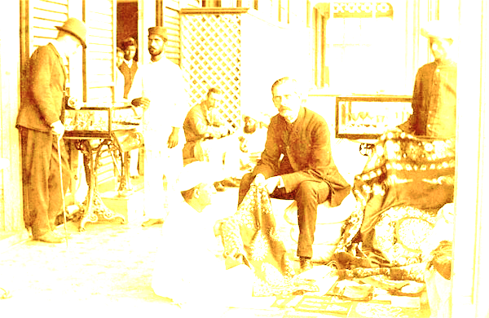
Impacts: Changing Attitudes and Policies after 1857
Strict separation and emphasis of hierarchy between whites and natives: separate neighborhoods, whites-only social clubs. Indians excluded.
Emergence of so-called “scientific” racism help emphasize these divisions.
New Communications. Railways, Telegraph Postal Service help consolidate British rule, and introduced for that purpose
  Railways (all imported with loans guaranteed by Indian taxes), e.g. ran from PORTS to producing areas, apart from connecting areas of strategic importance to the rulers.
Unforseen consequence of connecting Indians from different parts of the country, especially a western-educated elite NATIONALISTS.
Thus British rule unwittingly create the forces that were to undermine in the next century.

