Slide 1
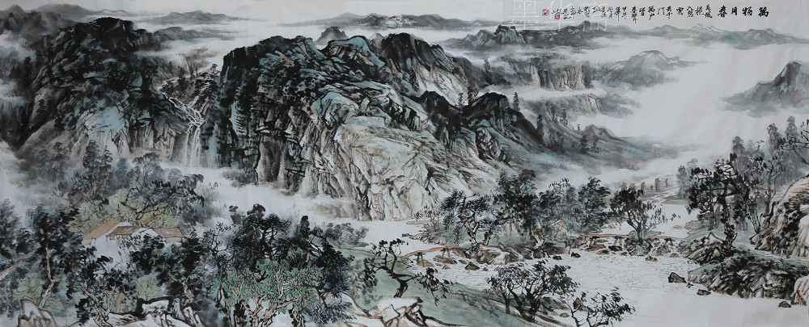
“Traditional” China
In interests of full disclosure: Some of the following is shamelessly appropriated from Dr. John Leung’s original set of slides on Traditional China

Slide 2
Overview
Geography
History
Society
Culture and Ideologies
Political Structures and Systems
Changes and World Views
Misrepresentations and Lead Up to War

Slide 3
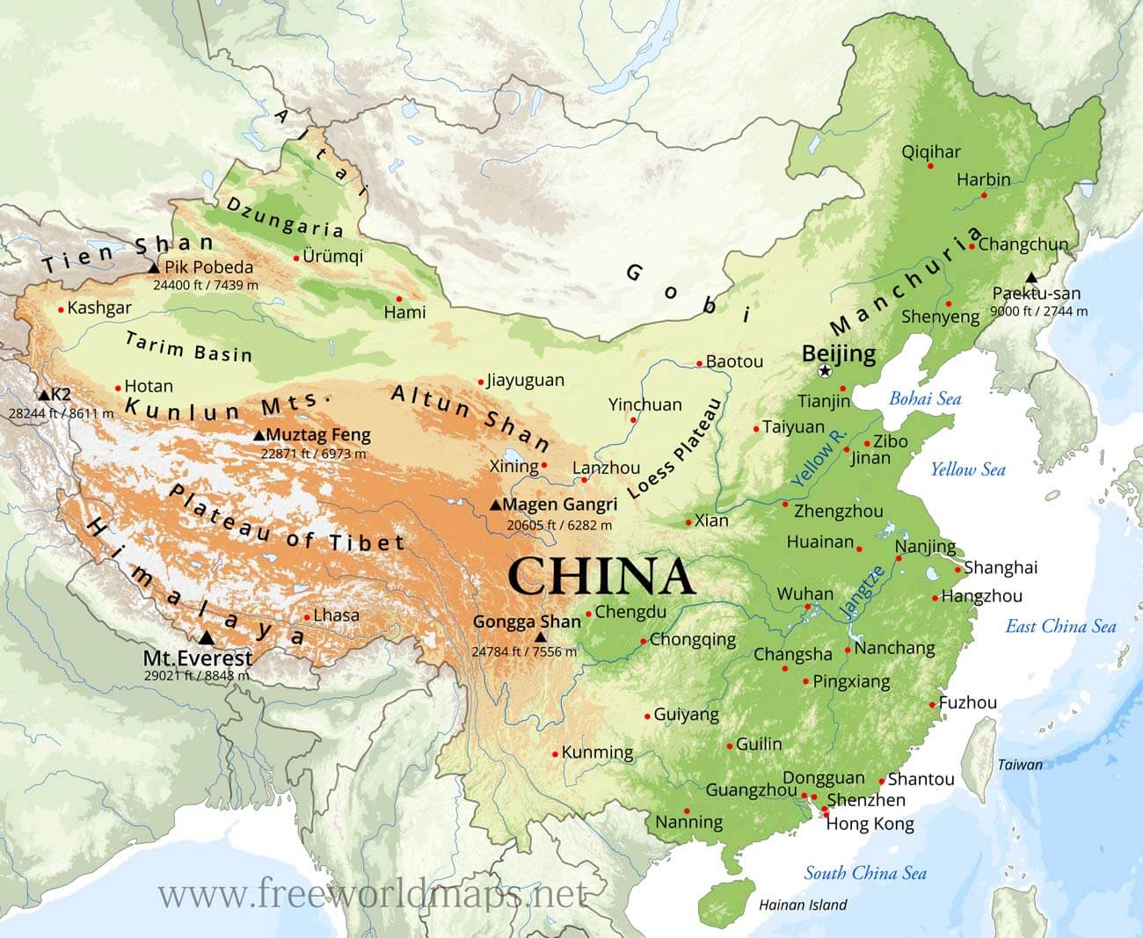
Physical Features

Slide 4
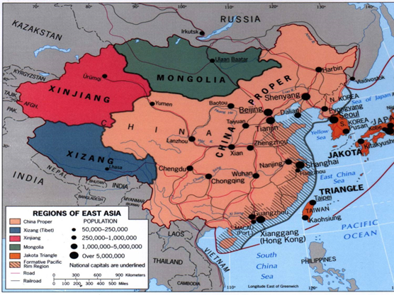
Regions of China
Outlying regions
NW: XINJIANG (desert, mountains, but strategically important to defend China proper)
NORTH: MONGOLIA (OUTER MONGOLIA independent) Again, strategically important frontier
NE of BEIJING: MANCHURIA: historically not China proper, land of JURCHEN tribal groups,
TIBET: not conquered or annexed till the 18th C, ambiguous and contested place within China even today, with many claiming it as Chinese occupied.
China “proper”
  North of the Huang he (Yellow) river. Yellow River basin “cradle of Chinese civilization”
  Central, along JANGTZE river: most fertile, most populous, milder climate
  “South”more of a residual category: mild climate, mountains, but pretty good for people

Slide 5
History
A continuous recorded history of a political and cultural formation that arose as early 1300 BCE
Difference with South Asia (India): political control over most of “China proper” since about 211 BCE
Though important not to OVERPLAY this.
Cannot assume homogeneity, or that a single ideology -- social, political, or cultural -- pervaded the entire area.
Many divisions too, ethnically between Han and others

Slide 6
Ethnic co-existence and contestation: “The Chinese” is a modern social and political “construction.” “China” traditionally (and now) is a multiethnic and multicultural entity, fraught with issues of co-existence and contestation.
(Periods of non-Han rule of all or parts of China)
Northern dynasties 386-581 CE
Liao 907-1125
Jin 1115-1234
Mongol/Yuan 1206-1368
Manchu/Qing 1644-1911
(Total: 933 in 2231 yrs. = 42%)
Many ethnicities: e.g. Han, Meng (Mongol), Uighur, Zang (Tibetan), Man (Manchu), etc.

Slide 7
Thought & Culture (Vohra, pp. 5-10)
“Confucianism” – dominant ideology of Chinese society and state since 1st Century BCE
Original teachers:
Kong Qiu (“Confucius”) ca. 550-480 BCE
Meng Ke (“Mencius”) ca. 370-290 BCE
Xun Qing (“Xun zi”) ca. 313-238 BCE
Five Cardinal Relationships: Father-son; Sovereign-subject; husband-wife; older brother-younger; friend

Slide 8
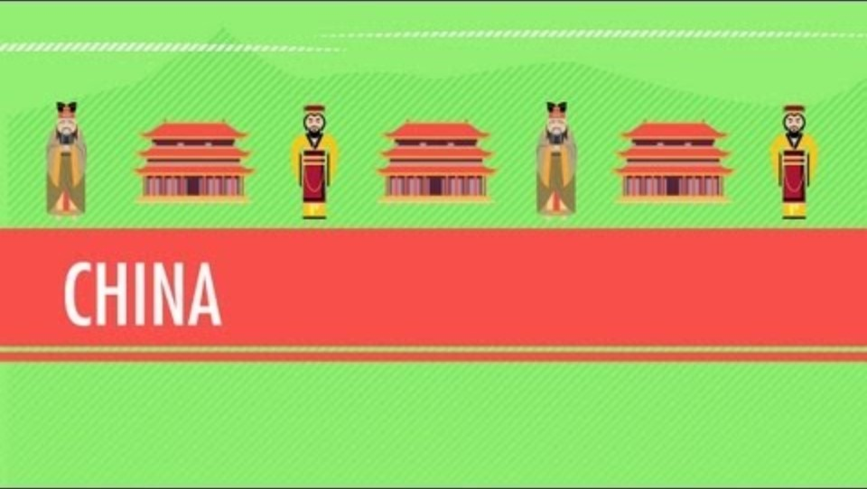
Confucius and the –ism 6:30 to 8:18
https://www.youtube.com/watch?v=ylWORyToTo4
6:30 to 8:18

Slide 9
What does “Confucianism” mean? It is both Philosophy and Orthodoxy – the underpinning of a concept of a rigid universal social and state order
IMPERIAL CONFUCIANISM emerged as a mix of Confucian and LEGALIST ideas, emphasize the importance of laws, strict punishment, and political control. The establishment of Imperial order
Helps sustain support of auxiliary social systems (govt. endorsement, bureaucracy, education, examination system – ladder of success)
Extension of Confucian cultural influence and the expansion of the Chinese empire

Slide 10
Significance of Confucianism for our comprehension of Modern China
Orthodoxy: tremendous and deep influence on Chinese society, values, and state
Notion of MANDATE OF HEAVEN. But mandate of heaven could be withdrawn and as “heaven sees as people see” implied that if people dissatisfied, then rebellion justified
Enduring tradition but also target of change
Manchu monarchy adopted and adapted itself to the Confucian order and its teachings – hence in the modern period rebellion against the Manchu imperial system also involved to some degree rebellion vs. Confucianism

Slide 11
Other cultural influences
Philosophical traditions: Daoism, Buddhism (introduced in 1st C CE; processes of Sinicization; becomes one of the major pillars of cultural connection between China – including the Chinese state – and the rest of Asia;
unquestionably the most populous religious system in China, if not in Asia; Buddhism’s varieties – not a monolithic system of belief in China)

Slide 12
Society
Hierarchies: Classes
Gentry (two intertwined types: govt & landed)
Peasant farmers (the vast majority; differentiated by economic prosperity)
Industrial workers, artisans, and the commercial class: Culturally demeaned but real historical growth; Commercial economies mostly medium and small; industry run the gamut from peasant household-based “cottage industries” to large scale productivity industries (e.g., mining.) Limited mechanization until late-19th C
Patriarchy dominant throughout traditional Chinese (esp. Han) society. Reinforced by “neo-Confucian” ethics since 12th C

Slide 13
Political Structures & Systems
(Vohra, pp. 2-3; 7; 10-11; 12-14)
Monarchies and dynasties
SCHOLAR-GENTRY
Bureaucracy: Officials chosen for “merit” (however that maybe defined) vs. a nobility-dominated govt. has been a characteristic of MOST (not all) of traditional Chinese political history
Bureaucracy existed UNDER monarchy
The “Mandate of Heaven” concept applied to the legitimation of imperial rule and dynastic prolongation (compare w/ “Divine Right of Kings” in Western tradition of monarchical absolutism)
Constant tension between Central govt. (centralism) and the politics and power of the regions: Persistent regionalism; several times resulted in political division

Slide 14
China Compared, ca. 1600
In1600 China one of the largest, most sophisticated realms in the world.
Larger than Russia in 1600, by when India was not yet fully integrated under Mughals and American empires in decline, only Ottomans comparable
Technologically, Chinese skills in printing, manufacture (porcelain and silk, e.g.) unparalleled
Nearby societies either conquered or modelled their own states and societies on Chinese models.
Not for nothing then did the Chinese consider themselves the MIDDLE KINGDOM

Slide 15
Changes and World View
1644 the Han Ming Dynasty gives way to the Manchu Qing
Qing/Manchus adopted “traditional” ideologies and practices of government, patronize Confucian scholars etc.
Also maintain idea of “middle kingdom” and label of but as Vohra tells us, in practice deal with different

Slide 16
Misrepresentations
Manchu policies were misrepresented by Western traders
Chinese conceptions of law were different. Few written law codes. Law based on COLLECTIVE and not INDIVIDUAL responsibility. Thus, family or lineage or even clan or tribe could be punished.
Not xenophobic, but a Chinese way of looking at the world shaped by own history. Not interested in outside world, because they did not need need anything

Slide 17
Times Were a Changin’
First SILK and then TEA make China trade very attractive to Western traders
Imbalance of Trade, so large outflow of precious metal from West to China
Need to balance this trade
Found in OPIUM, a commodity the EIC could grow in India (that they controlled by early 19thC)
Opium leads to war, the first war on drugs with the British and the US as the drug runners.

