Slide 1
Hindus and Muslims 1000-1500 CE

Slide 2
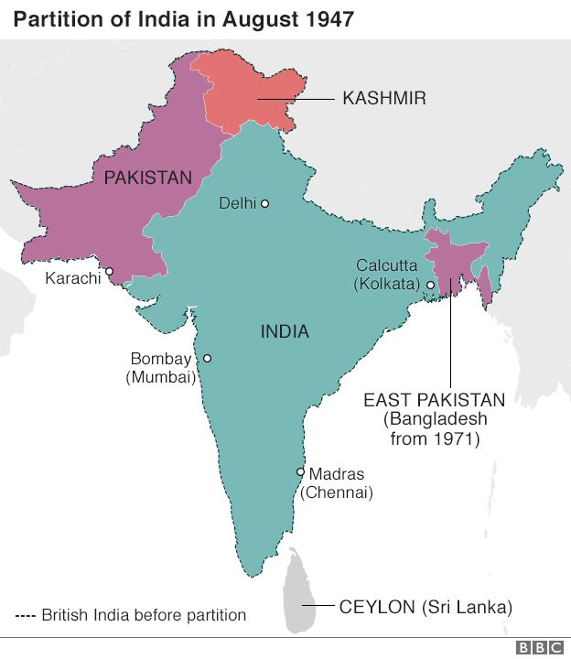
Start with more recent history!
1947 the British leave India, but leave behind a partitioned subcontinent
Two countries (later three): India, Pakistan (1971, also Bangladesh)
Pakistan created as homeland for Indian Muslims from Muslim majority areas of the subcontinent
Partition saw unbelievable amount of violence between Hindus and Muslims, over a million die and 10-15 million forced to move
Created antagonisms that have been read back into history

Slide 3
But who are Hindus?
The category “Hindu” describes a whole range of devotional and ritual practices
It describes folks divided by caste
Describes a range of folk whose history is a history of migration
So, who is Hindu?
  Dasas of Vedic period?
  Animists whose practices incorporated thru PURANAS?
  Lower castes who were not allowed even to listed to Vedas?
  Buddhists?
  Bactrians, Scythians, Huns?
  Rajputs, who were very recent migrants

Slide 4
A “Hindu” India?
Islam represented as “foreign” to India, but we have also discussed the problem of who is “foreign” going all the way back to the Arya migrants ca. 1500 BCE, through to the 6th or 7th CE migrants, the Huns, who became the archetypical Hindus, the “Rajput”
Most importantly, ca. 1000 CE, there was no notion of Hindu unity and certainly none of “India" being defended against foreigners
Example: The raids of Mahmud of Ghazni end in 1030 with his death. Between these raids and the next major invasion from the North West (Muhammad of Ghur), there was a gap of almost a hundred and fifty years. In this period Rajput power and authority increased across north India. Yet, no attempt made to fortify the passes in the North west through which invaders came, nor any attempt at a unified response. Rajputs were divided, lot of infighting, and for them war had almost become sport

Slide 5
Cultural Developments in the Sultanate Era
Continue the decentralized polities of previous 500 years or so but culturally a period of incredibly rich fusion
Critical developments in art and architecture, with a new kind of dome and arch introduced to India
Innovations in art, with a new school of miniature paintings developed, that fuse into one what has come to be known as the Indo-Islamic style
Major literary and technological and scientific changes, with exchange of ideas between Indian scholars and those of the Islamic world
Modern regional languages developed in this period, as did important forms of music and cuisine
What we know of as the Classical music of North India was created with significant inputs from one of nobles of the Allaudin Khalji’s court AMIR KHUSRAU
Khusrau was a disciple of Nizammudin Auliya, a CHISTI Sufi saint, and composed many fine poems -- not only in Persian or Arabic, but also in the local language of the region. His contributions help it develop into the language we today call HINDI, spoken by 65% of Indians, and functions as India's national language
Khusrau also credited with invention or innovation of many musical instruments, including the SITAR

Slide 6
How does one explain conversion to Islam?
Start with four “theories of conversion”: What are they?
1. Conversion by the SWORD, most common
why is this flawed?
What sort of ARGUMENTS and what DATA does he provide to refute this theory?
2. Religion of patronage, OK, but neither accounts for very large numbers, or the geographical spread
3. Religion of Social Liberation
Why is THAT flawed? That people converted to the ideals of the
Enlightenment and the French Revolution before they converted to Islam!

Slide 7
Eaton’s own argument 1
Central to his argument is that before we try to understand WHY people converted, we need to understand WHO converted
Converts from the FRONTIERS of Indian society (East and West) who were not already affiliated to any major religious system, nor integrated into agricultural practices
If you think back to Gupta era or even earlier, settled agriculture and incorporation into Hindu beliefs (and into the varna-jati system) were simultaneous processes
The reason why Muslim populations in the subcontinent had the peculiar concentrations (that allowed for a [much-later] physical partition into two nation-states) was because areas on the frontiers – east and west -- had large groups who had not been incorporated into existing major religious systems

Slide 8
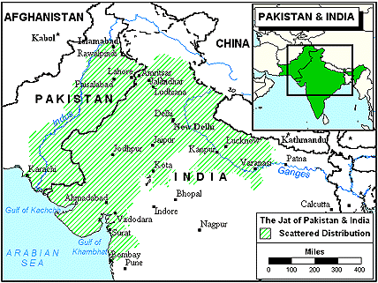
Conversion by the Plough 1
In the west, JATS, who are today an agricultural community, but were originally nomadic cattle herders
16th century begin process of sedentarization Jats, who became agriculturalists
SUFI saints (Muslim mystics) given land grants in the frontiers WESTERN PUNJAB by Mughals in 16th C (as Gupta kings had to Brahmins in their time)
Sufi shrines incorporate Jats into a new economic order, and along with it, a cultural practice -- Islam

Slide 9
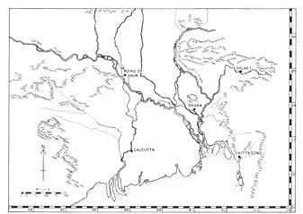
Conversion by Plough 2
In the east, EASTERN Bengal has most Muslims
Shift in river Ganges eastward in the 16thC opens up arable land
Here again Muslim intermediaries (Pirs) introduce rice cultivation to former forest-dwelling non-agrarian communities
So important that even today “being a good Muslim is closely associated with being a good farmer”

Slide 10
What was conversion?
SLOW and long drawn process marked by TWO phases,
  FIRST phase, from 13 to 19th centuries, ACCRETION, when being Muslim did not mean an adherence to ONLY Islamic beliefs, but also a variety of other local beliefs and practices
  NAMES e.g., (bottom p. 113): from 13th to 15th centuries only 10% names of a particular community professing to be Muslims in Punjab had ISLAMIC names. In 15th to 17th C 56%, and only by early 19th C were all names Muslim names
  SECOND PHASE19th C improved communications, and politics saw a REFORM movement emerging, making people more conscious of identity as MUSLIMS. Reforms urged adherence to Islamic principles as laid out in the Quran
  CONVERSION to ISLAM, much the same PROCESS that “conversion” to Hinduism, closely related to economic life, and though political power plays a role in both, not the determinant factor

Slide 11
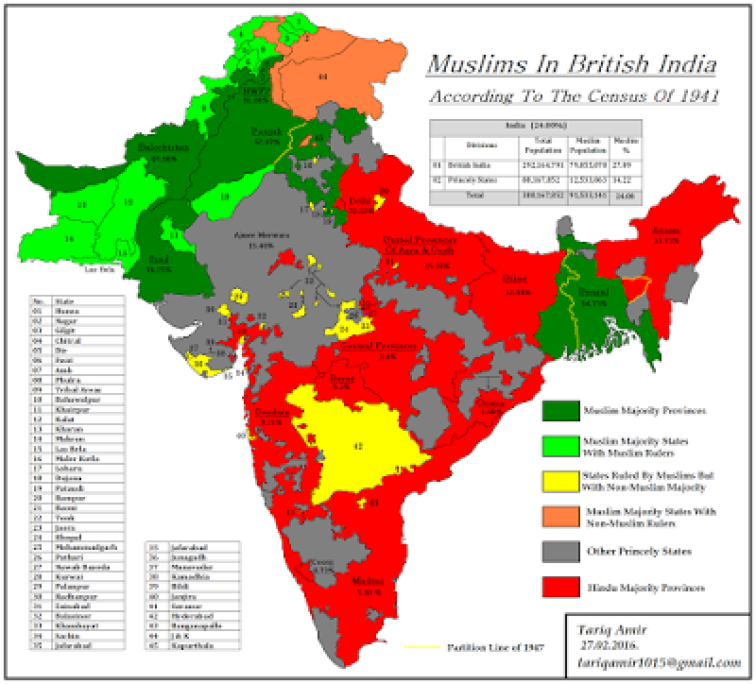
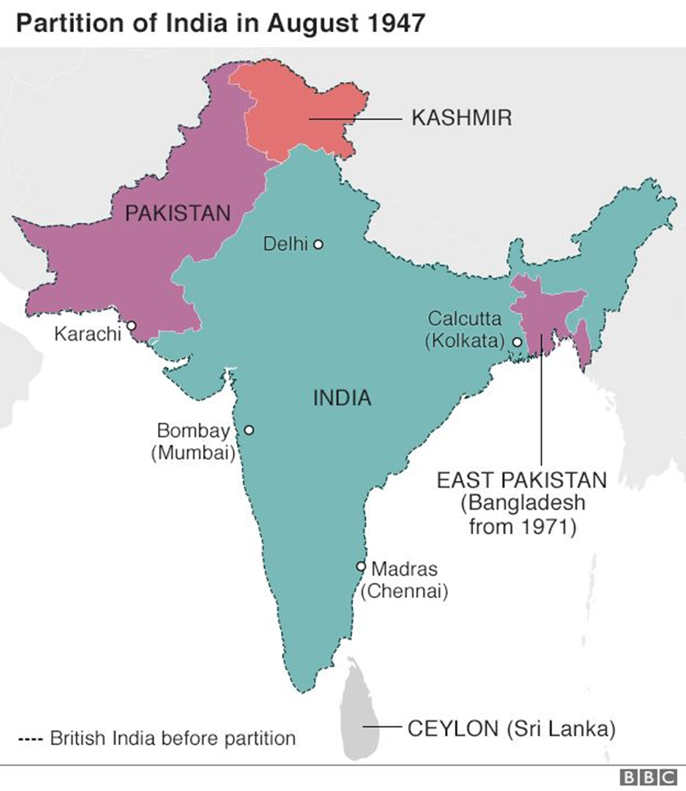
Eaton: Two concentrations of Muslim populations in East and West

