Slide 1
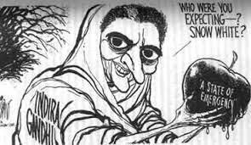
Indira Gandhi and the Emergency

Slide 2
POPULISM
no real respect for institutions, personalize politics, politics was about HER popularity
Cult of Personality

Slide 3
Context for Emergency
Lack of any real progress on economic growth, literacy or women’s empowerment
TWO elements that contribute to the Emergency were
1. Growing opposition,
2. Mrs. Gandhi’s LEGAL problems
Start with focus on the growing opposition
1972-73 Price Rise (OPEC Crisis)
Though not her fault, because she won PERSONAL accolades after B’desh, now blamed for difficulties (a feature of populism)
Anti Price Rise Movement (women-led)
NAV NIRMAN Movement
Students invite JP to lead the opposition to Mrs. Gandhi

Slide 4
JP (Jayaprakash Narayan)
Jayaprapash Narayan (JP) was an old Socialist
Originally a member of INC
In 1935 JP and other leftists broke with INC in 1935, to form CSP
Close to Nehru and personally, to Indira as well.

Slide 5
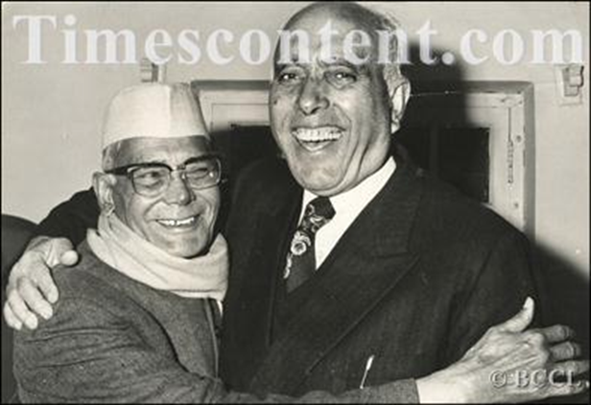
JP Reputation
Used by Nehru and Mrs Gandhi as “honest broker” in dealing with separatist or other crises. Nagaland and Kashmir, e.g.
Has MAHATMA GANDHI like credentials, a RENOUNCER, who, like Gandhi, never accept office, always a critical voice outside of corridors of power.
JP and Sheikh Abdullah

Slide 6
JP Movement
In 1974, invited by students in native state BIHAR to lead the growing protests against Indira. Soon became the JP movement.
Demand that Indira resign

Slide 7
JP Movement Issues
NO IDEOLOGICAL COHERENCE Included:
JANA SANGH (RSS Political Front)
Also former SOCIALISTS
AND former INC members alienated by IG and her coterie.
Mrs Gandhi feels EMBATTLED, but rather than confront these DEMOCRATICALLY, take on the debate, turn to her own advisors, and her own son, Sanjay!!

Slide 8
Allahabad High Court Verdict
On 12th June 1975 ALLAHABAD HIGH COURT rules against Mrs. Gandhi on a case lodged against Mrs. Gandhi over her 1971 election. She stands convicted of MINOR electoral malpractice.
Mrs Gandhi appeals the judgements and the Supreme Court STAYS the High Court orders disbarring her from Parliament. But she cannot vote in Parliament.
CONVENTION demand she resign, but instead, she declares a state of EMERGENCY!!

Slide 9
Emergency
There WAS Constitutional provision for the PM to take Emergency Powers
Most opposition leaders, from left and right, including JP imprisoned
Press censored
MISA, somewhat akin to Patriot Act, allows for imprisonment without habeas corpus.
SANJAY, her son, acquires huge political power

Slide 10
What happened in 1975-77
Opposition Jailed
Censorship
Forced Sterilization “Family Planning”
“Beautification” Cult of Personality
Important CONSTITUTIONAL AMENDMENTS #s 38, 39 and 42, to establish the supremacy of Parliament over the Judiciary -- the one institution Mrs G could only control indirectly

Slide 11
ANALYSIS
WHY EMERGENCY?
Fear of disbarment
Personality
JP movement?
RESPONSES
Middle class elite love it, industrialists love it, foreign press fawn over Emergency
Some literary figures oppose it
Had very few positive outcomes
JANUARY of 1977, Mrs Gandhi, surprisingly, ENDS the Emergency. Calls for new elections, where she is roundly defeated by the JANATA PARTY, a new coalition based on the JP Movement.

Slide 12
RESULTS?
Very little in terms of concrete outcomes
Prolong Mrs. Gandhi’s Premiership and promote Sanjay
Set back Family Planning program, would be two decades before any government could promote FP again
No real industrial progress, no real beautification, just some fancy new buildings, some folks displaced
A HUGE blot on history of Indian democracy
It was in many ways a LOGICAL OUTCOME of Indira’s populism. Her impatience or lack of respect for institutions and democracy, just took a more VIRULENT form because of Sanjay and many others

Slide 13
Another Emergency?

