Slide 1
Indira Second Innings

Slide 2
Second Innings
Sanjay death
Mrs. Gandhi’s reliance on family increases. Rajiv Gandhi pushed into politics
Populism and Autocracy
States’ Rights and States Pride : NTR in Andhra Pradesh, AASU in Assam, and Separatism in PUNJAB
Populist Communalism in KASHMIR

Slide 3
Kashmir
BEGIN COMMUNALIZING the situation in Kashmir.
In 1983 Farooq Abdullah, Sheikh Abdullah’s son joins an opposition coalition
Mrs Gandhi, in her campaign, painted him as a secessionist.
BLATANTLY appealed to HINDUS of Jammu, and invoked FEAR of VALLEY MUSLIMS.
Farooq won, but this event first created RELIGIOUS polarization in Kashmir
Even separatists , TILL THAT TIME had spoken of need to secede because they were KASHMIRI and included Hindu Kashmiris in their description of Kashmir. This was to change soon after.
1984, political machinations by Mrs. Gandhi ensure that Farooq is removed as Chief Ministers. Kashmiris begin to believe that Delhi will never let them exercise their own political will within India. Leads to support for separatism.

Slide 4
PUNJAB and Sikhism
SIKHISM: 15-16th C, founder Guru NANAK
Given present form by Guru Gobind 17th C
18-19th C RANJIT SINGH Sikh kingdom
19th C reformers, SINGH SABHAS
Early 20th C AKALI DAL
1947 Tara Singh demand for separate Sikh homeland. Dismissed
1966 Punjab as Linguistic State

Slide 5
Political Context of 1980s
Akali Dal vs INC main rivalry
Rough parallels to Sikh and Hindu pop.
Green Revolution makes many Sikh middle peasants richer
Indira Gandhi tries to break the hold of Akalis by promoting an extremist Sikh religious leader Jarnail Singh BHINDRANWALE

Slide 6
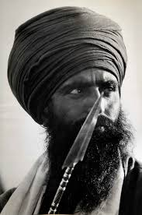
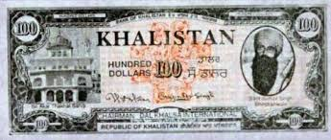
BHINDRANWALE

Slide 7
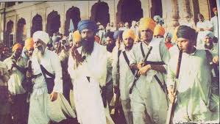
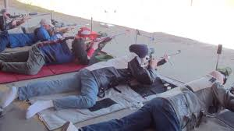
Out of Control in Punjab
Political Assassinations
Civilian Massacres
Targeted Killings police and military personnel
Take over and fortify the Golden Temple in Amritsar

Slide 8
Operation Blue Star and Assassination
Army Called in
Parts of temple destroyed in seige (use of mortars deemed necessary)
Bhindranwale and followers killed
Anger at desecration
Mrs. Gandhi assassinated by Sikh bodyguards in 1984
Anti Sikh pogroms in in Delhi and other cities

Slide 9
Assessing Mrs. Gandhi
Punjab and Kashmir reveal the disastrous results of a short term focus on popularity and winning elections by any means necessary
A widespread erosion of the idealism that had characterized earlier years of politics was a singular product of Indira Gandhi’s contribution to Indian politics
This included encouraging corruption and criminality. Most politicians under Nehru would not think of personally profiting from political office, nepotism perhaps, but corruption was a fact of life under Indira Gandhi.
Similarly with using violence, Nehru NEVER condoned it but Indira simply treated it as another means by which politics carried out.
No commitment to economic planning other than sops to important constituencies in election years
DO READ KRISHNA RAJ’s ASSESSMENT. Guha, pg. 567-68.

Slide 10
Dynasty Established: The Other Son
RAJIV GANDHI
Elections following assassination lead to LARGEST EVER MANDATE
Seen as fresh, new, honest, and NOT a traditional politician. Immense hopes, quickly belied!!
Began well, quick accords with regionalists, in ASSAM, MIZORAM, and PUNJAB.
Promised to recreate democracy within the INC

Slide 11
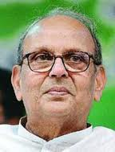
Rajiv’s Populism
INC Reforms don’t work out
BABRI MASJID
Shah Bano Case
Then, BOFORS, Corruption Accusations
VP Singh

Slide 12
Economic Liberalization
Starts under Rajiv and VP Singh is his finance minister
But after promising start, does not deliver in the dismantling of the “license-raj”
PV Narasimha Rao 1991 crisis
Manmohan Singh as Finance Minister
BJP ambivalence “Swadeshi” on the one hand and “Pro-Business” on the other

Slide 13
CONTEXT
Soviet Union collapse, valuable trade partner. India e.g. barter foodstuff for oil with USSR for a long time. NO loss of foreign exchange.
IDEOLOGICALLY big blow to planned economics, state control of economies, and immense and perhaps unjustifiable faith in the market replace that.
Attack from international economists, often expatriate Indian = State controls of the economy had led to stagnation, lack of competition, lack of growth. Jagdish BHAGWATI (now at Columbia University) was the major spokesmen for a NEW IDEOLOGY asking for removal of state control, free market and free enterprise, opening up of the barriers to international trade , as the only solutions.
Some change needed, no doubt, and governments, since Rajiv era, tempered by DEMOCRATIC politics, introduced market oriented reforms, slowly.

Slide 14
Questions About Growth
Growth for WHOM? HOW will it solve the problem of illiteracy, inequality, etc. Would it simply make the rich even richer?
Liberalization, market forces work towards “growth,” but as Edward Abbey said, “growth for the sake of growth is the ideology of the cancer cell!!”
Rather than just “growth” need to focus on what KIND of growth, to ask WHO grows and who doesn’t?
Ultimately though it come back to the central paradox. How will can one balance democracy with economic growth?
WHY is this an issue in India?
Paradox of a democracy, competing demands on state from different interests, often locally and parochially organized, at a time when there are not enough resources.

Slide 15
Economy Achievements and Failures: Nehru to Rajiv
END FAMINE
LIFE EXPECTANCE 30>60
DEMOCRACY
LARGE SCIENTIFIC COMMUNITY
INDUSTRIAL INFRASTRUCTURE
NUCLEAR & SPACE PROGRAMS
POCKETS OF ECONOMIC GROWTH
WORLD’S LARGEST MIDDLE CLASS
LOW FOOD AVAILABILITY: 35% LIVE BELOW POVERTY LINE = ONE SQUARE MEAL A DAY
STILL WELL BELOW CHINA
DALIT, POOR, WOMEN OFTEN DENIED RIGHT TO VOTE
WIDESPREAD ILLITERACY, 50% ADULT LITERACY RATE
LARGE NUMBERS LEFT OUT OF DEVELOPMENTAL PROCESS
LACK OF BASIC EDUCATION, UNIVERSAL HEALTH CARE, ACCESS TO CLEAN WATER
REGIONAL IMBALANCES
SOME OF THE WORLD’S POOREST

