Slide 1
The Indus Valley Civilization (IVC) aka Harappan Civilization, peak during 2500-1700 BCE

Slide 2
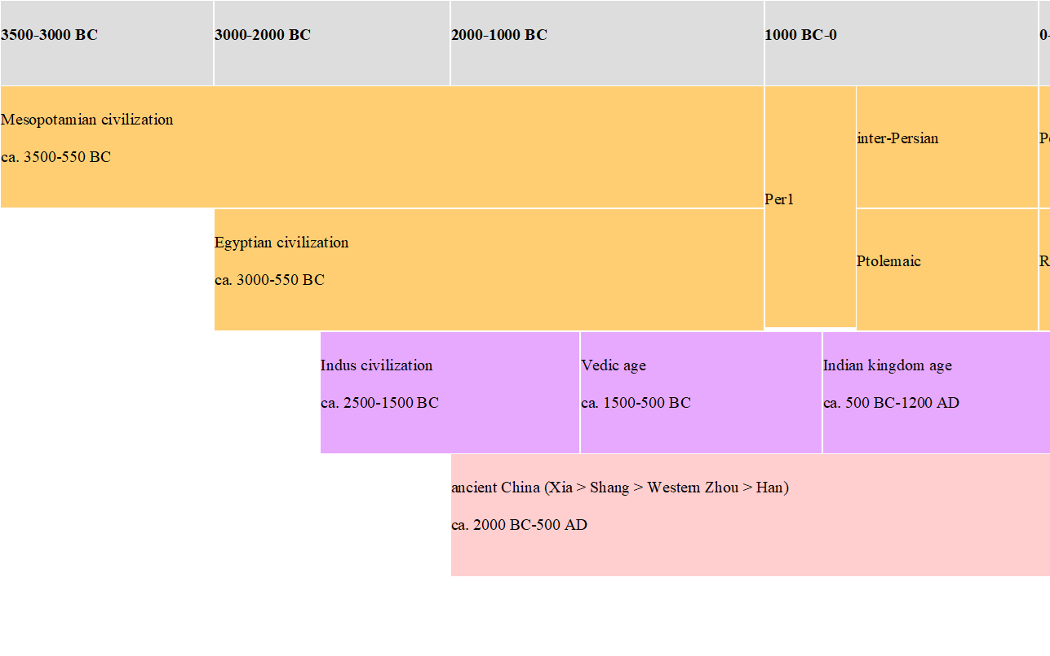
Comparisons with other Ancient Civilizations
One of the oldest civilizations in the entire world. Right after SUMERIAN or MESOPOTAMIAN and the EGYPTIAN

Slide 3
Largest of the three (four) in size

Slide 4
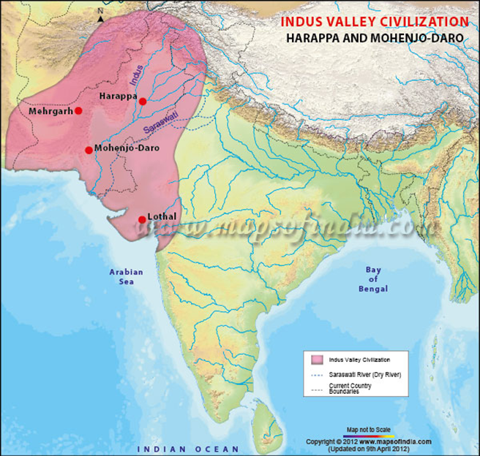
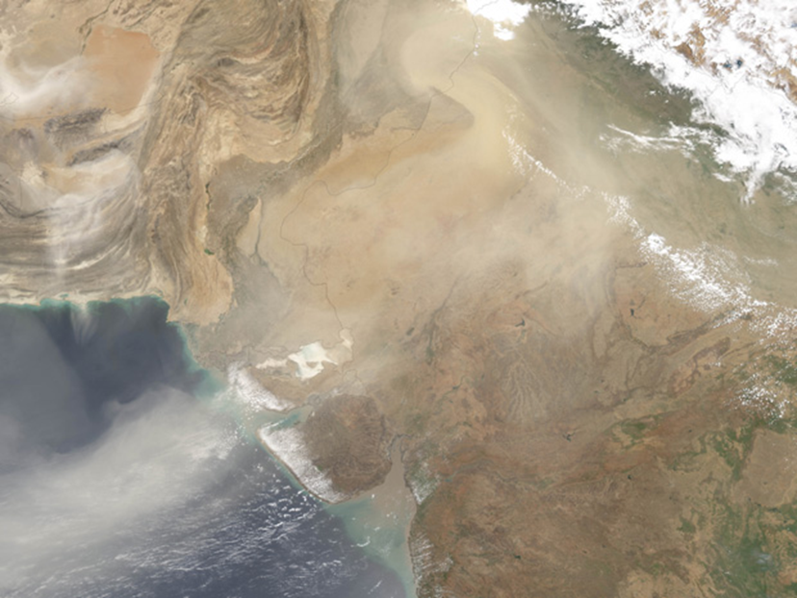
Size: Extent of IVC
Of the three oldest civilizations the IVCs was the LARGEST. We estimate about 4 million people within its limits with almost 40,000 estimated to live in the city of Harappa alone

Slide 5
Harappa.Com
One of the best online resources available on the subject
Curated Photo essays
Written essays
State of current research
And much more
Some important cities in the IVC
Mohenjo Daro
Harappa
Lothal
Kalibangan
Mehrgarh
Among others

Slide 6
Accidental Discovery (for Anglophone world)
Some ruins first mentioned in British travel accounts of 1842, but locals already spoke of a great city that existed in times past
Need for local intelligence 1830s, and use of railway ballast for early railway tracks in 1856 led to discovery of burnt bricks from Harappa
Visit of an Indian archeologist Rakhal Das Banerji ca 1919 alerted authorities to the presence of an ancient city
Sir John Marshall invited to undertake more extensive archeology done around 1921
1922 discovery of Mohenjodaro

Slide 7
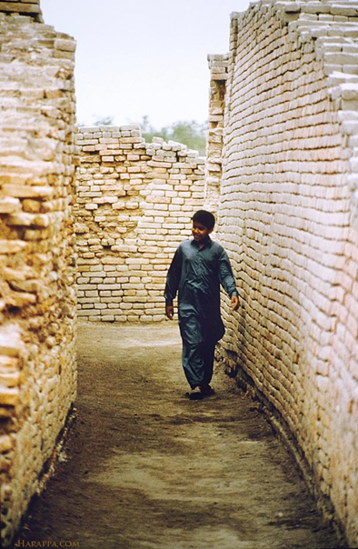
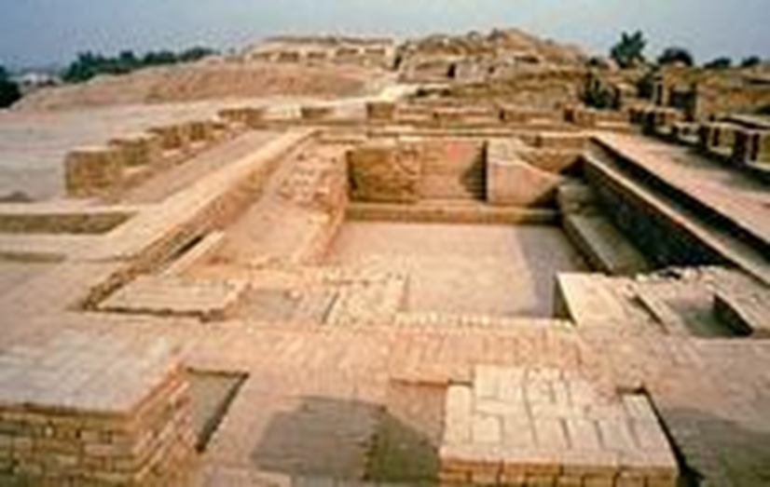
Some Highlights of Archeological Discoveries
PLANNED Cities built with manufactured bricks
“Great Bath” or water storage in A typical street in the IVC
MOHENJODARO

Slide 8
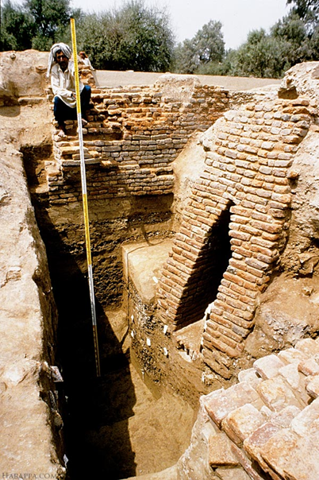
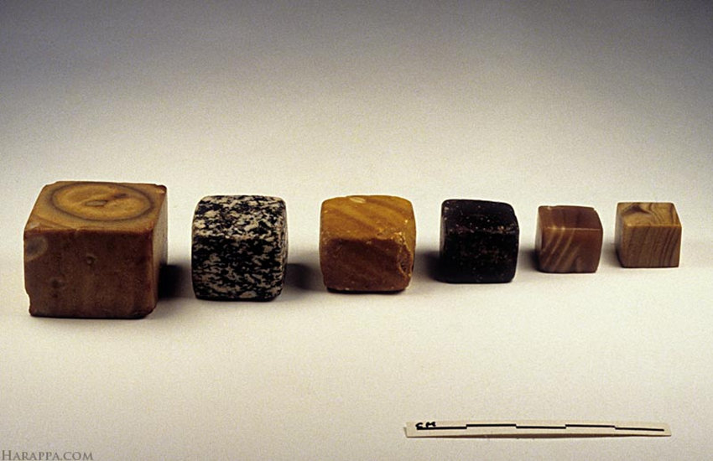
More Highlights
Even the poorer parts Uniform Weights and Measures
of cities had drains (including measures as small
and underground sewers! as 1.6 mm!)
Drains Weights used

Slide 9
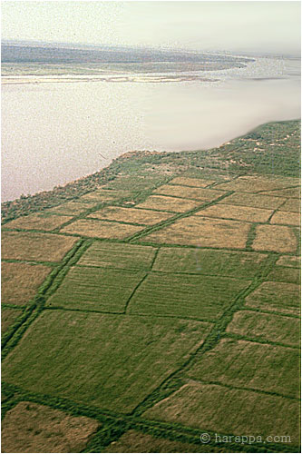
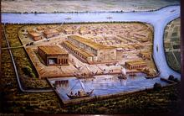
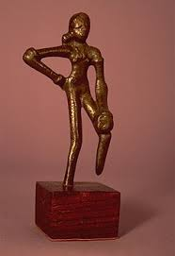
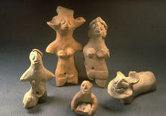
What did they DO in the Indus Valley
FARMING
to support cities.
Area is still cultivated
CRAFTS made beads,
figurines, pots, toys
BUILDERS from brickmakers to architects and planners,
TRADERS The port city of LOTHAL traded with Mesopotamia
(an imaginative representation of Lothal)

Slide 10
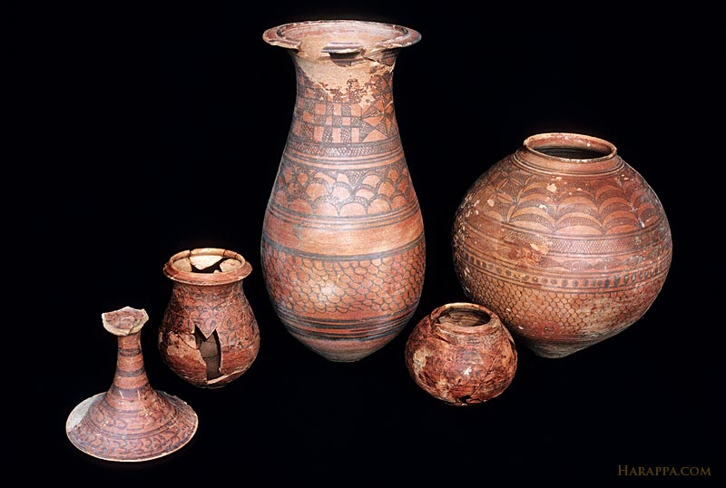
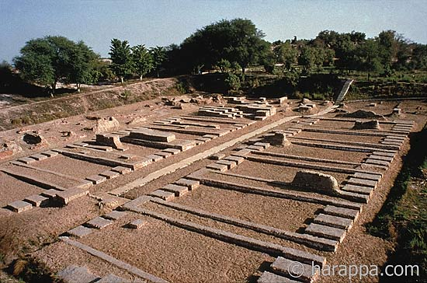
Artisans and Builders
Fine Pottery
NOT a “granary” Harappa

Slide 11
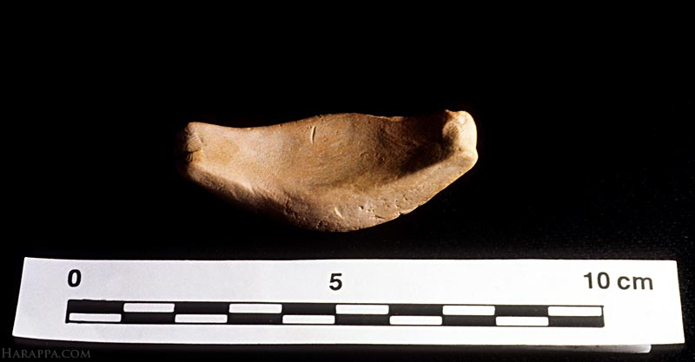
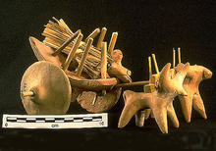
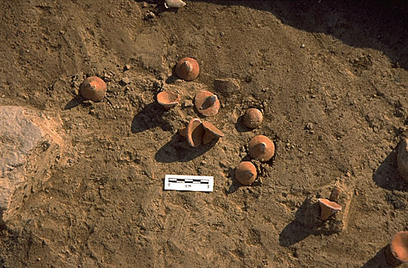
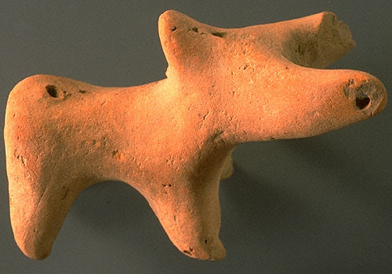
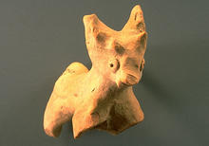
Clearly loved their Children! Following are probably Toys found in excavations: Ox Cart, Boat, Tops, Animal with moveable head and tail, deer/fawn

Slide 12
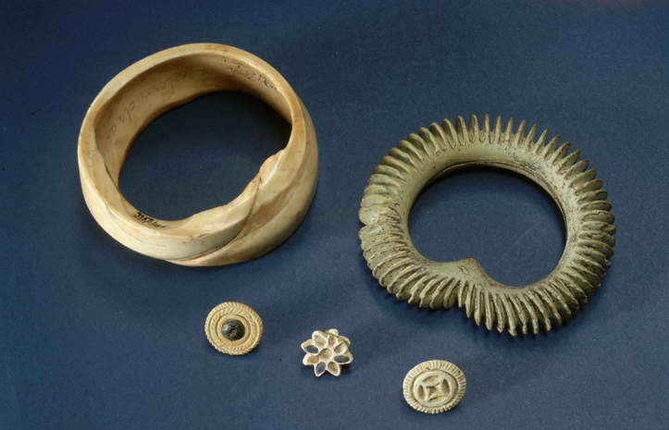
And finer things in life!

Slide 13
What they did NOT do
Very few weapons found throughout the IVC, so although they clearly had a government and folks giving and accepting orders, there was no armed militia and certainly no army

Slide 14
Economic Basis of the IVC
Urban Civilizations need an agrarian hinterland
Had to produce enough for there to be SURPLUS (why? to feed townspeople ) but also ways of that surplus being APPROPRIATED so that builders, artisans, etc. could be paid to produce goods, which can then be traded to again access to more resources, and obtain more surplus.
Such is the basis of all “civilization,” even to some extent, our own
This allows us to also make some speculations about economic SOCIAL ORGANIZATION in the IVC

Slide 15
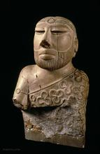
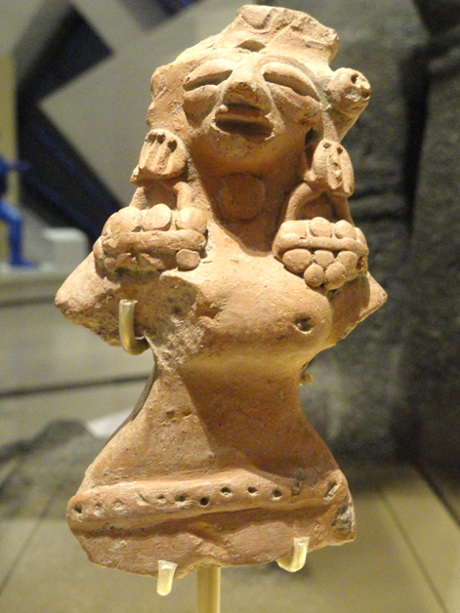
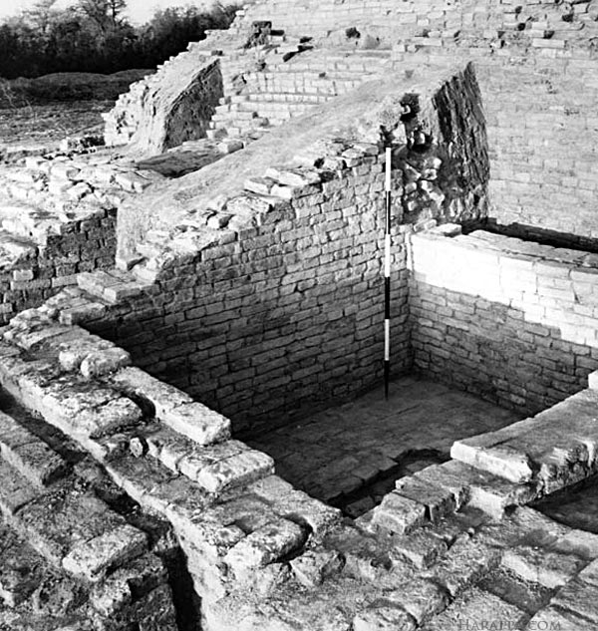
Was Everyone the Same? No
The elite lived on higher ground, in larger homes in “the Citadel,” and commoners had smaller homes on lower ground, though even smaller homes had their own wells
Gate of the “Citadel”
The level of planning, uniformity, etc., IMPLIES some kind of government or authority
Priest King? Mother Goddess?

Slide 16
Emergence of Inequalities in Human Society
Primitive society, hunting and gathering, involved some amount of cooperation, but no surplus. They produce to consume, and though there may have been some hierarchies, not established. Certainly no mechanisms of surplus extraction
Surplus extraction means some can live off the labor of others, e.g. in IVC we can infer that some kind of class society had already emerged
Classes can only come about when surplus extraction mechanisms in place, whether through force, through deceit, superior technology, or knowledge.
For IVC this is not simply SPECULATION, but based on TENTATIVE evidence. In MD and HR, DIV of cities into ACROPOLIS, on mound, and the "lower" city. Different access to resources. Clearly, two different classes of people
Many scholars have also argued for a HETERARCHIC rather than HIERARCHIC social and political order in the IVC

Slide 17
IVC
We could be a lot surer about our understanding of the IVC if we could crack some of the mysteries surrounding this civilization
The Biggest of them is the mystery of their SCRIPT
We have solved, to most people’s satisfaction what used to be another big mystery: about the Origins of the IVC
We are in a better position to understand the DECLINE of the IVC
BUT, mysteries remain, and probably will as History is seldom complete or absolute

Slide 18
Mystery solved: Origins of IVC
The earliest theories about the origins of IVC based on limited archeological evidence
Knowing about the Mesopotamian civilization, archeologists assumed IVC cities were outposts of the Mesopotamian empire
clear evidence of contact
many similarities between the two
However, later research seems to point in another direction
Shows the gradual and indigenous evolution of IVC cultures
Excavations show evolution from Neolithic villages to an urban culture AT THE SAME SITE

Slide 19
MEHRGARH: About 150 miles NW of Mohenjodaro

Slide 20
Archeological Digs at Mehrgarh Show:
From primitive hunting and gathering around the 6th Millennium BC to settled lifestyles, with domesticated animals and grain, and an interesting wheel amulet
Tiny Steatite Beads from ca. 5500 BCE
Production of crude bronze handicrafts around 4000 BC
Skills improve, and around 3500 BC potters were producing eggshell thin pots with intricate designs
Artefacts at the same site dated to around 3000-2600 BC show signs of urbanization and increasing wealth, almost mass production, a kiln found with 200 jars in it

Slide 21
Mystery #2 Indus Valley DECLINE ca. 1900-1800 BCE
After about 800 years of doing very well, longer than most modern empires, “sudden” collapse over approximately 200 years,
Archeological finds at IVC sites of this time show cities hastily abandoned
JHUKAR and JHANGAR culture
The few places where populations resettled, they did so in a haphazard manner
Structures were built with broken bricks, without strict central planning that characterized the IVC cities at their peak, pottery less advanced

Slide 22
WHY?
Earlier thought to have been invaded, by the Vedic Aryans, the people from Central Asia who then established their sway over so much of North India
IVC had few weapons
Nice idea, but little evidence of that (plus about 200 year gap)
Earthquakes and consequent floods. Earthquakes, change course of rivers
disrupt agriculture, end the production of SURPLUS
No agriculture = less wealth = cannot support people who would make bricks, lay roads, plan towns, create or buy beads etc.
Explains Jhukar and Jhangar too
Did trade stop? We know trade and manufacture were big for them
Climate Change? We know rainfall declined in the 200 years around 1700 BCE, could this have led to the collapse?

Slide 23
Climate Change and Decline (and Origin) of IVC
PALEOBOTANICAL evidence shows:
rise in rainfall ca. 3rd Millennium BCE > increase in agricultural productivity = possibly allow for the production of surplus > IVC mature phase
rapid decline in rainfall between ~ 1800 and 1500 BC > lowering of available surplus and consequent decay of IVC
IVC cities depend on immediate hinterland for surplus. No army, so not able to extract from further afield, if latter was at all possible
Maybe migrate to other, more southern cities, like Lothal, which do stay in business for longer
but eventually with surplus gone, all urban life disappeared, thus Jhukar/Jhangar
Climate changes continue to impact history of region
rise in rain after 1500 BCE could have attracted Vedic Aryas
decline in rainfall after 1000BCE could have facilitated Aryas’ efforts at clearing the forests of the Indo-Gangetic plain in their eastward expansion

Slide 24
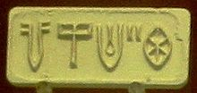
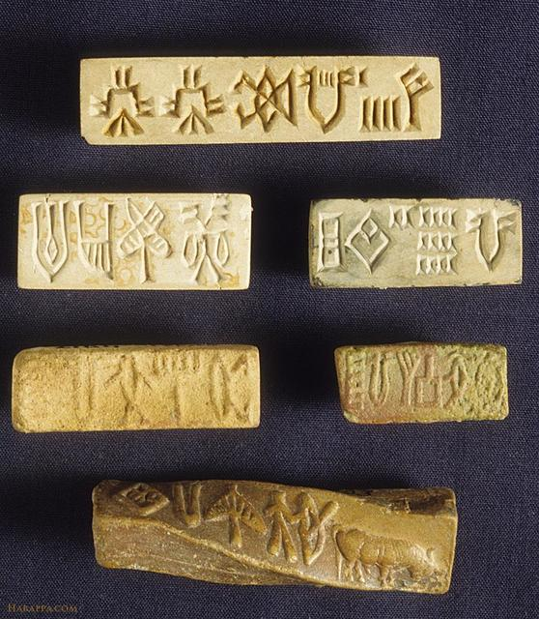
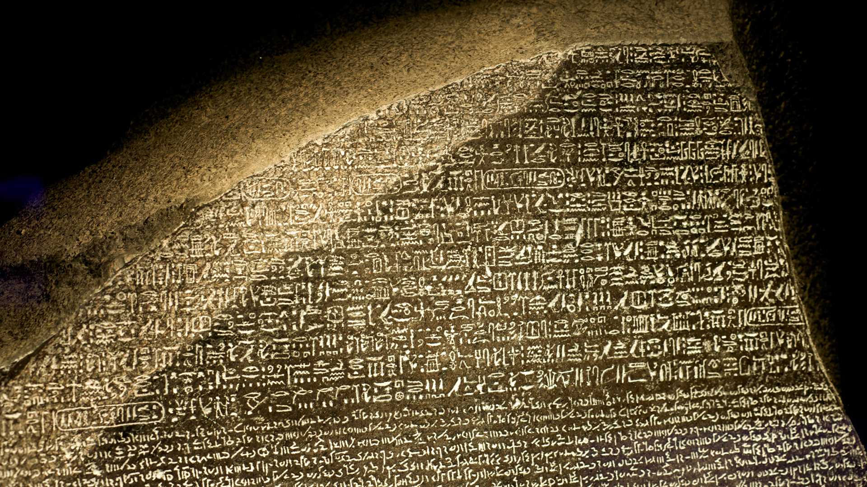
What we Don’t Know: The IVC Script
Although there are many seals and inscriptions
from the Indus Valley, as yet we have not been
able to TRANSLATE any of them
No “Rosetta Stone”
for the IVC yet
Debates about social and political organization,
about religious beliefs, would benefit from deciphering of the script
Perhaps YOU will be the one to crack one of
the greatest mysteries of the ancient world!

Slide 25
Dangers of Reading Back
uniformity in construction, in weights and measures, plans and layout of cities across wide area, suggest a strong, centralized, state
but in history, a danger of reading back our knowledge of later events or ideas into the past, seeing everything in the past as a precursor of something familiar
possible that IVC state something quite different from what we know
striking ABSENCE in IVC of weapons of war, if a strong state, it was probably not one based on a strong army
there MAY have been some sort of priest-king in IVC, and hierarchy, but very little evidence that IVC culture anticipate the caste hierarchies of later Vedic period

Slide 26
IVC, Politics, and History
History becomes the playground of politics! Very evident in some “debates” about IVC
Prior to discovery of IVC, Indian history began with VEDIC ARYA who spoke SANSKRIT, and whose legacy is what we call “Hinduism”
For some, “Hindu Nationalists,” proving IVC to be part of VEDIC culture a paramount obsession
To do this even willing to fake translations of script and images of a horse (unknown in IVC period, but central to Vedic age)
Integral part of Hinduism, as we will see, is hierarchical idea of “caste”
Yet other political activists want to trace origins of an indigenous “Dravidian” civilization to IVC, to prove that “the Aryans” colonized a Dravidian culture to push it further south

Slide 27
“Real” IVC
To establish veracity of many of the claims, needs much more research
Words become important, whether to call it IVC or Harappan, e.g.
Indus in Pakistan and Harappa in India
Question of who were the IVC/Harappan people becomes attached to current political debates in India or Pakistan
What they forget is that in some way the REAL, REAL, inhabitants, were workers: brick-layers, bead makers, agriculturalists
THEIR history will seldom be told
Even an amazing site like Harappa.com has more pictures of the ACROPOLIS, of the finer things, rather than the mundane ways of life of the peasant, worker, and mothers who created the surplus that made IVC possible

