Slide 1
Introduction to India
GEOGRAPHY
Geography and HISTORY

Slide 2
Terms
INDIA
SOUTH ASIA (not SOUTH EAST Asia)
INDIAN SUBCONTINENT
ALL REFER TO THE SAME ENTITY and will be used interchangeably for much of this course

Slide 3
TIME: Geologic and Historical
Much history is about time. We measure HISTORY mostly in terms of human settlements in a region. But geologically, a few thousand years make little difference
First, Pangea, single mass
About 180 million years ago GONDWANALAND (S.America/Anatarctica/Africa and India part of same landmass)
About 54 million years ago, the Indian landmass, bumped into the Asian plate
Himalayan mountains result of the "bump", slow, rate of growth estimated at 2cm per century
Current Geography shaped by that “bump” pretty stable for the last 50 million years
First HUMANS, 400 - 700,000 years ago

Slide 4
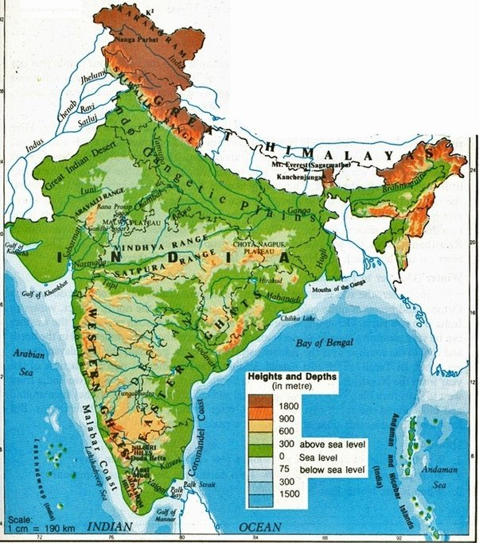
Basic Geography
Where
How large?
  Compare

Slide 5
Geography
Features
Mountains
Seas
Desert(s)
Forest
Geographical Basis of
  UNITY: Mountains, Seas, Deserts give a certain “unity” to subcontinent
  and
  DIVERSITY: 22 different languages, 13 different scripts ; Most major world religions, differences in culture, diet, clothing, etc.
  UNITY IN DIVERSITY was slogan of Indian nationalists, and a focus of this course!

Slide 6
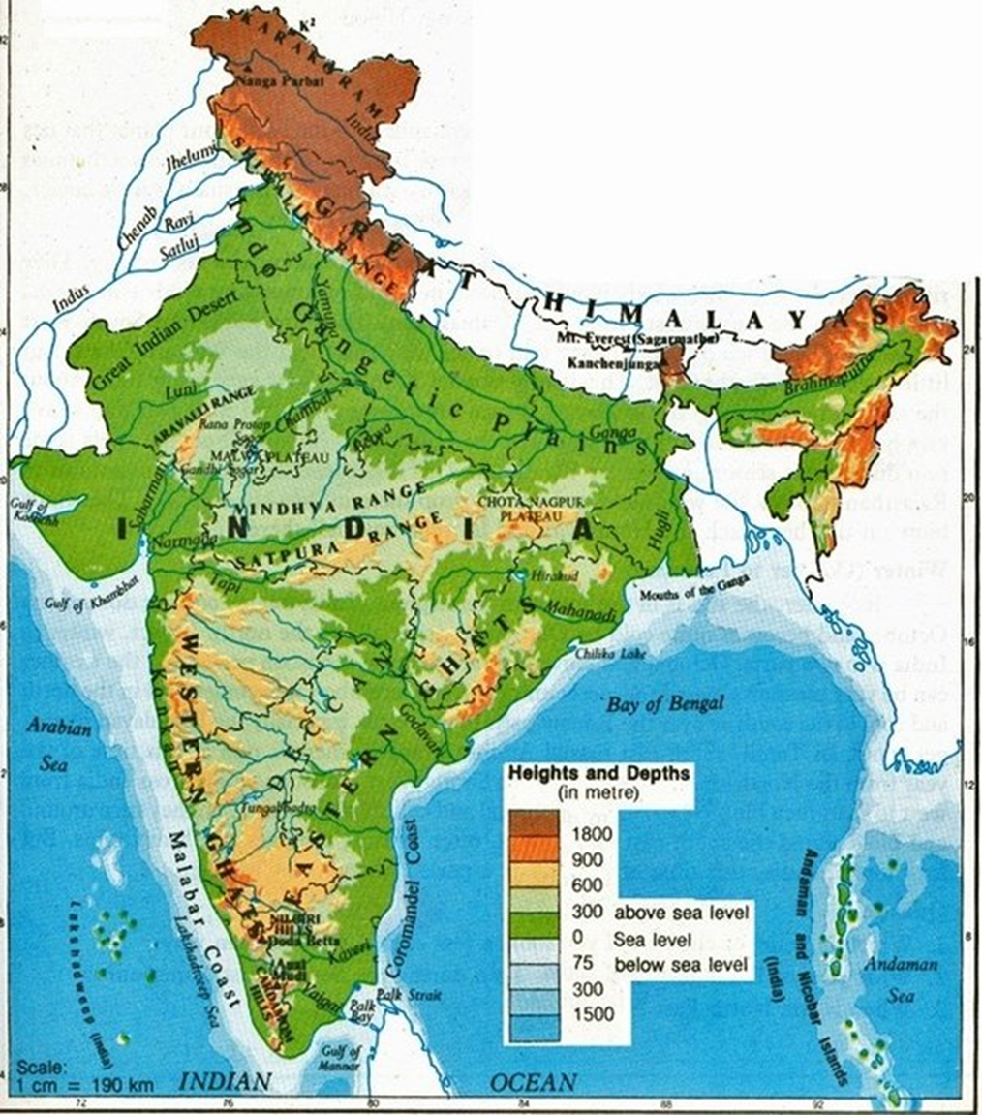
Regions
Main regions (will ignore the “sub-regions” for now)
Himalayan
Indo-Gangetic plain
Peninsular India (Intermediary Zone for Kulke and Rothermund)
Coastal India

Slide 7
Geography and History
Geography has determined patterns of human settlement
  compare map of current population density with maps on p. xiii (second page of Introduction to Kulke and Rothermund)
Shows why some regions have been central to history of region
  Indo-Gangetic plain
  Some coastal concentrations
  Connect with Monsoonal flows
Indo-Gangetic plains = rivers => well irrigated, fertile soil
  West desert, low
  North mountains, low
  These regions not as much “movers and shakers” of the history we will study
Topography often responsible for patterns of history

