Slide 1
Islam and Muslim Rulers in India
Seventh to the Sixteenth Centuries CE

Slide 2
Controversies and Context
The later history of India (a violent partition of the subcontinent in 1947) and current Islamophobia make this a more controversial subject than it should normally be
Given the context, we cannot look at this development, in the same way, for instance that we look at the Bactrians or Kushans (or the Huns!) in Indian history, to examine important cultural political and social developments that accompanied the rise of Islam in the region
There was no sudden mass conversion of “Hindus” to Islam (see Eaton essay)
Little change to political structures, that remain (until the Mughal era 16th C) decentralized, much as they had in “samanta” era, though Muslim rulers called them by different words, e.g. IQTAs
Most controversies come from an ahistorical READING BACK of history that we will discuss more specifically later

Slide 3
Islam
Literally, "submission to God," Islam is a monotheistic faith first established in Arabia in the 7th century CE, and is today the world's second largest religion
Followers of Islam are called Muslims
According to Muslims, God (Allah in Arabic) sent a number of prophets, and Islam respects Jesus, Moses and Abraham as prophets of God
But, for Muslims, Muhammad was the final Prophet
Crash Course on the rise of Islam

Slide 4
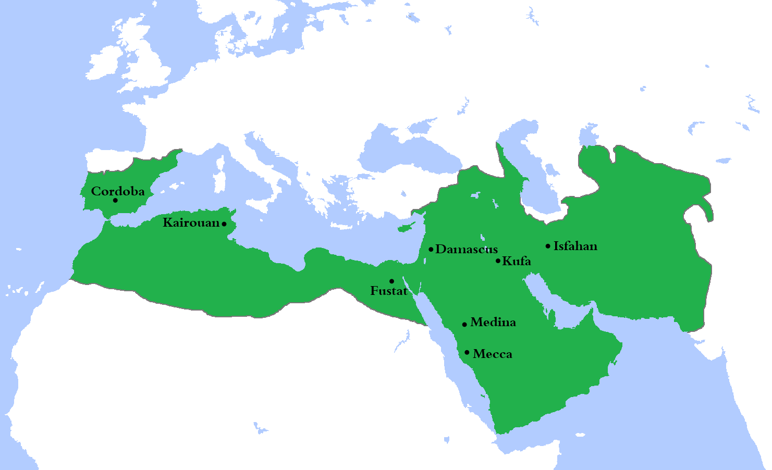
BY 750 CE, a massive GLOBAL Islamic empire

Slide 5
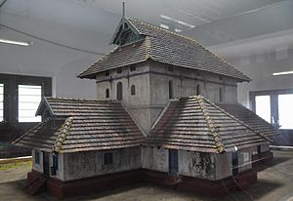
Early Indian Encounters with Islam
First contact with Islam through Arab traders and on the Southwestern coastal area
629 CE Malik Bin Deenar (an Arab trader) built the first mosque in modern KERALA during the life time of Prophet Muhammad (c. 571–632)
An Arab-Islamic kingdom in SIND by 711, by Muhammad bin Qasim during the time of the Umayyad Caliphate
None of these developments appear to have created unusual conflict
The Sind kingdom co-existed as peacefully as was the norm of the time, with neighboring kingdoms ruled by “Hindu” kings

Slide 6
Muslims and Political Rule in India: Overview
711-12 Arab rulers in kingdom of SIND
977 or 1000 to 1030 Annual raids by Mahmud of Ghazni, a central Asian ruler, targets temples (more from the Thapar essay later)
1182 and 1185, invasions, led by the ruler of Ghor (Muhammad Ghuri) who left his former slave, Qutbuddin Aibak as governor in India
In 1206 when Muhammad Ghuri (or Ghori) was killed, Aibak declared independence and became the first of the many SULTANS of Delhi
1526, the last of the Delhi Sultans defeated by the Mughal (also from central Asia) called BABUR. Babur starts the MUGHAL dynasty that rules India till early 1700s (in name, until 1857)

Slide 7
The Delhi Sultanate
DELHI SULTANATE the collective name given to five dynasties ruling between ca. 1200 and 1526 from Delhi
Thematically, the sort of struggle to centralize power that we saw in the “samanta” era, continues, though with a significant change in personnel
Sultans from diverse ethnic backgrounds, and their courts were even more diverse, Turks, Afghans, Persians, and Arabs were all represented in the Sultanate courts
The main link between these diverse groups was religion
This period opens up India to a vast Islamic world, and through this exposure we see the development of ideas, science, art, architecture, and languages

Slide 8
EARLY SULTANATE “Slave” Dynasty and After
Sultans attempt to centralize, by 14th century even reach deep into south, but never able to establish a centralized empire
Two major problems, communications and control over the nobility, who, when opportunities arise try to become independent rulers
There was no legitimate theory of kingship or succession in Islam, adding to tension between Sultan and nobility
Aibak (1206-1210) seen as “first among equals” by nobles who helped him conquer
His son-in-law, Iltutmish (1211-1236) became sultan by “election” among nobility
Succeeded by daughter Razia Begum (1236-1240) though an excellent ruler, was murdered
A period of confusion after Razia’s death abated only with the rise of Balban (1266-87)
To establish authority, Balban attempts at increase the ritual or symbolic as well as political authority of office of the Sultan
  “Balban's court was an austere assembly where zest and laughter were unknown and where wine and gambling were banished." He "introduced rigorous court discipline such as prostration before the king and kissing his feet.”

Slide 9
KHALJIS (aka Khilji) 1290-1320
The second dynasty of the Sultanate were the (Turko-Afghan) Khaljis
The second ruler, Allaudin Khalji (AK) tried to centralize the economy and administration
His armies conquered kingdoms in the Deccan and far south, and rulers of these territories became feudatories of the Sultanate. Campaigns also a source of great accumulated wealth. In one campaign alone AK’s general needed 1000 camels to carry back the war booty
To finance armies needed more wealth in royal treasury, and enhance the authority of the state, he resumed and redistribute all IQTAs
  IQTA system, where regions parceled out to important officials, who were to collect revenue, keep a share and send the bulk to the Sultan.
Neither Iqtas nor feudatories very different from what had gone on before, in the "feudalized“ or “samanta-ized” post Gupta period
AK also imposed newer and higher taxes on agriculture
To balance, AK tried to impose extensive controls on the market, setting prices for all essential commodities
Controls only work in limited area, probably no more than 100 miles around Delhi, his capital.

Slide 10
TUGHLAQS 1320-1390s
Tughlaqs, of debated ancestry (Indo-Turkish?, Turk?) succeeded Khalji
Muhammad bin Tughlaq 1325-1351 (MBT) probably the most notorious and misjudged of the Tughlaqs
MBT’s notoriety comes from his experiments (such as moving the capital from Delhi to Daulatabad or introduction of token currency)
Though attributed to his “madness” these were logical responses to the historical context of his time
  Problems with communication when empire expanded to peninsula (AK’s feudatories all rebel once Khaljis weakened)
  Shortage of cash to finance armies, so token currency idea was a good one, taken from Chinese paper currency
Both experiments fail, forgeries led to massive outflow of silver… like a run on banks!! Capital transfer led to political problems in North, MBT returns, humiliated

Slide 11
LATER SULTANATE
MBT's successor Firoz Shah Tughlaq (FST) had to go back on many of the attempts at centralization, be lax about Iqtas and revenue. With little support from nobility, tries to win over religious orthodox by adopting a more strictlty Islamic stance, unlike MBT
But Sultanate in decline, and following dynasties, the SAYYIDs and more so the LODIS make an attempt to re-centralize, but by then regional kingdoms were too strong
Bengal asserts indepedence from 13thC onward, Mslim governors in Gujarat, Sind and others establish own independent states. In addition Rajputs reviving, under two important principalities in western India, MEWAR and MARWAR
In 1526, a young adventurer with an impeccable warrior lineage called BABUR, defeats the last of the LODIS and inaugurates the MUGHAL dynasty

Slide 12
Cultural Developments in the Sultanate Era
Continue the decentralized polities of previous 500 years or so but culturally a period of incredibly rich fusion
Critical developments in art and architecture, with a new kind of dome and arch introduced to India
Innovations in art, with a new school of miniature paintings developed, that fuse into one what has come to be known as the Indo-Islamic style
Major literary and technological and scientific changes, with exchange of ideas between Indian scholars and those of the Islamic world
Modern regional languages developed in this period, as did important forms of music and cuisine
What we know of as the Classical music of North India was created with significant inputs from one of nobles of the Allaudin Khalji’s court AMIR KHUSRAU
Khusrau was a disciple of Nizammudin Auliya, a CHISTI Sufi saint, and composed many fine poems -- not only in Persian or Arabic, but also in the local language of the region. His contributions help it develop into the language we today call HINDI, spoken by 65% of Indians, and functions as India's national language
Khusrau also credited with invention or innovation of many musical instruments, including the SITAR

Slide 13
Religion and the Delhi Sultanate
Though never a centralized empire, by 1500 large parts of Indian subcontinent being ruled by people of Turkic or Afghan descent who were Muslim
For majority of Indians, rural, life unchanged, landlords remained same, just paid taxes to different overlords
Religion of rulers did make an impact
Some rulers (FST, e.g.) compelled to adopt a more stringently religious policy, often this in tandem with political interests
Jaziya, a tax on non-Muslims, but this was imposed or not according to political circumstances of the time
Large scale religious conversions came with the help of the state, but through the plough (integration into agrarian society) rather than the sword (state power) as we will see

