Slide 1
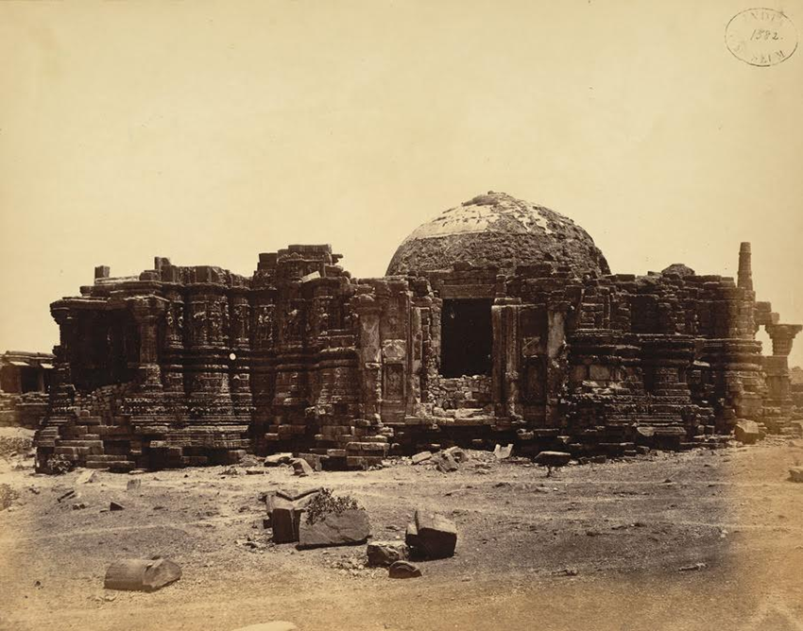
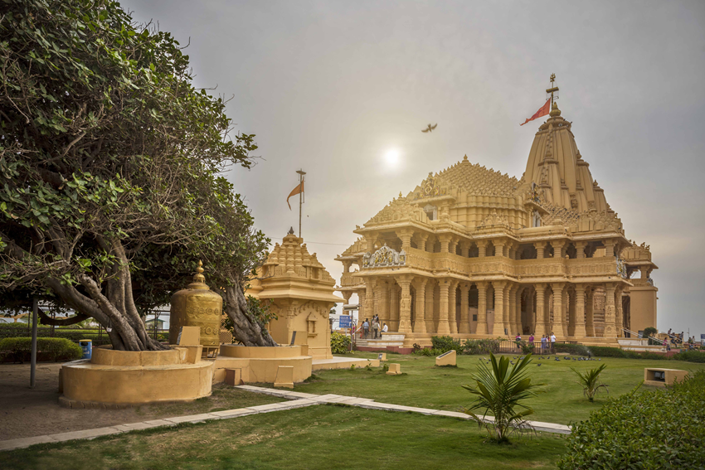
Islam in India: Romila Thapar on Mahmud of Ghazni’s raids on Somnath
Somnath: Old (19th C)
Somnath rebuilt (1951)

Slide 2
What do we mean by “Islam in India”?
1. Presence of Muslims in SOCIETY (we have discussed how this happens via Eaton’s essay)
2. Presence of Muslim RULERS over parts or whole of India (Textbook, From rulers in SINDH to SULTANATE)
3. A certain READING BACK of later history to the pre modern era (again something we have discussed, but to which we will return)
A discussion of Thapar’s essay will bring all of these together in the context of Mahmud of Ghazni’s raids on the temple of Somnath

Slide 3
Partition: A longer history of colonially created difference
Partition came with horrific riots. Partition riots though BUILD ON earlier events
1930s saw many riots, between groups who self-identify as Hindu of Muslim
In 1919 and 1934 colonial government under the British create SEPARATE electorates for Hindus and Muslims
Even earlier from 1870s decennial census identify and reify religious difference
The census in turn built on the knowledge created by 18th C Orientalists (British and European scholar administrators who studied India
All of that created a PERCEPTION of Indian society, as ESSENTIALLY religious, so that rather than highlight differences between languages, regions , or classes, or even castes, RELIGION becomes the significant form of identity for British (and later, Indian) perceptions of India and the basis of governance

Slide 4
A history of representations: the “Hindu slavery” trope
THAPAR tells us that the first known instance we have of Mahmud’s raid being a “severe shock to the psyche of the Hindus” and a 1000 years of painful feelings “rankling” among Hindus, first comes from supporters of Lord Ellenborough (Governor General in India) in a debate in the British House of Commons in 1843
Why is there THAT perception?
British rule over India (or any other colony) constantly needs JUSTIFICATION. British replace the MUGHALS as rulers of India, who were Muslims. Thus the need to represent Muslims as evil, bad, rapacious, etc.
This becomes easier to do because they themselves have an older PERCEPTION of a historical antagonism toward Islam going back to crusades.

Slide 5
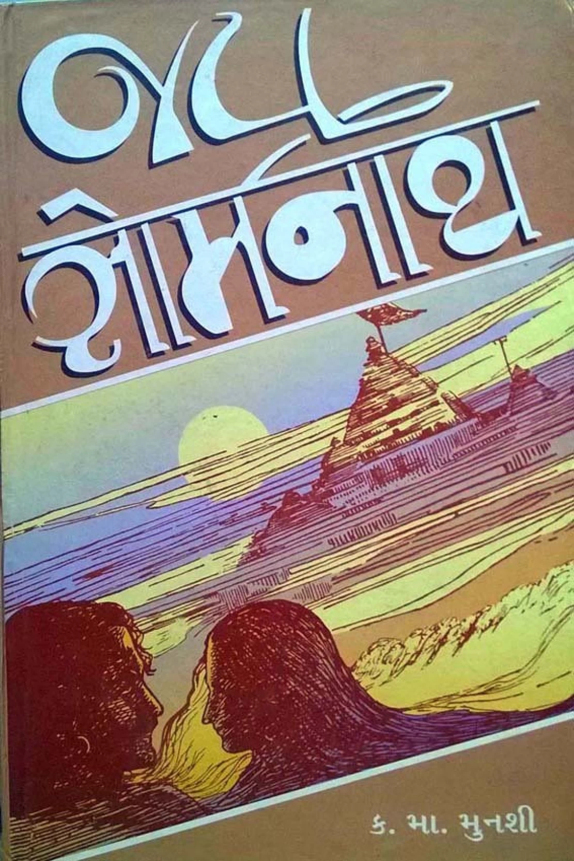
Hindu Nationalism: A Derivation
HINDU nationalists, such as K. M. MUNSHI build on colonial constructs and authored a very popular anti-Islamic fictional account of the temple, called Jai Somnath
Hindu nationalists argued that Hindu first enslaved by Muslims and then by British. For freedom, must assert HINDU PRIDE
Hindu nationalist antagonism actually creates support among Muslims for separate homeland
The creation of Pakistan as a Muslim state though, reinforces perception of India as HINDU
Although Jawaharlal Nehru, India’s first Prime Minister, was staunchly secular, he had people like Munshi in his cabinet
Munshi pressed for restoration of the Somnath temple, supposedly desecrated by Mahmud to revive “Hindu pride”
Archeological excavations done at his insistence in 1950, contradict his assertions
Center of this narrative, as with British, is that MUSLIM rulers enslave HINDUS

Slide 6
Muslim Rulers in India: Mahmud’s raid
Does the case of Somnath, for one, prove that a Muslim ruler, Mahmud of Ghazni, actually set out to “enslave” Hindus?
Let’s put some things in perspective. To deny the above is not to say that he was a great guy! As rapacious as any one else at that time
Did rulers of the time destroy temples, YES, of course they did. Did they do so out of religious fervor. In part
Here is where Thapar says historians, unlike political ideologues, need to rely on more than one source and undertakes an exploration of multiple sources; contemporary and later accounts

Slide 7
Turko-Persian Sources (p. 28-33)
There appear to be LOTS of different reasons these sources attribute to Mahmud’s raid
Some confusion whether the temple destroyed was a Shiva temple or one dedicated to pre-Islamic goddess Manat, place of Manat = Su-Manat= Somnath
Thapar also points to various contradictions of the descriptions of the Idol and the raid between chronicles, including those claiming to be eyewitness accounts
Finally, Thapar notes, that the nature of the Turko Persian narratives CHANGE over time
14th C narratives of Barani or Isami now represent Mahmud as FOUNDER of Islamic rule in India. This ignores the ARAB rulers of Sind who predated Mahmud of Ghazni by 3 centuries
Although all Muslims, there were ethnic and political differences between C. Asian Turks. Afghans, Persians, Arabs over this time. Persian sources downplay significance of Arabs in establishing Muslim rule over India

Slide 8
Jaina Sources (p. 33-37)
Interestingly enough, JAINA sources of the time don’t have much to say about the raid
They do mention the raid, but have more about how THEIR temples remained safe, proving the superiority of their faith over that of the Shiva worshippers, the Shaivites!
When they mention a local ruler’s anger at destruction of temples, the anger is directed at other local rulers who plunder pilgrims but don’t maintain the temple
We also have evidence of temples being destroyed by other Hindu kings
And, the replacing of a dilapidated (note: not destroyed) wooden Somnath temple with a stone building in the late 12th C (Mahmud’s raid early 11th C)

Slide 9
Sanskrit Sources from Somnath (p. 37-41)
12th and 13th century inscriptions show efforts of Chalukya rulers to protect temple… not from Muslims, but from local Hindu rajas (rulers) and other Hindu kings
Little mention of Mahmud’s raid, perhaps because raids on a temple or worshippers were a common fact of the time
We will return to Thapar’s detailed discussion of the 1264 CE document (p. 38-41) later!

Slide 10
Mahmud’s motivations
We could well say that his inspiration WAS religious in part, at least in rhetoric
Would be completely ahistorical to believe that religion could have been insignificant to Mahmud in the 11th C, though we have to understand “religion” as an important ideology for the time
In our own times we know ideologies help to mobilize for war, whether Weapons of Mass Destruction or the cause of democracy. Are those irrelevant? No. Are those the ONLY reasons to go to war? NO again. Similarly, there were other reasons for temple destruction too
A. Everyone does that at the time. Somnath history shows that it was raided and plundered by Hindus and Muslims alike
Why do Sanskrit inscriptions not mention anything.... Because common place
B. TRADE, horse trade in particular. Destroying the sea borne horse trade would mean that horses could now only be imported via the NW, via Ghazni
Muslim rulers, in other words, worked like other rulers did, destroy symbols of opposition, get wealth, BUT also represent their efforts in ideological terms
One putative raid on Somnath, though, certainly cannot be taken to be EMBLEMATIC of Muslims in Indian society either

Slide 11
Muslims in Indian Society: The Somnath Case
What was the place of Muslims in Indian society, particularly in Somnath?
Keep in mind Eaton’s arguments. There was no “clash of civilizations”, rather a slow process of “conversion by the plough”
Thapar gives us another instance of a world of co-existence
For this, focus on the agreement to endow a mosque in Somnath in 1264, 200 years after a raid which was supposed to signal a 1000 years of humiliation for Hindus
Show harmony between the locals and Muslim merchants

Slide 12
Temples, Turks & Arabs
The 1264 CE document (p. 38-41) shows Hindus (even those running the temples) are willing to sell or give away resources to ensure that mosque can be endowed. There is evidently no antipathy towards Muslims AS Muslims in Somnath
Clincher is the inscription on the temple itself 15th C, recounting the bravery of a Bohra Muslim of Arab descent who died defending the temple from Turkish Muslim invaders
A more important, but often forgotten point when discussing the presence of Islam in Indian society is that contemporaries from the 12th through to the 15th C in India appear to be much more able to distinguish between Turks, Persian, Arabs and other Muslim ethnicities, describe them as such, and differentiate between them much more than the British did, or in fact WE are able to do today
So in some ways, then, the very QUESTION we are posing today – that is what were relations between Hindus and Muslims – would seem somewhat strange to contemporaries in pre modern India. From what we can infer from the records, at least from Somnath, the categories of “Hindu” and “Muslim” are not the categories along which people operate or identify.

Slide 13
Return to representation, politics and history
The idea of Muslims vs Hindus comes to us from the Persian chroniclers who wish to give an ideological spin to Mahmud’s actions
It is then picked up by the British for their own reasons. This notion of a homogenous group called “Muslims” who “invade” and then “enslave” India assumes the mantle of historical truth. British textbooks from the 19 to 20th c have Indian history PERIODIZED into Hindu, Muslim and British eras, e.g.
But equally important in perpetuating this myth are Indians themselves, particularly HINDU nationalists, such as K. M. Munshi. Their “popular” histories, novels etc., perpetuate this myth
Munshi became cabinet member in India’s post-indepedence federal government. Though his excavations don’t show what he wanted them to, he is able to push through a “rebuilding” of the temple
. When a Hindu nationalist party BJP FIRST won elections in 1990s (now back in power, btw) they began their campaign, symbolically, at Somnath. Historical truth becomes casualty to politics.... as happens only too often in our own times too!

