Slide 1
Janata Party and Aftermath
In March 1977 the Janata Party defeated the Indian National Congress in elections to the Lok Sabha
The Janata alliance won 345 of 545 seats in the Lok Sabha
The INC only won 154 seats
This was the first time in the history of independent India that the INC had NOT formed a government at the Federal level

Slide 2
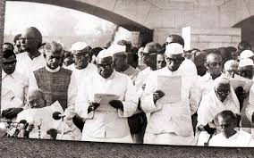
JANATA PARTY
Who were the JANATA PARTY?
  Members of the INC (O),
  INC (I) defectors like Jagjiwan Ram (Dalit leader)
  Socialists such as Limaye, Fernandes, Dandavate
  Rising representatives of MIDDLE PEASANT and BACKWARD CASTE population such as CHARAN SINGH
  Most significantly, the old JANA SANGH.
All of these DISSOLVED their old parties, and joined a NEW organization called the JANATA or Peoples Party
Main objective, oppose Indira Gandhi and in March 1977, they defeated her

Slide 3
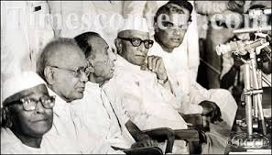
Janata Problems
Short lived. The Janata interregnum lasted only from March 1977 to Jan 1980. Mrs G was back in power in 1980
First, bickering over who would be PM. Finally Morarji DESAI gets to be PM. RAM (Dalit) and CHARAN Singh (Middle Peasant) and Jana Sangh (RSS) leader VAJAPAYEE and ADVANI get plum cabinet posts
NO IDEOLOGICAL unity. Anti Indira, and that did not keep them together for long
CORRUPTION. Not too unlike the INC, quick to dip snouts in the trough. While charges of corruption had not prevented INC politicians from being elected, Janata had promised a new start, people did not expect corruption from them so quickly!

Slide 4
Significance of Janata Era
The era crystallized some important emerging TRENDS in contemporary India which only now were allowed a POLITICAL expression.
The overwhelming presence of the INC since independence MASKED significant social and economic changes in the.
Ironically, the divided, bickering, non-cohesive Janata Party allowed expression to these changed realities.
Janata Party did not last, but these new trends remain a significant aspect of Indian politics

Slide 5
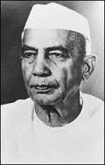
Middle Peasants
British agrarian policies on the 20thC gave lower caste CULTIVATORS of land a lot more rights than traditionally had.
ABOLITION of ZAMINDARI benefited similar CULTIVATING groups.
Many of these groups had been the backbone of Nehru’s lieutenants such as Kamaraj. They then came to support parties such as DMK in Tamilnadu, were the backbone of the CPM in Bengal.
Where the GREEN REVOLUTION was successful, the folks who really benefited most were the middle peasants/ cultivators
Indira’s populism work to their benefit. Erase debts of electricity e.g.
Middle peasants gaining clout in states for a while, now wanted a say at the Federal or CENTRAL government level. Got it with CHARAN SINGH and the support of Socialists in Janata.

Slide 6
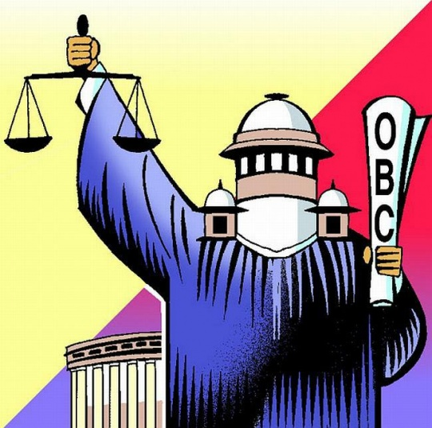
Other Backward Castes (OBC)
Now these groups coalesce around the label of OBC
No classical text had this notion of BACKWARD or FORWARD Castes
A product of modern politics: folk who felt themselves to be dispossessed.
Commission of Enquiry (Mandal Commission) set up by JANATA Government pointed out the relative disadvantage in terms of jobs, education, etc. of OBCs
In the Forward category were the Brahmins, the Rajputs (aka Kshatriya) Kayastha and Bania (Vaisya) who had “historically monopolized literacy, scholarship, commerce, and political power” (Guha, 530) to which must be added, historically, control over LAND.
But, Dalit (formerly, untouchable) and OBC together formed well over 60% of the population.
They were the real CULTIVATORS, leased land or small owners. In turn OBC employed other, LOWEST caste, often DALIT LABORERS in the farms they cultivated

Slide 7
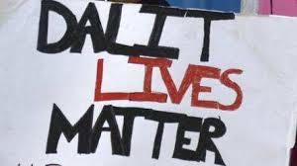
Dalit-OBC conflicts
A Dalit-OBC combination was the demographic majority, but there were contradictions between the two groups.
OBC middle peasants employed Dalit labor, and wanted to give them the lowest possible wages
Dalits, meanwhile, had been organizing politically since Ambedkar’s time, but were economically badly off
Dalits though, did have constitutionally-mandated reservations for jobs and schools
OBC landlords resented Dalit “uppityness” and often came down brutally on any sign of Dalits acting in ways beyond their assigned station in life
A massacre of Dalits in Bihar during the Janata era actually allowed Indira Gandhi a way back into mainstream politics. She made a politically successful visit to console the victims, and reached out to Dalits as their savior from the OBCs.

Slide 8
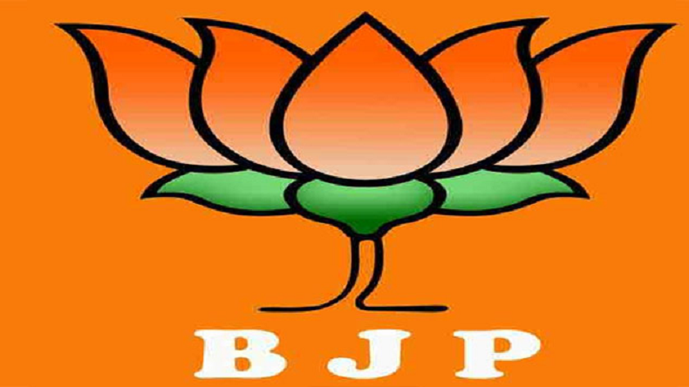
Rise of Hindu Nationalism
The Janata era was the first time Hindu Nationalists were a component of the National Government
Important Ministries: Foreign Affairs, Information and Broadcasting, and most significantly, Education, run by Hindu Nationalists
Able to recruit fellow Hindu nationalists as teachers, shaping ideology of future generation
Status of Hindu Nationalists as “beyond the pale” changed
New Party, BJP, said their ideology was “Gandhian Socialism”

Slide 9
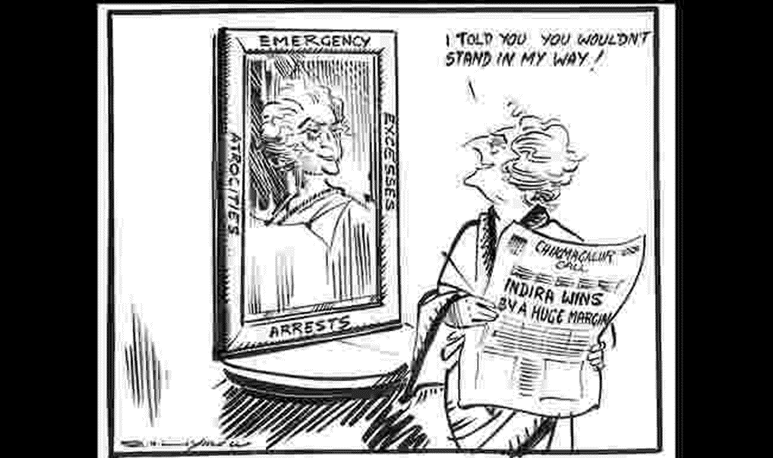
Ineptitude of Janata: Paving the way for Indira’s Return
Ineptitude of the Janata government helped Indira Gandhi no end.
They botched her first arrest and she was out of jail in no time.
After she won reelection to Parliament from southern India, they jailed her again for violating Parliamentary Privilege in her earlier terms in office.
The courts released her after 7 days in jail.
She was stripped of Parliamentary seat, but was re-elected in a matter of weeks

Slide 10
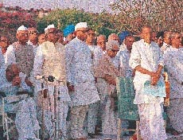
Other Long Term Impacts of Janata Era
DECENTRALIZATION of Indian politics
Greater autonomy of States (especially as compared to Indira Gandhi’s era)
Emergency spawned many new social movements, civil society, civil liberties, feminists, etc. Censorship led to revival of interest in Journalism!!
Many of these appear to be rolled back in the last 8 years

