Slide 1
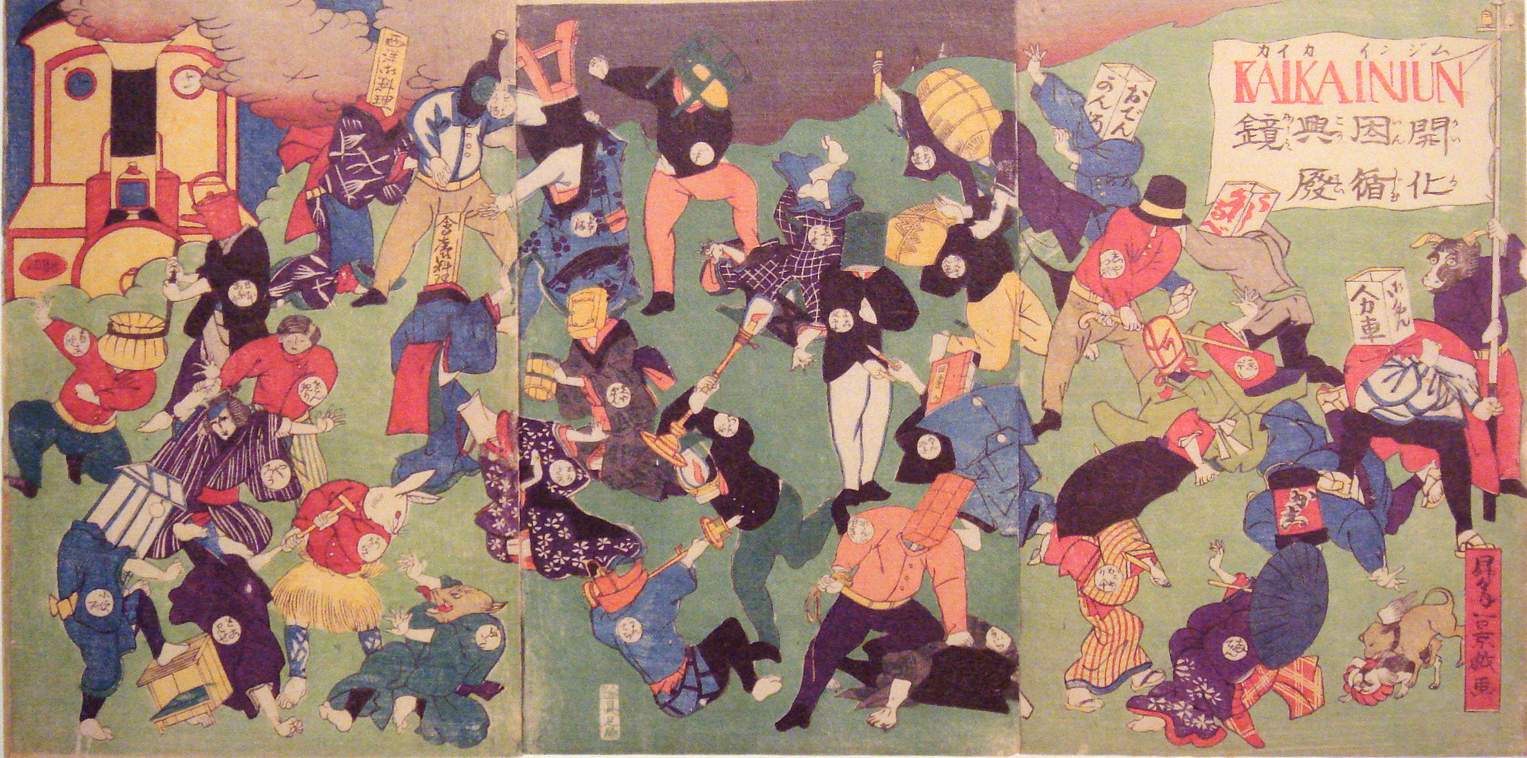
Japan: Third Case Study of Asian Modernity

Slide 2
Successful Modernization
Unlike China or India, which, by the end of the nineteenth century, were still struggling to come to terms with modernization, Japan already well on its way towards industrialization
1895 War with China was the demonstration of success in this endeavor
All made possible by the events of 1868, often called the MEIJI restoration or even, a revolution

Slide 3
Overview and Comparisons
Though the roots of “modern Japan” traced to Meiji Era, actually predicated upon earlier history, processes that began in mid 16th C.
A clan called the TOKUGAWA, became the SHOGUNS, or the chiefs, and effective rulers of Japan for over 250 years.
We will trace both parallels and some distinct differences between histories of China & India and of Japan, and the way we cover them.
As with other case studies, we will start with the history of regimes IN PLACE (Mughals/Successor states or Manchus in India and China respectively) and then discuss crises of indigenous regimes -- internal and external. Japan similar.
Today background and emergence of TOKUGAWA SHOGUNATE, then crisis, then Western intervention.
In Japan’s case, not British, but US imperialism, in the form of Commodore Perry

Slide 4
Comparing History of Western Contact
The Portuguese reach Japan a very few years after they did India (1499)
But little in the way of TRADE
Later, the Dutch traded with the Japanese, but under the terms that were imposed by the Tokugawa Shogunate
Fortunately for Japan, there was little to attract large scale European intervention in the pre-industrial period.
Unlike India which had a continuous and aggressive European presence since the Portuguese, the Japanese were left well alone till the middle of the 19thC.
Thus, Japan was left with time to evolve indigenous processes of change, something that the early colonial interference in India did not allow.

Slide 5
Japan: Geography
Four main Islands:
(north to south)
Hokkaido
Honshu (largest)
Shikoku
Kyushu

Slide 6
Japan: Social & Historical Background
Basic division in Japanese society between the hereditary warrior class, the SAMURAI, and the rest, the commoners. Many further distinctions within both classes
The samurai ranked from foot soldiers, and clerks of the great lords, to the largest, most powerful lords, later come to be called the DAIMYO
Among the commoners there were range from peasants and laborers, to rich peasants and very rich and powerful merchants
According to tradition, even a poor samurai ranked above the merchants, but merchants started acquiring more wealth and power in late Tokugawa era
Since the seventh century, Japan had an EMPEROR, believed to be of divine origin
For the longest time, the emperor had been a sort of titular Monarch, who reigned but did not rule
Real power with the Daimyo, control countryside and therefore the economy
Main product rice, and a lord’s wealth, prestige, rank depended on the amount of rice produced

Slide 7
End of warring states 1500s to 1600
1550s: the so called “warring states” period was coming to an end.
During the Warring States Era, power was highly localized, and politics very fluid. Power with 100s of local lords, who with their samurai followers, waged constant war against each others’ territories.
Samurai, warriors, had an important role during warring states era. Constant flux, war, with samurai defecting, or changing loyalties.
Between the 1560s and 1600 there was a sort of upward integration: less powerful lords joining or pledging allegiance to more powerful
Emergence of the DAIMYO, large overlords. Power more stabilized. Samurai have less personal choice in terms of choosing or changing their loyalty.

Slide 8
Changes in Samurai Role
Based in their newly-constructed castle towns the Daimyo systematize revenue collection
Earlier Samurai paid with fiefs (compare Babur) Now they were settled in towns and paid a cash salary.
Change nature of samurai from landlord to Bureaucrat, who administered the daimyo or lords’ estate, collected revenue etc.
Castle-based settlements led to URBANIZATION, and hence more market economy, end of self sufficiency. Also impact on peasants who now produce cash crops

Slide 9
A New Kind of State: 1550s-1600
From mid 1500s on, a series of DAIMYO begin to acquire more power, emerge as more powerful than others
Based on principles of modern statecraft: TOYOTOMI HIDEYASHI, e.g., made a land revenue survey and reallotment, quite like Akbar’s in Mughal India
To keep peace, restrictions on non-samurai carrying arms, and restrictions on mobility
Thus, a more modern state emerges, with an efficiently-administered tax base, greater control over means of violence, and mechanisms of stability
One this which this lacked was a clear head, plus ideological legitimacy. This was to be provided by the TOKUGAWAS

Slide 10
Tokugawa Shogunate 1600-1868
Through a series of battles, particularly the Battle of SEKIGAHARA in 1600, the TOKUGAWA family acquires preeminence and the pledge of loyalty from all other daimyo
Mechanisms of legitimacy
In 1603, the title of SHOGUN – General, but increasingly coming to mean de facto Ruler
Emperor though not powerful, symbolically important.
Shogun Title was first step, then other means of legitimacy too.
Marry into nobility and then royalty itself
Religion, to the extent of Tokugawa Shogun being declared a Shinto god after death
Other ideological tools, included patronizing religion such as Confucianism that reinforced social distinctions, obedience to the rulers, etc. Also Shinto
Plus severe restrictions on Christianity
Portuguese claims of 100s of 1000s of converts exaggerated, but a foreign religious ideology in no way support, but undermine divine emperor, and by implication authority of Shogun. So curbs, particularly when some important Daimyo said to have converted

Slide 11
Controlling the Daimyo
Other powerful and rival daimyo too, SATSUMA and the CHOSHU.
later to provide much of the impetus towards the downfall of the Tokugawas in the 19thc.
Tokugawas own 1/4 of all land, so large base. But system not allow them to tax other Daimyos’ domains
Rearrange domains, to reward followers and restrict opponents. But limits to this, could not antagonize the all-powerful rivals. Limits to their military power
So, come up with the ALTERNATE ATTENDANCE SYSTEM

Slide 12
Alternate Attendance System
Alternate attendance system: Every other year Daimyo need to spend a year in Edo, with the Shogun. Families stay behind in Edo
Expensive, two homes, costs of moving, etc.
WHY? Shogun (even the emperor) could not levy taxes on the DAIMYO, supreme in own domains
Too many resources with Daimyo could undercut Tokugawa power, this undermined their resources
Also restrict foreign relations. Not xenophobia, but independent trade by Daimyo would give them independent sources of wealth. So this was means of control

Slide 13
Changes in Tokugawa Japan
RESULTS of AA system?
URBANIZATION (already been a trend from late warring states period, with settling down of Samurai in castle towns)
COMMERCIALIZATION
WHY was this an issue?
leads to conspicuous consumption among Daimyo. Spend more money when in capital: this in turn provides a boost to a market economy; as daimyo have to sell grain to get money for consumption.
Further boosts to urban markets!
Merchants Prosper and Rich Peasants (GONO) start to produce for the market

Slide 14
Tensions in Tokugawa Japan
Much like Mughals, the very system that allowed Tokugawa dominance, also paved way for decline
Samurai lost contact with land, peace made warrior function useless, peace and urbanization led to trade, and prosperity of other groups,
Social and economic status of Samurai not coincide, and create tension

