Slide 1
KASHMIR 1846-1964 (and to 2019)
The Genealogy of a Crisis

Slide 2
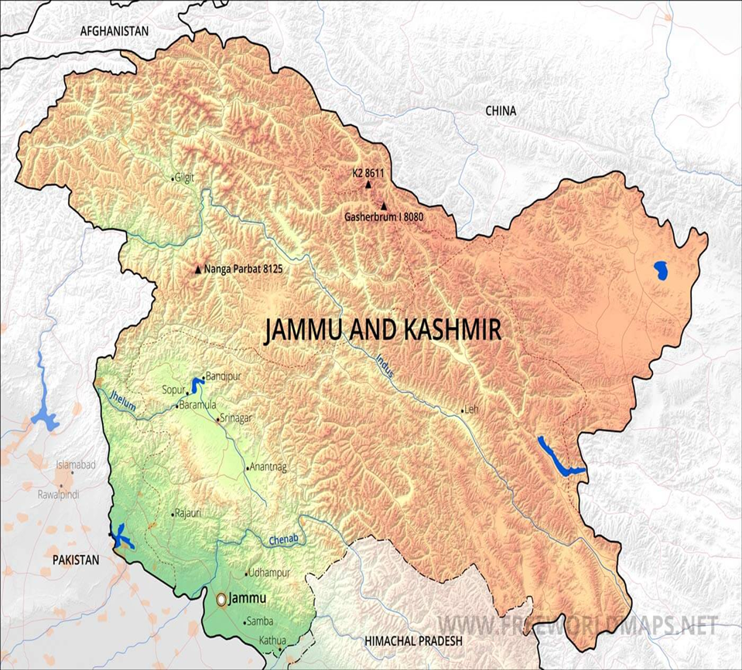
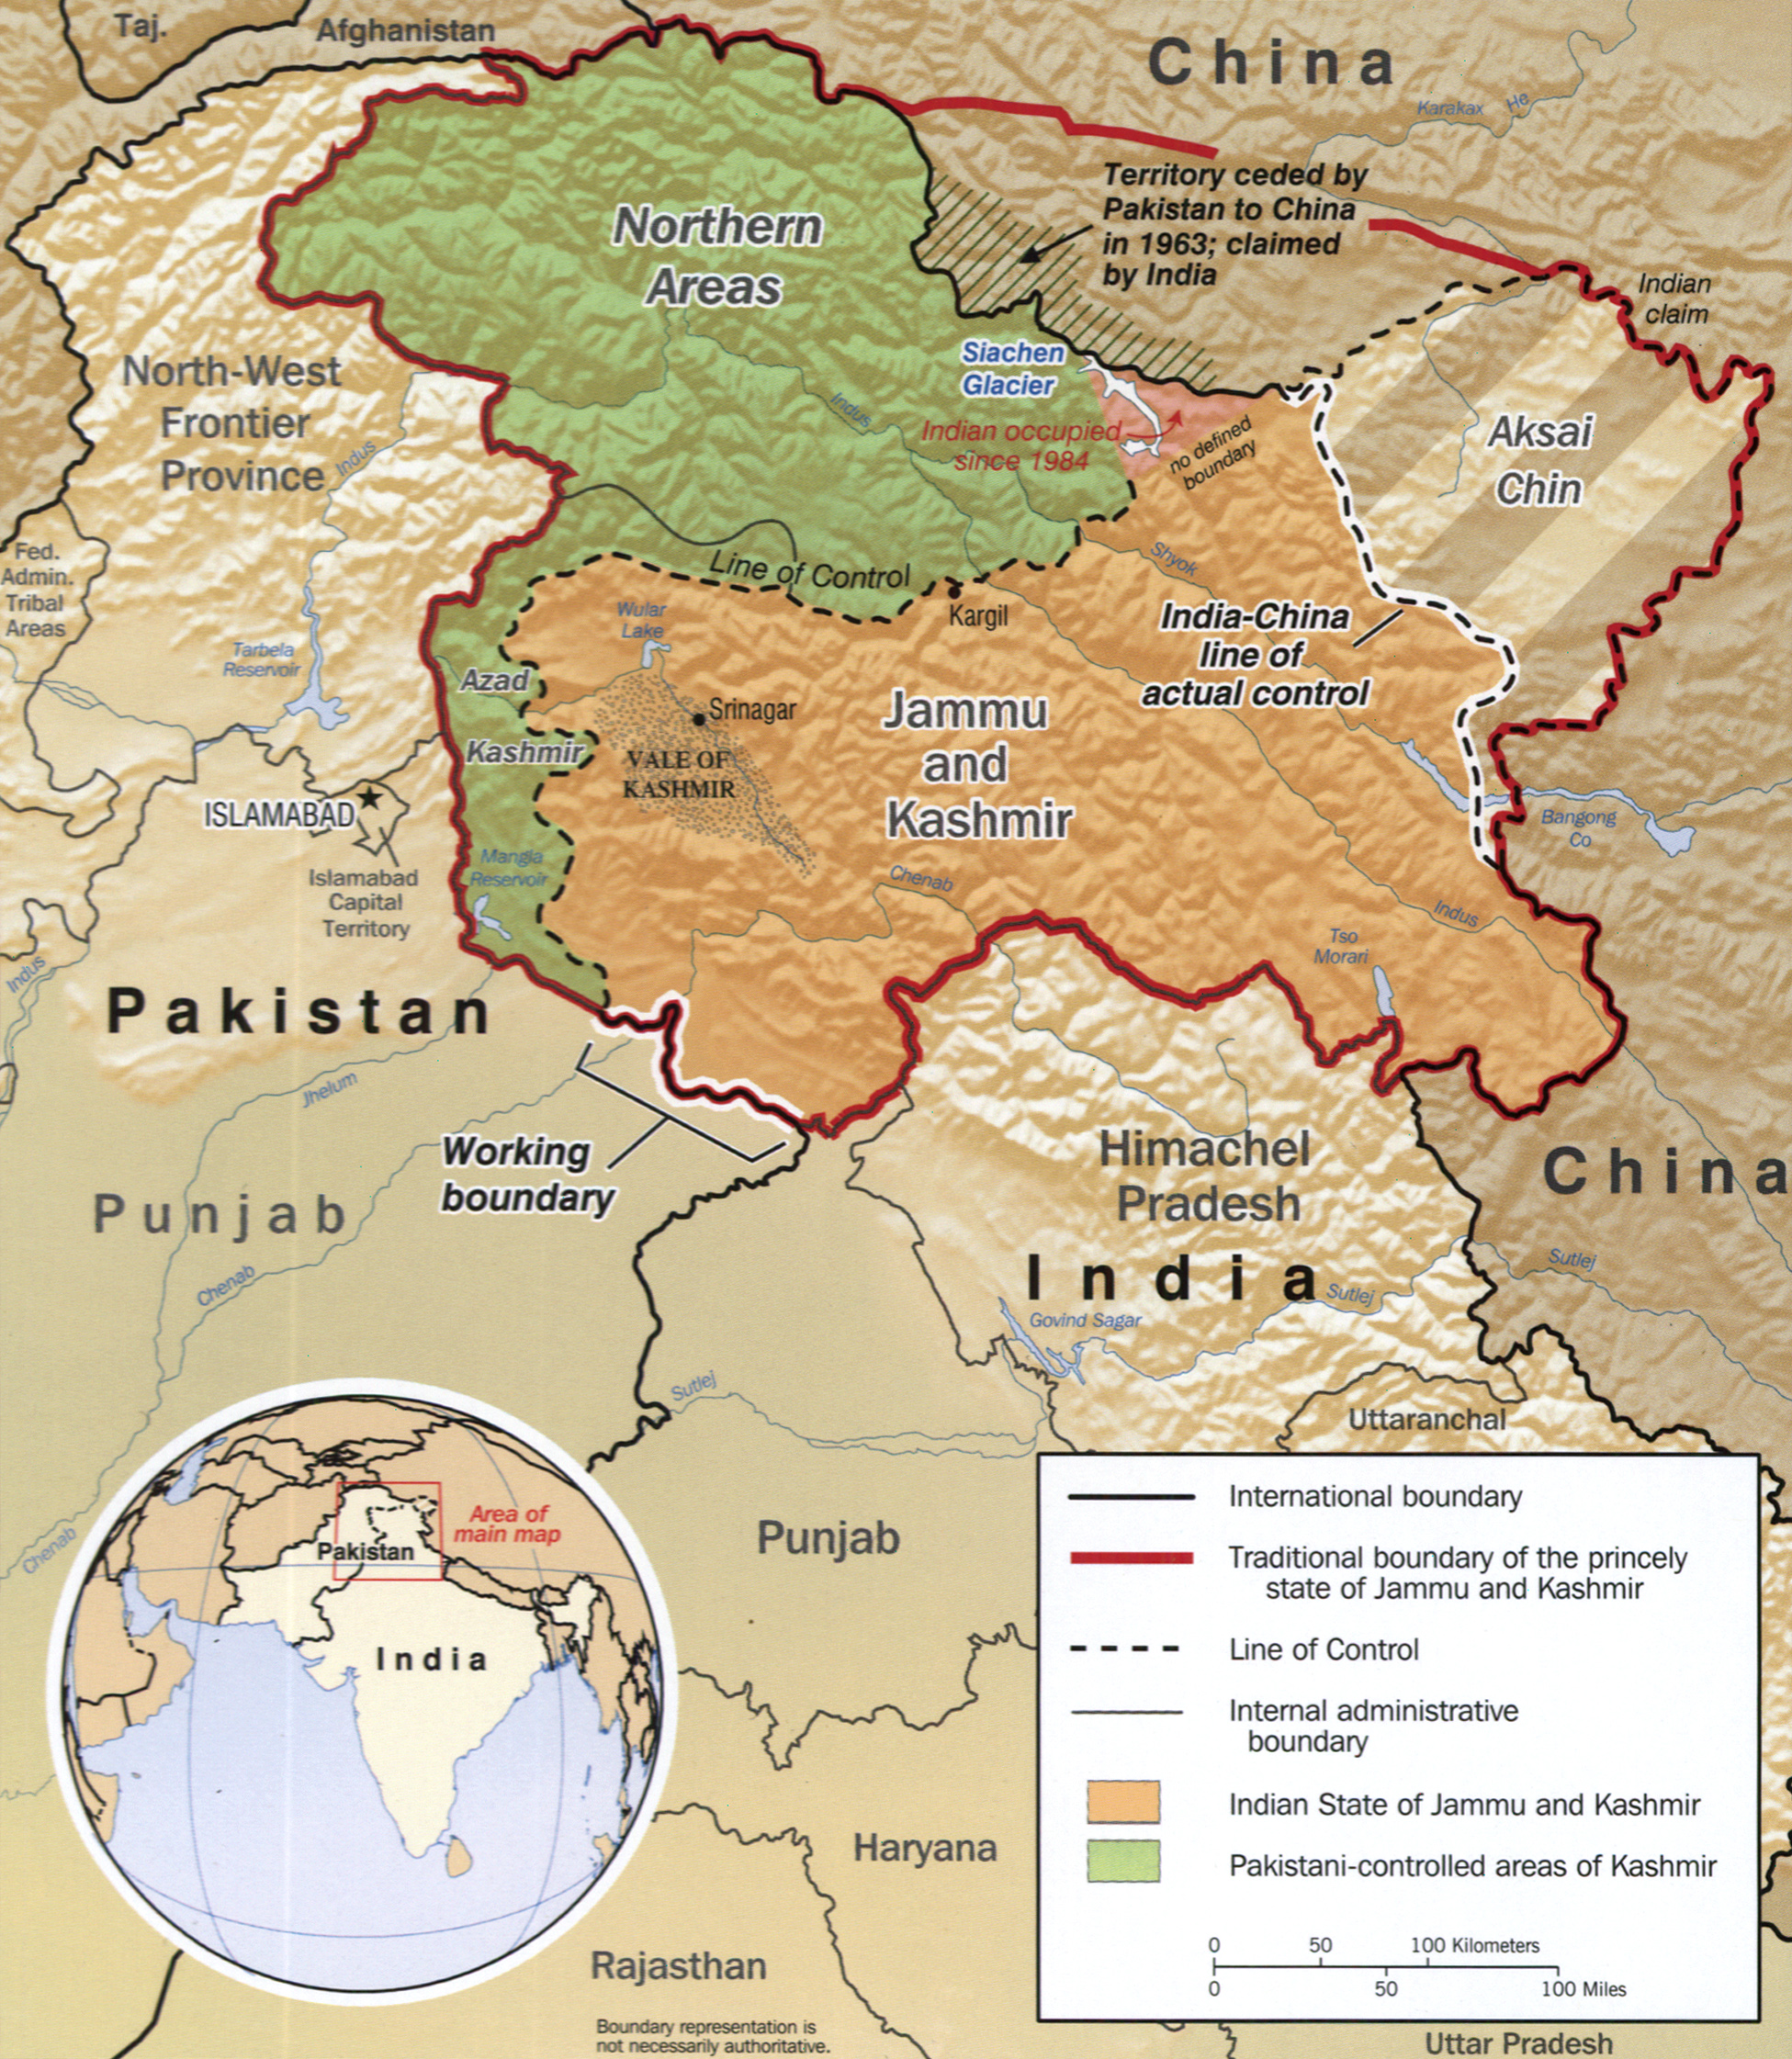
The PLACE we are studying

Slide 3
Regional Differences: Jammu and Ladakh
Jammu and Ladakh historically had an identity distinct from Kashmir
Jammu geographically and historically closer to Punjab in the plains of north India
The majority of LANDLORDS in Jammu were Hindu after the DOGRAS come to power (more below) fear Abdullah’s commitment to land redistribution would hurt them
Ladakh, high altitude desert, small population.
Buddhist, with close ties to Tibet

Slide 4
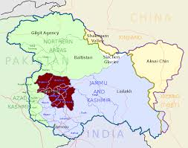
Early History
Until 19th C, the history of “Kashmir” refers only to the Kashmir VALLEY
  Jammu, Ladakh different histories
Geographic location produces a mix of many cultures, Central Asian, Himalayan, Indic, Islamic
Unique Language, Dardic not Sanskrit derived

Slide 5
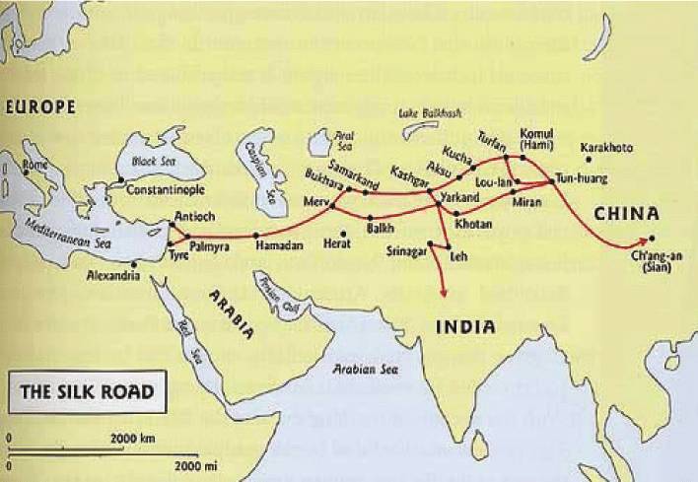
In the context of the Silk Route

Slide 6
Kashmir’s History: Longue Duree
Vedic tribes settled in Kashmir in later Vedic era 1000 to 700 BCE
Incorporated into 4th C BCE empire of the Mauryas. BUDDHISM introduced
7-th to 14th C CE Hindu dynasties, Shaivite Monism
  8th C CE KARKOTA empire reach far southward (Gangetic Plain)
  12th C CE Rajatarangini, called the earliest historical chronicle of the subcontinent
14th to 16th C, Indigenous Shahmiri (Muslim) Dynasty. Islam spread by SUFI saints
1586 annexed by Akbar into Mughal empire
1752–1819: Afghan Durrani Empire
1819–1846: Sikh Rule under Ranjit Singh

Slide 7
British and Dogra Rule
1846: Treaty of Amritsar: Following the First Anglo-Sikh War, the British “sell” Kashmir to Gulab Singh, establishing the Dogra dynasty. This created the new state of Jammu and Kashmir (including Ladakh)
  “the Dogra state created a new group of landed elites, mostly Hindus” (Hussain, 92)
  Hari Singh, ruler at time of accession 1947, was Gulab’s great-grandson
Like all “princely states” after 1857, Dogra rulers also completely dependent upon and subservient to the British imperial rulers of India
Dogras discriminated against both Kashmiri Muslims AND Hindu Kashmiri Pundits (Brahmins)
The first articulation “Kashmir for Kashmiris” came not from the king’s Muslim subjects but from Pandits (Hussain, 93)

Slide 8
Towards Azaadi (freedom)?
“The watershed in the history of Kashmir is . . . not Islam . . . but the changeover from a Kashmiri to a non-Kashmiri rule.” (Puri, p. 9)
1931 protests and brutal clampdown (Hussain, 94)
  Sheikh Abdullah and Muslim Conference
  Leftist, secular orientation, name change, NATIONAL Conference (NC), 1939
  Role of Prem Nath Bazaz, a Hindu Kashmiri Pandit
  Still drew on older, mystical, forms of Islam for outreach
REMEMBER: these are agitations for more rights for Kashmiri subjects of the MAHARAJA (Hari Singh), for Azaadi FROM the Maharaja
1944 NC presents the “Naya [New] Kashmir” manifesto to Hari Singh, planning a constitutional monarchy and welfare state (Hussain, 98)
Abdullah’s opponents include older Hindu Jammu elite and some Muslims, who felt NC too close to INC. Both want Hari Singh to decide (Puri, p.6)
Quit Kashmir movement 1946 supported by NEHRU, opposed by Jinnah. Abdullah jailed for sedition

Slide 9
Partition: India, Pakistan and Kashmir
Partition folds movements WITHIN Kashmir into NATIONALIST politics of India and Pakistan
Hari Singh not sign articles of accession, but a “stand-still agreement” with Pakistan, with the assurance that “"Pakistan would not touch a hair of his head or take away an iota of his power.” (Puri p. 6)
Poonch uprising, demobilized (WWII) Muslim soldiers, Kashmiri army divided along communal lines, desertions, led to armed revolt, with support from Pakistan.
September 1947, Hari Singh released Abdullah from jail, who says “accession secondary” freedoms of Kashmiris paramount! (Puri p.10)
October 1947, massacre of Muslims in Jammu: Retaliation? State-sponsored? 50-100,00 Muslims killed, changed demography. Jammu had a small Muslim MAJORITY population, after riots a Hindu majority

Slide 10
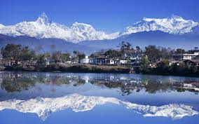
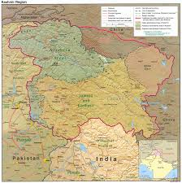
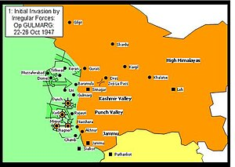
Pathan Raiders and Accession to India
21 October Pakistan-backed “Pathan Raiders” invade the state almost reach capital, Srinagar. Brutal. Jinnah says, “Kashmir is in my pocket”
Hari Singh no choice but to sign articles of accession to India, October 26, 1947
Indian troops airlifted to Srinagar, reclaim some territory
Line of Control created
Abdullah -- Puri suggests most Kashmiris -- supported accession “The ignorance and distrust shown by the Pakistani rulers . . . pushed Kashmir to the Indian Union” According to Puri Kashmiris said, “"India has come to defend our azadi while Pakistan tried to enslave us."(p. 12)

Slide 11
Partition and Kashmir: The Ideological Dimension
Important to understand not just POLITICAL or GEOPOLITICAL context, but the IDEOLOGICAL place of Kashmir for India, Pakistan, and Kashmiris
For Pakistan, accession of Kashmir to India was wrong: Kashmir, with a Muslim majority had to be part of Pakistan (it was the K in original acronym making PAKISTAN: P(unjab), Afghania, Kashmir, Sind and BaluchisTAN)
For NEHRU and INC, India was premised on the idea of diversity. Religion nothing to do with citizenship. Hindus AND MUSLIMS belonged equally to India. Kashmir critical for that claim
THIRD and one that GUHA DOES NOT REALLY tell us much about: ABDULLAH was popular precisely because he stood for KASHMIRIAT, highlighting the UNIQUENESS of Kashmir as different from both India AND Pakistan

Slide 12
Kashmir After Accession
January 1948 India refer the issue to the United Nations
PLEBISCITE promised, but never happen (thanks to Indo-Pakistan conflict)
  MIGHT have happened in 1948, but after 1950 Indian state also reluctant “India was more enthusiastic than Pakistan about a plebiscite in the State till the early fifties.” (Puri, 18)
Cease Fire Line (Line of Control) becomes accepted de-facto (not legal) border
Kashmir also starts getting entangled with cold war and other geopolitical strategies
  (A few years later: Abdullah’s meeting with Adlai Stevenson in May 1953 led to his dismissal and arrest by his friend, Prime Minister Nehru.)

Slide 13
Kashmir: Political and Regional dimension
The UN had called for a plebiscite, but neither party withdrew armies. India claimed Hari Singh signature on accession made that legal. Abdullah’s popularity and elections became the main moral, justification for retaining Kashmir
BUT Abdullah’s ambivalence made things difficult for Nehru!
TWO related issue contribute to the ambivalence (and helps understand how this history relates to recent events)
a. Abdullah’s idea of Kashmiriat, often drifted into idea of an independent Kashmir
b. Abdullah’s popularity high in KASHMIR VALLEY, but not so in JAMMU, with Muslims not Hindus. Loss of land through his reformist-populism lead to PRAJA PARISHAD formed in 1949

Slide 14
Article 370
Indian state trying to consolidate former princely states: Plebiscite in Junagarh, February 20, 1948, brings it to the Union of India, and “Police Action” brings Hyderabad into the Union, Sept 13–18, 1948
Constitution of India being debated and heading in a direction of most power to the Center (federal government)
A provisional Article 370 included, limiting power of Indian Parliament to legislate for Kashmir, but expected the J&K Constituent Assembly to transfer powers to Govt. of India (Puri, 25)
Yet Abdullah not want to give up autonomy or authority
Hussain, “In the mid-1950s, India moved toward a centralized state structure that would facilitate national integration” (100)
Becomes the first point of tension between Nehru and Abdullah

Slide 15
Abdullah and his opposition
Response of Hindu Right increases Abdullah’s ambivalence, and
  1950 meeting with US Ambassador, reportedly discussed independence
Won the elections to the Jammu and Kashmir Constituent Assembly in 1951, (unopposed!). There were complaints of political pressure on the electoral process.
After 1951 elections Abdullah clearly says does not stand for independence, but AUTONOMY crucial. Prefers India to Pakistan because the Indian state had ‘never tried to interfere in our internal autonomy’
Leads to 1952 Delhi Agreement, confirming full accession to India. Article 370 and 35a of the Indian Constitution grants “temporary” autonomy to J&K and Kashmiri Constitution accepts the state as part of India. Fundamental Rights apply to J&K and it would accept jurisdiction of Indian Supreme Court.

Slide 16
1953
Hindu Right OUTRAGED by Delhi Agreement (context: wiped out in first general election, Jana Sangh won only 3 seats in a 489-seat Parliament. NEEDED an issue to gain political traction, and Kashmir became that. Protest against special status.
Shyama Prasad Mukherjee (leader of Jana Sangh) die in custody in 1953. Massive protests that push Abdullah to “rethink” ties to India
Split engineered in National Conference (Abdullah’s party) and Abdullah’s government dismissed, Bakshi Ghulam Muhammad installed as Premier and Abdullah arrested.
“India’s covert authoritarianism had replaced Dogra despotism” in the minds of both supporters and opponents of Abdullah in Kashmir (Hussain, 101)
Abdullah’s supporters create a new political party, the Plebiscite Front, raising once again, the demand for a plebiscite to decide the fate of the state

Slide 17
Kashmiri Politics 1953-58
Bakshi was a populist but faced serious charges of nepotism and corruption. Bakshi seen as “India’s man” and his corruption came to be associated with Nehru and India
See Hussain, p. 101
Plebiscite Front gets support of NC original social base (poor, middle class, and some urban intelligentsia) but members face repression and torture under the Bakshi regime
  “… mafia-style group of thugs called the Peace Brigade assisted the police in inhuman interrogations to silence opposition” (Hussain, 102)
Abdullah released and rearrested in 1958. Both in 1953 and 1958, on charges that even Guha says were “trumped up”

Slide 18
Kashmiri Perceptions (Kanjwal) 1
Kanjwal (2018): interviews with Muslim middle class conducted over 2013-14 in Srinagar, many from the bureaucracy of the 1950s-60s
She sees their responses as “an attempt to seek coherence amidst contradiction and incommensurate political and ideological commitments” (41)
Importance of Muslim LINEAGE, contributes to prestige of “khandaan” (clan/family) A MUSLIM identity important to them, perhaps to counter “state-sponsored dominant narratives of a shared, syncretic, history that either erased or undermined Kashmir’s ‘Muslim’ identity in attempts to seek connection with India.” (45)
Almost all recall Dogra oppression of Muslims (not Pandits)
Differences within Muslim community at Partition, Muslim Conference had more support among traditional elites and NC the more left-leaning, also impressed by Jinnah but also Gandhi
NC seen as leading Kashmiris to MODERNITY, yet support for Abdullah not equal support for INC, defend Kashmir from tribal raiders, not support India
  Earlier, says shift away from support to NC (but does not reference the Plebiscite Front)

Slide 19
Kashmiri Perceptions (Kanjwal) 2
Many respondents claim they were pro-Pakistan at partition, perhaps because felt safer in Muslim majority state, because of geographical proximity, or thought would have better economic prospects there, or associations of Pakistan with modernity
  BUT also “Recollecting this ‘memory’ (of being pro-Pakistan) could be influenced by the contemporary moment, which is marked by increased anti-India sentiments in the Valley.” (49)
  Yet also evidence of opposite sentiment, see letter (52)
Kanjwal: “neither Pakistan nor India was able to fully accommodate Kashmiri aspirations at the time” (52)
“The only group that fully aligned themselves with India. . . were the Kashmiri Pandits. ‘They always said they were the true Indians.’ (53)
Ambivalence, while critique the pro-India bias of Pandits, also recall their interactions with now-departed community very fondly (54-55)

Slide 20
Nehru’s last plan for Kashmir
The HAZRATBAL incident (loss of a relic from mosque), loss in war to China, and Nehru’s desire to “settle” Kashmir, lead to Abdullah release in 1963 and Nehru’s last attempt to solve the Kashmir conundrum
Abdullah committed to secularism and a multicultural Kashmir (thus close to Nehru in vision). But also an ambitious politician willing to use *any* leverage he had to forward his politics. Settle for what he got for a while and then try to push the stakes up when he could
Climate of POSSESSIVE NATIONALISM, not just Hindu Right parties but also sections within the INC (especially old right wing of party)
  Kashmir is OURS, the accession is SETTLED, we will not GIVE AWAY WHAT IS OURS. No real concern for the feelings of KASHMIRIS
  Abdullah’s later visit to PAKISTAN suggests mainstream opinion there not very different
But senior and responsible leaders such as C. Rajgopalachari (Rajaji) and JP (about whom we will hear a lot more in 10 years), did want to settle the Kashmir issue. To do this, as we see, they were even willing to give up the absolutist position of accession to India
Abdullah willing to go along to reach a compromise by which India, Pakistan AND Kashmir would benefit. Not a zero sum game
EVEN plebiscite not ruled out, but also variety of other options, such as provincial autonomy, confederation etc.
After staying with N at his residence, Abdullah travel to Pakistan to talk with President Ayub Khan
But while there Nehru dies, as does this plan

Slide 21
Context for Changes
Pakistan’s loss in 1971 war, secession of Bangladesh. India’s dominance and weakening of a possible ally in struggle.
Massive centralization of power over state autonomy across the country after 1972 election victory
1974 release of Abdullah and 1975 accord with Indira Gandhi (seen as capitulation by some)
Indira Gandhi’s Emergency 1975-77
Janata Party 1977-79 commitments to decentralized leadership, less interference in state governments

Slide 22
Kashmir/Abdullah 1964-79
The Sheikh’s arrest and 11 years in jail (1953-64) was a period when support for separatism grows in Kashmir. Despite his populism, Bakshi seen as “India’s man” in Kashmir
NC merged with INC in 1965, becomes the state unit of INC
Abdullah’s supporters create “The Plebiscite Front” a political party demanding a plebiscite to determine Kashmir’s future as promised in India’s submission to the UN
1965, Abdullah arrested AGAIN, after conversations with Chinese Premier Chou Enlai in Algiers, remains imprisoned until 1968 (this is 3 years after India defeated in Sino-Indian war, any connection with China still seen as traitorous act!)
Indira keeps Abdullah in jail, released in 1968, but not allowed to return to Kashmir
After Bangladesh war, Abdullah agrees to an Accord with Indira Gandhi in 1974. Plebiscite Front disbanded. Abdullah installed as Chief Minister with Mrs. Gandhi’s support
1977 when the Janata Party is in power, sees one of the only free and fair elections in J&K, with Abdullah leading a revived NC to victory
Abdullah enacts the Public Safety Act (PSA) in 1978 giving him power to arrest political opponents on grounds of “public safety.” Would be used against Kashmiri citizens extensively in later years

Slide 23
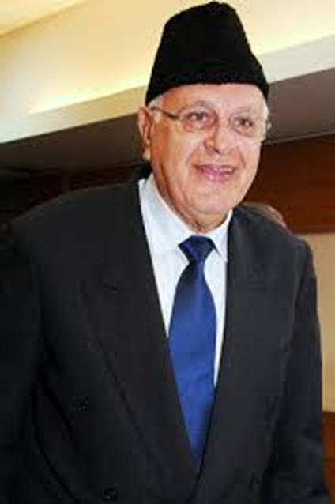
Kashmir (from “Indira, Second Innings”)
Sheikh Abdullah dies in 1982
This is also the start of a process that BEGINS COMMUNALIZING the situation in Kashmir.
In 1983 Farooq Abdullah, Sheikh Abdullah’s son joins an opposition coalition
Mrs. Gandhi, in her campaign, painted him as a secessionist.
BLATANTLY appealed to HINDUS of Jammu, and invoked FEAR of VALLEY MUSLIMS.
Farooq won, but this event first created RELIGIOUS polarization in Kashmir
Even separatists , TILL THAT TIME had spoken of need to secede because they were KASHMIRI and included Hindu Kashmiris in their description of Kashmir. This was to change soon after.
1984, political machinations by Mrs. Gandhi ensure that Farooq is removed as Chief Ministers. Kashmiris begin to believe that Delhi will never let them exercise their own political will within India. Leads to support for separatism.

Slide 24
Rajiv Gandhi and the 1987 Fix
Rajiv and Farooq reach an agreement in 1986, form a joint INC-NC government in J&K
1987 elections left almost no room for political dissent as the two major parties formed a, “election cartel” trying to monopolize the available political space
Great disenchantment with the NC in Kashmir valley in particular, and opposition now coalesced around a “Muslim United Front” (MUF)
100s of MUF activists arrested, and blatant electoral rigging was prevalent in the 1987 election
This was the tipping point for a people who had been denied fair democratic representation. Politics in Kashmir changed, with the bomb replacing the ballot box as mode of political expression.
Do look at the summary on the next slide and the declining rates of participation in Kashmir after the mid 1980s

Slide 25
State Elections in J&K | Kashmiris have not been well served by electoral democracy. Unfortunately, BOTH the INC and the National Conference (NC) have participated in undermining free and fair elections in the state
1951 Constituent Assembly Elections | All seats won UNOPPOSED by NC. Praja Parishad candidates had nomination papers rejected, boycott the election. In 1953 Abdullah arrested and BAKSHI GHULAM MOHAMMAD made Premier.
1957 First Assembly | NC under BAKSHI won 47 seats unopposed. Charges of electoral rigging. Abdullah loyalists create the PLEBISCITE FRONT.
1962 Second Assembly | NC won 33 seats unopposed; once again credible allegations of malpractices. Not only was Bakshi forced to step down, in 1965 his rival, G.M. Sadiq, merged the INC and NC to become CM. The NC now became the state branch of the INC!
1967 Third Assembly | The new NC- INC, won the election, remaining unopposed in 39 seats, nomination papers of 118 candidates rejected.
1972 Fourth Assembly | Even a semblance of opposition disallowed as the Plebiscite Front banned; and in 1975, following the Accord with Mrs. Gandhi, Sheikh Abdullah returns to power!
1977 Fifth Assembly | Possibly the first free and fair elections in the state. Abdullah disassociates from the INC and fights and wins elections independently. Passes away in 1982, only to be succeeded by his son, Farooq Abdullah
1983 Sixth Assembly | Farooq Abdullah wins despite Indira’s opposition (and communalizing of electoral campaign). INC engineered split in the NC, Farooq ousted, then reappointed CM in 1986 after accord with Rajiv Gandhi.
1987Seventh Assembly | Probably the most blatantly rigged elections in the state as Farookh and Rajiv join hands to prevent any opposition voices from emerging in state politics. Arrests of opposition, suspicious results, disqualification of candidates, all marked this election. 1987 often seen as the watershed, after which Kashmiris lost faith in the democratic process as representing them in a fair or free fashion.

Slide 26
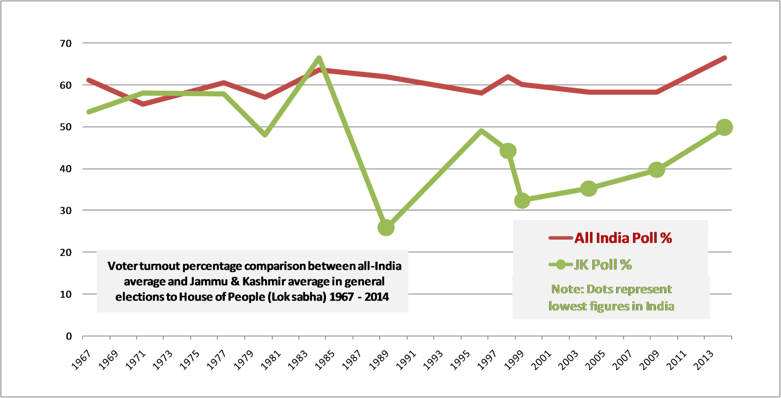
Kashmir Political Alienation after 1987

Slide 27
From Autonomy to Azaadi (Independence)
Betrayed by the Indian state and perceived collaborators like Farooq, Kashmiri Muslim youth in particular, looked across the border to Pakistan for help
Pakistan itself had been undergoing a strong shift toward Islamic fundamentalism under General Zia ul Haq, was obviously keen to offer support
The anti-India movement was initially led by the Jammu and Kashmir Liberation Front (JKLF), a relatively secular group
But the more fundamentalist groups such as Hizb-ul-Mujahideen soon displace the JKLF
Gives a much more SECTARIAN (communal) to the struggle, and the victimization of Kashmiri Pandits (Hindu Brahmins) who were driven out of the valley by violence and threats
Attacks on those labelled “collaborators” including all those who disagreed with the fundamentalists
Clampdown on non-Islamic (by their interpretation) dress, entertainment, social habits
Enabled by US funding given to Pakistani intelligence (ISI) to encourage Islamic militancy against the Soviet occupation of Afghanistan, but has continued long after

Slide 28
Kashmiri Muslims
Major Sufi (mystical tradition) influence on Islam in Kashmir
Differences between more Wahabi influenced militants and the local variants of Islam
Despite an element of romanticization, there were close connections between Hindus and Muslims in Kashmir. Shared tribal names between Hindus and Muslims, e.g., “Dar” or “Bhat”
But, over time, closer identification of Azaadi and Islam

Slide 29
Azaadi: Separatist Groups
JKLF led the struggle in the 1980s, focus on Kashmiri independence
Displaced by the Hizb-ul-Mujahideen in the 1990s and then even more extremist groups such as Lashkar-e-Toiba and Jaish-e-Mohammed. These groups have strong support from Pakistan (particularly the ISI) and only see Kashmir’s future as a part of Pakistan
Various Kashmiri political groups created an umbrella coalition in 2004, called the All Parties HURRIYAT Conference (APHC) that included a faction of the JKLF led by Yasin Malik (who renounced violence in 1995 to participate in the political process). APHC has since broken into two major factions, roughly, the Geelani (pro integration with Pakistan) and Mirwaiz ( standing for Kashmiri independence) factions

Slide 30
Militarization of Kashmir
The Indian state has responded by militarizing Kashmir. Over 700,000 military and paramilitary police personnel routinely serve in the (former) state to try and keep Kashmir a part of India
Over 70,000 people died in Kashmir between 1989 and 2002, that number includes over 4500 security personnel almost 14,000 civilians
AFSPA (Armed Forces Special Powers Act) in Kashmir 1990. Created in 1958 and used against separatist movements in North Eastern India
AFSPA gives armed forces unchecked powers that have led to credible evidence of gross misuse of that power, including mass torture, rape, and ethnic cleansing of suspected terrorists. See next slide for AFSPA.
The “disappearance” of thousands of Kashmiri men after being picked up by the military has created a whole generation of “half widows” who don’t know if their husbands are dead or alive
Kashmiris still recall the Gawkadal massacre of January 1990, when Indian paramilitary troops opened fire on unarmed Kashmiri protesters in the capital, Srinagar, killing over 200, or the mass rape of women by the military in Kunan and Poshpora villages in 1991, among many other atrocities by the armed forces
Nor has this immense militarization been able to prevent outrages by militants such as the Chittisinghpora massacre in 2000 or the 2019 attack on armed forces at Pulwama, that led to a cross-border military retaliation by India and is widely believed to have facilitated PM Narendra Modi’s re-election that year.

Slide 31
AFSPA/PSA allow, among other things
Soldiers to “Fire upon or use other kinds of force even if it causes death, against the person who is acting against law or order in the disturbed area for the maintenance of public order,
To arrest without a warrant anyone who has committed cognizable offences or is reasonably suspected of having done so and may use force if needed for the arrest.
To enter and search any premise in order to make such arrests, or to recover any person wrongfully restrained or any arms, ammunition or explosive substances and seize it.
Stop and search any vehicle or vessel reasonably suspected to be carrying such person or weapons.”
Army officers have *legal immunity* for their actions. There can be no prosecution, suit or any other legal proceeding against anyone acting under that law. Nor is the government's judgment on why an area is found to be disturbed subject to judicial review.

Slide 32
Haider (2014) and Kashmir
It is a big deal for a commercial filmmaker, investing millions on such a project, to make a film on Kashmir that questions mainstream Indian views on the subject
Haider captures the alienation of Kashmiri youth, the powers of AFSPA, a gendered dimension of the conflict, the motives of collaborators, the attraction of militancy, and through some elements of the character, “Roohdar,” the complicity of Pakistan in promoting militancy. But it also does much more!

Slide 33
Contemporary Context
In August 2019- Indian government stripped Jammu and Kashmir (J&K) state of the special status that gave it significant autonomy. In fact J&K is no longer a STATE at all, but two UNION TERRITORIES, J&K and Ladakh.
To understand the significance of this step though, we have to return to HISTORY we examine in this course
At the very start of chapter 12, Guha points out that the Indian Constitution treated Kashmir as part of India, but “guaranteed the state a certain autonomy; thus Article 370 specified that the president would consult the state government with regard to subjects other than defence, foreign affairs, and communications”
He also asks question that is very telling for our own times: “Could a Muslim majority state exist, without undue fuss or friction, in a Hindu-dominated but ostensibly ‘secular’ India?”
BOTH of these animate the contemporary situation

