Slide 1
Kashmir 1964-2026
From Autonomy to Azaadi: History, Interpretations and Victims

Slide 2
Slides 3-16 are modified from the earlier slide set (Kashmir One)
Please look at Kashmir One to remind yourself of the earlier history

Slide 3
Context for Changes in INDIAN politics (Post Nehru)
Pakistan’s loss in 1971 war, secession of Bangladesh. India’s dominance and weakening of a possible ally in struggle of Kashmiris
Massive centralization of power over state autonomy across the country after 1972 election victory
1974 release of Abdullah and 1975 accord with Indira Gandhi (seen as capitulation by some)
Indira Gandhi’s Emergency 1975-77
Janata Party 1977-79 commitments to decentralized leadership, less interference in state governments

Slide 4
Changes in Kashmir, Focus on Abdullah 1964-79
The Sheikh’s arrest and 15 years in jail (1953-64, 1965-68) was a period when support for separatism grows in Kashmir. Despite his populism, Bakshi seen as “India’s man” in Kashmir
NC merged with INC in 1965, becomes the state unit of INC
Abdullah’s supporters create “The Plebiscite Front” a political party demanding a plebiscite to determine Kashmir’s future as promised in India’s submission to the UN
1965, Abdullah arrested AGAIN, after conversations with Chinese Premier Chou Enlai in Algiers, remains imprisoned until 1968 (this is 3 years after India defeated in Sino-Indian war, any connection with China still seen as traitorous act!)
Indira keeps Abdullah in jail, released in 1968, but not allowed to return to Kashmir
After Bangladesh war, Abdullah agrees to an Accord with Indira Gandhi in 1974. Plebiscite Front disbanded. Abdullah installed as Chief Minister with Mrs. Gandhi’s support
1977 when the Janata Party is in power, sees one of the only free and fair elections in J&K, with Abdullah leading a revived NC to victory
Abdullah enacts the Public Safety Act (PSA) in 1978 giving him power to arrest political opponents on grounds of “public safety.” Would be used against Kashmiri citizens extensively in later years

Slide 5
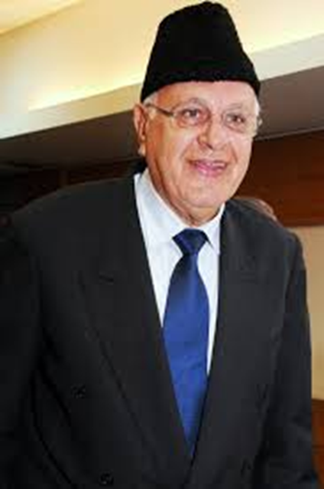
Kashmir (from “Indira, Second Innings”)
Sheikh Abdullah dies in 1982 succeeded by son, Farookh
This is also the start of a process that BEGINS COMMUNALIZING the situation in Kashmir.
In 1983 Farooq Abdullah, Sheikh Abdullah’s son joins an opposition coalition
Mrs. Gandhi, in her campaign, painted him as a secessionist.
BLATANTLY appealed to HINDUS of Jammu and invoked FEAR of VALLEY MUSLIMS.
Farooq won, but this event first created RELIGIOUS polarization in Kashmir
Even separatists , TILL THAT TIME had spoken of need to secede because they were KASHMIRI and included Hindu Kashmiris in their description of Kashmir. This was to change soon after
1984, political machinations by Mrs. Gandhi ensured Farooq removed. Kashmiris begin to believe that Delhi will never let them exercise their own political will. Leads to support for separatism

Slide 6
Rajiv Gandhi and the 1987 Fix
Rajiv and Farooq reach an agreement in 1986, form a joint INC-NC government in J&K
1987 elections left almost no room for political dissent as the two major parties formed a, “election cartel” trying to monopolize the available political space
Great disenchantment with the NC in Kashmir valley in particular, and opposition now coalesced around a “Muslim United Front” (MUF)
100s of MUF activists arrested, and blatant electoral rigging was prevalent in the 1987 election
This was the tipping point for a people who had been denied fair democratic representation. Politics in Kashmir changed, with the bomb replacing the ballot box as mode of political expression.
Do look at the summary on the next slides, the following for declining rates of participation in Kashmir after the mid 1980s

Slide 7
State Elections in J&K | Kashmiris have not been well served by electoral democracy. Unfortunately, BOTH the INC and the National Conference (NC) have participated in undermining free and fair elections in the state
1951 Constituent Assembly Elections | All seats won UNOPPOSED by NC. Praja Parishad candidates had nomination papers rejected, boycott the election. In 1953 Abdullah arrested and BAKSHI GHULAM MOHAMMAD made Premier.
1957 First Assembly | NC under BAKSHI won 47 seats unopposed. Charges of electoral rigging. Abdullah loyalists create the PLEBISCITE FRONT.
1962 Second Assembly | NC won 33 seats unopposed; once again credible allegations of malpractices. Not only was Bakshi forced to step down, in 1965 his rival, G.M. Sadiq, merged the INC and NC to become CM. The NC now became the state branch of the INC!
1967 Third Assembly | The new NC- INC, won the election, remaining unopposed in 39 seats, nomination papers of 118 candidates rejected.
1972 Fourth Assembly | Even a semblance of opposition disallowed as the Plebiscite Front banned; and in 1975, following the Accord with Mrs. Gandhi, Sheikh Abdullah returns to power!
1977 Fifth Assembly | Possibly the first free and fair elections in the state. Abdullah disassociates from the INC and fights and wins elections independently. Passes away in 1982, only to be succeeded by his son, Farooq Abdullah
1983 Sixth Assembly | Farooq Abdullah wins despite Indira’s opposition (and communalizing of electoral campaign). INC engineered split in the NC, Farooq ousted, then reappointed CM in 1986 after accord with Rajiv Gandhi.
1987Seventh Assembly | Probably the most blatantly rigged elections in the state as Farookh and Rajiv join hands to prevent any opposition voices from emerging in state politics. Arrests of opposition, suspicious results, disqualification of candidates, all marked this election. 1987 often seen as the watershed, after which Kashmiris lost faith in the democratic process as representing them in a fair or free fashion.

Slide 8
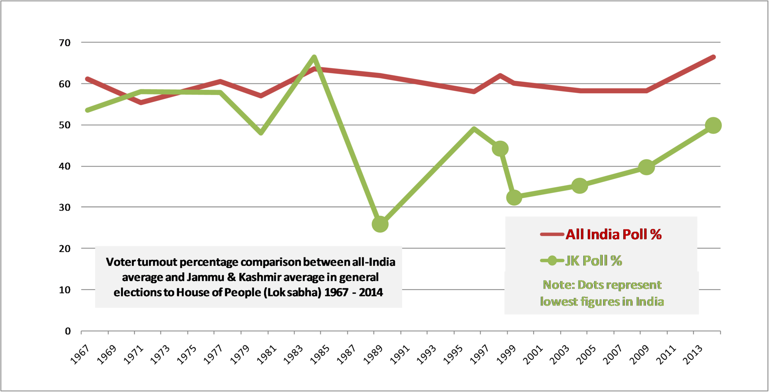
Kashmir Political Alienation after 1987

Slide 9
From Autonomy to Azaadi (Independence)
Betrayed by the Indian state and perceived collaborators like Farooq, Kashmiri Muslim youth in particular, looked across the border to Pakistan for help
Pakistan itself had been undergoing a strong shift toward Islamic fundamentalism under General Zia ul Haq, was obviously keen to offer support
Enabled by US funding given to Pakistani intelligence (ISI) to encourage Islamic militancy against the Soviet occupation of Afghanistan, but has continued long after
The anti-India movement was initially led by the Jammu and Kashmir Liberation Front (JKLF), a relatively secular group
But the more fundamentalist groups such as Hizb-ul-Mujahideen (HM) soon displace the JKLF
Gives a much more SECTARIAN (communal) to the struggle, leads to targeting of Kashmiri Pandits (Hindu Brahmins) who are driven out of the valley by violence and threats
Attacks on those labelled “collaborators
Clampdown on non-Islamic (by their interpretation) dress, entertainment, social habits

Slide 10
Kashmiri Muslims
Major Sufi (mystical tradition) influence on Islam in Kashmir
Differences between more Wahabi influenced militants and the local variants of Islam
Despite an element of romanticization, there were close connections between Hindus and Muslims in Kashmir. Shared tribal names between Hindus and Muslims, e.g., “Dar” or “Bhat”
But, over time, closer identification of Azaadi and Islam
Note what Suvir Kaul wrote, “Indian political thinking … is that this region represents a palimpsestic history, where the confluence of Buddhism, Hinduism and Islam has created a cultural texture that is particularly "Indian". This certainly is a laudable religio-cultural ideal, but not when it is asserted to repress the socio-economic history of a state since at least the mid-19th century …. And, if anything, the last two decades have meant that many Kashmiris, if not the largest mass of them, have looked anywhere but to their south for cultural, religious and political orientation.”

Slide 11
Azaadi: Separatist Groups
JKLF led the struggle in the 1980s, focus on Kashmiri independence
Displaced by the Hizb-ul-Mujahideen in the 1990s and then even more extremist groups such as Lashkar-e-Toiba and Jaish-e-Mohammed. These groups have strong support from Pakistan (particularly the ISI) and only see Kashmir’s future as a part of Pakistan
Various Kashmiri political groups created an umbrella coalition in 2004, called the All Parties HURRIYAT Conference (APHC) that included a faction of the JKLF led by Yasin Malik (who renounced violence in 1995 to participate in the political process). APHC has since broken into two major factions, roughly, the Geelani (pro integration with Pakistan) and Mirwaiz ( standing for Kashmiri independence) factions

Slide 12
Militarization of Kashmir
The Indian state has responded by militarizing Kashmir. Over 700,000 military and paramilitary police personnel routinely serve in the (former) state to try and keep Kashmir a part of India
Over 70,000 people died in Kashmir between 1989 and 2002, that number includes over 4500 security personnel almost 14,000 civilians
AFSPA (Armed Forces Special Powers Act) in Kashmir 1990. Created in 1958 and used against separatist movements in Northeastern India
AFSPA gives armed forces unchecked powers that have led to credible evidence of gross misuse of that power, including mass torture, rape, and ethnic cleansing of suspected terrorists. See next slide for AFSPA.
The “disappearance” of thousands of Kashmiri men after being picked up by the military has created a whole generation of “half widows” who don’t know if their husbands are dead or alive

Slide 13
AFSPA/PSA allow, among other things
Soldiers to “Fire upon or use other kinds of force even if it causes death, against the person who is acting against law or order in the disturbed area for the maintenance of public order,
To arrest without a warrant anyone who has committed cognizable offences or is reasonably suspected of having done so and may use force if needed for the arrest.
To enter and search any premise in order to make such arrests, or to recover any person wrongfully restrained or any arms, ammunition or explosive substances and seize it.
Stop and search any vehicle or vessel reasonably suspected to be carrying such person or weapons.”
Army officers have *legal immunity* for their actions. There can be no prosecution, suit or any other legal proceeding against anyone acting under that law. Nor is the government's judgment on why an area is found to be “disturbed” subject to judicial review.

Slide 14
Oppression and its Limits
Kashmiris still recall the Gawkadal massacre of January 1990, when Indian paramilitary troops opened fire on unarmed Kashmiri protesters in the capital, Srinagar, killing over 200
They remember the mass rape of women by the military in Kunan and Poshpora villages in 1991, among many other atrocities by the armed forces
Militarization not able to prevent outrages by militants such as the Chittisinghpora massacre (that some argue was a “false flag” operation) in 2000
Militarization certainly unable to prevent the 2019 attack on armed forces at Pulwama, that led to a cross-border military retaliation by India. This retaliation is widely believed to have facilitated PM Narendra Modi’s re-election that year.
Nor could the most militarized region in the world prevent the Pahalgam massacre of 26 tourists in April 2025

Slide 15
Contemporary Context
In August 2019- Indian government stripped Jammu and Kashmir (J&K) state of the special status that gave it significant autonomy. In fact J&K is no longer a STATE at all, but two UNION TERRITORIES, J&K and Ladakh.
To understand the significance of this step though, we have to return to HISTORY we examine in this course
At the very start of chapter 12, Guha points out that the Indian Constitution treated Kashmir as part of India, but “guaranteed the state a certain autonomy; thus Article 370 specified that the president would consult the state government with regard to subjects other than defence, foreign affairs, and communications”
He also asks question that is very telling for our own times: “Could a Muslim majority state exist, without undue fuss or friction, in a Hindu-dominated but ostensibly ‘secular’ India?”
BOTH of these animate the contemporary situation

Slide 16
Mirza Waheed Article
A well-known journalist and award-winning novelist, Mirza Waheed’s report is written in the context of August 5, 2019
Reports the arrests, repression, curfew, lockdown, isolation, cutting off internet, to silence potential protests
Not many Kashmiris (other than political leaders) really believed there was much left of the provisions of Article 370 over the decades
  Reminder: Article 370 of the Indian Constitution – 1949 -- gave special status to J&K, including right to have own flag, constitution and limited applicability of Indian Constitution without consent of J&K assembly. Art 35a – 1954 – allowed the state to determine rights of residency
  Abrogation controversial. Two schools
    That it was unconstitutional because 370 gave authority to J&K Constituent Assembly (CA), which was dissolved 1957, so power devolved to J&K State Assembly, which itself had been dissolved, replaced by Central Government and President’s Rule via a Governor. Appointed officer did not have powers to abrogate 370.
    Because no more CA, or in 2019 an Assembly, so Governor had powers to recommend, and on his recommendation, India’s President had power to abrogate Art 370
  India Supreme Court in 2023 upheld the abrogation

Slide 17
Kashmir in a Larger Context
Please keep in mind that Suvir Kaul’s essay dates from 2011
Kaul locates the Kashmir issue both in the history we have studied (from accession onward) but also a LARGER context
That Indian state replicates the orientation of the IMPERIAL-COLONIAL state in many ways, counter to the notion “that independence inaugurated a fundamentally different form of sovereign, constitutional rule that safeguards the state from assuming any of the attributes of the colonial state” (67)
Instead, the postcolonial state, “acts primarily to preserve the boundaries of the union in the form inherited from the British empire” and its massive security apparatus “developed under the cover of an aggressive, celebratory nationalism, is an important element of the post-colonial state's claims to legitimacy.” (67)
This used to contain and repress internal dissent. Kashmir, Northeast, Naxalites, among other
In this it acts the same way as the IMPERIAL state did, honing “its capacity for military violence at home even as it projects it across its borders” (71)

Slide 18
The NeoColonial State and Kashmir
Kashmiris not consulted over borders, colonial cartography and accession by an unelected ruler determined borders
Power was TRANSFERRED from the British to an independent India
ALL subjects within the borders of “India” – however disputed the accession or borders -- now had to abide by the dictate of state modeled in too many respects on the colonial one
  No wonder then, Kashmiri activists use the rhetoric of nationalism paralleling the one used by Indian anti colonial activists in the British era
Kashmiris reluctant to “participate in episodes of supposedly democratic politics” although there was enthusiasm for Abdullah and his redistributive policies under “Naya Kashmir”
But any notion of autonomy, talk of plebiscite, self determination, was suspect, and even suspicious brought arrest or worse
Elections rigged (other than 1977 and perhaps 1983) “in pursuit of a malleable state administration….in the name of national security; of safeguarding the mainland's territorial interests by foreclosing the possibility of Kashmir becoming… effectively autonomous” (72)
PSA and AFSPA used to suppress dissent

Slide 19
Haider (2014) and Kashmir
It is a big deal for a commercial filmmaker, investing millions on such a project, to make a film on Kashmir that questions mainstream Indian views on the subject
Haider captures the alienation of Kashmiri youth, the powers of AFSPA, a gendered dimension of the conflict, the motives of collaborators, the attraction of militancy, and through some elements of the character, “Roohdar,” the complicity of Pakistan in promoting militancy. But it also does much more!
Uttaran Dasgupta puts the film in context of the 2019 abrogation of Art 370 and loss of statehood that was celebrated across the rest of India and by exiled Pandit community)
Also, a reminder about the upcoming paper!

Slide 20
Context for Haider
A retelling of Shakespeare’s Hamlet
Set in 1995 please do remember that. This is after :
  Hugely rigged elections, even MORE than usual in 1987 (remember Kaul re: Mohammed Yusuf Shah who later to take nom de guerre of Syed Salahuddin became head of HM, he was initially arrested PROTESTING the elections because he was a CANDIDATE – p 72)
  Impetus to Azaadi movement, young men start crossing border to get training in Pakistan
  1990 BBC timeline Indian Army kills about 100 demonstrators at Gawakadal Bridge. Attacks and threats lead to the flight of almost all Hindus from the Kashmir Valley area of the state. India imposes Armed Forces Special Powers Act (AFSPA) in Jammu and Kashmir.
  The mass rape of women by the military in Kunan and Poshpora villages in 1991, among many other atrocities by the armed forces
This is the context for Haider saying “All Kashmir is a Prison my friends”
We see the unmarked graves of martyrs (also brilliantly visualized in Kak’s Jashn e Azaadi)
We see the power of the army, AFSPA, overriding civilian authorities (who were often also, Kashmiri)
“Roohdar” (Ghost of Hamlet’s father) spent time in Indian prison camps and bring to Haider a message of revenge, mother’s “betrayal” -- unlike Shakespeare’s Hamlet Haider does NOT kill uncle

Slide 21
Imperial? NeoColonial? Settler Colonial? Capitalist-Exploitative?
Connecting KAUL to essays by Mohamad Junaid & Hafsa Kanjwal on the one hand and Shahla Hussain on the other brings us to another debate.
While rooted in the realities of contemporary Kashmir, this is a debate about the nature of the Indian state’s presence in Kashmir
Following a rich vein of scholarship on North America, Australasia, Southern Africa, and the Middle East, Junaid and Kanjwal see the Indian state as a form of settler colonialism. See Channel Four Video for details -- an entire syllabus premised on the settler colonial model at The Kashmir Syllabus
Based on her close examination of legal, political, economic and emotive issues connected to the “land question,” Shahla Hussain OTOH argues this characterization is much too simplistic
NONE of these scholars is holding a brief for the Indian state. All of them are scholars who have spent a significant part of their lives living in Kashmir, many of them lived in Kashmir through the troubled 1990s
So, what are their differences?

Slide 22
Settler Colonial Argument
Junaid and Kanjwal see their work as part of an activist-teacher-scholar continuum, as advocates for a position as much as teachers about or scholars of the region
Kashmir often located within “India Studies” in the US, dominated by Indocentric scholars and “attachments to Indian nationalist narratives when it comes to Kashmir” 375
India claims “legacy of anti colonialism,” and title of “worlds largest democracy” but “India’s early “secular state” discourse… used to dismiss the Kashmiri movement as “separatist” and “Islamist.” 377 while “liberal or progressive focus on the violence of Hindu nationalism obscures the violence and coloniality of the seemingly more “secular-liberal” India, which is often depicted with nostalgia” 378
While the 2019 abrogation of Art 370 provides a good context, scholars locate this model in the entire history of Indian “occupation” of Kashmir
Drawing on Patrick Wolfe, they argue “settler colonialism is not to be understood as a single event, but as a structure or a constant “normalization of dispossession””
Among the recommended readings, Mona Bhan, Haley Duschinski, and Ather Zia follow this model

Slide 23
Shahla Hussain’s Counter
While highlighting “India’s sustained imperial-capitalist endeavors in Kashmir, aimed at suppressing Kashmiri Muslim aspirations for self-determination “ (151) Hussain argues that the settler-colonial model is, 1. too simplistic, and 2. denies any agency to Kashmiris
Model ignores the complexity of Kashmiri responses. There was both complicity and resistance. Also overlooks diversity, many Hindu and Buddhist Kashmiris support integration with India
Settler colonialism premised on indigenous-settler binary. Given a long and complex history of connections, difficult to point to a single “indigenous” Kashmiri identity
Traces “indigenous” category to Dogra era when Muslims from “different sub-regional cultural and linguistic groups, claimed identification with ‘Kashmir’ to legitimate their negotiations with the Dogra state” (153)
Mulki (of Kashmir) and Ghairmulki (outsider) legal categories connected to right to own LAND that under political pressures morphs into political identities around homeland
  Landownership key to Abdullah’s demands, lead to Article 35a
  Land redistribution a key element of Abdullah’s “Naya [new] Kashmir” manifesto (156-57)
Prefers to understand it as a “capitalist-imperial strategy, aiming not only for demographic changes but also to fully integrate Kashmir into India’s neoliberal economic framework” (155) Kashmiri nouveau riche with help of state, benefit
Sections of the KASHMIRI elite, whether in NC or PDP collaborate, they were more than “clients” (163)
“In Kashmiri narratives of resistance, India’s denial of self-determination and its integration and assimilation agenda led Kashmiris to view India as an imperial power, but not a settler-colonial state” 169

Slide 24
Kashmir as a Perspective on Contemporary India
Whether or agreeing with the settler colonial model, or complicating its history, a focus on the history of Kashmir allows us a different perspective from which to see the entire history we have covered in the course
With this background, perhaps Sanjay Kak’s critical review of our textbook we read early in the course might resonate more evidently
The history of partition looks slightly different when seen with a focus on Kashmir, once we try to look at the region outside of the paradigm of differences between India and Pakistan
The focus on power centralized at the federal level rather than provincial autonomy (first during partition negotiations and then in the constitutional debates) shapes the relations between India and Kashmir
Sheikh Abdullah’s complicated relationship with Nehru and India, overlaps and differences, highlights both regional identities and the project of emphasizing a single India
Kashmir as a perspective might allow for a reconsideration of the trajectory we have mapped from the “liberalism” of Nehru to the illiberalism of Hindu Nationalists

