Slide 1
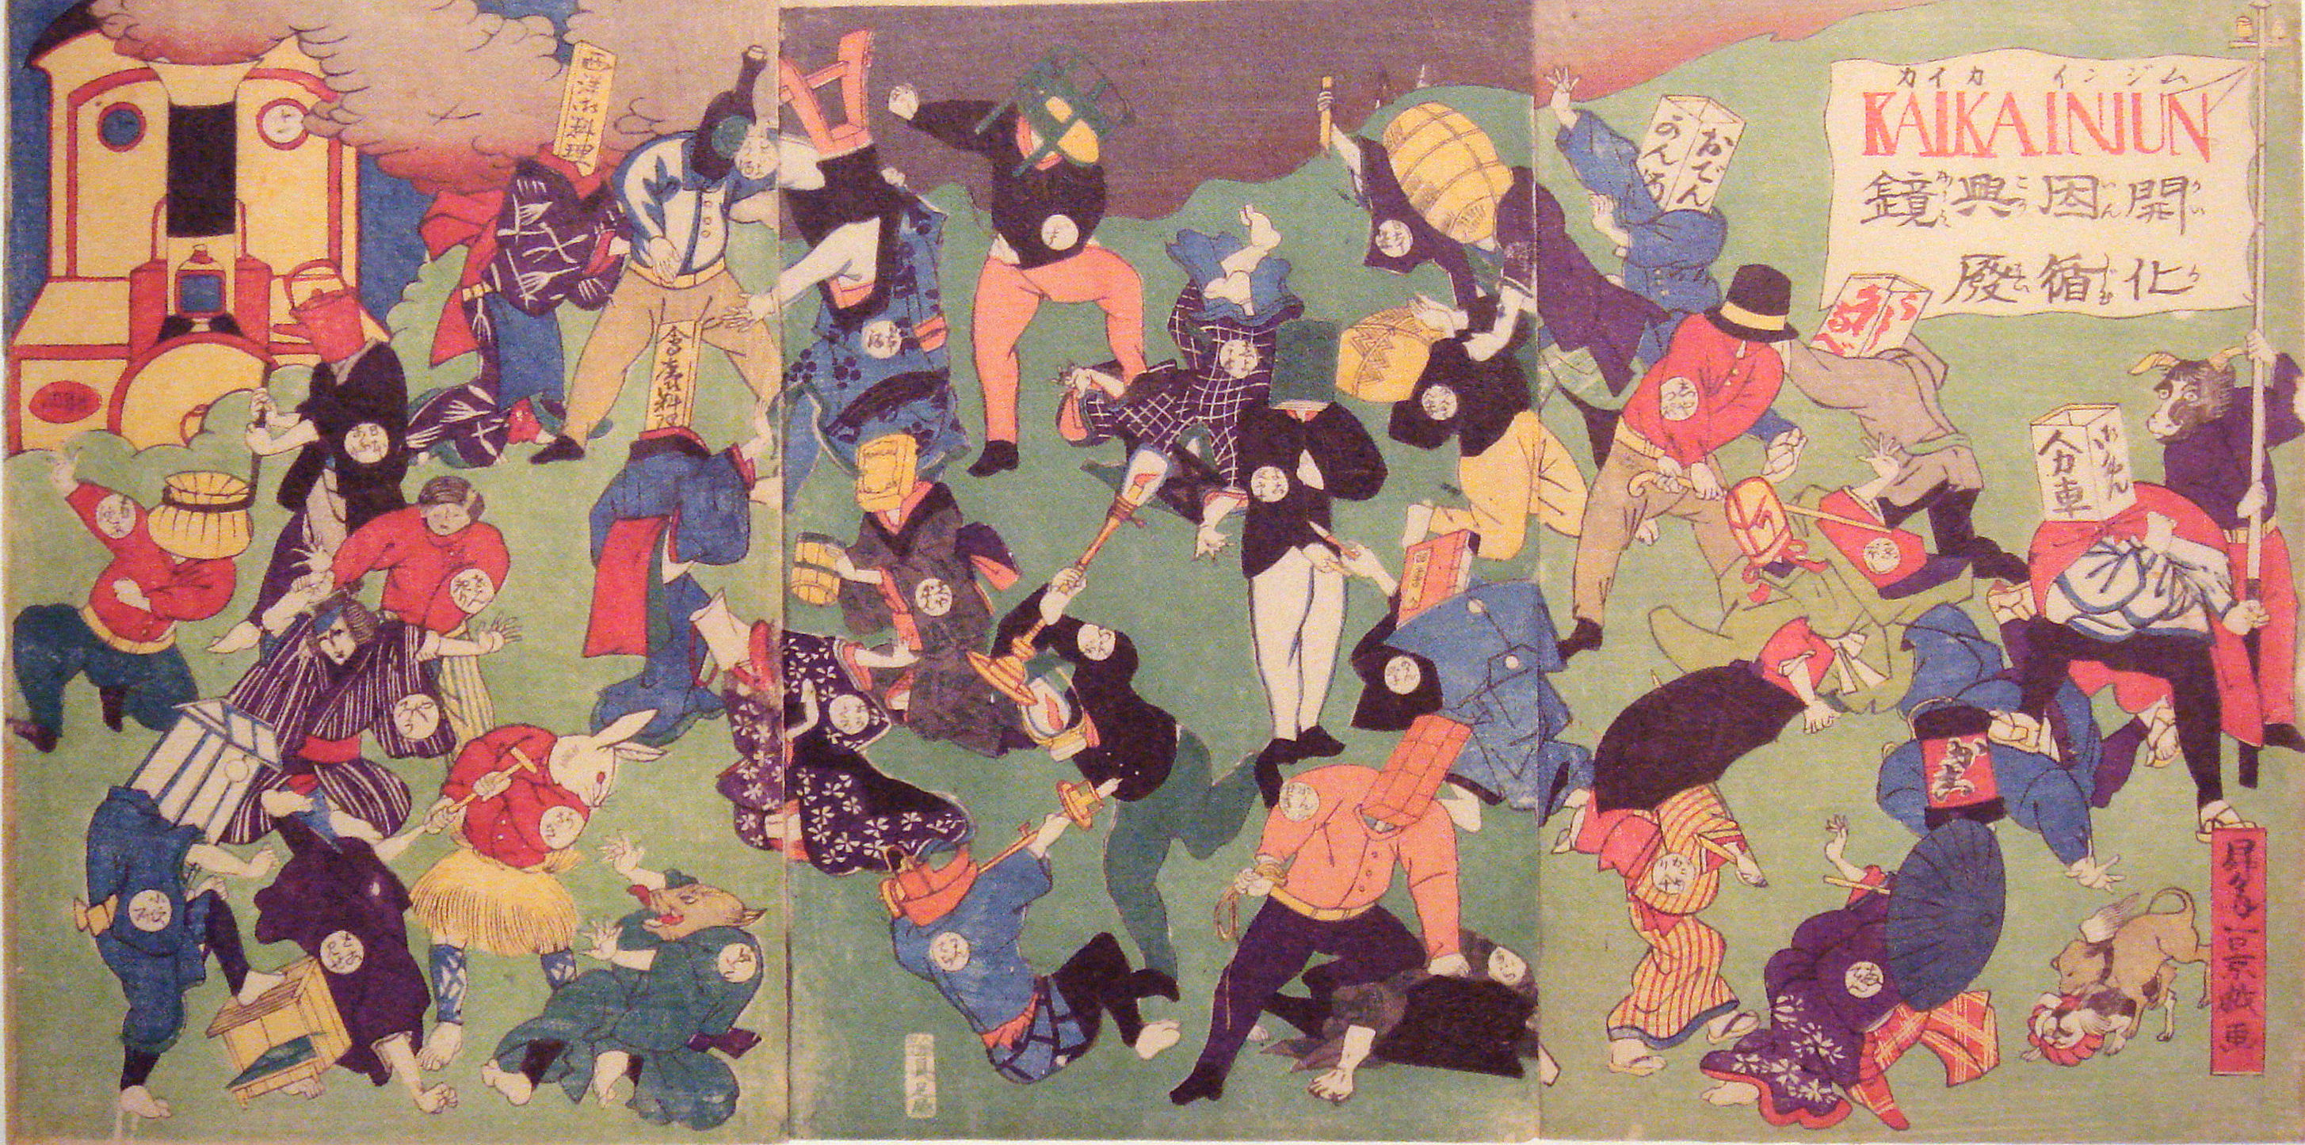
MEIJI JAPAN
The Third Case Study of Nationalism, or
“the most remarkable transformations ever undergone by any people in so short a time”

Slide 2
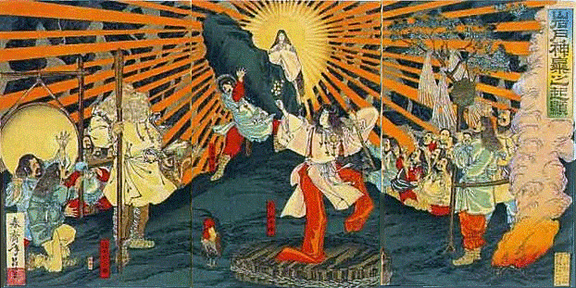
Difference/ Similarities with Other Asian Nationalisms
Japan becomes a major industrial and military power by the end of the 19th C.
  India is still 50 years away from even independence
  China is struggling to establish a nationalist government
Japan becomes the symbol of violent militarist Nationalism in Asia
  Indian nationalism comes to be associated with non violence (more on this later)
  China moves to communist nationalism (more on this later)
BUT at least at two levels we can see parallels in the nationalist projects
India China and Japan ALL exhibit a degree of ambiguity towards modernity, despite their very different experiences,
And, in ALL THREE cases, nationalism becomes a project both of popular MOBILIZATION but also popular CONTROL

Slide 3
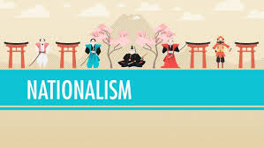
Historical Context
See Crash Course on Nationalism and start of the Meiji Restoration
Go back to earlier slides on Japan
Internal and External causes
INTERNAL
  Changing Role of Samurai
  Economic Changes
  Daimyo of Choshu and Satsuma
EXTERNAL
  Perry and ultimatum
  Unequal treaties
  Westernization and ambiguity

Slide 4
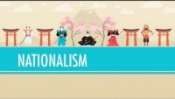
Crash Course: 4:46-11:19

Slide 5
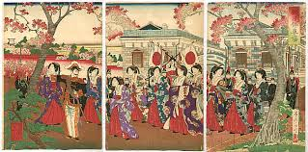
Outline / Plan
Changes: Some Central Features
CAUSES: A major focus
Next Lecture: NATURE of changes: Connections with Nationalism

Slide 6
Changes
ECONOMIC: Certainly the most striking. Foundations of Japan’s emergence and continued presence as a world economic power in Meiji era changes. The state took a very active role in promoting industrial enterprises and provided technical and commercial infrastructure for emergence of modern industry
CULTURAL-SOCIAL Almost as important, some argue that economic transformations not possible without cultural shifts (others argue the exact opposite!)
  the cult of westernization, emulation of everything from top-hats to beef eating, from railways to the ROKUMEIKAN indicated major change in outlook of Japanese leadership
  IWAKURA MISSION stayed away TWO YEARS to complete observations in Europe and US at a time when the new regime was in its infancy -- unthinkable in the pre-Meiji period
  Changes in the social hierarchy: Removal of formal legal discrimination, end of legal and symbolic privileges of the samurai -- by the samurai themselves
  Domestically: the attempts to change family life and the position of women in society
All of these (and others that you should read about!) were significant changes in Japanese society, economy, and culture

Slide 7
Causes (general)
NO SINGLE CAUSE EXPLANATIONS POSSIBLE: For this, or any other significant historical phenomena. Often the result of LAZY or CASUAL thinking
  To explain changes as a result of Japan’s “inherent” adaptability, any essential cultural trait of the Japanese people, or even solely as a result of the western impact, is WRONG. Of course Japanese history, culture, and impact of the west had SOMETHING to do with the changes; BUT none of them SINGLY can explain the changes, we have to look for MULTI CAUSAL explanations, to look at historical CONJUNCTURES
  looking closely at the causes of the rapid and far reaching changes in the Meiji era, ironically, does show up major continuities with the earlier period of Japanese history
The small size of Japan, and (compared to India and China) the relative cultural homogeneity of its population allowed policies originating at the top to be implemented at different levels
A tradition of borrowing from outside the islands, e.g. from the Chinese, may have allowed for easier borrowing from the west
But these by themselves do not explain WHY such far reaching changes occurred

Slide 8
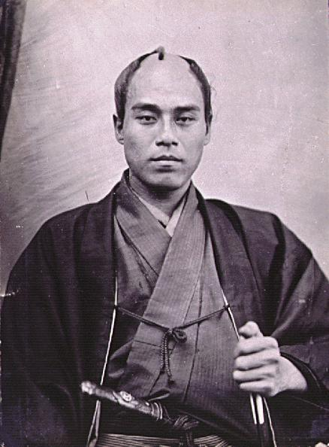
Causes (earlier history)
The age of the new leadership, average around 30, certainly played a part in the change.
But the changes that took place in Meiji Japan in fact had roots in the history of Japan of an earlier period
  Lower Samurai undergoing transformations almost throughout the Tokugawa period, and struggling to find a place for themselves.
  Thus, unlike the Chinese scholar-gentry for example, they had little stake in the perpetuation of the old order. Thus able to depart radically from the traditions of the past. Writings such as those of FUKUZAWA YUKICHI advocating wholesale westernization appealed to them. Yukichi was a translator and official for the TOKUGAWA regime
  SCHOOLS were a major agent fore changes that took place in Japan in the Meiji era: western culture, technology, lifestyles, industrial discipline were all imparted by the school system, but this too, was anticipated in great measure by Tokugawa era developments. Please read details from the textbook
  Economic changes that took place in Meiji Japan were products of a consciously-directed state economic policy. But state policies could not have worked without people like the merchants and Gono who HAD prior economic experience in a market-economy. Commerce and commodity production (producing for the market) in cottage industries, allowed a class of Japanese to participate in the new industrial and commercial economy of the Meiji period

Slide 9
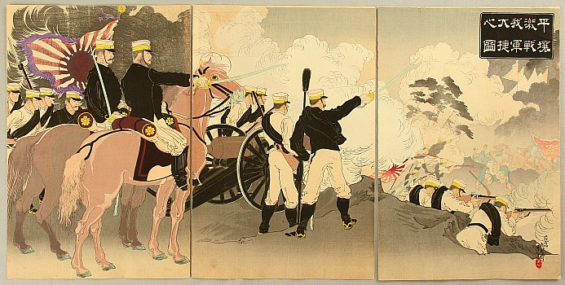
Causes (western impact)
Ahistorical to speculate if NO western intervention. some trends toward a market economy. But, Japanese economy developed at the rate and extent to which it did in the Meiji era precisely BECAUSE of the western intervention
Japanese leaders borrowed, bought, or leased the latest in western technology, took major steps towards competing with the western powers who had imposed the humiliating unequal treaties on Japan. THUS clearly the second cause of the transformations that took place in the Meiji rea have to be traced to the impact of the west
Though reading FUKUZAWA, looking at the way and extent to which Japanese society adopted western norms, lifestyles, and ideas suggests that ALL Japanese eagerly accepted all that was western because they thought it a better alternative, Westernization of Japan has to be seen in the context of COMPETITION with the west, as a means of catching up
Aim was not so much the westernizing Japan as of making Japan stronger and able to OVETHROW the west.
Paradoxical, but have to understand Japanese westernization in the context of an emerging NATIONALISM. Most evident in the ECONOMIC policies (“CATCH UP VISION” in Chapter 7)
Far from being totally enamored of the west, Japanese officials recognized the nature of western imperialism, and worked to create a state where they could compete on EQUAL terms with the western powers. Knowing that they could not compete militarily as yet, they set about transforming Japanese society so that they could at some point do so

