Slide 1
Modi’s India
“High(?)lights” and Potential Consequences

Slide 2
Contrast Modi and Nehru
Nehru’s pseudonomic auto-critique vs Modi’s narcissism
Refers to himself in third person
His multiple changes of clothes
Wore a suit with his own name woven in*
Cultivation of democratic institutions
versus undermining them
Necessity for inclusive diversity in a complex society such as India? North-South; Hindu-Muslim; Rich-Poor; Men-Women; Savarna-Dalit; OBC-Forward etc etc
*Modi was given the suit as a gift from a businessman… but … Modi may have run afoul of the very ethical guidelines he endorsed when he took office. Government ministers are not to accept gifts worth more than 5,000 rupees ($80) unless they pay for them. The suit was later sold at auction to raise money for an environmental project

Slide 3
Modi Elected PM 2014
Reputation, Godhra violence,
But runs on platform of economic development
Sabka saath, Sabka vikaas (collective effort, inclusive growth)
Hindutva takes a back seat in this election: dog whistles, but no overt Muslim baiting
Reasons for victory include:
Accusations of corruption against the previous INC govt
High rate of economic growth, but insufficient redistributive justice
Rich got much richer, but poor remain poor
BJP said, “give us a chance”
Even those who did not support Hindutva voted BJP
Received 31% of the popular vote

Slide 4
Timeline of Events
May 2014, Modi sworn in as Prime Minister
2015 Dadri Lynching (cow protection)
Demonetization 2016
Bhima Koregaon violence and arrest of dalit activists
May 2019 Modi Wins Second term (37.4% of popular vote)
August 5, 2019 Reading down of Art 370 of Constitution and “demotion” of Jammu and Kashmir from State to Union Territory
November 9, 2019 Supreme Court judgement on Ayodhya
December 11, 2019 Citizenship Amendment Act (CAA)
September 2020, Farm Laws (repealed November 2021)
November 2020, “Love Jihad” laws
2020-2021 up to 4.7 million Covid related deaths (officially < 400k)

Slide 5
Dadri Lynching 2015
“Cow Protection” has been an important issue for Hindu nationalists in India, who see the cow as sacred, although many Hindus do eat beef, as do Muslims and Christians
Emboldened by “their” government in power in New Delhi, Hindu vigilantes unleashed a reign of terror (since 2014, at least 44 people have been murdered and 280 injured on this account, says Subramanian)
Hindu vigilantes attacked and killed a Muslim man, Mohammad Akhlaq, on the suspicion that he had slaughtered a cow
Prime Minister Modi did not condemn the killing
RSS spokesman, and BJP MP, Tarun Vijay practiced “whataboutery” asking why there was no outrage at the killing of Hindus, and indirectly blamed Muslims for not standing with Hindus
Pratap Bhanu Mehta eviscerated Vijay’s logic and facts

Slide 6
Bhima Koregaon 2018
Vijay tried to distract his readers by pointing to the plight of Dalits and claiming that the RSS was their supporter
Events of 2018 show this to be a lie
Dalits in Maharashtra had long celebrated a victory at a battle in Bhima Koregaon in 1818, when, fighting for the English East India Company they had defeated the upper caste army of the Maratha rulers
January 2020 celebrations led to violence between Hindu nationalist organizations and Dalits (incited by the Hindu nationalists)
Hindu nationalist participants not arrested
But later that year, prominent Dalit and labor activists were arrested under national security laws, claiming they had colluded with Maoists against the state
Forensic analysis of the evidence (computers) revealed that the evidence was introduced later into the computer
The Koregaon activists remain in prison, with one of them, a Jesuit priest, dying in prison

Slide 7
Demonetization 2016
On 8th November, with no prior notice the government “demonetized” currency notes with values of 500 and 1000 rupees
Originally claimed it was to smash the shadow “black money” economy flourishing in India and counter terrorism, but goalposts kept shifting as 99.3% of the demonetized notes were legally exchanged
No impact on the shadow economy except greater corruption
Long term damage to the small and medium sector of the Indian economy and ultimately to economic growth in India
It was alleged that the real reason for this was to undermine the chances of BJP’s opposition in the upcoming elections in India’s largest state of Uttar Pradesh
BJP won the elections

Slide 8
Second Term
Modi wins a second term in office in 2019, with an even larger victory than 2014. This time with >37% vote share
A conveniently timed terrorist attack on Indian paramilitary forces in Kashmir, in Pulwama, helped sway the votes
As the economy was in shambles, the 2014 strategy would not work, hence old Hindutva platform comes to the fore
Separatism in Kashmir, Uniform Civil Code, accusations of all opposition harboring “anti national” sentiments
And of course, “Hindutva” in general was part of the platform (in 1995, the Supreme Court ruled that “Hindutva is understood as a way of life or a state of mind and is not to be equated with or understood as religious Hindu fundamentalism”)
But the idea of creating a Hindu Rashtra is never far from Hindutva

Slide 9
Jammu and Kashmir August 5 2019
Jammu and Kashmir was India’s only Muslim majority state
Ambiguity about accession to India (see Guha chapter 12) and cause of two wars between India and Pakistan. Remains as a “disputed area” in many international maps
Ambiguity with the idea of Kashmiriyat under Abdullah, twice arrested by Nehru and Indira
A rigged election in 1987 led to rise of armed militancy where many took a Islamicist position
Demand for azaadi, independence, for Kashmir
In August 2019- Indian government stripped Jammu and Kashmir (J&K) state of the special status that gave it significant autonomy. In fact J&K is no longer a STATE at all, but two UNION TERRITORIES, J&K and Ladakh.

Slide 10
Citizenship Amendment Act December 2019
Citizenship Amendment Act (CAA) Passed on Dec. 11, 2019, effective Jan. 2020, fast-tracks citizenship of Hindu, Sikh, Buddhist, Jain, Parsi and Christian immigrants from Afghanistan, Pakistan and Bangladesh who arrived in India before 2015. However, it excludes Muslims
First time religion introduced as criteria of citizenship
CAA is closely connected with a proposed NRC, National Register of Citizens, where ALL people in the country will have to PROVE that they are citizens. Though Govt denies it, the Home Minister Amit Shah had clearly said it was going to follow a chronology, where CAA would be followed by an NRC, allowing all Hindu immigrants to be given citizenship. The Muslims who could not prove citizenship, would be deemed “ illegal immigrants” and deported

Slide 11
“love jihad”
November 2020 India’s largest state by population passed the Prohibition of Unlawful Religious Conversion Act prohibiting any religious conversion for marriage, even if it is with the consent of the individual … except when prior sanction is obtained from the state
The law followed a national outcry against what Hindu nationalist groups called “love jihad”
Started with protests by a fringe even among Hindu nationalists who believed there was an organized conspiracy by Muslims to marry and convert Hindu women to Islam. Equated to an armed “jihad” by Muslims, then taken up by more “respectable” members of the BJP
Through this Hindu nationalists try to control two of the most intimate aspects of people’s being: love and faith
Tanika Sarkar, “it entirely exonerates Hindus from all charges of fraud, allurement or intimidation when they convert people from another community. For in the case of shifting from another faith to Hinduism, conversion ceases to be conversion. It will be defined as “homecoming” or ghar wapsi – returning to one’s authentic roots, one’s true faith.”
The only real historical comparison Sarkar can make is to Nazi Germany’s Nuremburg Laws of 1935

Slide 12
Social Media
Adept at use of social media, recall Mishra from last class
Mr. Modi is preternaturally alert to the fact that the smartphone’s screen is pulling hundreds of millions of Indians, who have barely emerged from illiteracy, into a wonderland of fantasy and myth… Mr. Modi uninhibitedly participates …in digital media’s quasi-egalitarian culture of exhibitionism.
Nachiketa Joshi informs us of how widespread the reach of Hindutva has become in the realm of digital popular culture, particularly with the rise of “H-Pop”
Gives a new commercial opportunity to perhaps fading singers
Allows for a new, brash and in-your-face anti-Muslim to prosper
Regardless of outcomes of 2024, this genie is going to be impossible to bottle up again in a hurry

Slide 13
Ayodhya Judgement Nov 2019
Destruction of the Babri Mosque in December 1992 did not resolve dispute at Ayodhya
Matter was before the court, and the Supreme Court in November 2019 declared a judgement favoring Hindus and opened the way for legally constructing a Hindu temple there
This, despite acknowledging that the destruction of the Babri mosque was an illegal act the court ruled that there was better evidence favoring the building of a temple there
In complete defiance of convention, the then Chief Justice of India Ranjan Gogoi was nominated to the upper house of Parliament by the ruling party less than six months after presiding over this verdict

Slide 14
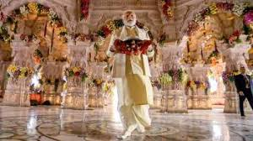
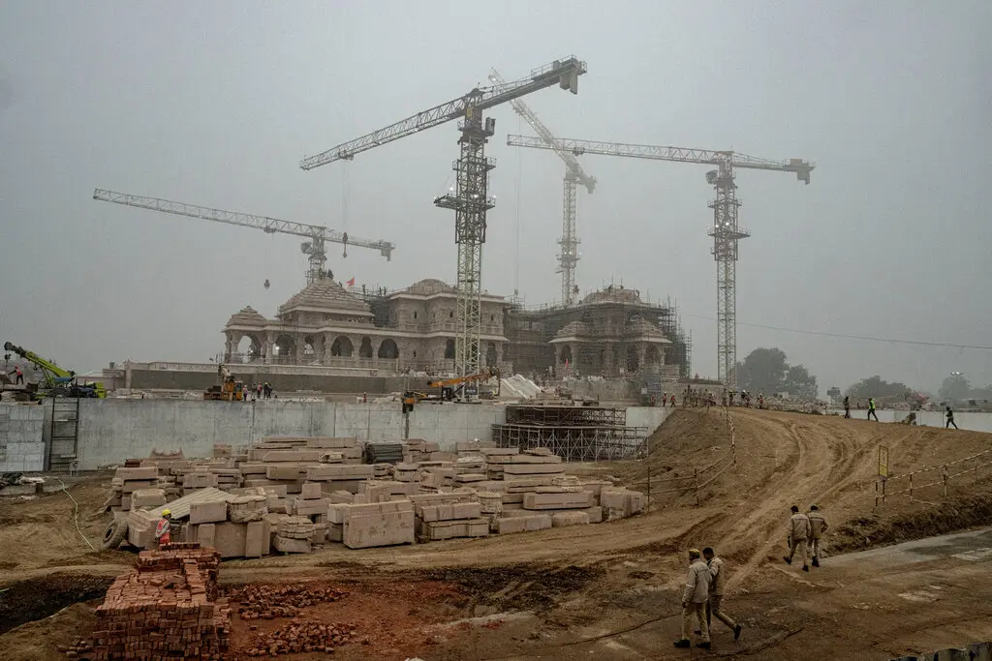
Inauguration of the Ayodhya Temple
On Jan 22, 2024, shortly before elections were announced in India, Modi himself inaugurated the “rebuilt” Ram temple in Ayodha
Event celebrated with great fanfare across the
country, as a day of national liberation with
some states even declared it a holiday
Do note the solo framing of Modi, though
This, despite the fact that the temple was still
incomplete. Scriptures don’t allow for worship at a
temple until the building is complete
Elections were clearly on his mind

Slide 15
Modi and Democratic Institutions
Modi’s authoritarian impulses evident even when he was Chief Minister of Gujarat
His response to protests has been to go around institutions rather than work with them (think Indira Gandhi)
With the media in his pocket, little national opposition, and use of state institutions to intimidate critical voices, Modi’s government has been able to be the only voice people hear
Rahul Gandhi, son of Rajiv, Indira’s grandson, was portrayed as a privileged dynast out of touch with reality
Rahul’s decision to undertake a 4000 km journey on foot (called the Bharat Jodo Yatra [Unite India Journey]) from the southern tip of India to Kashmir in the north changed his image (Sept 2022 to Jan 2023)

Slide 16
A Populist Drifting to Authoritarianism (redux)
Post yatra Rahul brought the issue of corruption to public attention, using the Hindenberg group’s report on Gautam Adani calling it the “largest con in corporate history”(Adani group lost almost $100 BILLION in market value as a result)
Adani meteoric rise from modest beginnings to the wealthiest man in India, one of the richest in the world, after his close associations with Modi had always been a matter of suspicion
The entire opposition, led by Rahul, demanded a JPC (joint parliamentary committee) into Adani’s finances
Modi’s response was to use the courts to have Rahul Gandhi disqualified from Parliament! An INC Chief Minister (CM) of the tribal state of Jharkhand arrested and jailed in January 2024. Arvind Kejriwal, CM of Delhi, jailed March 21st, 2024 even as he was campaigning for the national elections.

Slide 17
Potential Consequences
Nehruvian or Gandhian Secularism was a way of managing India’s immense diversity
Rejecting it could lead to strains, demands for break up
The only option then would be authoritarianism
RSS ideology not averse to authoritarianism
Intolerance of dissent already evident whether in Jamia or JNU attacks, arrests of Bhima Koregaon activists, or social media attacks on “anti nationals” labelled as part of the “tukde tukde gang” -- those determined to break India into pieces
Hence people look to history and worry about India’s future after this sort of “ethnic democracy” populism
Beyond India too, the growing global confidence of the regime is leading to extra judicial strikes against the “enemies of India” – in Pakistan, Canada and the USA

Slide 18
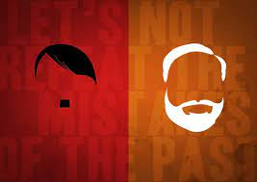

Slide 19
Recommended Readings

Slide 20
Resisting Hindutva: Women of Shaheen Bagh
Rai tells us “Anti CAA protests “resulted in astonishing political spectacles of solidarity – hundreds of people, particularly women, who had never participated in political protests coming out and peacefully occupying public spaces in opposition to this exclusionary and discriminatory law.”
Not only protested discriminatory law, but assert civic rights, of dissent and protest
Led and coordinated by a group deemed by Hindu Nationalists to be oppressed victims of Muslim culture – Muslim Women
From poor or lower middle class backgrounds
Appropriation of Nationalist symbols by a community branded as “anti-national” by Hindu Nationalists
See images of MAP cutout, dresses in Indian tricolor, practices of the Nationalist movement, and symbolic readings of the Preamble of the Indian Constitution
Other Images from Shaheen Bagh Protests

Slide 21
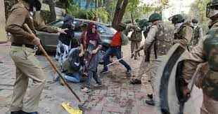
State Pushback: Jamia Milia
Women of Shaheen Bagh were moved to protest after seeing the crackdown by the police on students studying at JAMIA MILIA ISLAMIA UNIVERSITY, in their neighborhood
Jamia is well-regarded University with strong programmes in communications and the humanities
Muslim students protested against the CAA and were brutally attacked by the police on December 15, 2019

Slide 22
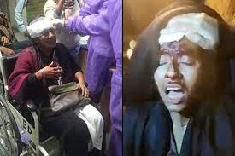
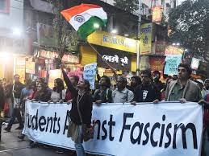
State Permitted Pushback: JNU
Samanth Subramanian article “long read” describes the attack on students at Jawaharlal Nehru University (JNU)
Named after the first PM and a bastion of leftist ideology, JNU seen as “the enemy” by Hindu Nationalists
January 5, 2020 thugs later identified as belonging to Hindu nationalist organization, brutally attacked students at JNU
Police stood by or actively helped attackers

Slide 23
Love Jihad: Social and Legal Context
In India it’s the norm that marriages arranged by family elders, who prefer partners from the same religion, caste, class, region, linguistic community
The new law does not apply to inter-faith marriages under the Special Marriage Act, where both individuals can retain their separate religious identities but to inter-faith marriages where either the husband or the wife seeks to convert to a different religion to marry under personal laws
Why would they do that? Because marrying under the special marriages act requires a one-month waiting period, during which parents or families can intervene.
Hence, couples will often choose to convert to one or the other religion and seek to marry their partners of choice
This ordinance makes that illegal, or at least much more difficult. Sarkar: “The ordinance outlaws conversions supposedly based on fraud, coercion and what it strangely calls “allurement”. The potential convert must apply to the magistrate for permission to convert and the magistrate – not the person whose faith is at stake – will take the final call on it. The person who is accused of making unlawful conversions will need to prove that he is not guilty of fraud, etc. Once again, the would-be convert’s own religious preference will not possess legal validity.”

Slide 24
Jim Crow Hindutva
Although many have drawn comparisons between Modi’s India and Nazi Germany, Ashutosh Varshney makes a comparison with Jim Crow South
Just as white nationalists in the US used legislative powers to disenfranchise African Americans, even as lynchings created a climate of fear in the Jim crow era in the US, in India, Varshney argues:
Laws are being made to turn Muslims into second-class citizens; mob lynchings and intense hatred are instilling fear; and both law and violence are being combined to prevent religious mixing and deepen communal segregation…. What race was to the American South, ethnicised religion is to Hindu nationalists.
Amended “public safety” laws give the government the power to designate any individual as a terrorist or “anti-national”, imposing preventive detention with uncertain access to courts
via the Citizenship Amendment Act (CAA), a religious requirement was introduced in citizenship laws, excluding only Muslims
laws prohibiting interfaith marriages are being passed in BJP-ruled states; and the “love jihad” militia punish Hindu-Muslim personal intermixing.

Slide 25
A bigot who gets things done?
Nicholas Kristof of the New York Times warns against the dangers of religious fundamentalism unleashed in Modi’s India and the increasing authoritarian polity created under him
Sweden’s V-Dem Institute called India not a democracy but an “electoral autocracy” ranking 108th among 179 countries in its electoral democracy index
Kristof disapproves of the cult of personality cultivated by Modu, but concedes his successes in the campaign against open defecation, distribution of gas cylinders, and improving transport infrastructure
Though “what I fear is that the authoritarian, Hindu nationalist Modi is eclipsing the economy-boosting, toilet-building Modi.”
Ramachandra Guha pointed out, two years earlier though, that the arrogance, small-mindedness of focusing on short-term popularity, prevents Modi from seeing a bigger picture

