Slide 1
August 1947 Pakistan Created with two “wings” East and West Pakistan

Slide 2
Issues
WEST Pakistan politically dominant, but demographically smaller
EAST Pakistan larger population, spoke BENGALI
URDU and PUNJABI dominant languages of West Pakistan
Attempts to create Urdu as NATIONAL language of Pakistan resented by EAST

Slide 3
Mohammad Ali Jinnah (the founder of Pakistan) dies in 1948

Slide 4
Liaqat Ali Khan (Jinnah’s protégé and Pakistan’s first Prime Minister) assassinated in 1951

Slide 5
Major General Iskander Ali Mirza Takes over as GOVERNOR-GENERAL in 1955 and after PROMULGATION OF PAKISTAN’s FIRST CONSTITUTION in 1956, becomes Pakistan’s FIRST PRESIDENT

Slide 6
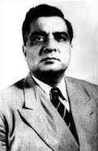
Mirza
Imposed martial law in 1958 after suspending the constitution and dissolving the Pakistan Parliament.
Was the first to bring in military influence in national politics after he appointed his army chief as chief martial law administrator of the country.

Slide 7
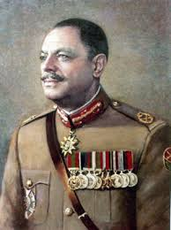
Ayub Khan
After only 20 days of martial law, Chief Martial Law Administrator Field Marshal Ayub Khan forced him out of the presidency. He was exiled to London.

Slide 8
1960 Ayub “assumes” Presidency 1965 War with India

Slide 9
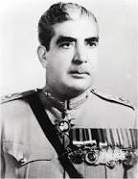
1969 Martial law declared; General Ayub Khan resigns and General Yahya Khan takes over.

Slide 10
1970 First General Elections in Pakistan
Sheikh Mujibur Rahman's party The Awami League, hugely popular in EAST Pakistan secures absolute majority in new National Assembly
Zulfiqar Ali Bhutto’s Pakistan’s People’s Party wins in West Pakistan

Slide 11
Winners : East and West
Mujibur Rahman
Zulfiqar Ali Bhutto

Slide 12
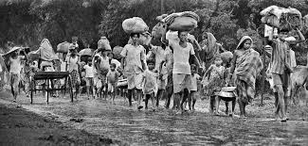
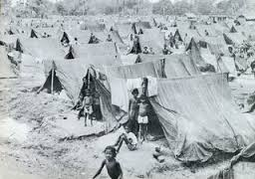
Mujib should have been PM, but Yayha and Bhutto have other ideas
Response by Yahya and Bhutto is military action, led to CIVIL WAR in East Pakistan. Hindus and Muslims flee, 7 MILLION refugees in India

Slide 13
War and Surrender in East Pakistan: December 1971

Slide 14
1971 Creation of Bangladesh

