Slide 1
Regional Kingdoms ca. 500-1000 CE

Slide 2
What we will cover
TWO BROAD themes
1. Political history of regional powers
  Lots of detail, can sometimes be confusing, do ASK QUESTIONS
2. Perhaps more important than the details: we will examine some GENERAL ways in which they were administered
  See how the limits set by historical contexts enabled the changing (therefore, for us, confusing) political history
  Yet, at the same time, how this was a very important moment in the emergence of regional identities in India

Slide 3
Overview
We will be looking at:
A. Four stages of political history of peninsular and northern India
  The “Prehistory” of peninsular India
  Phase I (seventh to eighth century)
  Phase II (late eighth to ninth century)
  Phase III (ninth to twelfth-thirteenth centuries)
    Lots of detail. Important parts of these changes summarized in the study guide, and these are the ones you need to FOCUS on.
B. The LOGIC of these states
  Samnata-ization
  Land Grants to Brahmins and Temple Building one way to keep control of Samantas (aka connections between “religion” and “politics”

Slide 4
WHY a “Prehistory” of peninsular India?
Not really a “prehistory”: So far almost exclusive focus on NORTH India. Some of the details we have read about but ignored!
Writing of history of India has had an “Epicenter-ic view” (influence of colonial & nationalist historiography). Like ideas about caste or religion, British (and from them, Indian nationalists) took the idea of INDIA from north, focus on northern imperial states, where the post-imperial = decline. but not necessarily so …as we’ll see
Start with repeating some of the details about peninsular India you would already have read about

Slide 5
How regional kingdoms emerge in South
Initially, not too different from the way states emerged earlier in the Gangetic plain. But context means the nature of these states, kingdoms and empires was different
Ist stage: tribal chieftain to petty king... for the rest of the tribe a change from member of a relatively egalitarian social and political arrangement to peasant – hood. They now become cultivators of land that other people have SUPERIOR rights over land
2nd stage: petty ruler to king, with other SAMANTA (word originally meant neighbors), that now refers to those neighboring rulers incorporated as feudatories. They maintain control over own territories, but pay “tribute” either in money, or troops for their new king’s armies, or only attendance at court. Sometimes all three
New king would required some legitimacy, he or ancestors had been first among equals not so far back. So, NORTHERN MODEL comes in handy. Brahmins had been heading south, propagating their ideas about religion and society. When tribal chiefs want to become kings, they are useful. Throughout central and south India, this is a time of many land grants to Brahmins, and also construction of temples... we’ll come to the significance of that in a minute!
3rd stage achieved when one of the local kings would then conquer and absorb others as his inferiors, to create “empire” (some with territorial control at least as large as some of the European empires of this time). When absorbed, they became a “MAHASAMANTA” or the “Great Samanta” of this emperor, attend his courts etc., while THEY have their own kingdoms and courts and own Samantas

Slide 6
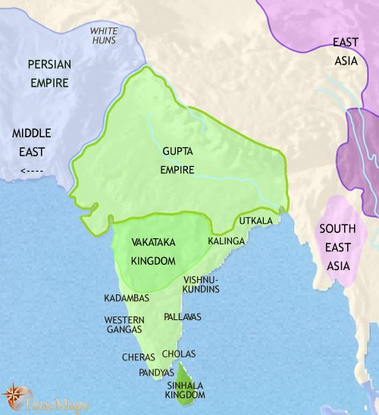
India “of the Guptas” more than the Guptas

Slide 7
Geographically: Some important regions
1. North, aka Indo Gangetic plain. Last we covered, ruled by the GUPTAS
2. Far south: Three kingdoms: CHOLAS, CHERAS, PANDYAS, important from c. 3rd Century BCE onward
  Patrons of the SANGAMS: Literary assemblies between first and third centuries C.E.
  Probably defeated by a tribal group the Kalabhras who may have been Buddhists.
  Important for trade with ROME, which declined in third and fourth century, C.E.
3. Central India, Deccan plateau, Even while Gupta empire at peak VAKATAKAS so powerful, that Guptas arranged a marriage alliance with them. After Vakatakas, came CHALUKYAS and RASHTRAKUTAS

Slide 8
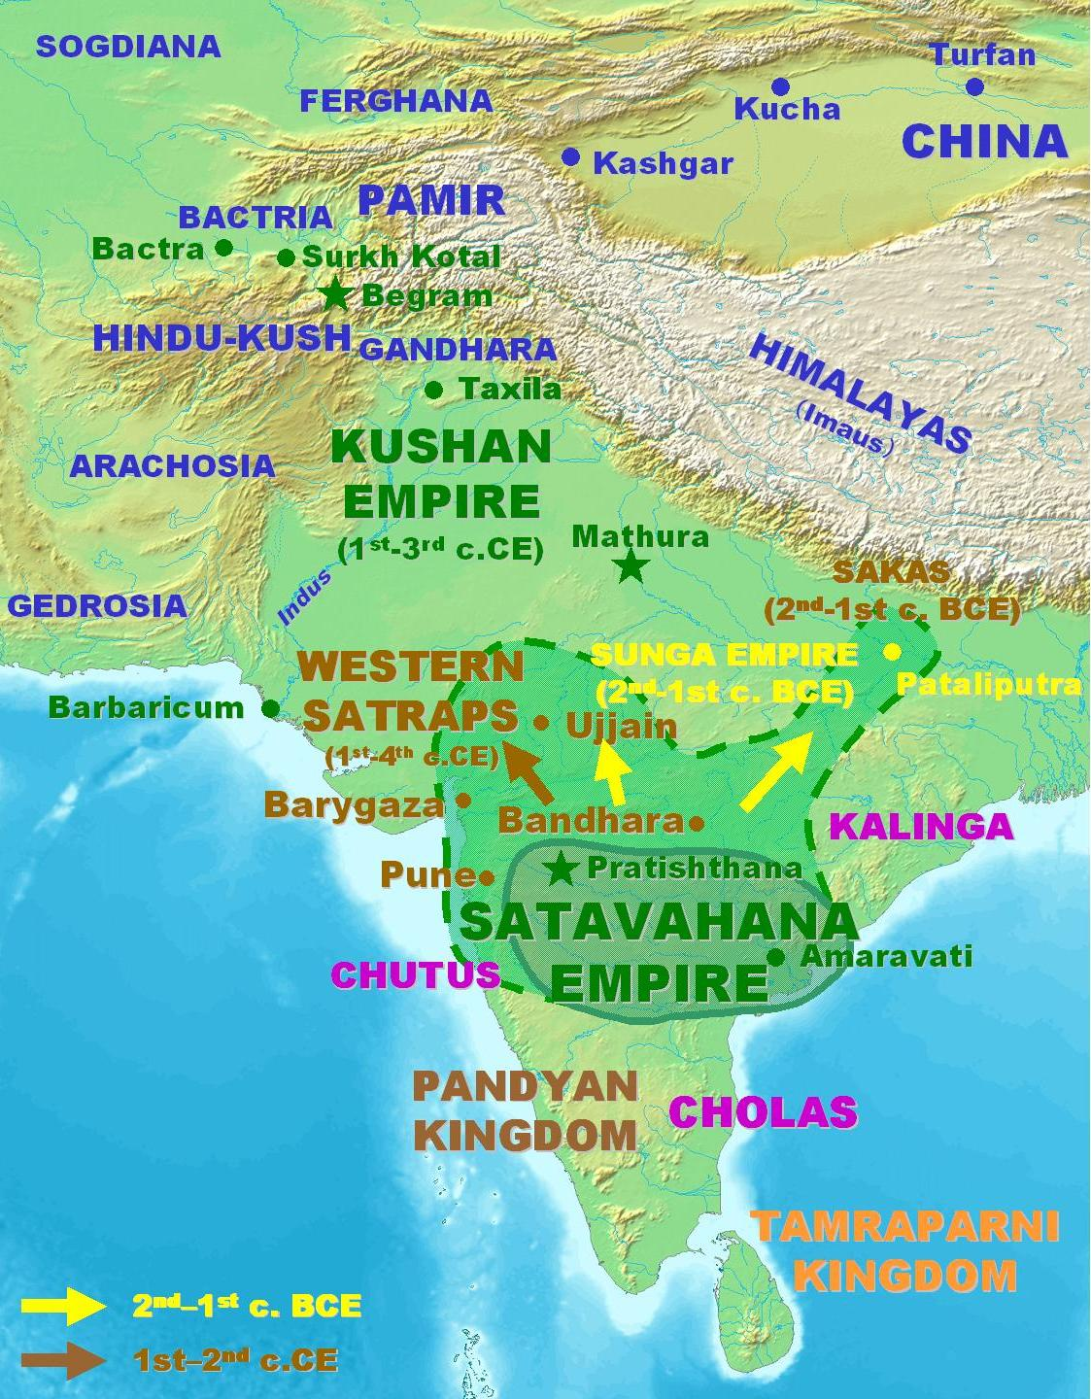
Some, from BEFORE the Guptas
4. East: even BEFORE the Guptas, was the astounding king KHARAVELA of ORISSA, reached far enough west to challenge some Greek kingdoms and his empire included large parts of central and southern India. But short-lived. Later came the PALAS and then SENAS of Bengal.
5. Western India SHATAVHANAS Also pre-dated the Guptas based in PAITHAN (Pratishthan) in western India, strong centralized empire lasted a long whie.

Slide 9
Post Gupta Era (our main focus)
We will divide into three stages, focusing on most part on political history
Phase I (seventh to eighth century)
Phase II (late eighth to ninth century)
Phase III (ninth to twelfth-thirteenth centuries)

Slide 10
Phase I: ca end of 6th to 8th C, aka 500s to 700s
In the NORTH End of Guptas thanks to raids of HUNS from China/Central Asia. Smash political empire, but also trade routes, difficult to re-establish. End of Gupta dominance, allow emerging regional kingdoms, to establish own area of strength
LAST of the great northern emperors till the SULTANS of Delhi in the 12th century was early 7th C., HARSHAVARDHANA. Looking at a map alone, appears to replicate Guptas. Unlike them, faced challenges, first by king of BENGAL, Shashanka, later, by PULAKESHIN II (PII)of the CHALUKYAS.
More important, though, Harsha depend on FEUDATORIES (what is a feudatory?)
Harsha defeat by CHALUKYA King, PII c. 630 , inaugurates a period of constant infighting, struggle for supremacy. In this struggle ACTORS change, but by and large REGIONS and PLOTS remain the same. Rise of ONE, often a feudatory of earlier dynasty and then eventually undermined either by attack by more powerful neighbor, or own feudatory, or a combination of both!

Slide 11
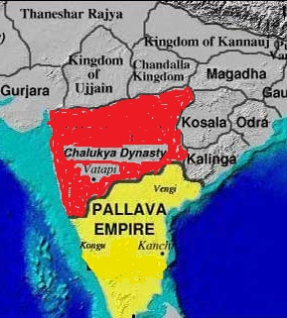
Pallava – Chalukya Struggle
IMMEDIATELY after Harsha’s defeat emerged a struggle between the central-India based CHALUKYAS of BADAMI who rise to prominence in 6th Century and a rising SOUTH INDIAN dynasty, the PALLAVAS (Over much of seventh to eighth century). Their areas of interest coincided, and constant battle between them. The details are really not important for us. PALLAVAS were able to emerge after the KALABHRAS had defeated the Chola-Chera-Pandyas in southern peninsular India

Slide 12
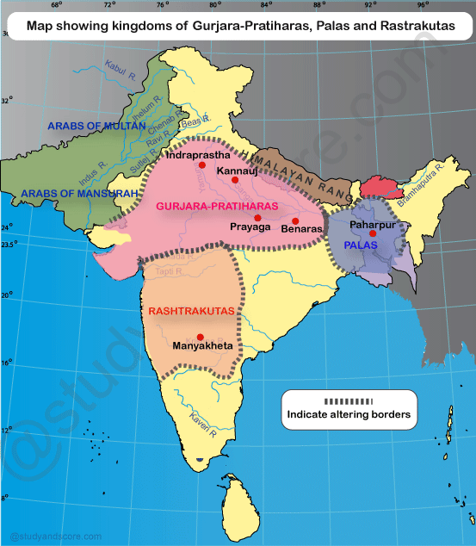
Phase II(late 8th-9th C): Players Change, not the plot!!
RASHTRAKUTAS (RK) take over as the major power in CENTRAL India from the CHALUKYAS, in the EIGHTH century
PALAS become important in EAST
A new group: GURJARA - PRATIHARAS (GP) in north. Origin with HUNs or one of the many waves of migrants, and were ASSIMILATED into the VARNA system through a major FIRE SACRIFICE, whereby they were “purified” and admitted as KSHATRIYAS. They were the first of the Rajputs!
These Three (RK- PALA- GP) struggle for control over Imperial capital KANNAUJ (Harsha’s kingdom) for a long time. While PALLAVAS remain dominant in south

Slide 13
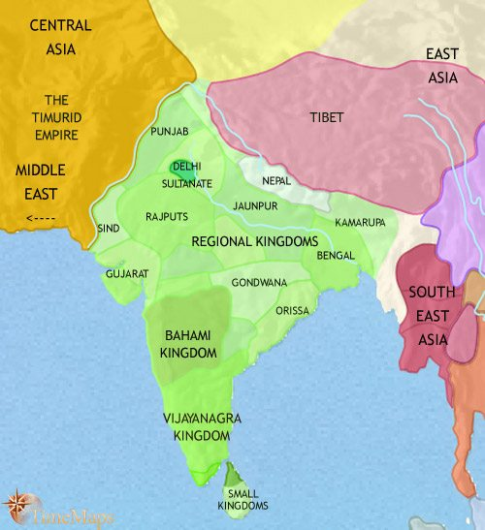
Emergence of Regional Kingdoms, ca. 9th C
Struggle b/w the three (RK-Pala-GP) in the north leads to their ultimate demise and allowed smaller regional kingdoms to gain independence
NEPAL, Kamarupa (modern Assam) KASHMIR, Utkala (Orissa) emerge. Along with the famous Rajputs
Regional languages and identities emerge/consolidated

Slide 14
Phase III (ninth to twelfth-thirteenth centuries)
TWO important changes:
1. Decline of GP and the rise of RAJPUTS
RAJPUTS represented as the "defenders of Hindu India" against Muslims invaders. But Rajputs, who now claimed kshatriya status, were of relatively recent (post 6thC) C Asian descent, assimilated into the Brahmanical Hindu fold via the performance of sacrifices and the efforts of the Brahmins they employed
GP were such “Rajputs” but while in power intergrated many Rajput clans into their imperial / feudatory system. With demise of GP, establish own regional kingdoms in western and central India, with a “regal culture” that included constant infighting. Bards praises of the chivalry of their patrons, and spread Rajput culture. But militarily pretty inefficient (more on that later!)
2. Decline of Pallavas and RESURGENCE of CHOLAS
Cholas, an old dynasty, became feudatories of the PALLAVAS in the 8th and 9th C. Under two dynamic rulers, RAJARAJA CHOLA and his son RAJENDRA CHOLA, spread rule not only across large part of South India, but also over Sri Lanka, and South East Asia
Rajendra Chola between 1022 and 1023 defeated the Palas and reached the river Ganges. It was this that finally ended the tri-partitite struggle in the North. Under the Cholas, temples as well as literature, dance, music, and art flourished in South India, and culture spread to SE Asia
An interesting parts of the history of this period that we have not time to explore, are the reasons that drove Cholas to overseas expansion, and the nature of this Indian Imperialism

Slide 15
LOGIC of these states
Politically, mark a different era in state formation in India. No centralized empires. Model is of a great ruler and his feudatories (smaller kings who paid tribute and acknowledge the supremacy of the great ruler). They serve him in times of war or other needs
However, the ruler not have direct control. Possibly on account of lack of funds (remember Huns, smashing of silk route), so instead of salaries, there were grants of land. This eventually eroded power of central monarch, though monarchs used a variety of methods to keep feudatories in check
The word to describe feudatories was SAMANTA – that originally meant “neighbor”
One MAJOR difference between these kingdoms and earlier northern empires was that PRESTIGE of a king was measured in terms of number of SAMANTAS who attended upon his, came to his court, paid tribute etc.

Slide 16

Controlling Samantas … Creating Problems
Frequent dynastic changes of the time indicate controlling samantas was not easy!
Samant-ized polity like series of concentric circles... but difficult to keep under control, rebellions, usurpations and creation of new dynasties was common
One way of control was the building of temples and grants of land to Brahmins. No coincidence that the most amount of temple building occur in this period as well. Grants of REVENUE FREE land to Brahmins and the building of huge temples on land of Samanta
Though expensive, this undercut the power of the samanta who lost taxable land. BECAUSE giving to Brahmins accepted as good and pious, the samanta could not protest. But Brahmins support the “mahasamanta” who built the temple and granted them land
This increases the authority of the Mahasamanta when there were few avenues of centralization. One reason why so many temples built b/w 800 and 1200 CE
But only works up to a point! Loss of revenue meant less money for state activities. So less irrigation work, smaller army, administration suffers. Thus more popular support for the next rebellion and more political change. Cycle continues

Slide 17
Evaluating the Samanta Era
This period often seen as one of fragmentation of India
But seen from the POV of these regions, or what we could call a SOUTH ASIAN view of the developments, we can see them differently
Many scholars, including authors of your textbook suggest that rather than a degeneration, this period can be seen as one where we see regional state formation
Associated with regional states was the patronage rulers gave to writers, scholars, poets, playwrights, and others, who wrote in the language of the region
We see, therefore the emergence of regional languages and scripts, literatures, musical forms; in short, regional identities
This era is critical for understanding the internal diversity of India, where 23 different languages are recognized by the Constitution

