Slide 1
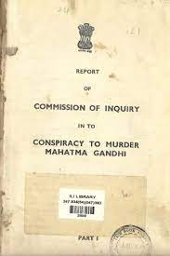
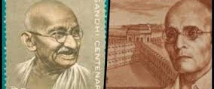
Savarkar, Hindutva and Gandhi’s assassination

Slide 2
Vinayak Chaturvedi
Point of the essay? Was it only a PERSONAL QUEST about the origin of his name?
It’s a way to tell a history, of a relatively minor figure in the assassination conspiracy, one who was ultimately acquitted
Can it help us better understand the motives of the assassins?
Or the Hindu nationalist position on Gandhi, and potentially his assassination?

Slide 3
Summary of Events
Mahatma Gandhi was assassinated by NATHURAM GODSE on January 30, 1948, but a wider conspiracy was suspected
V.D. Savarkar, former President of the HMS, among those arrested for the conspiracy to assassinate Gandhi
At trial, DIGAMBAR BADGE, a co-conspirator turned approver, said those who attempted the earlier bomb attack on January 10, and the ones directly involved in the January 30 assassination, met with and received Savarkar’s blessings
The trial convicted some but let off Savarkar, controversially, because of lack of corroborative evidence
Savarkar dies in 1963, and the Kapur Commission created in 1966 to re-examine Gandhi’s assassination
Now, Savarkar’s former bodyguard and secretary testify that they knew about his meetings with the individuals convicted in the assassination conspiracy
With new testimony, Justice Kapoor concluded “All these facts taken together were destructive of any theory other than the conspiracy to murder by Savarkar and his group”

Slide 4
Need for Context
Savarkar’s own history and legacy, a record of instigating others and then claiming innocence
Savarkar’s own significant political position, fear of popular upheaval
Sympathy for Hindu Nationalism among important members of the INC (recall Pandey’s essay)
Political context (BEFORE first general elections, govt did not have an electoral mandate)
State did not appeal of the judgement against Savarkar, though others who were convicted did (some successfully) appeal their conviction

Slide 5
“Veer” (the brave) Savarkar?
Born 1883 into an upper caste Chitpavan Brahmin family in western India. Some biographers suggest he held anti-Muslim ideas from childhood
As a youth Savarkar was a revolutionary nationalist who believed in violent overthrow of the British government
Arrested, tried, and for conspiracy against the King-emperor and the murder of a colonial official, given two 50-year sentences to be served at the Cellular jail in the Andaman Islands
While a prisoner, made multiple appeals for clemency, offering “to serve the[colonial] “government in any capacity” as it thought fit.” (Ashraf)
Ashraf also points to “Savarkar’s trait of encouraging others to take the precipitous course without joining them”
Transferred from the Andamans back to mainland in 1921, published his book Hindutva in 1923, and released on promise of loyal behavior in 1924 (finally, 1937)
As part of the deal for his release, “Savarkar declared he had a fair trial and just punishment. He also wrote: “I heartily abhor methods of violence resorted to in days gone by, and I feel myself duty bound to uphold Law and the constitution…”” (Ashraf)

Slide 6
Savarkar and Legacy
Despite his craven apologies, Savarkar was deified by Hindu Nationalists in his own lifetime and beyond
In 2002 when a BJP-led alliance was in power, a painting of Savarkar was installed in the Indian Parliament
With electoral victories in 2014, Savarkar’s deification has accelerated
Even Godse, Gandhi’s assassin has been rehabilitated
One of the BJP candidates in 2019 referred to Godse as a patriot and Vinay Lal says,“The glorification of Gandhi’s assassin evidently is a passport to political success in India”
Prime Minister Narendra Modi paying tribute to Savarkar at Parliament of India

Slide 7
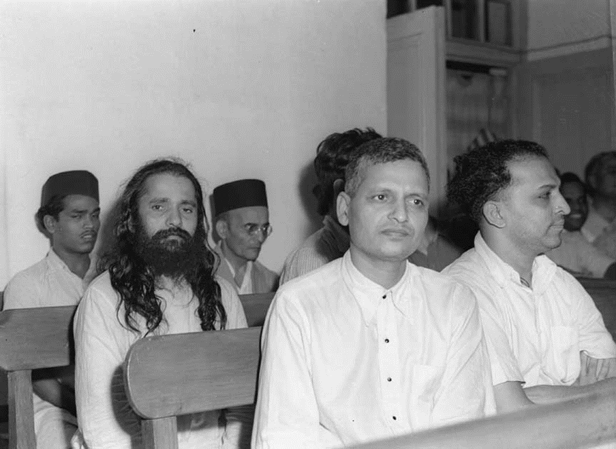
The Trial: 27 May 1948 to 10 February 1949
Godse and eight others, including Savarkar were brought to trial
Digambar BADGE turned approver – state witness – and outlined a conspiracy that included Savarkar
The judge thought Badge’s testimony was truthful, but there was no independent evidence to corroborate his testimony
The accused, Godse front and Savarkar, back row, with black cap

Slide 8
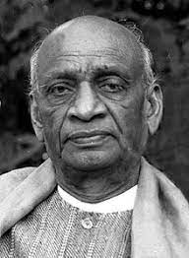
Political Context
ca. 1948 the Hindu Mahasabha still had a dedicated political following
Deputy Commissioner of Police in charge of the Bombay Criminal Investigation Department’s (CID) Jamshed Nagarvala had asked Morarji Desai (Home Minister in the Province of Bombay) for permission to arrest Savarkar. Desai refused ‘with the angry query: ‘Are you mad? Do you think I want this whole province to go up in smoke?’” (Noorani)
Union (Federal) Home Minister, Vallabhbhai Patel, said he believed “It was a fanatical wing of the Hindu Mahasabha directly under Savarkar that “[hatched] the conspiracy and saw it through”

Slide 9
Sympathy for Savarkar’s Cause
There was a strong right-wing of the INC that included both Patel and Desai. Some among the right had sympathy with the Hindu Mahasabha agenda too (for more on this, see, Pandey essay)
Patel was personally close to Gandhi and obviously upset at his death
However, despite his belief on Savarkar’s complicity, Patel wrote to the current HMS President (and fellow Cabinet member), Mookerjee
the question of inclusion of Savarkar must be approached purely from a legal and judicial standpoint and political considerations should not be imported into the matter. … if they come to the view that Savarkar should be included the papers should be placed before me before action is taken (Noorani)
I quite agree with you that the Hindu Mahasabha, as an organisation, was not concerned in the conspiracy that led to Gandhiji’s murder (Noorani)
Desai’s evidence at the trial is peculiar to put in mildly “‘ Shall I give the full facts? I am prepared to answer. It is for him [Savarkar] to decide.’” (Noorani)
There is also the question of why the judge did not allow follow-ups on this cryptic statement

Slide 10
No Electoral Mandate
Gandhi’s assassinated while Constituent Assembly still debating the shape of India’s Constitution (Guha Ch. 6)
Governments at both the national and provincial levels were provisional governments, based on electoral results of the 1945-46, with limited franchises
Governments were unsure of the real mass support they had for their views, until the 1951-52 elections with universal franchise confirmed the popularity of the INC and Nehru
The very vocal and aggressive Hindu Nationalists were seen as representing a real political threat until elections proved otherwise

Slide 11
Gandhi’s Assassination: Questions Remain
Given that incriminating evidence conveniently came only AFTER Savarkar’s death, questions remain for curious scholars, journalists and activists
We know that Patel supported the HMS in Hyderabad against the Nizam, who then ruled independently (see Guha Ch. 3)
He was against the extremist elements in the RSS and the HMS, and may well have hoped to have drawn them into the INC (as a base of support against Nehru)
Was there some pressure on the investigators and the judge?
Why did the judge not press Desai to reveal what he knew of Savarkar?
Why was Savarkar’s acquittal never appealed to the High Court?
Some of these are probably unanswerable. But we might be able to better understand them with a closer look at Savarkar’s ideas and actions

