Slide 1
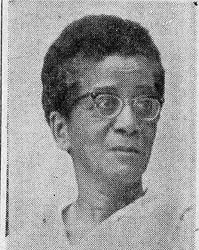

Self-silencing on race:
MAri SoMMerville and the silence of a Perpetual SubAltern
Paper for the Association of Asian American Conference, Hawaii, April 2, 2026
Sanjay Joshi
Northern Arizona University

Slide 2
CENTRAL QUESTION
WHY does Mari Sommerville not discuss race in her writing?
  To answer that, more about WHO she was

Slide 3
Who WAS SHE?
Born in 1903 to an Indian Christian mother and an Afro-Caribbean father, Marie Muriel Sommerville preferred to be called Mari
Though she grew up poor, Mari worked hard to qualify as a teacher from one of the top institutions in British India
Her mixed race looks and her background made her an outsider to most of her contexts
She came to the US for her Ph.D. in English Lit. from 1949-53, and after retiring from her teaching position at Isabella Thoburn College in Lucknow, India, moved to the US in 1966.
Shortly after her doctorate and again after 1966, Mari taught at several colleges in the US, many in the deep South
She later moved to a retirement community in Claremont, CA where she died in 1988.

Slide 4
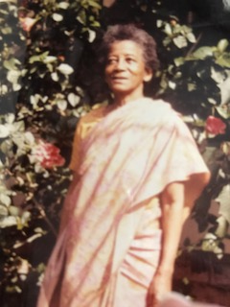
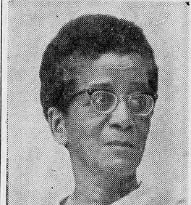
Mari looked black

Slide 5
Yet DID NOT ADDRESS race
She lived in the U.S. in three phases: Between 1949-53 as a graduate student at UNM; between 1959-61 as a visiting lecturer at Keuka College NY, and then after fall 1966 when she permanently moved to the States.
One of her students at a school in upstate NY recalled:
  Because Dr. Sommerville was Black but not American, I as Black and American felt responsible for making sure I could help her if she ran into any discrimination problems on campus or in town
Much of her stay overlapped with the Civil Rights era in the US
Given her birth-heritage, her academic discipline, and the times she lived through in the US, I had expected to find more discussions of race in her writing. Yet she hardly ever discussed race

Slide 6
MARI IDENTIFIES as an INDIAN in the U.S.
Always dressed in a sari when in the US, a theme I have discussed elsewhere
Dissertation at UNM was on the Indian author and Nobel Laureate, “Rabindranath Tagore as a Bridge Between the East and West”
Most of her published writing comments on India in general and Indian women in particular. She’s quite anodyne in her analysis… a “native informant”?
Was this explicit identification as an Indian a way to negotiate a segregated world?
  A former student of hers from India, also of mixed racial heritage (white and South Asian), recalled an incident from Louisville, KY, in the 1950s where she and her white boyfriend were denied entry to a movie theater. The student quickly changed into a sari, and the couple were allowed in!
Did Mari Sommerville also take refuge in exotica to escape blackness?
It could well be, but that does not square with other elements of her life

Slide 7
ALWAYS THE OUTSIDER
As an Indian she was not accepted as one of the ruling elite in British India
Her biracial identity, marked by her hair and skin color, and her Christianity, separated her from her Indian counterparts even after independence
  As an Afro-Caribbean-Indian biracial person she faced significant discrimination in India, as those of African descent often do in contemporary India (although see Gerald Horne)
There were also clear limits to which she would be accepted into the mainstream, white, academic or religious community in the US
Hence, I argue, she was the perpetual outsider in all contexts she occupied

Slide 8
MARI AS A Product of A global history
To understand her status as perpetual outsider, we need to locate her biography in a more global context
Mari Sommerville was, quite literally, made possible by imperial transnational connections
Her birth, her parents’ marriage made visible a prohibited form of colonial intimacy (Lowe), making her an outcast, who did not “belong” to any easily definable group
Her life unfolded across colonial South Asia, postcolonial India, and Jim Crow America, and her subjectivity cannot be contained within a single national frame

Slide 9
ASIA in ASIAN-AMERICAN HISTORY
From a global perspective, Mari’s story complicates spatial and conceptual boundaries of Asian American studies
Often this is a history that starts with Ellis or Angel Island, assuming a fresh start, related to American contexts, with little or tangential reference to the worlds left behind
Mari spent 57 of her 85-year life in India, we can’t understand her without taking into account those formative years of her life
Contrasting Mari with another South Asian American woman might allow us to highlight that

Slide 10
CONTRAST WITH SHYAMALA GOPALAN
Both women came to the US to be part of the academic world
Shyamala Gopalan, today known as the mother of Vice President Kamala Harris, came to the US in 1958 as a Ph.D. student in biology at UC Berkeley. She was 35 years younger than Mari
  Mari was teaching at Keuka Girls’ College NY 1959-61
Unlike Mari, Shyamala joined the civil rights movement with gusto, and met (and later married) Donald Harris, a black left-wing economist from Jamaica. They met at a meeting of the radical Afro-American Association --whose members went on to found the Black Panther Party
Harris has often written and spoken about her mother introducing her daughters to political issues, going to demonstrations, etc. Shyamala clearly had liberal and perhaps left-wing sympathies and wasn’t shy of making the world aware of her sympathies

Slide 11
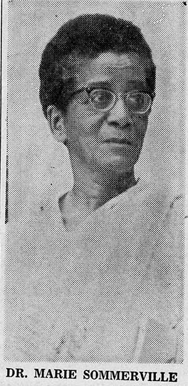
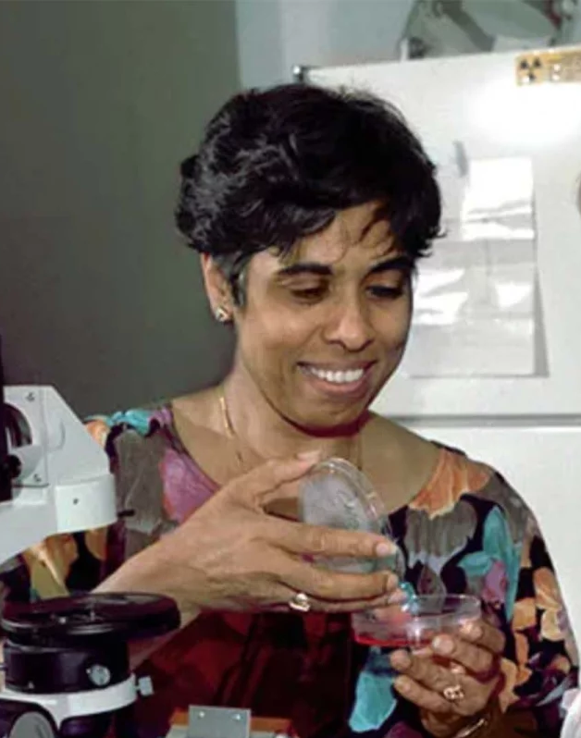
Differences between MARI and SHYAMALA
Much older
Quieter Personality
No known political affiliations
19 when she came
to Berkeley
Attended
political meetings
Married a left-wing
black Jamaican
Graduate student

Slide 12
WHAT ACCOUNTS FOR THEIR DIFFERENCES ?
SHYAMALA
Born in 1938 to a relatively affluent Tamil Brahmin family
Father was a civil servant, often posted overseas (a rarity in the 1950s and 1960s)
Studied at elite schools in Madras and overseas
Her privileged background, cosmopolitan experiences give her a degree of confidence to take controversial political stances
MARI
Poor, biracial upbringing, religion (after 1947) makes her marginal to all her contexts
Little, if any, family support no close friends
Her first two experiences of America are during the Jim Crow era
Her experiences teach her to keep her head down
Tries to live to ideals of an assimilative, model minority

Slide 13
Race, “Weathering” and self-silencing
Perhaps there are other explanations for Mari’s silence on race too?
Recent literature (both in the sciences and humanities) has explored the results of the “wear and tear” of everyday racism
The “weathering” hypothesis highlights the biological wear and tear caused by striving to overcome hardships in an unequal society
Other scholars have also linked this to self-silencing by women, arguing for “self-silencing as a vigilance-based coping strategy [by women of color] to preserve their mental and physical well-being”
Could we read Mari’s silence on race as an example of merely trying to preserve her mental and physical well being?

Slide 14
SILENCE AND THE SUBALTERN
In the broadest definition, “subalterns” are those EXCLUDED from hierarchies of power
By this definition Mari Sommerville, for all her education, her mobility (social and geographic) can arguably be referred to as a subaltern subject
Gayatri Chakravorti Spivak’s argument is not that “the subaltern cannot speak” but rather the subaltern is one who is not heard, seldom understood or comprehended
The subaltern is thus one who is REPRESENTED by others, is SPOKEN FOR rather than her speech or acts being understood as intended
Without celebrating subalternity, perhaps we simply respect Mari’s silence rather than conferring agency on her, to represent a voice that I would have liked her to have?

Slide 15
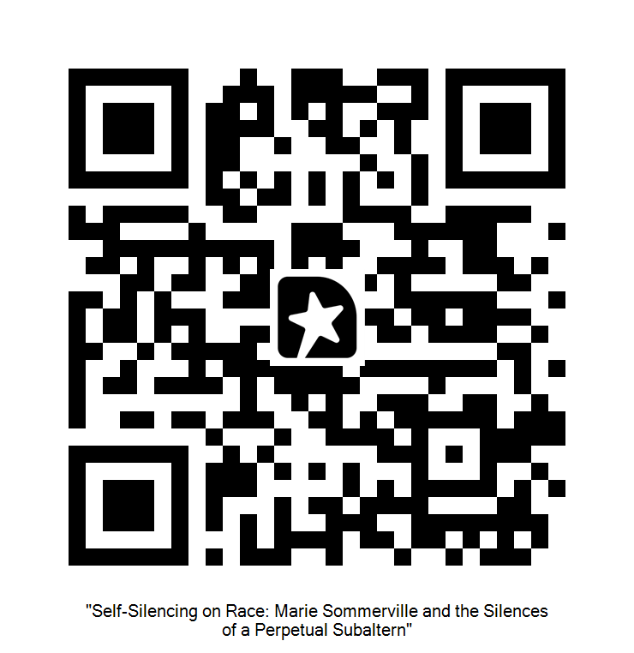
Feedback? Scan the code

