Slide 1
The Chinese Nationalist Revolution of 1911

Slide 2
Overview
Introduction
Phases of Development
Assessment

Slide 3
Introduction
Reading:
Vohra, chs. 4-5; focus: pp. 97-106
Keith Schoppa, Revolution and Its Past, (3rd ed.) pp. 136-145
Immanuel Hsu, The Rise of Modern China, (6th ed.) pp. 408-418, 452-475
Timing
The 1911 Chinese Revolution in world history context

Slide 4
Global Historical Context
The 19th Century: “The Age of Revolution” (Crane Brinton, R.R. Palmer, Eric Hobsbawm, Theda Skocpol)
Patterns of revolutionary development
Expansion of scope and discourse
Whether it was the ultimate solution remains to be seen
The place of the Chinese 1911 Revolution in the history of Revolution
Two perspectives: Stand alone, or the beginning of a revolutionary process
Western Influences on Chinese Revolutionary Ideologies and Purposes

Slide 5
The international context of Chinese history in the 19th century
Wars: From the Opium War to the Sino-Japanese War
Insurrection/Revolution: From Taipings to Boxers
Threat of national destruction (wangguo) and dismemberment: Spheres of Influence and Scramble for Concessions (“Open Door Policy” and the Boxer Protocol)
Overseas Chinese and national identity

Slide 6
Overlapping Phases of Development
The Early Phase (1895-1905)
The Organizational Phase (1903-1908)
The Activist Phase (1908-1911 & beyond)
The Aftermath

Slide 7
The Early Phase: Formation of the Revolutionary Movement 1895-1905
Revolutionary ideologies and discourses
Basic idea: Zou Rong, Gemingjun (The Revolutionary Army) 1903: “Revolution is a universal rule of evolution. Revolution is a universal principle of the world. Revolution is the essence of a transitional period of struggle for survival. Revolution follows nature and corresponds to the nature of man. Revolution eliminates what is corrupt and holds on to what is good. Revolution is to advance from savagery to civilization. Revolution is to eradicate slavery and become the master…”

Slide 8
Revolutionary Ideologies
Anarchism
European influence: Li Shizeng, Wu Zhihui, Liu Shifu
Proudhon, Utopian Socialists, Bakunin, Kropotkin
Equality
Natural state of man and society vs. enslavement
Removal of the state and of social restrictions
Zou Rong: “If there is to be great construction, there must be destruction. For great destruction, there must first be construction. This has been an immutable and fixed principle through the ages. The revolution we are carrying on today is a revolution to destroy in order to permit construction.”
Anti-Manchu? Anti-Monarchy?
Democracy and Republicanism

Slide 9
The contested terrain of Chinese “nationalism”
The model of European nation states
The tripartism of modern Chinese nationalism:
China as a nation
Anti-Manchu nationalism
Centralism vs. division & regionalism
(Synthesis: A new China: a Nation of nations)
Three-in-One Revolutionary “nationalist” ideology
Zou Rong’s precedent: The 19 Points
1-6 (Anti-Manchu); 7 (Anti-imperialism); 8-13 (Republicanism & central government); 14-19 (Equality, democracy, people’s rights)

Slide 10
Sun Yat-sen (1906) San min zhuyi (“Three People’s Principles”)
Minzu (People’s national identity – “nationalism”)
Minquan (People’s rights/power – “democracy”)
Minsheng (People’s livelihood – “socialism”)
1907 Tongmenghui Revolutionary Proclamation
1. Expulsion of Manchus
2. Restoring China to the Chinese (Han Chinese?)
3. Establishing a republic
4. Equality of land ownership
Revolutionary discourses: National, political, social, cultural: Priority and inequality

Slide 11
The revolutionary movement vs. the constitutional movement
Competition at home
Competition abroad
Southeast Asia
Japan
Europe and America
Implications for the revolution

Slide 12
Revolutionary personalities
Intertwined with ideologies
Some arbitrary typologies
Anarchists, anti-dynastic and anti-Manchu
Revolutionary organizers
Revolutionary romantics
Intellectuals and activists

Slide 13
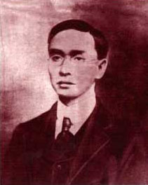
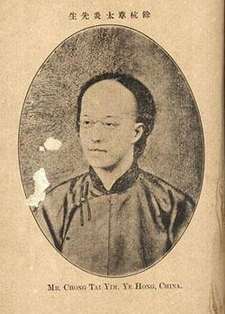
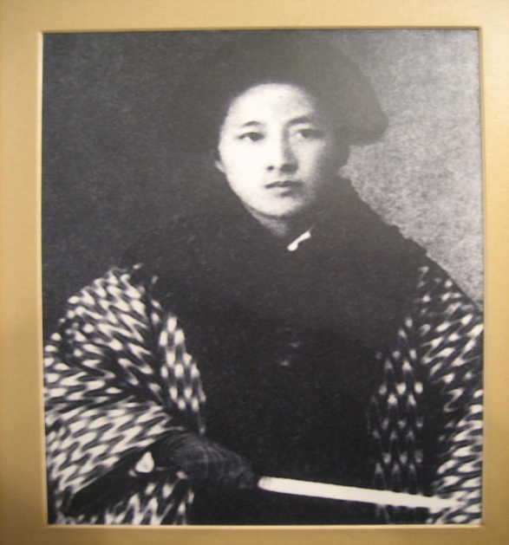
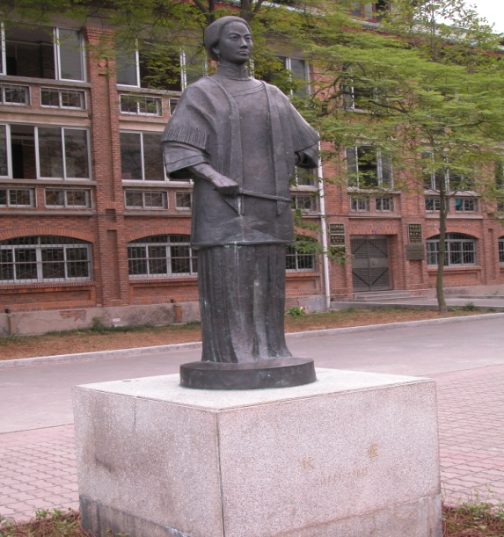
Liu Shifu, Zhang Taiyan, Qiu Jin

Slide 14
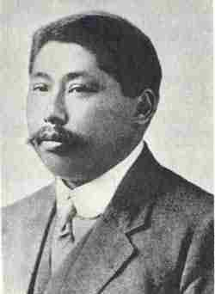
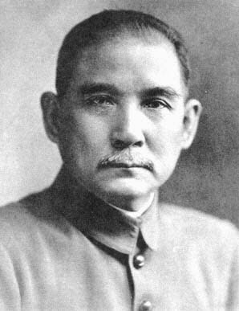
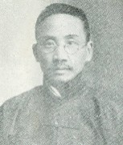
Sun Yat-sen, Huang Xing, Cai Yuanpei

Slide 15
The Organizational Phase of the Revolution 1903-1908
The precursors of the Tongmenghui
The Tongmenghui
Revolutionary associations and connections with the “new” social organizations

Slide 16
The precursors to the Tongmenghui
Sun Yat-sen, the Revive China Society, and the Guangzhou Uprising (1895)
The Huizhou Uprising (1900)
The Recovery Society – Cai Yuanpei (1903)
The China Revival Society – Huang Xing (1903) & the Changsha (Hunan) Uprising
Peripheries (e.g. the GeLaohui, the Hongmen, the Chinese Masons)

Slide 17
The Tongmenghui
The influence of the Japanese
The Organization of the Tongmenghui (1905)
Impact of the Tongmenghui
The consolidation of ideology
Dissemination of the revolutionary agenda
What’s missing? (Unity, discipline, military capacity, political standing)

Slide 18
Revolutionary Associations and Chinese Society
Schools
Publications: Newspapers and journals
The Subao Case (1903)
Zou Rong, Gemingjun (The Revolutionary Army)
Urban organizations
merchants and workers
women’s organizations
Connections with foreign supporters
Provincial assemblies
Railroad companies
Local military corps

Slide 19
The Action Phase of the Revolution (1908-1911)
Fuses of the Revolution
The New Army and the provincial academies and units, officer corps
The provincial assemblies and new structures of provincial governments
The railroads: “nationalization” and “protection”
The Wuchang Uprising
A brief revolutionary war
The abdication of the Xuantong Emperor

Slide 20
IV. The Aftermath of the Revolution
The Rise of warlordism
The weaknesses of the revolutionary movement
China divided: The abortion of the revolution, Warlord rule and regrouping of the revolution

Slide 21
Weaknesses of the Revolution
Ideological problems
Organizational issues
Military weaknesses
The role of Western powers

