Slide 1
Trinidad: Brief Historical Background

Slide 2
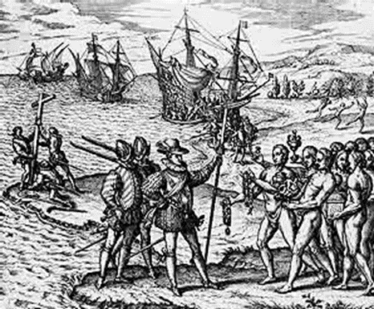
Trinidad and Tobago
Caribbean islands just off the Venezualan coast
Indigenous populations of Trinidad and Tobago included , Arawak speaking and some Carib speaking groups
Claimed by Columbus for the Spanish empire in 1498

Slide 3
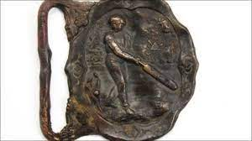
Planation and Empires
Spanish empire, but not become a plantation economy till late 18th C
Like the rest of the islands, sugar cane was the major plantation crop. Coffee added much later
In the early 19th C Trinidad and Tobago ceded to Britain as a result of imperial wars and negotiations

Slide 4
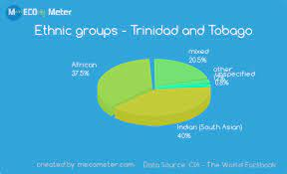
Indian Indentured Labor and ethnic diversity
In 1833 slave trade was abolished within British Empire
Labor still required for sugar cultivation though
Starting 1845 came indentured labor (fixed contracts, highly exploitative) from India – then a British colony
Today Trinidad’s population has 35.4% of South Asian descent, 34.2% of African descent, 23.0% mixed races, and 8.4% of other ethnic groups

Slide 5
Sugar to Oil
Oil first discovered 1857
Serious oil drilling by the early 20th C
Today Trinidad and Tobago remail a small but not insignificant exporter of oil to the regional and global economy

Slide 6
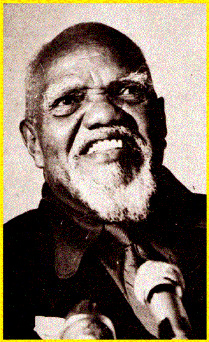
Political History
Governed as a Crown colony, with a Governor and (from 1831) a legislative council consisting of top officials and so-called unofficial members nominated by the governor.
Universal suffrage in 1945
In 1956 the People's National Movement (PNM) under the PNM's founder and leader, Eric Williams became the first Prime Minister
Trinidad and Tobago attained independence in 1962 and became a republic within the Commonwealth in 1976

Slide 7
C. L. R. James
Cyril Lionel Robert James (4 January 1901 – 31 May 1989)
CLR James’ boyhood home: note the window! (Photo ca. 1991)
1918 graduates from Queens Royal College and starts teaching
Anticolonial writer, activist, athlete (held the island high-jump record from 1918 to 1922), and cricketer
1932 moves to England, with help of Learie Constantine
Worked as cricket correspondent for The Guardian of Manchester
Championed West Indian independence, pan Africanism, anti fascist, and Marxist causes
Published widely, fiction and non-fiction (history, politics, international affairs)
1938-53 in the United States associated with a number of socialist groups
1958 returned to Trinidad to work with the pro-independence movement
Beyond a Boundary published in 1963
1981 Back to London, and died there in 1989 at the age of 88

