Slide 1
Two Themes in Recent Indian Politics
Hindu Right and OBC
aka
MANDIR and MANDAL

Slide 2
Hindu Right: Mandir (meaning temple)
Background: RSS, Partition, Gandhi assassination, JANA SANGH, Hindu Code, Kashmir, etc.
First experience of real power when Jana Sangh dissolved and merges into Janata Party (wins 1977 post-Emergency elections)
1952, 3 seats; 1957, 4; 1962, 14; 1967, 35, 1971, 22
In a Parliament of 489-518 seats!
Post-Janata create the BHARATIYA JANATA PARTY (BJP)
Only TWO seats in Lok Sabha in 1984. Up to 120s by 1991.
It was the MANDIR issue that brought them political success.

Slide 3
The Mandir Campaign 1989-1992
AYODHYA Dispute
Rekindled by Rajiv Gandhi decision to re-open locks on the temple
Vishwa Hindu Parishad (VHP) -BJP insist they will “reconstruct” the temple to Rama at the same spot where the Babri mosque then stood.
National campaign to popularize this via Advani’s Rath Yatra (Rath = Chariot, Yatra = Journey) from Somnath to Ayodhya
International support from Non-Resident Hindu Indians

Slide 4
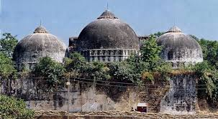
Mosque and Mandir
EXISTING MOSQUE till 1992
Proposed Temple in its place. Not constructed to date

Slide 5
The Toyota Rath

Slide 6
The Yatra

Slide 7
Lead up to the crisis of Dec 1992
This outline may help make sense of quickly changing governments between 1989-98
1991 Rajiv Gandhi Assassination
1991 elections sees INC win a slim majority, single digits
BJP largest opposition party with 120 seats
UP control by a BJP govt
Dec 6 1992 a mob of Hindu activists demolish the Babri Mosque
Landmark event in Indian history and politics

Slide 8
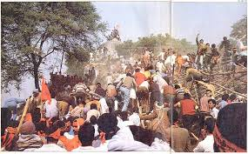
Dec 6, 1992

Slide 9
BJP Government
Demolition of Babri Mosque followed by a series of riots, mainly initiated by Hindu nationalists, provoking or attacking Muslims
Only in Bombay, now Mumbai, was there overt Muslim defiance
There had been ten days where mobs were allowed to attack, rape, loot, pillage Muslim homes. Retaliation came in shape of bombs, directed by mafia dons hiding in Dubai and other locations
Rising popularity for the Hindu right, in 1996 first time become largest party in Parliament and form a short-lived government. But able to return and, under the moderate VAJPAYEE rather than the militant ADVANI, formed longest non-INC govt. till that time, from 1998-2004

Slide 10
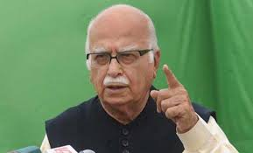
Vajpayee and Advani

Slide 11
Impacts
As political tactic, Mandir could not be sustained. In 2004 BJP loses general elections. Their slogan was they had made “India Shine.” BUT, the BJP won only 138 seats -- down from 181 in 1999.
HOWEVER, 1989-2004 brought Hindu Right and BJP Political Respectability AND Access to State Power.
Appointments of Hindu Ideologues to powerful positions.
Anti Muslim Violence grew

Slide 12
Narendra Modi
Riding BJP wave of the 90s, became Chief Minister of the state of GUJARAT (Mahatma Gandhi’s home state!) in 2001
Overtly anti Muslim in speeches
2002 GODHRA. To revive popularity invited millions of Hindus to build temple at Ayodhya. VHP volunteers, called kar sevaks, were attacked in Godhra in Gujarat. Their coach set on fire, and 58 Hindus burnt to death
MASSIVE reaction, in which over 2000 Muslims died when CM of Gujarat, Modi, gave mobs a free hand to rampage against Muslims. Police stood by and even helped the rioters
Modi justifies with Newtonian mechanics: Each action has opposite reaction!
2014 Modi elected PM of India in massive electoral victory
Mandate reinforced by 2019 victory in General Elections. Second term saw Supreme Court decision on Ram Temple in favor of Hindus. Also dissolution of Jammu and Kashmir and “reading down” of Articles 370 and 35A of the constitution that granted Kashmir special status. Moves to undermine citizenship rights of Muslims led to huge nationwide protests led by women and students

Slide 13
Connect with Economics
Rise of Hindu Right a product of new aspirations. Nehruvian liberalism seen as getting in the way of “growth”
Modi success in bringing business to Gujarat
Modi in his 2014 election campaign stress Economic Development rather than Hindutva
Promised a new “business friendly” economic environment. Abolished the Planning Commission. New Land law debated currently

Slide 14
Connect with Caste Politics
Why does Hindu Nationalism re-emerge as a political force in the 1990s?
No real reason to fear MUSLIMS, who were frankly a small and relative powerless minority
The aim of Hindu nationalism was always to consolidate a HINDU political constituency
BUT if there was political organization around CASTE, particularly with the rising BACKWARD CASTE and DALIT leadership, it would destroy myth of Hindu majority all together
Upper caste Hindus also a minority like Muslims!! Very important to find an issue that would bring HINDUS together against MUSLIMS. In MANDIR find such an issue
No coincidence that the MANDIR campaign gathers momentum just at the time the OBC/Mandal agitation is starting
See who arrests ADVANI ending his YATRA in 1990 (see Guha, pp. 626-27!)

Slide 15
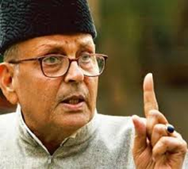
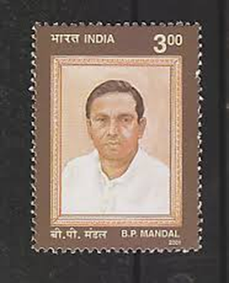
Mandal Background/Context
History of OBC (see http://jan.ucc.nau.edu/~sj6/Janata%20Party%20and%20Aftermath.pptx) National Role under Charan Singh during Janata Party era.
Less significant in Mrs. Gandhi’s second innings and under Rajiv Gandhi
Return to center stage when VP Singh in 1989 announced implementing of Mandal Commission Report Recommendations
VP Singh
BP Mandal

Slide 16
Mandal Commission (1979) : Major Recommendations
Wikipedia Page
Argued that 52% of the population (excluding SCHEDULED CASTES and TRIBES) can be classified as OBC, suffered historical deprivation.
Sought to level the playing field through recommending AFFIRMATIVE ACTION programs for admission to colleges and for GOVERNMENT jobs
Huge Protests from Upper Castes (see next slide)
Led to more support for OBC leaders and groups in politics

Slide 17
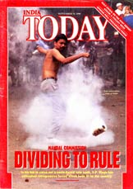
Mandal Protest

Slide 18
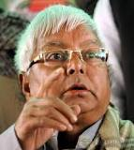
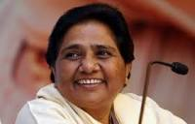
New Lower Caste Political Leaders
Lalu Prasad Yadav
Mulayam Singh Yadav
But OBC politics distinct from DALIT politics. New Dalit leaders such as MAYAWATI emerging around the same time.

Slide 19
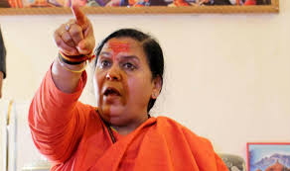
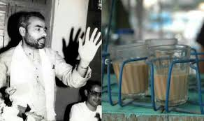
New OBC Hindutva Leaders
Unlike Vajpayee, Joshi or even Advani, new leadership of the BJP is often from an OBC background
Leaders such as Uma Bharti and putative former tea seller and now Prime Minister, Narendra Modi, both from OBC backgrounds

Slide 20
New Leaders and end of INC hegemony
The new leadership, whether from DALIT or OBC backgrounds is a direct product of the end of the hegemony of the INC in Indian politics
INC sought to “manage” lower castes through working of “the Congress machine”
Janata and post Rajiv Gandhi coalitions have allowed them much greater space in national politics
This space of course predicated on their previous acquisition of economic power

Slide 21
Democracy without Liberalism?
Less westernized and cosmopolitan than Nehru, Indira, Rajiv, or even Vajpayee or Advani of the BJP
Hindi or other local languages rather than English
Raw and brash. Not averse to use of violence. Reflect the mood and position of their constituencies
Democracy without Liberalism?

