Slide 1
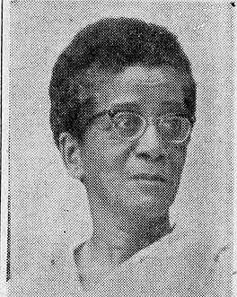

Unexpected Silences:
ClAss, Race, Gender and MAri SoMMerville’s Perpetual SubAlternity
Sabbatical Presentation at NAU, March 27, 2026
Sanjay Joshi
Northern Arizona University

Slide 2
Who WAS SHE?
Born in 1903 to an Indian Christian mother and an Afro-Caribbean father, Marie Muriel Sommerville preferred to be called Mari
Though she grew up poor, Mari worked hard to qualify as a teacher from one of the top institutions in British India
Her mixed race looks and her background made her an outsider to most of her contexts
She came to the US for her Ph.D. in English Lit. from 1949-53, and after retiring from her teaching position at Isabella Thoburn College in Lucknow, India, moved to the US in 1966.
Shortly after her doctorate and again after 1966, Mari taught at several colleges in the US, many in the deep South
She later moved to a retirement community in Pomona, CA where she died in 1988.

Slide 3
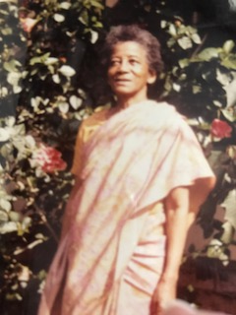
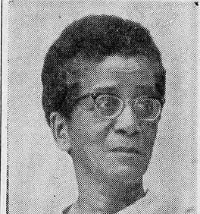
Mari looked black

Slide 4
UNEXPECTED SILENCE
One of her students at a school in upstate NY recalled:
  Because Dr. Sommerville was Black but not American, I as Black and American felt responsible for making sure I could help her if she ran into any discrimination problems on campus or in town
Her blackness was a reason (though not the only one) for her marginalization during her life in India (a theme I will return to)
She lived in the U.S. in three phases: Between 1949-53 as a graduate student at UNM; between 1959-61 as a visiting lecturer at Keuka College NY, and then after fall 1966 when she permanently moved to the States.
Much of her stay overlapped with the Civil Rights era in the US
Given her birth-heritage, her academic discipline, and the times she lived through in the US, I had expected to find more discussions of race in her writing. Yet she hardly ever discussed race

Slide 5
Strict, aloof, or lonely?
Almost all her students from India, whether middle and senior school students in Almora in the mid-1930s or her college students from the mid-1960s mention she was a very strict teacher, and did not have personal bonds with her students
Her father died early, when she was 9, a brother lived only a few months, and a sister born in 1905 died in 1929. ( I am yet to trace her mother’s death, who might have remarried)
  She does not mention her family at all in interviews or articles, not even among those whose help she acknowledges in her doctoral dissertation
She never married and had no sustained friendships that I have been able to trace
The lack of connections, of belonging, may well have influenced her unusual decision to relocate to the US at the age of 63

Slide 6
IDENTIFIES as an INDIAN in the U.S.
Always dressed in a sari when in the US, a subject I have explored earlier (currently revising for publication in JAAS)
Dissertation at UNM was on the Indian author and Nobel Laureate, “Rabindranath Tagore as a Bridge Between the East and West”
Most of her published writing comments on India in general and Indian women in particular. She’s quite anodyne in her analysis… a “native informant”?
Was this explicit identification as an Indian a way to negotiate a segregated world?
  A former student of hers from India, also of mixed racial heritage (white and South Asian) mentions an incident from Louisville, KY, where she and her white boyfriend were denied entry to a movie theater. She quickly she changed into a sari and they were allowed in!

Slide 7
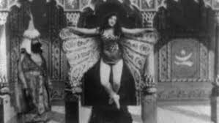
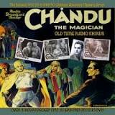
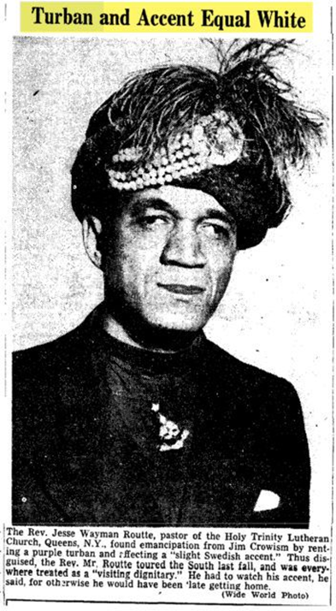
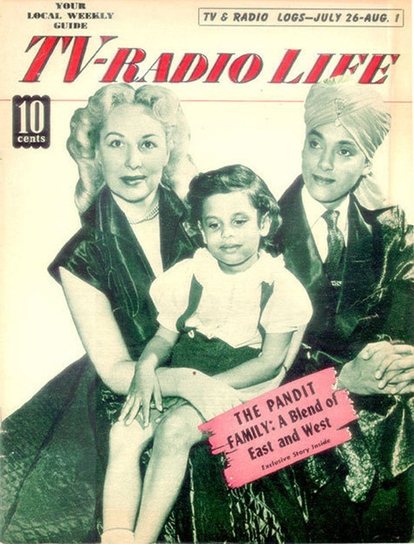
Being “Exotic” easier than being black
US interest in “wisdom of the east” goes back to the 19th C
Marketable too. Edison’s 1902 “Hindoo Fakir”
Radio drama Chandu the Magician 1930s
John Roland Redd, son of an African American minister became “Korla Pandit” in the 1950s
“Exotica,” Manan Desai argues allowed Pandit to cloak “Blackness through stereotypes of the Third World”
Rev. Routté’s turban allowed him to circumvent the color bar, Paul Kramer says by wearing a turban, “Routté … projected and confounded blackness by rendering it illegible” (220)

Slide 8
Returning to Mari Sommerville
Did Mari Sommerville also take refuge in exotica to escape blackness?
It could well be, but that does not square with other elements of her life
She fought her way out of poverty, and despite her biracial, underprivileged, heritage she made a successful academic career in India
Being fellow-religionists of the British rulers did give Indian Christians status, some even claiming closer affinity with the British than fellow-Indians, but in the years leading up to independence in 1947, and after, Christian loyalty to India was seen as suspect
As an Afro-Caribbean-Indian biracial person she had faced significant discrimination in India, as those of African descent often do in contemporary India (although see Gerald Horne)

Slide 9
The PERPETUAL OUTSIDER
As an Indian she was not accepted as one of the ruling elite in British India
Her biracial identity, marked by her hair and skin color, and her Christianity, separated her from her Indian counterparts even after independence
There were also clear limits to which she would be accepted into the mainstream, white, academic or religious community in the US
Hence, I argue, she was the perpetual outsider in all contexts she occupied

Slide 10
Product of A global history
To understand her status as perpetual outsider, we need to locate her biography in a more global context
Mari Sommerville was, quite literally, made possible by imperial transnational connections
Her birth, her parents’ marriage were a form of prohibited colonial intimacy (Lowe), made her an outcast from all communities in India, she did not “belong” to any easily definable group
Because her life unfolded across colonial South Asia, postcolonial India, and Jim Crow America, her subjectivity cannot be contained within a single national frame

Slide 11
ASIA in ASIAN-AMERICAN HISTORY
From a global perspective, Mari’s story complicates spatial and conceptual boundaries of Asian American studies
Often this is a history that starts with Ellis or Angel Island, assuming a fresh start, related to American contexts, with little or tangential reference to the worlds left behind (but see Erika Lee, Lisa Lowe, Madeline Hsu, among others)
Mari spent 57 of her 85-year life in India, we can’t understand her without taking into account those formative years of her life
A contrast with another South Asian American woman might allow us to highlight that

Slide 12
CONTRAST WITH SHYAMALA GOPALAN
Both women came to the US to be part of the academic world
Shyamala Gopalan, today better known as the mother of Vice President Kamala Harris, came to the US in 1958 as a Ph.D. student in biology at UC Berkeley. She was 35 years younger than Mari
  Mari was teaching at Keuka Girls’ College NY 1959-61
Unlike Mari, Shyamala joined the civil rights movement with gusto, and met (and later married) Donald Harris, a black left-wing economist from Jamaica, at a meeting of the radical Afro-American Association --whose members went on to found the Black Panther Party
Harris has often written and spoken about her mother introducing her daughters to political issues, going to demonstrations, etc. Shyamala clearly had liberal and perhaps left-wing sympathies and was not shy of making her world aware of that

Slide 13
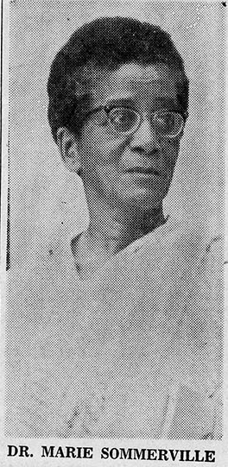
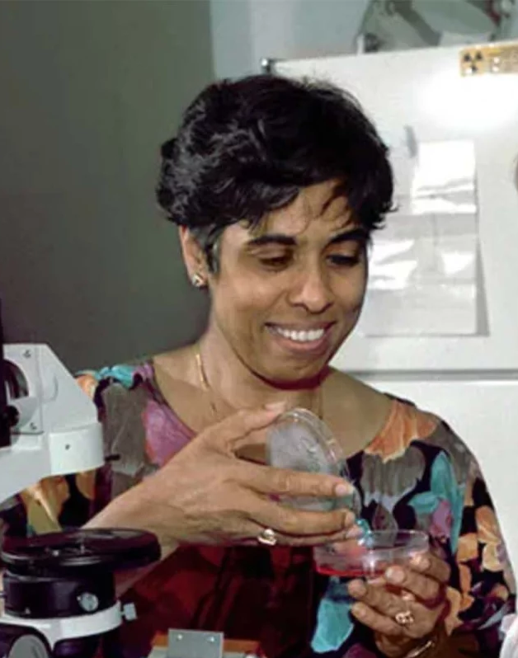
MARI and SHYAMALA differenceS
Much older
Quieter Personality
No known political affiliations
19 when she came
to Berkeley
Attended
political meetings
Married a left-wing
black Jamaican
Graduate student

Slide 14
WHAT ACCOUNTS FOR THEIR DIFFERENCES ?
SHYAMALA
Born in 1938 to a relatively affluent Tamil Brahmin family
Father was a civil servant, often posted overseas (a rarity in the 1950s and 1960s)
Studied at elite schools in Madras and overseas
Her privileged background, cosmopolitan experiences give her a degree of confidence to take controversial political stances
MARI
Poor, biracial upbringing, religion (after 1947) makes her marginal to all her contexts
Little, if any, family support no close friends
Her first two experiences of America are during the Jim Crow era
Her experiences teach her to keep her head down
Tries to live to ideals of a model minority

Slide 15
MARI’S academic field
Mari joined the ranks of American academia when English Literature was at its peak, accounting for the largest percentage of doctoral degrees
  In 1953, she had been the third Ph.D. in English granted by UNM
But the field was largely rooted in the canons of English and American literature
Race, class, and gender were NOT the dominant categories of intellectual analysis
Mari’s own doctoral work on Tagore was very much within the dominant parameters of the discipline (emphasizing the “universality” of Tagore’s ideas than “difference”)
Perhaps we shouldn’t EXPECT a foreign, black-looking Ph.D., an adjunct teacher without tenure, to be writing about race, especially her own complicated racial mix, at that time?

Slide 16
Race, “Weathering” and self-silencing
Recent literature (both in the sciences and humanities) has explored the results of the “wear and tear” of everyday racism
The “weathering” hypothesis highlights the biological wear and tear caused by striving to overcome hardships in an unequal society
Other scholars have also linked this to self-silencing on race, particularly by women, arguing for “self-silencing as a vigilance-based coping strategy [by women of color] to preserve their mental and physical well-being”
Could we perhaps read Mari’s silence on race as an example of merely trying to preserve her mental and physical well being?

Slide 17
Mari and SELF SILENCING
Mari was, after all, carrying a heavier load of lifetime marginalization than even many of the subjects of the studies referred to earlier
Her in background in India -- marginalization based on race, class, gender, and religion
  Her lack of a network of kin or social connection
Even if she wanted a fresh start in the US, recall her Keuka student saying Mari was Black but NOT AMERICAN
In these circumstances, perhaps it would be more surprising if someone from her background would have spoken more explicitly of her racial experiences in published writing
  No luck with personal correspondence… yet!

Slide 18
SILENCE AND THE SUBALTERN
In the broadest definition, “subalterns” are those EXCLUDED from hierarchies of power
By this definition Mari Sommerville, for all her education, her mobility (social and geographic) can arguably be referred to as a subaltern subject
Gayatri Chakravorti Spivak’s argument is not that “the subaltern cannot speak” but rather the subaltern is one who is not heard, seldom understood or comprehended
The subaltern is thus one who is REPRESENTED by others, is SPOKEN FOR rather than her speech or acts being understood as intended
Perhaps we need to simply respect Mari’s silence rather than conferring an agency, a voice, that I would have liked her to have?

