Slide 1

A Culture of Literacy
What Leads to Academic Success?
Jon Reyhner, Ed.D., Professor of Education
BME 210, Week 1

Slide 2
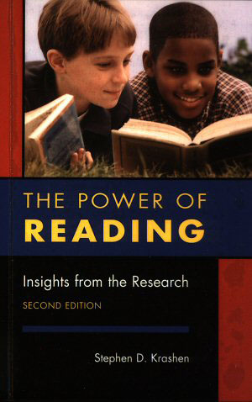
Dr. Stephen Krashen, who has done much research on teaching English as a Second Language (ESL) and bilingual education, summarizes the research on reading. He found that students who read more, tend to be better readers and do better in school.
http://www.sdkrashen.com

Slide 3
There’s no such thing as a kid who hates reading. There are kids who love reading, and kids who are reading the wrong books.
—James Patterson, Best Selling Author
A parent’s testimony: “Ashley in her early years in elementary school had trouble identifying letters and sounds (phonics). It was a struggle for her to understand her assigned readings. Then one of her teachers discovered what type of books she liked, and the teacher started her with matching picture books, then she progressed into chapter books. She loves to read now!”

Slide 4
My doctoral dissertation was on “Realism” in elementary school reading textbooks.
I chose the topic after reading that some psychologists in the 1960s had found the stories in basal reading textbooks to be boring.
My research found that they were still boring in the 1980s.
Any thoughts about the stories in them today or when you were in elementary school?
Can you teach a child to read and have them end up hating to read?

Slide 5
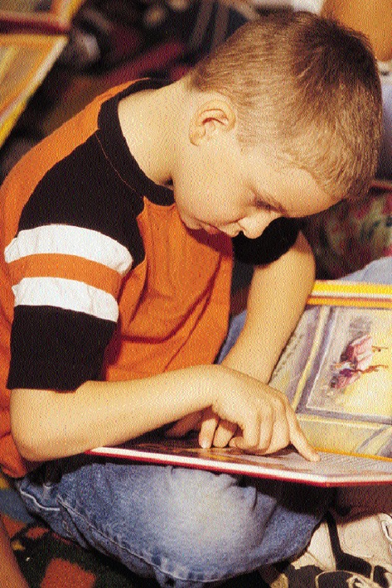
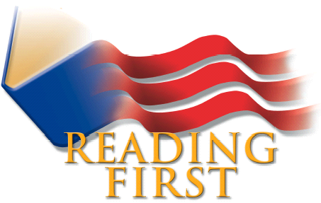
Promoting the bipartisan No Child Left Behind Act of 2001 President George W. Bush stated, “The most basic educational skill is reading. The most basic obligation of any school is to teach reading”

Slide 6
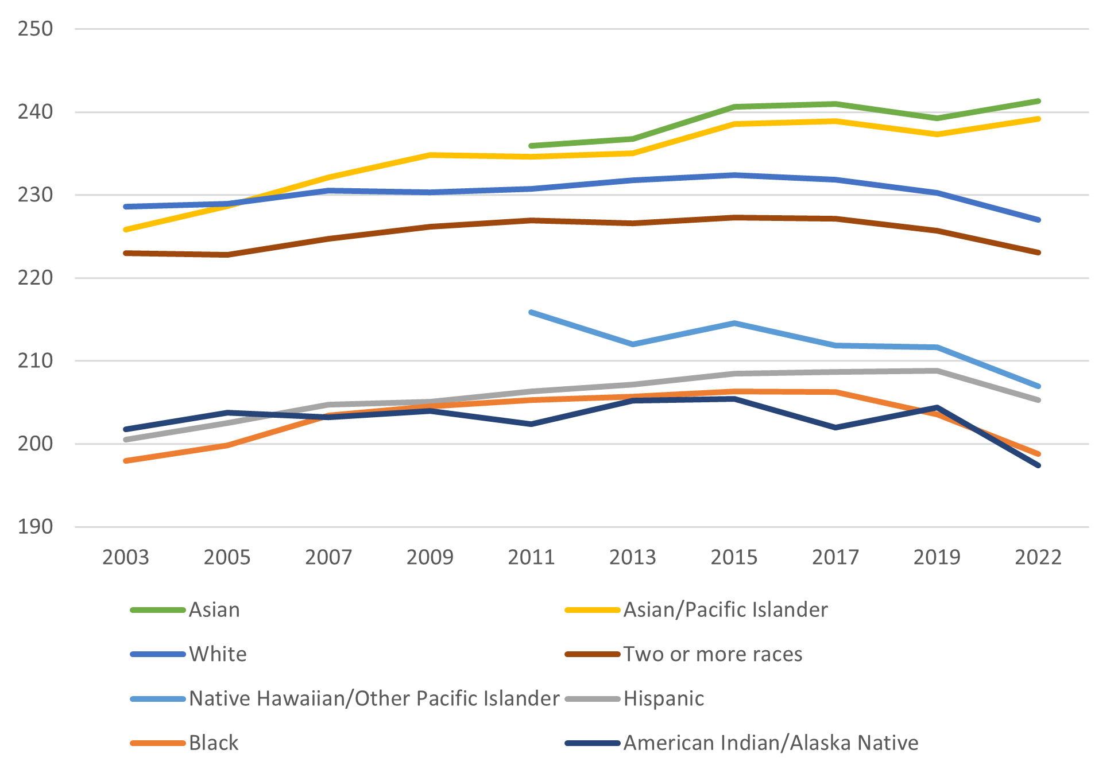
4th Grade Reading Scores: National Assessment of Student Progress

Slide 7


Students who read well tend to do well in school. Some cultures promote literacy more than others. Jews, Christians and Muslims are sometimes called “People of the Book.”

Slide 8

During the Protestant Reformation in Europe the idea was that “Every man would be his own priest.” Martin Luther and others translated the Bible from Latin to their local languages.
In colonial New England the purpose of teaching reading was to be able to read the Bible, participate in Christian culture and be “born again” so you could go to heaven.

Slide 9
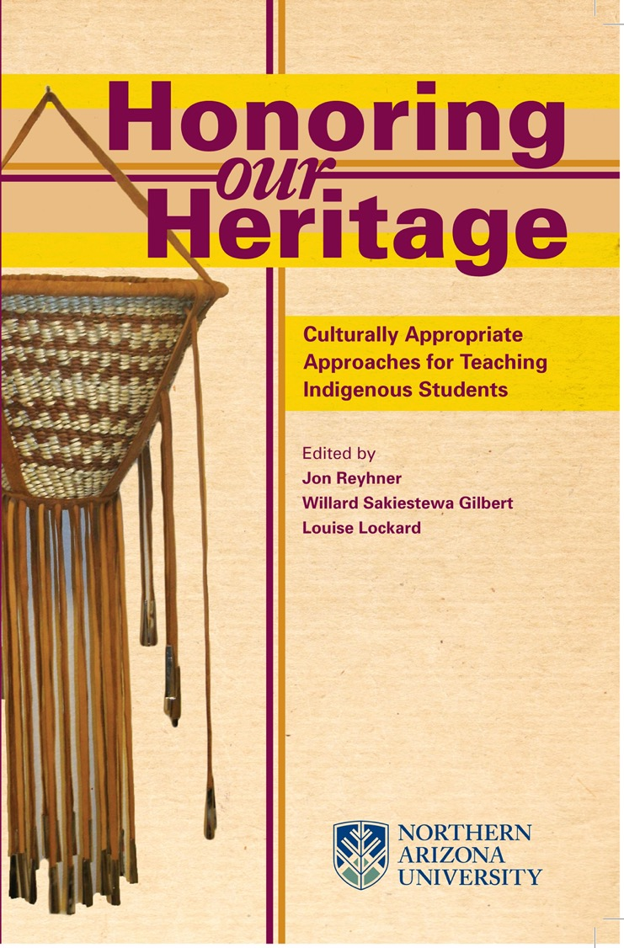
NCLB (2001) & Every Student Succeeds (2015) Acts Ignored the Role of Culture & Motivation in Learning
Students have trouble finding meaning in the one-size-fits-all decontextualized textbook- and standards-based curriculum and instruction used in many schools today.
The best way to contextualize education is to relate what students are learning to their experiential background—their heritage, land, and lives. In other words: To Their Culture!

Slide 10

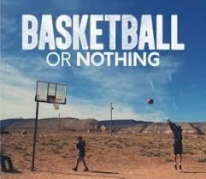
Today we seem to live in a Sports Culture.
What makes a good basketball player?
Coaching (Teaching)?
Practice?
Drive?
Is making a good reader any different?

Slide 11
Is being a reader a part of your identity?

Slide 12
Oppositional Identities
Mick Fedullo in Light of the Feather: Pathways Through Contemporary Indian America (1992) illustrates a case of cultural conflict with a quote from an Apache elder who stated that students’ parents had “been to school in their day, and what that usually meant was a bad BIA boarding school. And all they remember about school is that there were all these Anglos [White People] trying to make them forget they were Apaches; trying to make them turn against their parents, telling them that Indian ways were evil.”

Slide 13
“Well, a lot of those kids came to believe that their teachers were the evil ones, and so anything that had to do with ‘education’ was also evil—like books. Those kids came back to the reservation, got married, and had their own kids. And now they don’t want anything to do with the white man’s education. The only reason they send their kids to school is because it’s the law. But they tell their kids not to take school seriously. So, to them, printed stuff is white-man stuff.”

Slide 14
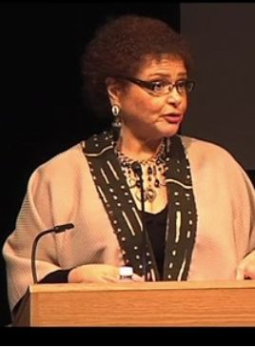
School can be seen as a place for becoming white! Black scholar Lisa Delpit has a 2013 book entitled “Multiplication is for White People.”
Dr. Delpit writes how non-standard dialects of English can be criticized by teachers and others, and that can turn off students who speak them and create “oppositional identities” like Fedullo describes

Slide 15
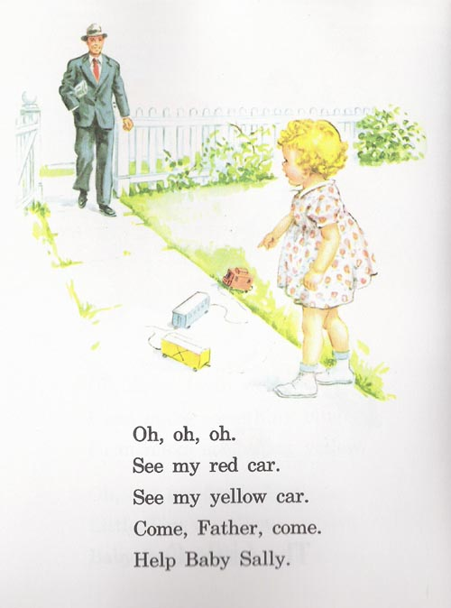
The Dick and Jane Readers were very popular in the 1950s. All the characters were white and middle class. They used a “whole word” or “look-say” approach that taught vocabulary as sight words rather than having the student sound them out. They were based on “scientific” research about how many times a word had to be repeated for the student to learn the word.

Slide 16

Books used in schools in the 1960s and before, like the Dick & Jane readers usually reflected an all-white middle class culture that had little or no relation to the lives of ethnic minorities in the U.S.
University of New Mexico Professor Joseph Suina from Cochiti Pueblo described how reading the them in school affected him: “The Dick and Jane reading series in the primary grades presented me with pictures of a home with a pitched roof, straight walls, and sidewalks. I could not identify with these from my Pueblo world. However, it was clear I didn’t have these things and what I did have did not measure up.”

Slide 17
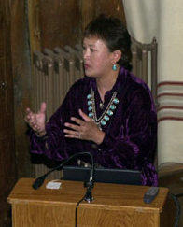
Dr. Lori Arviso
Alvord, MD
The first Navajo woman surgeon and a former associate dean at the Dartmouth and University of Arizona medical schools Dr. Arviso Alvord is an example of academic success for American Indian and other “minority group” students.

Slide 18
In her 1999 autobiography The Scalpel and the Silver Bear, Dr. Alvord wrote, “I made good grades in high school, but I had received a very marginal education. I had a few good teachers, but teachers were difficult to recruit to our schools and they often didn’t stay long. Funding was inadequate. I spent many hours in classrooms where, I now see, very little was being taught.” She was encouraged by a friend to apply to Dartmouth.

Slide 19
Dr. Alvord’s education in Crownpoint Public Schools left her “totally unprepared for the physical and life sciences. After receiving the only D of my entire life in calculus, I retreated from the sciences altogether.”
What saved her was her “strong reading background.” She writes, “I read my way through the tiny local library and the vans that came to our community from the Books on Wheels program,” encouraged by her parents “to read and dream.” She could even get out of chores by reading.

Slide 20

Cecelia Fire Thunder
Addressing the National Indian
Education Association in 2005
in Denver, Cecelia Fire Thunder, then President of the Oglala Sioux Nation, spoke about how in her youth, her reading specialists were the National Geographic and Readers Digest magazines to which her parents subscribed. She got to practice her reading with them after her parents read them.

Slide 21
Would Any of You Care To Share Your Experiences,
Good or Bad,
with Learning to Read?

Slide 22
Indian agent and teacher Albert H. Kneale remembered monotonous lessons in the boarding school where he worked in Oklahoma in the early 20th century: “Few of the pupils had any desire to learn to read, for there was nothing to read in their homes…”

Slide 23
Evans, et al. (2010) found that “Children growing up in homes with many books get 3 years more schooling than children from bookless homes, independent of their parents’ education, occupation, and class. This is as great an advantage as having university educated rather than unschooled parents, and twice the advantage of having a professional rather than an unskilled father. It holds equally in rich nations and in poor; in the past and in the present; under Communism, capitalism, and Apartheid; and most strongly in China. Data are from representative national samples in 27 nations, with over 70,000 cases…

Slide 24
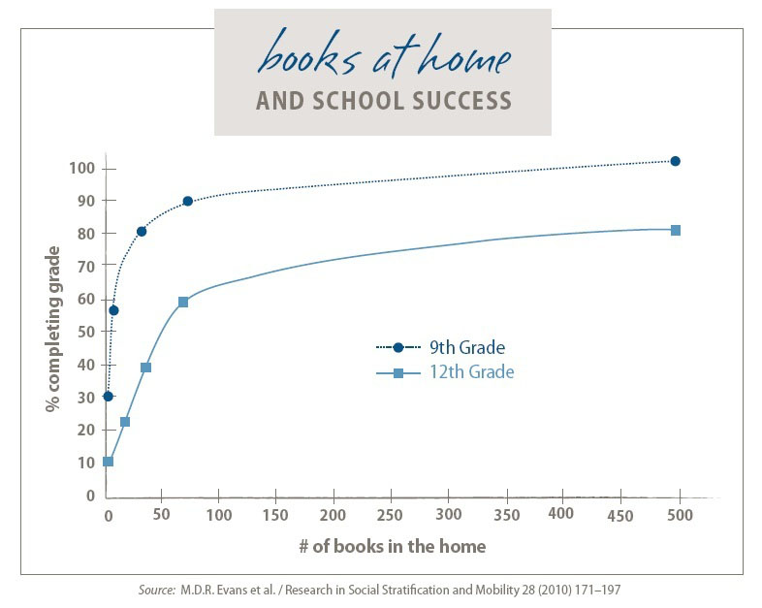

Slide 25

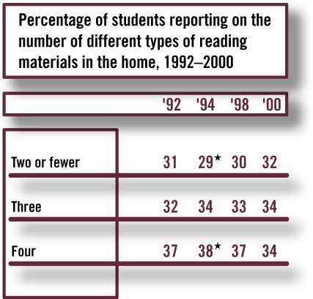
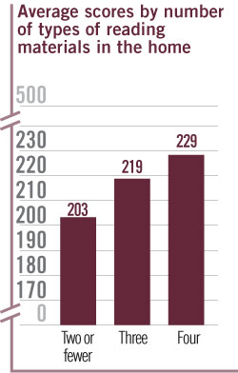

Significantly different from 2000.
SOURCE: National Center for Education Statistics, National Assessment of Educational Progress (NAEP), 1992–2000 Reading Assessments.

Slide 26
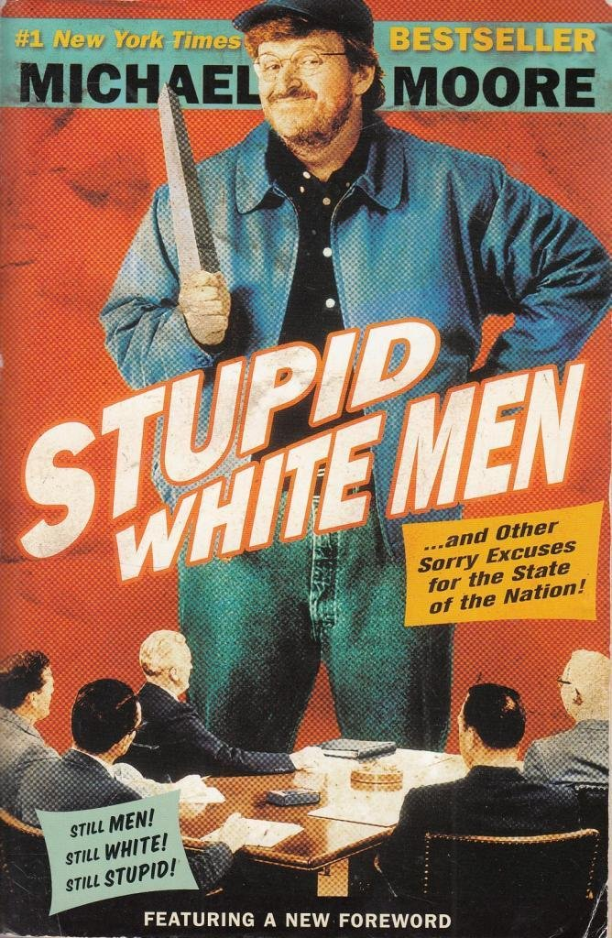
Documentary Filmmaker and author Michael Moore writes, “For kids who are exposed to books at home, the loss of a library is sad. But for kids who come from environments where people don’t read, the loss of a library is a tragedy that might keep them from every discovering the joys of read—or gathering the kind of information that will decide their lot in life.

Slide 27
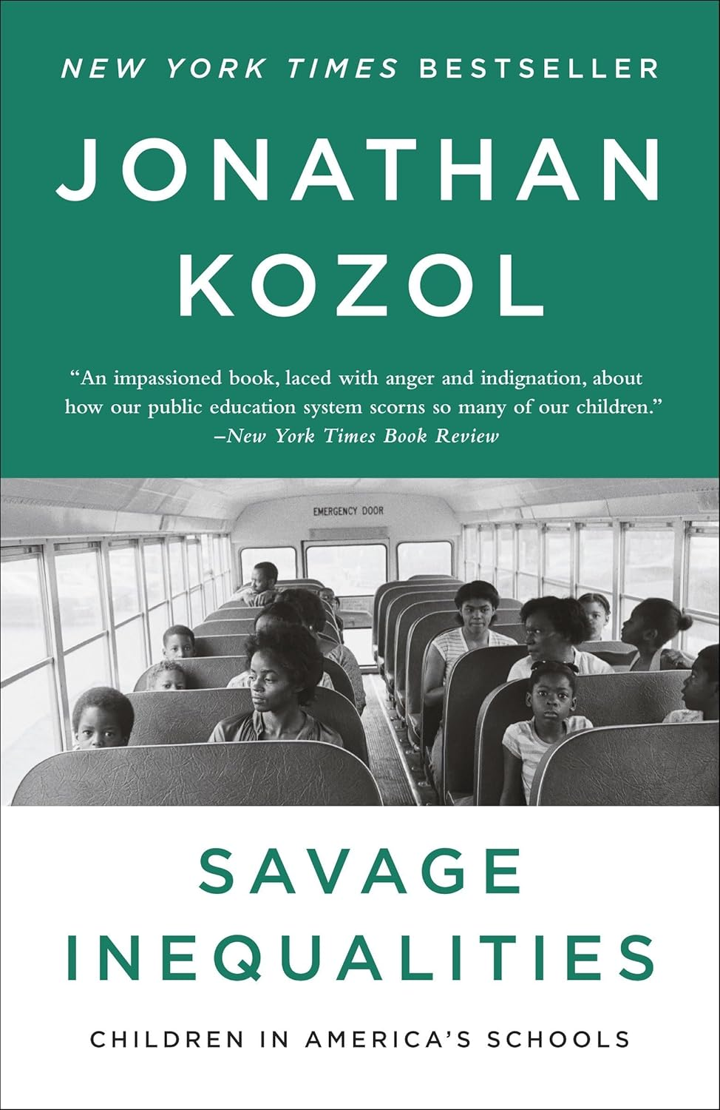
Jonathan Kozol declares that school libraries “remain the clearest window to a world of noncom-mercial satisfactions and enticements that most children in poor neighborhoods will ever know.’”

Slide 28
The 2011 National Indian Education Study Reported:
Low Density AI/AN Public Schools 58% of homes had more than 25 books
High Density AI/AN Public Schools 44% of homes had more than 25 books
Bureau of Indian Education Schools 37% of homes had more than 25 books
AI/AN = American Indian/Alaska Native
BIE = Bureau of Indian Education
I suspect that if one examined Low and High Density Hispanic and Black schools one would find the same pattern that this research shows. Generally non-Asian ethnic minority students have fewer books in their homes and less access to school and public libraries.

Slide 29
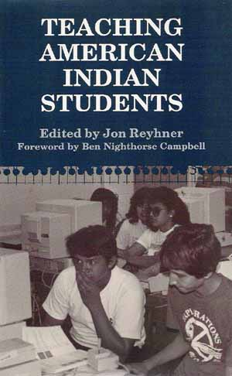
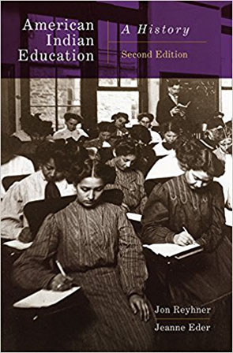
Researching American Indian education, I have looked at how American Indian and other students were taught to read, what reading experts have recommended, and whether American Indian and other non-English languages and cultures should be taught and valued in schools. Too often there has been too much emphasis on pronouncing words “right” in standard English versus understanding the meaning of what is being read.

Slide 30
After visiting Indian schools Reverend S.D. Hinman reported in 1869, “It is a wonder to me how readily they learn to read our language; little fellows will read correctly page after page of their school books, and be able to spell every word, and yet not comprehend the meaning of a single sentence” and he complained about the “monotony and necessary sameness of the school-room duty.”
The importance of student interest and engagement is highlighted in the 2006 report, The Silent Epidemic: Perspectives on High School Dropouts, which found that the major reason for dropping out given by almost half of high school dropouts was that their classes were boring; over two-thirds said they were not motivated to work hard in school (Bridgeland, DiIulio & Morison).

Slide 31
Today, American Indian students have twice the national dropout rate and the most common reason they (and other students) give for dropping out is that school is boring. Hispanic, Black, and American Indian students are doing better, but still have not closed the graduation gap with White and Asian students. However, when the Congressionally chartered National Reading Panel studied how to teach reading it did not look at the role of student engagement/ motivation.

Slide 32
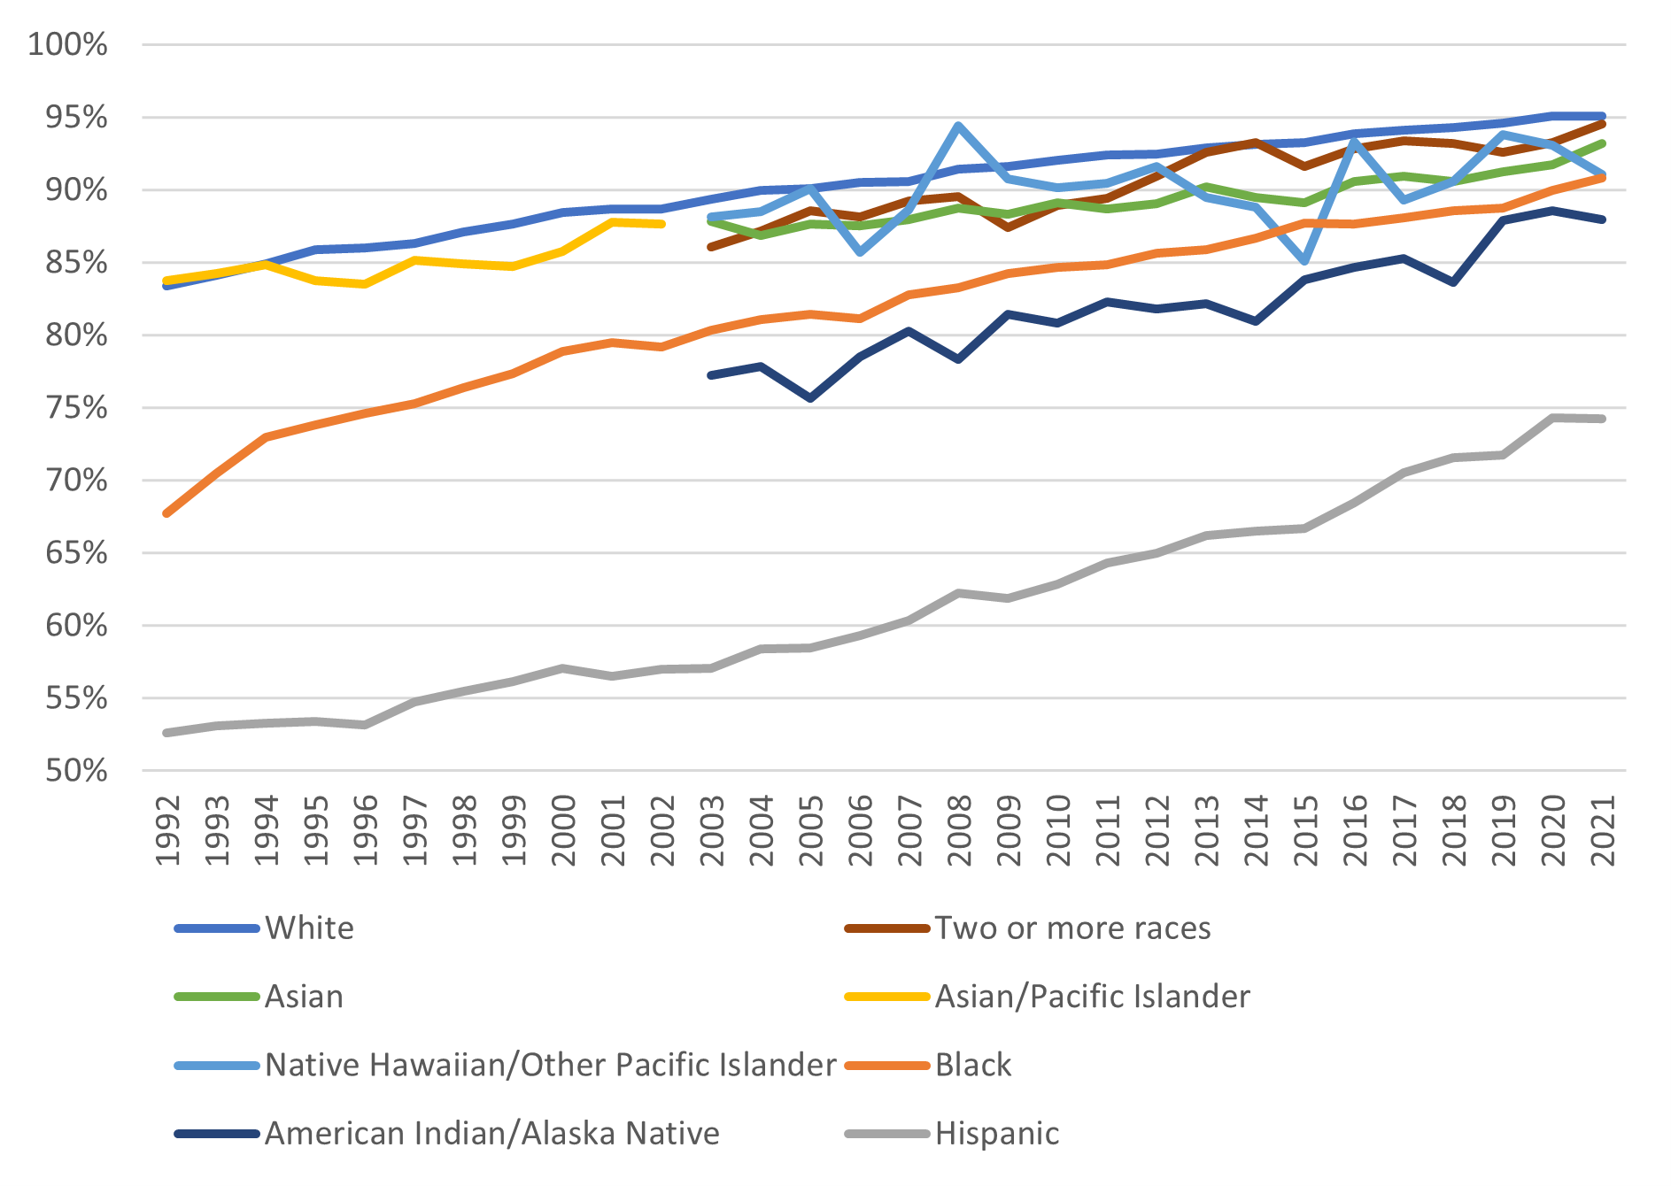
High school completion rates of 25-year-olds and older,
by race/ethnicity
U.S. Department of the Treasury
https://home.treasury.gov/news/featured-stories/post-5-racial-differences-in-educational-experiences-and-attainment

Slide 33
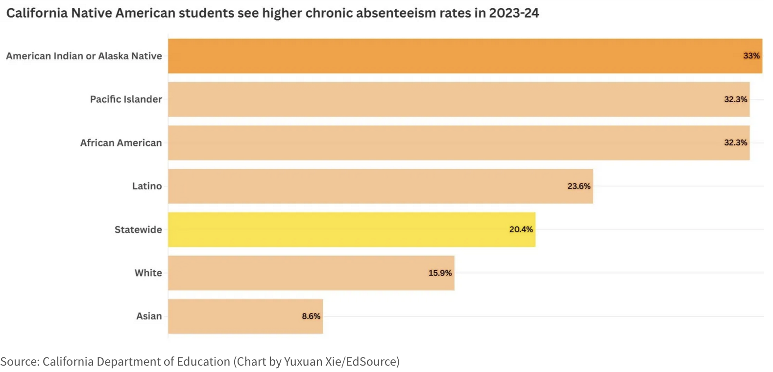
What are some of the reasons that students are absent from their classes?

Slide 34
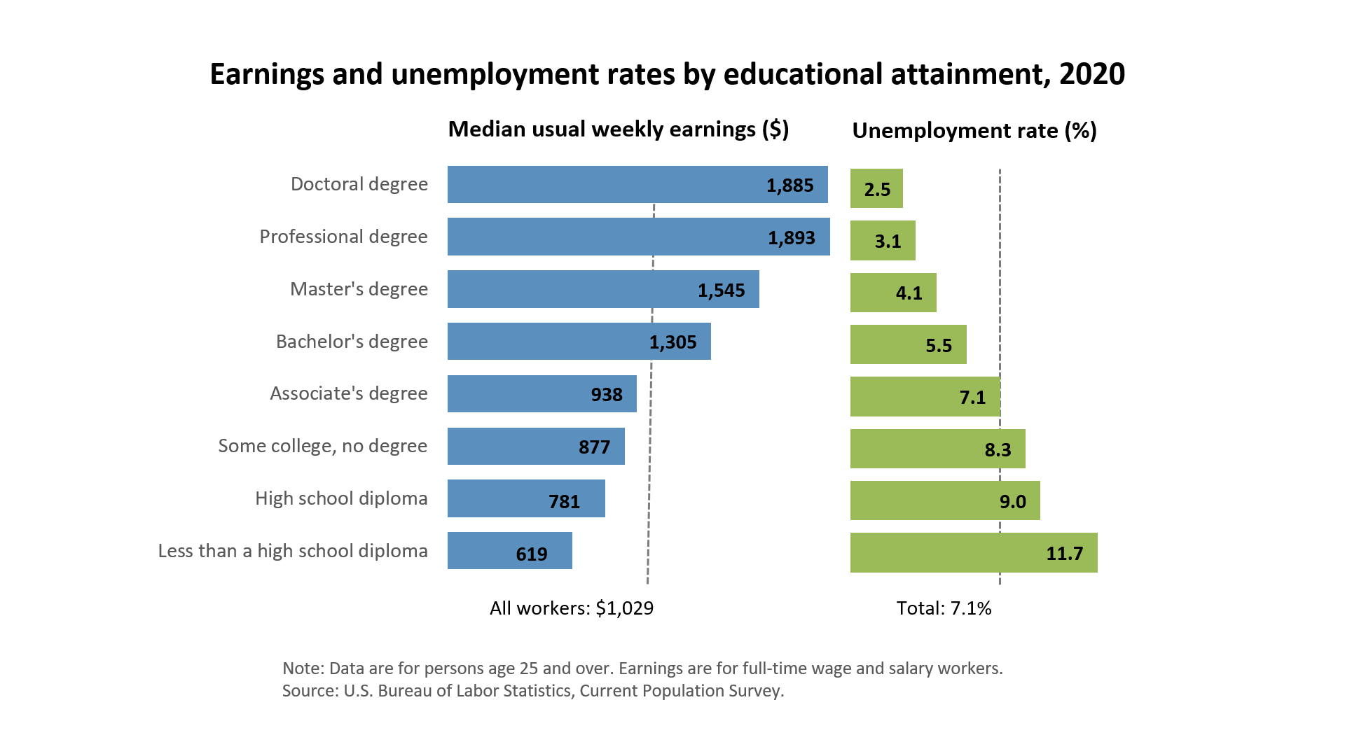
Source: Postsecondary Education Opportunity
Notes:
Earnings for year round full-time workers 25 years and older Source: Bureau of the Census

Slide 35
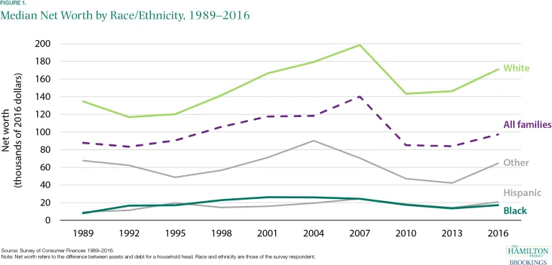
Low educational achievement usually (but not always) leads to living in poverty. Children growing up in poverty, on average, do not do well in school.

Slide 36
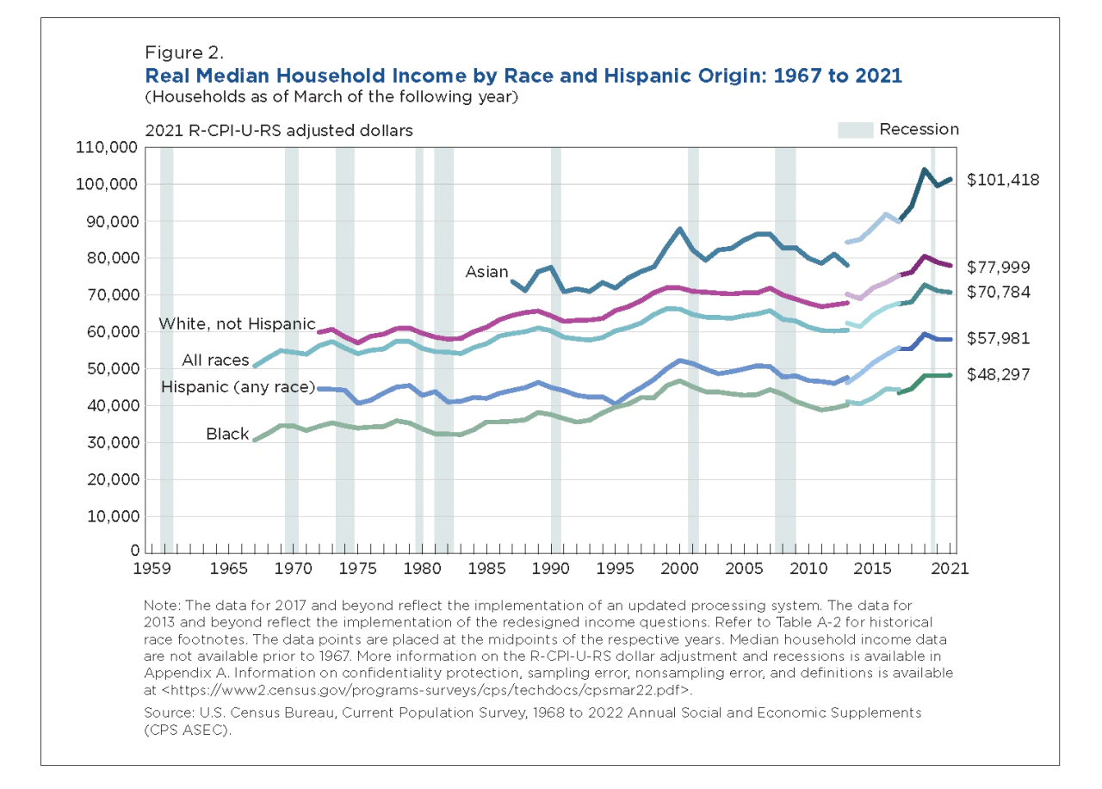

Slide 38
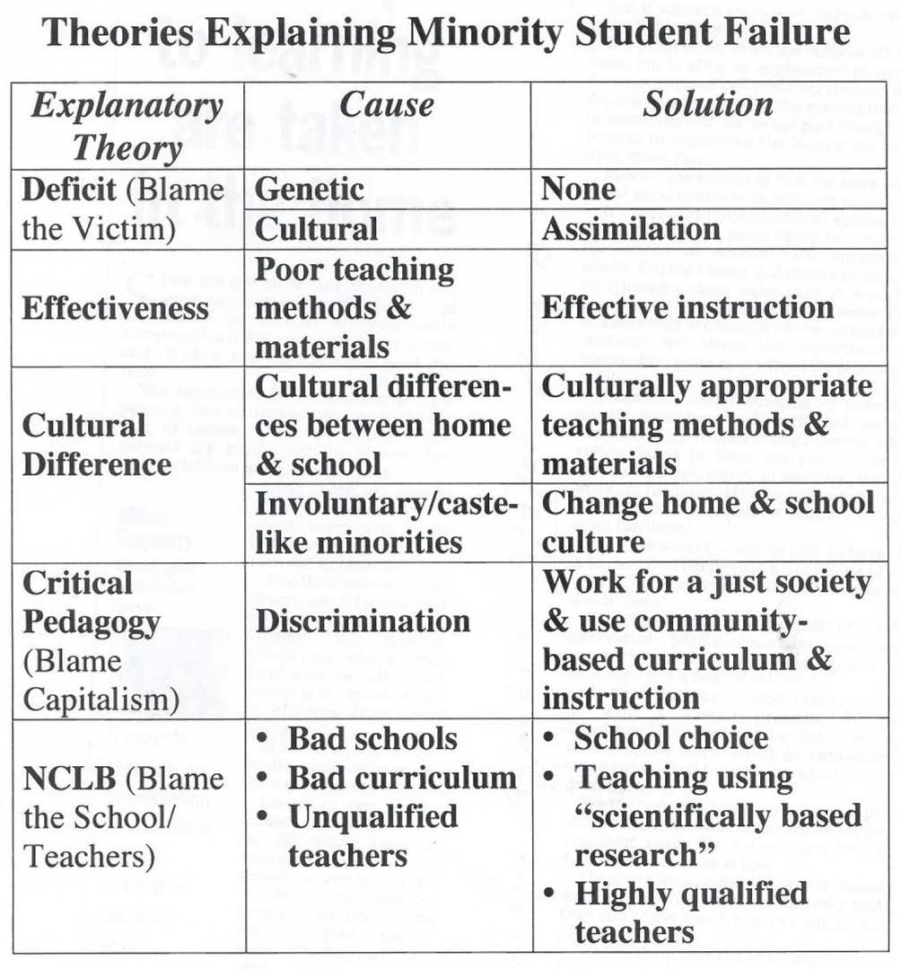

Slide 39
Phonics as promoted by NCLB and Reading First not a Panacea
An evaluation of reading achievement around the world found that time spent in voluntary reading was a strong predictor of reading achievement along with reading in class, reading material in the school, having a classroom library, borrowing more books from libraries, comprehension instruction, number of books per student in the school library, and emphasis on literature. Phonics, which NCLB’s Reading First emphasized, was far down on the list (#41).

Slide 40
The Importance of
Background Knowledge & Context
Mary had a little lamb.
Its fleece was white as snow.
Mary had a little lamb.
She spilled mint jelly on her dress.
Mary had a little lamb.
It was such a difficult delivery that the vet needed a drink.
Mary had four dates and ate three of them.

Slide 41
“When children were asked the purpose of reading, poor readers, often ethnic minority children, were left with the understanding that reading was decoding and vocalizing the words correctly for the teacher. In contrast, middle-class children learned that reading was garnering information.”
“In my district, fourth graders who can already read long and short vowel sounds within the context of their readings are required to spend time with worksheets categorizing these sounds.”
“In these basals [reading textbooks that her school used], each story seems to exist in its own vacuum, unconnected to the common history and humanity of the many groups within the American and global culture” (Fayden, 2005).

Slide 42

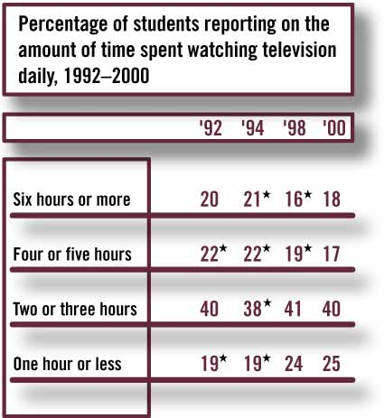
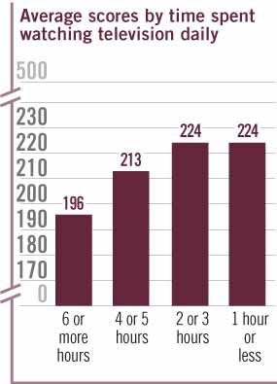
Significantly different from 2000.
SOURCE: National Center for Education Statistics, National Assessment of Educational Progress (NAEP), 1992–2000 Reading Assessments.

Slide 43
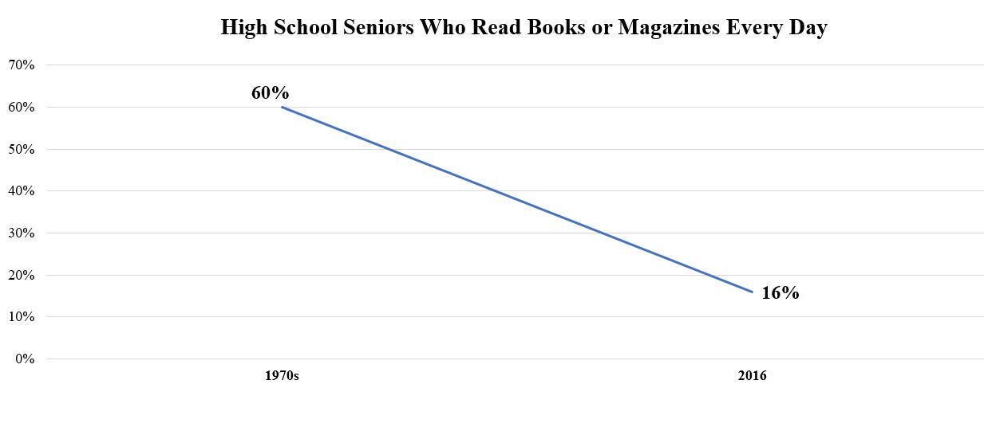
A study out of the American Psychological Association, conducted by psychologist Jean Twenge and her colleagues, finds that the reading decline among American teens is worse than expected. In 2016, only 16 percent of high school seniors reported daily reading of a book or magazine. In the past it was a problem of watching too much TV, now it’s too much social media.

Slide 44
Forty years ago, 60% of high school seniors reported reading daily. Teens have replaced book and print media reading with digital activities such as video games and social media. According to Twenge this sets up high schoolers for failure in college when they must read hundreds of pages in order to keep up with schoolwork: “Being able to read long-form text is crucial for understanding complex issues and developing critical thinking skills—like deciding which presidential candidate to vote for this coming November. Democracies need informed voters and involved citizens who can think through issues, and that might be more difficult for people of all ages now that online information is the norm.”

Slide 45
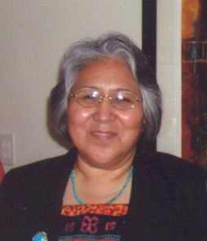
A Navajo elder told NAU Professor
Emeritus Dr. Evangeline Yazzie, “You
are asking questions about the reasons
that we are moving out of our language, I know the reason. The television is robbing our children of language…Our children should not sit around the television.” Yazzie continues, “The use of the native tongue is like therapy, specific native words express love and caring. Knowing the language presents one with a strong self-identity, a culture with which to identify, and a sense of wellness.”

Slide 46
Today’s Television & Internet Culture
A Navajo elder told Dr. McCauley, “television has ruined us. A long time ago, they used to say, don’t do anything negative or say anything negative in front of children. It doesn’t take that long for a child to catch onto things like this. Therefore a mother and a father shouldn’t use harsh words in front of the children…. These days…they see movies with people having sex in them and they’re watching. In these movies they shoot each other…. Movies are being watched every day, but there is nothing good in it.”

Slide 47
Is social media ruining us today?
Any Comments?

Slide 48
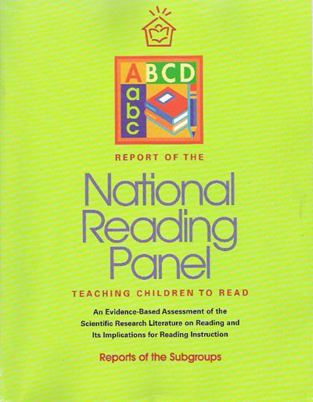
The National Reading Panel’s 2000 report found that there was “common agree-ment that fluency develops from reading practice.” However, it placed its greatest emphasis on teaching phonics.

Slide 49
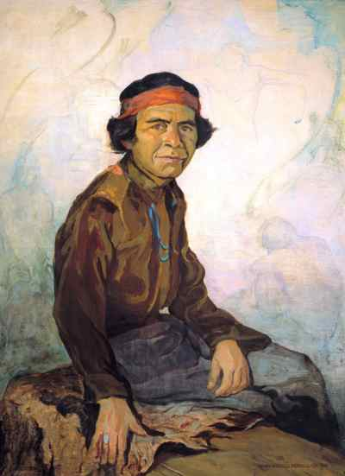
Is the Current Emphasis in the USA On the Importance of Phonics Going in the Wrong Direction
Often students were taught to just sound out (parrot) words. Edmund Nequatewa (Hopi) recalled going to school in the 1890s: “The only thing they were learning in the classes was reading and arithmetic. I could read all right but many times I really won’t understand what I was reading about. I could pronounce the words, that’s all…”

Slide 50
The National Reading Panel ignored what Sylvia Ashton Warner learned in teaching Māori students in New Zealand that:
First words must have an intense meaning [for the child].
First words must be already part of the dynamic life [of the child].
First books must be made of the stuff of the child himself, whatever and wherever the child. (Teacher, 1963)

Slide 51
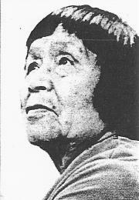
Polingaysi Qoyawayma in the 1930s
was told by her supervisors to use
a “canned” curriculum to teach only
in English, but she wrote in her 1964
autobiography No Turning Back,
“What do these white-man stories
mean to a Hopi child? What is a ‘choo-choo’ to these little ones who have never seen a train? No! I will not begin with the outside world of which they have no knowledge. I shall begin with the familiar. The everyday things. The things of home and family.”

Slide 52
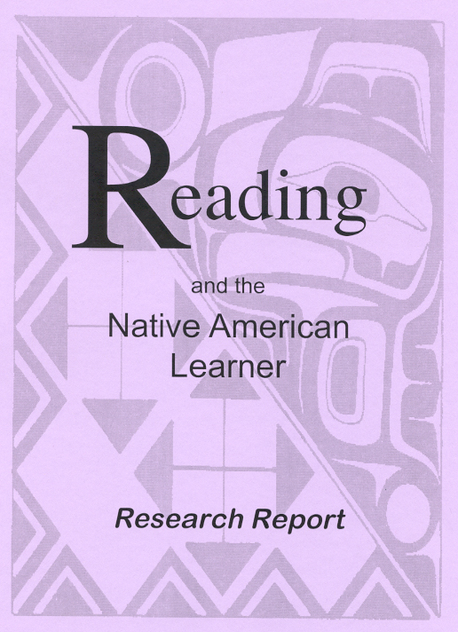
Cultural Discontinuities Between Home and School
The 2001 Reading and the Native American Learner Research Report concluded: “current research suggests that the relatively low level of academic success among American Indian elementary and secondary school students, as a group, is largely the result of discontinuities between the cultures and language of these students’ homes and the communities and the language and culture of mainstream classrooms.

Slide 53
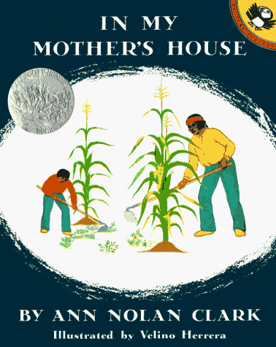
Newbery Award winner and teacher Ann Nolan Clark wrote, “What a book says must be interesting to the child who reads it or listens to it read to him. The story must be vital to him. He must be able to live it as the pages turn. It must enrich the world he knows and lead him into a wider, larger unfamiliar world.”

Slide 54
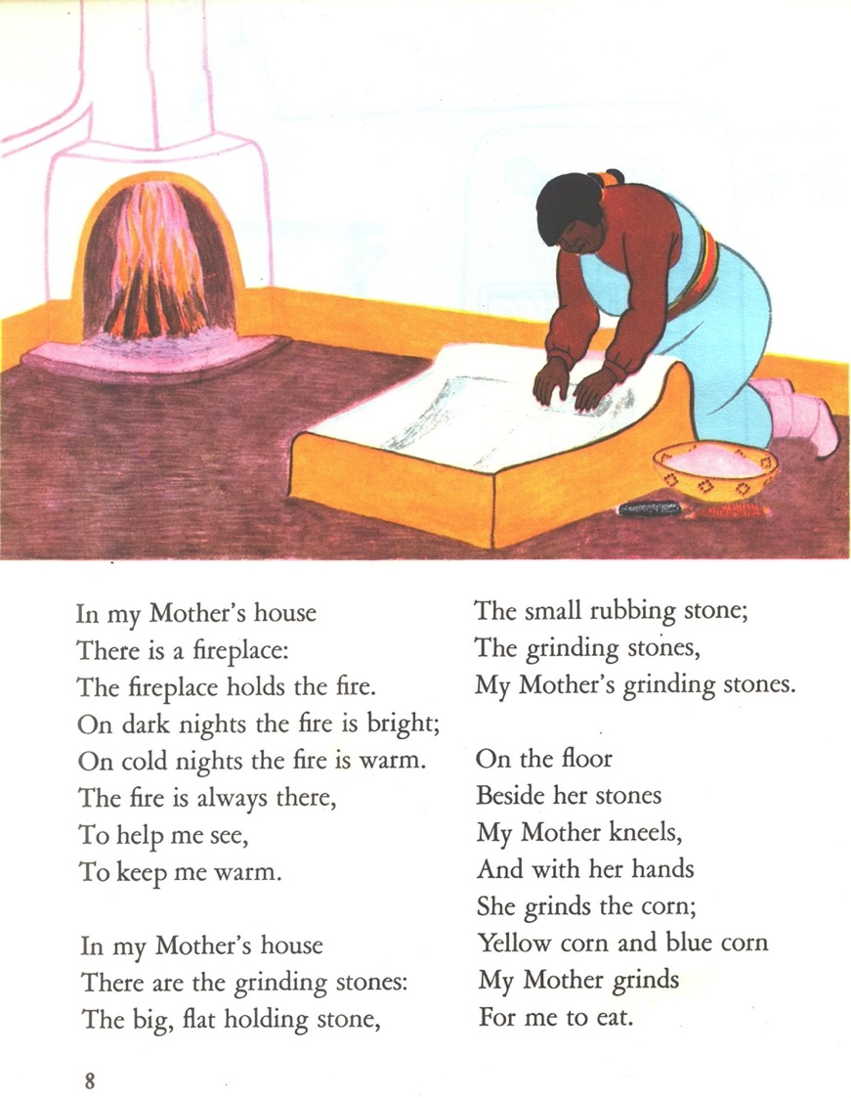
Clark’s 1941 Caldecott Medal book In My Mother’s House illustrated by Velino Herrera was written for her third grade Tesuque Pueblo students in New Mexico.

Slide 55
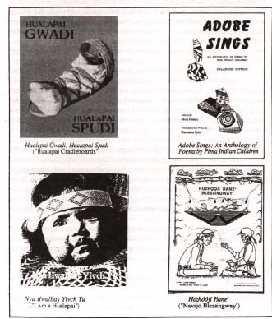
To Read Well
Children Need:
Home Libraries
Classroom Libraries
School Libraries
Community/Public Libraries
Children need to be read to and encouraged to read.

Slide 56
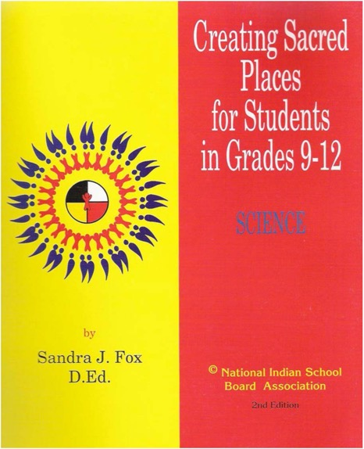
Dr. Sandra Fox
Oglala Sioux educator and recipient of the NIEA’s Lifetime Achievement Award Dr. Sandra Fox in her Creating Sacred Places for Students curriculum asserts that “reading to children is the single most important activity that parents can provide to help their children succeed in school.” For teachers, she recommends:

Slide 57

Use reading materials that relate to children’s lives, to help them understand that literature is experience written down and that it is interesting to read.
Strengthen and expand children’s language abilities by providing them many opportunities to have new experiences, to learn new words, and to practice oral language in English and in their Native language.

Slide 58
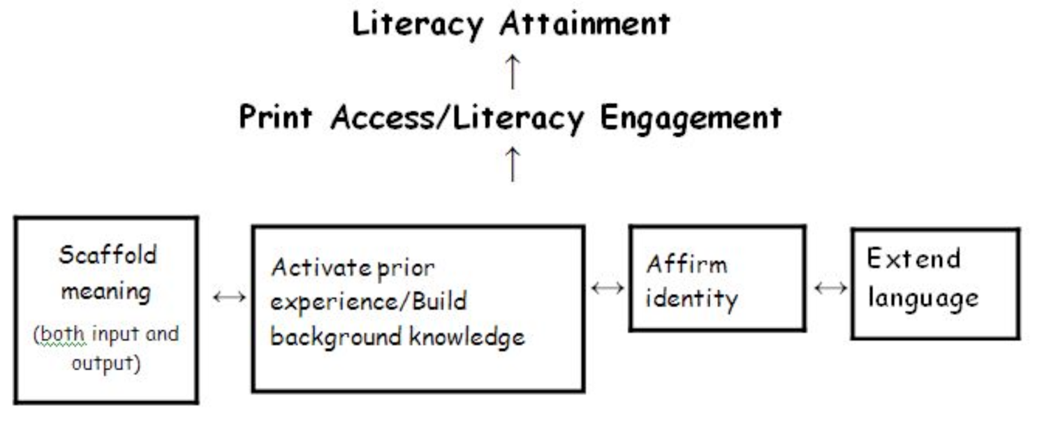
The Literacy Engagement Framework (Jim Cummins, 2011)

Slide 59
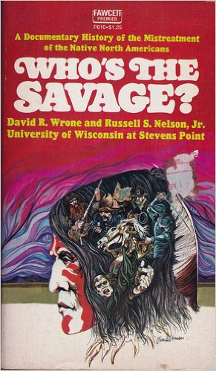
How a child’s ethnic/racial group is portrayed in books (including children’s books and history textbooks), movies, and other media can be very important for the child’s identity development.

Slide 60
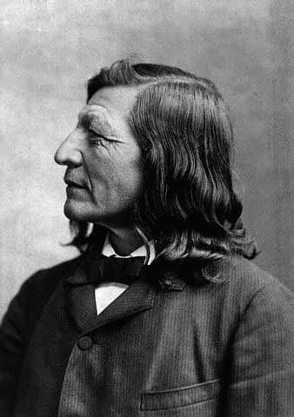
It is long past time to remember what Luther Standing Bear declared in 1933 about young Indians (and other children) needing to be “doubly educated” so that they learn “to appreciate both their traditional life and modern life.”

Slide 61
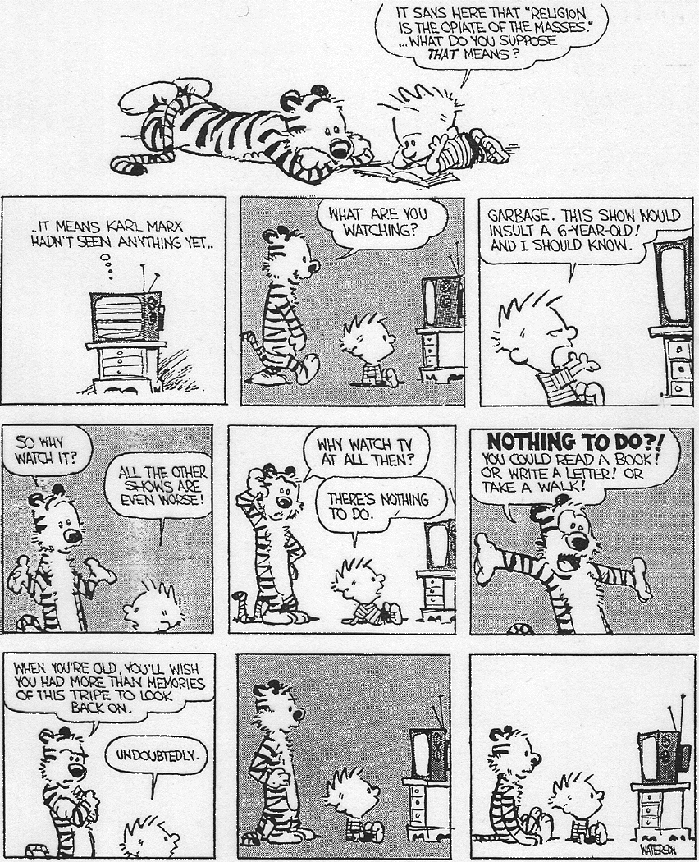

Slide 62
Avoid
Readicide
And
Writicide

Slide 63
What makes a good basketball player?
Coaching (Teaching)?
The Joy of Playing?
Practice?
Drive/Grit?
Is the making of a
good reader any different?

Slide 64
E. D. Hirsch’s Literacies:
Functional Literacy: The ability to read and understand the average newspaper article. (Being able to read conversational language written down)
Cultural Literacy: Includes being able to understand allusions to cultural activities like “Three strikes and you’re out.”
Critical Literacy: How to tell fake news. (Triangulation)

Slide 65
5 Reasons You Should Get Caught Reading This Month
A study by the National Endowment for the Arts found that people who read books are more likely to be civically engaged, exercise, and enjoy cultural experiences.
Reading fiction was found to make readers more empathetic with others who are different from themselves.
The more types of reading materials available in a home, the higher students are in reading proficiency, according to the Educational Testing Service.
Research suggests that people who read are two and a half times less likely to be diagnosed with dementia.
Reading expands your vocabulary, and makes you smarter!

Slide 66
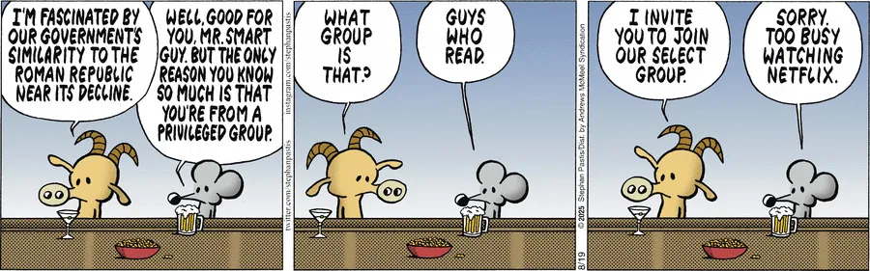
Arizona Daily Sun 8/19/2025i

Slide 67
Want a Good Grade in this Class?
Come to class.
Take notes. Taking notes helps keep you engaged, even when the class is boring.
Before midterm and final review notes
Do the weekly discussions & don’t wait to Sunday evening to do them.
Take notes on Alexie book & CRT articles to help you write your essay on them.
Self discipline is a key to academic & life success.

Slide 68
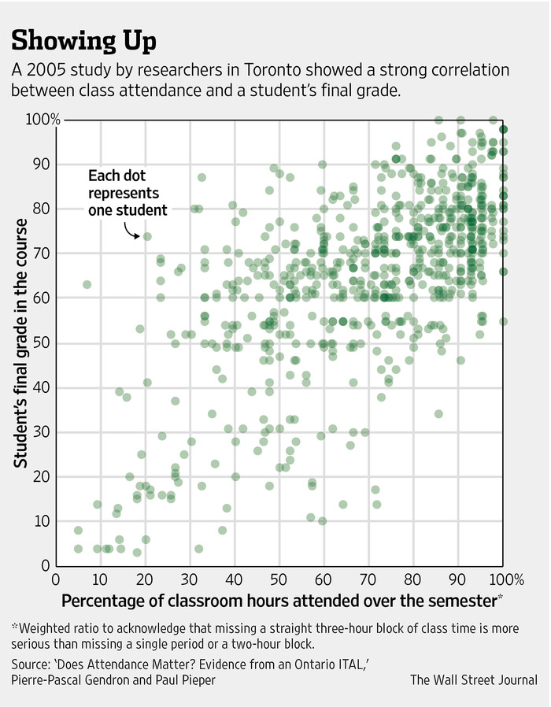
There are a number of correlates to academic success besides being a good reader. Students who watch less television and whose parents have higher incomes do better, on average, in school. In addition, K-12 and university students who miss fewer classes on average get better grades.
The Importance of Being There.
From the Wall Street Journal, 1/14/2015

Slide 69
Selected References
Alvord, Lori Arviso, & Van Pelt, E. C. (1999). The Scalpel and the Silver Bear. New York: Bantam.
Ashton Warner, Sylvia. (1964). Teacher. Toronto: Bantam.
Bridgeland , J.M., DiIulio, Jr., J.J., & Morison, K.B. (2006). The Silent Epidemic: Perspectives on High School Dropouts. Washington, DC: Civic Enterprises (a report of the Bill & Melinda Gates Foundation).
Clark, Ann Nolan. (1969). Journey to the People. New York: Viking.
Cummins, Jim. (2011). Putting the evidence back into evidence-based policies for underachieving students. Language Policy Division, Directorate of Education and Languages, DGIV, Council of Europe, Strasbourg.
Evans, M. D. R., Kelley, J., Sikora, J, & Treiman, D. J. (2010). Family scholarly culture and educational success: Books and schooling in 27 nations. Research in Social Stratification & Mobility, 28(2), 171-197.
Fayden, Terese, (2005). How Children Learn: Getting Beyond the Deficit Myth. Boulder, CO: Paradigm.
Fox, Sandra J. (2000). Creating a Sacred Place to Support Young American Indian and Other Learners (Vol. 1). Polson, MT: National Indian School Board Association.
Hirsch, Jr., E.D. (1987). Cultural Literacy: What Every American Needs to Know. Boston: Houghton Mifflin.
Kneale, Albert H. 1950. Indian Agent. Caldwell, ID: Caxton.
Krashen, S. (2004). The Power of Reading (2nd Ed.). Westport, CN: Libraries Unlimited.
Reyhner, Jon. (2001). Teaching Reading to American Indian/Alaska Students. Charleston, WV: ERIC/CRESS. http://www.ericdigests.org/2002-3/reading.htm

Slide 70
Reyhner, J., & Cockrum, W. (2016). Cultural Issues Related to Teaching Reading. In P.R. Schmidt & A.M. Lazar (Eds.), Reconceptualizing Literacy in the New Age of Multiculturalism and Pluralism, 2nd ed. (pp. 215-232). Greenwich, CN: Information Age.
Reyhner, J., & Cockrum, W. (2015). Promoting Indigenous literacy. In J. Reyhner (Ed.). (2015). Teaching Indigenous Students: Honoring Place, Community and Culture (pp. 51-69). Norman, OK: University of Oklahoma.
Reyhner, Jon, & Hurtado, D.S. (2008). Reading First, literacy, and American Indian/Alaska Native students. Journal of American Indian Education, 47(1), 82-95.
Seaman, P. David, (Ed.). (1993). Born a Chief: The Nineteenth Century Hopi Boyhood of Edmund Nequatewa, as told to Alfred F. Whiting. Tucson: University of Arizona Press.
Standing Bear, Luther. (1928). My People the Sioux. Edited by E. A. Brininstool. Boston: Houghton Mifflin.
St. Charles, J., & Costantino, M. (2000). Reading and the Native American Learner: Research Report. Olympia, WA: Office of the Superintendent of Public Instruction, Office of Indian Education.
Suina, Joseph H. (1988). Epilogue: And When I Went to School. In R. Cocking & J. P. Mestre (Eds.), Linguistic and Cultural Influence on Learning Mathematics. Hillsdale, NJ: Erlbaum.
Twenge, Jean M., Gabrielle N. Martin, Brian H. Spitzberg. (2018). Trends in U.S. Adolescents’ Media Use, 1976–2016: The Rise of Digital Media, the Decline of TV, and the (near) Demise of Print. Psychology of Popular Media Culture, 8(4), 329-345.
Qöyawayma, Polingaysi. (Elizabeth Q. White) (as told to Vada F. Carlson). (1964). No Turning Back: A Hopi Indian Woman's Struggle to Live in Two Worlds. Albuquerque: University of New Mexico Press.

