Slide 1
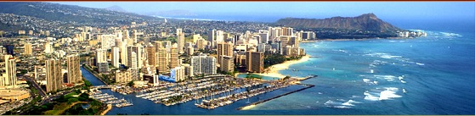
Prof. John Barkai
William S. Richardson School of Law
University of Hawaii
Cultural Dimension Interests,
the Dance of Negotiation,
and Weather Forecasting:
A Perspective on Cross-Cultural Negotiation and Dispute Resolution

Slide 2
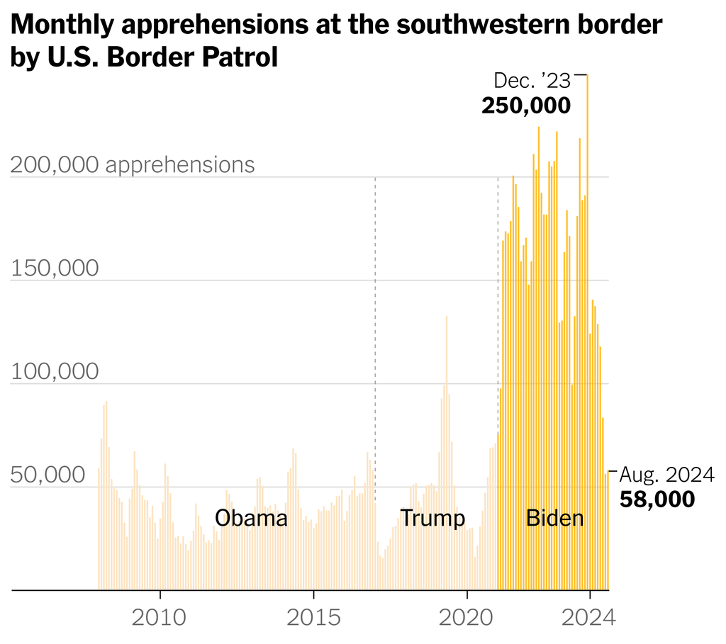

Slide 3
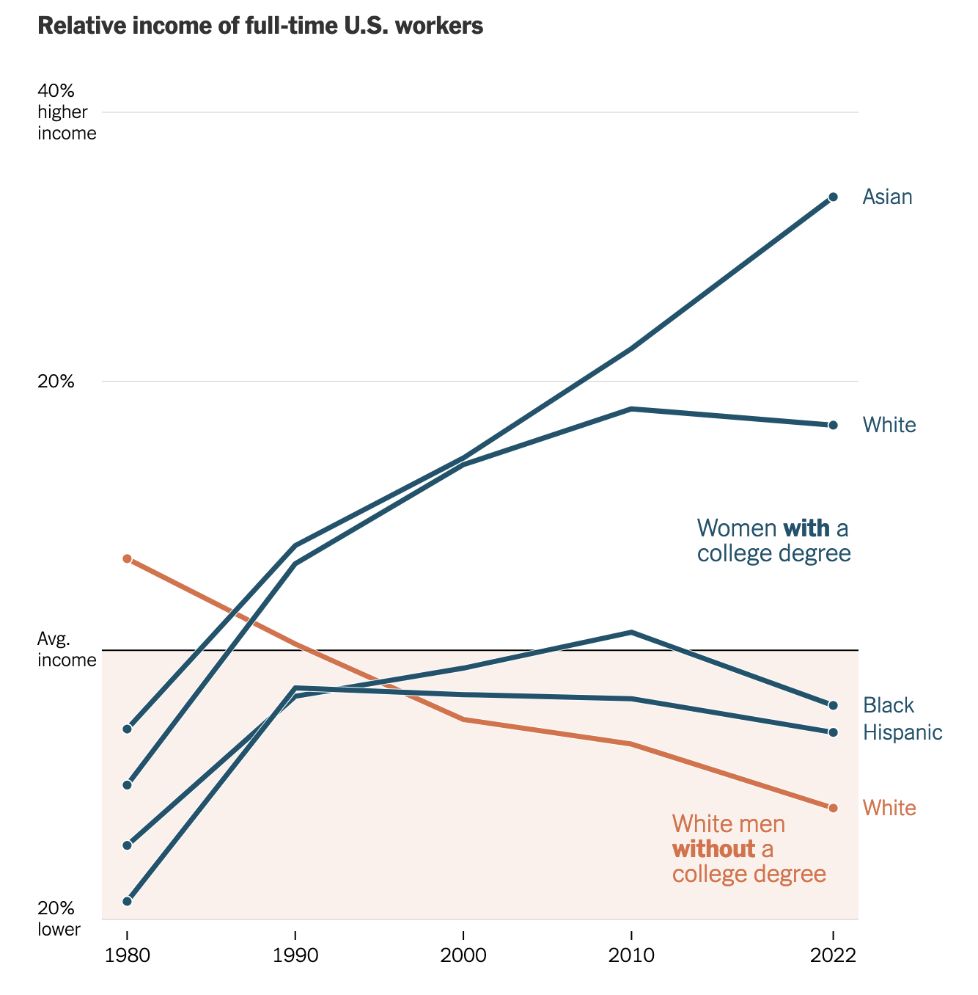
Source: New York Times, October 2024,
From Census Data

Slide 4
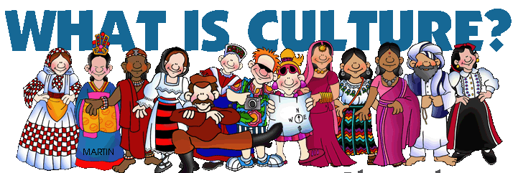
Ideals, values, and assumptions about life that are widely shared among people and that guide specific behaviors. (Brislin 1993)

Slide 5
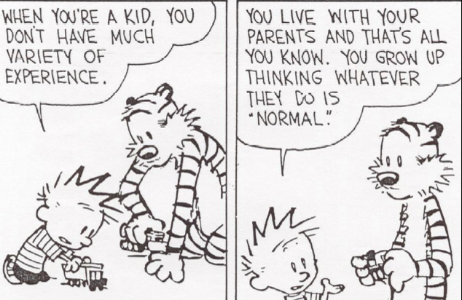
Notes:
Like a fish in water. Water is the culture

Slide 6
warning warning warning warning warning warning warning warning warning warning warning warning warning warning warning warning warning warning warning warning warning warning warning warning warning warning warning warning warning warning warning warning warning warning warning warning warning warning warning warning warning warning warning warning warning warning warning warning warning warning warning warning warning warning warning warning warning warning warning warning warning warning warning warning warning warning warning warning warning warning warning warning warning warning warning warning warning warning warning warning warning warning warning warning warning warning warning warning warning warning warning warning warning warning warning warning warning warning warning warning warning warning warning warning warning warning warning warning warning warning warning warning warning warning warning warning warning warning warning warning warning warning warning warning warning warning warning warning warning warning warning warning warning warning warning warning warning warning warning warning warning warning warning warning warning warning warning warning warning warning warning warning warning warning warning warning warning warning warning warning warning warning warning warning warning warning warning warning warning warning warning warning warning warning warning warning warning warning warning warning warning warning warning warning warning warning warning warning warning warning warning warning warning warning warning warning warning warning warning warning warning warning warning warning warning warning warning warning warning warning
Statements about culture are never statements about individuals.

Slide 7
Sophisticated
Stereotypes

Slide 8
The Western View of the
Business Deal
Party A
The Deal
Party B

Slide 9
Asian View of the
Business Deal
Trust-based
Relationships
Business bonding
Via
Entertainment
Party A
The Deal
Party B
Contracts based
On a
Handshake
Gifts
and
Favors

Slide 10
Emic & Etic
Approaches
Emic: cultural specific - only in one culture
Etic: cultural general – in many cultures
(from psycholinguistics)

Slide 11
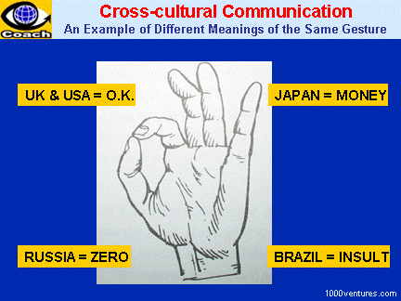

Slide 12
Levels of culture

Slide 13
Top 10 Countries by Population

Slide 14
Ranked in millions Population
China 1337
India 1189
United States 313
Indonesia 246
Brazil 203
Pakistan 187
Bangladesh 159
Nigeria 155
Russia 139
Japan 126

Slide 15
If there were 100 people in the world how many would live in…?
Africa
Asia
Europe
N. America
S. & Latin America
Pacific Islands

Slide 16
If there were 100 people in the world how many would live in…?
Africa
Asia
Europe
N. America
S. & Latin America
Pacific Islands
14
60
12
5
8
1

Slide 17

Interests
Drive
Negotiations
Iceberg Theory

Slide 18

Iceberg Theory
“Below the line” issues
Huge & invisible.
Purposely hidden, or simply
Out of awareness

Slide 19
CROSS CULTURAL

Slide 20
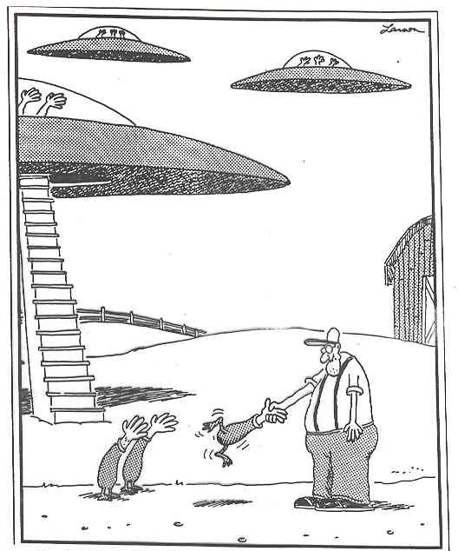

Slide 21
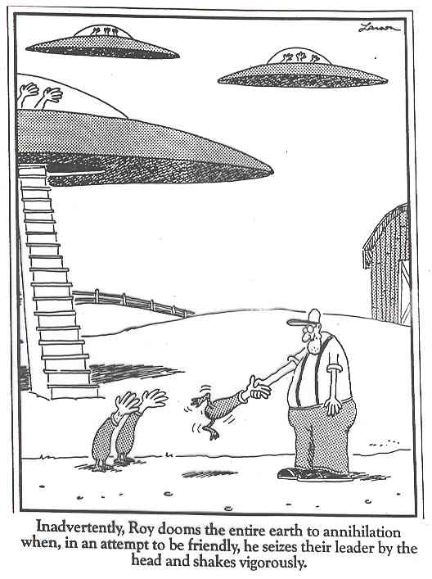

Slide 22
LIVING
CROSS CULTURALLY

Slide 23
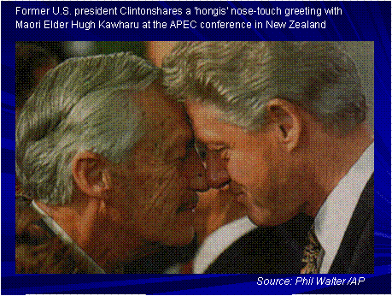

Slide 24
Contrasting Cultural Differences in Negotiation and Mediation
WESTERN | ASIAN
Low Context (direct) Communication | High Context (indirect) Communication
Low Power Distance | High Power Distance
Individualism | Collectivism
Low Uncertainty Avoidance | High Uncertainty Avoidance
Masculinity (Assertive) | Femininity (Cooperative)
Short-Term Orientation | Long-Term Orientation
Monochronic Time | Polychronic Time
Space - far apart | Space – close

Slide 25
Contrasting Cultural Differences in Negotiation and Mediation
WESTERN | ASIAN
Risk Takers | Risk Avoiders
Brief Rapport building time (short) | Extensive Rapport building time (long)
Aggressive | Passive
Contract focus | Relationship focus
Win-lose approach | Win-win approach
Informal approach | Formal approach
Show emotions | Hide emotions
Preference for specific agreement | Preference for general agreement
Contract is fixed | Re-negotiation is possible
Individual Decision-making | Group Decision-making
Logical decision-making | Emotional decision-making
All equals | One leader
Face Saving | Face Giving
Inductive logic | Deductive logic
Low Government involvement | High Government involvement
Linear-Active | Multi-Active | Reactive

Slide 26


High context, low context
Edward T. Hall
Hofstede Dimensions
Power distance
Individualism v. collectivism
Masculinity v. femininity (Comp v Coop)
Uncertainty avoidance
Long-term v. short term orientation
Geert Hofstede

Slide 27

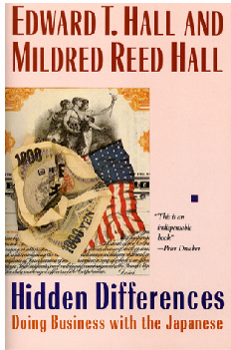
High context, low context (U.S.)
Edward T. Hall

Slide 28
The high-context communication style
is associated with a nonverbal, implicit, high-context style of communication, which predominates in non-Western, collectivist countries. It does not focus on just the immediate issues, but puts a particular focus on long-term and emotional aspects of the relationship between the parties and is preoccupied with considerations of symbolism, status, and face; It also draws on highly developed communication strategies for evading confrontation." Raymond Cohen (paraphrased)
The meaning is not in the words, but in the greater context.
“That’s just great.” (when its not) – “That would be difficult.”

Slide 29
The low-context communication style
is infused with the can-do, problem-solving spirit, assumes a process of give-and-take, and is strongly influenced by Anglo-Saxon legal habits. When negotiation experts suggest a model of negotiation (usually involving such features as the "joint search for a solution," "isolating the people from the problem," and the "maximization of joint gains"), they are proposing a version of the low-context, problem-solving model. Rational thought is at the base of this model; people are part of the problem, not the solution; each problem can be solved discretely; goals are defined in terms of material, not psychic, satisfactions.
Raymond Cohen
(paraphrased)
The words convey the meaning

Slide 30
Conflicts
A High Context Perspective
Non-Western negotiators tend to be surprised by their negotiation partner’s ignorance of history, preoccupation with individual rights, obsession with the immediate problem while neglecting the overall relationship, excessive bluntness, impatience, disinterest in establishing a philosophical basis for agreement, extraordinary willingness to make soft concessions, constant generation of new proposals, and inability to leave a problem pending. They are frustrated by their American partner's occasional obtuseness and insensitivity; tendency to see things and present alternatives in black-or-white, either-or-terms; appetite for crisis; habit of springing unpleasant surprises; intimidating readiness for confrontation; tendency to bypass established channels of authority; inability to take no for an answer; and obsession with tidying up loose ends and putting everything down on paper.
Raymond Cohen

Slide 31
Conflicts
A Low Context Perspective
American negotiators tend to be surprised by their negotiation partner’s preoccupation with history and hierarchy, preference for principle over nitty-gritty detail, personalized and repetitive style of argument, lack of enthusiasm for explicit and formal agreement, and willingness to sacrifice substance to form. They are frustrated by their partners' reluctance to put their cards on the table, intransigent bargaining, evasiveness, dilatoriness, and readiness to walk away from the table without agreement. Raymond Cohen
Negotiating Across Cultures

Slide 32
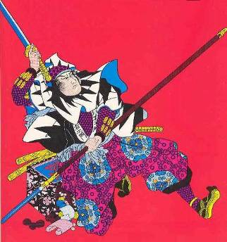
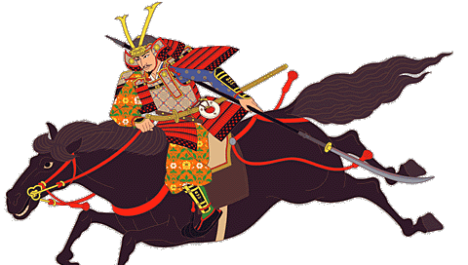
Smart Bargaining: Doing Business with the Japanese
Graham & Sano
Japan External Trade Organization's (JETRO)

Slide 33
16 ways
Japanese avoid saying “No”
1. Vague “no”
2. Vague and ambiguous “yes” or “no”
3. Silence
4. Counter question
5. Lateral responses
6. Exiting (leaving)
7. Lying (equivocation or making an excuse—
sickness, previous obligation, etc.)
8. Criticizing the question itself
9. Refusing the question
10. Conditional “no”
11. “Yes, but . . .”
12. Delaying answer (e.g., “We will write you a letter.”)
13. Internally “yes,” externally “no”
14. Internally “no,” externally “yes”
15. Apology
16. The equivalent of the English “no”—
primarily used in filling out forms, not in conversation

Slide 34
No – Maybe Game
Ways of saying "no" without saying "no.“
- vague and ambiguous answer
- ask a question back rather than answering their question
- say something that is not on point
- criticize the question
- active listen, paraphrase, or summarize the question
- make the "no" conditional
- saying "yes, but ..."
- delaying the answer
- making an apology
- silence
- tell a lie or make an excuse
- walking away

Slide 35
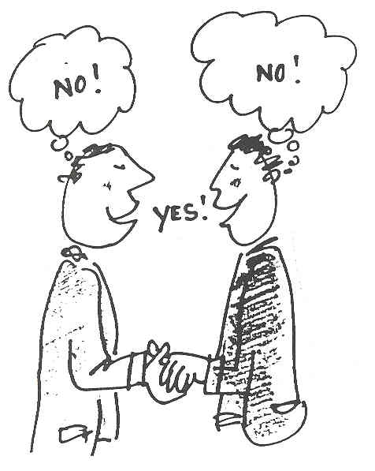

Slide 36
High Context Implicit
Japanese
China
Arabian
Latin American
Spanish
Italian
English (UK)
French
North American (US)
Scandinavian
German
Low Context
Explicit
Swiss

Slide 37
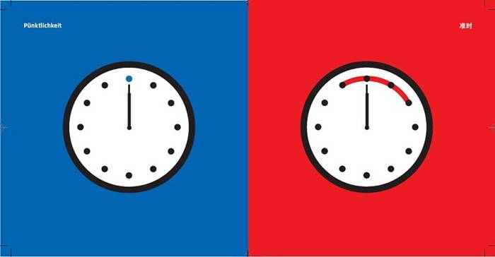
Punctuality
Western Asian

Slide 38

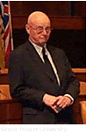
Geert Hofstede (1980, 1991)
  Studies of 117,000 IBM employees covering 72 national subsidiaries, 38 occupations, 20 languages.
  Used employee attitude surveys taken in 1968-69 and 1971-73 within IBM subsidiaries in 66 countries.
  Statistically analyzed answers which revealed four central and largely independent bi-polar dimensions of a national culture.
  Dimensions to explain systematic differences in work values and practices at the country level:
    Power distance
    Uncertainty avoidance
    Masculinity and femininity
    Individualism and collectivism
    [Confucianism and dynamism]

Slide 39
HOFSTEDE’S
CULTURAL DIMENSIONS
Masculinity-femininity
Dominance, independence vs. compassion, interdependence, & openness.
Individualism-collectivism
Emphasis on individual goals, needs, & success vs. group needs, satisfaction, & performance.
Power distance
Degree to which people accept power & status differences in society.
Notes:
6

Slide 40

Confucianism dynamism
Long-Term Orientation
A future oriented perspective
"sacrifice for the future."
Uncertainty avoidance
Degree to which people are comfortable with ambiguity & uncertainty. (Not Risk Tolerance)
Masculinity-femininity
Dominance, independence vs. compassion, interdependence, & openness. (Competition v. Cooperation)
Individualism-collectivism
Emphasis on individual goals, needs, & success vs. group needs, satisfaction, & performance.
Power distance
Degree to which people accept power & status differences in society.
Notes:
6

Slide 41
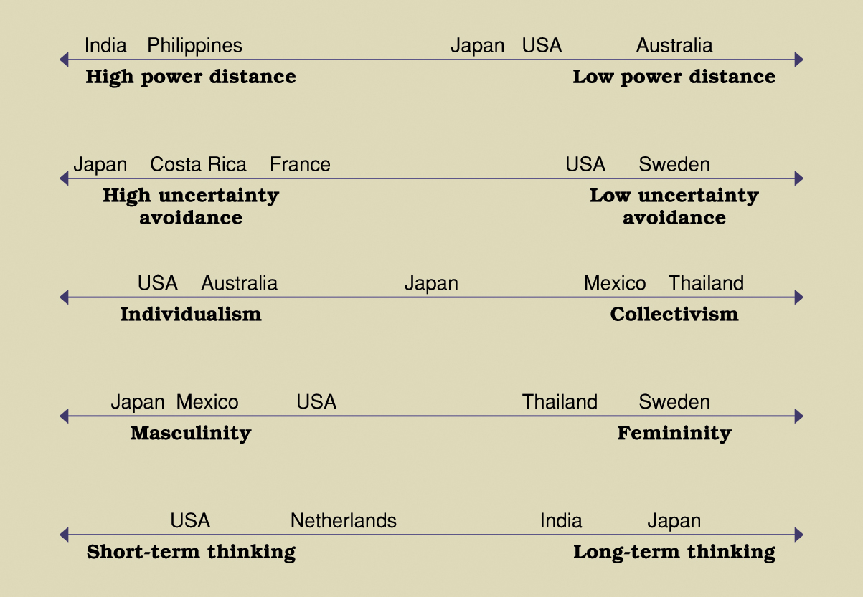

Slide 42
Power Distance | Hierarchy, Status “Respect your elders” v. “We are all equal.” “Just call me John.”
Individualism-collectivism | “What’s in it for me?” “How does my group look?”
Long-Term Orientation | However long it takes Short term profits

Slide 43
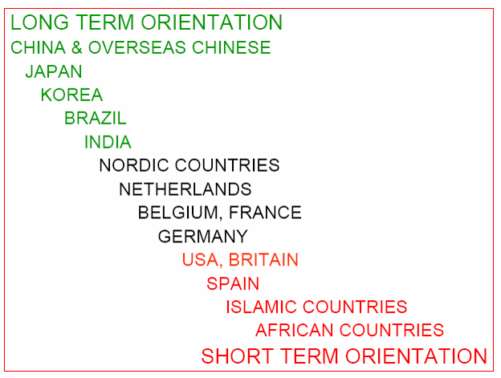

Slide 44
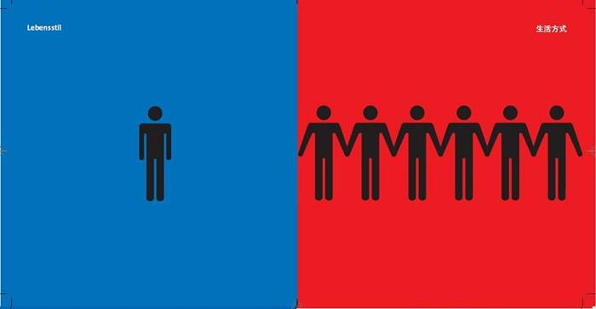
Way of Life
Individualism - Collectivism

Slide 45
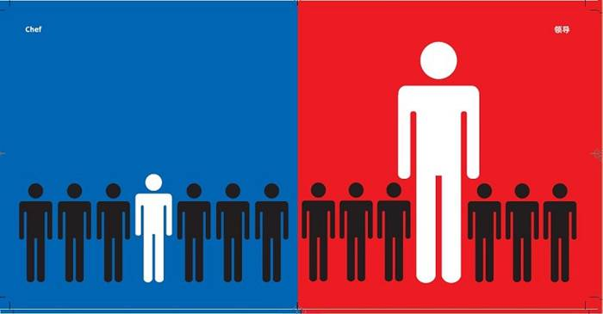
The Boss and Work
Power Distance

Slide 46



Slide 47
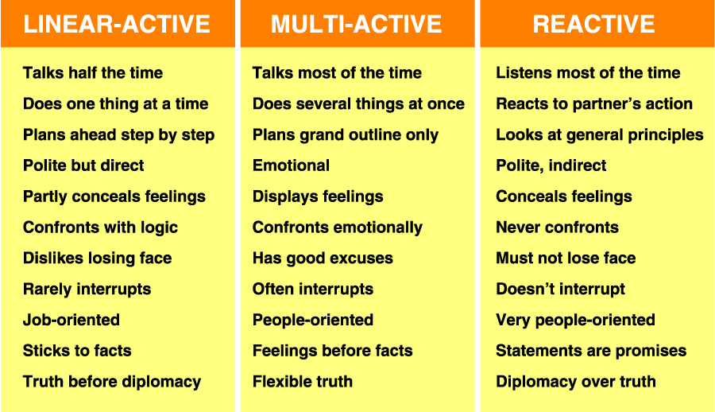
Cultural Categories

Slide 48
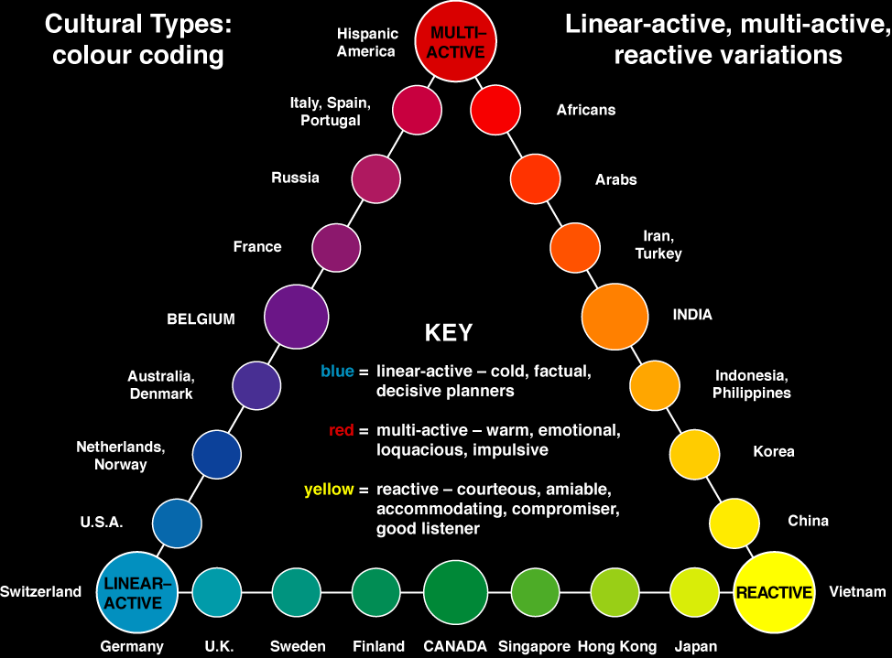
© 2001 Richard D Lewis

Slide 49
Common Asian Groupings
High context
Collective
High Power Distance
Long-Term Orientation

Slide 50
American Stereotype
Low context
Individualist
Low Power Distance
Short-Term Orientation

Slide 51
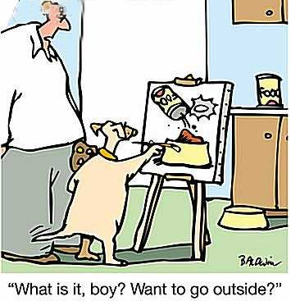
Context of Communication

Slide 52
High Context Communication
Communication is indirect
Meaning is indirect, implied, and derived from the context
Difficult to hear/infer interests
Implied meanings arise from the setting/context
Non-verbals are very important
Lots of inferences need to be drawn
Words promote harmony
Conflict is avoided
Says "No" without using the word "No"
Linked to: Collectivism, Hierarchy, spiral logic

Slide 53
Low Context Communication
Words communicate information directly
Literal meanings independent of setting/context
Meaning is in the words; its clear
“Read my lips"
Conflict is OK
Says "No" easily
Linked to: individualism, Equality, Linear logic

Slide 54
How would you negotiate with
High Context Communicators?

Slide 55
Negotiating with
High Context Communicators
Read between the lines
Don't take them literally; gather "clues"
Pay close attention to context & non-verbals
Ask for further clarification
Draw out their full ideas with questions
Ask them to be more direct
Face is very important
Don't challenge them; they may lose face
Explain that you do not fully understand;
Take time to build a good relationship

Slide 56
Tips for
Low Context Communicators
Read between the lines; be sensitive to the non-verbals; assess the context
Don’t be too direct
Don't overwhelm them; be less aggressive
Soften your words when expressing disagreement
Tone down emotions
Engage in more "small talk"
Build relationships early

Slide 57
Negotiating with
Low Context Communicators
Take their words at face value
No need to read between the lines
What you hear, is what you get
Communicate clearly and explicitly. Be "upfront"
Ask direct questions; share frank observations
Say "no" if you mean "no"
Avoid ambiguous expressions
Reframe their directness as helpful information
(not rudeness)
Listen & active listen
Be ready to negotiate at the first meeting
Handle some business over the phone or internet

Slide 58
Tips for
High Context Communicators
Don't assume they understand the larger context
Be more direct; don't be ambiguous
Say "no" if you mean "no"
Don't assume they can read your mind
They won't understand the nuances
Be ready to negotiate at the first meeting
Handle some business over the phone or internet
Use less relationship building time

Slide 59
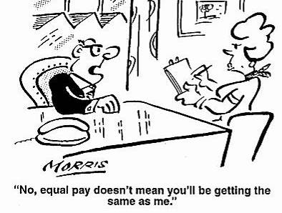
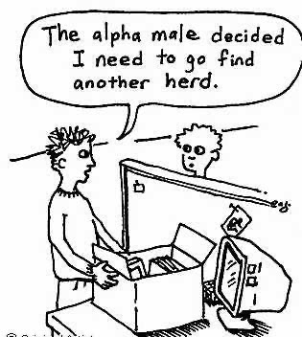
Power Distance
(Hierarchy)

Slide 60
Power distance
Extent to which members of a society accept that status and power are distributed unequally in an organization
Organizations in these cultures tend to be autocratic, possess clear status differences and have little employee participation

Slide 61
The Boss at Work
Power Distance

Slide 62
High Power Distance
Lower status people recognize and accept that power is held unequally in society.
Hierarchy & status are very important.
Motto: "Respect for the leader or the elder."

Slide 63
Low Power Distance
A belief that "all people are equal"
Status comes from competence, not age
Very limited rapport-building time

Slide 64
Negotiating with
High Power Distance Cultures
Understand & defer to their hierarchy
Use titles (don't be informal) & respect authority
Prepare by learning about the position of each person on their team
Match eagles with eagles
Exchange business cards early (Japanese meishi)
Treat them with respect.
Don’t be intimidated by their status
Demonstrate your rank
Privileges are expected by superiors
Blame subordinates
Remember that everyone has their place
Better to be too respectful than to lack it
Don't insist on everyone's input
Expect highly centralized decision making. Authority may be limited

Slide 65
Tips for
Low Power Distance Cultures
Have a leader; discover their leader
Respect their superiors, rank, and age
Recognize differences in status
Be extremely respectfully
Summarize after your meeting to assure consensus
Remember your "place" in their eyes
Don't get too close to people with less power
Be more formal
Match their rank with your rank
(Eagles with Eagles)

Slide 66
Negotiating with
Low Power Distance
"Just call me John;” be less formal
Titles won’t impress them
Don’t expect the same respect you receive at home (if you are high status)
Address questions to the whole group
Treat them all as equals
Use teamwork
Acknowledge experience & expertise, not status
Respect individuality
Respect subordinates; ask for their opinions

Slide 67
Tips for
High Power Distance Cultures
Do not expect the respect you receive at home
Leave your ego at the door
Respect everyone, regardless of position
Be egalitarian, humble and not condescending
Delegate more
Listen carefully to their subordinates & expect their ' opinions to count
Do not judge the value of their opinions by their status
Accept informality
Learn who has the power to make decisions
Solicit opinions of others, including subordinates
Their lower level people may have more decision making authority than yours
Agree to disagree with subordinates.

Slide 68
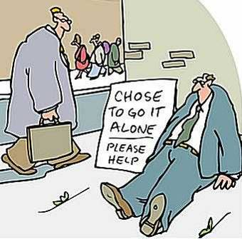
INDIVIDUALISM

Slide 69
Way of Life
Individualism - Collectivism

Slide 70

Me

Slide 71
Individualism and collectivism
Individualism
Reflects the extent to which the individual expects personal freedom and the liberty to act as an individual
Collectivism
means the acceptance of responsibility by groups and nationalities and the liberty to act as a collective member of a group

Slide 72
Individualism
The individual is most important.
Goals & interests are individual goals & interests
Things are done for the benefit of the individual
Negotiating teams usually have the power to make decisions on the spot
It may be hard to determine who is "in charge"

Slide 73
Collectivism
The group is most important
Goals are the group's goals
Things are done for the benefit of the group
Concessions & decisions are not make "at the table" but rather in private, after conferring with others
Consensus style decision making may require the input of people who are not part of the negotiation team

Slide 74
Negotiating with
Individualists
Expect low context communication and extroverted behavior
They will have personal goals distinct from group goals
Stress personal gains & individual goals
Use a "What's in it for me" approach
Recognize their individuality; they value individual rights
They will want some personal time and privacy
Expect them to think and act individually
Seek their personal opinions
Talk of "Me" and "I"
Individualists are the minority of the world

Slide 75
Tips for
Collectivists
Have a person TOP can view as a leader
Be more an individual – dress, ideas, etc.
Express an opinion
Be self-reliant
Realize the importance of the individual
The interests of multiple people at stake.
Be more direct
Consider individual rights and privacy

Slide 76
Negotiating with
Collectivists
Expect your proposals to be received by a larger group
Expect high context communication and introverted behavior
Expect a team
Don’t expect immediate action; they must consult others
Everything will take longer
Consider the collective goals and interests
Individual rights are less important
Insiders are treated differently than outsiders
Expect them to think and act collectively
Give them face
Harmony may be more important than honesty
Talk of "We"
They are the majority of the world

Slide 77
Tips for
Individualists
Realize the importance of the group
Consider yourself as part of a group
Represent your group
Conform to your group
Consider the common good
Consider "face" issues
Work towards harmony
Be less confrontational
Appeal to collective interests of their group

Slide 78
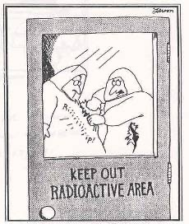
MASCULINITY
So, Foster. That’s how you want it, huh?
Then take THIS!

Slide 79
Masculinity versus femininity
Masculine culture is COMPETITIVE with an emphasis is on earnings, recognition, advancement, achievement, wealth, performance and challenge
Feminine culture is COOPERATIVE where the dominant values are caring, sharing and the quality of life

Slide 80
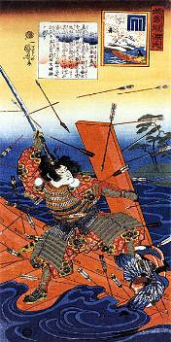
Masculinity
(competitiveness or assertiveness)
"Win at any cost."
Display assertive behavior designed to get what they deserve and can take.
Focus on money, power, control, competition, aggression, and an adversarial approach
“The marketplace is a battlefield”

Slide 81
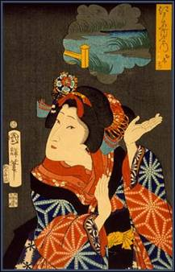
Femininity
( nurturance and relationships)
Cooperation
A concern for everyone's interests
Win-win, peaceful approach
Caring for others is most important

Slide 82
How would you negotiate with a
Masculine Culture?

Slide 83
Negotiating with a
Masculine Culture
Approach the negotiation competitively
Be ready to argue
Assume they are going for a “win,” not a win-win
Money & power are key
Be assertive; shake hands; avoid emotions
Expect "power plays," power tactics, a rights based discussion and positional bargaining
Challenging them may result in consequences.
Expect them to be loud and verbal, with a tendency to criticize and argue
They will be reluctant to make concessions.
They want to win because it "feels good" and that's what they do

Slide 84
Tips for
Feminine Culture
Be ready to stand your ground
Protect yourself; be competitive
Relationship may be less important than the “deal”
Women might need to defer to men
Speak up; be willing to interrupt
Be pro-active
“Think” as well as “feel”
They might just want to win for winning's sake.

Slide 85
Negotiating with a
Feminine Culture
Use interest-based bargaining
Behave “win-win”
Try to not be competitive; be caring
They may support your goals (if possible)
“Separate the people from the problem.“
Seek a long-term relationship
Support the relationship
Engage in small talk; active listen them
They will be willing to offer concessions
Be mindful of the emotions involved

Slide 86
Tips for
Masculine Culture
Tone down your behavior; be less competitive
Its negotiation - not war
Listen more
Reduce your posturing
Consider & allow some emotions
Seek harmony and a solution, not conflict
You don’t need to beat them to “win”
Both side need to win – especially if you want a second contract

Slide 87
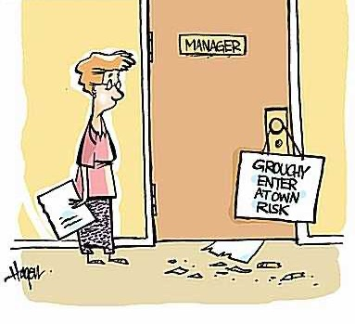
Uncertainty Avoidance
(risk taking)

Slide 88
Uncertainty avoidance
The extent to which members of a society tolerate the unfamiliar and unpredictable
Organizations in these cultures tend to value experts, prefer clear roles, avoid conflict and resist change

Slide 89
Uncertainty Avoidance should not be confused with risk avoidance says Geert Hofstede but almost everyone talks as if they are the same

Slide 90
High Uncertainty Avoidance
Risk avoiders who resist change
Feel threatened by unstructured or unknown situations
Motivated by the fear of failure
Has a need for structure and ritual in the negotiation
Expect technical specialists on the negotiating team
They will be wary of novel situations.
Precision and punctuality are important to them
They will seek precise instructions and detailed descriptions
They will seek harmony and to avoid conflict
Likely to be conservative & hesitant
Makes few changes or concessions in their proposals
Seen as rigid or paranoid
Refusal to consider alternatives, seen as bargaining "in bad faith.“
Motto: "Respect the law"

Slide 91
Low Uncertainty Avoidance
Risk takers who readily accept change take more and greater risks.
Motivated by the hope of success and willing to "go for it"
Makes many proposals, especially at the negotiation table
Always pushing for changes
Seen as unprincipled, amoral, confusing, wild, untrustworthy and unreliable
May not plan much

Slide 92
Negotiating with
High Uncertainty Avoiders
Stick with the status quo
Persuade them with history
Establish ground rules, regulations, and controls
Expect a lot of rules, regulations, and controls
Use agendas, structure, and ritual in the negotiation
Be clear on expectations
Prepare for their technical specialists on the negotiating team
Expect resistance to novel proposals
Expect a long negotiation; they need to remove ambiguities
Build & demonstrate a good “track record” so they are comfortable
Present all the details
Provide precise instructions and detailed descriptions
Expect few concessions
Seek harmony and avoid conflict

Slide 93
Tips for
Low Uncertainty Avoiders
Consider standard agreements & contracts
Set up ground rules & agendas
Avoid risky proposals
Recognize that they might not share your willingness to take risks
Seek out a 3rd party they trust.
TOP is not likely to trust your proposals

Slide 94
Negotiating with
Low Uncertainty Avoiders
Be more informal.
Propose something novel; they’ll like it
Brainstorm ideas
Consider the alternatives
Use generalists on your negotiating team
Be willing to take limited risks
Wait for them to propose the first concessions (good for both parties)

Slide 95
Tips for
High Uncertainty Avoiders
Loosen up. Just try it. Be flexible.
Be willing to "invent options,“
A little controlled risk could be helpful
Accept some risk
  Contingent agreements
Recognize value & promise in novel ideas
Think creatively

Slide 96
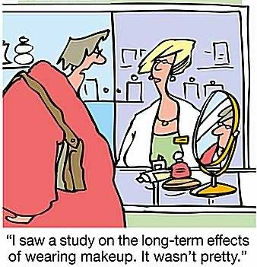
Long Term Orientation

Slide 97
Long-Term v. Short-Term
Orientation
Long-term orientation cultures tend to respect thrift, high savings rates and perseverance, status and order in positions, sense of shame.
Short-term orientation cultures tend to respect social and status obligations regardless of cost and low levels of savings.

Slide 98
Long Term Orientation
Pragmatic, future-oriented perspective
“Sacrifice for the future”
Long term commitments
Focuses on long-term interests
(e.g., market share)
Great respect for tradition
Thrifty with high savings rate
Current situation is less important to them
Strong work ethic
Long term rewards are expected from today’s hard work
Build life-long personal relationships
Respect: thrift, perseverance, status, order, sense of shame

Slide 99
Short Term Orientation
Conventional, historic, short-term perspective
Focus on present
Change can occur more quickly
Efforts should produce quick results
Focuses on short-term interests (profits)
Seem to be irresponsible and waste money
A concern for saving face

Slide 100
Negotiating with
Long Term Orientation Cultures
Expect "slow going“
Expect strong perseverance
Have a future focus
Expect future negotiation opportunities
Build long-term relationships
Demonstrate your long-term focus
Expect a strong work ethic.
Have great respect for tradition.
Work with their extensive personal networks - "guanxi"
Help them understand the current situation

Slide 101
Tips for
Short Term Orientation Cultures
Be patient. It will take longer than you think
Think about tomorrow
Build long-term relationships
Consider future contracts while you negotiate this one
Think of your children

Slide 102
Negotiating with
Short Term Orientation Cultures
Focus on today & the short term
Incorporate their immediate needs
Make it happen “right now”
Expect quick changes
Help them examine the "long run" and the consequences of a "quick win."

Slide 103
Tips for
Long Term Orientation Cultures
Do not overlook present concerns
Try to move at a faster pace
Spend some money now to ensure a good future
Spend less time in relationship building

Slide 104
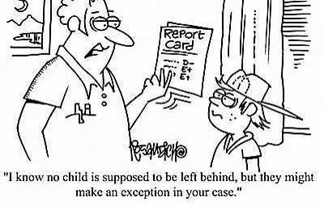
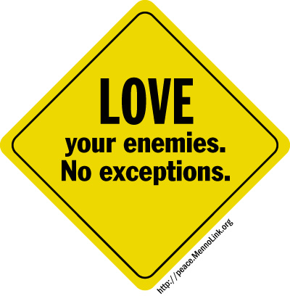
Universalism

Slide 105
Universalists
Do the “right” thing every time.
What’s right is right regardless of circumstances or who is involved
Apply the rules across the board to every situation
Place a high value on the rules
The rules are more important than the relationship
Obligation to society is more important than obligation to in-group
A contract is a contract

Slide 106
Particularists
Fit their actions to a particular situation
The relationship is more important than the rules
Demonstrate high connectedness to a group
Places a high value on the relationship
Obligation to in-group is more important than obligation to society
If conditions change, they expect the contract to change

Slide 107
Negotiating with
Universalists
They know the “right way” to do things
They may not be very flexible
Explain why it fits the rule and is not an exception
Treat everyone the same – no exceptions
Don’t expect to modify the contract later
- “A deal is a deal”

Slide 108
Tips for
Particularists
Work within the rules
Learn the normal operating procedures and industry practices. Do not expect to change them
Try to avoid renegotiating a completed contract – it is seen as “bad faith”
Exceptions to the rules might not be welcomed or tolerated.

Slide 109
Negotiating with
Particularists
Take circumstances into account
To each according to his/her needs
Insiders are treated differently
Focus on the relationship, not the rules
Be flexible
The contract is always in flux, even after signing

Slide 110
Tips for
Universalists
Be willing to make adjustments
Try to be flexible while you stay within the rules
Update your knowledge. Don’t be following rules that are not current

Slide 111
Problems With Translations
https://www.lytho.com/blog/translation-fails-advertising/

