Slide 1

Identity, Respect & Dignity BME 210 Week 11
Jon Reyhner
Professor of Education

Slide 2
It’s estimated that by 2055, the US will not have a single racial or ethnic majority. Most of this shift has been driven by immigration.
A near-record 14% of the United States' population is foreign born today, compared to the 5% in 1965.
Millennials, young adults born after 1980, are the most racially diverse generation in American history: 43% of Millennial adults are non-white.
Over the next forty years, Christians will remain the largest religious group in the world. However, Islam will grow faster than any other major religion because Muslims have more children than other religious groups. –Pew Research Center, 2017

Slide 3
Race Matters by Cornel West
https://www.hks.harvard.edu/centers/mrcbg/programs/growthpolicy/living-black-history-dr-cornel-west-cornel-west
Starting point is Rodney King Los Angles riots of 1992
Flaws in American Society vs. the Level Playing Field
Afrocentrism is a contemporary version of Black nationalism
Chocolate Cities vs. Vanilla Suburbs
Real wages of all American workers have declined 20% since 1973 and about 1 in every 5 children in U.S. live in poverty, including half of all black children and 40% of Hispanic children.

Slide 4
Stereotyping, Prejudice, and Racism
Jana Noel
Racial & Cultural Difference Theory: We instinctively fear & dislike people who are different.
Economic Competition Theory: I can get a better job if you can’t be considered for it. (”Dreamers” are taking our jobs)
Traumatic Experience Theory: I was mugged by a _______________
Frustration— Aggression Theory: We take out our problems on others.
Social Control Theory: We learned it from our families.

Slide 5
Cultural Differences
Researchers have documented how sociocultural contexts in the homes of different ethnic, racial, and linguistic groups in the United States can vary significantly from those of mainstream homes (Goldenberg et al., 1992; Heath, 1983, 1989).
Differences between home and school cultures for many minority children and the difference in school experiences provided bear directly on their academic achievement.

Slide 6
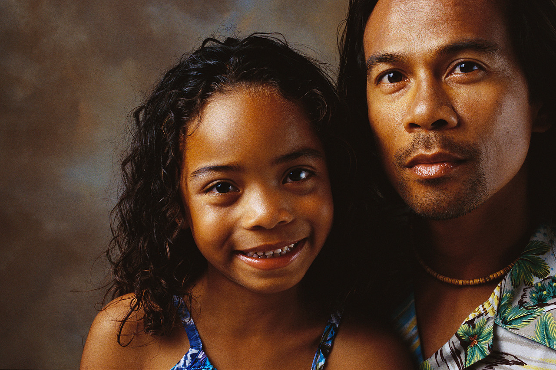
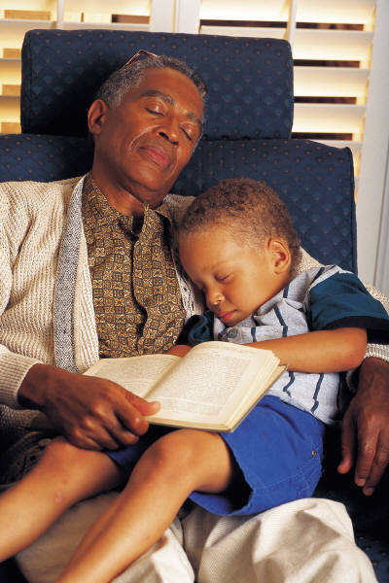
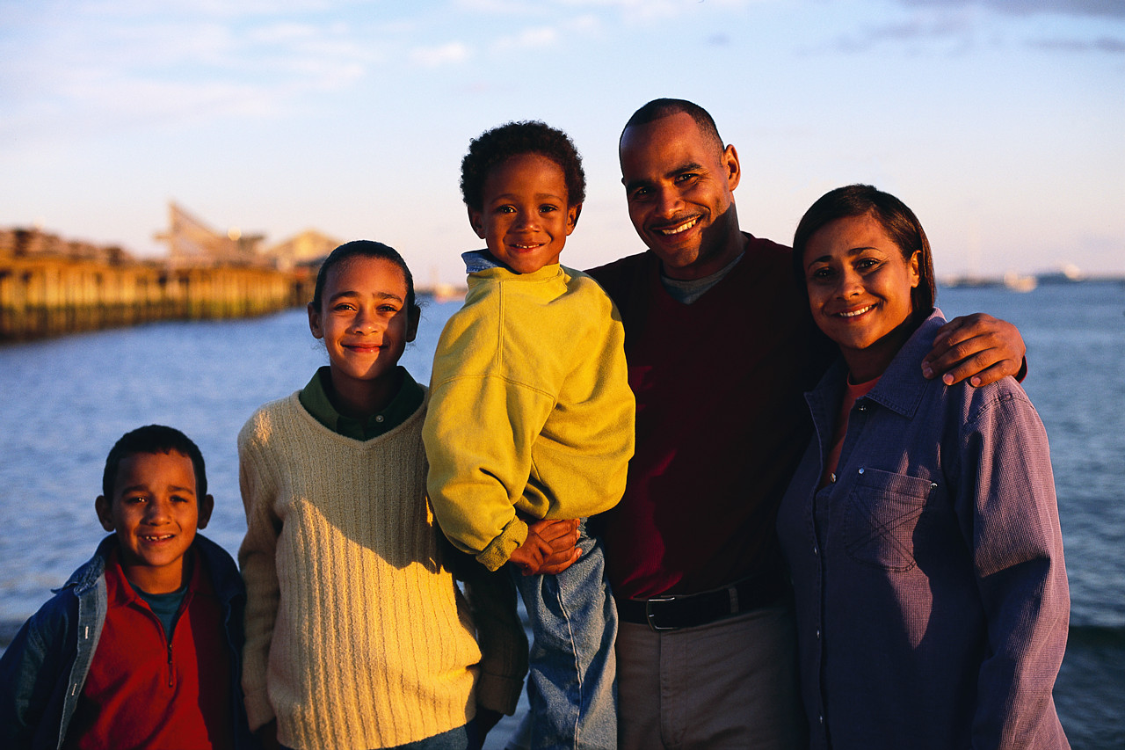
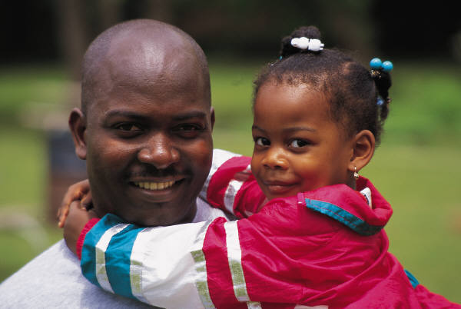
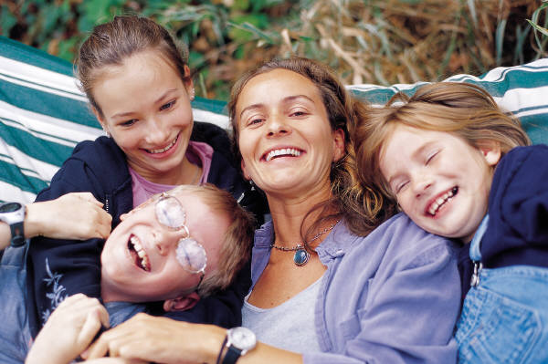
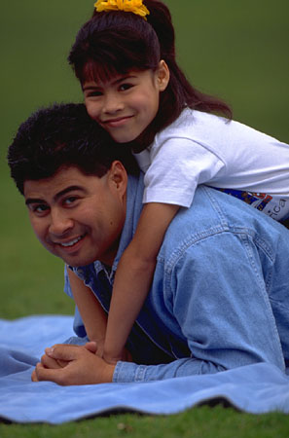
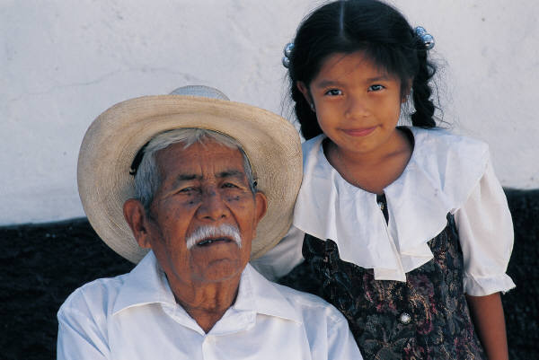
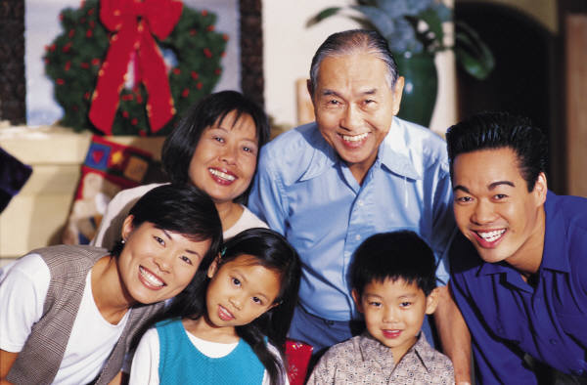
Student/Teacher Differences
First, while our students are become increasingly diverse, both culturally and ethnically, our teaching population has consistently originated from European-American, suburban experiences. Educators typically describe themselves as white and middle class and often add that during discussions about diversity, “I’m an American; I don’t have a culture” (Florio-Ruane, 1994; McIntosh, 1990; Paley, 2001; Schmidt, 1999; Sleeter, 2001; Snyder, Hoffman, & Geddes, 1997).

Slide 7
Need for Culturally Diverse Experiences
Second, most current and future teachers have not had sustained relationships with people from different ethnic, cultural, and lower socioeconomic backgrounds. As a result, much of their knowledge about diversity has been influenced by media stereotypes (Finkbeiner & Koplin, 2002; Pattnaik, 1997; Tatum, 1997).

Slide 8
School Curriculum
Third, school curriculum, methods, and materials usually reflect only European-American or white culture and ignore the backgrounds and experiences of students and families from lower socioeconomic levels and different ethnic and cultural backgrounds (Boykin, 1984; Delpit, 1996; Foster, 1994; Howard, 2001; Ladson-Billings, 1994; Ladson-Billings, 1995; Moll, 1992; Nieto, 1999; Purcell-Gates, L’Allier, & Smith, 1995; Walker-Dalhouse & Dalhouse, 2001).

Slide 9
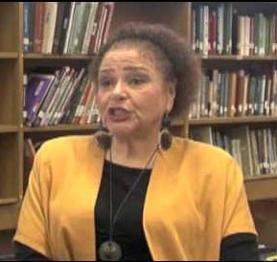
Lisa Delpit
https://www.youtube.com/watch?v=ZncKaP9ar70
Need to learn the Rules of the Culture of Power, Including:
Standard English
What is polite behavior
(What is considered rude)
How to dress (suit & tie?)

Slide 10
Lisa Delpit
https://www.youtube.com/watch?v=sBgkmaztKDU
Author of Teaching Other People’s Children and “Multiplication is for White People”
“Correcting” children’s home dialect (Ebonics, Spanglish, Red English) in the classroom can lead to children rejecting school.
Writing Bi-dialectical Dictionaries
Being Careful with known answer questions

Slide 11
Lisa Delpit (Continued)
Constant corrections by the teacher are likely to cause students to resist reading and to resent the teacher (Round Robin Reading).
Don’t confuse dialect intervention with reading instruction.
Book language always includes more words. The author can’t assume the readers’ prior knowledge.

Slide 12
Ethnocentrism Is Universal
American Indians did not see eye to eye with the U.S. government about what was good for them. Indian Agent Albert Kneale noted, “Every tribe with which I have associated is imbued with the idea that it is superior to all other peoples. Its members are thoroughly convinced of their superiority not alone over members of all other tribes but over the whites as well.... I have never known an Indian who would consent to being changed into a white man even were he convinced that such a change could readily be accomplished.”

Slide 13
All good people agree,
And all good people say,
All nice people like Us are We
And everyone else is They.
—Rudyard Kipling
Little Indian, Sioux or Crow,
Little frosty Eskimo
Little Turk or Japanee,
O! don’t you wish you were me?
—Robert Louis Stevenson

Slide 14
Reverse Assimilation
The Superintendent of the Ponca Agency in Oklahoma reported in 1917 the story of, “an old Ponca Indian, now dead, once said that it takes Chilocco [Boarding School] three years to make a White man out of an Indian boy, but that when the boy comes home and the tribe has a feast, it takes but three days for the tribe to make the boy an Indian again.”

Slide 15
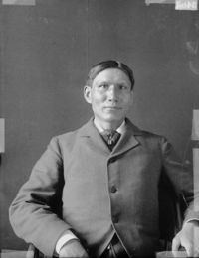
Who’s the Savage?
Sioux author and medical doctor
Charles Eastman (1915) felt the real
civilizing influences on the Indians
were whiskey and gunpowder with
the result that Indians often learning the worst habits of the whites.
Lewis Meriam, who headed an extensive study of the U.S. Indian Office in the 1920s, was told repeatedly by missionaries that their “real difficulties” lay with “sinister white influences” rather than with the Indians.

Slide 16
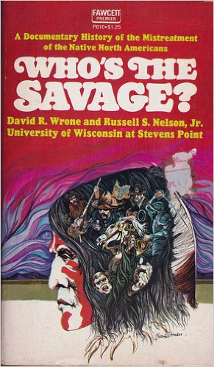
How a child’s ethnic/racial group is portrayed in books (including history textbooks), movies, and other media can be very important for the child’s identity development.

Slide 17
In 1920 John Collier observed the Taos Red Deer Dance in which he found a power for living that, “If our modern world should be able to recapture... the earth’s natural resources and web of life would not be irrevocably wasted within the twentieth century which is the prospect now. True democracy, founded in neighborhoods and reaching over the world, would become the realized heaven on earth.... [Modern society has] lost that passion and reverence for human personality and for the web of life and the earth which the American Indians have tended as a central sacred fire.”

Slide 18
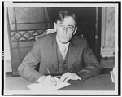
Collier, U.S. Commissioner of Indian Affairs from 1933-1945, concluded that, “Assimilation, not into our culture but into modern life, and preservation and intensification of heritage are not hostile choices, excluding one another, but are interdependent through and through.... It is the ancient tribal, village,
communal organization
which must conquer the
modern world.”

Slide 19
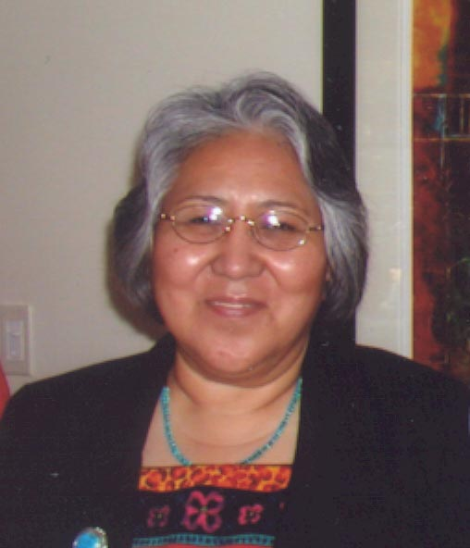
Traditional vs. Television Values
A Navajo elder told NAU Professor Dr.
Yazzie, “You are asking questions
about the reasons that we are moving
out of our language, I know the reason. The television is robbing our children of language. It is not only at school that there are teachings, teachings are around us and from us there are also teachings. Our children should not sit around the television. Those who are mothers and fathers should have held their children close to themselves and taught them well, then our grandchildren would have picked up our language.”

Slide 20
Who is Raising the Children?
A Navajo elder told Dr. McCauley, “television has ruined us. A long time ago, they used to say, don’t do anything negative or say anything negative in front of children. It doesn’t take that long for a child to catch onto things like this. Therefore a mother and a father shouldn’t use harsh words in front of the children…. These days…they see movies with people having sex in them and they’re watching. In these movies they shoot each other…. Movies are being watched every day, but there is nothing good in it.”

Slide 21
Dr. Yazzie found in her doctoral research that, “Elder Navajos want to pass on their knowledge and wisdom to the younger generation. Originally, this was the older people's responsibility. Today the younger generation does not know the language and is unable to accept the words of wisdom.” She continues, “The use of the native tongue is like therapy, specific native words express love and caring. Knowing the language presents one with a strong self-identity, a culture with which to identify, and a sense of wellness.”

Slide 22
Could a countries obsession with its “greatness” and lack of humility lead to it having little or no need to improve itself? What does make America great?
In the 2015 proposed congressional budget there was more money for defense but not for the US State Department whose diplomacy might keep us out of war. More money for the state department might of also helped protect embassy staff in Libya.

Slide 23
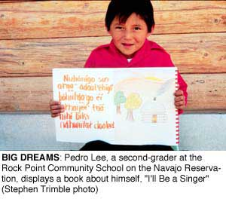
Respect and Self-Discipline
The Rock Point Community School Board felt in the 1970s “that it was the breakdown of a working knowledge of Navajo kinship that caused much of what they perceived as inappropriate, un-Navajo, behavior; the way back, they felt was to teach students that system.”
Their answer was to establish
A bilingual education program
with an extensive Navajo
Social Studies component
that included the theory of
Navajo kinship.

Slide 24
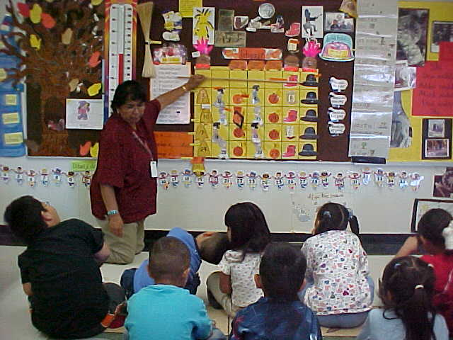
The Rock Point Program has been modified and continued in the Window Rock Public School’s Navajo Immersion School. There it was found that “More-traditional Navajo expectations of children were that they would work hard and act responsibly—in adultlike ways. Anglos tend to expect children to act in more childlike ways…. More-traditional parents tend to perceive such [childlike] behavior as self-indulgent and irresponsible. At worst, children
come to exploit the gap between
parental and teacher
expectations.”

Slide 25
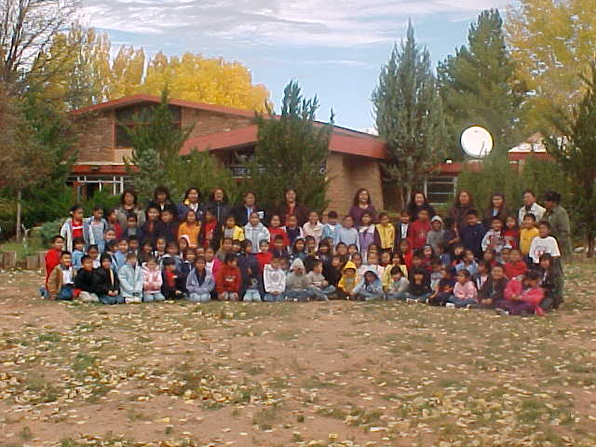
“More-traditional Navajo parents come to think that the children are behaving as their non-Navajo teachers expect or allow them to; non-Navajo teachers come to think that the children are behaving as Navajo parents expect or allow them to. In time, both parents and teachers come to accept that ‘that’s the way things are.’” In the Navajo
immersion school students
tended to act more
responsibly as that was
the behavior that was taught
and expected.

Slide 26
The Window Rock Navajo Immersion School emphasizes bringing traditional values into the classroom. “Navajo values are embedded in the classroom pedagogy.” Teachers address their students according to Navajo kinship relations. A parent, “noticed a lot of differences compared to the other students who aren’t in the immersion program. [The immersion students] seem more disciplined and have a lot more respect for older, well anyone, like teachers. They communicate better with their grandparents, their uncles and stuff. It seems like it makes them more mature and more respectful. I see other kids and they just run around crazy. My kids aren’t like that…. It really helps, because it’s a positive thing.”

Slide 27
The Punana Leo (Hawaiian Immersion Language Nest) movement in Hawaii is built around re-establishing the Hawaiian philosophy of life, and their mission statement reads: “The Punana Leo Movement grew out of a dream that there be reestablished throughout Hawai’i the mana of a living Hawaiian language from the depth of our origins. The Punana Leo initiates, provides for and nurtures various Hawaiian language environments, and we find our strength in our spirituality, love of our language, love of our people, love of our land, and love of knowledge.”

Slide 28
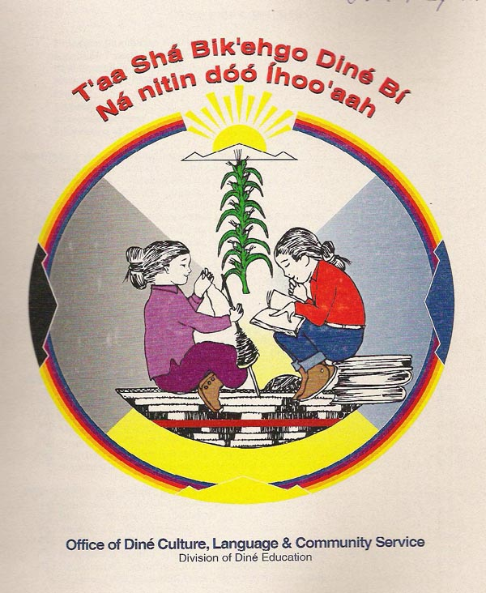
The Navajo Nation’s “Diné Cultural Content Standards [for schools] is predicated on the belief that firm grounding of native students in their indigenous cultural heritage and language, is a
fundamentallysound prerequisite
to well developed and culturally
healthy students.” Navajo values
to be taught include being
generous and kind, respecting
kinship, values, and sacred
knowledge.”

Slide 29

Empowering values of the Diné individual include not being lazy, impatient, hesitant, easily hurt, shy, or mad. Diné individuals are to respect the sacred, have self discipline, and prepare for challenges.
Navajo elder and statesman Jack Jackson notes how at Diné College they are “in a search to create our future based on our past.”

Slide 30
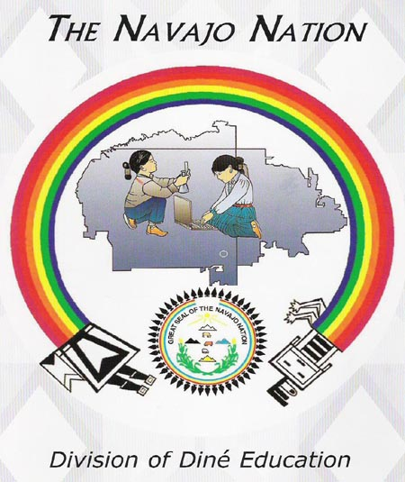
Jackson emphasizes the importance of teaching Navajos the Navajo philosophy of “Ké,” being a balanced person. This involves examining “beauty before me” (where am I going?), “beauty behind
me” (where did I come
from?), “beauty under-
neath (my relation to
mother earth), beauty
above, and beauty around;
with beauty I speak with
the outcome of becoming
a ‘balanced person.’”

Slide 31
Navajo Education
East
Thinking
Spiritual–Praying/Singing
Reverence/Sacrifice
Curiosity
Active/Laziness
Memory/Forgetfulness
Common Sense/Stupidity
South
Planning
Personality–Dress/Behavior
Self Actualization
Positive Self-Concept/Boastful
Care/Jealousy–Envy
Mindful/Stubborn
North
Sense of Protection
Physical Hygiene/Exercise
Patience
Cleanliness/Lice
Proper Diet/Hunger-Thirst
Health/Sickness-Rapidly Aging
West
Life
Social – Clans/Kinship terms
Respect/Communication
Good Stories/Gossip
Generosity/Greed
Conserve/Poverty
As presented by Ernest Harry Begay for WRUSD No.8

Slide 32
As Dr. Martin notes that subject matter preparation was not the only problem Navajos like Dr. Lori Arviso Alvord faced in college: “Navajos are taught from the youngest age never to draw attention to ourselves. So Navajo children do not raise their hands in class. At a school like Dartmouth, the lack of participation was seen as a sign not of humility but lack of interest and a disengaged attitude.” Later in medical school she was viewed as “remote and disinterested" for similar reasons.”

Slide 33
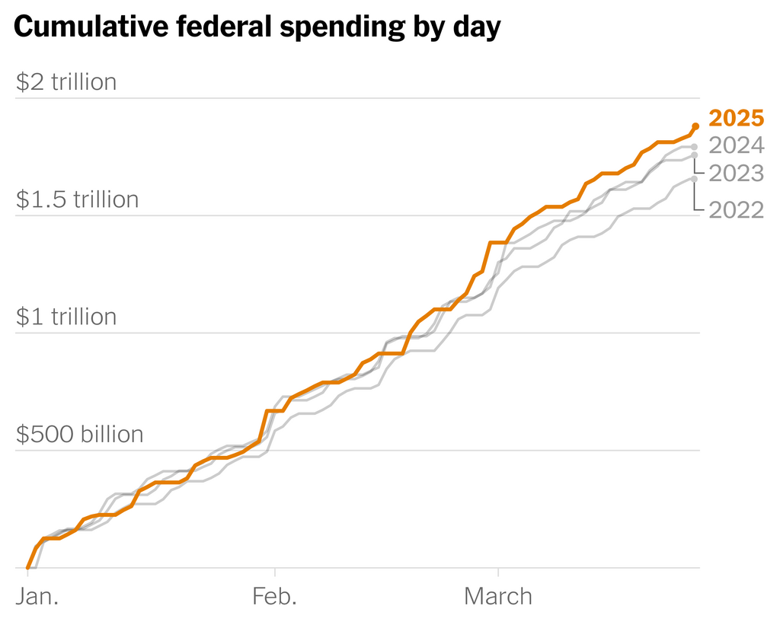
Source: The Hamilton Project | Data is not adjusted for inflation, and is through March 26 for all years. | By The New York Times
Source: The Hamilton Project | Data is not adjusted for inflation, and is through March 26 for all years. | By The New York Times

Slide 34
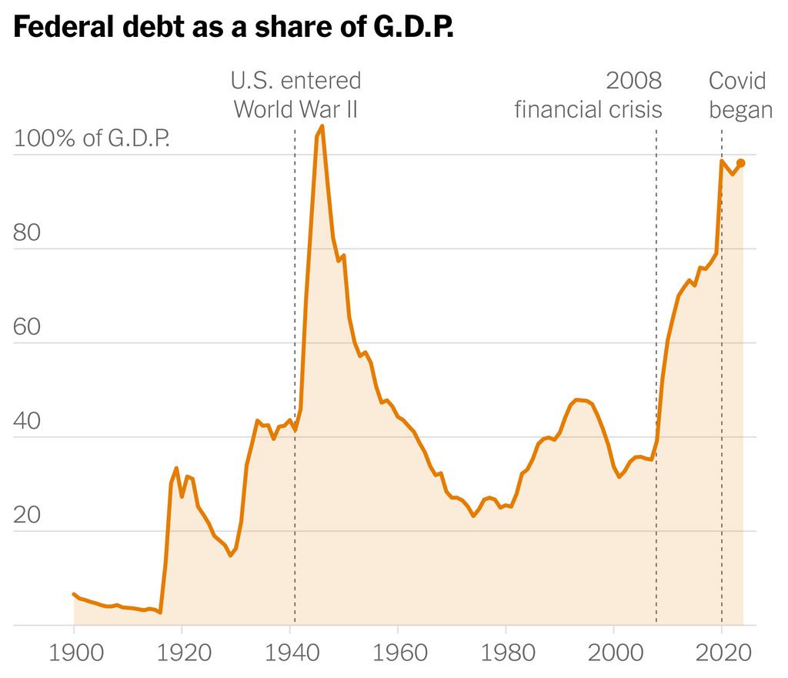
Source: Congressional Budget Office | Chart excludes debt the federal government owes itself. | By The New York Times

Slide 35
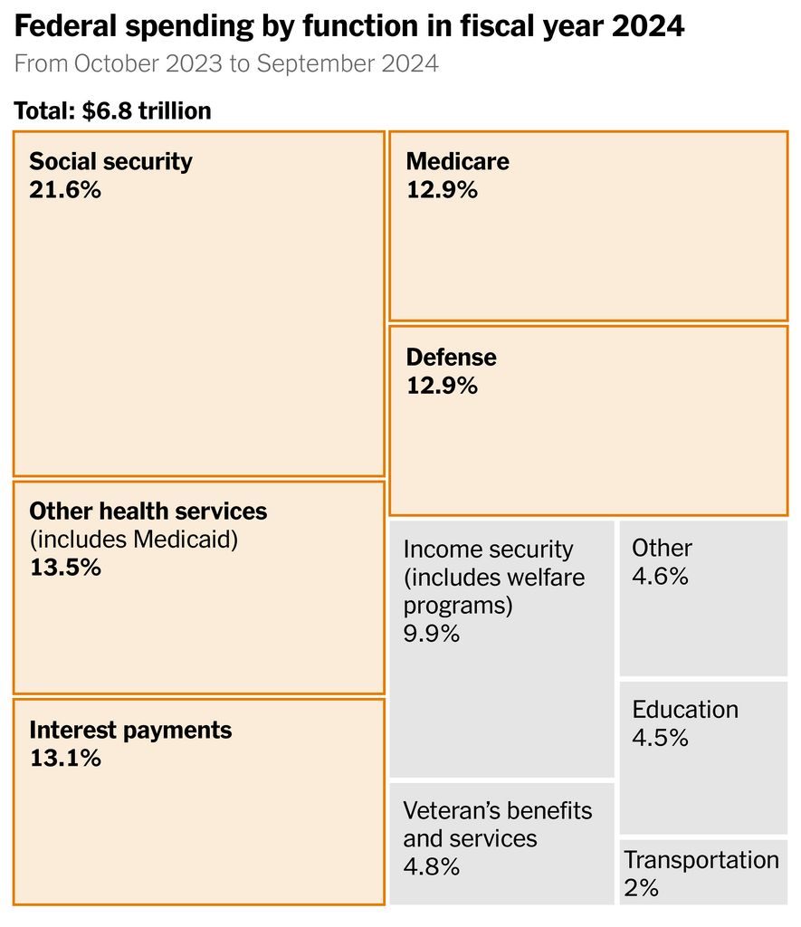
Source: Treasury Department | Numbers may not add up to 100 percent due to rounding. | By The New York Times

Slide 36
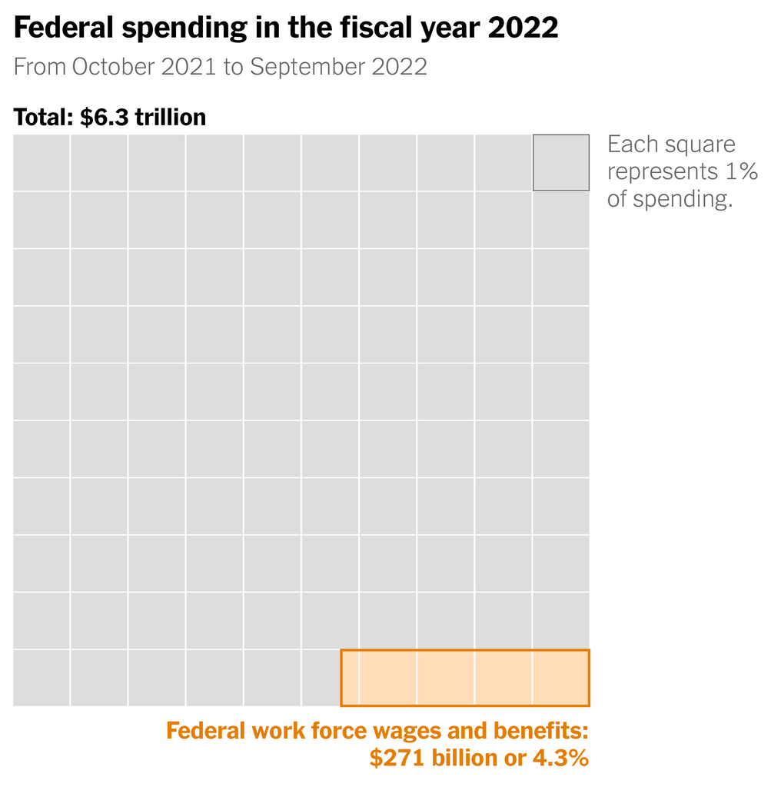
Sources: Congressional Budget Office; Treasury Department | By The New York Times

