Slide 1
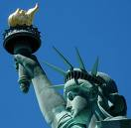
Immigration
With silent lips. "Give me your tired, your poor, Your huddled masses yearning to breathe free, The wretched refuse of your teeming shore. Send these, the homeless, tempest-tossed to me, I lift my lamp beside the golden door!"

Slide 2
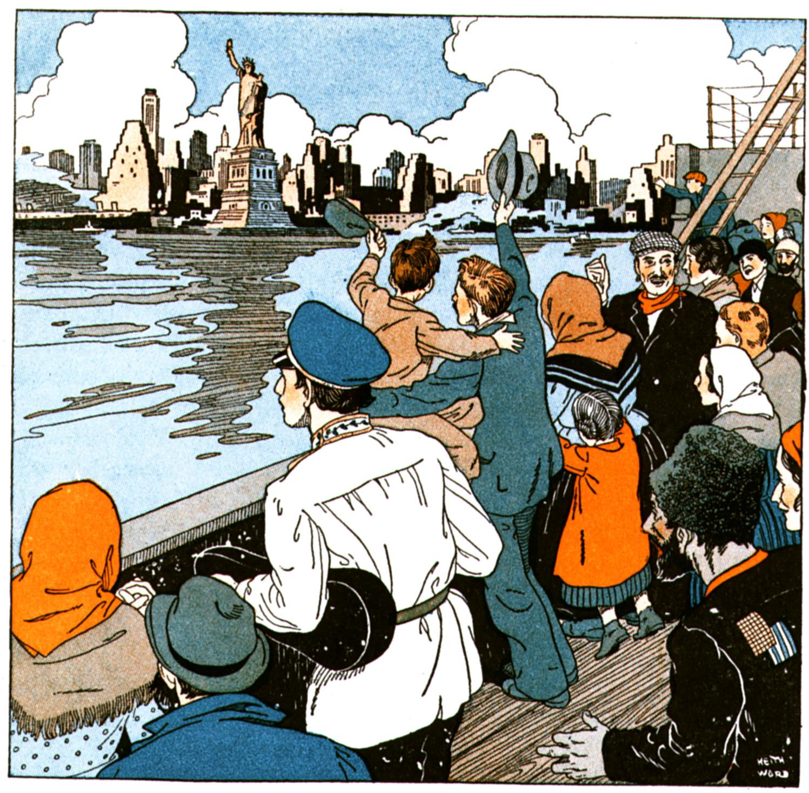
Through the Golden Door
Escaped difficult conditions like famine, land shortages or religious and political persecution.
Birds of Passage- intended to temporarily earn money and then return to their homeland.

Slide 3
Europeans
Between 1870- 1920, 20 million Europeans arrived in the U.S.
Before 1890- most were from western and northern Europe
From 1890’s increasing number from southern and eastern Europe
Why did they leave? Most to escape religious persecution.
Jews were driven out by Pogroms (organized attacks on Jews)

Slide 4
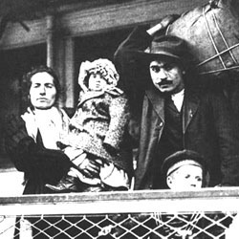
Others left due to rising population; doubled to 400 million between 1890-1900
Land was scarce for farming
Farmers competed with laborers for industrial jobs
Many young women and men sought independent lives

Slide 5
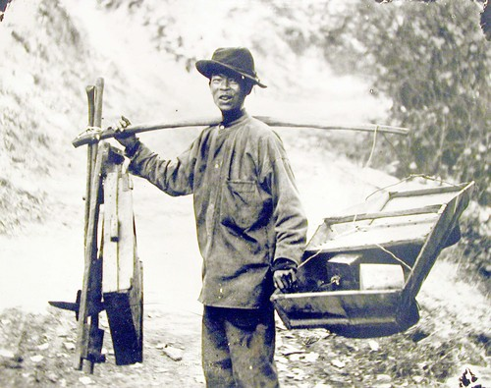
Chinese and Japanese
Between 1851-1883, 300,000 Chinese arrived.
Many came to seek gold fortunes in the gold rush.
Helped build nations railroads
Turned to farming, mining and domestic services
However, Chinese immigration was limited by a Congressional Act of 1882.

Slide 6
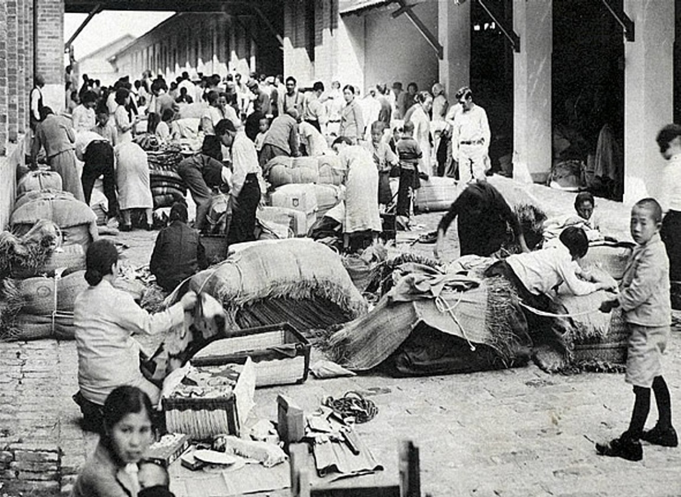
Japanese
1884- Japanese boom begins
1898 annex of Hawaii increase Japanese immigration to the west coast
High American wages
Peak in 1907 of 30,000 totaling 200,000 by 1920

Slide 7
The West Indies and Mexico
1880-1920 260,000 immigrants from West Indies: Jamaica, Cuba, Puerto Rico, and others
Left homelands due to lack of jobs and the promise of work in the industrial boom in the U.S.
Mexicans came north for work and to escape political turmoil
1902-the National Reclamation Act created new farmland and drew Mexican workers

Slide 8
Life in the New Land
A difficult journey usually by ship
Trip from Europe took one week, from Asia took three weeks.
Traveled in cheap accommodations, usually cargo hold.
Rarely allowed on deck; very crowded
Slept in louse-infected bunks, shared toilets with other immigrants
Disease spread quickly

Slide 9
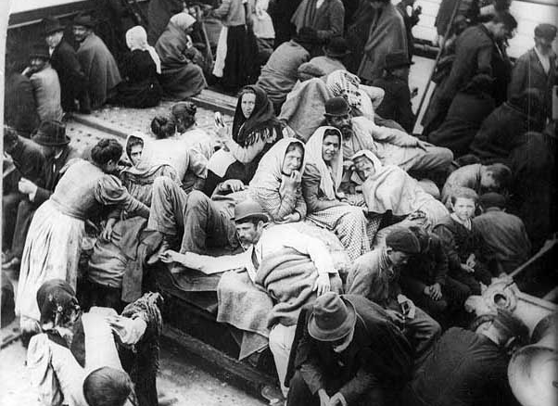
Government inspectors boarded ships from foreign ports to identify passengers with infectious diseases.
Some immigrants died before reaching America

Slide 10
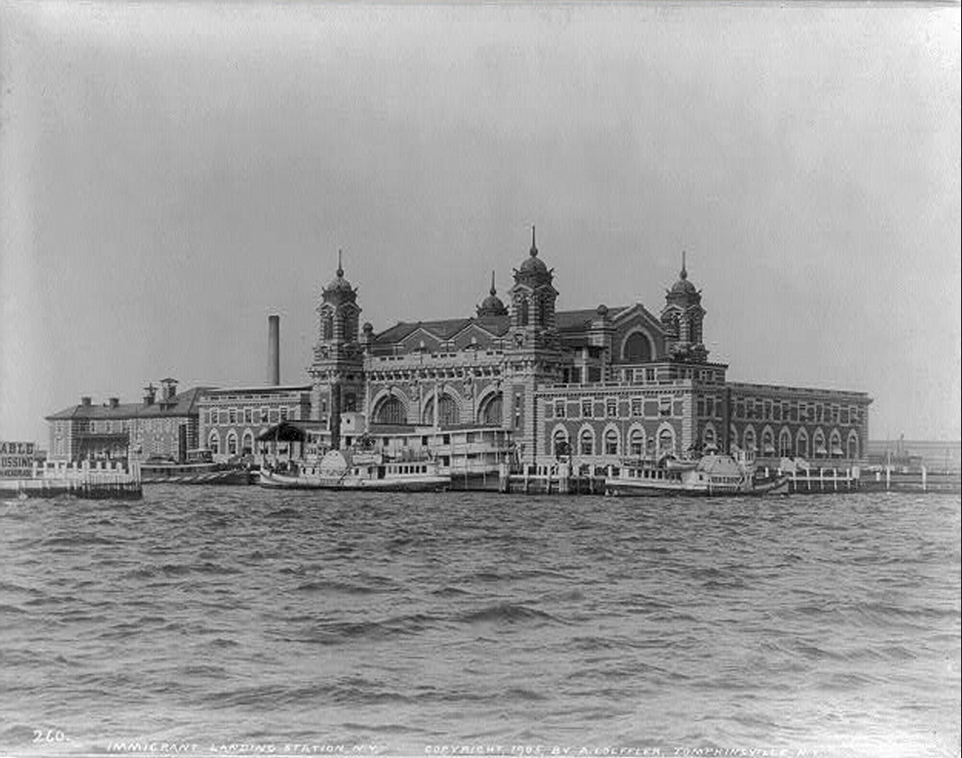
Ellis Island
Inspection station in the New York harbor where immigrants had to pass inspections.
About 20% were detained for a day or more before inspection
Only about 2% were denied entry

Slide 11
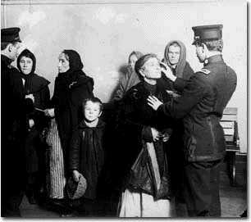
Processing
Physical examination by a doctor
Those with serious health problems or a contagious disease were sent home (deported).

Slide 12
Government Inspector
Checked documents and questioned immigrants on whether they met legal requirements:
1. Must be able to prove they had never been
convicted of a felony,
2. Able to work
3. Showing they had some money.
1892-1924 Ellis Island was chief processing station for nearly 17 million immigrants

Slide 13
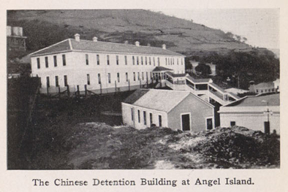
Angel Island
Inspection Station in San Francisco Bay processing Asians primarily Chinese
1910-1940 processed about 50,000 Chinese Immigrants
Immigrants endured harsh questioning and long detention in ramshackle facilities

Slide 14
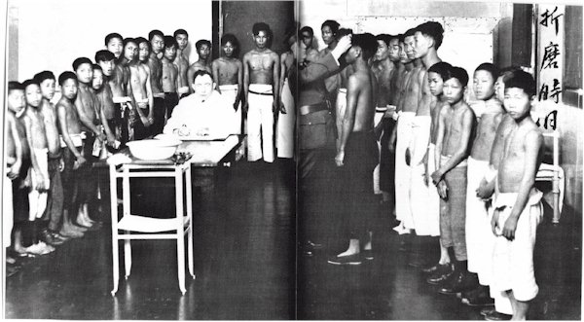
Processing at Angel Island

Slide 15
The Walls of Angel Island
I told myself that going by this way would be easy. Who was to know that I would be imprisoned at Devil’s Pass? How was anyone to know that my dwelling place would be a prison?

Slide 16
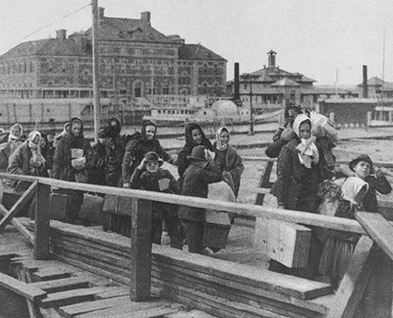
Survival-Challenges
Finding a place to live
Getting a job
Trying to understand the languages and customs
https://www.pbs.org/video/italian-americans-sacco-and-vanzetti/

Slide 17
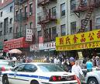

Survival
Life Rafts-immigrants congregating with people who shared same cultural values, religions and languages
Pooled money to build churches and synagogues
Formed social clubs and aid societies
Founded orphanages and old peoples homes
Published newspapers in their own languages

Slide 18
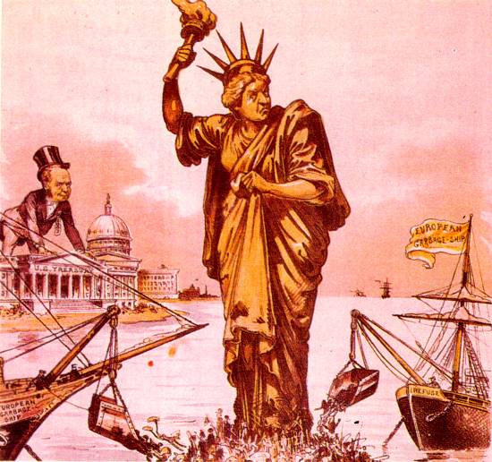
Hyphenated Americans
Committed to their own cultures while growing new identities
Friction with people born in America-viewed immigrants as a threat to American Way of life.

Slide 19
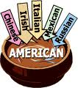
Melting Pot
A mixture of people form different cultures and races who are blended together by abandoning their native languages and customs.
Many refused which gave way to anti-immigrant sentiments

Slide 20
Nativism
Overt favoritism toward native born Americans
Suspicion and fear grow (Protestants feared Catholics)
Immigrants from the “right” countries were ok (British and German)
Immigrants from the “wrong “ places were not okay. (Slavs. Latin, Asia, Mexico)
Ethnocentrism- Anglo-Saxons were superior to others.
https://www.zinnedproject.org/materials/viva-la-causa/

Slide 21
Anti-Asian Sentiments
Directed more on Chinese because they looked different.
Depression of 1873-many feared their jobs would be taken away by Chinese.
Chinese Exclusion Act: Passed in 1882 and banned entry of Chinese to the US for 10 years.
Extended until 1892 and was not officially repealed until 1943.

Slide 22
Gentlemen’s Agreement
1907-1908
Japan agreed to limit emigration to the United States in exchange for the removal of segregation orders in San Francisco.

Slide 23
Immigration Today
Many Immigrants come from Mexico, Central and South America
Also many are refugees from war torn countries.
Immigration reform-heated debate on how to handle immigration.
Nearly a quarter of all U.S. children in 2008 were the sons and daughters of at least one immigrant parent.
But….

Slide 24
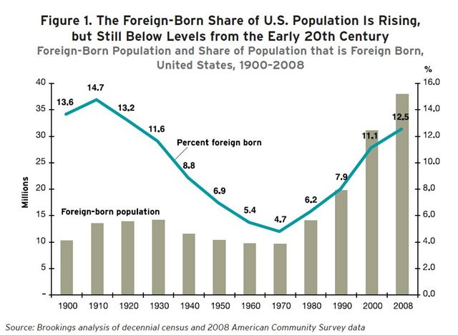

Slide 25
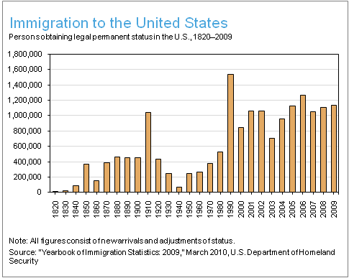

Slide 26
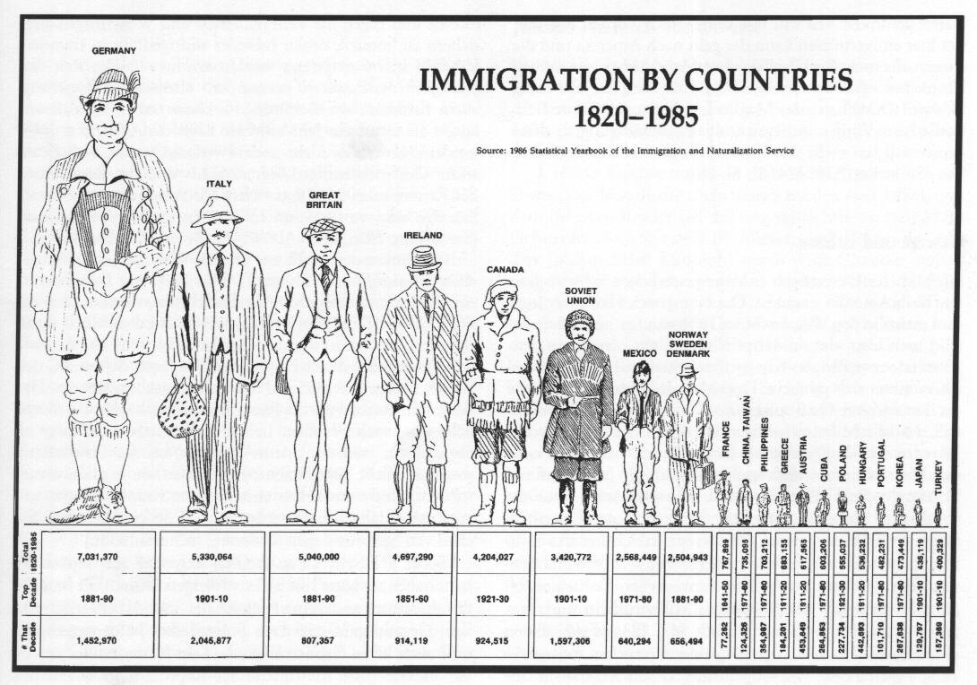

Slide 27
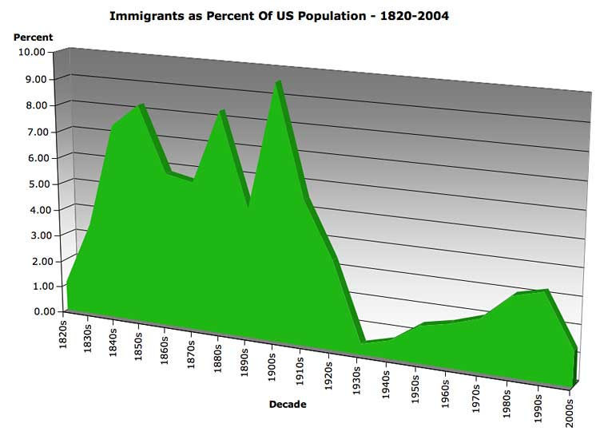

Slide 28
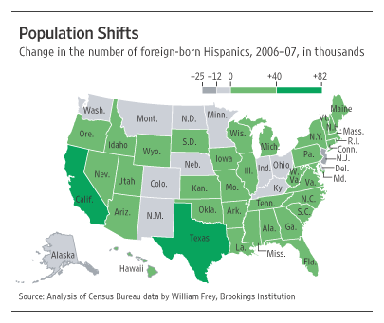

Slide 29
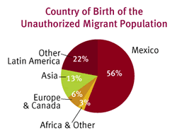

Slide 30
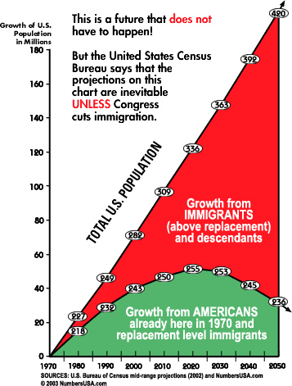

Slide 31
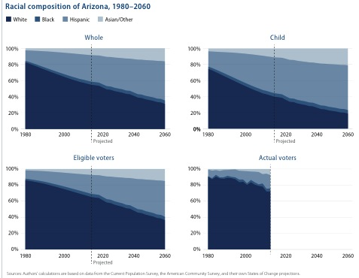

Slide 32





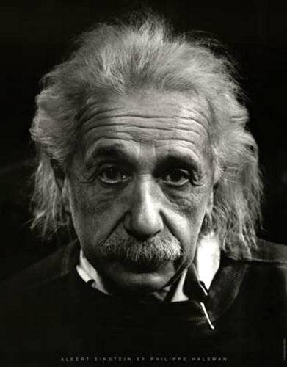
Famous Immigrants

